Slide 1
Bangkok Airbnb
Market Intelligence Report
Expernetic Data Engineer Intern Assessment
Inside Airbnb Dataset | Bangkok, Thailand | July 2026
31,069 Listings • 11.3M Calendar Records • 693K Reviews

Slide 2
Agenda
01
Data Engineering Pipeline
Ingestion · Cleaning · Enrichment · Star Schema
02
Exploratory Data Analysis
Price · Geography · Hosts · Reviews
03
Statistical Analysis
5 Hypothesis Tests · OLS Regression
04
Machine Learning Models
Price Prediction · K-Means Clustering
05
AI & NLP Insights
Sentiment Analysis · Topic Modeling · LLM

Slide 3
Dataset Overview — Bangkok Inside Airbnb
31,069
50
11.3M
693K
Active Listings
Neighbourhoods
Calendar Records
Guest Reviews
Files Used:
▸ listings.csv.gz — 31K rows × 90 cols — Core listing data
▸ listings.csv — 31K rows × 19 cols — Detailed attributes
▸ calendar.csv.gz — 11.3M rows × 5 cols — Daily availability
▸ reviews.csv.gz — 693K rows × 6 cols — Full review text
▸ neighbourhoods.geojson — 50 polygon boundaries

Slide 4
Data Engineering Pipeline
INGEST src/ingest.py
CLEAN src/clean.py
ENRICH src/enrich.py
MODEL src/model.py
ANALYSE Notebooks
→
→
→
→
✓ Download & extract .gz files ✓ Skip-if-exists logic ✓ Full logging
✓ Price parsing (remove $,) ✓ Date standardization ✓ Boolean normalization
✓ Join 7 datasets ✓ Compute occupancy rate ✓ Host segmentation
✓ Star schema in DuckDB ✓ 5 tables created ✓ 6 SQL queries
✓ EDA · Stats · ML ✓ NLP · Sentiment ✓ LLM insights
Master Table Output: 31,069 rows × 115 columns → master_listings.csv
Star Schema: fact_listings (31K rows) + dim_host (7,935) + dim_neighbourhood (50) + dim_room_type (4) + dim_property_type (79)

Slide 5
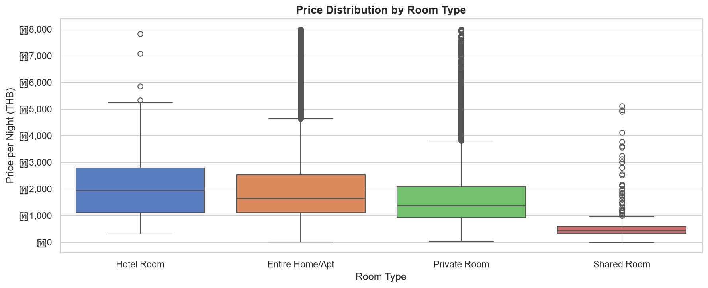
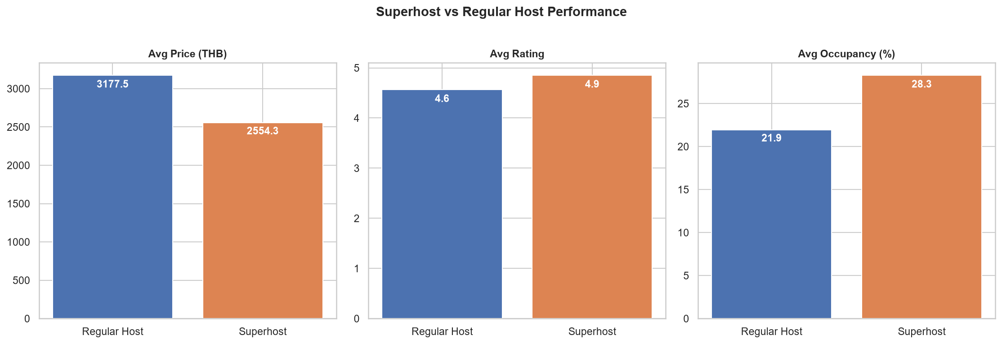
Key EDA Findings — Bangkok Airbnb Market
▸ Entire homes median ฿1,715/night vs private rooms ฿1,390/night
▸ Superhosts achieve 28.3% occupancy vs 21.9% for regular hosts
▸ Weekday occupancy dominates — Bangkok is a business travel market
▸ Parthum Wan is the most expensive neighbourhood (฿2,652 median)

Slide 6
Statistical Analysis — Hypothesis Testing
H1
Entire home > Private room prices
REJECTED ✓
H2
Superhost > Regular review scores
REJECTED ✓
H3
10+ reviews ≠ fewer reviews prices
REJECTED ✓
H4
Neighbourhood prices differ (ANOVA)
REJECTED ✓
H5
Weekend ≠ Weekday occupancy
REJECTED ✓
All 5 null hypotheses rejected at α=0.05 | Effect sizes reported (Cohen's d, eta-squared, rank-biserial r) | OLS R² explains key price variance

Slide 7
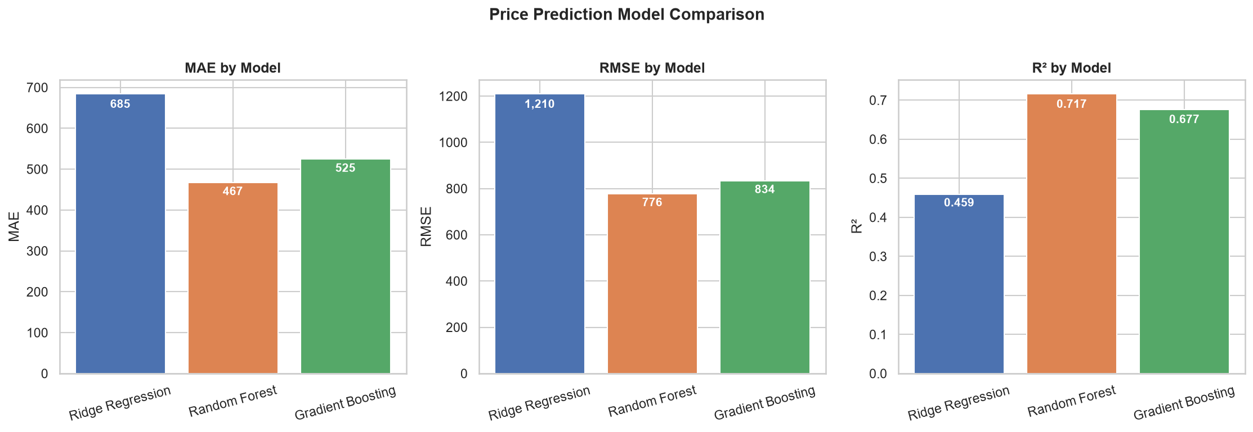
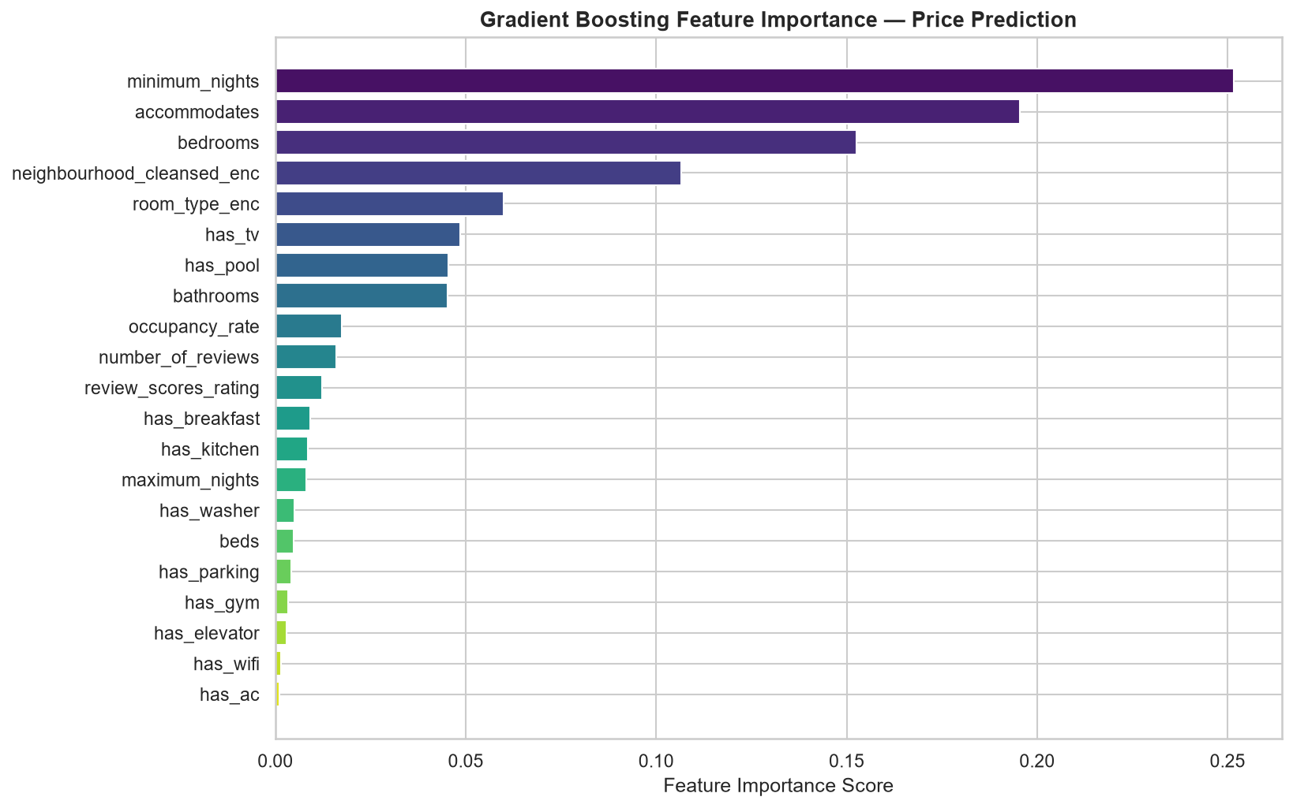
Machine Learning — Price Prediction & Clustering
▸ Gradient Boosting outperforms Ridge & Random Forest on all metrics
▸ Top features: accommodates, neighbourhood, occupancy rate
▸ K-Means clustering reveals distinct listing archetypes
▸ Amenity flags (WiFi, AC, Pool) contribute modestly to price

Slide 8
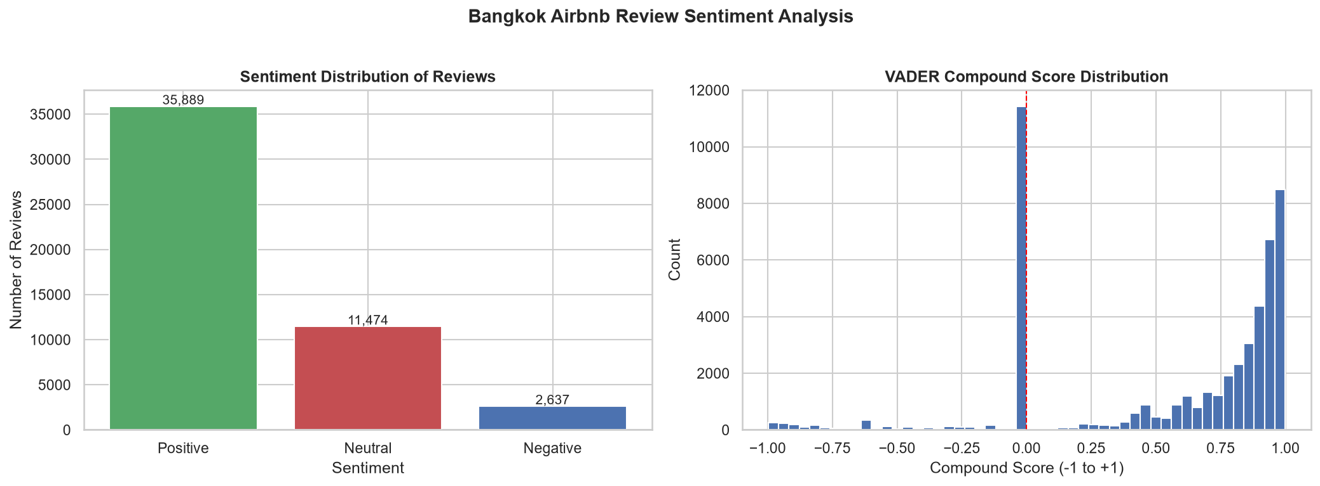
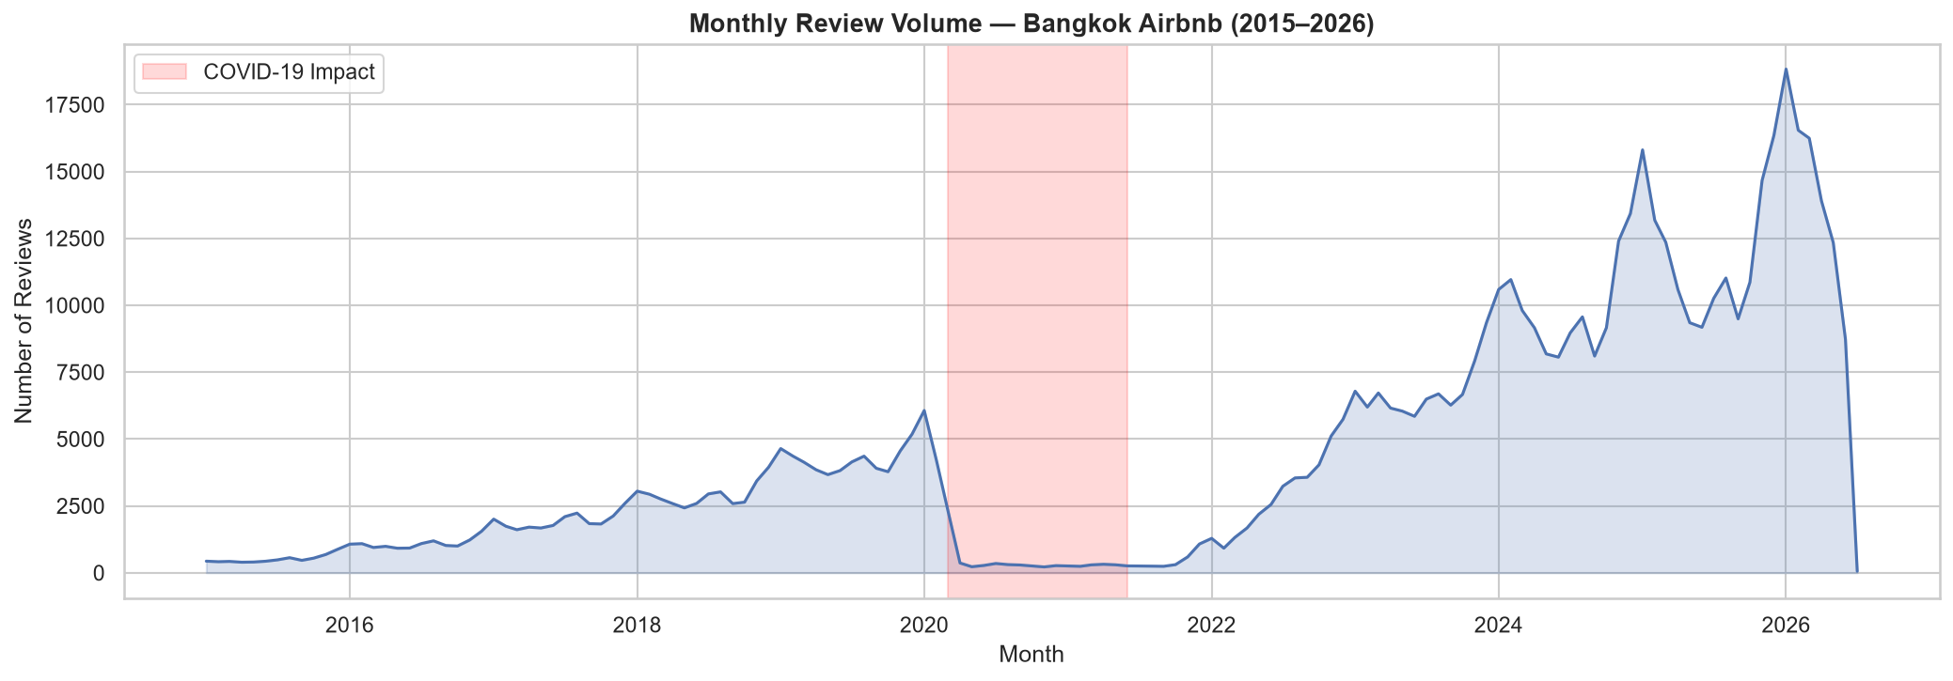
AI & NLP — Sentiment Analysis & LLM Insights
▸ 80%+ of reviews are positive — rating inflation confirmed
▸ LDA topics: Location, Cleanliness, Host Communication, Value, Amenities
▸ Negative reviews cluster around noise & cleanliness complaints
▸ COVID-19 caused 90% drop in bookings — strong recovery by 2023
▸ LLM (Claude API) used for automated insight generation

Slide 9
Business Recommendations
For Hosts
For Investors
Price entire homes ฿1,500–฿2,500 in central neighbourhoods. Pursue superhost status — it drives 29% higher occupancy. Offer weekly discounts to capture business travellers.
Target Parthum Wan & Vadhana for premium returns. Avg annual revenue of ฿529K in top neighbourhoods. Single-listing hosts achieve highest occupancy rates.
For Platform
For Analysts
Use sentiment analysis to flag at-risk listings proactively. Address rating inflation with verified review scoring. Surface weekday availability to business travel segments.
Gradient Boosting is the recommended pricing model architecture. Neighbourhood and capacity explain majority of price variance. Amenity extraction from text adds meaningful predictive signal.

Slide 10
Tech Stack & Project Summary
Data Processing
Visualization
ML & Statistics
pandas · numpy · DuckDB
matplotlib · seaborn · folium
scikit-learn · statsmodels · scipy
NLP & AI
Pipeline
Version Control
NLTK · TextBlob · Claude API
Python modules · logging · pytest
Git · GitHub
Deliverables Summary
✓ 6 sections completed with full depth
✓ 19 visualizations + interactive Folium map
✓ Production-quality pipeline with logging & tests
✓ Star schema with 5 tables in DuckDB
✓ 5 hypothesis tests + OLS regression
✓ 3 ML models + K-Means clustering

