Slide 1
IE3142 · DEVOPS SECURITY
Containerization, Orchestration
& Secure CI/CD
Lecture 05 — Docker, Kubernetes, and integrating security into the delivery pipeline
IE3142 · DevOps Security

Slide 2
LECTURE ROADMAP
Topics Covered
1
Introduction to Containerization
7
Container Runtime Security
2
Containers vs Virtual Machines
8
Introduction to Kubernetes
3
Docker Architecture
9
Kubernetes Architecture
4
Container Security Challenges
10
Kubernetes Security
5
Container Security Best Practices
11
Secure Kubernetes Configuration
6
Container Image Security
12
Container Security in DevSecOps
IE3142 · DevOps Security · Lecture 05
1

Slide 3
PART 1
Containerization and
Orchestration Security
From Docker fundamentals to Kubernetes hardening

Slide 4
CONTAINERIZATION
What is Containerization?
Containerization packages an application together with its dependencies, libraries, configuration files, and runtime components into an isolated unit called a container.
Example — packaging a web application
Python 3.12
Flask
Python libraries
A container allows an application to run consistently across different environments.
Configuration files
Application source code
"It works on my computer" → "It works everywhere."
↓ Container Image
↓ Container
IE3142 · DevOps Security · Lecture 05
2

Slide 5
CONTAINERIZATION
Why Do We Use Containers?
1
2
3
Portability
Consistency
Isolation
Runs across laptop, test, CI/CD, cloud, and production environments.
Same dependencies and runtime throughout the development lifecycle.
Applications run in isolated environments without interference.
4
5
6
Scalability
Efficiency
DevSecOps Benefit
Created and destroyed quickly, suited for dynamic workloads.
Share the host kernel, making them lighter than virtual machines.
Security controls integrate into build, test, deploy, and runtime.
IE3142 · DevOps Security · Lecture 05
3

Slide 6
CONTAINERIZATION
Containers vs Virtual Machines
Feature | Virtual Machine | Container
Virtualization | Hardware-level | OS-level
Operating System | Each VM has its own OS | Shares host kernel
Size | Generally larger | Generally smaller
Startup | Slower | Faster
Resource Usage | Higher | Lower
Isolation | Strong | Process-level isolation
Portability | Good | Very high
Typical Technology | VMware, Hyper-V | Docker, containerd
Important: Containers share the host OS kernel. a kernel or runtime vulnerability can affect multiple containers. Container isolation does not mean containers are automatically secure.
IE3142 · DevOps Security · Lecture 05
4

Slide 7
CONTAINER SECURITY
What is Container Security?
Container security is the practice of protecting containerized applications throughout their lifecycle including images, registries, runtime, hosts, networks, secrets, APIs, and orchestration platforms.
Develop
→
Build
→
Test
→
Store
→
Deploy
→
Run
→
Monitor
Security should not be added only after the container reaches production.
IE3142 · DevOps Security · Lecture 05
5

Slide 8
DOCKER
Docker Overview — Core Components
What is Docker?
Docker is a platform used to build, package, distribute, and run applications using containers.
Docker allows developers to create a consistent application environment using Docker images.
1
2
3
Docker Client
Docker Engine
Docker Image
Used to interact with Docker.
Runs and manages containers.
Read-only template used to create containers.
4
5
6
Docker Container
Dockerfile
Docker Registry
A running instance of an image.
Text file with instructions for building an image.
Repository for storing and distributing images (Docker Hub, ECR, ACR).
IE3142 · DevOps Security · Lecture 05
6

Slide 9
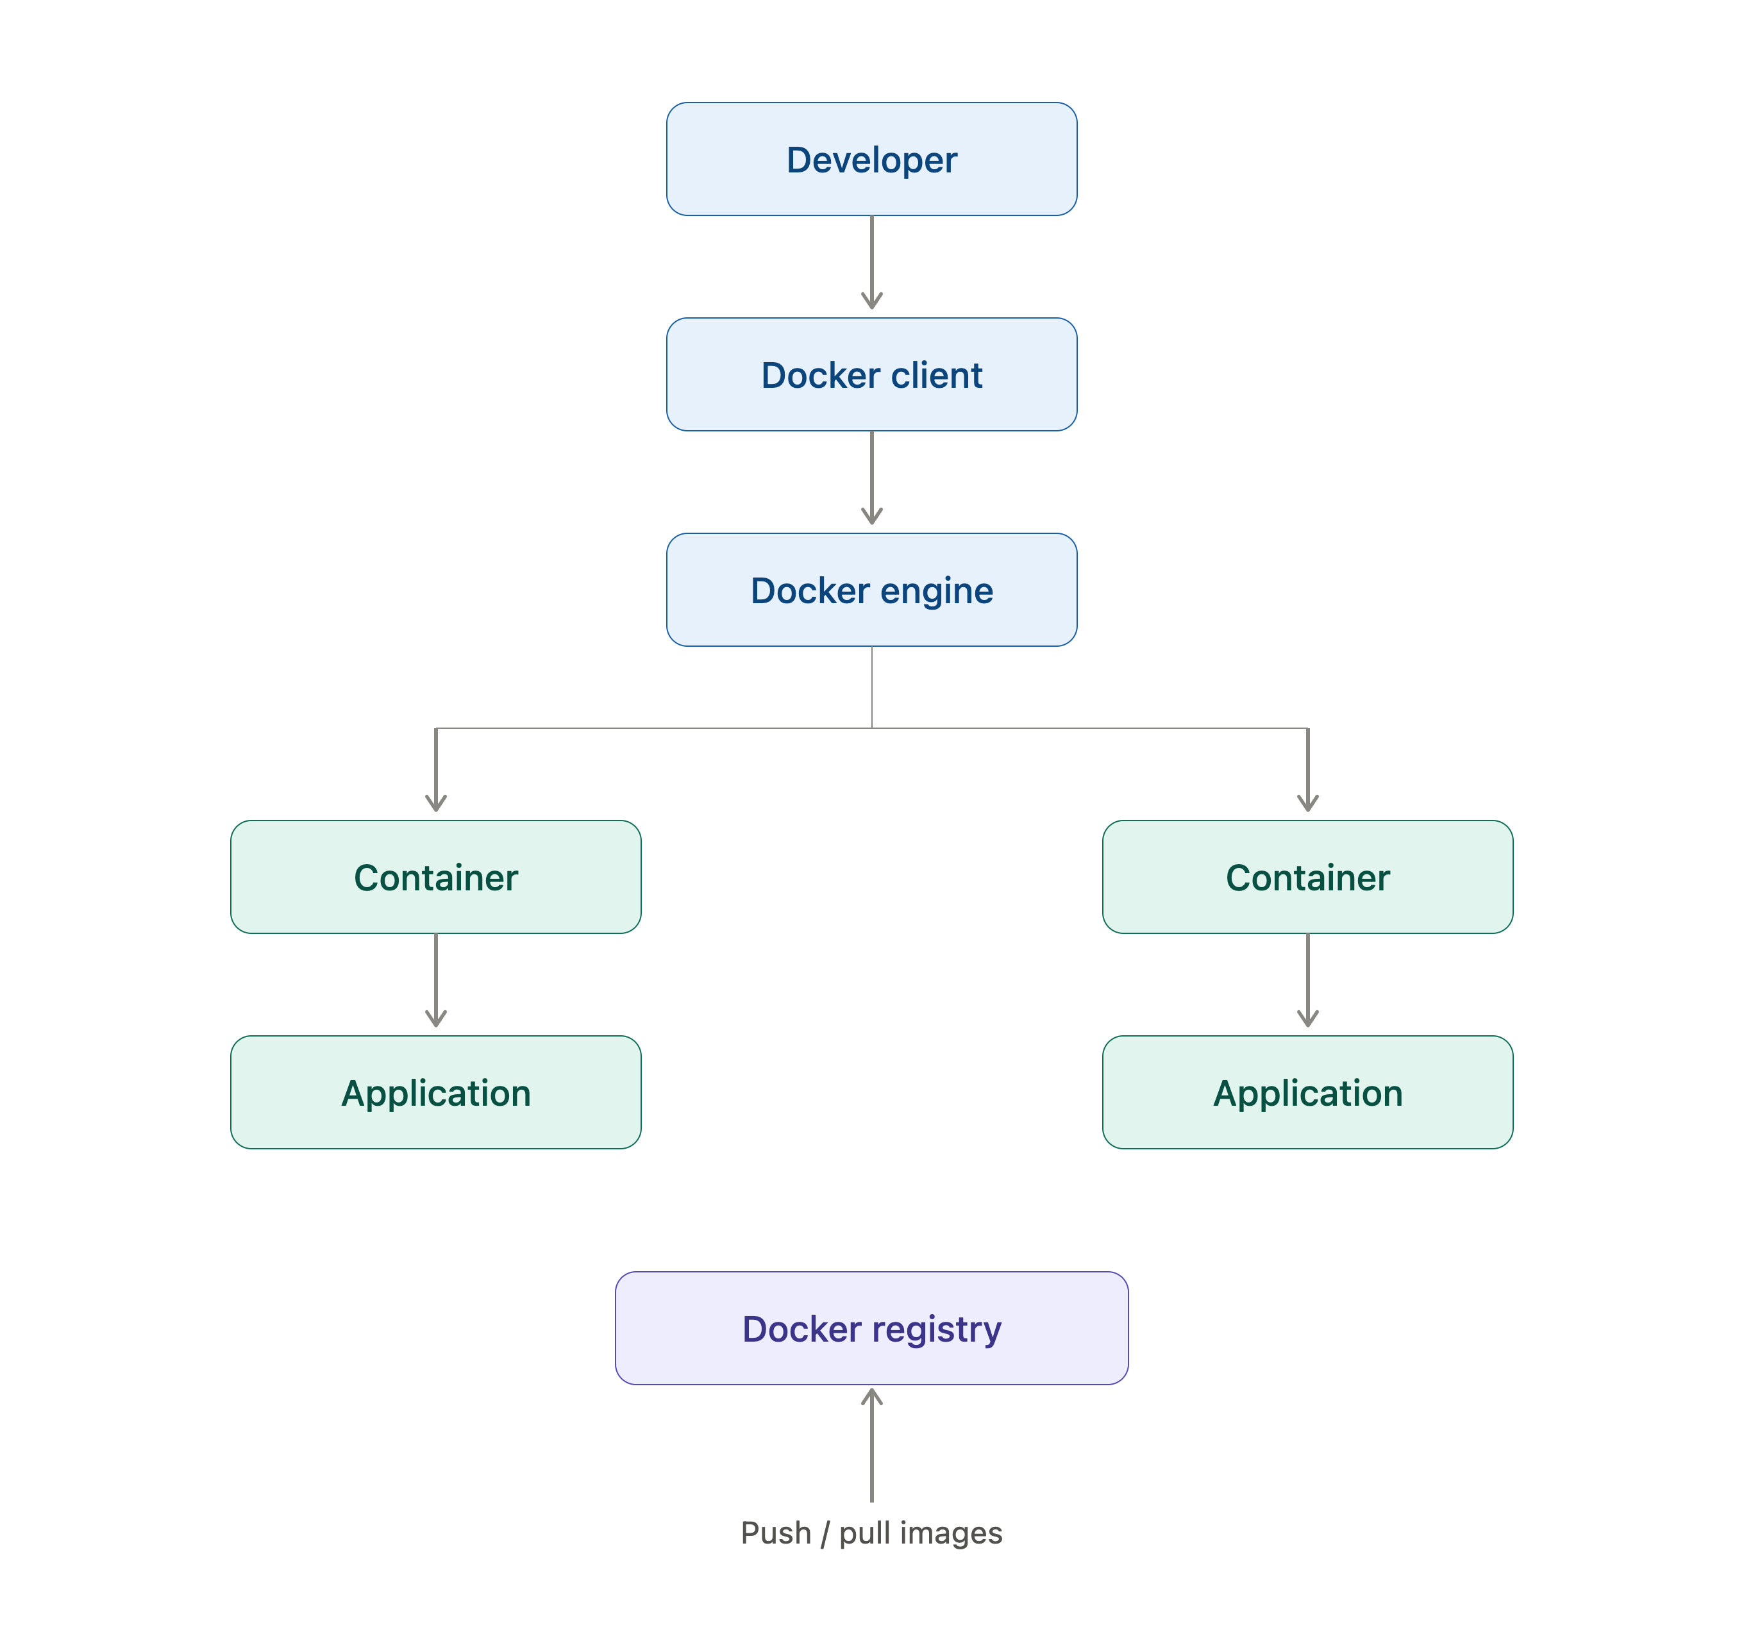
DOCKER
Docker Architecture
Security Perspective
Compromised Docker image
Vulnerable Docker daemon
Insecure registry
Excessive container privileges
Exposed Docker API
IE3142 · DevOps Security · Lecture 05
7

Slide 10
CONTAINER SECURITY
Container Security Threats
1
2
3
4
Vulnerable Images
Malicious Images
Secrets in Images
Privileged Containers
Outdated libraries or known vulnerabilities.
Published to compromise systems.
Passwords, API keys, tokens accidentally included.
Excessive privileges can access host resources.
5
6
7
8
Container Escape
Insecure Docker Config
Weak Networking
Supply Chain Attacks
Breaking out to access the underlying host.
Poor config allows unauthorized communication.
Compromised dependencies, images, or registries.
Misconfigured services expose resources.
IE3142 · DevOps Security · Lecture 05
9

Slide 11
CONTAINER SECURITY
Container Security Best Practices
1
2
3
Image Security
Runtime Security
Network Security
Trusted, updated, minimal, scanned base images.
No root, restrict privileges, limit resources, read-only filesystems.
Segment networks, restrict comms, avoid open ports.
4
5
Secrets
Monitoring
Never hard-code — use dedicated secret management.
Monitor activity, collect logs, detect anomalies.
IE3142 · DevOps Security · Lecture 05
10

Slide 12
CONTAINER SECURITY
Principle of Least Privilege for Containers
Containers should operate with the minimum privileges required. Excessive privileges increase the impact of a compromise.
✕ Avoid
✓ Prefer
Container
Container
↓ Root User
↓ Non-Root User
↓ Limited Permissions
↓ Full Host-Level Privileges
↓ Required Resources Only
Best Practices
Run applications as non-root users
Drop unnecessary Linux capabilities
Avoid privileged containers
Restrict access to host resources
Use read-only filesystems where possible
IE3142 · DevOps Security · Lecture 05
11

Slide 13
CONTAINER IMAGE SECURITY
What is a Container Image?
A container image is a packaged, immutable template; Image may application code, runtime, libraries, dependencies, configuration, and OS components.
Images are commonly built using a Dockerfile.
Dockerfile
→
Docker Build
→
Container Image
→
Docker Run
→
Running Container
IE3142 · DevOps Security · Lecture 05
12

Slide 14
CONTAINER IMAGE SECURITY
Container Image Layers
Container images are built using multiple stacked layers. Each Dockerfile instruction may create a new layer.
Security Importance
If an insecure package exists in an underlying layer, it may introduce vulnerabilities into the final image. Therefore:
Application Layer
Dependency Layer
Use trusted base images
Keep dependencies updated
Runtime Layer
Remove unnecessary components
Regularly scan images
Base OS Layer
IE3142 · DevOps Security · Lecture 05
13

Slide 15
CONTAINER IMAGE SECURITY
Secure Base Images
A base image provides the starting environment for a container. The security of the final container depends partly on the security of the base image.
FROM python:3.12
Bloated vs. Minimal Images
Large OS Image + Compiler + Package Manager + Unused Tools + Application
Best Practices
Use official or trusted images
Use minimal base images where appropriate
Avoid outdated images
↓ prefer
Regularly update base images
Minimal image containing only what the application requires
Verify image provenance
Scan base images for vulnerabilities
IE3142 · DevOps Security · Lecture 05
14

Slide 16
CONTAINER IMAGE SECURITY
Vulnerability Scanning of Container Images
Container image scanning identifies known vulnerabilities in OS packages, libraries, application dependencies, and software components.
Container Image
→
Security Scanner
→
Vulnerability DB
→
Findings
→
Risk Assessment
→
Fix / Update
→
Rescan
Common Tools
Example Finding
Trivy
Grype
Package: OpenSSL
Version: X.X.X
Docker Scout
Clair
Severity: HIGH
Fix Available: Yes
IE3142 · DevOps Security · Lecture 05
15

Slide 17
CONTAINER IMAGE SECURITY
Software Bill of Materials (SBOM)
An SBOM is an inventory of the software components and dependencies contained within an application or container.
Example — Application SBOM
Application
An SBOM can identify:
├── Flask
Libraries
Packages
├── OpenSSL
Versions
Dependencies
├── SQLite
Licenses
Known vulnerabilities
├── Requests
├── NumPy
Why it matters: if a critical vulnerability is found in a popular library, teams can use the SBOM to instantly check whether their containers are affected.
SBOMs improve software supply-chain visibility.
IE3142 · DevOps Security · Lecture 05
16

Slide 18
CONTAINER IMAGE SECURITY
Container Registry Security
Registry Security Risks
Security Best Practices
Unauthorized image uploads
Use private registries for sensitive apps
Malicious images
Implement authentication
Image tampering
Apply role-based access
Public exposure
Scan images before deployment
Stolen credentials
Sign and verify images
Vulnerable images
Remove obsolete images
Monitor registry activity
IE3142 · DevOps Security · Lecture 05
17

Slide 19
CONTAINER IMAGE SECURITY
Container Image Signing and Verification
Developer
→
Build Image
→
Sign Image
→
Registry
→
Verify Signature
↓
Deploy
Image signing verifies a container's origin and integrity, it protects against supply-chain attacks and unauthorized modification.
IE3142 · DevOps Security · Lecture 05
18

Slide 20
CONTAINER SECURITY
Container Secrets Management
Insecure Approach
Secure Approach
Never place secrets in a Dockerfile
Docker secrets
Source Code
Kubernetes Secrets
Container Image
AWS Secrets Manager
Git Repository
Azure Key Vault
Example: ENV DB_PASSWORD=MyPassword123
HashiCorp Vault
This can expose the password through image layers.
IE3142 · DevOps Security · Lecture 05
19

Slide 21
CONTAINER RUNTIME SECURITY
Container Runtime Security
1
2
3
User Security
Filesystem Security
Resource Security
Run as non-root; restrict privileges.
Read-only filesystems; restrict writable directories.
Apply CPU and memory limits to prevent exhaustion.
4
5
Network Security
Monitoring
Restrict unnecessary connections and exposed ports.
Processes, network, file access, system calls, behavior.
IE3142 · DevOps Security · Lecture 05
20

Slide 22
CONTAINER RUNTIME SECURITY
Container Escape
Container escape occurs when an attacker breaks out of a container's isolation and gains access to the underlying host or other resources.
Attacker
→
Vulnerable App
→
Compromised Container
→
Container Escape
→
Host System
→
Other Containers
Possible Causes
Prevention
Kernel vulnerabilities
Keep host OS updated
Container runtime vulnerabilities
Keep container runtime updated
Excessive privileges
Avoid privileged containers
Privileged containers
Use least privilege
Insecure host configuration
Restrict Linux capabilities
Monitor runtime behavior
IE3142 · DevOps Security · Lecture 05
21

Slide 23
CONTAINER RUNTIME SECURITY
Resource Limits and Denial of Service
Containers share host resources. A compromised or malfunctioning container could consume excessive CPU, memory, disk space, or network bandwidth affecting other applications on the same host.
CPU Limit
Memory Limit
Storage Limit
Network Limit
Resource Limits Help Prevent
Resource exhaustion
Application crashes
Denial-of-Service conditions
Noisy-neighbor problems
IE3142 · DevOps Security · Lecture 05
22

Slide 24
CONTAINER RUNTIME SECURITY
Container Network Security
Security Risks
Best Practices
Unnecessary open ports
Expose only required ports
Unauthorized container communication
Restrict container-to-container communication
Network sniffing
Use network segmentation
Lateral movement
Encrypt sensitive communication
Apply network policies
Avoid unnecessary public exposure
IE3142 · DevOps Security · Lecture 05
23

Slide 25
KUBERNETES
Introduction to Container Orchestration
Managing a few containers manually may be simple. But consider an application with:
100
10
Multiple
Multiple
Containers
Servers
Networks
Services
Container orchestration automates:
Deployment
Scaling
Networking
Load balancing
Service discovery
Health monitoring
Recovery
IE3142 · DevOps Security · Lecture 05
24

Slide 26
KUBERNETES
What is Kubernetes?
Kubernetes is an open-source container orchestration platform used to deploy, manage, scale, and operate containerized applications.
Why Kubernetes Matters to DevSecOps
Kubernetes becomes part of the infrastructure where applications run. Its configuration, identities, workloads, networking, and secrets must also be secured.
Kubernetes can automatically:
Deploy containers
Restart failed containers
Scale applications
Distribute workloads
Provide service discovery
Manage networking
Perform rolling updates
IE3142 · DevOps Security · Lecture 05
25

Slide 27
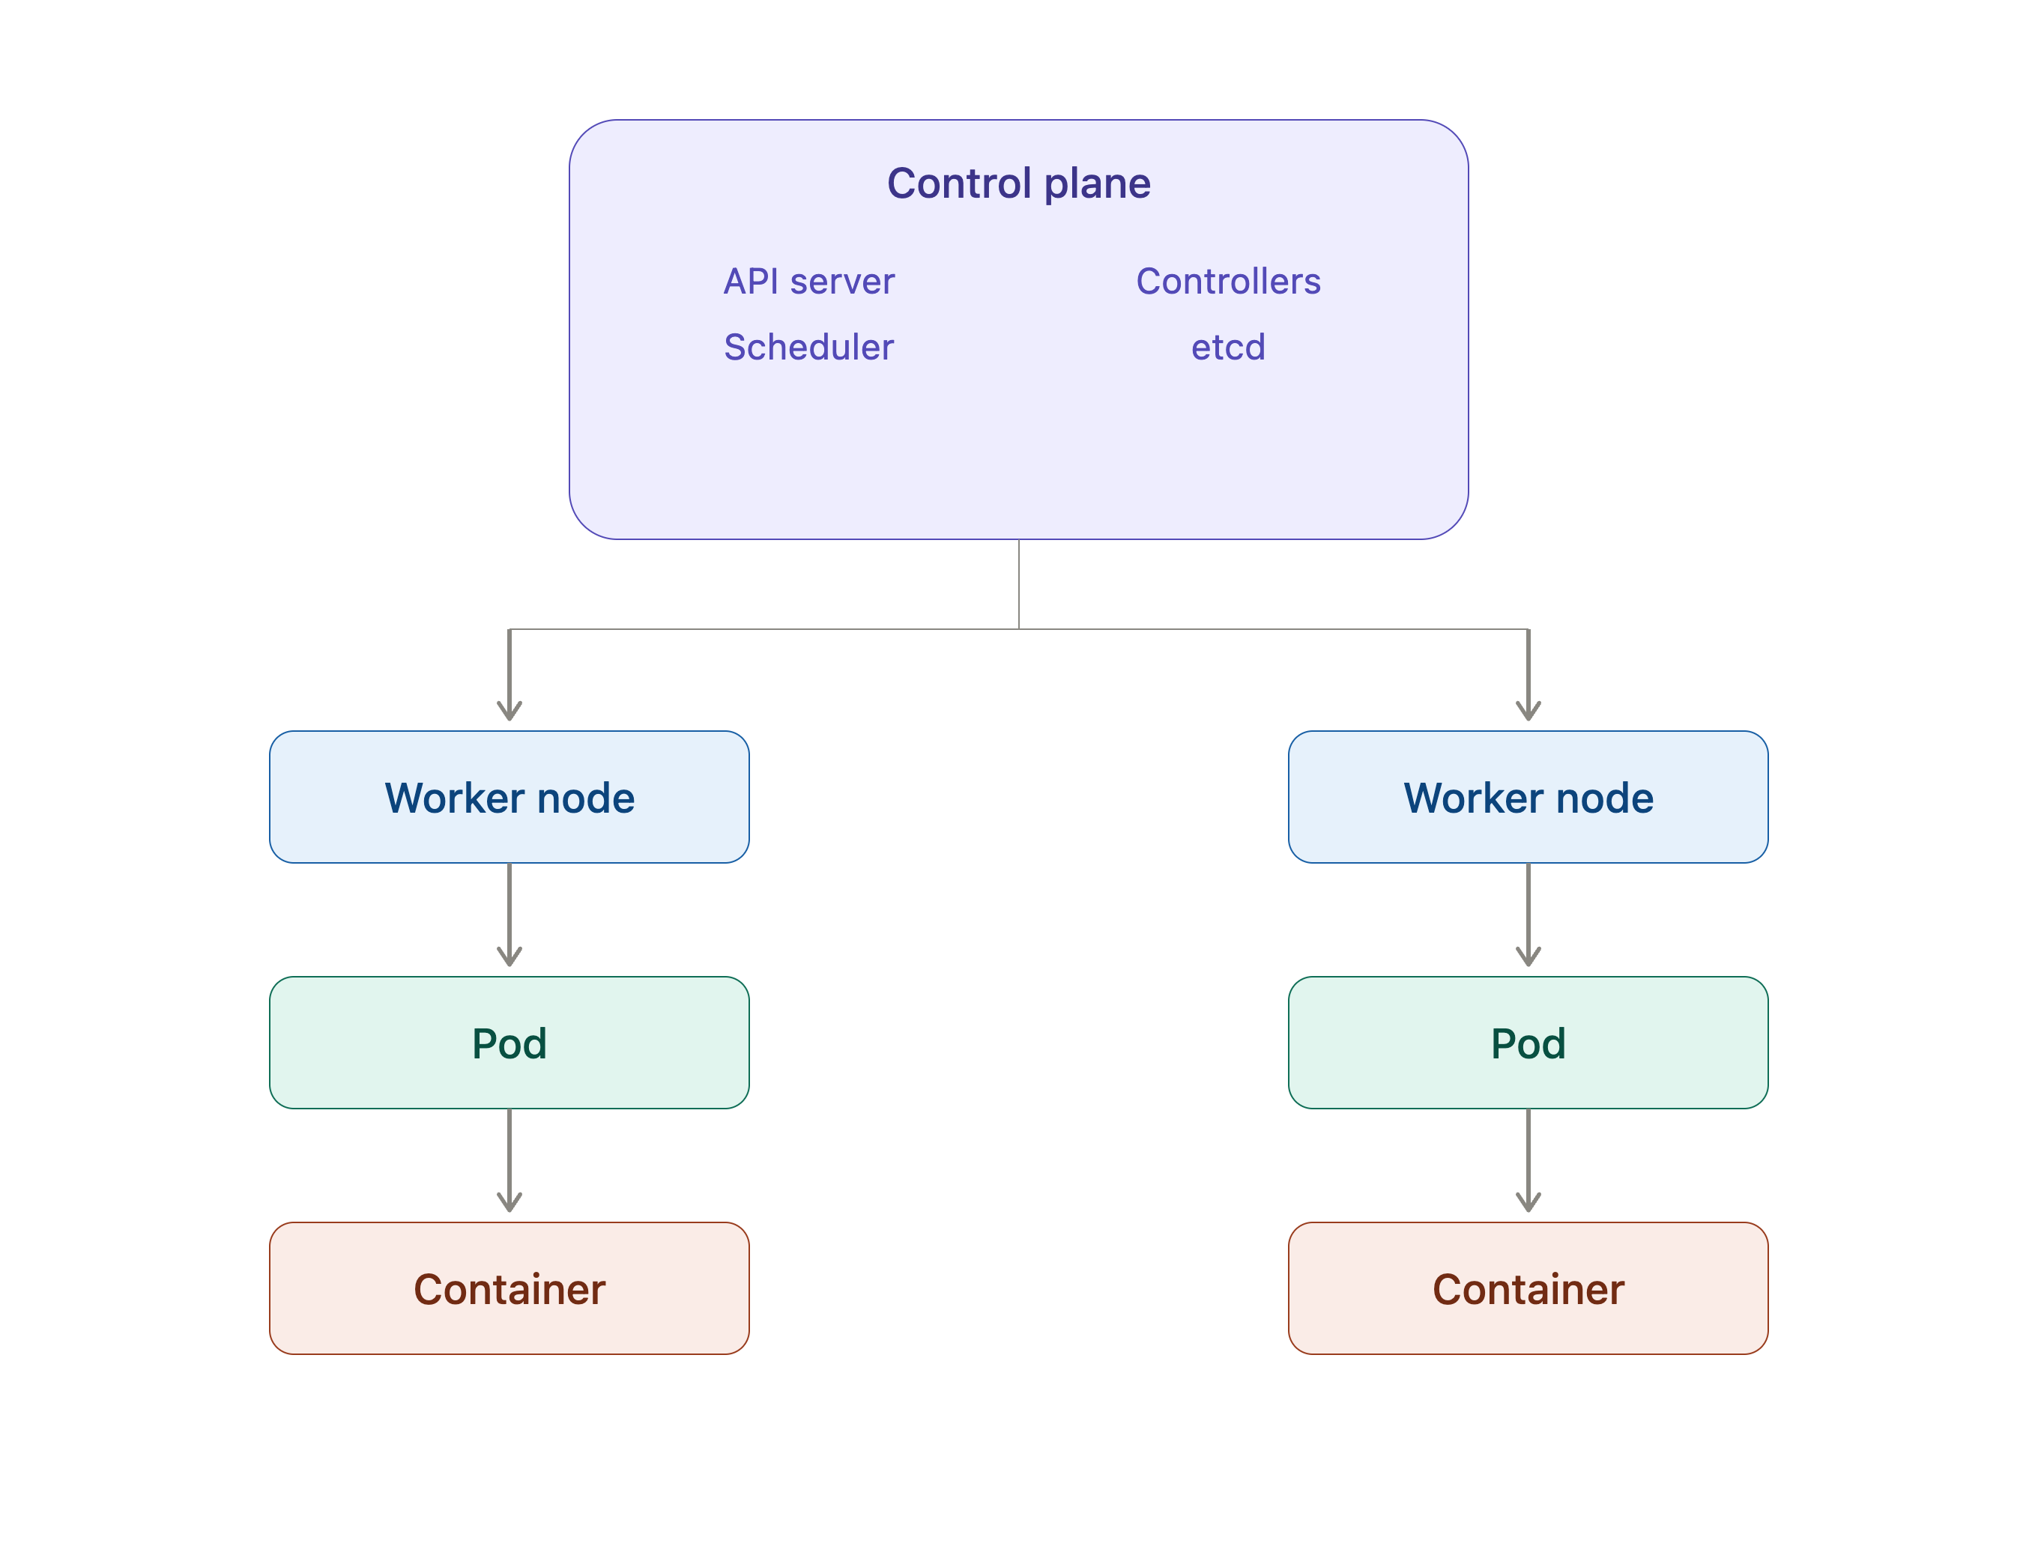
KUBERNETES
Kubernetes Architecture
A Kubernetes cluster consists mainly of a Control Plane and Worker Nodes.
Control Plane
Components include:
API Server
Scheduler
Controller Manager
Etcd
Worker Nodes
Components include:
Kubelet
Container Runtime
Pods
IE3142 · DevOps Security · Lecture 05
26

Slide 28
KUBERNETES SECURITY
Kubernetes Security Challenges
1
2
3
4
5
Exposed API Server
Excessive Permissions
Insecure RBAC
Privileged Containers
Vulnerable Images
6
7
8
9
10
Exposed Secrets
Insecure Networking
Misconfigured Workloads
Compromised Nodes
Unrestricted Pod Comms
IE3142 · DevOps Security · Lecture 05
27

Slide 29
KUBERNETES SECURITY
Kubernetes RBAC
Role-Based Access Control controls what users and workloads can do within a cluster. RBAC determines “who can access which resources?”, and “what actions they can perform?”.
A developer MAY be allowed to:
But NOT:
View pods
Delete namespaces
Deploy applications
Modify cluster-wide security policies
Access secrets belonging to other apps
Best Practices
Follow least privilege
Avoid unnecessary cluster-admin permissions
Separate dev and production access
Review permissions regularly
IE3142 · DevOps Security · Lecture 05
28

Slide 30
KUBERNETES SECURITY
Kubernetes Secrets
Kubernetes applications often require sensitive information such as database passwords, API keys, tokens, and certificates. Kubernetes provides a Secret object for storing this configuration.
Kubernetes Secrets should not automatically be treated as equivalent to a dedicated enterprise secret-management solution.
Organizations Should
External Secret Managers
Restrict access using RBAC
AWS Secrets Manager
Encrypt secrets at rest
Azure Key Vault
Avoid exposing secrets unnecessarily
HashiCorp Vault
Avoid committing secrets to source code
Consider external secret-management systems
IE3142 · DevOps Security · Lecture 05
29

Slide 31
KUBERNETES SECURITY
Kubernetes Network Security
Without restrictions, a compromised pod may communicate with other workloads unnecessarily. Kubernetes NetworkPolicy controls which pods, namespaces, and traffic are allowed.
Instead of allowing:
The policy allows only:
Frontend → Database
Frontend → Backend → Database
Network Policies can control:
• Which pods can communicate
• Which namespaces can communicate
• Which traffic is allowed
• Which traffic is denied
This reduces lateral movement.
IE3142 · DevOps Security · Lecture 05
30

Slide 32
KUBERNETES SECURITY
Kubernetes Pod Security
Best Practices
Security Context Defines
Do not run containers as root
Pods
Avoid privileged containers
Containers
Drop unnecessary Linux capabilities
Users
Use read-only filesystems where possible
Linux capabilities
Prevent privilege escalation
Filesystems
Define resource limits
Privilege escalation settings
Use appropriate security contexts
IE3142 · DevOps Security · Lecture 05
31

Slide 33
DEVSECOPS
Container Security in DevSecOps
Container security should be integrated into every stage of the DevSecOps lifecycle.
Plan
→
Code
→
Build
→
Test
→
Scan
→
Deploy
→
Run
→
Monitor
Code
Build
Registry
Deploy
Runtime
Secret detection, dependency scanning
Secure Dockerfile, image scanning
Image signing, access control
Policy enforcement, config validation
Monitoring, threat detection
This is the essence of DevSecOps for containers: security becomes continuous and automated rather than a final manual check.
IE3142 · DevOps Security · Lecture 05
32

Slide 34
PART 2
Secure Continuous Integration
and Deployment
Integrating security into CI/CD pipelines, building on Lecture 01's DevSecOps foundations

Slide 35
CI/CD
What is CI/CD?
Continuous Integration (CI): frequently integrating code changes into a shared repository and automatically building and testing the application.
Typical Pipeline
Developer
Code compilation
Git Repository
Unit testing
Build
Integration testing
Code quality analysis
Test
Security scanning
Security Checks
Continuous Delivery (CD): prepares validated software for release.
Continuous Deployment (CD): automatically deploys validated changes to production.
Package
Deploy
Production
IE3142 · DevOps Security · Lecture 05
33

Slide 36
CI/CD SECURITY
Why Integrate Security into CI/CD?
Traditional security testing happens near the end of development, vulnerabilities are discovered late, forcing teams back to earlier stages.
Traditional Approach
DevSecOps Approach
Code → Build → Test → Deploy
Code → Security Checks → Build
→ Security Testing
→ Security Tests → Deploy
→ Vulnerability Found
→ Continuous Monitoring
Benefits
Earlier vulnerability detection
Lower remediation cost
Faster feedback
Automated security testing
Consistent security controls
Reduced human error
IE3142 · DevOps Security · Lecture 05
34

Slide 37
CI/CD SECURITY
Security in the CI/CD Pipeline
Stage | Security Activity
Code | SAST, secret scanning
Dependencies | SCA
Build | Secure build validation
Container | Image scanning
Testing | DAST, security tests
Infrastructure | IaC scanning
Deployment | Policy checks
Runtime | Monitoring and threat detection
IE3142 · DevOps Security · Lecture 05
35

Slide 38
CI/CD SECURITY
Shift-Left Security in CI/CD
Shift Left means moving security activities earlier in the software development lifecycle.
Traditional — too late
Shift Left
Development → Testing → Deployment → Security
Security → Development → Testing → Deployment
Example — catching a vulnerable dependency early
Developer adds dependency
→
SCA Scan
→
Vulnerability detected
→
Developer fixes it
This reduces the cost and effort of remediation.
IE3142 · DevOps Security · Lecture 05
36

Slide 39
SECURITY TESTING
Static Application Security Testing (SAST)
SAST analyzes source code or compiled code without executing the application.
Source Code
SAST Can Identify:
SAST Tool
SQL Injection
Hardcoded credentials
Security Analysis
Weak cryptography
Findings
Insecure functions
Input validation issues
Developer Fix
Example Tools
SonarQube · Semgrep · Checkmarx · Fortify
IE3142 · DevOps Security · Lecture 05
37

Slide 40
SECURITY TESTING
Software Composition Analysis (SCA)
Modern applications depend heavily on third-party libraries. SCA identifies vulnerabilities in these dependencies.
SCA Checks
Application
Dependency versions
├── Flask
Known vulnerabilities
├── Requests
Outdated packages
├── OpenSSL
License information
├── Other Libraries
Dependency relationships
Example Tools: OWASP Dependency-Check · Snyk · Dependabot
IE3142 · DevOps Security · Lecture 05
38

Slide 41
SECURITY TESTING
Secret Scanning
Sensitive credentials can accidentally be committed to source-code repositories; AWS access keys, API tokens, database passwords, private keys.
Developer
→
Commits Code
→
Secret Scanner
→
AWS Key Detected
→
Pipeline Fails
Best Practices
Example Tools
Never hard-code secrets
GitHub Secret Scanning
Scan repositories automatically
Gitleaks
Rotate exposed credentials immediately
Use secret-management systems
TruffleHog
IE3142 · DevOps Security · Lecture 05
39

Slide 42
SECURITY TESTING
Dynamic Application Security Testing (DAST)
DAST tests a running application from the outside to identify vulnerabilities. Unlike SAST, DAST does not analyze source code directly.
Running Web Application
DAST Can Identify:
DAST
SQL Injection
Cross-Site Scripting
Simulated Attacks
Authentication weaknesses
Session management problems
Vulnerability Report
Security misconfigurations
Example Tool: OWASP ZAP
IE3142 · DevOps Security · Lecture 05
40

Slide 43
SECURITY TESTING
Infrastructure as Code Security
Modern DevOps environments use Infrastructure as Code (IaC) to define infrastructure through configuration files, Terraform, AWS CloudFormation, Azure Bicep.
Terraform Code
→
Security Scanner
→
Misconfiguration Found
→
Developer Fixes
→
Infrastructure Deployment
IaC Scanning Can Identify
Example Tools
Public storage
Open firewall rules
Checkov
Excessive permissions
tfsec
Unencrypted resources
Insecure network configurations
KICS
IE3142 · DevOps Security · Lecture 05
41

Slide 44
CONTAINER + CI/CD
Container Security in CI/CD
Code
→
Build Image
→
Image Scan
→
Vulnerability Check
→
Image Signing
→
Registry
→
Deployment
Security Checks
Pipeline Decision
Security Scan
Scan image vulnerabilities
Scan dependencies
Critical Vulnerability
Detect secrets
Pipeline FAILED
Verify base images
Check Dockerfile security
Deployment BLOCKED
Generate SBOM
Verify image signatures
This prevents vulnerable container images from reaching production.
IE3142 · DevOps Security · Lecture 05
42

Slide 45
CONTAINER + CI/CD
Security Gates in CI/CD
A security gate is an automated condition in a CI/CD pipeline that determines whether a build can proceed to the next stage.
Build
→
SAST
→
SCA
→
Container Scan
→
Security Gate
↓
Pass?
Yes → Deploy
No → Stop
Example Policy
• No Critical vulnerabilities
• Maximum 5 Medium vulnerabilities
• No exposed secrets
• No high-risk IaC misconfigurations
IE3142 · DevOps Security · Lecture 05
43

Slide 46
SECURITY AUTOMATION
Security Automation in CI/CD
1
2
3
Automated Code Scanning
Automated Dependency Scanning
Automated Container Scanning
Every code commit is scanned.
Container images are scanned before deployment.
New dependencies are checked for vulnerabilities.
4
5
Automated Infrastructure Scanning
Automated Compliance
Configurations checked before provisioning.
Checked against security policies.
IE3142 · DevOps Security · Lecture 05
44

Slide 47
SECURITY AUTOMATION
CI/CD Pipeline Security
Pipeline Security Threats
Security Controls
Compromised developer credentials
Strong authentication & MFA
Malicious code commits
Least privilege
Compromised build servers
Protected branches
Stolen CI/CD tokens
Code review
Malicious dependencies
Secure build agents
Unauthorized pipeline modifications
Secret management
Supply-chain attacks
Artifact signing
Audit logging
IE3142 · DevOps Security · Lecture 05
45

Slide 48
SUPPLY CHAIN
Software Supply Chain Security
Modern applications are built using many external components, each dependency introduces potential security risk.
Application
Attackers May Compromise
├── Open Source Libraries
Open-source packages
├── Container Images
Container images
├── Build Tools
Build systems
├── APIs
CI/CD pipelines
├── Third-Party Services
Package repositories
Security Measures
Dependency scanning
SBOM
Trusted repositories
Image signing
Artifact verification
Version pinning
Continuous monitoring
IE3142 · DevOps Security · Lecture 05
46

Slide 49
SUPPLY CHAIN
Secure Artifact Management
An artifact is a file produced during the software build process executables, packages, container images, libraries, and deployment packages.
Artifacts should be securely stored and verified before deployment.
Best Practices
Use trusted artifact repositories
Control access
Scan artifacts
Sign artifacts
Verify integrity
Maintain version history
Prevent unauthorized modification
IE3142 · DevOps Security · Lecture 05
47

Slide 50
SUPPLY CHAIN
DevSecOps CI/CD Pipeline
Source Code
→
SAST
→
Dependency Scan
→
Build
↓
↓
↓
↓
↓
↓
↓
↓
↓
Container Build
→
Container Scan
→
DAST
→
IaC Scan
↓
↓
↓
↓
↓
↓
↓
↓
↓
Security Gate
→
Artifact Repo
→
Deploy
→
Monitor
Cyan boxes are security activities. Security is continuously integrated rather than performed as a final stage.
IE3142 · DevOps Security · Lecture 05
48

Slide 51
WORKED EXAMPLE
Example: Secure CI/CD Pipeline for an Online Shopping App
1
Code
6
IaC Scan
Secret scanning checks for exposed credentials.
Terraform configuration is checked for misconfigurations.
2
SAST
7
Security Gate
Source code is analyzed for vulnerabilities.
The pipeline checks whether security policies are satisfied.
3
SCA
8
Deployment
Third-party dependencies are scanned.
Only approved artifacts are deployed.
4
Build
9
Runtime Monitoring
The application is packaged into a container.
The application and infrastructure are continuously monitored.
5
Container Scan
The container image is checked for vulnerabilities.
IE3142 · DevOps Security · Lecture 05
49

Slide 52
WRAP-UP
Benefits of Secure CI/CD
1
2
3
4
Earlier Detection
Lower Remediation Cost
Faster Feedback
Consistency
Vulnerabilities identified earlier.
Automated tools provide immediate feedback.
Same checks applied to every build.
Fix issues before deployment.
5
6
7
Reduced Human Error
Continuous Compliance
Improved Collaboration
Automation reduces manual reliance.
Security policies enforced continuously.
Dev, security, and ops share responsibility.
IE3142 · DevOps Security · Lecture 05
50

Slide 53
KEY TAKEAWAYS
Container, Kubernetes & CI/CD Security
Container Security
Kubernetes Security
Secure CI/CD
Portability, consistency, isolation
Secure the control plane
Integrate security throughout the pipeline
Not automatically secure
Apply RBAC and least privilege
Use SAST, SCA, DAST, IaC & container scanning
Secure images, registries, runtime, hosts
Secure pods and containers
Scan for secrets
Use network policies
Use security gates
Apply least privilege
Scan images and dependencies
Protect secrets
Protect the CI/CD pipeline & supply chain
Protect secrets · monitor runtime
Avoid privileged workloads
Automate security wherever possible
IE3142 · DevOps Security · Lecture 05
51

Slide 54
DEVSECOPS
Questions?
IE3142 · DevOps Security · Lecture 05
52

