Slide 1
IE3122 – Network Security
Week 1: Module & Lecturer Introduction
Faculty of Computing — BSc (Hons) in Information Technology

Slide 2
Today's Agenda
Module overview — aim, learning outcomes, delivery structure
Assessment structure and grading breakdown
Weekly topic roadmap (Weeks 1–14)
Meet your lecturer
Ground rules and how the module runs
What's next: Networking Revision (this session) & Week 2
01
02
03
04
05
06

Slide 3
Module Overview
What this module is about, and how it's structured

Slide 4
Why This Module Exists
MODULE AIM
Enable you to identify security vulnerabilities in a network and recommend suitable mitigation techniques — and to evaluate a company's networking requirements and infrastructure to recommend security solutions that protect its network and communications.
Level | Credits | Delivery
Year 3, Semester 1 | 4 Credits | Lectures 2h + Tutorials 1h + Labs 2h / week

Slide 5
Module Learning Outcomes
LO1
Describe common network vulnerabilities and attacks
LO2
Evaluate mitigation techniques for vulnerabilities and make recommendations
LO3
Analyse a company's network/communication requirements and communicate security requirements
LO4
Evaluate modern security technologies (Firewalls, AAA, IPS/IDS, VPN, Cryptography)
LO5
Configure security technologies (ACL, VPN, Switch/Router Security, Zone-Based Firewalls)

Slide 6
Assessment

Slide 7
How You'll Be Assessed
Component | Weight | Learning Outcomes | Format
Final Exam | 50% | LO1–LO5 | MCQ + structured essay
Mid-Semester Test | 20% | LO1–LO2 | MCQ only
Group Assignment | 30% | LO2–LO5 | Scenario-based report + presentation
Weekly practical exercises (labs) run throughout the semester and build the hands-on configuration skills tested indirectly via LO5.
The group assignment is scenario-based: you'll analyse a company's network and recommend security solutions — directly mirroring LO3–LO5.
The final exam mixes MCQ (recall/LO1–LO2) with structured essay questions (evaluation/analysis, LO3–LO5).

Slide 8
Weekly Roadmap

Slide 9
Weekly Topics — Weeks 1–7
Wk | Topic | Focus
1 | Module Intro + Networking Revision | Orientation — layered stack, protocols
2 | Networking & Security Revision | Routers/switches, CIA Triad, threat analysis
3 | Network Attacks & Malware | Common attacks, vulnerabilities, malware types
4–5 | Layer-Specific Attacks | Layer 2, 3 & 4 attacks (2 lectures)
6 | Network Defense | Security policy, BCP/DR, malware mitigation
7 | Firewalls | Types, stateful inspection, zone-based, placement

Slide 10
Weekly Topics — Weeks 8–14
Wk | Topic | Focus
8 | AAA | Server/device-based auth, RADIUS, TACACS+
9 | VPN | VPN types, tunneling, SSL VPN vs IPSec
10 | IPS and IDS | Functionality, placement, types
11 | Cryptography* | Symmetric/asymmetric, block/stream ciphers
12 | Digital Certificates* | Hash functions, PKI, non-repudiation
13 | Wireless Security | WiFi security, WEP/WPA protocols
14 | Revision / Assignment Vivas | Buffer week — no new lecture content
Weekly practicals (20 lab hours) run throughout — switch/router security, ACL, AAA, VPN, zone-based firewalls.

Slide 11
Recommended Texts
📘
CCNA Security 210-260 Official Cert Guide, 1st Ed.
Omar Santos, John Stuppi
Cisco Press
📘
Network Security: Private Communication in a Public World, 3rd Ed.
Charlie Kaufman, Radia Perlman, Mike Speciner, Ray Perlner
Prentice Hall

Slide 12
Meet Your Lecturer

Slide 13
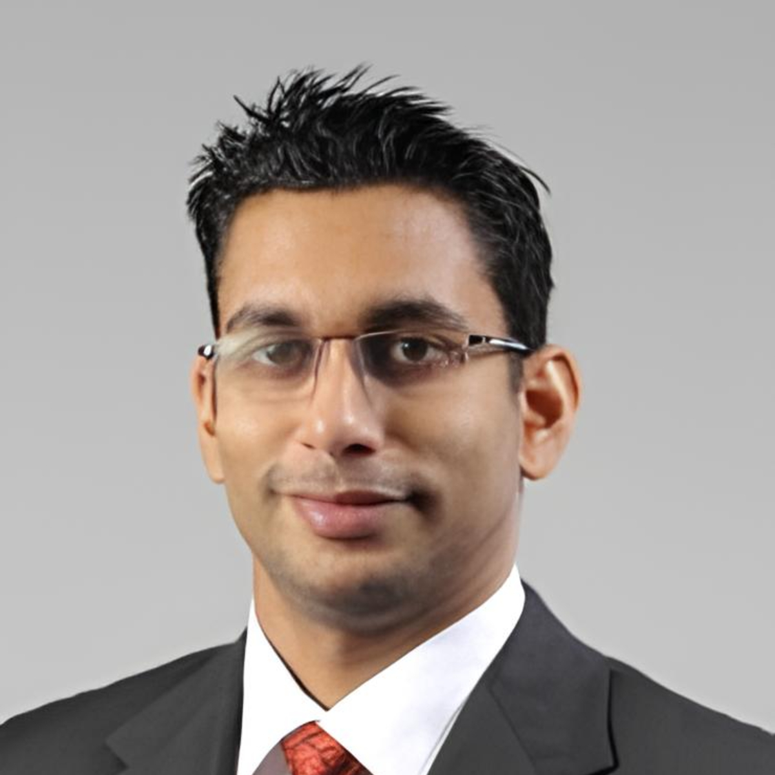
Prof. Harinda Fernando
Photo
Professor, Dept. of Computer Systems Engineering
18 years in tertiary education across Australia and Sri Lanka
Core expertise: Cybersecurity, Networking, and Machine Learning
PhD in Computing, Deakin University (2012)

Slide 14
Current Roles & Research
Current Roles
Full Professor
Cluster Lead — Information Assurance & Security Research Cluster
Program Coordinator, MSc in Cybersecurity
Research Domains
Cybersecurity
Networking
Internet of Things (IoT)
Applied AI

Slide 15
Recognitions & Supervision
200+
Undergraduate dissertations supervised
30+
Postgraduate dissertations supervised
FHEA
Fellow of the Higher Education Academy
SMIEEE
Senior Member, IEEE

Slide 16
Getting in Touch
Email
harinda.f@sliit.lk
Best way to reach me
Email first for anything not urgent; consultation slot details will be shared on the course page.
Please include
Your student ID and IE3122 in the subject line for faster routing.

Slide 17
Getting Started

Slide 18
How This Module Runs
Attendance
Lectures, tutorials, and labs are all part of the learning cycle — labs build the configuration skills examined under LO5.
Submissions
Deadlines for the group assignment will be posted on the course page; late policy follows faculty regulations.
Communication
Course announcements and materials go through the official course page; email for individual queries.
Academic Integrity
Group assignment work must be your own team's analysis — standard SLIIT academic integrity policy applies.

Slide 19
Tools You'll Need
Tool | Purpose | When
Cisco Packet Tracer | Switch/router config, ACLs, VPN, firewall labs | From the lab sessions onward
GNS3 (optional) | More advanced topology simulation | As needed for later labs
No lab session accompanies this Week 1 lecture — instead, this week's practical is an incident-analysis exercise (see the Week 1 lab guide).
Get Packet Tracer installed before Week 2's session so we can move straight into hands-on work.

Slide 20
What's Next
Right now
Networking Revision — a quick refresher of the layered stack and core protocols (Ethernet, IP, DHCP, ARP, TCP, UDP, HTTP) before we build on them.
This week's lab
Recent network security breach case studies — analyse real incidents and answer scenario questions.
Week 2
Networking and Security Revision — router/switch functionality, the CIA Triad, and threat analysis (LO1, LO3).

Slide 21
Summary
IE3122 builds skills across 5 LOs: describing threats, evaluating mitigations, analysing requirements, evaluating security technologies, and configuring them.
Assessment blends MCQ, structured essay, and a scenario-based group assignment — all tied to specific LOs.
14 teaching weeks: this orientation week, 12 core topic weeks, and a revision/viva week.
Reach out early and often — harinda.f@sliit.lk.

Slide 22
Questions?
harinda.f@sliit.lk — Let's move into the Networking Revision

