Slide 1
Networking Revision
IE3122 – Network Security | Week 1
A quick refresher before we build on it

Slide 2
What We're Refreshing
Layered architecture (OSI & TCP/IP)
Switching & routing fundamentals
Ethernet & IP addressing
DHCP & ARP
TCP & UDP
HTTP
Why revisit this?
Every attack and defense mechanism in this module sits on top of these fundamentals — you can't secure a layer you don't understand.
This is a refresher, not first-time teaching — we move quickly and focus on what matters for security.

Slide 3
How This Fits the Module
Underpins LO1 (describing vulnerabilities) and LO3 (analysing network/communication requirements).
Weeks 3–5 build directly on this: Layer 2, 3, and 4 attacks all exploit gaps in the protocols we're reviewing today.
If any of this feels shaky, flag it early — it only gets more security-focused from here.

Slide 4
Layered Architecture
Why we split networking into layers

Slide 5
Why Layered Architecture?
CONCEPT
Breaks a complex problem (moving data across a network) into independent, manageable pieces.
Each layer has one job and only talks to the layers directly above and below it.
Vendors can innovate within a layer (e.g. a new Ethernet standard) without breaking the layers above.
Security matters: attackers target specific layers, so defenders need layer-by-layer thinking.

Slide 6
The OSI 7-Layer Model
CONCEPT
7
Application
HTTP, DNS, SMTP
6
Presentation
Encryption, encoding
5
Session
Session mgmt
4
Transport
TCP, UDP
3
Network
IP, routing
2
Data Link
Ethernet, MAC, ARP
1
Physical
Cabling, signals

Slide 7
OSI vs TCP/IP Model
CONCEPT
OSI (7 layers) | TCP/IP (4 layers)
Application / Presentation / Session | Application
Transport | Transport
Network | Internet
Data Link / Physical | Network Access
TCP/IP is what's actually implemented on the Internet; OSI is the conceptual teaching model we use to reason about it.

Slide 8
Encapsulation & Decapsulation
CONCEPT
Data
+ TCP/UDP
Header (Segment)
+ IP
Header (Packet)
+ Ethernet
Header/Trailer (Frame)
Encapsulation: as data moves down the stack (sender), each layer wraps it with its own header (and sometimes trailer).
Decapsulation: as it moves up the stack (receiver), each layer strips off and reads its own header.
Security relevance: many attacks (spoofing, injection) work by tampering with a specific layer's header.

Slide 9
Switching Revision
Layer 2 forwarding fundamentals

Slide 10
What Switches Do
SWITCHING
Operate at Layer 2 — forward frames based on destination MAC address.
Build and maintain a MAC address table by learning source MACs on incoming frames.
Unknown destination → flood out all ports except the incoming one; known destination → forward out one port only.
Each switch port is its own collision domain — this is why switches replaced hubs.

Slide 11
Domains & VLANs
SWITCHING
Collision domain: a segment where frames can collide — each switch port is its own collision domain.
Broadcast domain: the set of devices that receive a broadcast — by default, all ports on a switch share one broadcast domain.
VLANs (Virtual LANs) split a switch into multiple broadcast domains for segmentation — a core building block for later security topics like zone-based defenses.

Slide 12
Common Switching Issues
SWITCHING
Switching loops: redundant links can cause broadcast storms — prevented by Spanning Tree Protocol (STP).
MAC table exhaustion / CAM overflow: an attacker floods fake MACs to force a switch into flooding all frames (foreshadows Week 4–5 Layer 2 attacks).
We'll dig into these as attacks — and their defenses — later in the module.

Slide 13
Routing Revision
Layer 3 forwarding fundamentals

Slide 14
What Routers Do
ROUTING
Operate at Layer 3 — forward packets based on destination IP address.
Maintain a routing table mapping networks to the best next-hop interface.
Connect different networks/broadcast domains together — a router is a natural boundary for security policy.
Every host needs a default gateway — the router it sends traffic to when the destination isn't on its local network.

Slide 15
Static vs Dynamic Routing
ROUTING
 | Static Routing | Dynamic Routing
Configuration | Manually entered by admin | Learned automatically via a routing protocol
Best for | Small, stable networks | Larger networks with changing topology
Security angle | Predictable, smaller attack surface | Vulnerable to route injection/spoofing if unauthenticated

Slide 16
Routing Protocols — Quick Overview
ROUTING
Protocol | Type | Notes
RIP | Distance-vector | Simple, hop-count based, limited scalability
OSPF | Link-state | Fast convergence, widely used internally
EIGRP | Advanced distance-vector | Cisco-developed, fast convergence
BGP | Path-vector | Routes the Internet itself, between autonomous systems

Slide 17
Ethernet
The dominant Layer 2 / Layer 1 technology

Slide 18
The Ethernet Frame
ETHERNET
Preamble
Dest
MAC
Src
MAC
Type
Payload (46–1500B)
FCS
Destination/Source MAC: 6-byte hardware addresses identifying sender and receiver on the local segment.
Type: identifies the encapsulated protocol (e.g. IPv4, ARP).
FCS (Frame Check Sequence): CRC checksum for error detection — not tamper protection.

Slide 19
MAC Addressing
ETHERNET
48-bit address, usually written as six hex pairs (e.g. 00:1A:2B:3C:4D:5E).
First 3 bytes (OUI) identify the manufacturer; last 3 bytes are the device-specific identifier.
Burned into hardware, but can be spoofed in software — a common Layer 2 attack technique we'll cover later.

Slide 20
Ethernet Standards & Speeds
ETHERNET
Standard | Speed | Common Use
10BASE-T | 10 Mbps | Legacy
100BASE-TX (Fast Ethernet) | 100 Mbps | Older LANs
1000BASE-T (Gigabit) | 1 Gbps | Standard LAN today
10GBASE-T and above | 10 Gbps+ | Data centers, backbones

Slide 21
IP
Logical addressing and routing at Layer 3

Slide 22
IPv4 Addressing
IP
32-bit address, written as 4 decimal octets (e.g. 192.168.1.10).
Split into network and host portions, defined by a subnet mask (e.g. /24 = 255.255.255.0).
Address classes (A, B, C) are largely historical — modern networks use CIDR (Classless Inter-Domain Routing).
Private ranges (10.0.0.0/8, 172.16.0.0/12, 192.168.0.0/16) aren't routed on the public Internet — relevant to NAT and perimeter security.

Slide 23
Subnetting Basics
IP
CIDR | Subnet Mask | Usable Hosts
/24 | 255.255.255.0 | 254
/25 | 255.255.255.128 | 126
/26 | 255.255.255.192 | 62
/30 | 255.255.255.252 | 2 (point-to-point links)
Subnetting isn't just addressing — smaller subnets mean smaller broadcast domains and tighter security boundaries.

Slide 24
IPv4 vs IPv6
IP
 | IPv4 | IPv6
Address length | 32-bit | 128-bit
Address space | ~4.3 billion | 3.4×10³⁸
Built-in security | None (IPSec optional) | IPSec support built into the standard
Notation | 192.168.1.10 | 2001:0db8::1

Slide 25
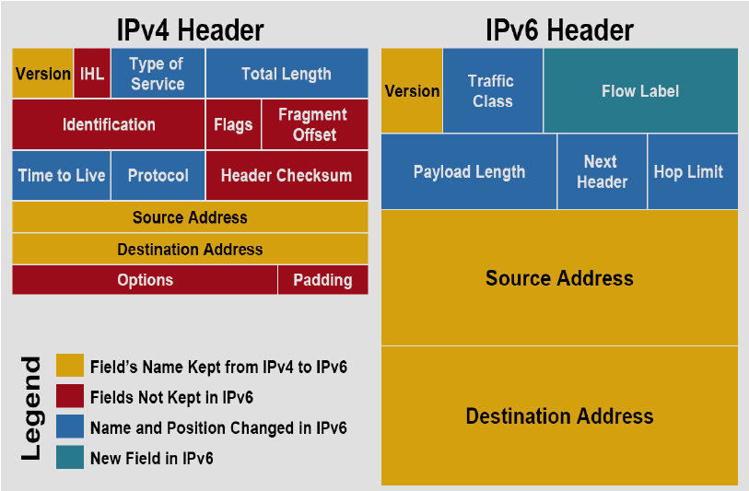
IPv4 vs IPv6 Header
IP

Slide 26
IP Header — Key Fields
IP
TTL (Time to Live): limits how many hops a packet can traverse — prevents infinite routing loops.
Protocol: identifies the transport-layer protocol carried (TCP=6, UDP=17, ICMP=1).
Source/Destination IP: the addresses routers use to forward the packet.
Fragmentation flags/offset: support splitting packets too large for a given link — also a historical attack vector (fragmentation attacks).

Slide 27
DHCP
Automatic IP address assignment

Slide 28
DHCP: DORA Process
DHCP
Discover
Offer
Request
Acknowledge
Client broadcasts for a DHCP server
Server offers an available IP
Client requests the offered IP
Server confirms the lease

Slide 29
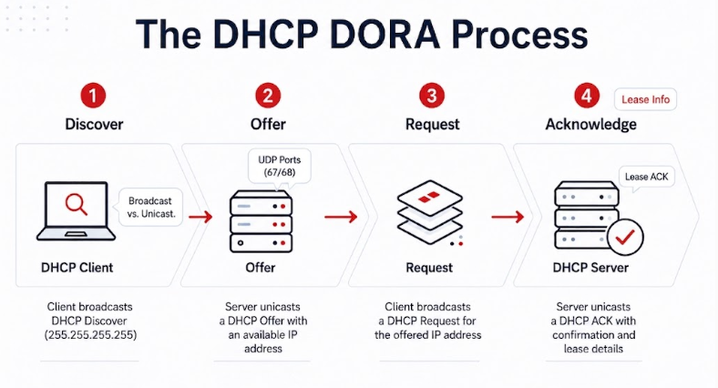
DHCP: DORA Process
DHCP

Slide 30
DHCP Details
DHCP
Uses UDP ports 67 (server) and 68 (client).
Leases are time-limited — clients must renew before expiry or risk losing their address.
DHCP options can also hand out gateway, DNS servers, and other config — not just an IP address.

Slide 31
DHCP: A Security Preview
DHCP
DHCP has no built-in authentication — any device can respond to a Discover.
Rogue DHCP server attack: an attacker's server races the real one to hand out a malicious gateway/DNS, redirecting victim traffic.
Mitigation preview: DHCP snooping on switches (we'll cover this properly under Layer 2 attacks & network defense).

Slide 32
ARP
Mapping IP addresses to MAC addresses

Slide 33
How ARP Works
ARP
A host needs a destination's MAC address to build an Ethernet frame, but usually only knows its IP.
ARP Request: broadcast — “Who has 192.168.1.5? Tell 192.168.1.10.”
ARP Reply: unicast — the owner of that IP responds with its MAC address.
The result is cached in the sender's ARP table to avoid repeating the broadcast for every packet.

Slide 34
ARP Cache — Example
ARP
IP Address | MAC Address | Type
192.168.1.1 | AA:BB:CC:00:11:22 | Dynamic
192.168.1.5 | AA:BB:CC:00:33:44 | Dynamic

Slide 35
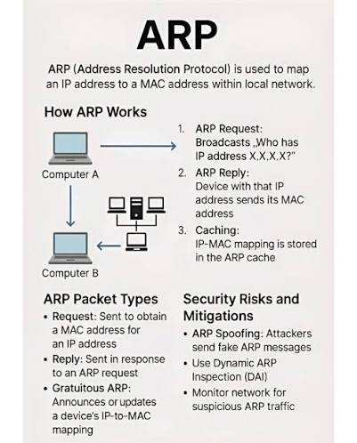
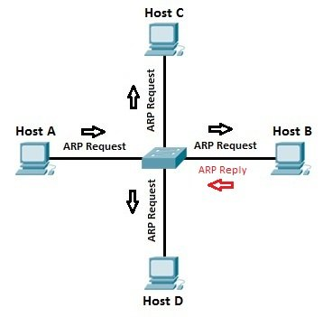
ARP Protocol
ARP

Slide 36
ARP: A Security Preview
ARP
ARP has no authentication — a host will accept an unsolicited ARP reply and update its cache.
ARP spoofing / poisoning: an attacker sends forged ARP replies to associate their own MAC with a victim's IP, enabling man-in-the-middle attacks.
We'll cover detection and mitigation (e.g. dynamic ARP inspection) under Layer 2 attacks in Weeks 4–5.

Slide 37
TCP
Reliable, connection-oriented transport

Slide 38
TCP Characteristics
TCP
Connection-oriented: a session is established before data flows (three-way handshake).
Reliable: lost segments are detected (via sequence numbers/ACKs) and retransmitted.
Ordered: segments are reassembled in the correct order at the destination.
Used where correctness matters more than speed: web (HTTP), email, file transfer.

Slide 39
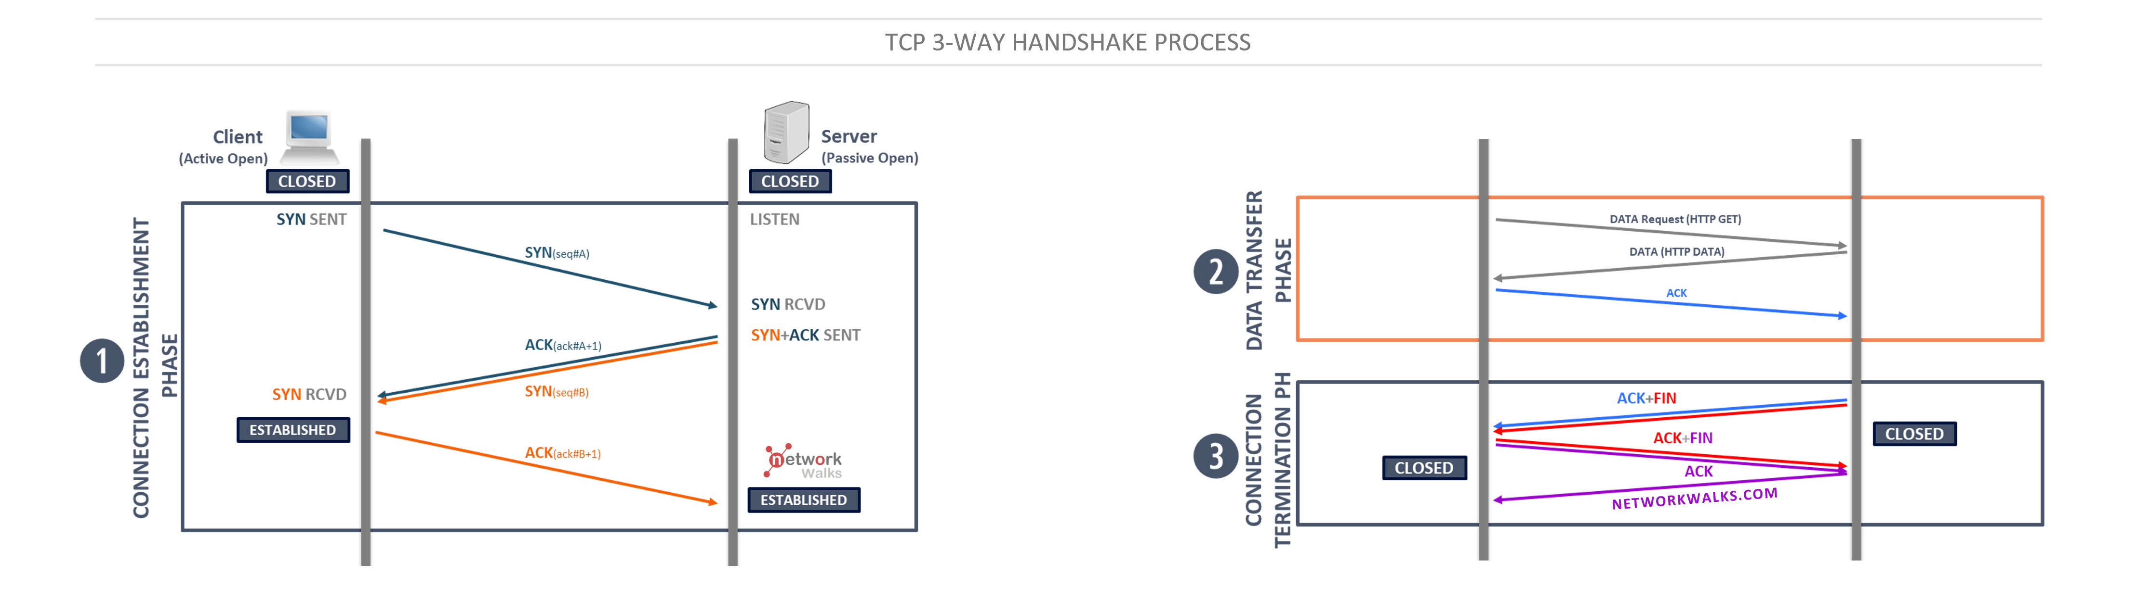
TCP Communication
TCP
This handshake establishes sequence numbers both sides will use to track delivery.
Security relevance: SYN flood attacks abuse this by sending many SYNs and never completing the handshake, exhausting server resources.

Slide 40
TCP Header — Key Fields
TCP
Field | Purpose
Source / Destination Port | Identify the sending and receiving application (socket)
Sequence / Acknowledgment Number | Track byte ordering and confirm receipt
Flags (SYN, ACK, FIN, RST) | Control connection setup, teardown, and reset
Window Size | Flow control — how much data the receiver can accept

Slide 41
Ports & Sockets
TCP
A port (0–65535) identifies a specific application/service on a host.
Well-known ports (0– 1023): HTTP=80, HTTPS=443, SSH=22, DNS=53.
A socket = IP address + port — uniquely identifies one end of a connection.
Firewalls commonly filter traffic by port — a preview of Week 7.

Slide 42
UDP
Fast, connectionless transport

Slide 43
UDP Characteristics
UDP
Connectionless: no handshake, no session state — just send.
No reliability guarantees: no retransmission, no ordering, no flow control.
Lower overhead than TCP — used where speed matters more than perfection: DNS, DHCP, VoIP, video streaming.
That same lack of state makes UDP an easy vector for spoofing and amplification attacks.

Slide 44
UDP Header — Much Simpler
UDP
Field | Purpose
Source / Destination Port | Identify sending and receiving application
Length | Size of header + data
Checksum | Basic error detection (optional in IPv4)

Slide 45
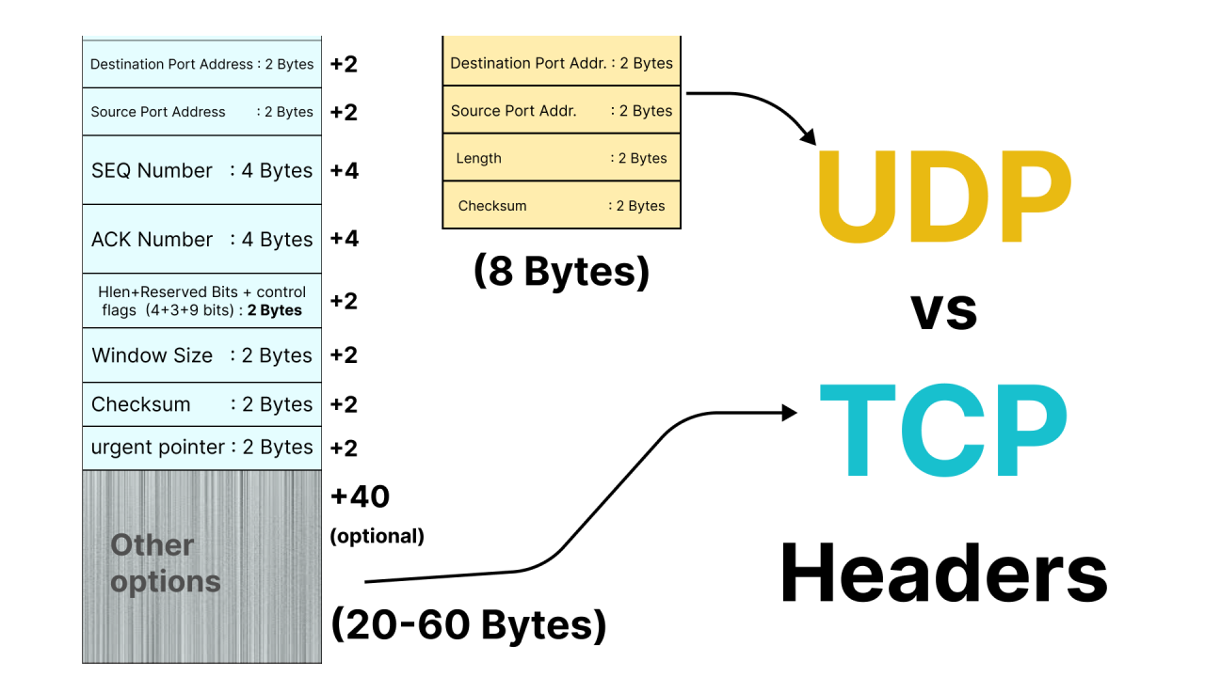
UDP vs TCP Header
UDP

Slide 46
TCP vs UDP
UDP
 | TCP | UDP
Connection | Connection-oriented | Connectionless
Reliability | Guaranteed delivery, ordered | Best-effort, no guarantees
Speed | Slower (handshake, ACKs) | Faster, minimal overhead
Typical use | Web, email, file transfer | DNS, DHCP, VoIP, streaming

Slide 47
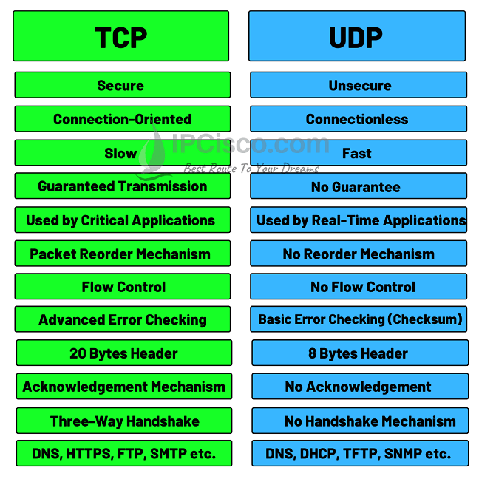
TCP vs UDP
UDP

Slide 48
HTTP
The protocol behind the web

Slide 49
HTTP Basics
HTTP
Request/response protocol: a client sends a request, the server sends a response.
Common methods: GET (retrieve), POST (submit data), PUT (update), DELETE (remove).
Runs over TCP, traditionally on port 80.
Stateless by design — each request is independent (cookies/sessions add state on top).

Slide 50
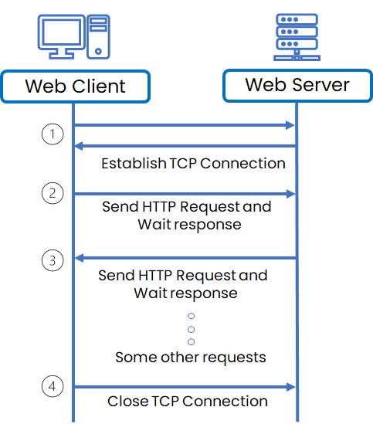
HTTP Protocol
HTTP

Slide 51
HTTP vs HTTPS
HTTP
 | HTTP | HTTPS
Port | 80 | 443
Encryption | None — plaintext | TLS/SSL encrypted
Data exposed to eavesdroppers? | Yes | No (in transit)

Slide 52
HTTP: A Security Preview
HTTP
Plaintext HTTP exposes credentials, cookies, and content to anyone who can see the traffic — relevant to Layer 3/4 attacks like sniffing.
HTTPS (TLS) provides confidentiality and integrity, but the certificate trust model itself can be attacked (covered under Digital Certificates, Week 12).
Common headers and misconfigurations here become relevant again when we reach cryptography and PKI.

Slide 53
Summary
Layered architecture (OSI/TCP-IP) gives us a shared vocabulary for where an attack or defense operates.
Switching and routing move frames/packets — and every hop is a place security policy can be enforced.
Ethernet, IP, DHCP, and ARP move data at Layers 1–3 — mostly without built-in authentication, which is why they're common attack targets.
TCP and UDP shape how attacks like SYN floods and spoofing work at Layer 4.
HTTP/HTTPS shows why encryption matters at the application layer.

Slide 54
This Week's Lab
Part A — Incident case studies: analyse real, recent network security breaches and answer scenario questions about vulnerability, impact, and mitigation.
Part B — Job market scan: review local and international entry-level cybersecurity job ads and tally how many require networking/network security skills.
See the Week 1 Lab Guide for full instructions.

Slide 55
References
Kaufman, Perlman, Speciner & Perlner, Network Security: Private Communication in a Public World, 3rd Ed., Prentice Hall.
Santos & Stuppi, CCNA Security 210-260 Official Cert Guide, 1st Ed., Cisco Press.
Cisco Networking Academy — Introduction to Networks curriculum.

