Slide 1
IPsec, SSL VPN, and Cisco Configuration
IE3122: Network Security | Week 9
What's actually happening inside the two dominant VPN technologies

Slide 2
Today's Agenda
IPsec: architecture, components, and modes
SSL VPN: architecture, client access modes, and its modular cryptographic building blocks
IPsec versus SSL VPN, compared directly
Configuring tunnels and VPNs on Cisco devices: concept and template, for GRE, IPsec, and GRE over IPsec

Slide 3
Learning Outcomes for Today
LO3
Analyse security requirements and recommend appropriate technologies.
LO4
Evaluate different security technologies, compare them, and identify appropriate use cases.
LO5
Configure security technologies to satisfy specific requirements.

Slide 4
IPsec VPN
Securing the network layer itself

Slide 5
IPsec: Overview
IPSEC
IPsec (Internet Protocol Security) operates at the network layer, securing IP packets themselves, regardless of which application generated them.
It is not one fixed protocol but a modular framework: it deliberately does not mandate which specific algorithm you use for any given job, only which job needs doing.
Because it protects at the IP layer, IPsec secures everything above it automatically. No individual application needs to be aware it's even running.

Slide 6
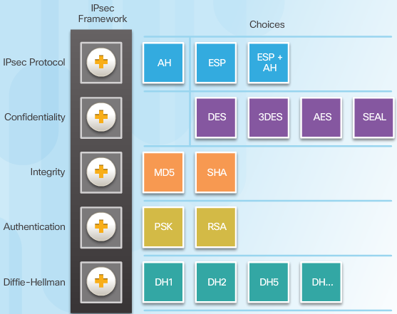
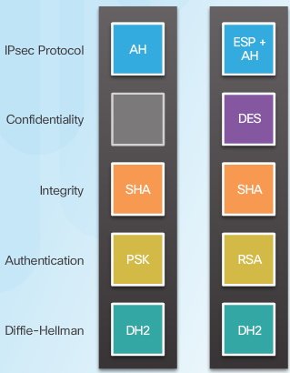
IPsec as a Modular Framework
IPSEC
IPsec defines five separate functions, each with a menu of interchangeable choices rather than one mandatory answer. The first row matters most: AH authenticates only, with no encryption; ESP adds real confidentiality, which is why ESP or ESP+AH is used far more often.
An actual configuration picks exactly one choice per row. The two examples on the right are both valid, built from that same menu.

Slide 7
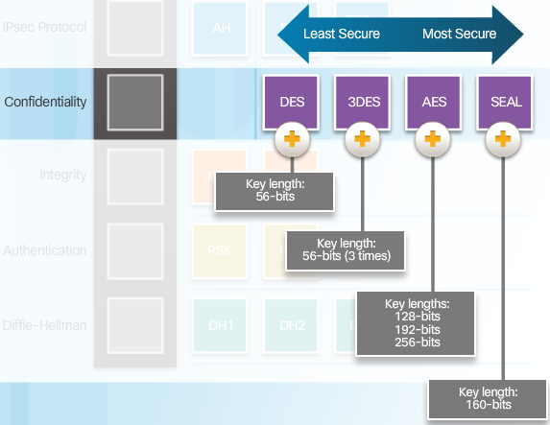
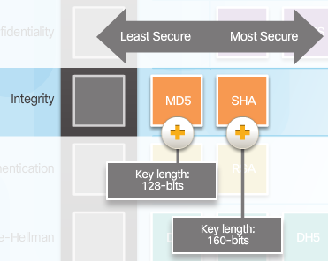
Choosing Confidentiality and Integrity Algorithms
IPSEC
Confidentiality and integrity are two separate rows in the same framework, each with its own menu, and each option carries a genuinely different security strength.

Slide 8
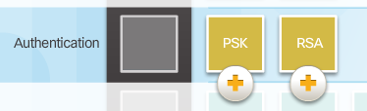
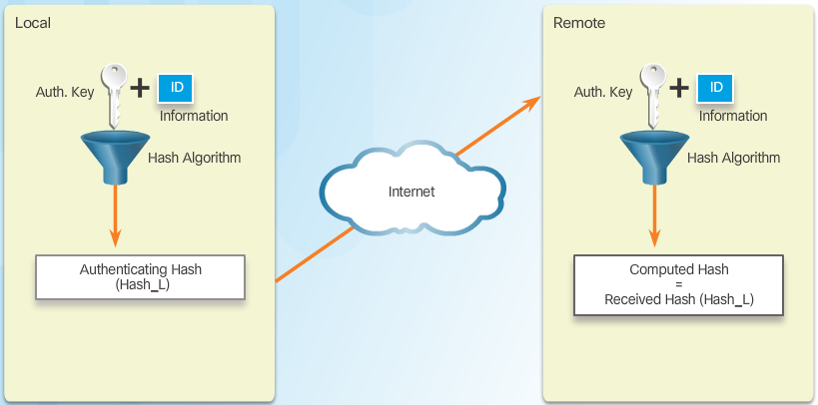
Peer Authentication Methods
IPSEC
The Authentication row offers two choices: PSK (pre-shared key, the same secret configured manually on both peers) or RSA (certificate-based, using public-key cryptography instead).
Either way, the mechanism is the same shape: each peer hashes its own authentication key together with its identity, and the two sides compare hashes to confirm they agree, without ever sending the key itself across the network.

Slide 9
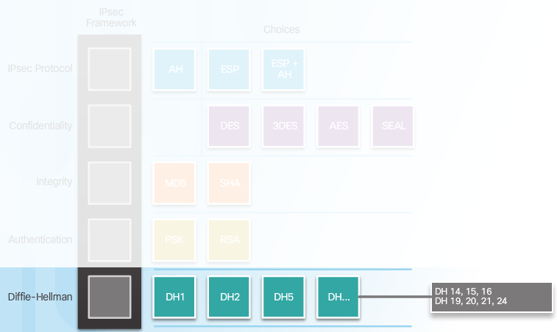
Diffie-Hellman Group Choices
IPSEC
The Diffie-Hellman row picks which mathematical group the key exchange itself uses. Higher-numbered groups generally mean larger, stronger keys.
This is a genuinely live consideration, not just historical: DH14 is the realistic minimum for production networks today, but older or simulated equipment doesn't always support it.

Slide 10
IPsec: IKE's Two Phases
IPSEC
IKE Phase 1 establishes a secure, authenticated channel between the two peers themselves, called the ISAKMP SA. This is the peers proving who they are to each other and agreeing on how to protect their own negotiation traffic.
IKE Phase 2 then uses that secure channel to negotiate the actual IPsec Security Associations that will protect real data traffic, the specific encryption and authentication parameters applied to the traffic itself.
Splitting negotiation into two phases means the peers only need to re-authenticate each other occasionally, in Phase 1, while Phase 2 can refresh the data-protection keys far more frequently without repeating full peer authentication every time.

Slide 11
IPsec: Transport Mode vs Tunnel Mode
IPSEC
Transport mode encrypts only the payload of the original IP packet, leaving the original IP header intact. This is typically used for direct host-to-host protection, where both ends are the actual communicating parties.
Tunnel mode encrypts the entire original IP packet, including its header, and wraps it inside a new IP packet with new addressing. This is what site-to-site VPNs use, since it hides the original internal addressing entirely from the public network in between.
The choice of mode is independent of whether you're using AH or ESP; either component can run in either mode, though ESP in tunnel mode is by far the most common real-world combination.

Slide 12
IPsec: Strengths and Limitations
IPSEC
Strengths: operates at the network layer, so it's completely application-transparent, protecting all IP traffic without needing any individual application to support it. It's a strong, mature, widely interoperable standard with robust authentication options.
Limitations: configuration genuinely is complex, involving several distinct components, an ISAKMP policy, a transform set, and traffic-matching rules, that all have to agree correctly. AH in particular struggles to cross NAT devices, since NAT modifies the very IP header AH is protecting, breaking its integrity check; ESP needs a NAT Traversal extension to reliably cross NAT too. It's also generally less naturally suited to simple browser-based remote access than SSL VPN.

Slide 13
SSL VPN
Built from interchangeable cryptographic building blocks

Slide 14
SSL VPN: Overview
SSL VPN
SSL VPN uses the same TLS/SSL protocol that secures ordinary HTTPS web traffic, rather than a dedicated network-layer protocol suite like IPsec.
Because it rides on the same protocol as HTTPS, it often needs nothing more than a standard web browser, or at most a lightweight client, rather than dedicated VPN client software.
It also tends to traverse firewalls and NAT more easily than IPsec in practice, simply because almost every corporate firewall already permits outbound HTTPS on port 443, so SSL VPN traffic blends straight into traffic that was already allowed.

Slide 15
SSL VPN Has Interchangeable Building Blocks Too
SSL VPN
IPsec is the technology most commonly held up as the modular one, precisely because of the explicit, named framework you just saw. SSL/TLS is built the same underlying way, just negotiated differently: as a single named cipher suite chosen from a list, rather than assembled row by row.
SSL/TLS is not one fixed algorithm. It's built from several independent functional building blocks, and the two peers negotiate which specific option fills each block at the start of every session.
This matters directly for security: an SSL VPN configured to allow older, weaker options in any one of these blocks can be seriously weakened, even if every other block is configured well.
The next slide breaks down exactly which functional block does what, and which real protocols and algorithms have historically filled each one.

Slide 16
SSL VPN's Functional Blocks, Visually
SSL VPN
The same idea as IPsec's framework, laid out the same way: one row per function, each with a menu of choices. Greyed-out options are deprecated and should never be selected today.
Protocol
Version
SSLv3
TLS 1.0
TLS 1.1
TLS 1.2
TLS 1.3
Key
Exchange
RSA
DHE
ECDHE
Bulk
Encryption
DES
RC4
3DES
AES-CBC
AES-GCM
ChaCha20
Integrity
/ MAC
MD5
SHA-1
SHA-256
in AEAD
Identity
/ PKI
X.509 Cert

Slide 17
Building Two Example Cipher Suites
SSL VPN
Pick one option from each row and you get a real, nameable cipher suite. These two are both valid TLS configurations, but they are not remotely equivalent in strength.
Weaker (avoid)
Stronger (prefer)
Protocol Version
TLS 1.2
TLS 1.3
Key Exchange
RSA
ECDHE
Bulk Encryption
AES-CBC
AES-GCM
Integrity / MAC
SHA-1
built into cipher

Slide 18
SSL VPN's Building Blocks, Function by Function
SSL VPN
Function | What it does | Protocols/algorithms that can fill it
Protocol version | Which version of TLS governs the whole session | SSLv3, TLS 1.0, TLS 1.1 (all deprecated); TLS 1.2 (widely used); TLS 1.3 (current)
Key exchange | How the two sides agree on a shared secret | RSA (no forward secrecy); DHE; ECDHE (modern, provides forward secrecy)
Bulk encryption | The cipher actually protecting the data | DES, RC4 (both insecure); 3DES (deprecated); AES-CBC; AES-GCM; ChaCha20
Integrity/MAC | Detecting if data was tampered with | MD5, SHA-1 (both deprecated); SHA-256/384; built into AEAD ciphers like AES-GCM
Identity/PKI | Verifying the server's, and optionally the client's, identity | X.509 certificates, validated through a Certificate Authority chain

Slide 19
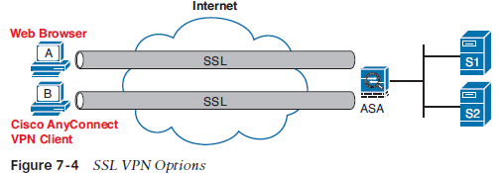
SSL VPN: Client Access Modes
SSL VPN
The cryptography isn't the only modular part of SSL VPN. How a client actually connects is also independently selectable.
Clientless (portal) mode: an ordinary web browser only, reaching a limited set of internal web applications through a secure portal.
A third mode, thin client (port-forwarding), sits between the two shown below: a small browser applet extends access to specific TCP applications without a full install.
Full tunnel client mode: a complete agent, such as Cisco AnyConnect, providing full network-layer access, using TLS as the underlying transport.
Figure 7-4, SSL VPN Options: the clientless browser path (A) and the AnyConnect full-tunnel path (B), both terminating at the same ASA.

Slide 20
IPsec vs SSL VPN
Two different answers to the same underlying problem

Slide 21
IPsec vs SSL VPN: Direct Comparison
COMPARISON
Aspect | IPsec VPN | SSL VPN
Layer of operation | Network layer (Layer 3) | Built on TLS, above the transport layer
Client requirement | Often needs dedicated client software | Often just a browser, in clientless mode
Traffic scope | Secures all IP traffic transparently | Typically specific applications or resources, though full-tunnel mode approaches IPsec's scope
NAT traversal | Can struggle, especially AH; needs NAT-T | Generally NAT-friendly, uses standard HTTPS
Access granularity | Network-level, largely all-or-nothing per tunnel | Can be very granular, down to specific applications or URLs
Typical use case | Site-to-site links, full-network remote access | Individual remote access, especially browser-based

Slide 22
Configuring VPNs and Tunnels on Cisco Devices
Concept alongside the actual command templates

Slide 23
GRE Tunnel: Concept
CONFIGURATION
A GRE tunnel is configured as a logical Tunnel interface, entirely separate from any physical interface, with its own IP addressing for the virtual point-to-point link it creates.
It needs a source, the local physical interface or address traffic will actually leave from, and a destination, the remote peer's real, public address.
Remember from earlier: this alone provides no encryption whatsoever. GRE just gets traffic there, in the clear.
interface Tunnel0
ip address 10.10.10.1 255.255.255.252
tunnel source GigabitEthernet0/0
tunnel destination 203.0.113.10

Slide 24
IPsec Site-to-Site: Step 1, the IKE Phase 1 Policy
CONFIGURATION
The first step defines how the two peers will authenticate each other and protect their own negotiation traffic, the ISAKMP policy from Phase 1 earlier in this deck.
crypto isakmp policy 10
encryption aes
hash sha256
authentication pre-share
group 14
lifetime 86400
exit
crypto isakmp key MySharedKey address 203.0.113.10

Slide 25
IPsec Site-to-Site: Step 2, the Transform Set
CONFIGURATION
The transform set defines the Phase 2 parameters, the actual encryption and authentication that will protect real data traffic once negotiation is complete.
crypto ipsec transform-set MYSET esp-aes esp-sha256-hmac

Slide 26
IPsec Site-to-Site: Step 3, Defining Interesting Traffic
CONFIGURATION
An ACL identifies exactly which traffic should actually be sent through the VPN, commonly called interesting traffic. Only traffic matching this ACL gets encrypted; everything else follows normal routing.
access-list 100 permit ip 192.168.10.0 0.0.0.255 192.168.20.0 0.0.0.255

Slide 27
IPsec Site-to-Site: Step 4, the Crypto Map
CONFIGURATION
The crypto map ties everything together: which peer to protect traffic toward, which transform set to use, and which ACL defines interesting traffic, then applies the whole thing to the outbound interface.
crypto map MYMAP 10 ipsec-isakmp
set peer 203.0.113.10
set transform-set MYSET
match address 100
exit
interface GigabitEthernet0/0
crypto map MYMAP

Slide 28
GRE Over IPsec: Bringing Both Together
CONFIGURATION
Configure the GRE tunnel exactly as shown earlier, giving you a working but unencrypted logical link.
Then configure IPsec exactly as in the previous four steps, with one key difference: the interesting-traffic ACL should match GRE traffic itself, protocol 47, between the tunnel endpoints, rather than the traffic riding inside the tunnel.
The result carries the best of both: GRE's flexibility, including support for dynamic routing protocols and non-IP traffic across the tunnel, protected by IPsec's actual encryption. This is a genuinely common real-world design, not just a teaching exercise.

Slide 29
Summary
IPsec secures the network layer itself using a suite of cooperating protocols, AH for integrity alone, ESP for encryption, and IKE to negotiate it all in two phases.
SSL VPN rides on the same TLS that secures HTTPS, and is genuinely modular: the protocol version, key exchange, bulk cipher, and integrity check are all independently negotiated, and the client access mode is a separate choice again.
Neither is simply better than the other. IPsec suits full-network, always-on connections; SSL VPN suits individual, often browser-based remote access.
GRE, IPsec, and GRE over IPsec each solve a different problem, plain transport, plain security, or both together, and the configuration for each builds directly on the last.

Slide 30
This Week's Lab & Tutorial
Lab: to be planned in a follow-up discussion, once we've confirmed which of today's configurations are genuinely supported and testable in Packet Tracer.
Tutorial worksheet: study-notes-style questions covering IPsec, SSL VPN's modular building blocks, and Cisco VPN configuration. Use it to prep for the mid-semester test.

Slide 31
References
Santos & Stuppi, CCNA Security 210-260 Official Cert Guide, 1st Ed., Cisco Press.
Kaufman, Perlman, Speciner & Perlner, Network Security: Private Communication in a Public World, 3rd Ed., Prentice Hall.
Cisco Networking Academy, CCNA Security curriculum (IPsec and SSL VPN chapters).

