Slide 1
CSC 331H · Honors Project · Spring 2026
Personal Budget & Expense Management System
Design Phase Presentation
BMCC · Department of Computer Information Systems

Slide 2
Project Overview
A C++ personal finance management system built entirely from scratch — no STL containers.
What This System Does
This system allows users to log and categorize expenses, track bill due dates, and query their spending history over any date range. It enforces per-category budget limits and immediately notifies the user when a limit is exceeded.
Three Core Actions
Action 1 — Log an expense and check if it exceeds a category budget. Action 2 — View the next upcoming bill and mark as paid/not paid and give prioritized alerts. Action 3 — Query spending history by date range & category.
System Composition
The system is composed of 7 components: Expense, Bill, CategoryInfo, HashMap, MinHeap, BST, and BudgetManager. All data structures are implemented from scratch. 8 header files define the full interface, reviewed and finalized before implementation.

Slide 3
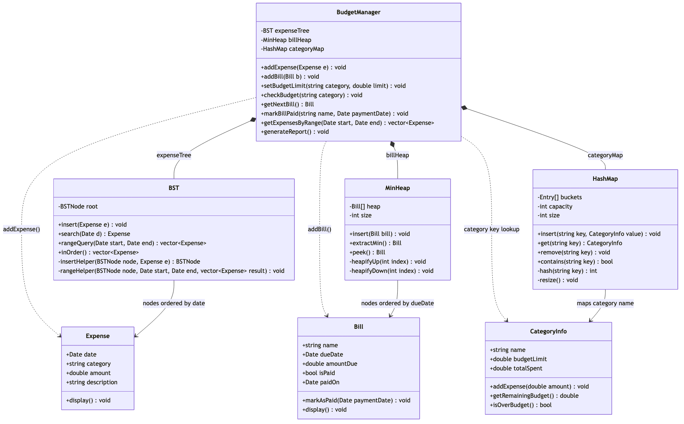
UML Class Diagram — System Architecture
7 components · 9 relationships · 3 composition · 3 dependency · 3 structural

Slide 4
Data Structure Design
Each data structure was chosen because it is the optimal fit for the operation it must support.
HashMap for Budget Tracking — O(1) lookup
Every time an expense is logged, the system must look up the category, update its running total, and compare it against the budget limit. This happens on every single log operation. A HashMap provides O(1) average-case lookup regardless of how many categories exist, making it the only structure fast enough for this use case. It uses open-addressing with linear probing and an isDeleted tombstone flag to safely support removal.
MinHeap for Bills — O(1) access to earliest due date
Action 2 always needs the bill with the earliest due date. A MinHeap keeps that bill at the root at all times, delivering it in O(1). Insertion and removal cost O(log n). A plain array would require scanning all bills — O(n) — on every request.
BST for Expenses — O(log n + k) range queries
Action 3 retrieves all expenses within a date range. A BST stores expenses sorted by date, so the system descends to the start date in O(log n) and collects all matching nodes without visiting the rest. A flat array would scan every expense — O(n) — on every query, degrading as history grows.

Slide 5
Module Specification & Interface Design
Every component exposes a well-defined public interface. All internal complexity is encapsulated.
BudgetManager — The Single Entry Point
BudgetManager is the only class the outside world interacts with directly. It owns BST, MinHeap, and HashMap as private members and exposes a clean public interface that hides all data structure complexity. No external code ever calls BST::insert() or HashMap::get() directly — every operation goes through BudgetManager.
Component Interfaces
BudgetManager delegates to BST for expense storage and range queries, to MinHeap for bill queue management, and to HashMap for category budget lookups. HashMap in turn communicates with CategoryInfo to update totals and check limits. Date is a shared value type passed by const reference across all interfaces.
Design Safety
The Rule of Three is applied to HashMap, MinHeap, and BST — all three own raw pointers and have their copy constructor and copy assignment operator deleted to prevent shallow copies and double-frees. All constructors zero-initialize numeric fields to eliminate undefined behavior from the start.

Slide 6
Algorithm Definition
Precise logic is defined for each core action and each supporting data structure operation.
Action 1 — Log an Expense and Check Budget
addExpense inserts the expense into the BST, then retrieves or creates the matching CategoryInfo in the HashMap. It calls categoryInfo.addExpense(amount) to increment totalSpent, then calls checkBudget, which prints a warning if totalSpent exceeds budgetLimit.
Action 2 — View Next Bill and Mark as Paid
hasPendingBills checks MinHeap::isEmpty() before any access. getNextBill returns heap[0] — the root — in O(1). markBillPaid delegates to markPaidByName, which scans the heap array linearly, sets isPaid = true and paidOn = paymentDate in place. No re-heapify is needed because the due date does not change.
Action 3 — Query Spending History by Date Range
rangeQuery calls rangeHelper recursively. If a node's date is before the start, only the right subtree is visited. If it is after the end, only the left subtree is visited. If it falls within the range, it is added to the result and both subtrees are explored. This achieves O(log n + k) where k is the number of results returned.

Slide 7
Data Flow Diagrams
These diagrams trace the path of data from user input to system output for each core action.
Action 1
User provides category, amount, date, and description → addExpense inserts into BST → HashMap retrieves or creates CategoryInfo → totalSpent is updated → checkBudget compares totals → if over budget, a warning with the excess amount is printed to the user.
Action 2
User requests next bill → hasPendingBills checks isEmpty → if bills exist, getNextBill calls peek and returns heap[0] → bill details are displayed → user confirms payment → markBillPaid calls markPaidByName → bill is updated in place.
Action 3
User provides start date and end date → getExpensesByRange calls rangeQuery → rangeHelper traverses the BST visiting only relevant nodes → matching expenses are collected into a vector → each expense's date, category, amount, and description are printed to the user.

Slide 8
Unit Test Planning
30 tests are planned across all 6 modules. Every test maps to a declared method in include/.
Test Coverage by Module
Date — 5 tests covering constructors, isBefore, operator==, and isBetween. CategoryInfo — 5 tests covering initialization, addExpense accumulation, isOverBudget, and getRemainingBudget. HashMap — 5 tests covering insert/get round-trip, contains, remove with tombstone, probe chain integrity, and resize. MinHeap — 5 tests covering isEmpty, peek ordering, extractMin, markPaidByName, and unknown-name handling. BST — 5 tests covering inOrder sorting, duplicate dates, search returning a vector, rangeQuery, and empty range. BudgetManager — 5 integration tests covering all 3 actions end-to-end plus edge cases.
Notable Edge Case Tests
Test 14 verifies that removing a HashMap entry does not break the probe chain for entries that were displaced past it during insertion. Test 22 verifies that two expenses on the same date are both preserved in the BST using the equal-dates-go-right strategy. Test 27 verifies that addExpense gracefully auto-creates a CategoryInfo entry when no budget limit has been set for that category yet.

Slide 9
Traceability Matrix
Every method in the system traces back to one of the three core user requirements.
Action 1 — Log an Expense and Check Budget
Fulfilled by: BudgetManager::addExpense, BudgetManager::checkBudget, BudgetManager::setBudgetLimit, BST::insert, HashMap::get, HashMap::insert, CategoryInfo::addExpense, CategoryInfo::isOverBudget, and CategoryInfo::getRemainingBudget.
Action 2 — View Next Bill and Mark as Paid
Fulfilled by: BudgetManager::hasPendingBills, BudgetManager::getNextBill, BudgetManager::markBillPaid, MinHeap::isEmpty, MinHeap::peek, MinHeap::markPaidByName, Bill::markAsPaid, and Bill::display.
Action 3 — Query Spending History by Date Range
Fulfilled by: BudgetManager::getExpensesByRange, BST::rangeQuery, BST::rangeHelper, Date::isBefore, Date::isAfter, Date::isBetween, and Expense::display.

Slide 10
Summary
The design phase is complete. All deliverables are documented and the system is ready for implementation.
What Was Accomplished
A UML class diagram was produced with 7 components and 9 relationships. Eight header files were written, reviewed across multiple passes, and corrected for uninitialized fields, missing constructors, pointer safety, and interface gaps. Algorithms were defined in pseudocode for all three core actions and all key data structure operations.
Documentation Produced
The reflection.md file contains the complete Detailed Design Document, including the component brainstorm, data structure justification, design changes, traceability matrix, algorithm definition, interface design, data flow diagrams, and unit test plan with 30 tests mapped to declared method signatures.
Next Step — Phase 2: Implementation
All .cpp stub files are in place in src/. The Makefile is configured and ready. Implementation begins with the foundational components — Date, Expense, Bill, and CategoryInfo — before moving on to the data structures and BudgetManager.

