Slide 1

Confusion Matrix Metrics Part 7 Matthew’s Correlation Coefficient (MCC)
Machine Learning

Slide 2
Imagine we make a classifier that is trying to differentiate between apples and oranges by looking at their images.
After testing the model on the test set, we get a confusion matrix like this:

Slide 3
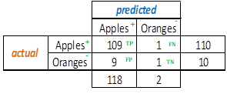
Now we need a positive and a negative class.
Case 1: Apples as positive and Oranges as negative class.
For this confusion matrix, accuracy = (109+1)/120 = 0.92 ☺ precision = 109/(109+9) = 0.92 ☺ recall = 109/(109+1) = 0.99 ☺ f1 score = 0.95 ☺
All looks super good, doesn’t it?
We did an excellent job at “recalling” the apples (109/110)
But did such a poor job at predicting the oranges (1/10)

Slide 4
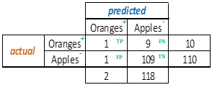
Now let us switch the classes with the same classifier results
Case 2: Apples as negative and Oranges as positive class.
For this confusion matrix, accuracy = (109+1)/120 = 0.92 (same as before) ☺ precision = 1/(1+1) = 0.50 (down from 0.92) ☹ recall = 1/(1+9) = 0.10 (down from 0.99) ☹ f1 score = 0.16 (down from 0.95) ☹
All of a sudden, nothing looks good, does it?
F1 went from 95% to 16% just by switching the classes.
Precision and recall took big hits as well.
Case 1 matrix

Slide 5
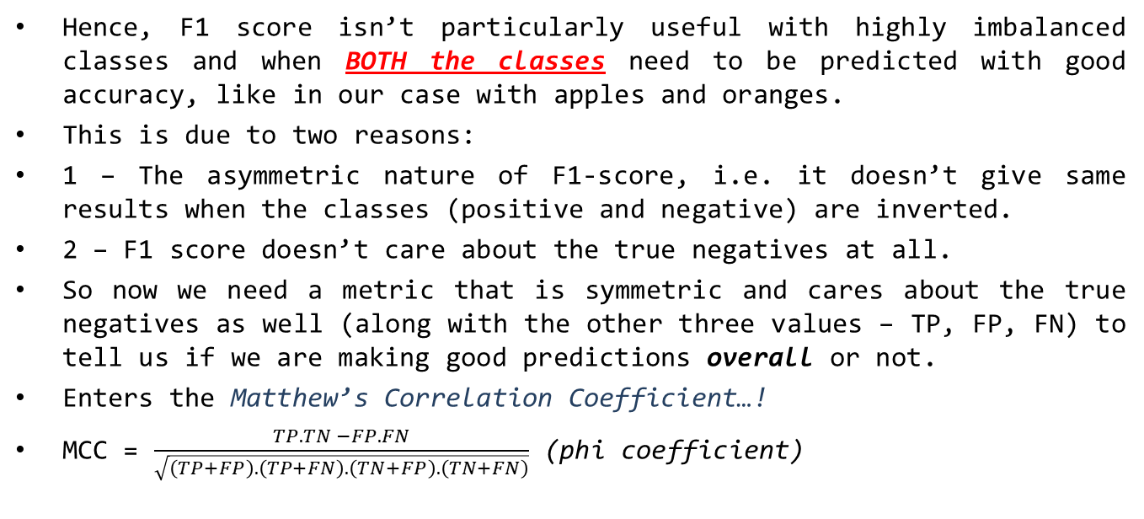
What do we learn?
Hence, F1 score isn’t particularly useful with highly imbalanced classes and when BOTH the classes need to be predicted with good accuracy, like in our case with apples and oranges.
This is due to two reasons:
1 – The asymmetric nature of F1-score, i.e. it doesn’t give same results when the classes (positive and negative) are inverted.
2 – F1 score doesn’t care about the true negatives at all.
So now we need a metric that is symmetric and cares about the true negatives as well (along with the other three values – TP, FP, FN) to tell us if we are making good predictions overall or not.
Enters the Matthew’s Correlation Coefficient…!
MCC = $\frac{TP.TN −FP.FN}{\sqrt{\left(TP+FP\right).\left(TP+FN\right).\left(TN+FP\right).\left(TN+FN\right)}}$ (phi coefficient)

Slide 6
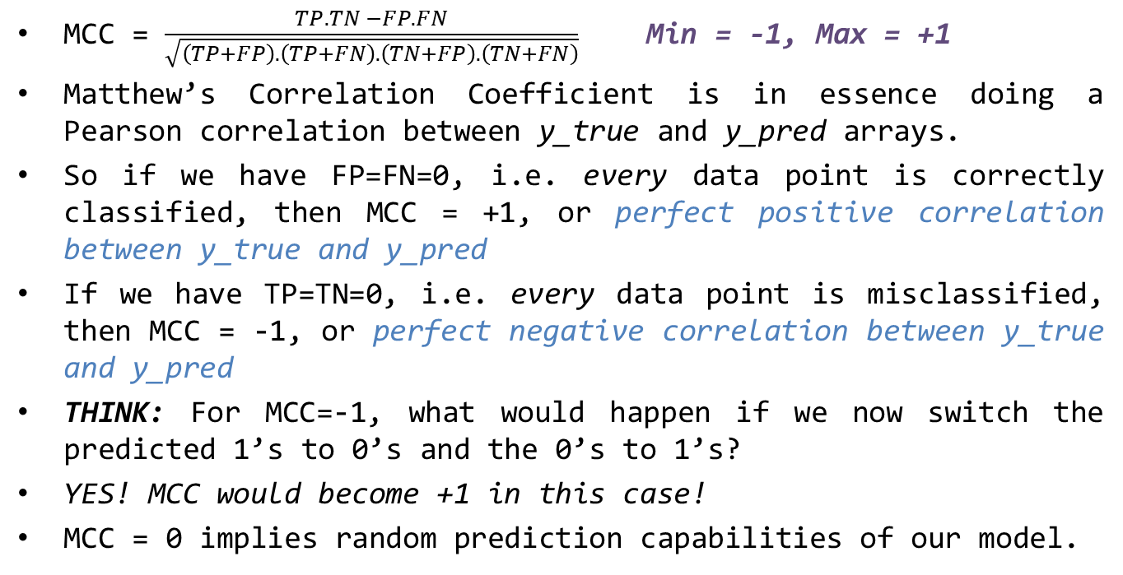
MCC
MCC = $\frac{TP.TN −FP.FN}{\sqrt{\left(TP+FP\right).\left(TP+FN\right).\left(TN+FP\right).\left(TN+FN\right)}}$ Min = -1, Max = +1
Matthew’s Correlation Coefficient is in essence doing a Pearson correlation between y_true and y_pred arrays.
So if we have FP=FN=0, i.e. every data point is correctly classified, then MCC = +1, or perfect positive correlation between y_true and y_pred
If we have TP=TN=0, i.e. every data point is misclassified, then MCC = -1, or perfect negative correlation between y_true and y_pred
THINK: For MCC=-1, what would happen if we now switch the predicted 1’s to 0’s and the 0’s to 1’s?
YES! MCC would become +1 in this case!
MCC = 0 implies random prediction capabilities of our model.

Slide 7
Imagine we have 93 sick (positive class) and 7 healthy people (negative class)
If we make a classifier that predicts TP = 91, FP = 6, FN = 2, TN = 1
Then, accuracy = 0.92 ☺
Precision = 0.94 ☺
Recall = 0.98 ☺
F1 score = 2*0.94*0.98/(0.94+0.98) = 0.96 ☺
But… MCC = 0.20 ☹
Here, MCC has done an excellent job at not getting swayed by the high “positive class” results, and gave us a poor score because our negative class was not well predicted (only 1 correctly out of 7)
If the classifier outputs this: TP = 91, FP = 1, FN = 2, TN = 6
Then our MCC = 0.79 ☺ along with a high F1 score (0.99)
The point is, MCC will only give a high score if both classes are excellently predicted, while F1 score will give high score regardless

Slide 8
That would be all for this one!
Thank you for watching! :)

