Slide 1

Outliers
Machine Learning

Slide 2
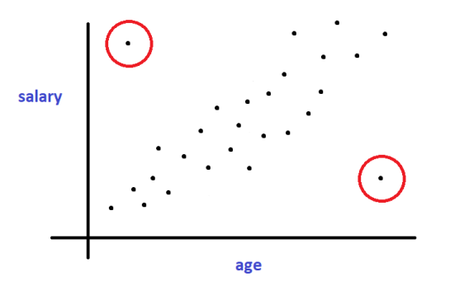
What are outliers?
Outliers are data points which differ “significantly” from the other data points
They are those head-scratching data points which can give you sleepless nights :p
Defining what is and what is not an outlier varies according to the business problem at hand
Outliers are supposed to be “rare” in nature

Slide 3
When are outliers bad?
For example, we do an online survey about usage habits of people on a particular social media platform which started 7 years back.
One question was, for how many years have they been using the platform
When we check the results, we find that one folk responded “17”
We know that it is not quite possible, right?
This is an outlier.
Also unfortunately we have no idea about its real value!
Hence it makes sense to drop that data point, or if possible, hunt down that person and note the correct value.

Slide 4

But it doesn’t really make sense to drop every single outlier from the data.
For eg, if we have a fraud detection scenario, most likely the fraud cases are going to be labeled as outliers, but they aren’t outliers, right?
Thus, we should ideally first check if they’re measurement errors or valid ones
Inspection of the outliers could also lead to some other interesting discovery about the data, like we could come to a conclusion that our data collection method was flawed, or maybe we need to include some extra features to handle the rare cases, etc.
Like in this case, we could add extra features that ask the respondent whether they were jobless for a period of time, or are they start-up founders, etc.

Slide 5
In short, when to drop the outliers?
1. When we’re absolutely sure the data is a measurement error
2. When the number of good cases dwarf the number of outliers
Like if we have a million data samples, and only a few thousands of potential outliers, then it might not be the worst decision to drop them altogether.
Otherwise, it is time to handle those messy outliers.

Slide 6
The effect of outliers
Outliers only tend to models which rely on assigning weights to parameters eg. linear models, Adaboost, etc.
Outliers do NOT normally affect tree based models, which rely on dividing the feature space into sub-sections.

Slide 7
In the following tutorials, we’ll look at a suite of measures we can adopt to handle the outliers

Slide 8
Graphical detection of Outliers
Machine Learning

Slide 9
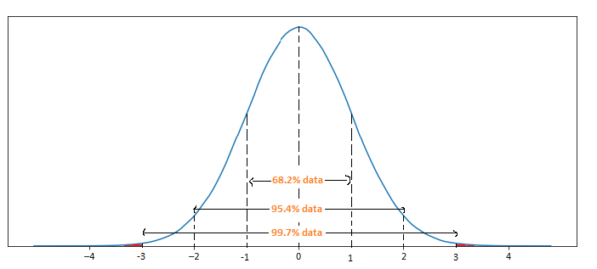

Z score method for handling outliers
This method assumes that the feature/column follows a normal distribution
Z score of each element (Xj) in a feature = $\frac{Xj − mean}{std. dev}$
Any element that has Z score of < -3 or > 3 is a potential outlier

Slide 10
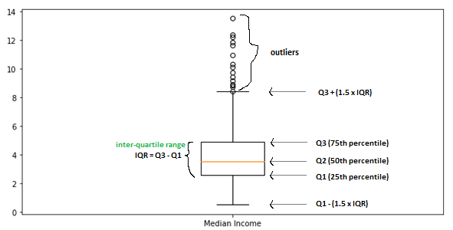
IQR method for handling outliers
Note that this method should be preferred over the Z score method when the particular column at hand is NOT normally distributed

Slide 11
How to calculate percentiles?
For eg, for a series of numbers: [ 9, 5, 4, 14, 7]
We arrange them in ascending order: [4, 5, 7, 9, 14]
Here, 4 and 14 are 0th and 100th percentiles respectively
To calculate percentiles:
Subtract one from the total number of numbers = 5 – 1 = 4
Now each “gap” is worth 100/4 = 25 percentile.
Hence, 5 is 25th percentile, 7 is 50th percentile, 9 is 75th percentile
To find 65th percentile, we first note that it will lie between 50th and 75th percentiles, which are 7 and 9 respectively
Now 9 – 7 = 2, so 2 is ”holding” 25 percentiles (75 – 50)
So value of 1 percentile between 7 and 9 = 2/25 = 0.08
Hence, value of 15 percentiles between 7 and 9 = 0.08 x 15 = 1.2
Hence 65th percentile = 50th percentile + 15 percentiles = 7 + 1.2 = 8.2

Slide 12
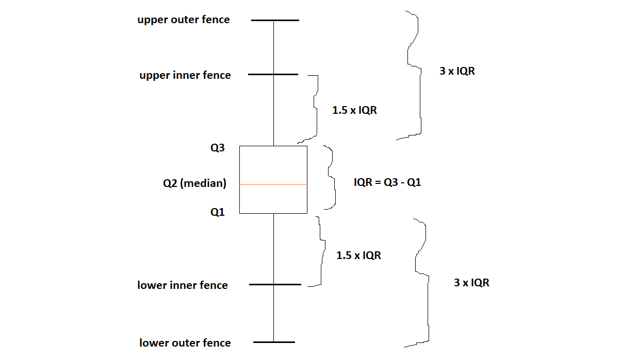
Inner and Outer Fences

Slide 13
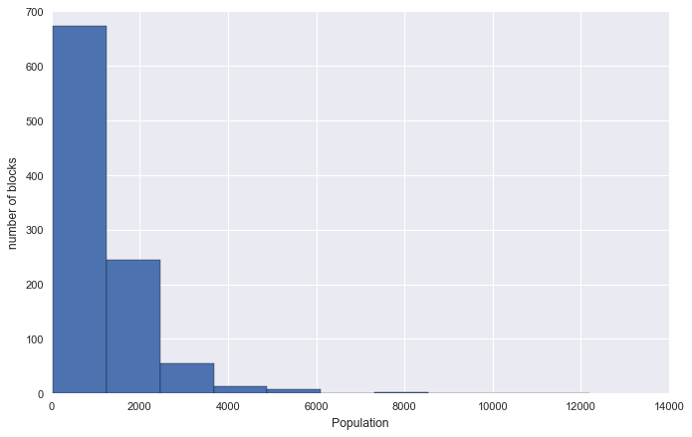
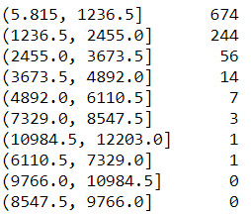
Histogram

Slide 14
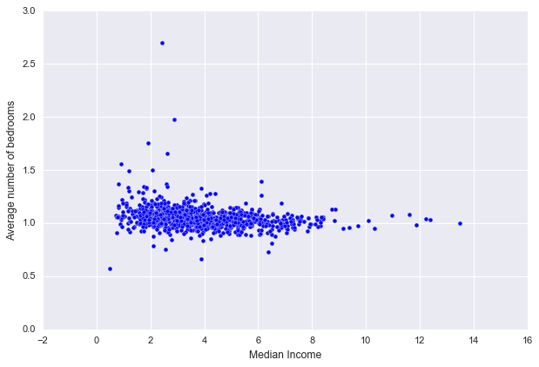
Scatter plot

