Slide 1

Notes:
Speaker note: Welcome. A real published dataset, FAIR as actual files and metadata decisions.

Slide 2
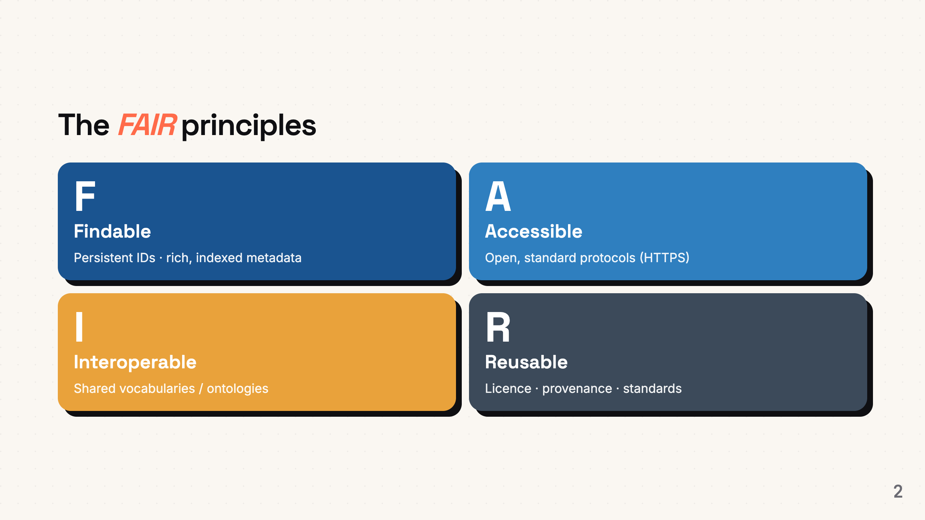
Notes:
Speaker note: A repository gives F and A; the I and R are the researcher's job.

Slide 3
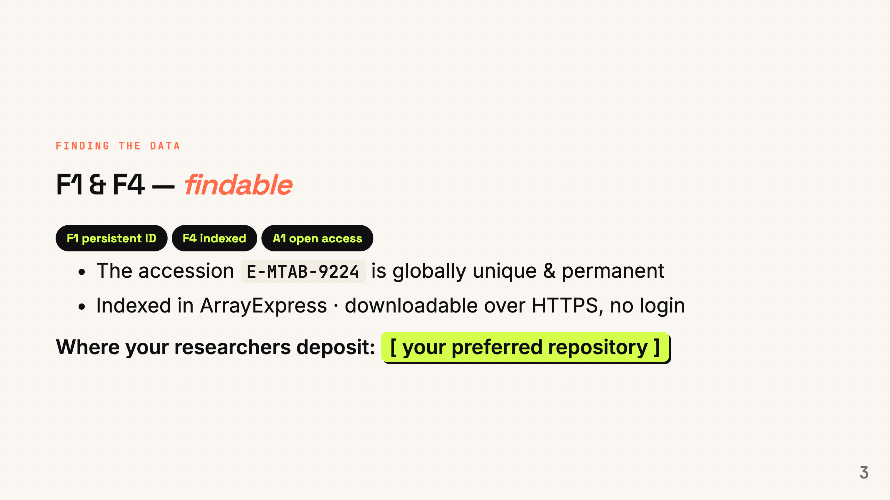
Notes:
Speaker note: F1 identifier, F4 discoverability. Point to YOUR repository.

