Slide 1
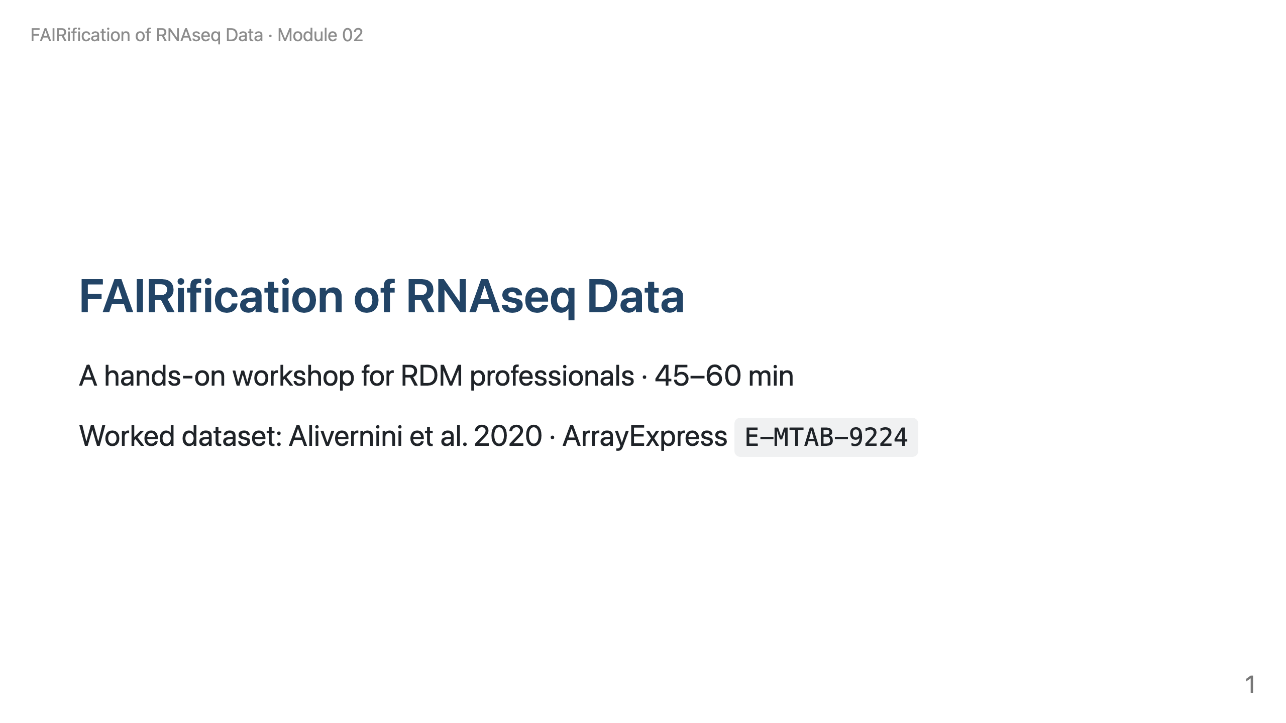
Notes:
Speaker note: Welcome. We work through a real, published dataset and see the FAIR principles as actual files, accession numbers and metadata decisions — not abstract theory.

Slide 2
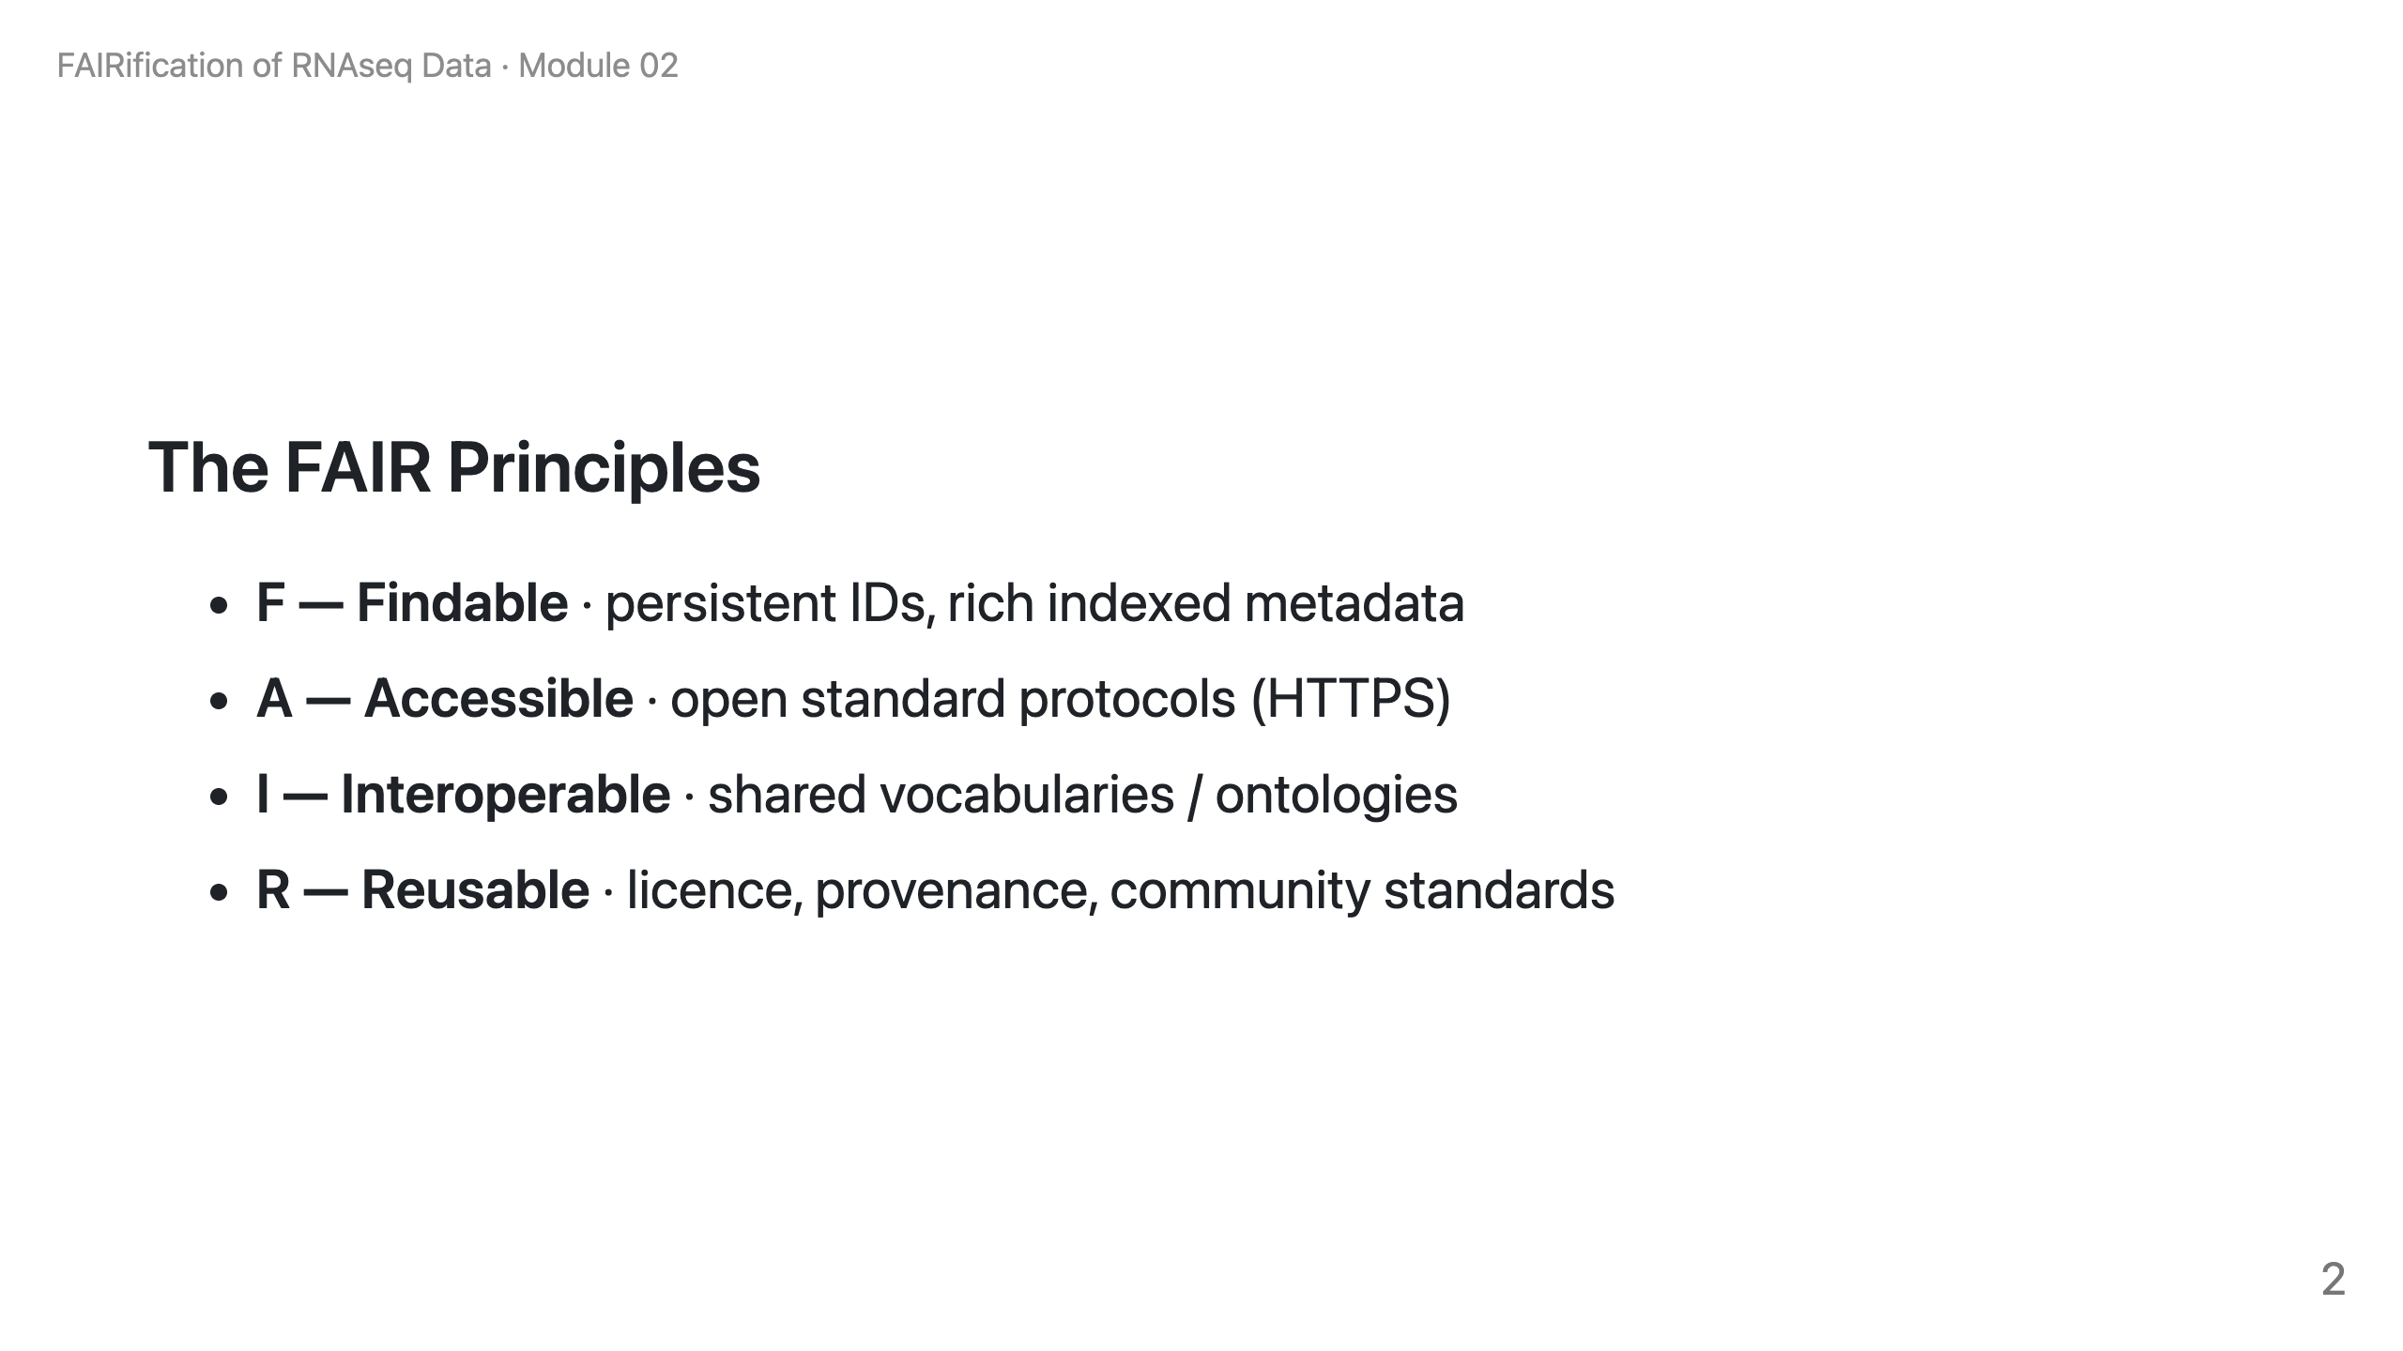
Notes:
Speaker note: A repository gives you F and A almost for free. The I and R — good metadata, ontology terms, a licence — are the researcher's job. That boundary is the whole workshop.

Slide 3
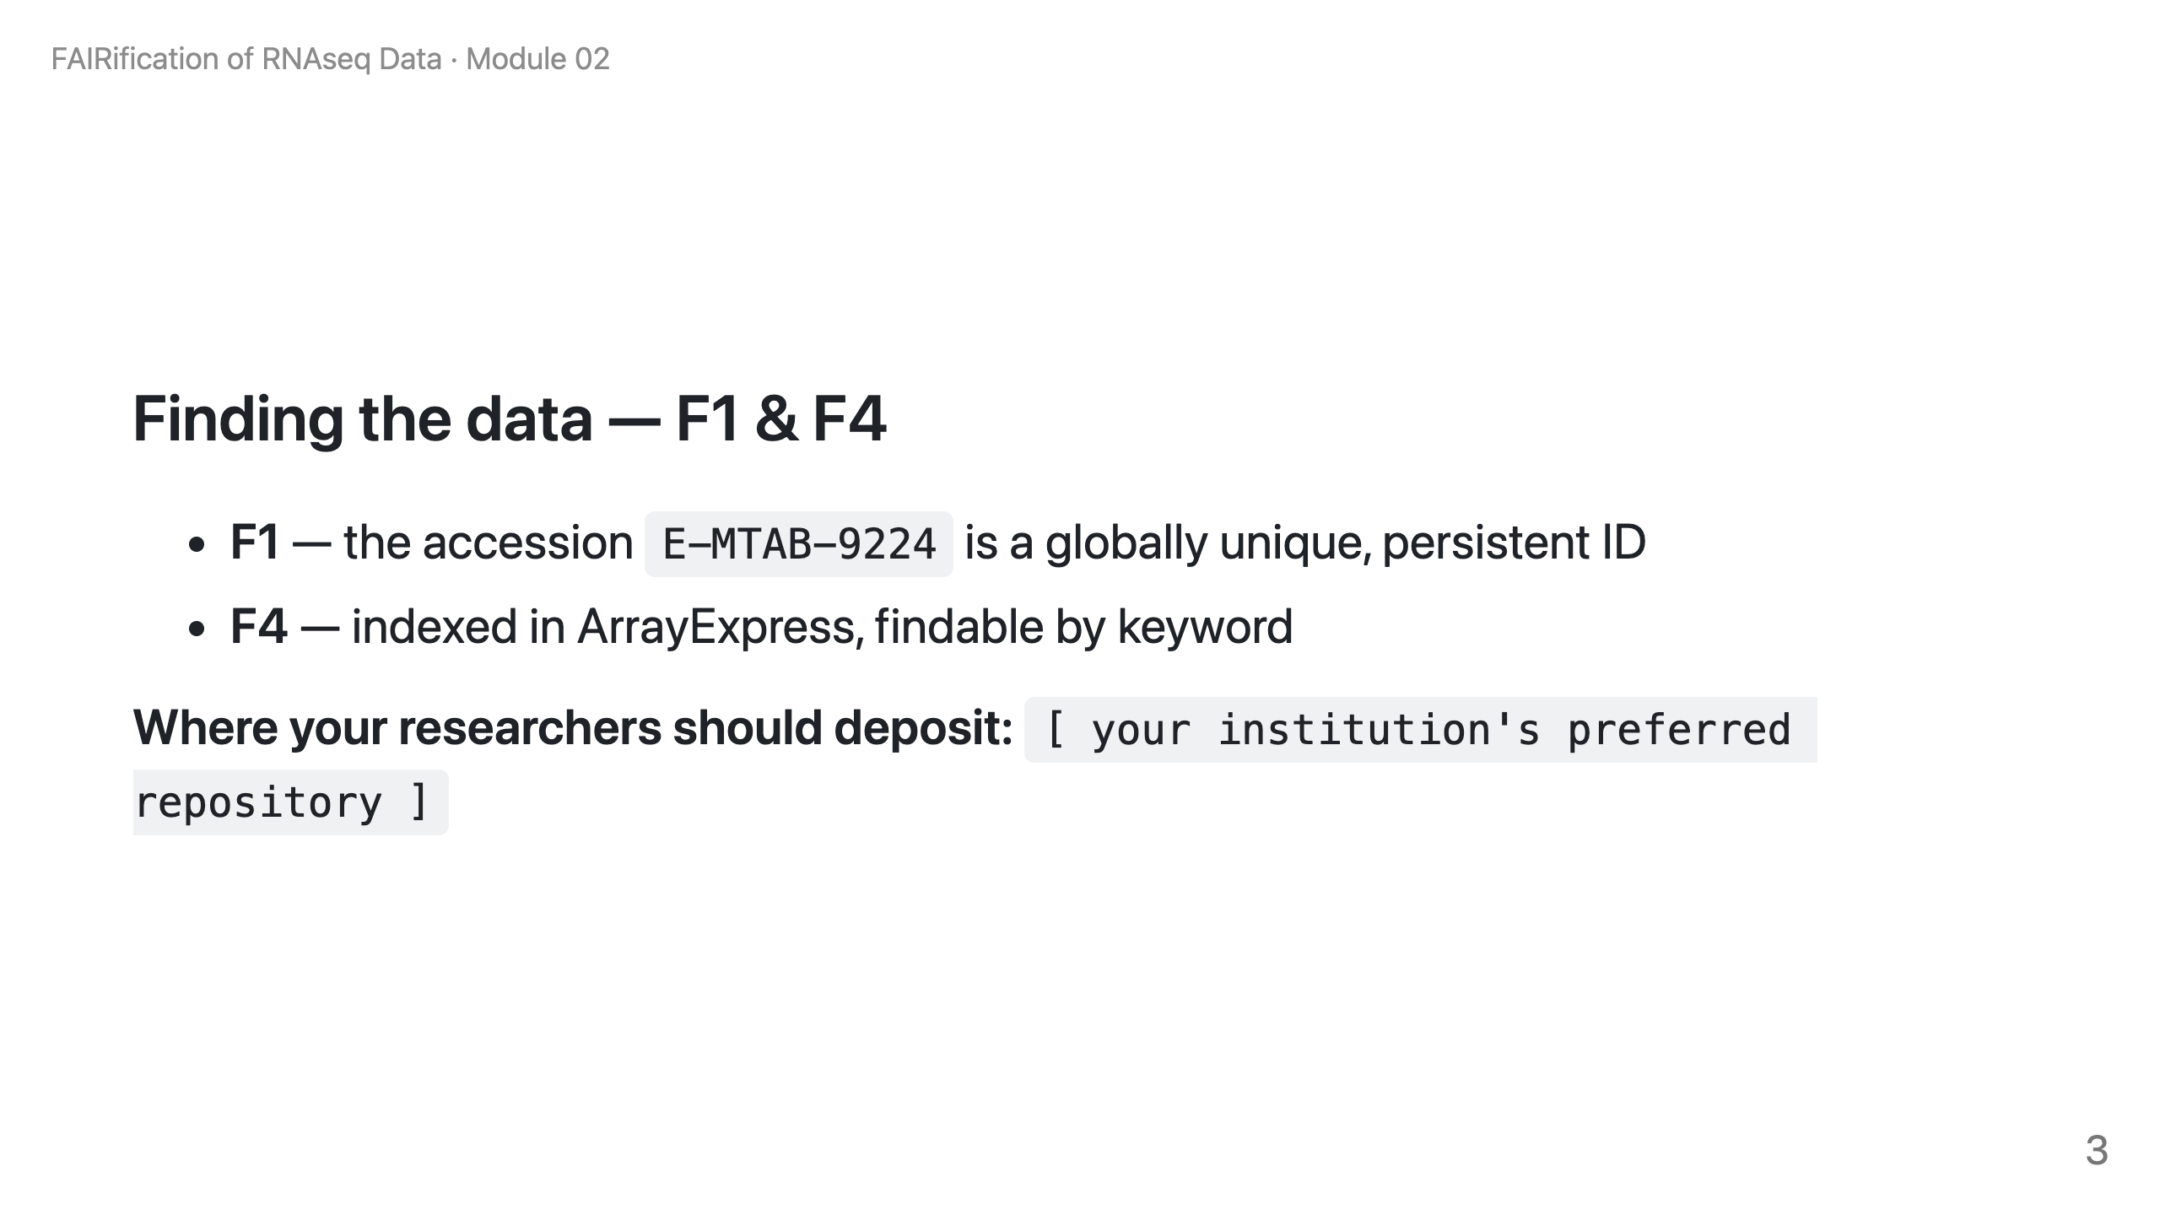
Notes:
Speaker note: F1 is the identifier; F4 is discoverability. Point them at YOUR institution's preferred repository. (In the live web kit this placeholder fills from the institution profile; in an exported PPTX/PDF it stays as a marked placeholder to fill once.)

