Slide 1

WORKSHOP · MODULE 02 · 6 STEPS · ~60 MIN
When a public repository solves most of the problem
For many data types in life sciences (sequencing, proteomics, structures), depositing in the appropriate community repository handles 80% of FAIR automatically. This module covers how to recognise that situation and guide researchers to the right home.
Built by the ELIXIR-UK RDM Club · commissioned by BioFAIR

Slide 2
Introduction & FAIR principles
10 min
• FAIR = Findable, Accessible, Interoperable, Reusable (Wilkinson 2016)
• The repository handles the plumbing; the researcher supplies the content
Built by the ELIXIR-UK RDM Club · Module 02 — FAIRification of RNA-seq
Notes:
Welcome. We'll work through a real, published dataset and see the FAIR principles as actual files and metadata decisions — not theory. The key idea: a repository gives you F and A almost for free; the I and R are your job.

Slide 3
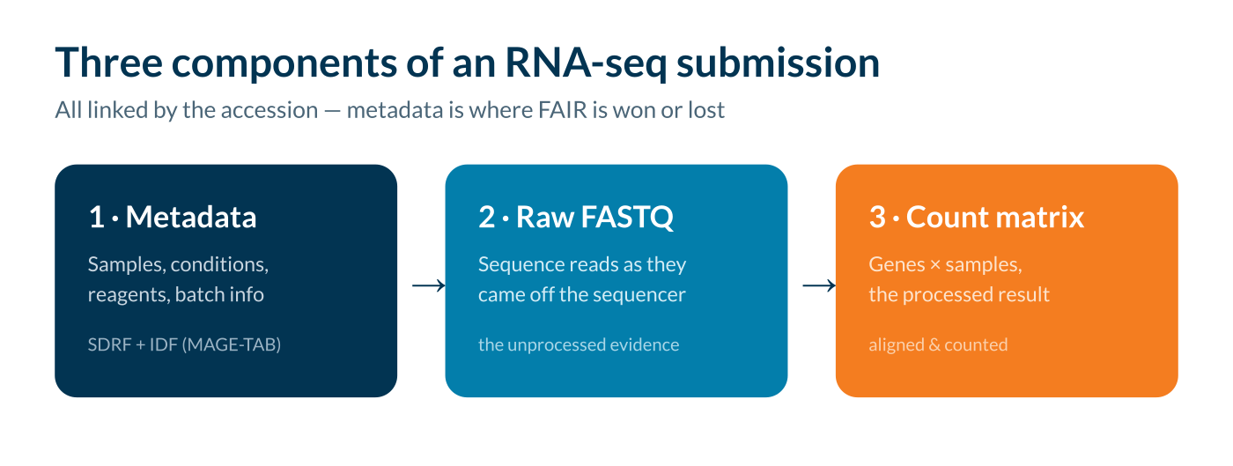
The dataset
5 min
• Worked dataset: Alivernini et al. 2020 · E-MTAB-9224
• Same structure for scRNA-seq, proteomics (PRIDE), metabolomics (MetaboLights)
Built by the ELIXIR-UK RDM Club · Module 02 — FAIRification of RNA-seq
Notes:
RNA-seq is a great worked example. Three things go into the repository: metadata, raw FASTQ, and the count matrix. Batch effects can swamp the biology — record them in metadata from day one.

Slide 4
Finding the data
10 min
• Accession E-MTAB-9224 is globally unique & persistent
• Where your researchers deposit: [ your institution's preferred repository ]
✏ Exercise: Exercise 1 (5 min): find the accession in the Alivernini paper, then locate it in ArrayExpress. What's visible before you download anything?
Built by the ELIXIR-UK RDM Club · Module 02 — FAIRification of RNA-seq
Notes:
F1 — the accession is a permanent, citable ID. F4 — indexed and keyword-searchable. One click downloads over HTTPS, no login: that's A1/A1.1. Then point them at your institution's preferred repository.

Slide 5
Metadata & community standards
15 min
• F2 rich metadata · F3 SDRF links each sample to its FASTQ
• R1.3 community standard (MAGE-TAB) · I1 controlled vocabularies
✏ Exercise: Exercise 2 (8 min): open the SDRF for E-MTAB-9224. Clear variable names? Batch info recorded? Ontology URIs or free text? Could you reuse it without contacting the authors?
Built by the ELIXIR-UK RDM Club · Module 02 — FAIRification of RNA-seq
Notes:
This is where FAIR is won or lost. MAGE-TAB = IDF (study-level) + SDRF (per-sample + file links). Use ontology terms (EFO, OBI, UBERON), not free text, so machines can read it.

Slide 6
Building a FAIR metadata spreadsheet
10 min
• Compulsory: sample IDs, condition, replicates, platform, reference genome + version, protocol
• Strongly recommended: batch (run/date/operator), RIN, QC, confounders, software versions
Built by the ELIXIR-UK RDM Club · Module 02 — FAIRification of RNA-seq
Notes:
Everything we've discussed comes from a spreadsheet you fill in as you run the experiment — which becomes the SDRF. Annotare can't conjure information that was never recorded; batch info especially is lost if not captured at the bench.

Slide 7
Licensing, provenance & wrap-up
10 min
• Repository handles F1, F3, F4, A1, A2 · you must provide F2, I1, R1
• Local support: [ set up your institution profile ]
Built by the ELIXIR-UK RDM Club · Module 02 — FAIRification of RNA-seq
Notes:
No licence = others can't legally reuse it (CC0 or CC-BY). Provenance: genome build and software versions matter. Take-home: repositories do F/A, you supply I/R, and FAIR starts at experimental design. Ask everyone for one specific change they'll make.

