Slide 1

BIG DATA TOOLS FOR MANAGERS
Unit-5 : Text Analysis using Pandas
by
Ankit Velani
Adjunct Faculty, Dept. of MBA,
Siddaganga Institute of Technology,Tumkur

Slide 2
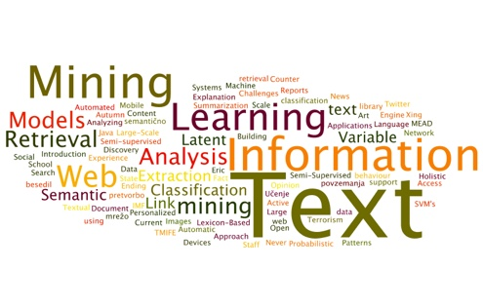
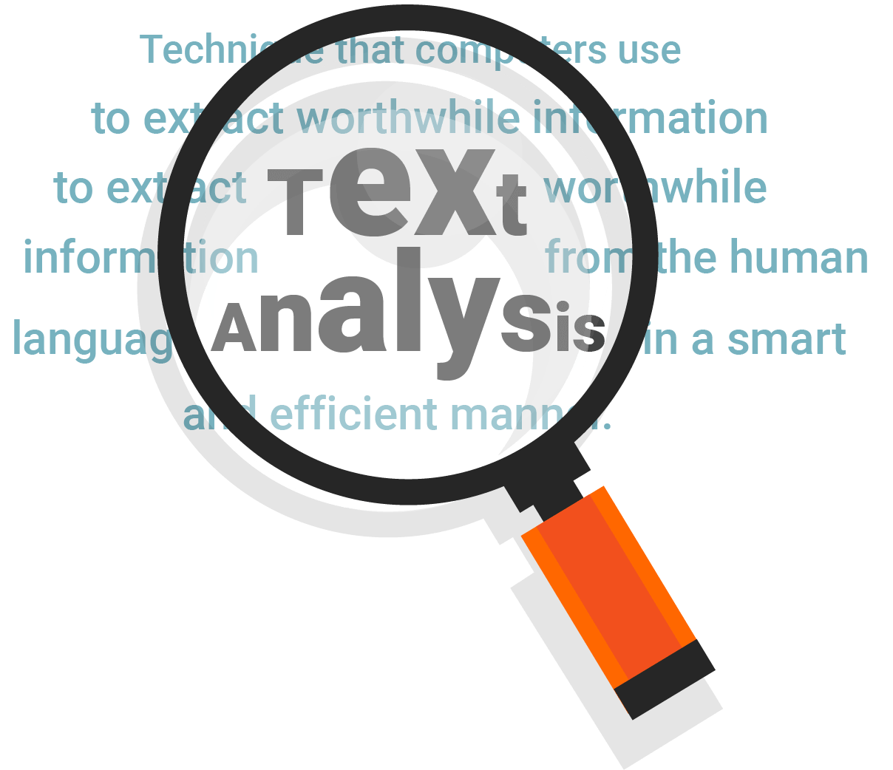
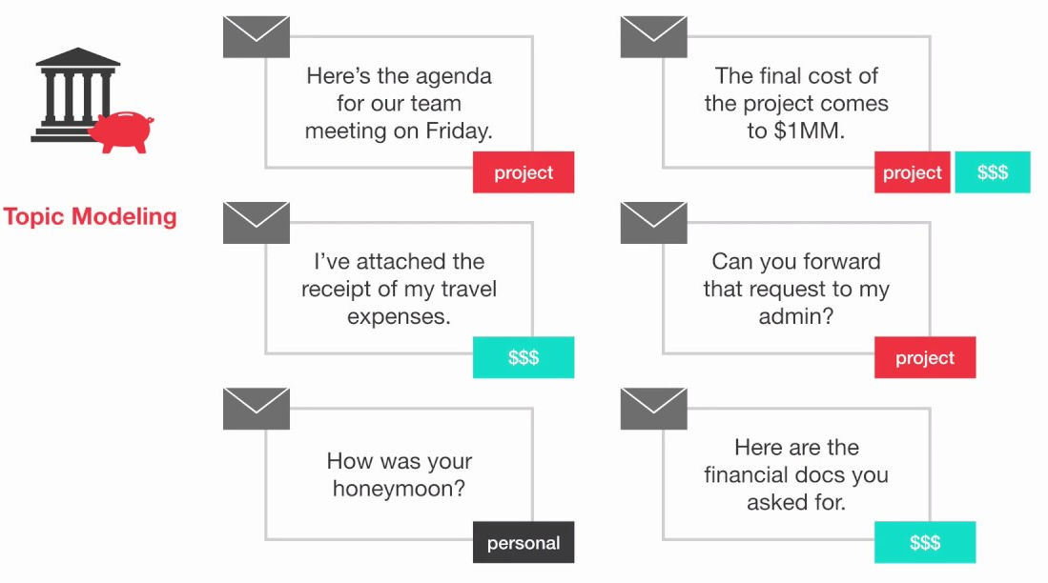
Text Analysis
Text analysis is the process of using computer systems to read and understand human-written text for business insights.
Text analysis software/libraries can independently classify, sort, and extract information from text to identify patterns, relationships, sentiments, and another actionable knowledge.
Text analysis is to efficiently and accurately process multiple text-based sources such as emails, documents, social media content, and product reviews, like a human would.

Slide 3
spaCy
spaCy is a free, open-source library for advance Natural Language Processing(NLP) in Python.
If you are working with a lot of text, you will eventually want to know more about it.
For example,
What’s it about?
What do the words mean in context?
Who is doing what to whom?
What companies are products are mentioned?
Which texts are similar to each other?

Slide 4
Basic spaCy features
Name | Description
Tokenization | Segmenting text into words, punctuation marks etc.
Part-of-speech (POS) Tagging | Assigning word types to tokens like verb/noun/pro-noun
Dependency Parsing | Assigning syntactic dependency labels, describing the relations between individual tokens, like subject or object.
Lemmatization | Assigning the base form of words. For example, the lemma of “was” is “be”, and the lemma of “rats” is “rat”
Named Entity Recognition | Labelling names “real-word” objects like persons, companies or locations.
Similarity | Comparing words, text spans and documents and how similar they are to each other.

Slide 5
Download spaCy
!pip install -U spacy
!python -m spacy download en_core_web_sm

Slide 6
Importing spaCy
import spacy
text_engine = spacy.load("en_core_web_sm")

Slide 7
Tokenization
During processing, spaCy/text mining first tokenizes the text. i.e. segments it into words, punction and so on. This is done by applying rules specific to each language.
import spacy
text_engine = spacy.load("en_core_web_sm")
doc = text_engine("Apple is looking to buying U.K. startup for $1 billion.")
for token in doc:
print(token.text)

Slide 8
Example:
import spacy
text_engine = spacy.load("en_core_web_sm")
doc = text_engine("Apple is looking to buying U.K. startup for $1 billion.")
for token in doc:
print(token.text, token.pos_,
token.dep_, token.tag_,
token.is_alpha, token.is_stop ,
token.shape, token.lemma_)

Slide 9
Example:
import spacy
text_engine = spacy.load("en_core_web_sm")
doc = text_engine("Apple is looking to buying U.K. startup for $1 billion.")
for token in doc:
print(token.text, token.pos_,
token.dep_, token.tag_,
token.is_alpha, token.is_stop , token.lemma_)
pos: The simple Part of speech tag based on language
dep: Syntactic dependency i.e relation between tokens
tag: The detailed part-of-speech tag
shape: The word shape – capitalization, punctuation, digits.
is alpha : is the token an alpha character?
is stop : is the token part of a stop words list.
lemma: the base form of the word.

Slide 10
Example: Named Entities
A named entity is a “read-world object that’s assigned a name – for example, a person, a country, a product or book title.
import spacy
text_engine = spacy.load("en_core_web_sm")
doc = text_engine("Apple is looking to buying U.K. startup for $1 billion.")
for ent in doc.ents:
print(ent.text, ent.start_char, ent.end_char, ent.label_)

Slide 11
Example: Named Entities
A named entity is a “read-world object that’s assigned a name – for example, a person, a country, a product or book title.
import spacy
text_engine = spacy.load("en_core_web_sm")
doc = text_engine("Apple is looking to buying U.K. startup for $1 billion.")
for ent in doc.ents:
print(ent.text, ent.start_char, ent.end_char, ent.label_)
text: the original entity text
start_char: Index of start of entity in the Doc
end_char: Index of end of the entity in the Doc
label: Entity label i.e. type

Slide 12
Text Analysis Example with spaCy
https://bit.ly/3CpcNWl

