Slide 1

BIG DATA TOOLS FOR MANAGERS
Unit-3 : Introduction to R
by
Ankit Velani
Adjunct Faculty, Dept. of MBA,
Siddaganga Institute of Technology,Tumkur

Slide 2
Session-2 : R data types
Advanced data structures (Continue from Part-1)
Vectors
Lists
Matrices
Data Frames

Slide 3
Vector
Vector is the essential building block for handling multiple items in R.
It’s a list of items that are of the same type.
Combine function c() used to combine multiple values of same type.
ie.
fruits ← c(“Apple”, “Banana”, “Orange”)
num ← c(1,2,3,4,5,6)
num ← 1:100 #Integer values in a sequence
dec ← 1.5 : 6.5 #Numeric values in a sequence

Slide 4
Vector
Length function which helps to find out how many items a vector has.
length(fruits)
length(num)

Slide 5
Vector
Combining two vectors
num_all <- c(num, dec)
print(num_all)
alpha = c(“A”, “B”, “C”, “D”)
fruits = c(“Apple”, “Banana”, “Orange”)
data = c(alpha, fruits, num_all)
print(data)

Slide 6
Vector
Sequence
common useful functions to create continuous number generation.
seq(from=, to=, by=)
seq(from=, to=, length.out=)
Example:
seq(from=1, to=10, by=2)
seq(from=1, to=10, length.out=20)

Slide 7
Vector
Repeat
common useful functions to repeat the certain values in vector.
rep(x=, each=, times=)
Example:
rep(x=c(1,2,3), each=2)
o/p: 112233
rep(x=c(1,2), each=2, times=4)
O/p :1122 1122 1122 1122

Slide 8
Vector
Repeat
common useful functions to repeat the certain values in vector.
rep(x=, each=, times=)
Example:
rep(x=c(1,2,3), each=2)
o/p: 112233
rep(x=c(1,2), each=2, times=4)
O/p :1122 1122 1122 1122
times provide no of times entire vector elements to repeat
each provide no of times each vector elements to gets repeat.

Slide 9
Vector
Sort
Sort function used to sort vector elements in increasing or decreasing order.
sort(x=, decreasing=)
x = is vector
decreasing is TRUE/FALSE
Example: Sort element in increasing order
sort(x= c(2.5, -1, -10, 3.44), decreasing=FALSE)

Slide 10
Vector
Accessing Vector Elements
Index to be used to access the vector elements, index starts from 1 to length of vector
Syntax:
vector_name[index]
Example :
num <- c(“A”, “B”, “C”, “D”, “E”)
num[1] #1st Element
num[5] #5th Element

Slide 11
Data Frames
A data frame is R’s most natural way of presenting two-dimensional dataset with collection of observation with one or more variables.
Data frame is one of the most important and frequently used in R for data analysis.
data.frame() function helps to create data frame in R

Slide 12
Data Frames
Creation of data frame
my_data <- data.frame(
name = c(“A”,”B”,”C”,”D”),
age = c(40,45,70,60),
gender = c(“F”,”M”,”F”,”M”)
)
name, age, gender are the vectors
Output:
Name | Age | gender
A | 40 | F
B | 45 | M
C | 70 | F
D | 60 | M

Slide 13
Data Frames
Accessing elements
data-frame_object[ row_range , col_range ]
Example:
my_data[] #display all the rows & cols
my_data[1, ] #first row with all the columns
my_data[1,3] # first row with only 3rd columns
my_data[1, 2:3 ] # first row with 2 & 3rd columns
my_data[2:3, 1] # 2 & 3rd row with 1st columns
index
index

Slide 14
Data Frames
Accessing elements with Variable Name
data-frame_object$variable_name
my_data$name
my_date$age
Accessing elements with condition on row index
data-frame_object[condition, ]
my_data[my_data$gender==“M”, ]
my_data[my_data$gender==“F”, 2]

Slide 15
Matrices
Matrices are the R objects wherein the elements are organized in a 2-D rectangular shape. In a matrix, it contains elements of the same type.
A column is a vertical representation of data, while a row is a horizontal representation of data.
Syntax:
matrix(x= ,nrow= ,ncol= ,byrow= )

Slide 16
Session-2 : R data types
Advanced data structures (Continue from Part-1)
Vectors
Lists
Matrices
Data Frames

Slide 17
Matrices
Syntax:
matrix(x= ,nrow= ,ncol= ,byrow= )
matrix() : Name of the functions in R
nrow : is number of rows to be created
ncol : is number of columns to be created
byrow : TRUE or FALSE data filling direction in matrix

Slide 18
Matrices
Example : Numeric data
data = c(10, 20, 30, 40, 50, 60, 70, 80, 90)
num_mat = matrix(data, nrow=3, ncol=3)
print(num_mat)

Slide 19
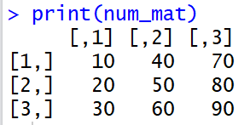
Matrices
Example:
data = c(10, 20, 30, 40, 50, 60, 70, 80, 90)
num_mat = matrix(data, nrow=3, ncol=3)
print(num_mat)
Output:

Slide 20
Matrices
Example: Character data
data = c("A", "B", "C", "D", "E", "F")
char_mat = matrix(data, nrow=2, ncol=3)
print(char_mat)

Slide 21
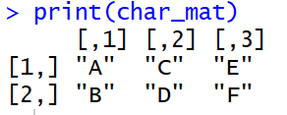
Matrices
Example:
data = c("A", "B", "C", "D", "E", "F")
char_mat = matrix(data, nrow=2, ncol=3)
print(char_mat)
Output:

Slide 22
Matrices
Filling direction:
R also allow to specify the filling direction for Matrix either by row or columns
byrow = TRUE/FALSE argument can control filling direction in matrix function.
m ← matrix(data=c(1,2,3,4,5,6),
nrow=3,
ncol=2, byrow=FALSE)

Slide 23
Matrices
m ← matrix(data=c(1,2,3,4,5,6),
nrow=3,
ncol=2, byrow=FALSE)
o/p:
1 4
2 5
3 6
m ← matrix(data=c(1,2,3,4,5,6),
nrow=3,
ncol=2, byrow=TRUE)
o/p:
1 2
3 4
5 6

Slide 24
Matrices
For equal length of Vectors/Matrices/DataFrame can be combined into rows or cols using rbind() and cbind() functions.
rbind() : for combining data by rows
cbind() : for combining data by cols
Ex
a ← c(1,2,3)
b ← c(4,5,6)
rbind(a,b)
1 2 3
4 5 6
cbind(a,b)
1 4
2 5
3 6

Slide 25
Matrices
dim() function is used to find the dimension of matrices.
> dim(m)
Output : number of rows, number of cols

Slide 26
Matrices
Accessing Elements
matrix_object[row-range, col-range]
Ex.
m[] # display all the rows & cols
m[1:2] # get the 1st element from row 1 & 2
m[1,1] # get the 1st column from 1st row
m[1, 2] # get the 2nd column from 1st row
m[3, 1:2] # get the 1&2 columns from 3rd row
diag(m) # get the diagonal elements of matrix

Slide 27
Operation on Matrices
A
2 5 2
6 1 4
Transpose t() function to get the transpose of matrix
t(A)
O/p:
2 6
5 1
2 4

Slide 28
Operation on Matrices
A
2 5 2
6 1 4
Scaler multiplication of matrix
matrix_obj * scaler value
Ex:
A * 2
Output:
4 10 4
12 2 8

Slide 29
Operation on Matrices
A
2 5 2
6 1 4
B
2 3 2
3 1 2
Element wise arithmetic operation
matrix_object1 + matrix_objct2
matrix_object1 - matrix_objct2
matrix_object1 * matrix_objct2
matrix_object1 / matrix_objct2

Slide 30
Operation on Matrices
A
2 5 2
6 1 4
C
5 -3
-1 1
1 5
Matrix Multiplication
matrix_obj %*% matrix_obj
Example:
A %*% C

Slide 31
Lists
List is powerful data structures in R, which allows to group together any kind of data types & data.
A single list contains vectors, matrix, logical vector, character, Data frame and list itself.
list() function used to create a list in R
list_1 = list(c(1,2,3,4,5,))

Slide 32
Lists
fruits_vector <- c("Apple", "Banana", "Orange")
num_vector <- c(1,2,3,4,5,6,7,8,9,10,11,12)
num_matrix <- matrix(c(10, 20, 30, 40, 50, 60),
nrow=3,
ncol=2)
my_data <- data.frame(
name = c("A","B","C","D"),
age = c(40,45,70,60),
gender = c("F","M","F","M")
)

Slide 33
Lists
fruits_vector <- c("Apple", "Banana", "Orange")
num_vector <- c(1,2,3,4,5,6,7,8,9,10,11,12)
num_matrix <- matrix(c(10, 20, 30, 40, 50, 60),
nrow=3,
ncol=2)
my_data <- data.frame(
name = c("A","B","C","D"),
age = c(40,45,70,60),
gender = c("F","M","F","M")
)
x = 100
y = 6+10i
flag = FALSE

Slide 34
Lists
fruits_vector <- c("Apple", "Banana", "Orange")
num_vector <- c(1,2,3,4,5,6,7,8,9,10,11,12)
num_matrix <- matrix(c(10, 20, 30, 40, 50, 60),
nrow=3,
ncol=2)
my_data <- data.frame(
name = c("A","B","C","D"),
age = c(40,45,70,60),
gender = c("F","M","F","M")
)
x = 100
y = 6+10i
flag = FALSE

Slide 35
Lists
Create a new list which contains vectors, matrix, data frame and basic datatype
all_data = list(fruits_vector,
num_vector,
num_matrix,
my_data,
x,
y,
flag)

Slide 36
Lists
Accessing List element: list element can be accessible by [[]] double square brackets with index.
all_data
all_data[[1]] # Accessing 1st elements
all_data[[2]] # Accessing 2nd elements
all_data[[2:5]] # Elements from 2 to 5 elements

Slide 37
Access DataFrame from list
all_data = list(fruits_vector, num_vector, num_matrix, my_data, x, y, flag)
all_data[[4]] #4th element is Data Frame
all_data[[4]][]
all_data[[4]][ 1 , 2 ] #1st row & 2nd Columns from 4th Element
all_data[[4]][ , 3 ] # all the rows and 3rd column
all_data[[4]][ 1:3 , 3 ] # 1 to 3 Rows and 3rd column
all_data[[4]][ 1:3 , 1:2 ] # 1 to 3 Rows & 1 to 2 columns
index
6
7
1
2
3
4
5

Slide 38
View Function
The View() function in R can be used to invoke a spreadsheet-style data viewer within RStudio.
Example:
View(x)
View(my_data)
View(all_data)
Note :
V is upper case in View function

Slide 39
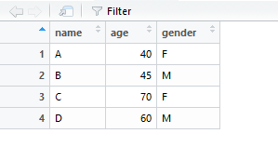
View(my_data)

Slide 40
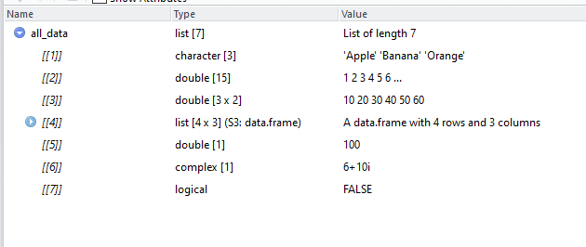
View(all_data)

Slide 41
Recap
Basic Data Types
Logical
Numeric
Complex
Character

Slide 42
Recap
Advance Data Types / Data Structure
Vector ( Single Dimension )
Matrix ( Two Dimension )
Data Frame (Two Dimension )
List (Mix in terms of dimension)

Slide 43
Recap
Accessing elements
Vector [index]
Matrix [row-index, col-index]
Data Frame [row-index, col-index]
List [[index]]
View function to view the data in excel format

Slide 44
Importing data into R
Text
CSV
Excel
SPSS
SAS files
Web
SQL

Slide 45
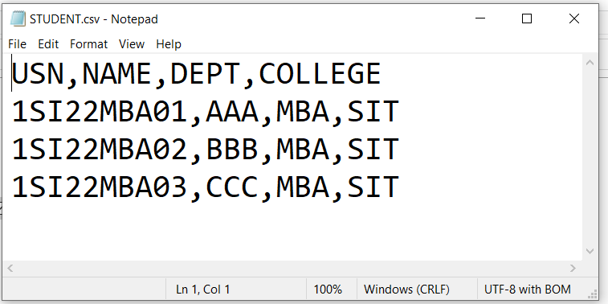
Importing CSV file into R
CSV (Comma Separated Values) is a text file in which the values in columns are separated by a comma.
Example:

Slide 46
Importing CSV file into R
read.csv() function to read CSV files
read.csv(file_path=" ", header=FALSE, sep=",")

Slide 47
Vehicle Park Data
Vehicle park data contains the no of vehicles are present on road or market in India from Year 2000 to 2022
Columns :
YEAR : Vehicle Sales Year
VEHICLE_TYPE : Type of vehicle sold to the market (Truck, Bus, Four & Two wheeler, Others)
BRAND : Vehicle brand & Manufacturer
VEHICLE_COUNT : No of vehicle sold in market for a year
AGE_GROUP : Age group of the vehicle
AGE : Vehicle age represent how old vehicle is
RTO_REGISTRATION_YEAR : Year of vehicle registration

Slide 48
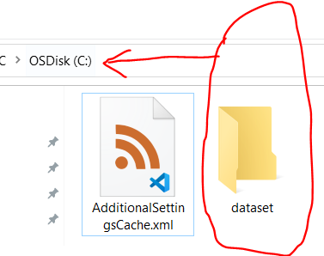
Import Vehicle data into R
Before importing any datasets in R, first create dataset folder in C drive

Slide 49
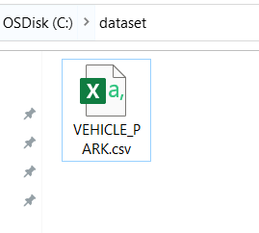
Download VEHICLE_PARK
Download the VEHICLE_PARK.csv file from link-1 or link- 2 and copy paste or save in C:\dataset folder
Link -1
https://raw.githubusercontent.com/sitmbadept/sitmbadept.github.io/main/BDTM/DATASET/VEHICLE_PARK.csv
Link -2
https://drive.google.com/file/d/1EPQhl0wVCZnNP1vx7BE43phOUljzZXGD/view?usp=sharing
Store in C:\dataset

Slide 50
Read VEHICLE_PARK data
Read CSV file in
data = read.csv("C:/dataset/VEHICLE_PARK.csv")

Slide 51
Structure of Data Frame
str() function gives details information about the data frame.
Syntax:
str(data-frame-variable)
Example:
str(data)

Slide 52
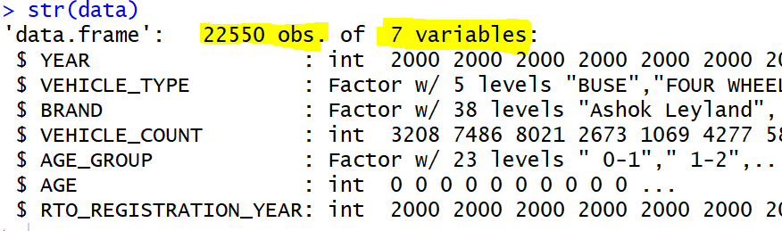
Structure of Data Frame
str() function gives details information about the data frame.

Slide 53
Structure of Data Frame
dim() function gives dimensions of data frame.
nrow() function gives #rows available in data frame
ncol() function gives #columns available in data frame
Syntax:
dim(data-frame-variable)
nrow(data-frame-variable)
ncol(data-frame-variable)

Slide 54
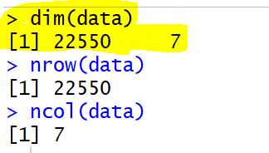
Structure of Data Frame
Example:
dim(data)
nrow(data)
ncol(data)
Output:

Slide 55
Columns of Data Frame
colnames() function gives columns name of the data frame.
Syntax:
colnames(data-frame-variable)
Example:
colnames(data)

Slide 56
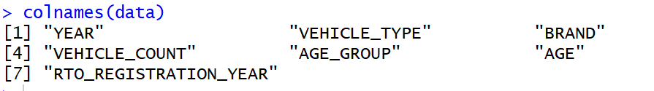
Columns of Data Frame
colnames() function gives columns name of the data frame.
Example:
colnames(data)

Slide 57
Summary
summary() function gives quick summary for the data frame.
Syntax:
summary(data-frame-variable)
Example:
summary(data)

Slide 58
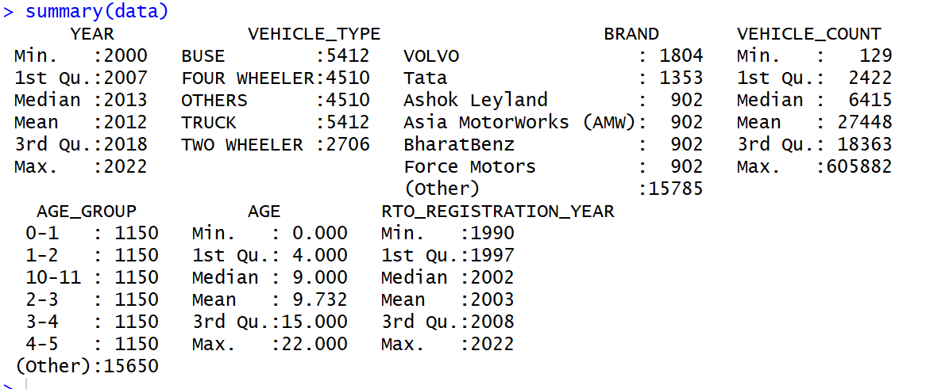
Summary
summary() function gives quick summary for the data frame.
Example:
summary(data)

Slide 59
First/Last few rows
head() function gives top records
tail() function gives last records
Syntax:
head(data-frame-variable, n= )
tail(data-frame-variable, n= )
Example:
head(data, n=10)
tail(data, n=20)

Slide 60
Slicing and Indexing of DataFrame
Access element using indexes
data_frame_variable[row-index, col-index]
data[ ] #Display all the rows & cols
data[5:7, ] #Display rows from 5 to 7 and all the cols
data[c(1, 10, 20), ] #Display rows 1, 10, 20 and all cols
data[ , c(1,3)] #Display all rows, 1 & 3 columns
data[ c(1, 10, 20), c(1,3)]
#Display 1, 10, 30 rows, 1 & 3 columns

Slide 61
Slicing and Indexing of DataFrame
Access Specific Columns using $ and c() function
data$AGE
data$YEAR
# All the rows & selected column
data[ , c('BRAND', 'YEAR', 'AGE') ]
# First 10 rows & selected column
data[ 1:10 , c('BRAND', 'YEAR', 'AGE’) ]

Slide 62
Recap
read.csv
str
dim
colnames
Summary
head
tail

Slide 63
Recap
read.csv
str
dim
colnames
summary
head
tail
Using Index ( row & column)
Using $ and c() combine function

Slide 64
Splitting
split() function perform partition on the dataset by specific columns/variables.
Syntax:
split(data-frame-variable, column-name-for-split)
Example: Split dataset by BRAND
result = split(data, data$BRAND)
View(result)

Slide 65
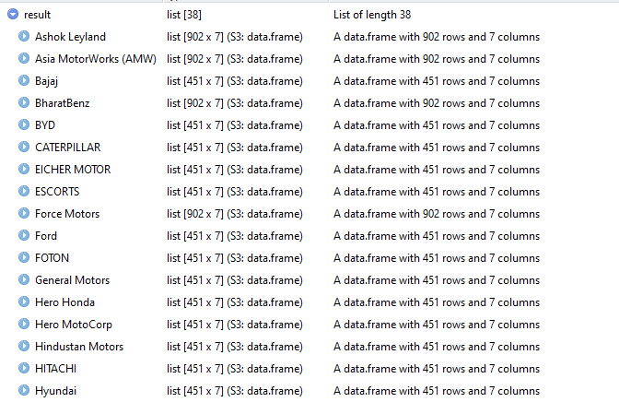
Splitting
split() function perform partition on the dataset by specific columns/variables.

Slide 66
Subset
subset() function perform data filter based on given conditions.
Syntax:
subset(data-frame-variable, conditions)
Example: Split dataset by AGE
subset(data, data$AGE == 10)

Slide 67
Subset
subset() function perform data filter based on given conditions.
Example: Split dataset by BRAND & AGE
subset(data, data$AGE == 10 & data$BRAND=='VOLVO')

Slide 68
Subset
Another option to filter data by applying condition in row index.
Syntax:
data-frame-variable[ conditions, column-index ]
Example:
data[data$AGE==10, ] # Filter where AGE is 10 and all columns
data[data$AGE==10, 2] # Filter where AGE is 10 and 2nd columns

Slide 69
Sorting / Ordering
order() function perform data sorting on data frame, order function apply on row index.
Syntax:
data-frame-variable[ order(col-name, decreasing=TRUE),
column-index ]
Example:
data[order(data$AGE, decreasing=TRUE), ]

Slide 70
Add New Column
Adding new columns to existing DataFrame is quite easy, here are the option
using cbind() function
using $ symbol

Slide 71
Add New Column
cbind() function must have same number of rows while creating new columns.
CITY = rep(c("TUMKUR"), times=22550)
data= cbind(data, CITY)
View(data)

Slide 72
Add New Column
Using $ symbol
data$COUNTRY = "INDIA“
data$PIN_CODE = 572103
View(data)

Slide 73
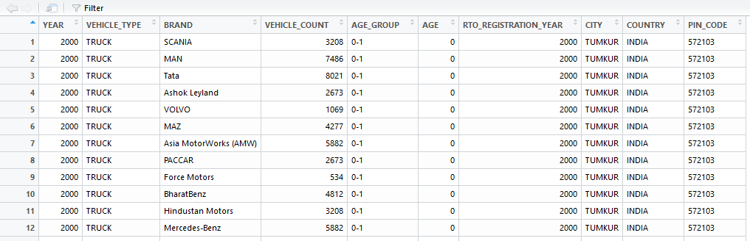
Data Frame after adding new cols

Slide 74
Vehicle Park (R-Code)
R-code is available for basic exercises
Double click to download →
OR
Download code from give link:
https://raw.githubusercontent.com/sitmbadept/sitmbadept.github.io/main/BDTM/CODES/R/VehiclePark.R

