Slide 1

BIG DATA TOOLS FOR MANAGERS
Unit-4 : Introduction to Python Programming
by
Ankit Velani
Adjunct Faculty, Dept. of MBA,
Siddaganga Institute of Technology,Tumkur

Slide 2
Session-1 Overview
Introduction to R-tool
R & R-Studio
Getting started with R
Variables
Comments
Packages

Slide 3
Introduction to Python
Python is a general-purpose interpreted, interactive, object-oriented, and high-level programming language
Python is designed to be highly readable. It uses English keywords frequently whereas the other languages use punctuations.

Slide 4
How Python is useful?
Python has built-in features of application development and other system related libraries.
Python can easily preprocess varieties of structure & unstructured data.
Python is available for all the operating system (Windows, Linux, macOS), and easy to move Python code from one operating system to another operating system.
Python has a wide & active community, and 2,00,00+ packages worldwide to improve project features and productivity while working with Python.
Python has various libraries for Statistical analysis, Text Analysis, Visualization.

Slide 5
Python Software
Python Interpreter/software, which is available for all the OS
Official website :
www.python.org
or
www.anaconda.com

Slide 6
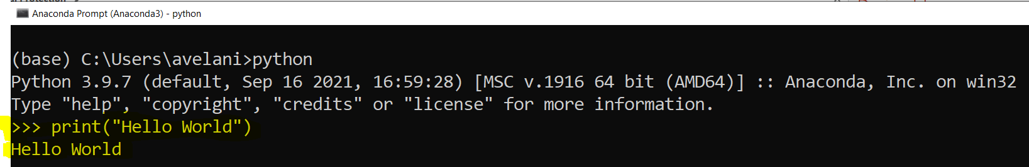
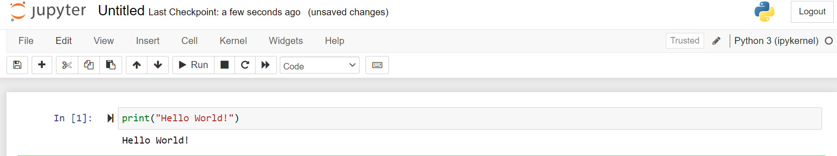
Tools to Run Python Code
Command Prompt
Jupyter Notebook

Slide 7
Reserved Words
The following list shows the Python keywords. These are reserved words and you cannot use them as variables or any other identifier names.
All the Python keywords contain lowercase letters only.
and | exec | not
as | Finally | or
assert | For | pass
break | from | print
class | global | raise
continue | if | return
def | import | try
del | in | while
elif | is | with
else | lambda | yield
except

Slide 8
Variables
Variables are container for storing data value in memory.
A variable is created the moment you first assign a value to it.
Example:
x = 5 y = "John" print(x) print(y)

Slide 9
Variables
Rules to create variable name:
A variable name must start with a letter or the underscore character
A variable name cannot start with a number
A variable name can only contain alpha-numeric characters and underscores (A-z, 0-9, and _ )
Variable names are case-sensitive (age, Age and AGE are three different variables)
Python does not allow punctuation characters such as @, $, and % within variable name or identifiers

Slide 10
Variables
Example:
2myvar = "John" my-var = "John" my var = "John"
myvar = "John"
my_var = "John"
_my_var = "John"
myVar = "John"
MYVAR = "John"
myvar2 = "John"
Invalid variable name
Valid variable name

Slide 11
Variables
Multi Words Variable Names:
Example:
myVariableName = "John"
MyVariableName = "John"
my_variable_name = "John"

Slide 12
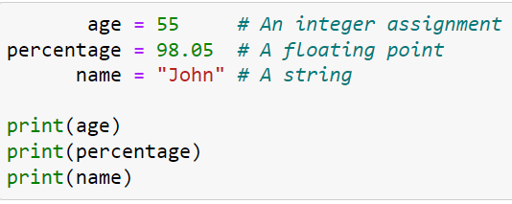
Variables
Example:
( ) → denotes Function Call, print is function and it display the value of variable.

Slide 13
Python Indentation
Python does not use braces({}) to indicate blocks of code for class and function definitions or flow control.
Blocks of code are denoted by line indentation, which is rigidly enforced.
The number of spaces in the indentation is variable, but all statements within the block must be indented the same amount

Slide 14
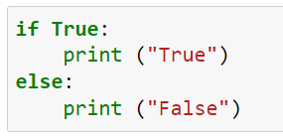
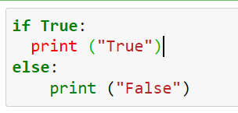
Python Indentation
Valid
Invalid

Slide 15
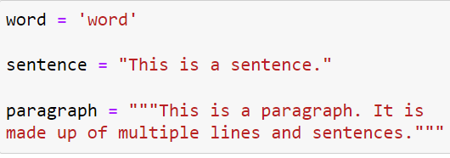
Quotation in Python
Python accepts single ('), double (") and triple (''' or """) quotes to denote string literals, as long as the same type of quote starts and ends the string.

Slide 16

Comments in Python
A hash sign (#) that is not inside a string literal is the beginning of a comment.
All characters after the #, up to the end of the physical line, are part of the comment and the Python interpreter ignores them.

Slide 17
Python Packages
R tools comes with lots of built in commands, function for numeric calculations for common statistical analysis, plotting visualization.
R packages are collection of R functions code and sample data that stored under a directory which called “library” in the R environment.
R package easily available on CRAN network & over the internet.

Slide 18
Python Packages
Install & download from Internet/ CRAN network

Slide 19
Python Packages
Install & download from Internet/ CRAN network
install.packages(“package-name”)
ie. > install.packages(“car”)
> install.packages(“caret”)
> install.packages(“MASS”)
Load/import package in R code
library(“package-name”)
Ie.
> library(“car”)
> library(“MASS”)

Slide 20
Recap
R is an open source programming language for statistical analysis.
To download R from official website (http://www.r-project.org)
R documentation & packages are available on CRAN (Comprehensive R Archive Network)
R Studio is development environment to develop & work with R projects.
R Studio has 4 window panel ( Code, Workspace, Terminal and Output)
Comments can be used to annotate R code and it start with hash(#)
getwd() functions to get the current working directory.
setwd() function to change or modify working directory.

Slide 21
Python Programming
Data Structures
List
Dictionary
Tuple
Set

Slide 22
Lists
List is powerful data structures in R, which allows to group together any kind of data types & data.
A single list contains vectors, matrix, logical vector, character, Data frame and list it self
list() function used to create a list in R
my_list <- list(c(1,2,3,4,5,6),
“John”
my_data)

Slide 23
Dictionary
List is powerful data structures in R, which allows to group together any kind of data types & data.
A single list contains vectors, matrix, logical vector, character, Data frame and list it self
list() function used to create a list in R
my_list <- list(c(1,2,3,4,5,6),
“John”
my_data)

Slide 24
Tuple
List is powerful data structures in R, which allows to group together any kind of data types & data.
A single list contains vectors, matrix, logical vector, character, Data frame and list it self
list() function used to create a list in R
my_list <- list(c(1,2,3,4,5,6),
“John”
my_data)

Slide 25
Set
List is powerful data structures in R, which allows to group together any kind of data types & data.
A single list contains vectors, matrix, logical vector, character, Data frame and list it self
list() function used to create a list in R
my_list <- list(c(1,2,3,4,5,6),
“John”
my_data)

Slide 26
Working with Pandas
Pandas Data Structures
Series
Data Frame

Slide 27
Working with Pandas
Pandas Data Structures
Series
Data Frame

Slide 28
Series
Pandas Data Structures
Series
Data Frame

Slide 29
Working with Series
Pandas Data Structures
Series
Data Frame

Slide 30
Data Frame
Pandas Data Structures
Series
Data Frame

Slide 31
Working with DataFrame
Pandas Data Structures
Series
Data Frame

