Slide 1

BIG DATA TOOLS FOR MANAGERS
Unit-1 : Introduction to Big Data
by
Ankit Velani
Adjunct Faculty, Dept. of MBA,
Siddaganga Institute of Technology,Tumkur

Slide 2

What is Big Data?

Slide 3






What is Big Data?
Every minute
~5 lacs comments,
~3 lacs status update,
~1.5 lacs photo upload
Every second
around 6000 tweets
Every hours
~2 million customer transactions
Every day around
~6.5 billion transactions
Every day
approximate 1.6 million shipment

Slide 4
Big Data
“Big data refers to data sets that are too large or complex to be deal with by traditional data-processing software.”
“Big data is structured, unstructured and semi-structured or heterogeneous in nature. It becomes difficult for computing system to manage “Big Data” because of the extreme speed and volume at which it is generated”

Slide 5
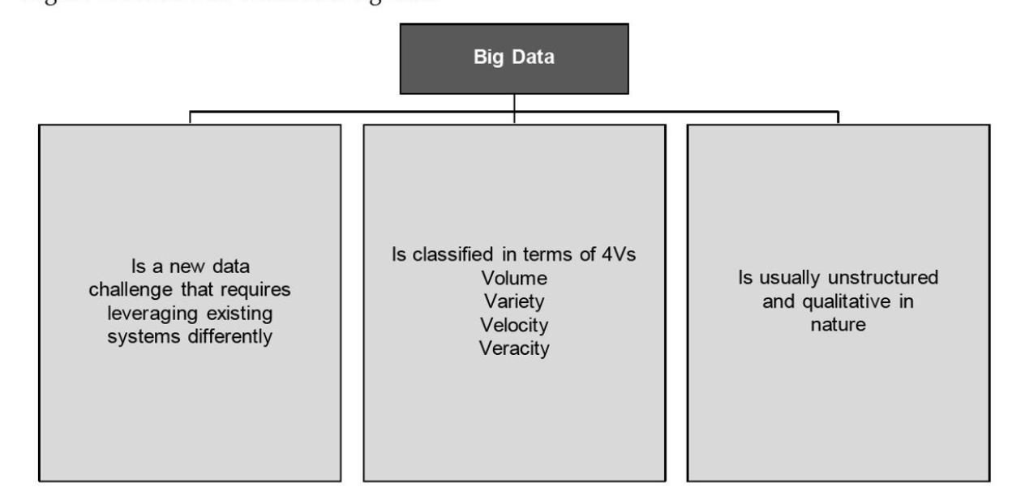
Big Data

Slide 6
Types of Data
Data Sources:
Internal sources, such as organizational or enterprise data.
External sources, such as social data, machine data
Internal source
Example:
Customer Relationship Management(CRM)
Enterprise Resource Planning(ERP) system
Customer, Products and sales data
Usually, OLTP and operation data
External source
Example:
Business partners
Syndicate data suppliers
Internet
Government
Market Research organization

Slide 7
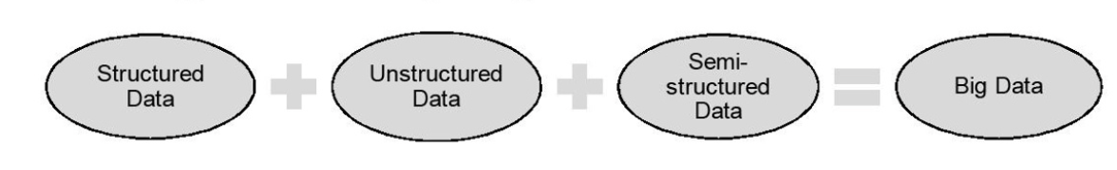
Types of Data
On the basis of the data received from the sources , Big Data comprises:
Structured data
Semi-structured data
Unstructured data
In a real-world scenario, typically the unstructured data is larger in volume than the structured and semi-structured data, approximately 70% to 80% of data in unstructured form.

Slide 8
Types of Data
Structured Data
Structured data can be defined as the data that has a defined repeating pattern.
This pattern makes it easier for any program to sort, read, and process the data.
Processing structured data is much easier and faster than processing data without any specific repeating patterns.
Example:
CustomerID | Name | ProductID | City | State
12365 | Smith | 241 | Graz | Styria
23658 | Jack | 365 | Wolfsberg | Carinthia
32456 | Kady | 421 | Enns | Upper Austria

Slide 9
Types of Data
Semi-Structured Data
Semi-structured data, also known as having a schema-less or self describing structure, refers to a form of structured data that contains tags or markup elements in order to separate elements and generate hierarchies of records and fields in the given data.
Example:
SlNo | Name | Email
1 | Sam Jocabs | smj@zyz.com
2 | First Name: David Last Name: Brown | davidb@xyz.com
3 | Name : Nick Sager | Email-1 : nick.sager@xzy.com Email-2 : nicksager@gmail.com

Slide 10
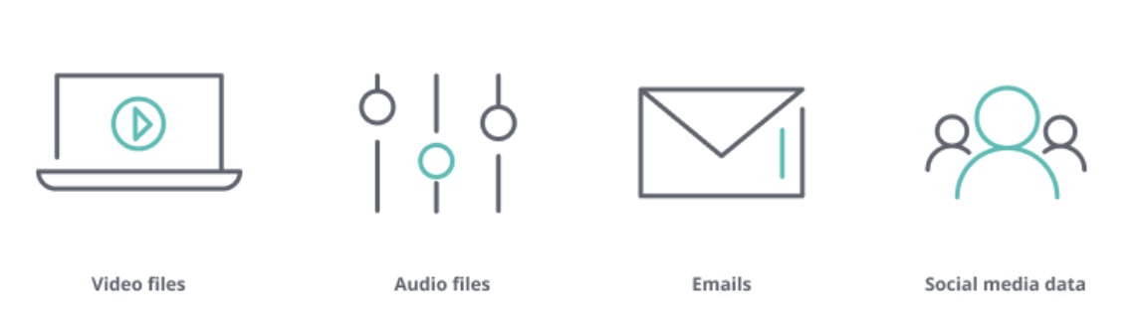
Types of Data
Unstructured Data
Unstructured data is a set of data that might or might not have any logical or repeating patterns. About 80% of enterprise data consist of unstructured content.
Example:

Slide 11
Elements of Big Data
According to Gartner, data is growing at the rate of 59% every year. This growth can be depicted in terms of the following four Vs.
Volume: Volume is the amount of data generated by organizations or individuals.
Velocity: Velocity describes the rate at which data is generated, captured, and shared
Variety: Variety describe the different formats for data such as images, text, video, audio, GPS…etc
Veracity: Veracity generally refers to the uncertainty of data, i.e. whether the obtained data is correct or consistent.

Slide 12
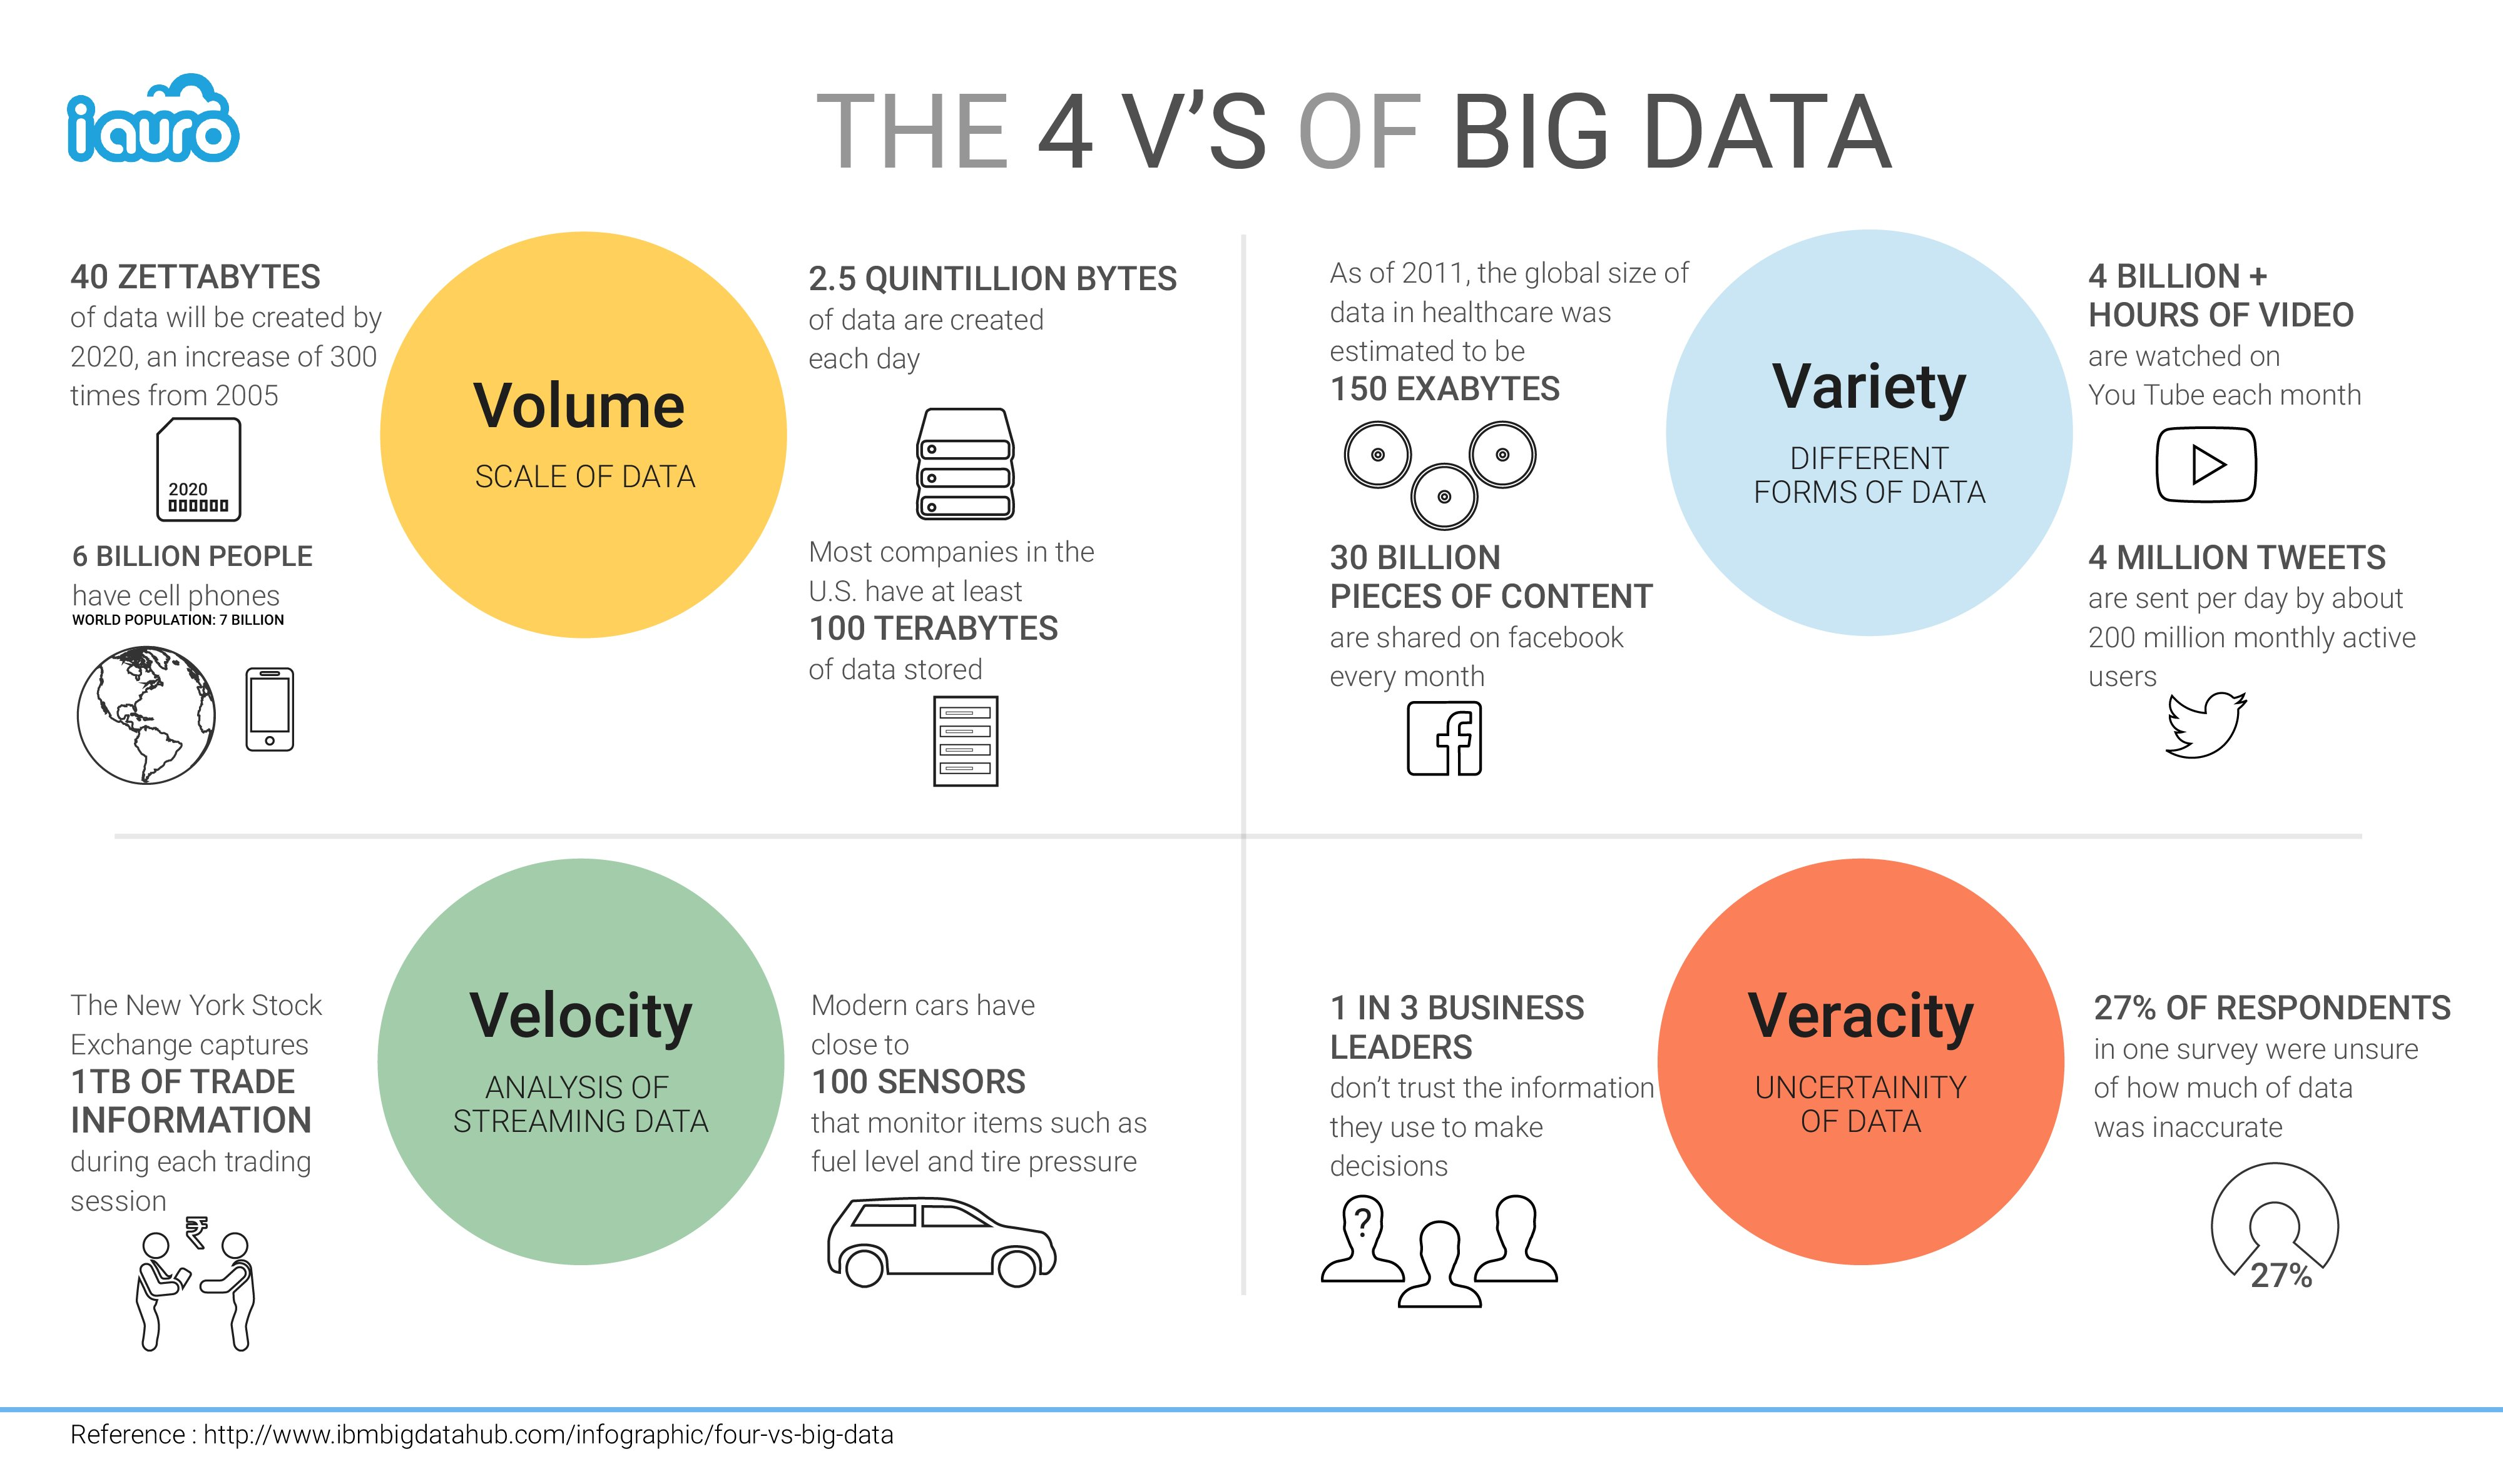
Elements of Big Data

Slide 13
Future of Big Data
Most organizations today consider data and information to be their most valuable and differentiated asset.
By analyzing this data effectively, organizations worldwide are now finding new ways to compete and emerge as leaders in their fields to improve decision making and enhance their productivity and performance.
At the same time, the volume and variety of data is also increasing at the immense rate every day.
The global phenomena of using Big Data to gain business value and competitive advantage will only continue to grow as will the opportunities associated with it.

