Slide 1

BIG DATA TOOLS FOR MANAGERS
Unit-5 : Text Analysis using Python
by
Ankit Velani
Adjunct Faculty, Dept. of MBA,
Siddaganga Institute of Technology,Tumkur

Slide 2
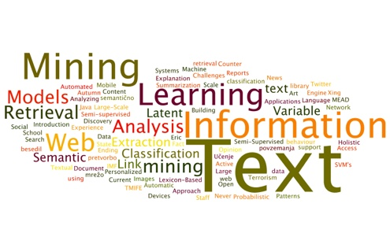
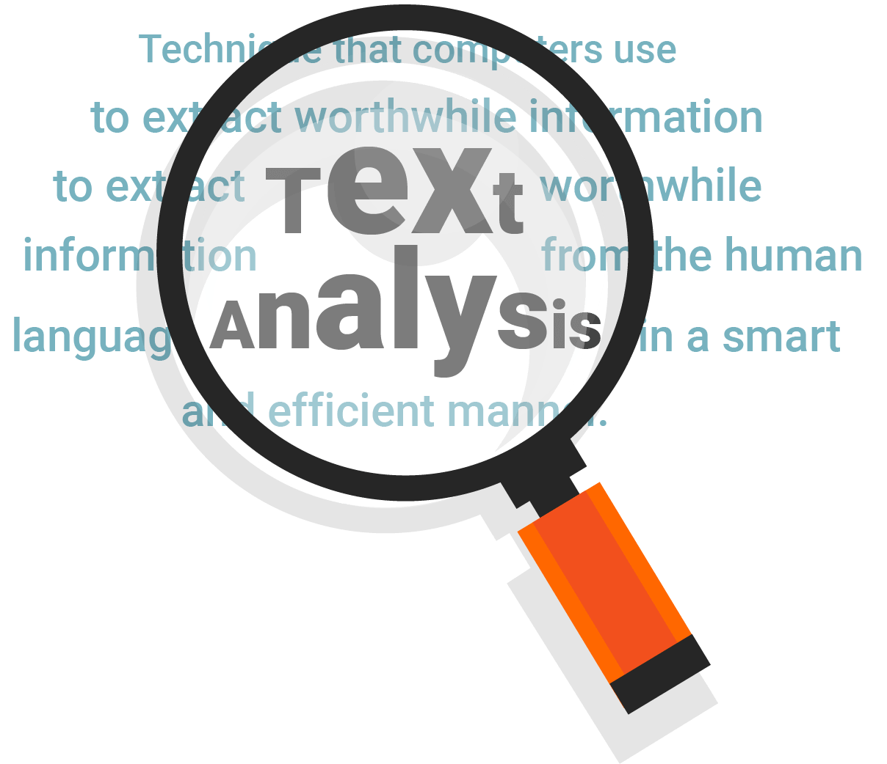
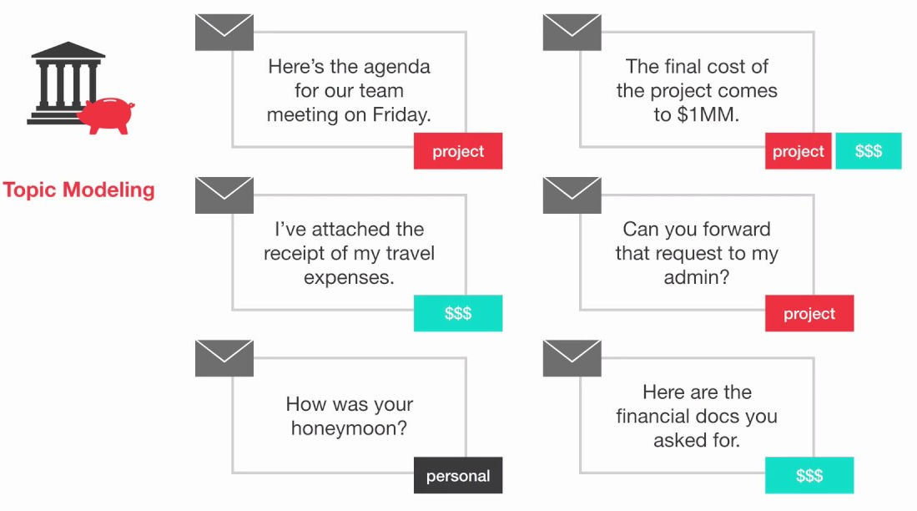
Text Analysis
Text Analysis is the process of analysing unstructured and semi-structured text data for valuable insights, trends and patterns.
Text analysis software/libraries can independently classify, sort, and extract information from text to identify patterns, relationships, sentiments, and another actionable knowledge.
Text analysis is to efficiently and accurately process multiple text-based sources such as emails, documents, social media content, and product reviews, like a human would.

Slide 3
What is the difference between text analysis, text mining and text analytics?

Slide 4
What is the difference between text analysis, text mining and text analytics?
Text analysis, text mining and text analytics are one and the same and are often used interchangeably.

Slide 5
Text Analysis Libraries
SpaCy
TextBlob
NLTK
Genism
PyNLPl

Slide 6
spaCy
spaCy is a free, open-source library for advance Natural Language Processing(NLP) in Python.
If you are working with a lot of text, you will eventually want to know more about it.
For example,
What are the text?
What is the word mean in context?
Who is doing what to whom?
What companies are products are mentioned?
Which texts are similar to each other?

Slide 7
Basic spaCy features
Name | Description
Tokenization | Segmenting text into words, punctuation marks etc.
Part-of-speech (POS) Tagging | Assigning word types to tokens like verb/noun/pro-noun
Dependency Parsing | Assigning syntactic dependency labels, describing the relations between individual tokens, like subject or object.
Lemmatization | Assigning the base form of words. For example, the lemma of “was” is “be”, and the lemma of “rats” is “rat”
Named Entity Recognition | Labelling names “real-word” objects like persons, companies or locations.
Similarity | Comparing words, text spans and documents and how similar they are to each other.

Slide 8
Download spaCy
!pip install -U spacy
!python -m spacy download en_core_web_sm

Slide 9
Importing spaCy
import spacy
text_engine = spacy.load("en_core_web_sm")

Slide 10
Tokenization
During processing, spaCy/text mining first tokenizes the text. i.e. segments it into words, punction and so on. This is done by applying rules specific to each language.
import spacy
text_engine = spacy.load("en_core_web_sm")
doc = text_engine("Apple is looking to buying U.K. startup for $1 billion.")
for token in doc:
print(token.text)

Slide 11
Example:
import spacy
text_engine = spacy.load("en_core_web_sm")
doc = text_engine("Apple is looking to buying U.K. startup for $1 billion.")
for token in doc:
print(token.text, token.pos_,
token.dep_, token.tag_,
token.is_alpha, token.is_stop ,
token.shape, token.lemma_)

Slide 12
Example:
import spacy
text_engine = spacy.load("en_core_web_sm")
doc = text_engine("Apple is looking to buying U.K. startup for $1 billion.")
for token in doc:
print(token.text, token.pos_,
token.dep_, token.tag_,
token.is_alpha, token.is_stop , token.lemma_)
pos: The simple Part of speech tag based on language
dep: Syntactic dependency i.e relation between tokens
tag: The detailed part-of-speech tag
shape: The word shape – capitalization, punctuation, digits.
is alpha : is the token an alpha character?
is stop : is the token part of a stop words list.
lemma: the base form of the word.

Slide 13
Example: Named Entities
A named entity is a “read-world object that’s assigned a name – for example, a person, a country, a product or book title.
import spacy
text_engine = spacy.load("en_core_web_sm")
doc = text_engine("Apple is looking to buying U.K. startup for $1 billion.")
for ent in doc.ents:
print(ent.text, ent.start_char, ent.end_char, ent.label_)

Slide 14
Example: Named Entities
A named entity is a “read-world object that’s assigned a name – for example, a person, a country, a product or book title.
import spacy
text_engine = spacy.load("en_core_web_sm")
doc = text_engine("Apple is looking to buying U.K. startup for $1 billion.")
for ent in doc.ents:
print(ent.text, ent.start_char, ent.end_char, ent.label_)
text: the original entity text
start_char: Index of start of entity in the Doc
end_char: Index of end of the entity in the Doc
label: Entity label i.e. type

Slide 15
Text Analysis Example with spaCy
https://bit.ly/3CpcNWl

