Slide 1

BIG DATA TOOLS FOR MANAGERS
Unit-4 & 5 : Introduction to Python Pandas
by
Ankit Velani
Adjunct Faculty, Dept. of MBA,
Siddaganga Institute of Technology,Tumkur

Slide 2
Comparison with Python Data structure
Lists | Tuple | Set | Dictionary
Lists are mutable | Tuples are immutable. | Sets are mutable | Dictionary are mutable
Lists are enclosed within square braces. [ ] | Tuples are enclosed within parenthesis. ( ) | Sets are enclosed in curly brackets. { } | Dictionaries are enclosed in curly brackets with key-value pairs. { key : value }
List element can be accessed using index/ range of index | Tuple element can be accessed using index/range of index | Have use iteration like for, while loop to access element | Dictionary element can be accessible using its key
len() function used to get length/size of list | len() function used to get length/size of Tuple | len() function used to get length/size of set | len() function used to get length/size of dictionary
Easy to combine two or more lists with + (plus) operator | Easy to combine two or more Tuple with + (plus) operator | union to be used for combining two set | update function used to combine two dictionary

Slide 3
Exercise
Create a List with given element [10,20,30,40,50,60,70,80,90,100]
Write a python code for :
Create a List
Print element using print()
Print element using iteration (For loop)
Multiply list elements with number 2
Display first element of list
Display last element of list
Display first 3 elements of list
Display last 3 elements of list

Slide 4
Exercise
# Create a dictionary for Employee data
employee_Name : John
employee_City : Bangalore
employee_Mobile: 9876512345
employee_Email : john@gmail.com
Write a python code for :
Create a employee dictionary
Display all the key present in dictionary
Display all the value present in dictionary
Print Dictionary element
Access dictionary element using employee_Name
Access dictionary element using employee_Email

Slide 5
About Pandas
Pandas is an open-source Python library providing high-performance data manipulation and analysis tool using its powerful data structure.
The name panda is derived from the word Panel Data.
In 2008 panda library introduced for high performance, flexible tool for analysis of data.
Python with Pandas is used in a wide range of fields including academic and commercial domains including finance, economics, Statistics, analytics, etc.

Slide 6
Key Features of Pandas
Fast and efficient DataFrame object with default and customized indexing.
Tools for loading data into in-memory data objects from different file formats.
Data alignment and integrated handling of missing data.
Label-based slicing, indexing and sub-setting of large data sets.
Columns from a data structure can be deleted or inserted.
Group by data for aggregation and transformations.
High performance merging and joining of data.
Time Series functionality.

Slide 7

Where to get pandas library?

Slide 8
Where to get pandas library?
Download pandas library from an internet using pip package manager
pip install pandas

Slide 9
how to import pandas library?
import statement used to import the pandas or any other libraries in Python.
import pandas
or
as keyword helps to create alias name of the package.
This helpful when package name is too large.
import pandas as pd
or
import pandas as xyz

Slide 10
Data Frames in R
Creation of data frame
my_data <- data.frame(
name = c(“A”,”B”,”C”,”D”),
age = c(40,45,70,60),
gender = c(“F”,”M”,”F”,”M”)
)
name, age, gender are the vectors
Output:
Name | Age | gender
A | 40 | F
B | 45 | M
C | 70 | F
D | 60 | M

Slide 11
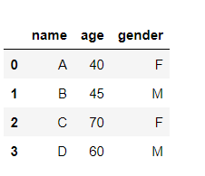
Data Frames in Python
Creation of data frame in Python
import pandas as pd
my_data = pd.DataFrame(
{
"name" :["A","B","C","D"],
"age" : [40,45,70,60],
"gender" :["F","M","F","M"]
}
)
name, age, gender are the dictionary key
Output:

Slide 12
Import files using Pandas
Pandas library has provided different methods for loading datasets with many different formats onto DataFrame.
*** Once data loaded into memory pandas creates Pandas DataFrame automatically for easy to manipulate data.
File format pandas support:
csv, json, excel, table, fwf(fixed with format)
Read function looks like:
read_csv()
read_excel()
read_table()

Slide 13
Import csv file using Pandas
Pandas has read_csv functions to read the csv file.
Example:
# Download dataset and save in C:/dataset location
https://drive.google.com/file/d/1EPQhl0wVCZnNP1vx7BE43phOUljzZXGD/view?usp=sharing

Slide 14
Import csv file using Pandas
Pandas has read_csv functions to read the csv file.
Example:
import pandas as pd
pd.read_csv("C:/dataset/VEHICLE_PARK.csv")
or
import pandas
pandas.read_csv("C:/dataset/VEHICLE_PARK.csv")

Slide 15
Import csv file using Pandas
Pandas has read_csv() functions to read the csv file.
After importing csv file, store the data in any variable.
Example:
import pandas as pd
data = pd.read_csv("C:/dataset/VEHICLE_PARK.csv")
Now, data variable having entire csv file data in form of rows & cols.

Slide 16
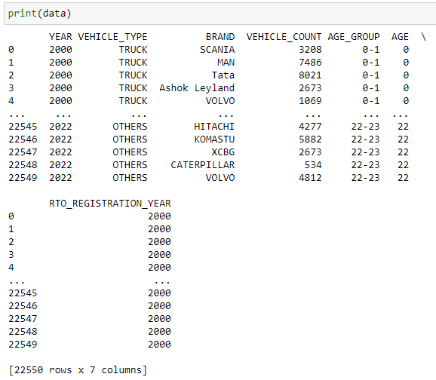
Python Pandas
print() function to display the data frame values
Example:
print(data)
Output:

Slide 17
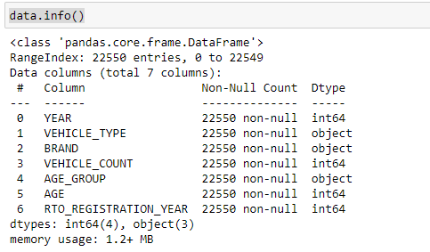
Python Pandas
info() Function to get the structure of Pandas DataFrame
Example:
data.info()
Output:

Slide 18

Python Pandas
shape is properties to get the no of rows & columns of DataFrame
Example:
data.shape
Output:

Slide 19
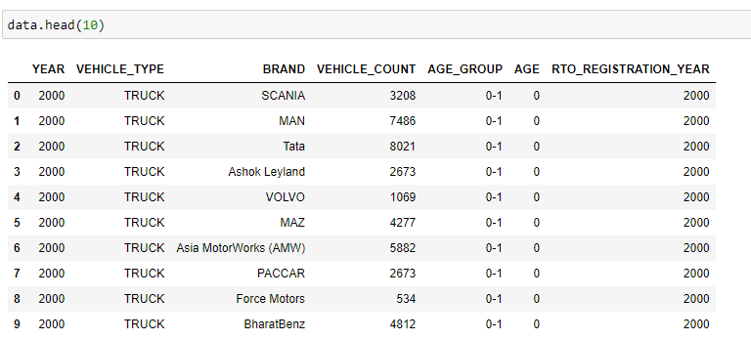
Python Pandas
head(n) & tail(n) are the functions to display top and bottom rows from the pandas DataFrame.
Example:
data.head(10)
data.tail(10)
Output:

Slide 20
Python Pandas
Column selection
[‘col-name’] – for selecting single column
[[‘col-name-1’,’col-name-2’,…..’col-name-n’]] - for selecting multiple columns
Example:
data['YEAR'] #One column
data[['YEAR', 'AGE_GROUP']] # Multiple columns

Slide 21
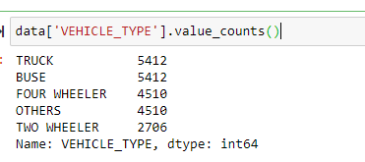
Python Pandas
value_counts(normalize=False) function Gives frequency of each unique value in a column
normalize=True will calculate the percentage of total frequency.
Example:
data['VEHICLE_TYPE'].value_counts()

Slide 22
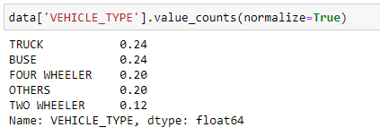
Python Pandas
value_counts(normalize=False) function Gives frequency of each unique value in a column
normalize=True will calculate the percentage of total frequency.
Example:
data['VEHICLE_TYPE']. value_counts(normalize=True)

Slide 23
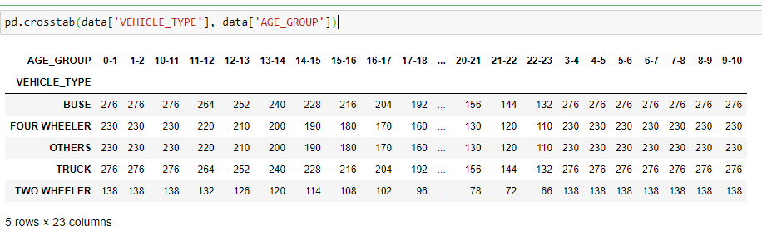
Python Pandas
crosstab() function Gives frequency of two columns.
Example:
pd.crosstab(data['VEHICLE_TYPE'], data['AGE_GROUP’])

Slide 24
Python Pandas
crosstab() function Gives frequency of two columns.
Example:
pd.crosstab(data['VEHICLE_TYPE'], data['AGE_GROUP’])

Slide 25
Python Pandas
sort_values(col-name, ascending=False) function sort the DataFrame based on the specified columns.
By default, sorting is done in ascending order.
Example (Single Column):
data.sort_values(["BRAND"], ascending=[False])
or
data.sort_values("BRAND", ascending=False)

Slide 26
Python Pandas
sort_values(col-name, ascending=False) function sort the DataFrame based on the specified columns.
By default, sorting is done in ascending order.
Example (Multi Columns):
data.sort_values(
['BRAND', 'VEHICLE_COUNT'],
ascending=[True, False]
)

Slide 27
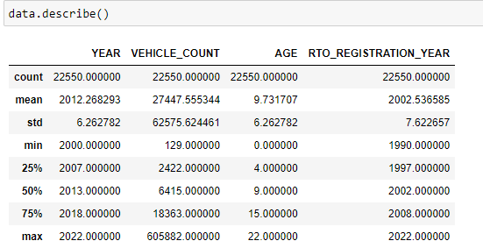
Python Pandas
describe() function to display quick summary of the DataFrame. By default, it gives summary for numeric data only.
Example
data.describe()

Slide 28
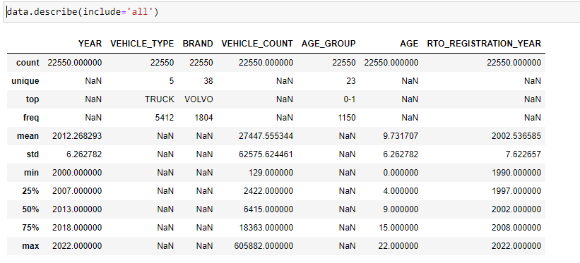
Python Pandas
describe() function to display quick summary of the DataFrame. By default, it gives summary for numeric data only.
describe(include=‘all’) function with include=‘all’ gives summary for all the columns available in DataFrame
Example
data.describe(include='all')

Slide 29
Python Pandas
describe() function to display quick summary of the DataFrame. By default, it gives summary for numeric data only.
describe(include=‘all’) function with include=‘all’ gives summary for all the columns available in DataFrame
Example
data.describe(include='all')

Slide 30
Python Pandas
describe() function to display quick summary of the DataFrame. By default, it gives summary for numeric data only.
describe(include=‘all’) function with include=‘all’ gives summary for all the columns available in DataFrame
Example
data.describe(include='all')

Slide 31
Python Pandas
Aggregate functions like count, sum, min, max, mean…etc can be applied on DataFrame.
Example
#Single Column to Count number of elements present
data['YEAR'].count()
#Multiple Cols, Count number of elements present
data[['YEAR', 'AGE']].count()
#all the columns
data.count()

Slide 32
Python Pandas
Aggregate functions like count, sum, min, max, mean…etc can be applied on DataFrame.
Example
#Single Column, check Avg values for Age column
data['AGE'].mean()
#Multiple Cols, check Avg values for Age, Vehicle Count columns
data[['AGE', 'VEHICLE_COUNT']].mean()
#all the columns (categorical values get excluded)
data.mean()

Slide 33
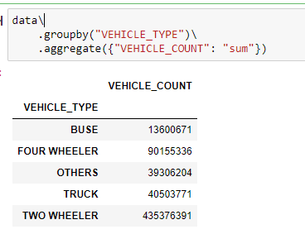
Python Pandas
groupby() functions to group the records based on specified columns and then apply for aggregation (max, min, sum, mean…etc)
Example
#Single Column, get the total number of vehicles by VEHICLE_TYPE
data\
.groupby("VEHICLE_TYPE")\
.aggregate({"VEHICLE_COUNT": "sum"})

Slide 34
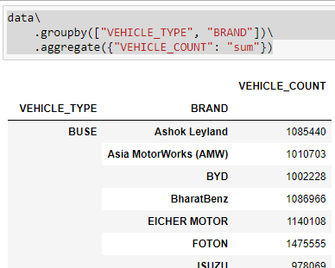
Python Pandas
groupby() functions to group the records based on specified columns and then apply for aggregation (max, min, sum, mean…etc)
Example
#Multi Column, get the total number of vehicles by VEHICLE_TYPE, BRAND
data\
.groupby(["VEHICLE_TYPE", "BRAND"])\
.aggregate({"VEHICLE_COUNT": "sum"})

Slide 35
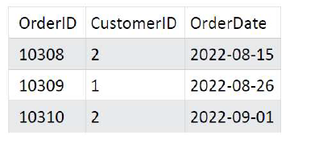
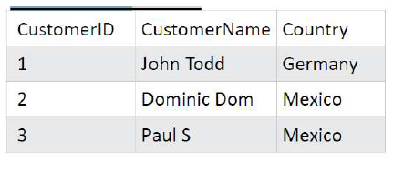
Python Pandas
merge() functions to join multiple DataFrame based on the column columns and nature of join.
Before doing join, first create two sample dataframe.
DataFrame : Orders
DataFrame : Customers

Slide 36
Python Pandas
# Step-1 Create dictionary
orders_dictionary ={
"OrderID" : [10308, 10309, 10310],
"CustomerID" : [2,1,2],
"OrderDate“ : ["2022-08-15", "2022-08-26", "2022-09-01"]
}

Slide 37
Python Pandas
# Step-1 Create dictionary
orders_dictionary ={
"OrderID" : [10308, 10309, 10310],
"CustomerID" : [2,1,2],
"OrderDate“ : ["2022-08-15", "2022-08-26", "2022-09-01"]
}
# Step-2 Create Pandas DataFrame
Orders = pd.DataFrame(orders_dictionary)

Slide 38
Python Pandas
# Step-1 Create dictionary
customer_dictionary = {
"CustomerID" : [1,2,3],
"CustomerName" : ["John Todd", "Dominic Dom", "Paul S"],
"Country" : ["Germany", "Maxico", "Maxico"]
}
# Step-2 Create Pandas DataFrame
Customers = pd.DataFrame(customer_dictionary)

Slide 39
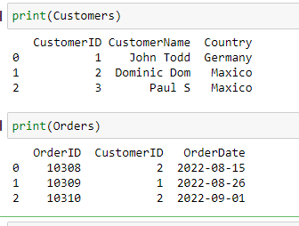
Python Pandas
# Step-3 Display the Orders & Customers DataFrame
print(Customers)
print(Orders)

Slide 40
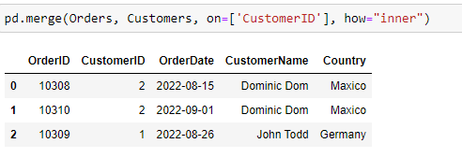
Python Pandas
# Step-4 Perform inner join
pd.merge(Orders, Customers, on=['CustomerID'], how="inner")

Slide 41
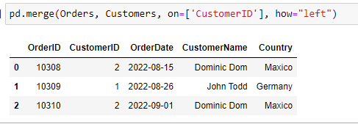
Python Pandas
# Step-5 Perform left join
pd.merge(Orders, Customers, on=['CustomerID'], how="left")

Slide 42
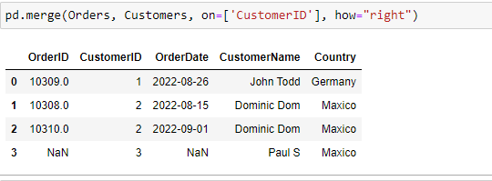
Python Pandas
# Step-6 Perform right join
pd.merge(Orders, Customers, on=['CustomerID'], how="right")

Slide 43
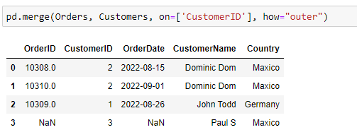
Python Pandas
# Step-7 Perform full join
pd.merge(Orders, Customers, on=['CustomerID'], how="outer")

Slide 44
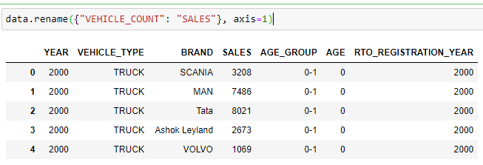
Python Pandas
rename() functions to rename the columns in DataFrame
data-frame.rename({“col-name”: “new-col-name”}, axis=1)
axis=1 represent column axis
axis=0 represent row axis
Example:
data.rename({"VEHICLE_COUNT": "SALES"}, axis=1)

Slide 45
Python Pandas
rename() functions to rename the columns in DataFrame.
Inplace additional parameters to specify with rename function, to rename column name permanently.
Syntax:
data-frame.rename({“col-name”: “new-col-name”},
axis=1,
inplace=True)
Example:
data.rename({"VEHICLE_COUNT": "SALES"},
axis=1,
inplace=True)

Slide 46
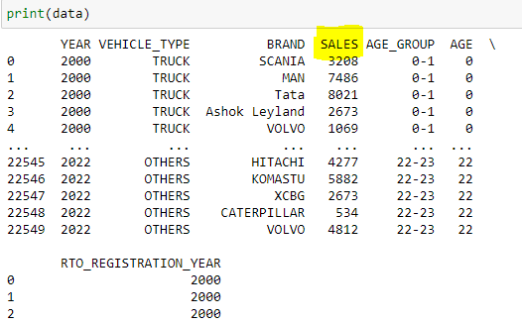
Python Pandas
Example:
data.rename({"VEHICLE_COUNT": "SALES"},
axis=1,
inplace=True)
print(data)

Slide 47
Python Pandas
drop() functions to delete columns from DataFrame.
Inplace additional parameters to specify with drop function, to delete column name permanently.
Syntax:
data-frame.drop({“col-name”: “new-col-name”},
axis=1,
inplace=True)
Example:
data.drop(["YEAR", "BRAND"], axis=1, inplace=True)

Slide 48
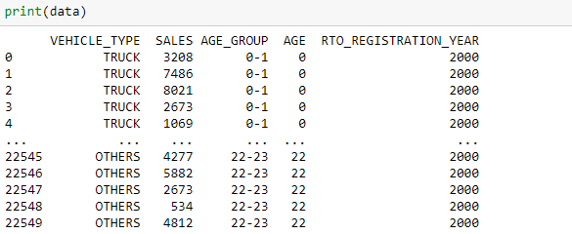
Python Pandas
Example:
data.drop(["YEAR", "BRAND"], axis=1, inplace=True)
print(data)

Slide 49
Python Pandas
Panda DataFrame allows to write conditions to filter out the data.
Syntax:
data-frame[conditions]
Example: display 10 years old vehicles from DataFrame
data[data['AGE']==10]

Slide 50
Python Pandas
Panda DataFrame allows to write conditions to filter out the data.
Multiple conditions can be combine with the help of logical operator ie. AND (&), OR (|)
Syntax:
data-frame[conditions]
data-frame[(conditions-1) & (conditions-2)] #AND(&) condition
data-frame[(conditions-1) I (conditions-2)] #OR(I) condition
Example: display 10 years old FOUR WHEELER vehicles from DataFrame
data[ (data['AGE']==10) &
(data['VEHICLE_TYPE']=='FOUR WHEELER')
]

Slide 51
Data Visualization
Python Libraries used for generating graphs
Matplotlib
Seaborn
Download data visualization libraries
pip install matplotlib
pip install seaborn

Slide 52
Data Visualization
Importing Matplotlib & Seaborn libraries
import matplotlib.pyplot as plt
import seaborn as sn
%matplotlib inline

Slide 53
Data Visualization Functions
Bar Graphs Syntax
sn.barplot(x=, y=, data=)
sn.barplot(x=, y=, hue= ,data=)

Slide 54
Data Visualization
Histogram
plt.hist(x, bins=)
Distribution or Density Plot
sn.distplot(x=)
Boxplot
sn.boxplot(x=, data=)
sn.boxplot(x=,y=, data=)

Slide 55
Data Visualization
Pairplot
sn.pairplot(df[selected-columns])
sn.pairplot(df) #For all the columns
Heatmap
sn.heatmap(df[selected-columns].corr(), annot=True)
***annotate show the data values on graph

