Slide 1
BIG DATA TOOLS FOR MANAGERS (N2MBA07)
Unit -1 : Overview of Database, SQL and MySQL

Slide 2





Database
?

Slide 3
A database is an organized collection of structured information or data, typically stored electronically in a computer system.
Database

Slide 4
A database is an organized collection of structured information or data, typically stored electronically in a computer system. Or The database is an organized collection of data so that, it can be easy to access and manipulate stored information.
Database

Slide 5

Database
Unorganized collection of data

Slide 6
Database
Unorganized collection of data
Organized collection of data

Slide 7

Database Example :
Consider college database organizes the data about the admin, students, libraries, and faculty.
Using the database, it can be easy to retrieve, insert, and delete information.
College Database
Former faculties
Students
Faculty
Alumnus
Faculties
Students
New admission
Hostel Block
Admission Inquiry
Hostel
Hostel Staff
Dropout

Slide 8
Assume that we have some data how do to manage it ?

Slide 9
Assume that we have some data how do to manage it ?
Using File

Slide 10
Assume that we have some data how do to manage it ?
Using File
Using Database

Slide 11
File based approach
File base approach/File Management system used to manage data needed for a specific use case or application.
Each user stores separate data for the application even if the same data stored by another user.
Like College, there are multiple department such as admin, hostel, library, exam each departments are maintaining student details separately
If there are 100 students and 5 departments then will be storing 5x100 = 500 records but storing details in 5 different places.

Slide 12
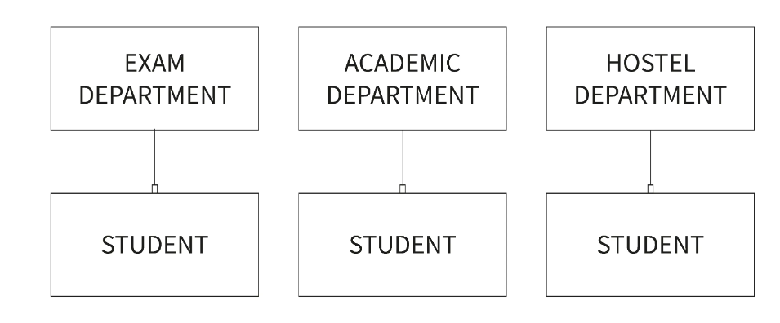
File Based Approach

Slide 13
File Based Approach
**Major drawback of the file-based approach is that containing repetition of data and wastage of resources.

Slide 14
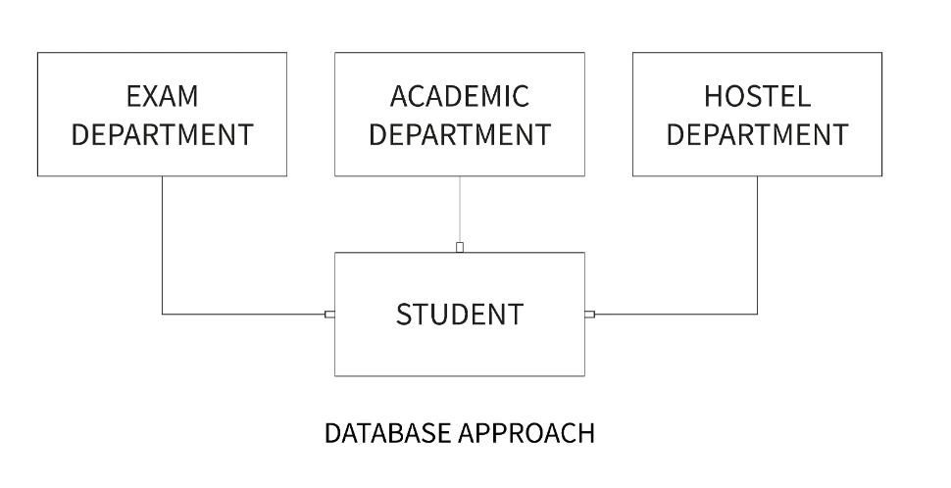
Database Approach
A database is used for storing and maintaining the data where data defined once and stored in single location, it available for multiple users or departments.

Slide 15
Characteristics of Database approach
Self-Describing Nature of a Database System

Slide 16
Characteristics of Database approach
Self-Describing Nature of a Database System
Insulation between Programs and Data, Data Abstraction and Multi-user Transaction Processing

Slide 17
Characteristics of Database approach
Self-Describing Nature of a Database System
Insulation between Programs and Data, Data Abstraction and Multi-user Transaction Processing
Support of Multiple Views of the Data

Slide 18
Characteristics of Database approach
Self-Describing Nature of a Database System
Insulation between Programs and Data, Data Abstraction and Multi-user Transaction Processing
Support of Multiple Views of the Data
Data Protection

Slide 19
Characteristics of Database approach
Self-Describing Nature of a Database System
Insulation between Programs and Data, Data Abstraction and Multi-user Transaction Processing
Support of Multiple Views of the Data
Data Protection
Supports Query Language to perform database operation effectively.

Slide 20
Characteristics of Database approach
Self-Describing Nature of a Database System
Insulation between Programs and Data, Data Abstraction and Multi-user Transaction Processing
Support of Multiple Views of the Data
Data Protection
Supports Query Language to perform database operation effectively.

Slide 21

Database management system
A database management system (DBMS) is a software tool that helps to organize, store and retrieve data from a database.
It involves several functions that collectively work together to ensure that the data is accurate, available and accessible.

Slide 22
DBMS Elements
Database management system consists of three main elements
A physical database that contains the data

Slide 23
DBMS Elements
Database management system consists of three main elements
A physical database that contains the data
A database engine that helps to access the data and modify its contents.

Slide 24
DBMS Elements
Database management system consists of three main elements
A physical database that contains the data
A database engine that helps to access the data and modify its contents.
A database schema which provides the logical structure of the data stored in the database.

Slide 25

Types of Database Management System
Relational database management system
Distributed database management system
Network database management system
Object-oriented database management system
Hierarchical database management system

Slide 26
Relational Database Management System (RDBMS)
A relational database management system or RDBMS is a database system that stores and fetches data in the form of tables.

Slide 27
Relational Database Management System (RDBMS)
A relational database management system or RDBMS is a database system that stores and fetches data in the form of tables.
How does a Relational database work?

Slide 28
Relational Database Management System (RDBMS)
A relational database management system or RDBMS is a database system that stores and fetches data in the form of tables.
How does a Relational database work?
Relational databases use tables to store data about related objects. Each column contains data attributes, whereas each row holds a record of unique data elements.
Relational databases or RDBMS are managed using SQL.

Slide 29

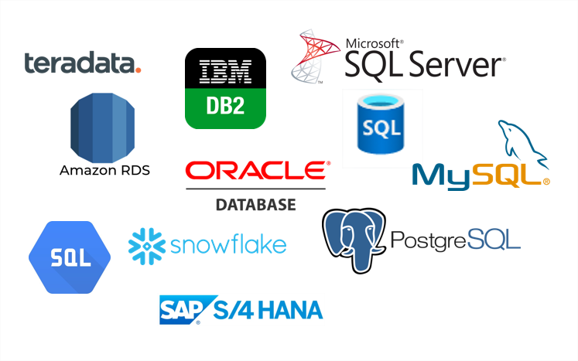
RDBMS Software
MySQL is currently the most popular database management system software used for managing the relational database.
It is open-source database software, which is supported by Oracle Company.
**Other RDBMS Software

Slide 30
In RDBMS terminologies
Columns/Fields/Attributes
EMP_ID | NAME | ADDRESS | AGE
1 | Rahul | Bengaluru | 23
2 | Suman | Kolkata | 25
3 | Raj | Delhi | 30
Records/
Tuples/
Rows

Slide 31
In RDBMS terminologies
Attribute: Attributes are properties that define the relational database. Eg: EMP_ID, NAME etc

Slide 32
In RDBMS terminologies
Attribute: Attributes are properties that define the relational database. Eg: EMP_ID, NAME etc
Relation Schema: A relational schema defines its relationship with other attributes alltogether. E.g., EMPLOYEE (EMP_ID, NAME, ADDRESS, AGE)

Slide 33
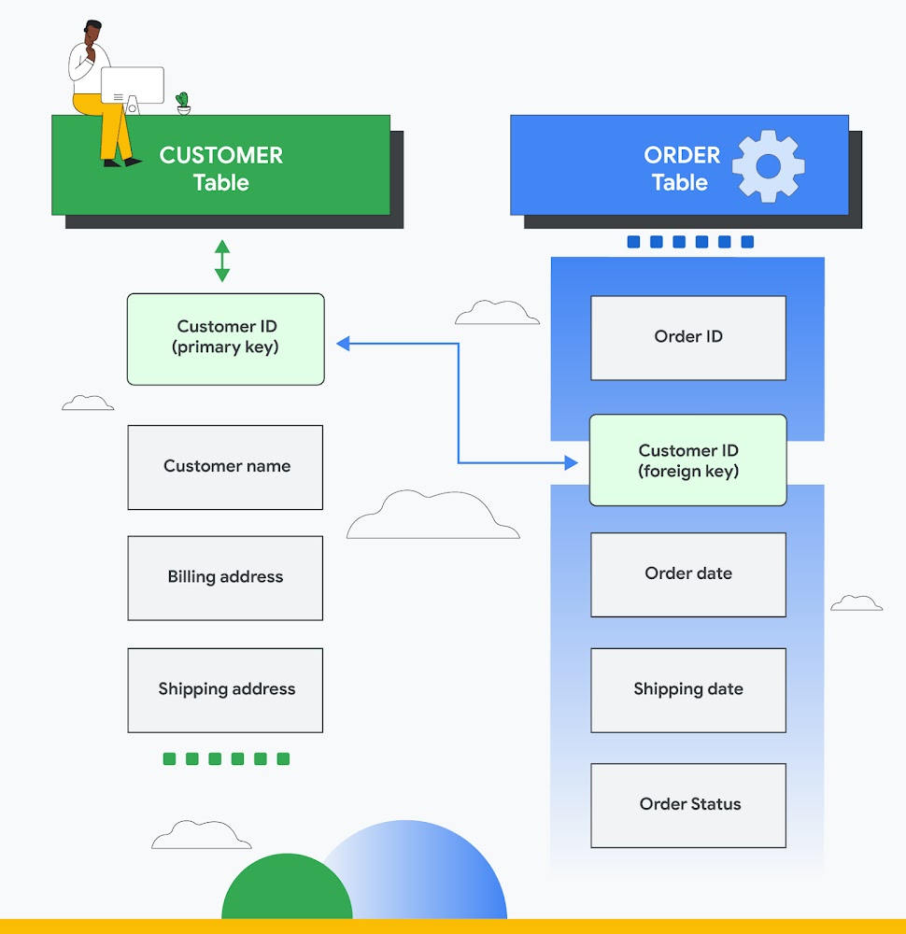

Slide 34
In RDBMS terminologies
Attribute: Attributes are properties that define the relational database. Eg: EMP_ID, NAME etc
Relation Schema: A relational schema defines its relationship with other attributes alltogether. E.g., EMPLOYEE (EMP_ID, NAME, ADDRESS, AGE)
Degree: Degree is defined by several attributes we have in a relational table. E.g., The degree of the EMPLOYEE table is 4

Slide 35
In RDBMS terminologies
Attribute: Attributes are properties that define the relational database. Eg: EMP_ID, NAME etc
Relation Schema: A relational schema defines its relationship with other attributes alltogether. E.g., EMPLOYEE (EMP_ID, NAME, ADDRESS, AGE)
Degree: Degree is defined by several attributes we have in a relational table. E.g., The degree of the EMPLOYEE table is 4
Cardinality: Cardinality is defined by the number of tuples in a relation. E.g., The cardinality of the EMPLOYEE table is 3.

Slide 36
In RDBMS terminologies
Attribute: Attributes are properties that define the relational database. Eg: EMP_ID, NAME etc
Relation Schema: A relational schema defines its relationship with other attributes alltogether. E.g., EMPLOYEE (EMP_ID, NAME, ADDRESS, AGE)
Degree: Degree is defined by several attributes we have in a relational table. E.g., The degree of the EMPLOYEE table is 4
Cardinality: Cardinality is defined by the number of tuples in a relation. E.g., The cardinality of the EMPLOYEE table is 3.
NULL Values: The values or data which are unknown are kept as NULL.

Slide 37
SQL
SQL is a standard programming language used to operate Relational databases and carry out various operations such as inserting, manipulating, updating, and retrieving data from relational databases.
SQL is not a database system, but it is a query language.
SQL is a short-form of the structured query language, and it is pronounced as S-Q-L or sometimes as See-Quell.

Slide 38
SQL
SQL is a standard programming language used to operate Relational databases and carry out various operations such as inserting, manipulating, updating, and retrieving data from relational databases.
SQL is not a database system, but it is a query language.
SQL is a short-form of the structured query language, and it is pronounced as S-Q-L or sometimes as See-Quell.
OR
This database language is mainly designed for maintaining the data in relational database management systems.
It is a special tool used by data professionals for handling structured data (data which is stored in the form of tables)

Slide 39
Features of SQL
RDBMS only understand SQL command and instruction to perform any kind of operation.
SQL is used to access data within the relational database.
SQL is very fast in extracting large amounts of data very efficiently.
SQL is flexible as it works with multiple database systems from Oracle, IBM, Microsoft, etc.
SQL helps to manage databases without knowing a lot of coding.

Slide 40
Some SQL Commands
The SQL commands help in creating and managing the database.
The most common SQL commands which are highly used are mentioned below:
CREATE command
INSERT command
SELECT command
UPDATE command
DELETE command
DROP command

Slide 41
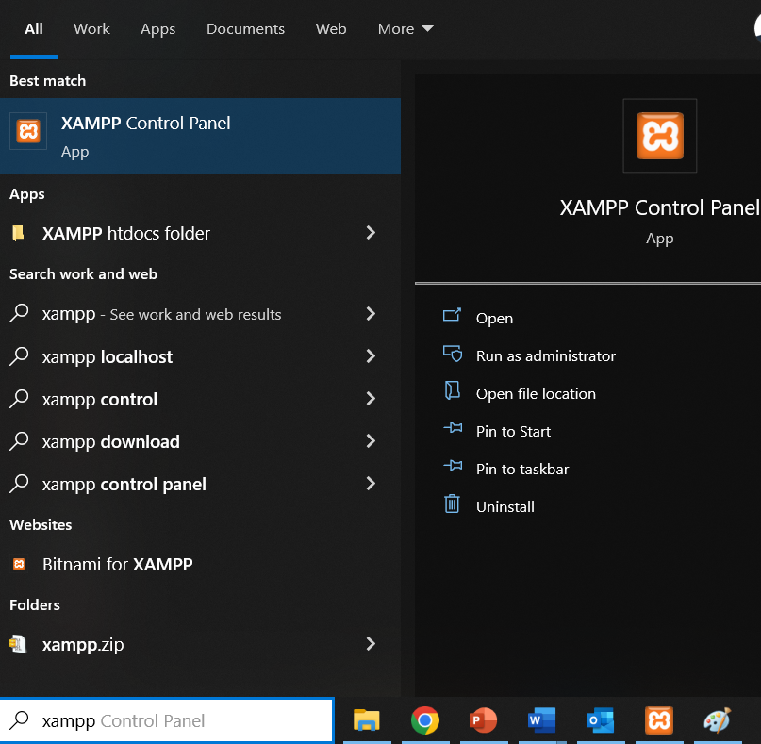
Working with MYSQL (XAMPP phpMyAdmin)
Start XAMPP application from all programs in Windows laptop

Slide 42
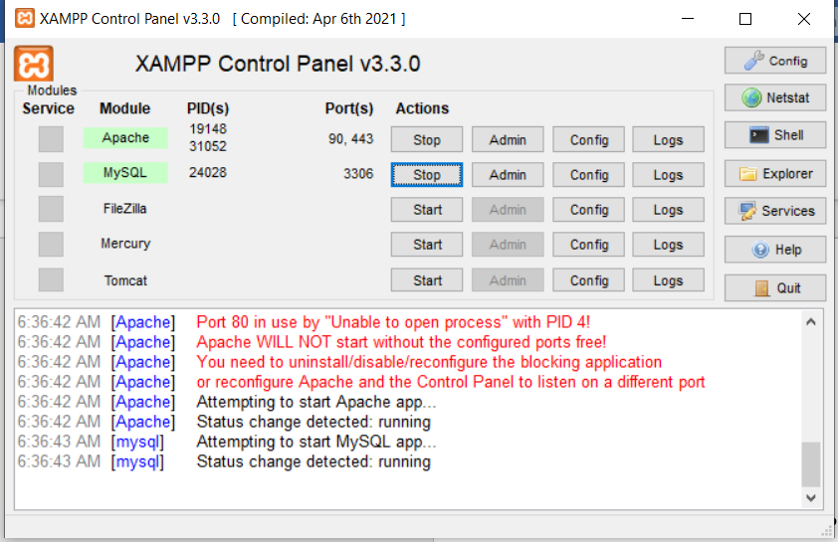
Working with MYSQL (XAMPP phpMyAdmin)
Start Apache & MySQL services on XAMPP control panel

Slide 43
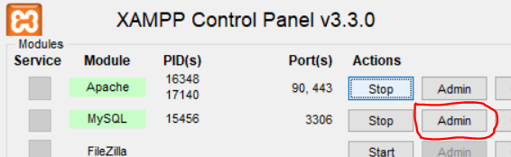
Working with MYSQL (XAMPP phpMyAdmin)
Start Apache & MySQL services on XAMPP control panel
Once both services are running click on Admin button of MySQL services. It will take you on web browser with URL like
http://localhost/phpmyadmin
http://localhost:8080/phpmyadmin
http://localhost:90/phpmyadmin

Slide 44
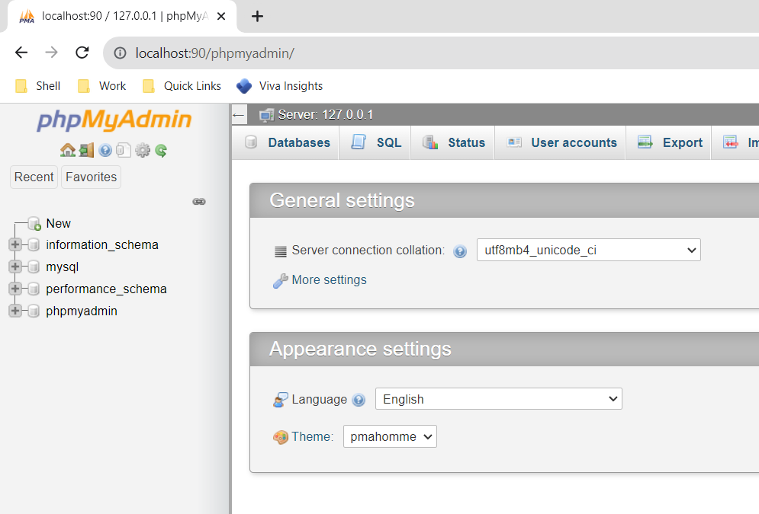
Working with MYSQL (XAMPP phpMyAdmin)
phpMyAdmin home page on web browser

Slide 45
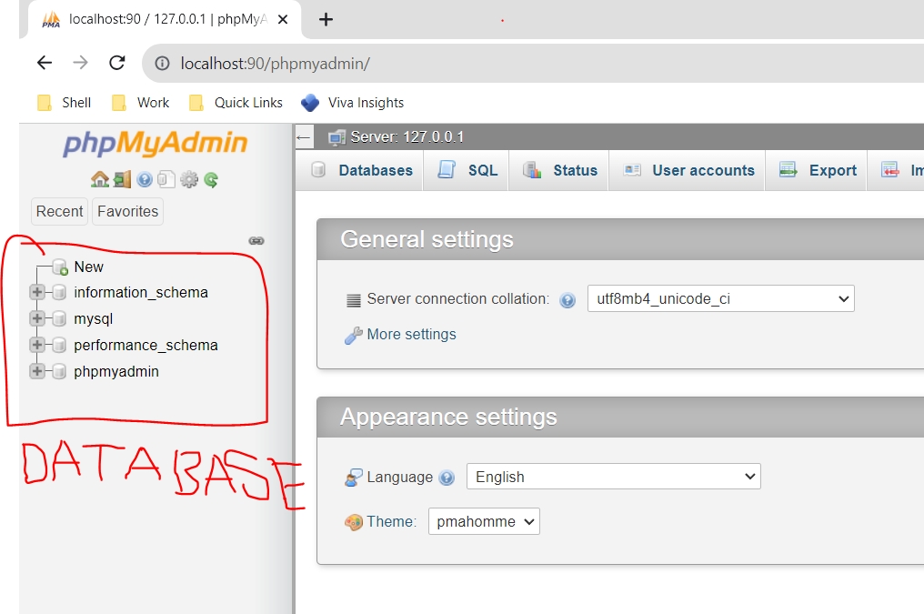
Working with MYSQL (XAMPP phpMyAdmin)
On left panel it contains all the database available on MySQL server.

Slide 46
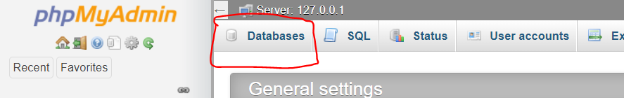
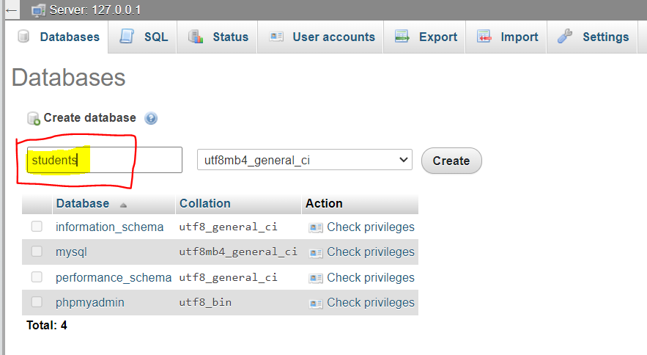
Working with MYSQL (XAMPP phpMyAdmin)
Creation of Database: Click on database on top row of phpMyAdmin
Type database name and click on Create button

Slide 47
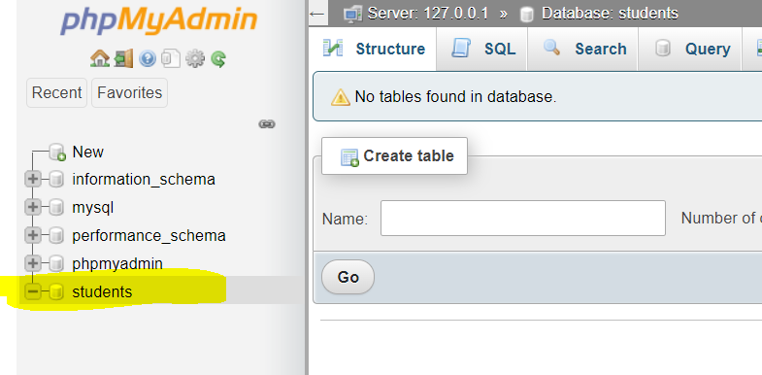
Working with MYSQL (XAMPP phpMyAdmin)
Once database created it will show in left panel windows.

Slide 48
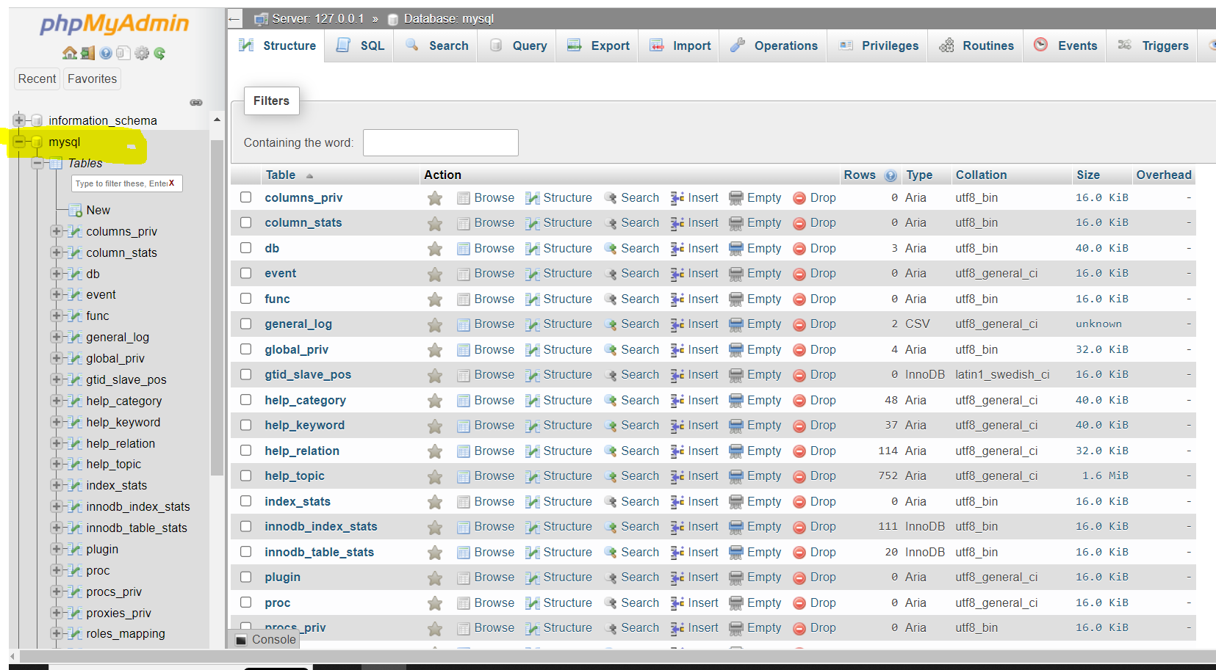
Working with MYSQL (XAMPP phpMyAdmin)
Selecting Databases
Clicking on database name it will get selected for data manipulation, and display lists of tables available in selected database.

Slide 49
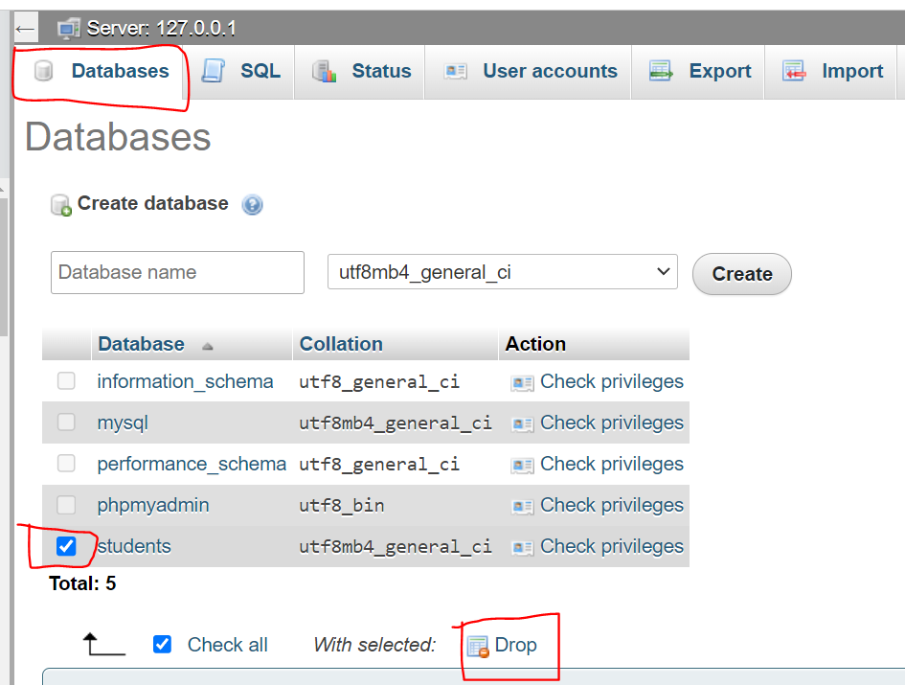
Working with MYSQL (XAMPP phpMyAdmin)
Drop Databases
Dropping database means deleting database from MySQL software.

Slide 50
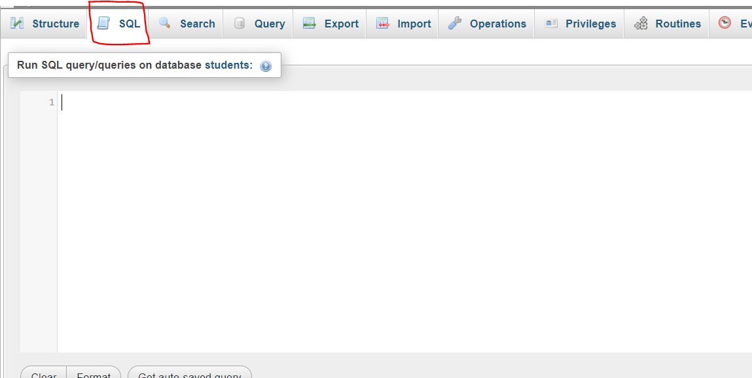
XAMPP - SQL Window
On top row of phpMyAdmin SQL button is available, click on SQL button gives SQL windows to write SQL commands / statements/ instructions.

Slide 51
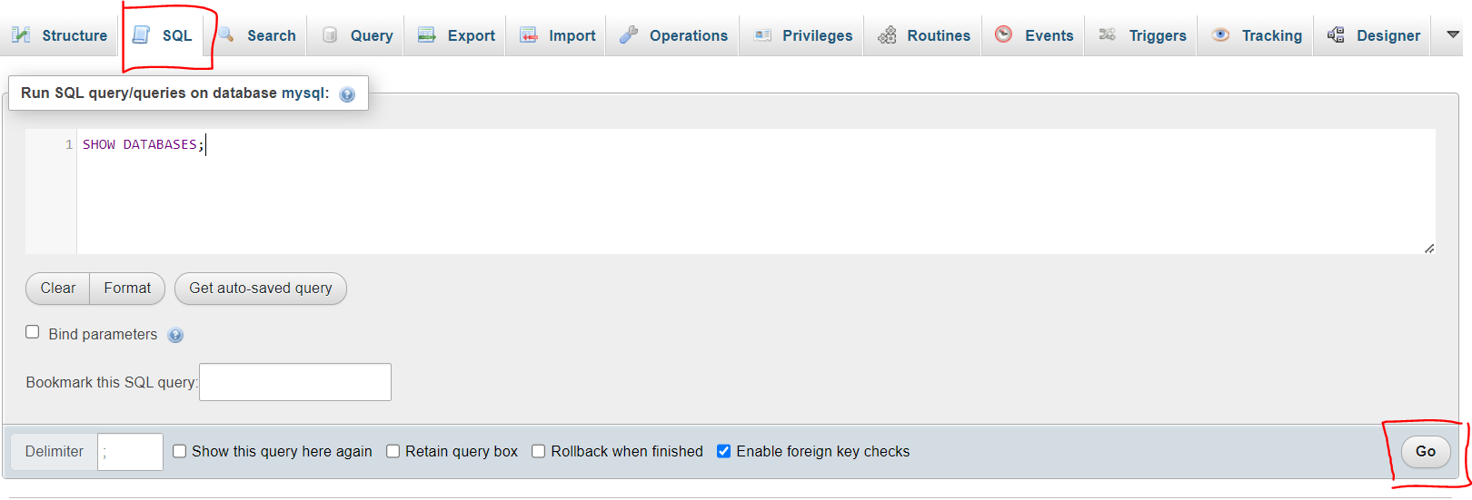
XAMPP - SQL Window
SQL Statement execution
SHOW DATABASES;

Slide 52
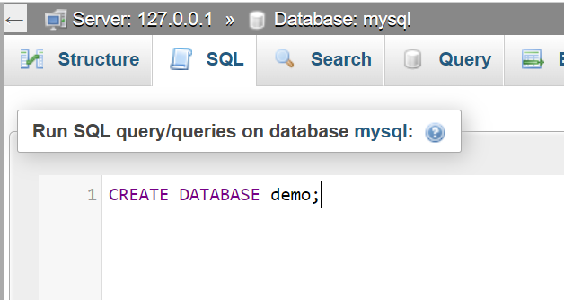
XAMPP - SQL Window
SQL Statement – Create new database “demo” using SQL command/statement in MySQL
CREATE DATABASE demo;

Slide 53
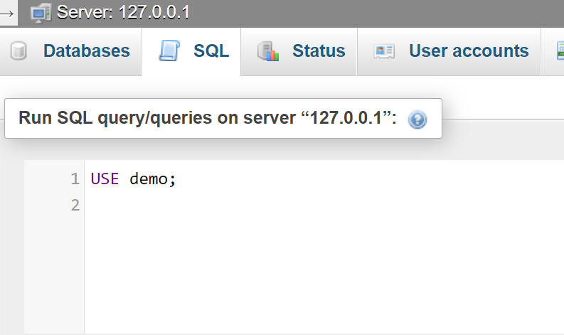
XAMPP - SQL Window
SQL Statement – Select “demo” database using SQL command/statement in MySQL
USE demo;

Slide 54
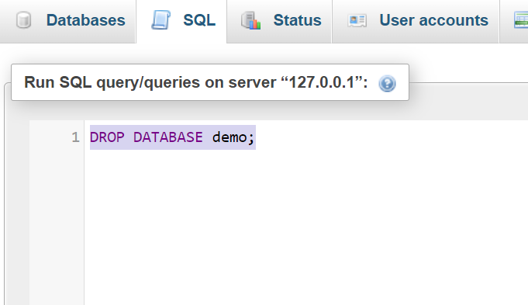
XAMPP - SQL Window
SQL Statement – Delete/Drop “demo” database using SQL command in MySQL
DROP DATABASE demo;

Slide 55
Recap
Getting familiar with XAMPP → MySQL (Start & Stop services)

Slide 56
Recap
Getting familiar with XAMPP → MySQL (Start & Stop services)
Getting familiar with phpMyAdmin(MySQL) windows.

Slide 57
Recap
Getting familiar with XAMPP → MySQL (Start & Stop services)
Getting familiar with phpMyAdmin(MySQL) windows.
Creating/Selecting/Deleting database using Navigation as well as SQL statement.

Slide 58
Exercises
Create EMPLOYEE database using SQL Statements/Command, write all the commands in a notebook and then execute in SQL windows.
LIST ALL the Database available in MySQL
CREATE EMPLOYEE statement
LIST ALL Database available in MySQL
USE EMPLOYEE statement
LIST ALL TABLE present in EMPLOYEE database

Slide 59
Exercises
Create MOVIE database using phpMyAdmin Navigation bar, create document file and copy paste the screenshot for each point.
CREATE MOVIE database
SELECT MOVIE database
Check are there any tables for MOVIE database

Slide 60
Till now…..
Database

Slide 61
Till now…..
Database
Example:
EMPLOYEE
MOVIE
demo
students

Slide 62
Till now…..
Database
What Next ?
Example:
EMPLOYEE
MOVIE
demo
students

Slide 63
What Next?
Tables
Table-1
Table-2
Table-3
Table-4
demo
Database

Slide 64
Working with Tables
Step-1 : Create EMPLOYEE database
CREATE DATABASE EMPLOYEE;
Step-2 : Select EMPLOYEE database
USE EMPLOYEE;

Slide 65
Working with Tables
Step-3 : Create employee_details table in EMPLOYEE database.
USE EMPLOYEE;
CREATE TABLE employee_details
(
ID text ,
NAME text ,
MOBILE text ,
CITY text
);

Slide 66
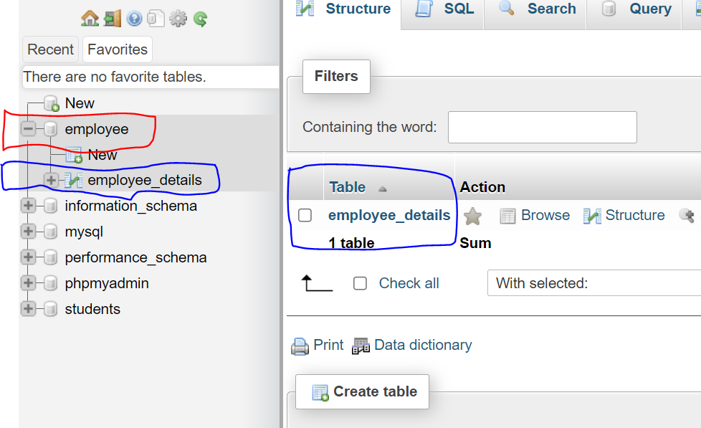
Working with Tables
Step-4 : Select EMPLOYEE database on left panel, employee_details table will be available

Slide 67
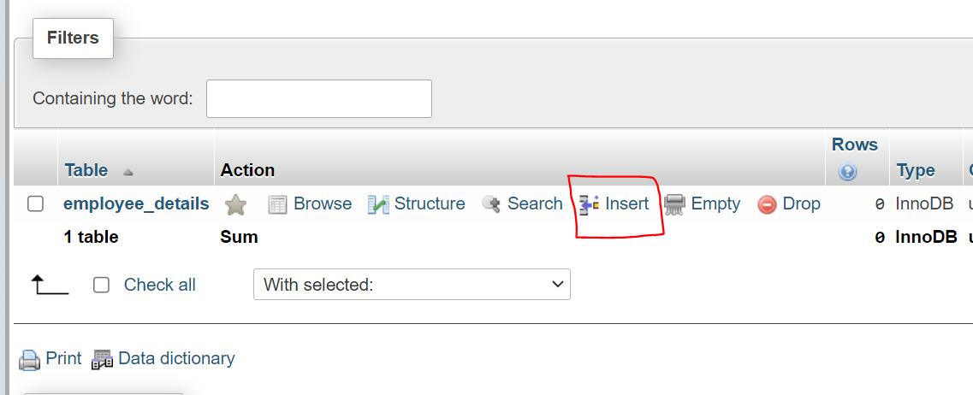
Working with Tables
Step-5 : Insert records in Table, select insert link on Table list.

Slide 68
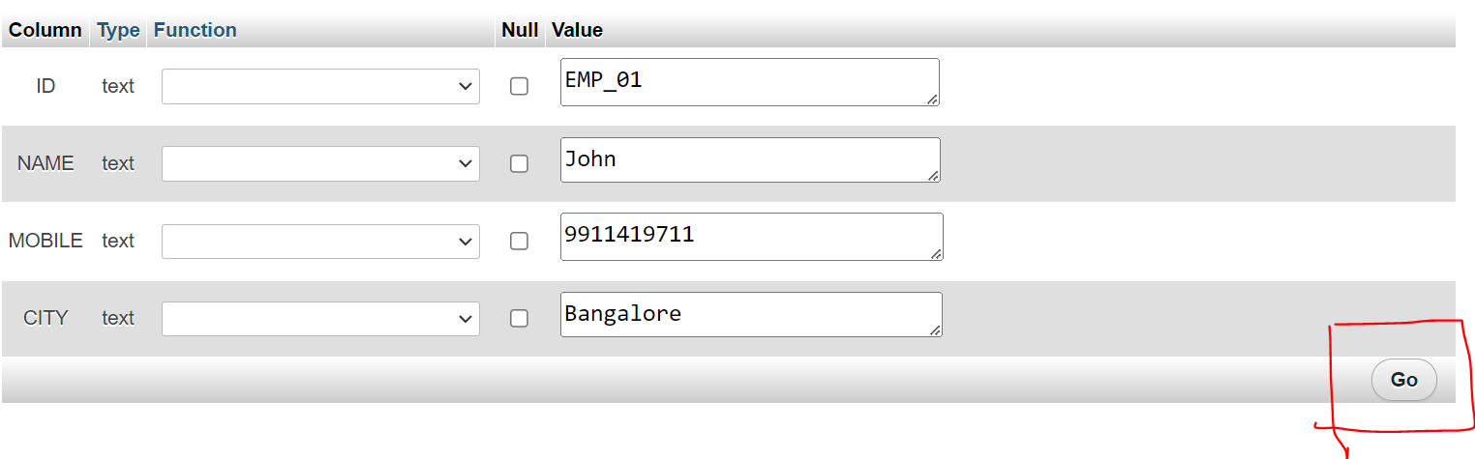
Working with Tables
Step-6: Enter the data for Table, and click on Go button to insert data into Table

Slide 69
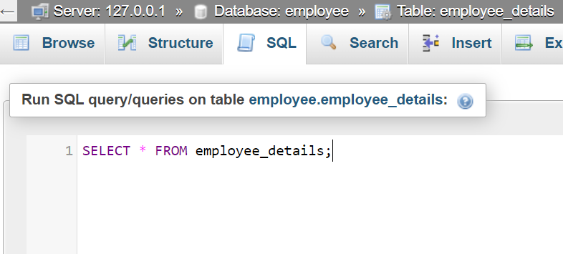
Working with Tables
Step-7:Display data from Table
SELECT * FROM employee_details;

Slide 70
Exercises
Create COLLEGE database using phpMyAdmin Navigation bar, create document file and copy paste the screenshot for each point.
CREATE COLLEGE database
CREATE student_details table in COLLEGE database
INSERT some records in student_details table
DISPLAY records from student_details table

Slide 71
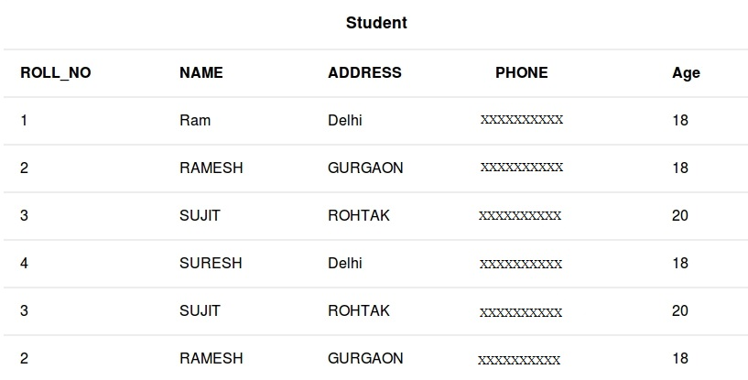
Exercises
student_details table data

