Slide 1

BIG DATA TOOLS FOR MANAGERS (N2MBA07)
Unit -2 : Data Querying and Retrieval using SQL

Slide 2
SQL- Structured Query Language
SQL commands are instructions for the database. It is used to communicate with the database.
SQL can perform various tasks like create a database/table, add data to tables, drop the table, modify the table, set permission for users.
SQL commands are case insensitive, but table and column names are case sensitive.

Slide 3
SQL- Structured Query Language
SQL statements are divided into two major categories.
Data definition language (DDL)
Data manipulation language (DML)

Slide 4
Data definition language (DDL)
DDL statements are used to build and modify the structure of tables in the database.
When you execute a DDL statement, it takes effect immediately.
It is also known as data descriptive language.

Slide 5
Data definition language (DDL)
DDL Commands
DDL statements are used to build and modify the structure of tables in the database.
When you execute a DDL statement, it takes effect immediately.
It is also known as data descriptive language.
CREATE
DROP
ALTER
TRUNCATE
1
2
3
4

Slide 6
Data manipulation language (DML)
Data Manipulation Language commands it allow you to manage the data stored in the database.
DML Command is used by the database user/ application programs to retrieve, add, remove or update the information in the database.

Slide 7
Data manipulation language (DML)
Data Manipulation Language commands it allow you to manage the data stored in the database.
DML Command is used by the database user/ application programs to retrieve, add, remove or update the information in the database.
INSERT
SELECT
UPDATE
DELETE
DML Commands

Slide 8
Data definition language (DDL)
CREATE
Create command is a DDL command used to create a table or a database some objects like tables, Views, indexes, functions.
Syntax :
CREATE TABLE table_name (
col-name-1 data-type ,
col-name-2 data-type ,
col-name-3 data-type ,
….
);

Slide 9
Data definition language (DDL)
CREATE
CREATE TABLE table_name (
col-name-1 data-type ,
col-name-2 data-type ,
col-name-3 data-type ,
….
);
CREATE TABLE emp_details (
EMP_ID TEXT,
EMP_NAME TEXT,
EMP_POST TEXT
);

Slide 10
Data definition language (DDL)
DATA TYPE
The data type is a guideline for SQL to understand what type of data is expected inside of each column, and it also identifies how SQL will interact with the stored data.
Most common data types:
String/Text
Numeric
Datetime
CREATE TABLE table_name (
col-name-1 data-type ,
col-name-2 data-type ,
col-name-3 data-type ,
….
);

Slide 11
Data definition language (DDL)
DATA TYPE
STRING
CHAR(size)
A fixed-length string between 1 and 255 characters
in length (for example CHAR(5)), right-padded with
spaces to the specified length when stored
Example:
CREATE TABLE student(
usn CHAR(10)
);

Slide 12
Data definition language (DDL)
DATA TYPE
STRING TYPES
CHAR(size)
A fixed-length string between 1 and 255 characters
in length (for example CHAR(5)), right-padded with
spaces to the specified length.
Example:
CREATE TABLE student(
usn CHAR(10)
);
1 | S | I | 2 | 3 | M | B | A | 0 | 1
1 | S | I | 2 | 3 | M | B | A | 2 | (space)
1 | S | I | 2 | 3 | B | A | 3 | (space) | (space)

Slide 13
Data definition language (DDL)
DATA TYPE
STRING
VARCHAR(size)
A variable-length string between 1 and 255
Example:
CREATE TABLE student(
usn VARCHAR(10)
);
1 | S | I | 2 | 3 | M | B | A | 0 | 1
1 | S | I | 2 | 3 | M | B | A | 2
1 | S | I | 2 | 3 | B | A | 3
1 | S | I | 2 | 3 | M | B | A | 0 | 4

Slide 14
Data definition language (DDL)
DATA TYPE
STRING
TINYTEXT
TEXT column with a maximum length of 255 characters
MEDIUMTEXT
TEXT column with a maximum length of 16777215 characters
LONGTEXT
TEXT column with a maximum length of 4294967295 or 4 GB of characters

Slide 15
Data definition language (DDL)
DATA TYPE
STRING
Example:
CREATE TABLE student (
USN CHAR(10),
NAME VARCHAR(50),
ADDRESS TINYTEXT,
CITY VARCHAR(20),
STATE VARCHAR(20),
PINCODE CHAR(5)
);

Slide 16
Data definition language (DDL)
DATA TYPE
NUMERIC
Data Type | Signed range(Number with Sign) | Unsigned range
TINYINT | -128 to 127 | 0 to 255
SMALLINT | -32768 to 32767 | 0 to 65535
MEDIUMINT | -8388608 to 8388607 | 0 to 16777215
INT | -2147483648 to 2147483647 | 0 to 4294967295
BIGINT | -9223372036854775808 to 9223372036854775807 | 0 to 18446744073709551615
FLOAT | Decimal precision can go to 24 places for a float type
DOUBLE | Decimal precision can go to 53 places for a double

Slide 17
Data definition language (DDL)
DATA TYPE
DATETIME
Data Type | Maximum Size
DATE | Values range from '1000-01-01' to '9999-12-31'.
TIME | Values range from '-838:59:59' to '838:59:59'.
DATETIME | Values range from '1000-01-01 00:00:00' to '9999-12-31 23:59:59'.
TIMESTAMP | Values range from '1970-01-01 00:00:01' UTC to '2038-01-19 03:14:07’ UTC.

Slide 18
Data definition language (DDL)
DATA TYPE
String Type
CHAR
VARCHAR
TINYTEXT
MEDIUMTEXT
LONGTEXT
Numeric Type
TINYINT
SMALLINT
MEDIUMINT
INT
BIGINT
FLOAT
DOUBLE
Date Type
DATE
TIME
DATETIME
TIMESTAMP

Slide 19
Data definition language (DDL)
DATA TYPE
Example : String, Int, and DateTime
CREATE TABLE student_details (
USN CHAR(10),
NAME VARCHAR(50),
DOB DATE,
AGE TINYINT,
CGPA FLOAT,
ADDRESS MEDIUMTEXT
);

Slide 20
Data definition language (DDL)
CREATE with Constraints
SQL constraints are used to specify rules for the data in a table.
Constraints are used to limit the type of data that can go into a table. This ensures the accuracy and reliability of the data in the table.
Syntax :
CREATE TABLE table_name (
col-name-1 data-type constraint ,
col-name-2 data-type constraint,
col-name-3 data-type constraint,
….
);

Slide 21
Data definition language (DDL)
CREATE with Constraints
Some basic SQL constraints:
NOT NULL
UNIQUE
PRIMARY KEY
DEFAULT

Slide 22
Data definition language (DDL)
CREATE with Constraints
NOT NULL Constraint
By default, a column can hold NULL values
The NOT NULL constraint enforces a column to NOT accept NULL values.
Syntax :
CREATE TABLE student_details (
USN CHAR(10) NOT NULL,
NAME VARCHAR(50) NOT NULL,
DOB DATE,
AGE TINYINT,
CGPA FLOAT,
ADDRESS MEDIUMTEXT
);

Slide 23
Data definition language (DDL)
CREATE with Constraints
UNIQUE Constraint
The UNIQUE constraint ensures that all values in a column are different.
Syntax :
CREATE TABLE student_details (
USN CHAR(10) UNIQUE,
NAME VARCHAR(50),
DOB DATE,
AGE TINYINT,
CGPA FLOAT,
ADDRESS MEDIUMTEXT
);

Slide 24
Data definition language (DDL)
CREATE with Constraints
PRIMARY KEY Constraint
The PRIMARY KEY constraint uniquely identifies each record in a table.
Primary keys must contain UNIQUE values, and cannot contain NULL values.
A table can have only ONE primary key; and in the table, this primary key can consist of single or multiple columns (fields).

Slide 25
Data definition language (DDL)
CREATE with Constraints
PRIMARY KEY Constraint
Syntax :
CREATE TABLE student_details (
USN CHAR(10) PRIMARY KEY,
NAME VARCHAR(50),
DOB DATE,
AGE TINYINT,
CGPA FLOAT,
ADDRESS MEDIUMTEXT
);

Slide 26
Data definition language (DDL)
CREATE with Constraints
DEFAULT Constraint
The DEFAULT constraint is used to set a default value for a column.
The default value will be added to all new records, if no other value is specified.

Slide 27
Data definition language (DDL)
CREATE with Constraints
DEFAULT Constraint
_{CREATE TABLE student_details (}
_{USN CHAR(10) UNIQUE,}
NAME VARCHAR(50) NOT NULL,
_{DOB DATE,}
_{AGE TINYINT,}
_{CGPA FLOAT,}
ADDRESS MEDIUMTEXT DEFAULT ‘TUMKUR,INDIA’
_{);}

Slide 28
View Table Structure
DESCRIBE
DESCRIBE or DESC command used to view the structure of the table.
Syntax :
DESCRIBE table_name ;
OR
DESC table_name ;
Example:
DESC student_details;

Slide 29
Data definition language (DDL)
TRUNCATE
TRUNCATE TABLE statement is used to delete the data inside a table, but not the table.
It permanently removes records/observation from the table.
Syntax:
TRUNCATE TABLE table_name;
Example:
TRUNCATE TABLE student_details;

Slide 30
Data definition language (DDL)
DROP
The DROP TABLE statement is used to drop an existing table in a database.
It permanently removes objects from the database or MySQL server.
Syntax:
DROP TABLE table_name;
Example:
DROP TABLE student_details;

Slide 31
Data definition language (DDL)
ALTER
Alter command is used to alter the structure of the tables in the database.
For Example :
To add a column to existing table.
To rename any existing Column.
Alter is also used to drop a column.
To Change datatype of any Column or to modify its size

Slide 32
Data definition language (DDL)
Example:
Create employee table with following columns : emp_id, ename, post, country
CREATE TABLE employee (
emp_id text,
ename text,
post text,
country text
);

Slide 33
Data manipulation language (DML)
Data Manipulation Language commands it allow you to manage the data stored in the database.
DML Command is used by the database user/ application programs to retrieve, add, remove or update the information in the database.
INSERT
SELECT
UPDATE
DELETE
DML Commands

Slide 34
Data manipulation language (DML)
INSERT
INSERT INTO statement is used to insert new records in a table.
Syntax:
INSERT INTO
table_name
VALUES (‘value-1’, ‘value-2’,……);

Slide 35
Data manipulation language (DML)
INSERT
INSERT INTO statement is used to insert new records in a table.
Syntax:
INSERT INTO
table_name
VALUES (‘value-1’, ‘value-2’,……);

Slide 36
Data manipulation language (DML)
INSERT
INSERT INTO statement is used to insert new records in a table.
INSERT INTO for selected columns
Syntax:
INSERT INTO
table_name (col-1, col-2,…)
VALUES (‘value-1’, ‘value-2’,……);

Slide 37
Data manipulation language (DML)
INSERT
Example :
INSERT INTO
employee
VALUES ( ‘E1’, ‘John’, ‘Manager’, ‘USA’);
INSERT INTO
employee
VALUES ( ‘E2’, ‘Nick’, ‘AVP’, ‘UK’);
INSERT INTO
employee
VALUES ( ‘E3’, ‘John’, ‘VP’, ‘INDIA’);

Slide 38
Data manipulation language (DML)
SELECT
The SELECT statement is used to select data from a database.
The data returned is stored in a result table, called the result-set.
Syntax:
SELECT
column1, column2, column3,... FROM table_name;

Slide 39
Data manipulation language (DML)
SELECT
SELECT * FROM table_name;
(asterisk) represent all the columns from table

Slide 40
Data manipulation language (DML)
SELECT
SELECT * FROM table_name;
(asterisk) represent all the columns from table
SELECT * FROM employee;

Slide 41
Data manipulation language (DML)
SELECT
SELECT * FROM table_name;
(asterisk) represent all the columns from table
SELECT * FROM employee;
SELECT ename FROM employee;

Slide 42
Data manipulation language (DML)
SELECT
SELECT * FROM table_name;
(asterisk) represent all the columns from table
SELECT * FROM employee;
SELECT ename FROM employee;
SELECT ename, country FROM employee;

Slide 43
Data manipulation language (DML)
SELECT DISTINCT
The SELECT DISTINCT statement is used to return only distinct (different) values.
Syntax:
SELECT
DISTINCT column1, column2… FROM table_name;
SELECT DISTINCT ename FROM employee;
SELECT DISTINCT ename, country FROM employee;

Slide 44
Data manipulation language (DML)
SELECT with WHERE
WHERE clause is used to filter records.
It is used to extract only those records that fulfill a specified condition.
Syntax:
SELECT
column1, column2, column3,... FROM table_name
WHERE condition;

Slide 45
SQL Operators
SQL WHERE
Operator | Description
= | Equal
> | Greater than
< | Less than
>= | Greater than or equal
<= | Less than or equal
<> | Not equal. Note: In some versions of SQL this operator may be written as !=
BETWEEN | Between a certain range
LIKE | Search for a pattern
IN | To specify multiple possible values for a column

Slide 46
SQL Operators
SQL WHERE
Condition can be applied in multiple columns using AND OR operators.
AND operator displays a record if all the conditions separated by AND are TRUE.
OR operator displays a record if any of the conditions separated by OR is TRUE.

Slide 47
SQL Operators
SQL WHERE
Example:
SELECT * FROM employee WHERE emp_id = ‘E1’;
SELECT * FROM employee
WHERE emp_id = ‘E2’ AND country = ‘UK’;
SELECT * FROM employee
WHERE post = ‘AVP’ OR country = ‘UK’;

Slide 48
GROUP BY
Aggregation
The GROUP BY statement groups rows that have the same values into summary rows, like "find the number of customers in each country.
The GROUP BY statement is often used with aggregate functions (COUNT(), MAX(), MIN(), SUM(), AVG()) to group the result-set by one or more columns.

Slide 49
GROUP BY
Aggregation
Syntax :
SELECT col-1, col-2, function(col-3) FROM table_name WHERE condition GROUP BY col-1, col-2;
Example:
SELECT USN, Sections, max(CGPS) FROM student_details GROUP BY USN, Sections;

Slide 50
GROUP BY with HAVING
Aggregation
The HAVING clause was added to SQL because the WHERE keyword cannot be used with aggregate functions.
HAVING clause is equivalent to WHERE clause but HAVING used with only GROUP BY clause.

Slide 51
GROUP BY
Aggregation
Syntax :
SELECT col-1, col-2, function(col-3) FROM table_name WHERE condition GROUP BY col-1, col-2
HAVING condition;
Example:
SELECT USN, Sections, max(CGPA) FROM student_details GROUP BY USN, Sections
HAVING max(CGPA) > 7.5;

Slide 52
ORDER BY
Sorting
The ORDER BY keyword is used to sort the result-set in ascending or descending order.
The ORDER BY keyword sorts the records in ascending order by default. To sort the records in descending order, use the DESC keyword.
Syntax:
SELECT
column1, column2, column3,... FROM table_name
ORDER BY col-1, col-2…ASC|DESC;

Slide 53
ORDER BY
Sorting
Syntax:
SELECT
column1, column2,,... FROM table_name
ORDER BY col-1, col-2…ASC|DESC;
Example:
SELECT * FROM student_details ORDER BY USN ASC;

Slide 54
ORDER BY
Sorting
Syntax:
SELECT
column1, column2,,... FROM table_name
ORDER BY col-1, col-2…ASC|DESC;
Example-1:
SELECT * FROM student_details ORDER BY USN ASC;
Example-2:
SELECT * FROM student_details ORDER BY USN ASC, CGPA DESC ;

Slide 55
Recap
MySQL
DDL
CREATE
DATA TYPE
String
Numeric
DateTime
CONSTRAINTS
NOT NULL
UNIQUE
PRIMARY KEY
DEFAULT
DROP
TRUNCATE
ALTER

Slide 56
Recap
MySQL
DML
INSERT
SELECT
SELECT
SELECT DISTINCT
SELECT WITH WHERE
OPERATORS
SELECT WITH GROUP BY
AGGREGATE FUNCTION
SELECT WITH ORDER BY

Slide 57
Data manipulation language (DML)
Data Manipulation Language commands it allow you to manage the data stored in the database.
DML Command is used by the database user/ application programs to retrieve, add, remove or update the information in the database.
INSERT
SELECT
UPDATE
DELETE
DML Commands

Slide 58
Data manipulation language (DML)
UPDATE
The UPDATE statement is used to modify the existing records in a table.
***Update statement without condition will update values for all the records available in Table
Syntax:
UPDATE table_name SET column1 = value1,
column2 = value2 WHERE condition;
**Columns with new values

Slide 59
Data manipulation language (DML)
UPDATE
The UPDATE statement is used to modify the existing records in a table.
***Update statement without condition will update values for all the records available in Table
Syntax:
UPDATE table_name SET column1 = value1,
column2 = value2 WHERE condition;
**WHERE condition tells which records to be updated.

Slide 60
Data manipulation language (DML)
UPDATE
Example: Create a STUDENTS table with below given data
ID | NAME | CITY | STATE | COUNTRY
1 | AAA | PUNE | MAH | INDIA
2 | BBB | MUMBAI | MAH
3 | CCC | TUMKUR | KAR
4 | DDD | BANGALORE
5 | EEE | MYSORE

Slide 61
Data manipulation language (DML)
UPDATE
Example: Updates States for Bangalore & Mysore with KAR value.
Syntax:
UPDATE table_name SET column1 = value1,
column2 = value2 WHERE condition;
Update Query:
UPDATE STUDENTS
SET STATE = "KAR"
WHERE CITY = "BANGALORE" OR CITY = "MYSORE";

Slide 62
Data manipulation language (DML)
UPDATE
Example: Updates Country as INDIA for all the records.
Syntax:
UPDATE table_name SET column1 = value1,
column2 = value2;
Update Query:
UPDATE STUDENTS
SET COUNTRY = "INDIA";

Slide 63
Data manipulation language (DML)
DELETE
The DELETE statement is used to delete records from the table.
***Delete statement without condition will delete all the records from the table.
Syntax:
DELETE FROM table_name
WHERE condition;

Slide 64
Data manipulation language (DML)
DELETE
The DELETE statement is used to delete records from the table.
***Delete statement without condition will delete all the records from the table.
Syntax:
DELETE FROM table_name
WHERE condition;
**WHERE condition tells which records to be deleted.

Slide 65
Data manipulation language (DML)
DELETE
Example: After UPDATE statement STUDENTS table will look like this.
ID | NAME | CITY | STATE | COUNTRY
1 | AAA | PUNE | MAH | INDIA
2 | BBB | MUMBAI | MAH | INDIA
3 | CCC | TUMKUR | KAR | INDIA
4 | DDD | BANGALORE | KAR | INDIA
5 | EEE | MYSORE | KAR | INDIA

Slide 66
Data manipulation language (DML)
DELETE
Example: Delete the students from PUNE
Syntax:
DELETE FROM table_name
WHERE condition;
Delete Query:
DELETE FROM STUDENTS
WHERE CITY = "PUNE";

Slide 67
Data manipulation language (DML)
DELETE
Example: Delete all the records from STUDENTS table
Here are the option to delete all the records:
Using DELETE FROM table -----> DML Statement without WHERE condition

Slide 68
Data manipulation language (DML)
DELETE
Example: Delete all the records from STUDENTS table
Here are the option to delete all the records:
Using DELETE FROM table -----> DML Statement without WHERE condition
Using TRUNCATE table ---- DDL Statement

Slide 69
Data manipulation language (DML)
DELETE
Example: Delete the students from PUNE
Syntax:
DELETE FROM table_name;
Delete Query:
DELETE FROM STUDENTS;
OR
TRUNCATE TABLE STUDENTS;

Slide 70
MYSQL Joins
Joins
A Join is an operation performed on database tables to fetch data from related tables, based on common fields/columns.
OR
A Join is used to combine rows from two or more tables, based on a related column between them.

Slide 71
MYSQL Joins
JOINS
A Join is an operation performed on database tables to fetch data from related tables, based on common fields/columns.
OR
A Join is used to combine rows from two or more tables, based on a related column between them.
INNER
LEFT
RIGHT
CROSS
1
2
3
4

Slide 72
MySQL Joins
A JOIN clause is used to combine rows from two or more tables, based on a related column between them.
Download Data: https://raw.githubusercontent.com/sitmbadept/sitmbadept.github.io/main/BDTM/SQL/join_demo.sql
Orders Table
OrderID | CustomerID | OrderDate
10308 | 2 | 2022-08-15
10309 | 1 | 2022-08-26
10310 | 2 | 2022-09-01
Customers Table
CustomerID | CustomerName | Country
1 | John Todd | Germany
2 | Dominic Dom | Mexico
3 | Paul S | Mexico

Slide 73
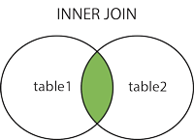
MYSQL Joins
INNER
The INNER JOIN keyword selects records that have matching values in both tables.
Syntax
SELECT col-1, col-2….columns(s) FROM table1 INNER JOIN table2 ON table1.column_name = table2.column_name;

Slide 74
INNER JOIN
Example: Selecting all the columns from both customer & orders the table
SELECT customers.* ,
orders.*
FROM customers
INNER JOIN orders
ON orders.CustomerID = customers.CustomerID;

Slide 75
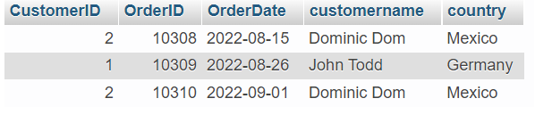
INNER
JOIN
Example: Selecting specified columns from tables
SELECT orders.CustomerID,
orders.OrderID,
orders.OrderDate,
customers.CustomerName,
customers.Country
FROM customers
INNER JOIN orders
ON orders.CustomerID = customers.CustomerID;
Output:

Slide 76
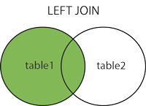
MYSQL Joins
LEFT
The LEFT JOIN keyword returns all records from the left table (table1), and the matching records (if any) from the right table
Syntax
SELECT col-1, col-2….columns(s) FROM table1 LEFT JOIN table2 ON table1.column_name = table2.column_name;

Slide 77
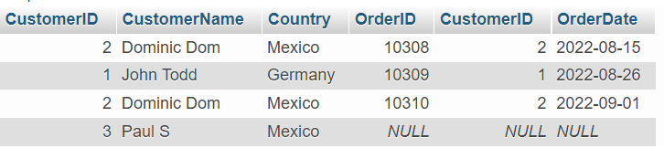
LEFT
JOIN
Example:
SELECT customers.* ,
orders.*
FROM customers
LEFT JOIN orders
ON orders.CustomerID = customers.CustomerID;
Output:

Slide 78
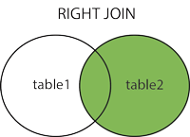
MYSQL Joins
RIGHT
The RIGHT JOIN keyword returns all records from the right table (table2), and the matching records (if any) from the left table (table1)
Syntax
SELECT col-1, col-2….columns(s) FROM table1 RIGHT JOIN table2 ON table1.column_name = table2.column_name;

Slide 79
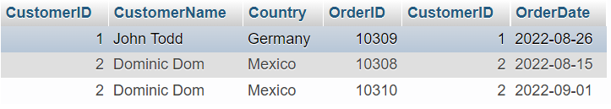
RIGHT
JOIN
Example:
SELECT customers.* ,
orders.*
FROM customers
RIGHT JOIN orders
ON orders.CustomerID = customers.CustomerID;
Output:

Slide 80
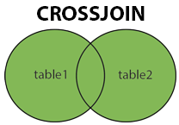
MYSQL Joins
CROSS
The CROSS JOIN keyword returns all records from both tables (table1 and table2).
Syntax
SELECT col-1, col-2….columns(s) FROM table1 CROSS JOIN table2;

Slide 81
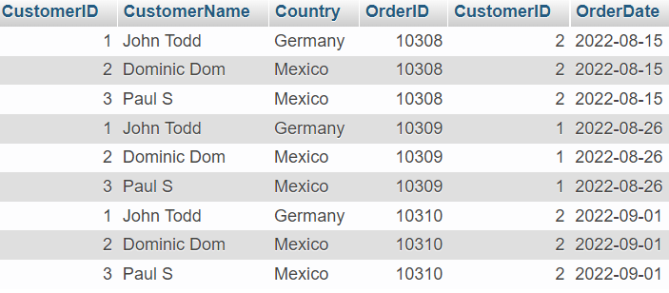
CROSS
JOIN
Example:
SELECT customers.* ,
orders.*
FROM customers
CROSS JOIN orders;
Output:

Slide 82
MYSQL SET Operators
UNION
The UNION operator is used to combine the result-set of two or more SELECT statements.
Important points :
Every SELECT statement with UNION must have the same number of columns.
Columns order must be same in all the SELECT statement.

Slide 83
MYSQL SET Operators
UNION
UNION Syntax
SELECT col1, col2,..etc FROM table1 UNION SELECT col1,col2,..etc FROM table2;
UNION ALL Syntax
SELECT col1, col2,..etc FROM table1 UNION ALL SELECT col1,col2,..etc FROM table2;

Slide 84
MYSQL SET Operators
UNION
UNION Syntax
SELECT col1, col2,..etc FROM table1 UNION SELECT col1,col2,..etc FROM table2;
UNION ALL Syntax
SELECT col1, col2,..etc FROM table1 UNION ALL SELECT col1,col2,..etc FROM table2;
****The UNION operator selects only distinct values by default. To allow duplicate values we need to use UNION ALL operators

Slide 85
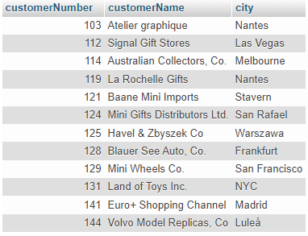
UNION
Example:
SELECT customerNumber, customerName, city FROM customers_1
UNION
SELECT customerNumber, customerName, city FROM customers_2;
Output:

Slide 86
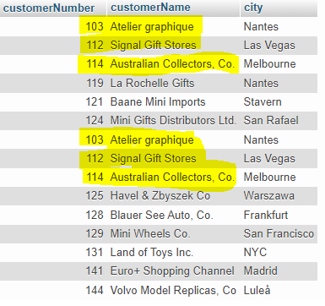
UNION
ALL
Example:
SELECT customerNumber, customerName, city FROM customers_1
UNION ALL
SELECT customerNumber, customerName, city FROM customers_2;
Output:

Slide 87
MYSQL SET Operators
INTERSECT
The INTERSECT operator returns the distinct and common elements in two sets or common records from two or more tables
Important points for INTERSECT operator:
Every SELECT statement with INTERSECT must have the same number of columns.
Columns order must be same in all the SELECT statement.

Slide 88
MYSQL SET Operators
INTERSECT
Syntax
SELECT col1, col2,..etc FROM table1 INTERSECT SELECT col1,col2,..etc FROM table2
INTERSECT ……;

Slide 89
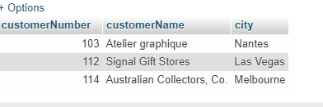
INTERSECT
Example:
SELECT customerNumber, customerName, city FROM customers_1
INTERSECT
SELECT customerNumber, customerName, city FROM customers_2;
Output:

Slide 90
MYSQL Views
VIEW
In SQL, a view is a virtual table, based on the result-set of an SQL statement.
A view contains rows and columns, just like a real table. The fields in a view are fields from one or more real tables in the database.
Create Syntax:
CREATE VIEW view_name AS SELECT column1, column2, ... FROM table_name WHERE condition;

Slide 91
MYSQL Views
VIEW
In SQL, a view is a virtual table based on the result-set of an SQL statement.
A view contains rows and columns, just like a real table. The fields in a view are fields from one or more real tables in the database.
Create Syntax:
CREATE VIEW view_name AS SELECT column1, column2, ... FROM table_name WHERE condition;
Drop Syntax:
DROP VIEW view_name;

Slide 92
MYSQL Views
VIEW
In SQL, a view is a virtual table based on the result-set of an SQL statement.
A view contains rows and columns, just like a real table. The fields in a view are fields from one or more real tables in the database.
Display Syntax:
SELECT * FROM view_name WHERE condition;

Slide 93
Data definition language (DDL)
DDL Commands
DDL statements are used to build and modify the structure of tables in the database.
When you execute a DDL statement, it takes effect immediately.
It is also known as data descriptive language.
CREATE
DROP
ALTER
TRUNCATE
1
2
3
4

Slide 94
Data definition language (DDL)
ALTER
The ALTER statement is used when to change the name of table or any table field. It is also used to add or delete an existing column in a table.
The ALTER statement is always used with "ADD", "DROP" and "MODIFY" commands according to the situation.
The ALTER TABLE statement is also used to add and drop various constraints on an existing table.

Slide 95
Data definition language (DDL)
ALTER
Example: Create a STUDENTS table with below given data
ID | NAME | CITY | STATE | COUNTRY
1 | AAA | PUNE | MAH | INDIA
2 | BBB | MUMBAI | MAH | INDIA
3 | CCC | TUMKUR | KAR | INDIA
4 | DDD | BANGALORE | KAR | INDIA
5 | EEE | MYSORE | KAR | INDIA

Slide 96
Data definition language (DDL)
ALTER
Adding Column:
ID | NAME | CITY | STATE | COUNTRY | MOBILE
1 | AAA | PUNE | MAH | INDIA
2 | BBB | MUMBAI | MAH | INDIA
3 | CCC | TUMKUR | KAR | INDIA
4 | DDD | BANGALORE | KAR | INDIA
5 | EEE | MYSORE | KAR | INDIA

Slide 97
Data definition language (DDL)
ALTER
Adding Column : ALTER with ADD statement allows to add new columns in existing table.
Syntax:
ALTER TABLE table_name
ADD COLUMN colum_name data-types constraints;

Slide 98
Data definition language (DDL)
ALTER
Adding Column:
Example:
ALTER TABLE STUDENTS
ADD COLUMN MOBILE VARCHAR(10);
Syntax:
ALTER TABLE table_name
ADD COLUMN colum_name data-types constraints;

Slide 99
Data definition language (DDL)
ALTER
Adding Multiple Columns:
Syntax:
ALTER TABLE table_name
ADD COLUMN colum_name data-types constraints,
ADD COLUMN colum_name data-types constraints,
….
…;

Slide 100
Data definition language (DDL)
ALTER
Adding Multiple Columns:
ID | NAME | CITY | STATE | COUNTRY | MOBILE | ALT_MOBILE | EMAIL
1 | AAA | PUNE | MAH | INDIA
2 | BBB | MUMBAI | MAH | INDIA
3 | CCC | TUMKUR | KAR | INDIA
4 | DDD | BANGALORE | KAR | INDIA
5 | EEE | MYSORE | KAR | INDIA

Slide 101
Data definition language (DDL)
ALTER
Adding Multiple Columns:
Example:
ALTER TABLE STUDENTS
ADD COLUMN ALT_MOBILE VARCHAR(10),
ADD COLUMN EMAIL VARCHAR(20);

Slide 102
Data definition language (DDL)
ALTER
Modify Columns: ALTER with MODIFY statement allows modifying of the column definition.
Syntax:
ALTER TABLE table_name
MODIFY COLUMN colum_name data-types constraints;

Slide 103
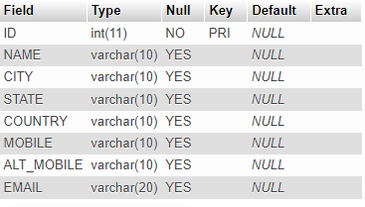
Data definition language (DDL)
ALTER
Modify Columns:
Set Default Values For CITY & STATE
(TUMKUR, KARNATAKA)

Slide 104
Data definition language (DDL)
ALTER
Modify Columns:
Example:
ALTER TABLE STUDENTS
MODIFY COLUMN CITY VARCHAR(20) DEFAULT "TUMKUR",
MODIFY COLUMN STATE VARCHAR(20) DEFAULT "KARNATAKA";

Slide 105
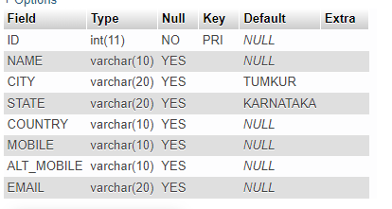
Data definition language (DDL)
ALTER
Modify Columns:
Set Default Values For CITY & STATE
(TUMKUR, KARNATAKA)

Slide 106
Data definition language (DDL)
ALTER
Change Column: ALTER with CHANGE statement allows to rename the column name along with the data definition.
Syntax:
ALTER TABLE table_name
CHANGE COLUMN old_column new_column data-types;

Slide 107
Data definition language (DDL)
ALTER
Change Column :
Example:
ALTER TABLE STUDENTS
CHANGE COLUMN EMAIL PERSONAL_EMAIL VARCHAR(50);

Slide 108
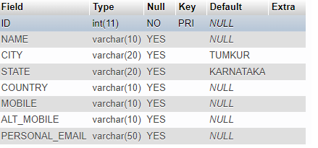
Data definition language (DDL)
ALTER
Change Column :

Slide 109
Data definition language (DDL)
ALTER
Removing Column/s: ALTER with DROP statement allows to remove existing columns from the table.
ID | NAME | CITY | STATE | COUNTRY | MOBILE | ALT_MOBILE | EMAIL
1 | AAA | PUNE | MAH | INDIA
2 | BBB | MUMBAI | MAH | INDIA
3 | CCC | TUMKUR | KAR | INDIA
4 | DDD | BANGALORE | KAR | INDIA
5 | EEE | MYSORE | KAR | INDIA

Slide 110
Data definition language (DDL)
ALTER
Removing Column/s:
Syntax:
ALTER TABLE table_name
DROP COLUMN colum_name,
DROP COLUMN colum_name,
….
…;

Slide 111
Data definition language (DDL)
ALTER
Removing Column/s:
Example:
ALTER TABLE STUDENTS DROP COLUMN STATE;
Syntax:
ALTER TABLE table_name
DROP COLUMN colum_name,
DROP COLUMN colum_name,
….
…;

Slide 112
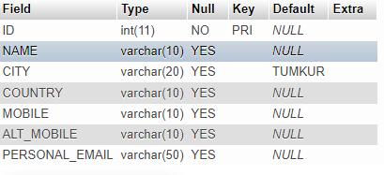
Data definition language (DDL)
ALTER
Removing Column/s:

Slide 113
Data definition language (DDL)
ALTER
RENAME statement allows to rename the table name.
Table
Syntax: ALTER TABLE table_name RENAME TO new_table_name;

Slide 114
Data definition language (DDL)
ALTER
RENAME statement allows to rename the table name.
Table
Example:
ALTER TABLE STUDENTS RENAME TO STUDENTS_DETAILS;

Slide 115
UNIT-2 ASSIGNMENT
Course Link :
https://cognitiveclass.ai/courses/learn-sql-relational-databases
Assignment Submission: Complete the course from the given link and submit the course completion certificate here.
Submission Date : 16-Sep-2023
https://docs.google.com/forms/d/e/1FAIpQLSewDToX1WaJ6DbS0B-HaKegQkHOBgkJNHdcmVXzZJlfRzxUhw/viewform?usp=sharing

