Slide 1

BIG DATA TOOLS FOR MANAGERS
Unit-3 : Introduction to R
by
Ankit Velani
Adjunct Faculty, Dept. of MBA,
Siddaganga Institute of Technology,Tumkur

Slide 2
Session-3 : Basic Graphs
Basic Graphs in R
Table
Histogram
Boxplot
Pie
Bar graph
Scatter plot
Line chart

Slide 3
Table
View() function to display the data in Table format.
Example:
v_data = read.csv("C:/dataset/VEHICLE_PARK.csv")
View(v_data)

Slide 4
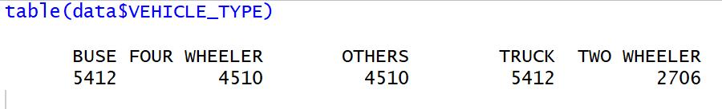
Table
table() function used to calculate the frequency count for the categorical variable.
Example:
v_data = read.csv("C:/dataset/VEHICLE_PARK.csv")
# Count the frequency for the Vehicle Type column
table(v_data$VEHICLE_TYPE)
Output:

Slide 5
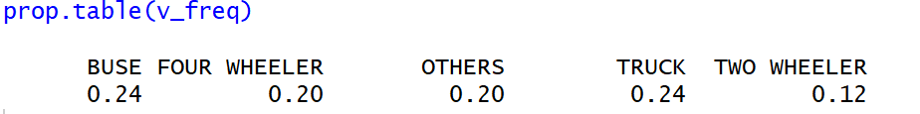
Table - prop.table
Example: prop.table
# Count the frequency for the Vehicle Type column
v_freq = table(v_data$VEHICLE_TYPE)
# Display data in fractions/percentage
prop.table(v_freq)
Output:

Slide 6
Marketing Data
This dataset is about monthly marketing spend for generating sales for each month. So here Sales is a dependent variable and Spends is an independent variable.
Columns :
Month | Spend | Sales
1 | 1000 | 9914
2 | 4000 | 40487
3 | 5000 | 54324
4 | 4500 | 50044
5 | 3000 | 34719
6 | 4000 | 42551
7 | 9000 | 94871
8 | 11000 | 118914
9 | 15000 | 158484
10 | 12000 | 131348
11 | 7000 | 78504
12 | 3000 | 36284

Slide 7
Read Marketing data
# Importing CSV file in R
data = read.csv("C:/dataset/marketing-spend.csv")

Slide 8
Histogram
hist() function to display the histogram for any dataset variable.
Example:
# Show Histogram for Sales
hist(data$Sales)

Slide 9
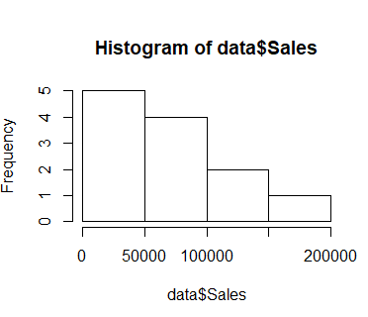
Histogram
hist() function to display the histogram for any dataset variable.
Example:
# Show Histogram for Sales
hist(data$Sales)

Slide 10
Histogram
hist() function to display the histogram for any dataset variable.
Customize histogram by setting up the title, color, x or y axis label

Slide 11
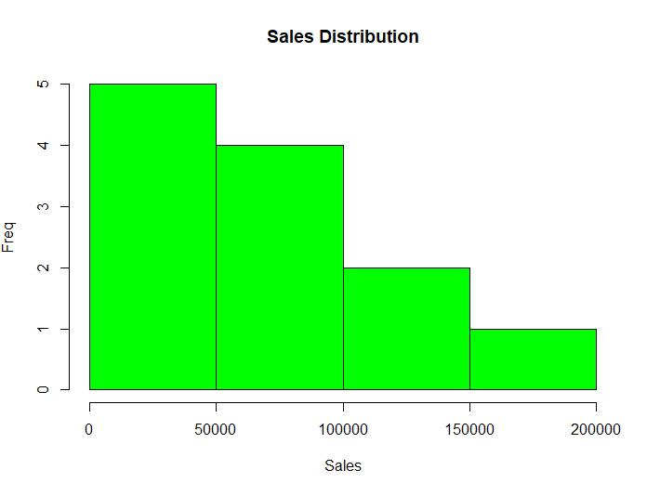
Histogram
# Show Histogram for Sales with colors and title
hist(data$Sales,
col = "green",
main = "Sales Distribution",
xlab = "Sales",
ylab = "Freq" )

Slide 12
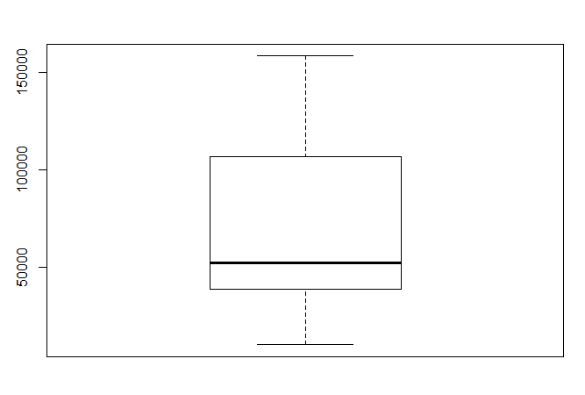
Boxplot
boxplot() function to display the boxplot for numeric variable.
Example:
# Show Boxplot for Sales
boxplot(data$Sales)

Slide 13
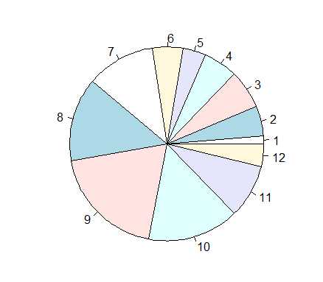
Pie Chart
pie() function to display the pie chart for numeric & categorical variable
Example:
# Display Pie chart for Monthly Spend
pie(data$Spend, data$Month)

Slide 14
Bar Graph
barplot() function to display the bar graph for numeric & categorical variable
Example:
# Display Bar graph for Monthly Spend
barplot(data$Spend,
names.arg = data$Month)

Slide 15
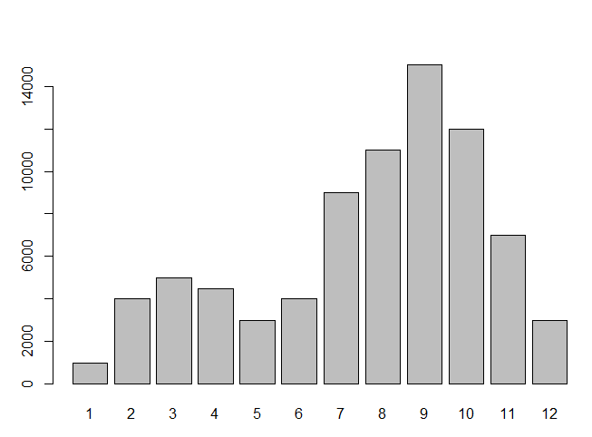
Bar Graph
barplot() function to display the bar graph for numeric & categorical variable
Example:
# Display Bar graph for Monthly Spend
barplot(data$Spend,
names.arg = data$Month)

Slide 16
Bar Graph
barplot() function to display the bar graph for numeric & categorical variable
Example:
# Display Bar graph for Monthly Spend
barplot(data$Spend,
names.arg = data$Month,
horiz= TRUE)
Convert Bar graph from vertical to horizontal

Slide 17
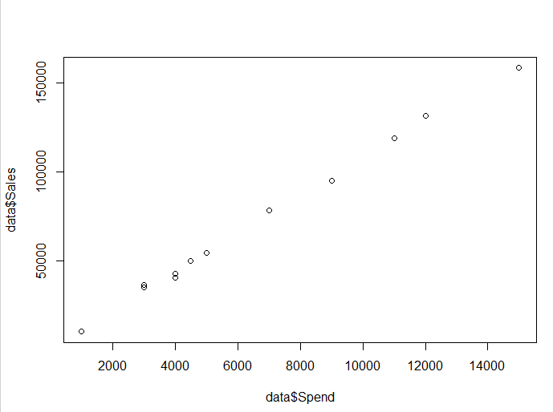
Scatter plot
plot() function will display scatter plot if both the variables are numeric.
Example:
# Display scatter plot for Spend vs Sales
plot(data$Spend,
data$Sales)

Slide 18
Line Chart
plot() function with additional parameters will display line chart.
Example:
# Display Line Chart Month vs Spend
plot(data$Month,
data$Spend,
type='b') # Type : p l b c o h s S

Slide 19
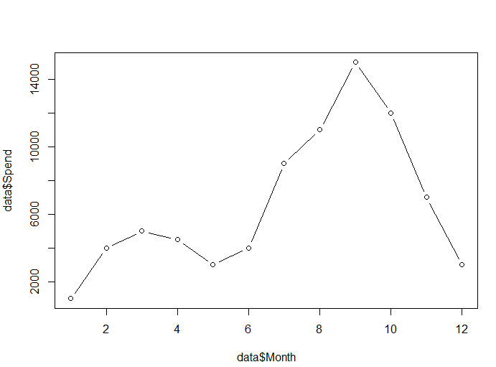
Line Chart
plot() function with additional parameters will display line chart.
Example:
# Display Line Chart Month vs Spend
plot(data$Month,
data$Spend,
type='b') # Type : p l b c o h s S

Slide 20
Regression
lm() function helps us to create regression model in R with given formula in the form of Y ~ X+X2+X3+X4…etc
summary() functions to look the model and it's parameters such as formula, coefficients,standard error, residual, multiple/adjusted R-Square..etc to analyze regression model
predict() function used to make a prediction on new data, and we can dervided formula forprediction y = b0 + b1x1 + b2x2 + b3*x3..etc

Slide 21
Correlation
cor() function helps us to get the correlation for the variables.
Example:
cor(data$Spend,data$Sales)
#Default method is pearson correlation

Slide 22
Correlation
cor() function helps us to get the correlation for the variables.
Example:
cor(data$Spend,data$Sales)
# Methods: "pearson", "kendall", "spearman"
cor(data$Spend,data$Sales, method = "spearman")

Slide 23
Regression
Parameters for lm() function
Dependent variable
Indepedent Variable
Data Source
Example:
model_1 <- lm(Sales~Spend, data) #Simple Linear Regression
model_2 <- lm(Sales~Spend+Month, data) #Multiple Linear Regression

Slide 24
Regression
Parameters for lm() function
Dependent variable
Indepedent Variable
Data Source
Example:
model_1 <- lm(Sales~Spend, data) #Simple Linear Regression
model_2 <- lm(Sales~Spend+Month, data) #Multiple Linear Regression

Slide 25
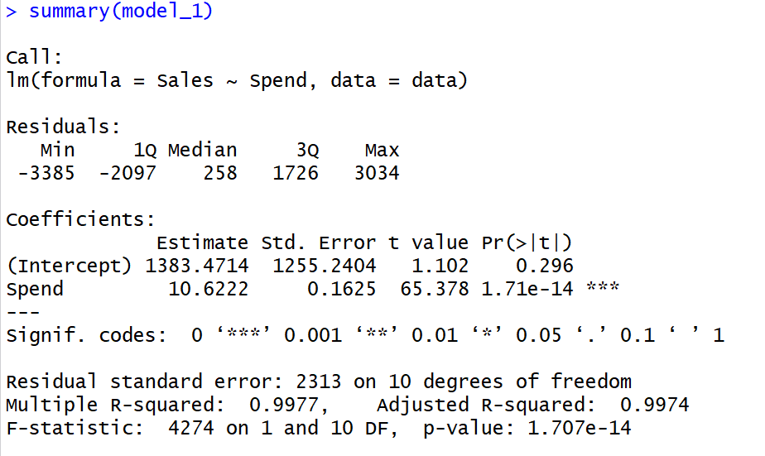
Regression - Summary
Example:
model_1 <- lm(Sales~Spend, data) #Simple Linear Regression
summary(model_1)

