Slide 1

BIG DATA TOOLS FOR MANAGERS
Unit-5 : Time Series & Text Analysis using Python
by
Ankit Velani
Adjunct Faculty, Dept. of MBA,
Siddaganga Institute of Technology,Tumkur

Slide 2
Time Series Analysis

Slide 3
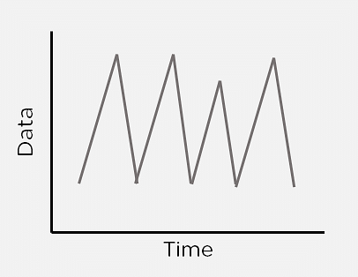
What is Time Series Analysis?
Sometimes data changes over time. This data is called time-dependent data. Given time-dependent data, you can analyze the past to predict the future.
The future prediction will also include time as a variable, and the output will vary with time. Using time-dependent data, you can find patterns that repeat over time.
A Time Series is a set of observations that are collected after regular intervals of time. If plotted, the Time series would always have one of its axes as time.

Slide 4
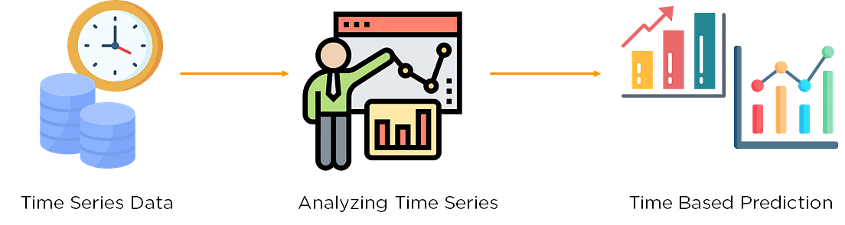
What is Time Series Analysis?

Slide 5
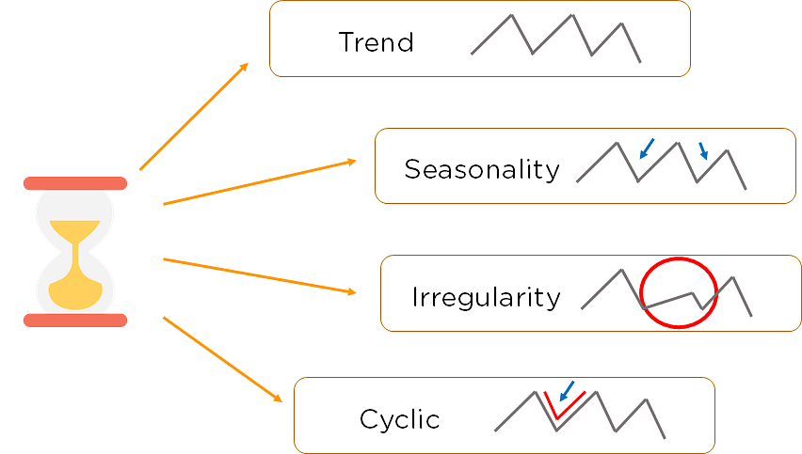
Components of Time Series

Slide 6
Components of Time Series
Trend:
The Trend shows the variation of data with time or the frequency of data. Using a Trend, you can see how your data increases or decreases over time. The data can increase, decrease, or remain stable. Over time, population, stock market fluctuations, and production in a company are all examples of trends.
Seasonality:
Seasonality is used to find the variations which occur at regular intervals of time. Examples are festivals, conventions, seasons, etc. These variations usually happen around the same time period and affect the data in specific ways which you can predict.
Irregularity:
Fluctuations in the time series data do not correspond to the trend or seasonality. These variations in your time series are purely random and usually caused by unforeseeable circumstances, such as a sudden decrease in population because of a natural calamity.
Cyclic:
Oscillations in time series which last for more than a year are called cyclic. They may or may not be periodic.

Slide 7
Time Series Common Algorithms
_{Autoregression (AR)}
_{Moving Average (MA)}
Autoregressive Moving Average (ARMA)
Autoregressive Integrated Moving Average (ARIMA)
Seasonal Autoregressive Integrated Moving-Average (SARIMA)
Seasonal Autoregressive Integrated Moving-Average with Exogenous Regressors (SARIMAX)
_{Vector Autoregression (VAR)}
Vector Autoregression Moving-Average (VARMA)
Vector Autoregression Moving-Average with Exogenous Regressors (VARMAX)
Simple Exponential Smoothing (SES)
Holt Winter’s Exponential Smoothing (HWES)

Slide 8
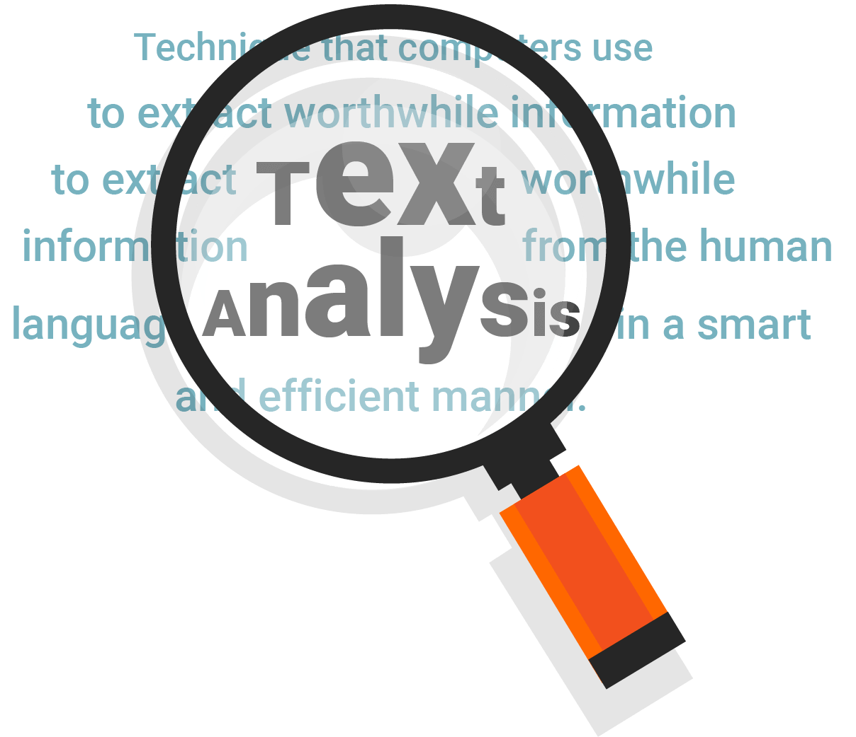

Slide 9
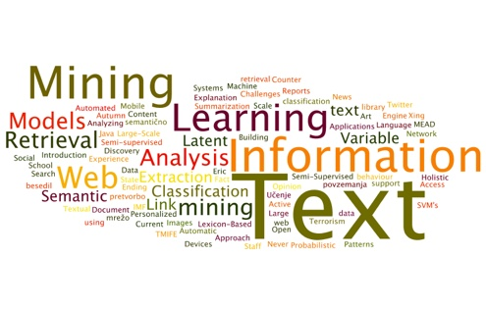
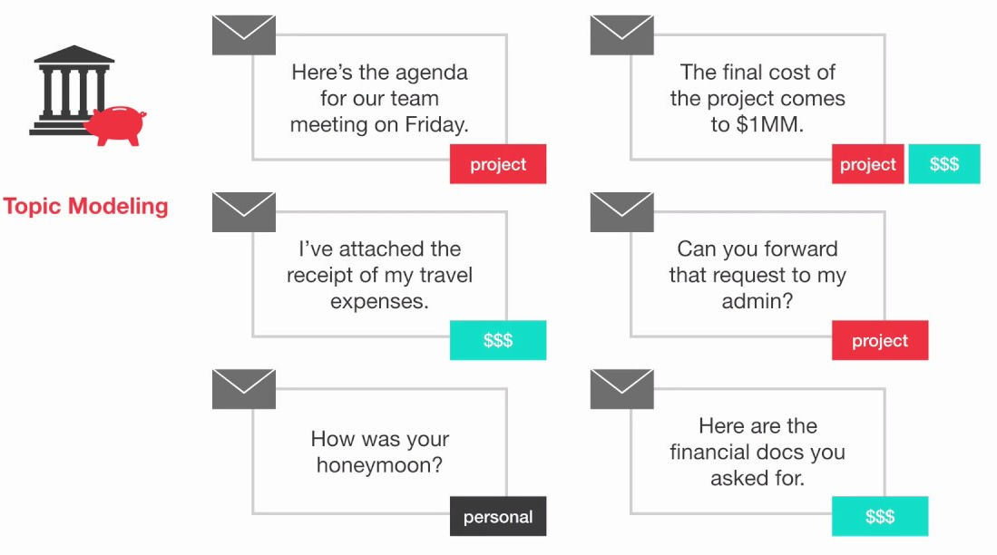
Text Analysis
Text Analysis is the process of analyzing unstructured and semi-structured text data for valuable insights, trends and patterns.
Text analysis software/libraries can independently classify, sort, and extract information from text to identify patterns, relationships, sentiments, and another actionable knowledge.
Text analysis is to efficiently and accurately process multiple text-based sources such as emails, documents, social media content, and product reviews, like a human would.

Slide 10
What is the difference between text analysis, text mining and text analytics?

Slide 11
What is the difference between text analysis, text mining and text analytics?
Text analysis, text mining and text analytics are one and the same and are often used interchangeably.

Slide 12
Text Analysis Libraries
SpaCy
TextBlob
NLTK
Genism
PyNLPl

Slide 13
spaCy
spaCy is a free, open-source library for advance Natural Language Processing(NLP) in Python.
For example,
What are the text?
What is the word mean in context?
Who is doing what to whom?
What are the companies, products, persons..etc mentioned?
Which texts are similar to each other?

Slide 14
Basic spaCy features
Name | Description
Tokenization | Segmenting text into words, punctuation marks etc.
Part-of-speech (POS) Tagging | Assigning word types to tokens like verb/noun/pro-noun
Dependency Parsing | Assigning syntactic dependency labels, describing the relations between individual tokens, like subject or object.
Lemmatization | Assigning the base form of words. For example, the lemma of “was” is “be”, and the lemma of “rats” is “rat”
Named Entity Recognition | Labelling names “real-word” objects like persons, companies or locations.
Similarity | Comparing words, text spans and documents and how similar they are to each other.

Slide 15
Download spaCy
!pip install -U spacy
!python -m spacy download en_core_web_sm
!python -m spacy download en_core_web_md
!python -m spacy download en_core_web_lg

Slide 16
Download spaCy
!pip install -U spacy
!python -m spacy download en_core_web_sm
!python -m spacy download en_core_web_md
!python -m spacy download en_core_web_lg

Slide 17
Importing spaCy
import spacy
text_engine = spacy.load("en_core_web_sm")

Slide 18
Tokenization
During processing, spaCy/text mining first tokenizes the text. i.e. segments it into words, punction and so on. This is done by applying rules specific to each language.
import spacy
text_engine = spacy.load("en_core_web_sm")
doc = text_engine("Apple is looking to buying U.K. startup for $1 billion.")
for token in doc:
print(token.text)

Slide 19
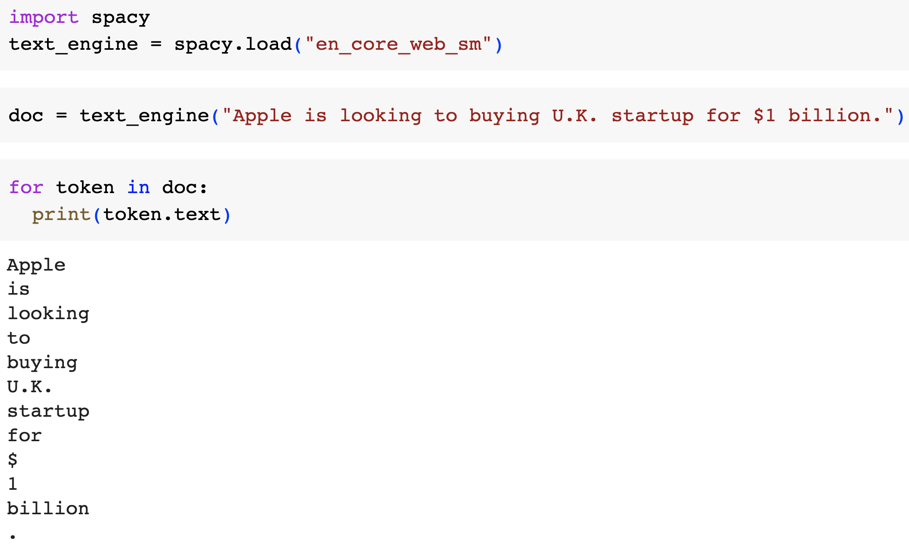
Tokenization

Slide 20
spacy : Linguistic Features
import spacy
text_engine = spacy.load("en_core_web_sm")
doc = text_engine("Apple is looking to buying U.K. startup for $1 billion.")
for token in doc:
print(token.text, token.pos_,
token.dep_, token.tag_,
token.is_alpha, token.is_stop ,
token.shape, token.lemma_)

Slide 21
spacy : Linguistic Features
import spacy
text_engine = spacy.load("en_core_web_sm")
doc = text_engine("Apple is looking to buying U.K. startup for $1 billion.")
for token in doc:
print(token.text)
print(token.pos_)
print(token.dep_)
print(token.tag_)
print(token.is_alpha)
print(token.is_stop)
print(token.lemma_)
pos: The simple Part of speech tag based on language
dep: Syntactic dependency i.e relation between tokens
tag: The detailed part-of-speech tag
shape: The word shape – capitalization, punctuation, digits.
is alpha : is the token an alpha character?
is stop: is the token part of a stop words list.
lemma: the base form of the word.

Slide 22
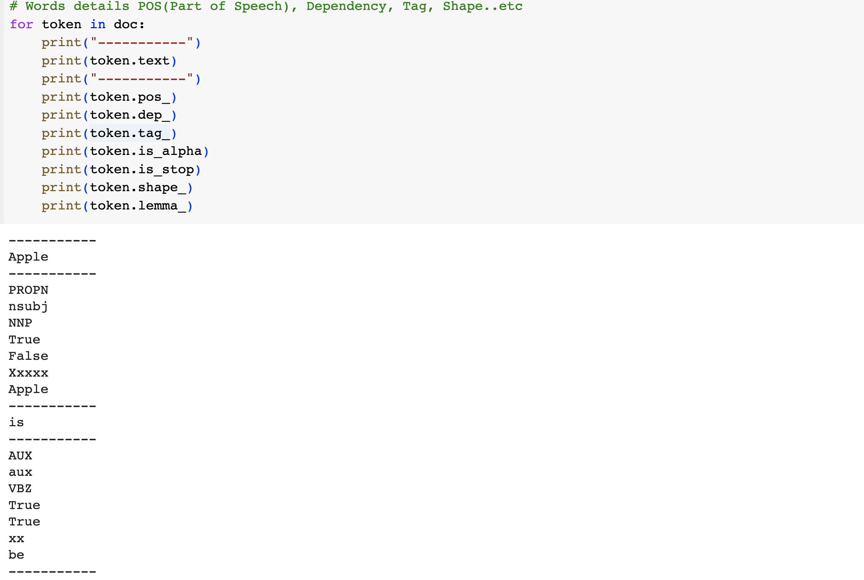
spacy : Linguistic Features

Slide 23
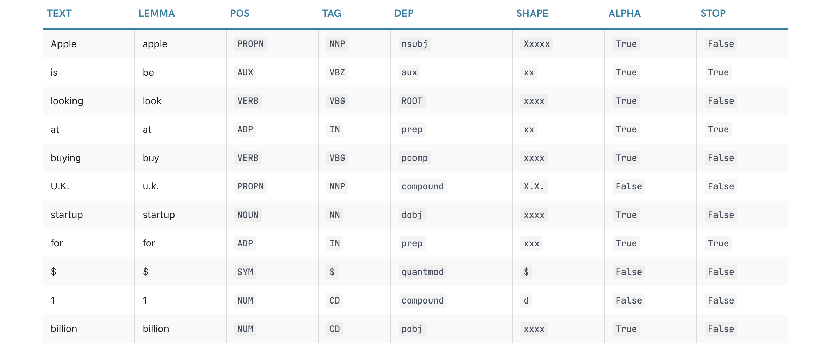
spacy : Linguistic Features

Slide 24
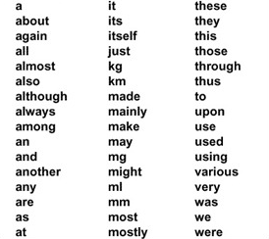
Stop words
Stop words are commonly used words

Slide 25
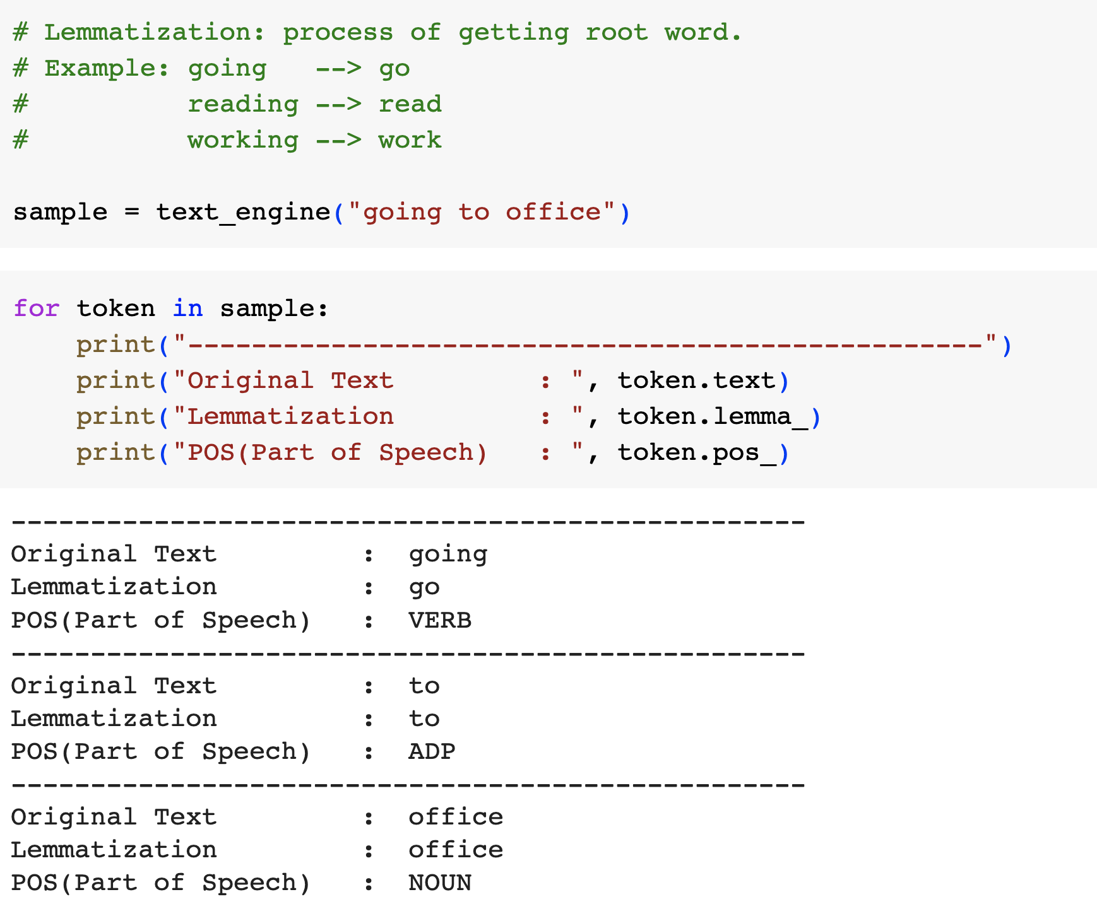
spacy : Linguistic Features

Slide 26
Example: Named Entities
A named entity is a “read-world object that’s assigned a name – for example, a person, a country, a product or book title.
import spacy
text_engine = spacy.load("en_core_web_sm")
doc = text_engine("Apple is looking to buying U.K. startup for $1 billion.")
for ent in doc.ents:
print(ent.text, ent.label_)

Slide 27
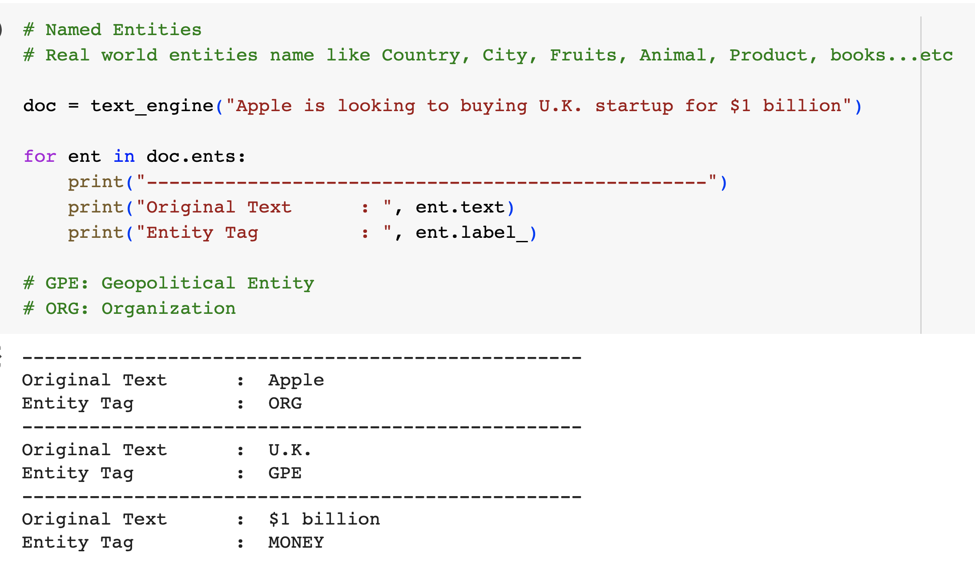
Example: Named Entities

Slide 28
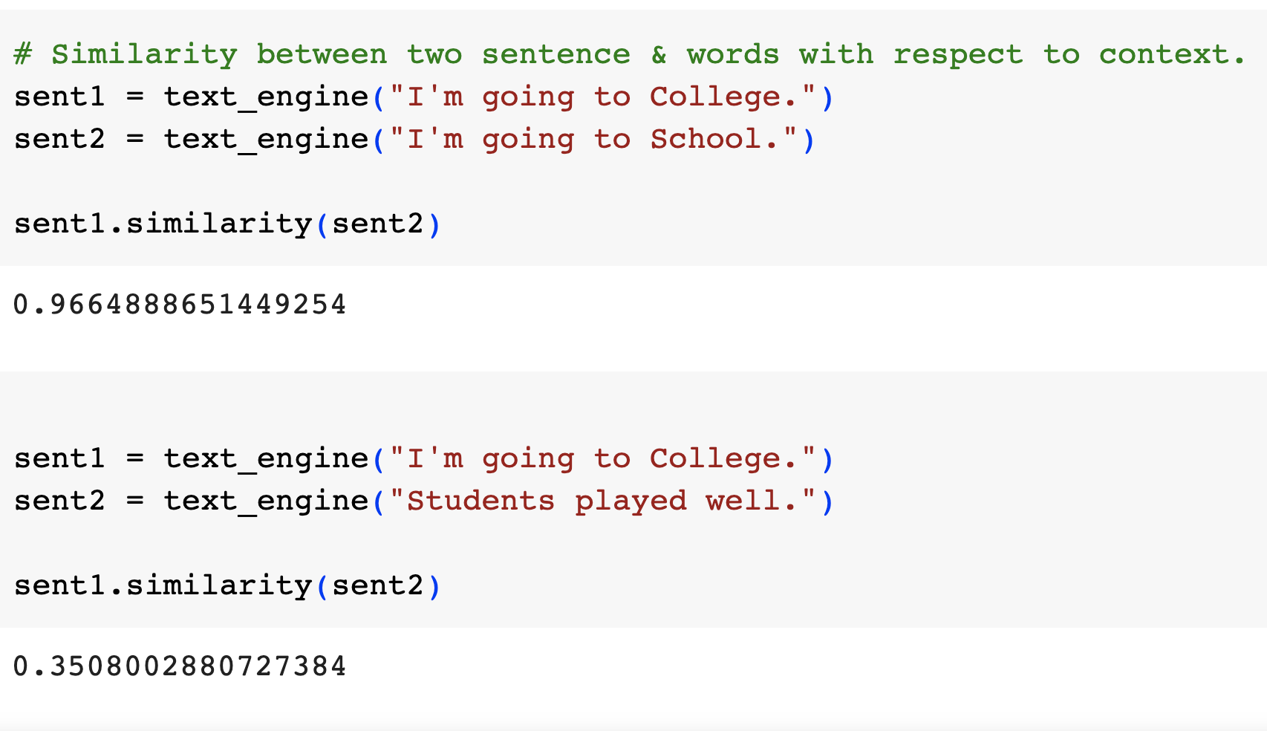
Example: Similarity

Slide 29


