Slide 1
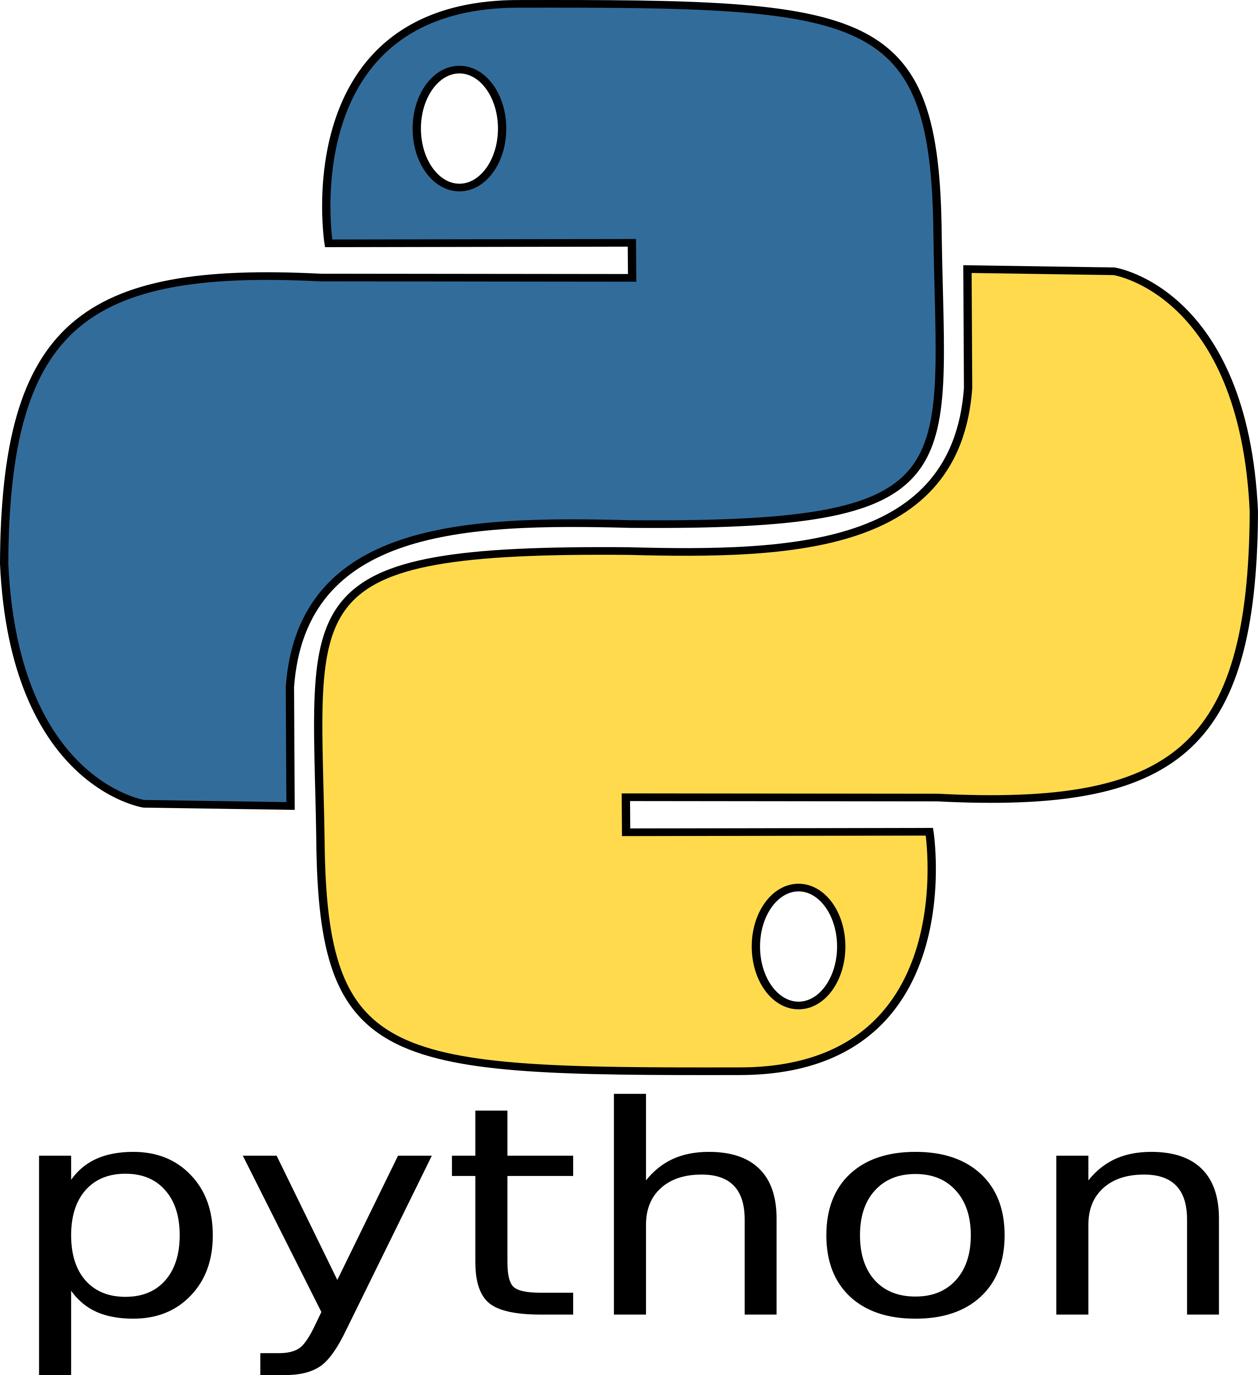
BIG DATA TOOLS FOR MANAGERS
Unit-4 : Introduction to Python Programming
by
Ankit Velani
Adjunct Faculty, Dept. of MBA,
Siddaganga Institute of Technology,Tumkur

Slide 2
Overview
Introduction Python
Python & Jupyter Notebook
Getting started with Python
Variables
Comments
Packages

Slide 3
Introduction to Python
Python is a general-purpose interpreted, interactive, object-oriented, and high-level programming language
Python is designed to be highly readable. It uses English keywords frequently whereas the other languages use punctuations.

Slide 4
How Python is useful?
Python has built-in features of application development and other system related libraries.
Python can easily preprocess varieties of structure & unstructured data.
Python is available for all the operating system (Windows, Linux, macOS), and easy to move Python code from one operating system to another operating system.
Python has a wide & active community, and 2,00,00+ packages worldwide to improve project features and productivity while working with Python.
Python has various libraries for Statistical analysis, Text Analysis, Visualization.

Slide 5
Python Software
Python Interpreter/software, which is available for all the OS
Official website :
www.python.org
or
www.anaconda.com

Slide 6
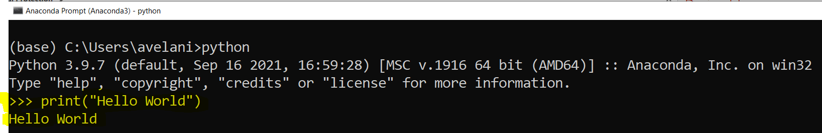
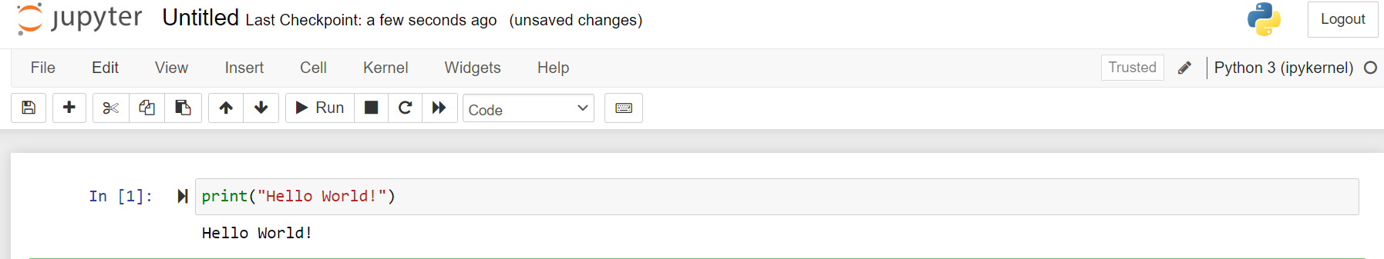
Tools to Run Python Code
Command Prompt
Jupyter Notebook

Slide 7
Reserved Words
The following list shows the Python keywords. These are reserved words and you cannot use them as variables or any other identifier names.
All the Python keywords contain lowercase letters only.
and | exec | not
as | Finally | or
assert | For | pass
break | from | print
class | global | raise
continue | if | return
def | import | try
del | in | while
elif | is | with
else | lambda | yield
except

Slide 8
Variables
Variables are container for storing data value in memory.
A variable is created the moment you first assign a value to it.
Example:
x = 5 y = "John" print(x) print(y)

Slide 9
Variables
Rules to create variable name:
A variable name must start with a letter or the underscore character
A variable name cannot start with a number
A variable name can only contain alpha-numeric characters and underscores (A-z, 0-9, and _ )
Variable names are case-sensitive (age, Age and AGE are three different variables)
Python does not allow punctuation characters such as @, $, and % within variable name or identifiers

Slide 10
Variables
Example:
2myvar = "John" my-var = "John" my var = "John"
myvar = "John"
my_var = "John"
_my_var = "John"
myVar = "John"
MYVAR = "John"
myvar2 = "John"
Invalid variable name
Valid variable name

Slide 11
Variables
Multi Words Variable Names:
Example:
myVariableName = "John"
MyVariableName = "John"
my_variable_name = "John"

Slide 12
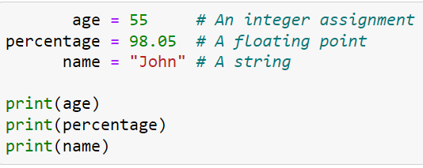
Variables
Example:
( ) → denotes Function Call, print is function and it display the value of variable.

Slide 13
Python Indentation
Python does not use braces({}) to indicate blocks of code for class and function definitions or flow control.
Blocks of code are denoted by line indentation, which is rigidly enforced.
The number of spaces in the indentation is variable, but all statements within the block must be indented the same amount

Slide 14
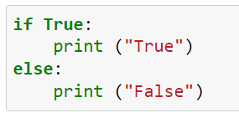
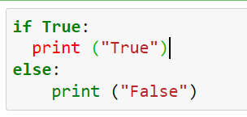
Python Indentation
Valid
Invalid

Slide 15
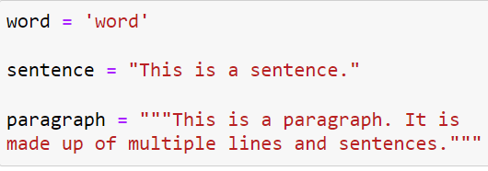
Quotation in Python
Python accepts single ('), double (") and triple (''' or """) quotes to denote string literals, as long as the same type of quote starts and ends the string.

Slide 16

Comments in Python
A hash sign (#) that is not inside a string literal is the beginning of a comment.
All characters after the #, up to the end of the physical line, are part of the comment and the Python interpreter ignores them.

Slide 17
Python Packages
PIP is a package manager for Python packages, or modules if you like.
A package contains all the files you need for a module/libraries.
Downloading Package from internet
pip install <package-name>
On-Jupyter Notebook
!pip install <package-name>

Slide 18
Python Packages
Example:
!pip install pandas
!pip install sklearn
!pip install spacy
!pip install matplotlib
!pip install pandasql

Slide 19
Import Packages
Import statement used to import python packages in Python code.
Example:
import pandas
import pandas as pd
Alias of package name
Ie. here pd is alias name of pandas

Slide 20
Read csv file in Pandas
read_csv() function used to read csv file in Pandas.
i.e
import pandas
data = pandas.read_csv("IPL.csv")

Slide 21
Read csv file in Pandas
read_csv() function used to read csv file in Pandas.
i.e
import pandas as pd #pd is alias of pandas
data = pd.read_csv("IPL.csv")

Slide 22
Recap
Python is a general-purpose interpreted, interactive, object-oriented, and high-level programming language.
Python is available for all the operating system.
Jupyter Notebook is an environment to execute Python Code.
Reserved Words can not used as variable or function name.
Variable name can only contain alpha-numeric character and underscores(A-z, 0-9 and _ )
Blocks of code are denoted by indentation, not with the braces ({})
Python accepts single ('), double (") and triple (‘ ‘ ‘ or “ “ ") quotes to create strings.
pip command used to download & install python packages from Internet.
Import statement used to import python package.

Slide 23
Python Programming
The focus will be on features that are important from data analysis perspective.
Declaring Variables
Conditional Statements
Control Flow
Functions
Data Structures/Collections (List, Tuple, Sets, Dictionary)

Slide 24
Declaring Variables
A variable can be declared and then assigned a value without specifying data type.
Python automatically infers the variable type from values assigned to it.
A Variable initialized with a value of one type can later be re-assigned as value of a different type.
int – Integer type
float – Floating point number
bool – Boolean value (True/False)
str – Textual data

Slide 25
Declaring Variables
Example:
var1 = 2
var2 = 5.0
var3 = True
var4 = "Python Programming"
Above are the variables creating with various data types (int, float, booleans, string)

Slide 26
Declaring Variables
print() used to print the value of any variables and type() function used check the data types of any variables.
print(var1)
print(var2)
print(var3)

Slide 27
Declaring Variables
print() used to print the value of any variables and type() function used check the data types of any variables.
print(var1)
print(var2)
print(var3)
type(var1) # gives result as int
type(var2) # gives result as float
type(var3) # gives result as bool
type(var4) # gives result as str

Slide 28
Conditional Statement
Python supports if-elif-else for writing conditional statements.
The condition should be terminated by : (colon) and code block following that must be indented.
Syntax:
if condition:
statements
elif condition:
statements
else:
statements

Slide 29
Conditional Statement
Example : Simple If
Write conditional statement to check whether variable contains positive value.
var1 = 5
if var1 > 0:
print("True. Variable contains positive numbers")

Slide 30
Conditional Statement
Example : If..Else Statement
Write conditional statement to check then condition and display appropriate message for True & False condition.
var2 = -20
if var2 > 0:
print("True. Value is positive numbers")
else:
print("False. Value is not positive numbers")

Slide 31
Conditional Statement
Example : if..elif..else
With the help of if..elif..else we can add & check multiple conditions.
x = 10
y = 20
if x>y:
print("X is greater than Y")
elif y>x:
print("Y is greater then X")
else:
print("X & Y are same")

Slide 32
Sequence Numbers Generation
range() function used to generate a sequence of numbers. If takes following parameters.
start : starting number of the sequence
stop : Generate numbers up to , but not including this number
step : Difference between each number and default value is 1
Example : Generate sequence number from 1 to 5
x = range(1, 5, 1) #step is 1
Y = range(1, 100, 5) #step is 5

Slide 33
Control Flow Statements
To display value of sequence of numbers by iterating using Control flow statements.
For Loop
While Loop

Slide 34
Control Flow Statements
Display sequence of numbers using For loop
x = range(1, 5, 1)
for num in x:
print(num)
Output:
1
2
3
4
5

Slide 35
Control Flow Statements
Display sequence of numbers using While loop
i = 1 # Initialize variable i with 1
while i < 5: # Check the condition
print(i)
i = i + 1 # increments
Output:
1
2
3
4
5

Slide 36
Functions
Functions are the most important part of a programming language.
Functions can be created using def keyword.
The function signature should contain the function name followed by the input parameters enclosed in brackets and must be end with colon (:)
The functions ends with a return statements. If no return statement implies the function returns Nothing (None).

Slide 37
Functions
Syntax:
def function_name(parameters1, parameters2…):
function-statements
function-statements
…
return statement

Slide 38
Functions
Example:
Write a functions to add of two integer numbers:
def addElement(a,b):
y = a + b
return y
addElement(5,10)
# 15

Slide 39
Data Structures/ Collections
Data Structures/Collections are useful containers to store and manipulate list of homogeneous or heterogeneous elements.
Following data structures in this sections:
List
Tuple
Set
Dictionary

Slide 40
List - Data Structures
List allows to contain heterogeneous items, that is, a single list can contain items of type int, float, string or object.
List can be created with square bracket [ ]
List values can repeat, it allows to store repeated values.
Lists are mutable and generally initialized with a list of values specified inside square brackets or an empty list.

Slide 41
List - Data Structures
Creation syntax:
variable_name = [element-1, element-2, element-3..etc ]
Example:
Create list of integer number
num_list = [ 1, 2, 3, 4, 5, 6, 7, 8, 9, 10 ]
print(num_list)

Slide 42
List - Data Structures
Creation syntax:
variable_name = [element-1, element-2, element-3..etc ]
Example:
Create list of integer number
num_list = [ 1, 2, 3, 4, 5, 6, 7, 8, 9, 10 ]
print(num_list)
Create list of city name
city_name = ["Tumkur", "Bangalore", "Mysuru",
"Mandya", "Davangere", "Shivamogga"]
print(city_name)

Slide 43
List - Data Structures
Accessing Elements from a List
List elements can be access using indexing range separated by colon (:)
Index range allows from 0 to n-1 element.
Syntax
list-variable-name[index]
or
list-variable-name[start:end] # with range of index

Slide 44
List - Data Structures
num_list = [ 1, 2, 3, 4, 5, 6, 7, 8, 9, 10 ]
print(num_list)
# Accessing first element
num_list[0]
# Accessing list using index range
num_list[3:7] #Index 7 will not be included (4,5,6,7)
# Accessing last element
num_list[-1] #Negative index display element from last
# Accessing last 3 element from a list
num_list[-3: ]

Slide 45
List - Data Structures
# Calculate list size (how many elements are present in list)
len(num_list)
# List allow to combine another list easily with + (plus) operator
num = [1, 2, 3, 4, 5]
alpha = ['a','b','c','d','e']
combined_list = num + alpha
print(combined_list)
Output:
[ 1, 2, 3, 4, 5, 'a’, 'b’ ,'c’ ,'d', 'e' ]

Slide 46
List - Data Structures
List allows to change/update the list elements
num_list = [1,2,3,4,5,6,7,8,9,10]
num_list[4] = 404 #updating 4th index element with new value
num_list[-2] = 99990 #updating 2nd last element of list
print(num_list)
Output:
[1, 2, 3, 4, 404, 6, 7, 8, 99990, 10]

Slide 47
Tuple - Data Structures
Tuple is also a list, but it is immutable. Once a tuple has been created it cannot be modified.
Tuple can be created with parenthesis ()
Tuple can have repeat value, and it allows to store repeated values also.
Tuple are immutable and generally initialized with a list of values specified inside parenthesis ().

Slide 48
Tuple - Data Structures
Creation syntax:
variable_name = (element-1, element-2, element-3..etc )
Example:
Create Tuple of integer number
num_list = (1, 2, 3, 4, 5, 6, 7, 8, 9, 10)
print(num_list)

Slide 49
Tuple - Data Structures
Creation syntax:
variable_name = (element-1, element-2, element-3..etc )
Example:
Create Tuple of integer number
num_list = (1, 2, 3, 4, 5, 6, 7, 8, 9, 10)
print(num_list)
Create Tuple of city name
city_name = ("Tumkur", "Bangalore", "Mysuru",
"Mandya", "Davangere", "Shivamogga")
print(city_name)

Slide 50
Tuple - Data Structures
Accessing Elements from a Tuple
Tuple elements can be access using indexing range separated by colon (:)
Index range allows from 0 to n-1 element.
Syntax
tuple-variable-name[index]
or
tuple-variable-name[start:end] # with range of index

Slide 51
Tuple - Data Structures
num_tuple = ( 1, 2, 3, 4, 5, 6, 7, 8, 9, 10 )
print(num_tuple)
# Accessing first element
num_tuple[0]
# Accessing tuple using index range
num_tuple[3:7] #Index 7 will not be included (4,5,6,7)
# Accessing last element
num_tuple[-1] #Negative index display element from last
# Accessing last 3 element from a tuple
num_tuple[-3: ]

Slide 52
Tuple - Data Structures
# Calculate list size (how many elements are present in list)
len(num_tuple)
# Tuple allow to combine another Tuple easily with + (plus) operator
num_tuple = (1, 2, 3, 4, 5)
alpha_tuple = ('a','b','c','d','e’)
combined_tuple = num_tuple + alpha_tuple
print(combined_tuple)
Output:
[ 1, 2, 3, 4, 5, 'a’, 'b’ ,'c’ ,'d', 'e' ]

Slide 53
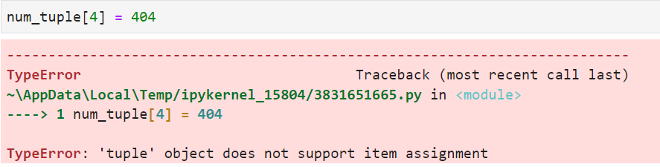
Tuple - Data Structures
#Tuple is immutable, means once it created, we can not change any elements.
num_tuple = ( 1, 2, 3, 4, 5, 6, 7, 8, 9, 10 )
print(num_tuple)
num_tuple[4] = 404 #This statement will throw error message, bcz tuple is immutable

Slide 54
Set - Data Structures
A set is a collection of unique elements, that is the value con not repeat.
Set can be created with curly brackets {}
The set automatically removes duplicates and contains only unique list of numbers.
Syntax:
variable_name = {element-1, element-2, element-3..etc }

Slide 55
Set - Data Structures
Example:
s = {1, 2, 3, 4, 1, 2, 3, 4, 5, 6, 7, 8, 9, 9,10}
print(s)
Iterate using For loop.
for ele in s:
print(ele)

Slide 56
Set - Data Structures
#Set Operation:
s1= {1,2,3,4,5,10,20,30,40}
s2= {4,5,6,7,8,9,10}
# Union
s3 = s1.union(s2)
print(s3)

Slide 57
Set - Data Structures
#Set Operation:
s1= {1,2,3,4,5,10,20,30,40}
s2= {4,5,6,7,8,9,10}
# Union
s3 = s1.union(s2)
print(s3)
# Intersection
s4=s1.intersection(s2)
print(s4)
#difference Set (A-B)
s5 =s1.difference(s2)
print(s5)

Slide 58
Dictionary - Data Structures
Dictionary is a list of key and value pairs. All keys in a dictionary are unique.
Dictionary can be created with curly brackets & key : value
{"Key": "Value"}
The value of dictionary can be accessed by using key.
Syntax:
dict_var_name = {
"key1": "value",
"key2": "value",
...
}

Slide 59
Dictionary - Data Structures
Example:
student = {
"USN": "1SI22MBA01",
"NAME": "John",
"CITY": "Tumkur",
"DEPT": "MBA",
"COLLEGE": "SIT, Tumkur"
}
print(student)

Slide 60
Dictionary - Data Structures
# Display all the Keys available in Dictionary:
student.keys()
# Display all the value available in Dictionary:
student.values()
# Access element using Key
student['USN’]
student['NAME’]
# Update value in Dictionary
student['USN']="1SI22MBA02" # Print dictionary after an update

Slide 61
Dictionary - Data Structures
# Combine two dictionary
sub = {
'Sub-1': 45,
'Sub-2': 55,
'Sub-3': 65
}
student.update(sub)
print(student)

Slide 62
Comparison with Python Data structure
Lists | Tuple | Set | Dictionary
Lists are mutable | Tuples are immutable. | Sets are mutable | Dictionary are mutable
Lists are enclosed within square braces. [ ] | Tuples are enclosed within parenthesis. ( ) | Sets are enclosed in curly brackets. { } | Dictionaries are enclosed in curly brackets with key-value pairs. { key : value }
List element can be accessed using index/ range of index | Tuple element can be accessed using index/range of index | Have use iteration like for, while loop to access element | Dictionary element can be accessible using its key
len() function used to get length/size of list | len() function used to get length/size of Tuple | len() function used to get length/size of set | len() function used to get length/size of dictionary
Easy to combine two or more lists with + (plus) operator | Easy to combine two or more Tuple with + (plus) operator | union to be used for combining two set | update function used to combine two dictionary

Slide 63
Exercise
Create a List with given element [10,20,30,40,50,60,70,80,90,100]
Write a python code for :
Create a List
Print element using print()
Print element using iteration (For loop)
Multiply list elements with number 2
Display first element of list
Display last element of list
Display first 3 elements of list
Display last 3 elements of list

Slide 64
Exercise
# Create a dictionary for Employee data
employee_Name : John
employee_City : Bangalore
employee_Mobile: 9876512345
employee_Email : john@gmail.com
Write a python code for :
Create a employee dictionary
Display all the key present in dictionary
Display all the value present in dictionary
Print Dictionary element
Access dictionary element using employee_Name
Access dictionary element using employee_Email

