Slide 1
BIG DATA TOOLS FOR MANAGERS (N2MBA07)
Unit -1 : Overview of Database, SQL and MySQL

Slide 2





Database
?

Slide 3
A database is an organized collection of structured information or data, typically stored electronically in a computer system.
Database

Slide 4
A database is an organized collection of structured information or data, typically stored electronically in a computer system. Or The database is an organized collection of data so that, it can be easy to access and manipulate stored information.
Database

Slide 5

Database
Unorganized collection of data

Slide 6
Database
Unorganized collection of data
Organized collection of data

Slide 7

Database Example :
Consider college database organizes the data about the admin, students, libraries, and faculty.
Using the database, it can be easy to retrieve, insert, and delete information.
College Database
Former faculties
Students
Faculty
Alumnus
Faculties
Students
New admission
Hostel Block
Admission Inquiry
Hostel
Hostel Staff
Dropout

Slide 8
File based approach
File base approach/File Management system used to manage data needed for a specific use case or application.
Each user stores separate data for the application even if the same data stored by another user.
Like College, there are multiple department such as admin, hostel, library, exam each departments are maintaining student details separately
If there are 100 students and 5 departments then will be storing 5x100 = 500 records

Slide 9
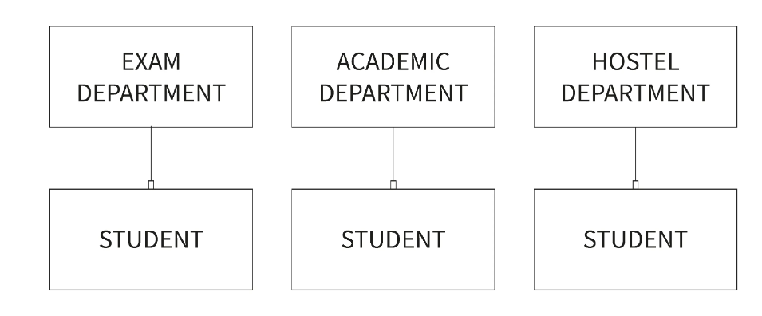
File Based Approach

Slide 10
File Based Approach
**Major drawback of file-based approach is repetition of data and wastage of resources.

Slide 11
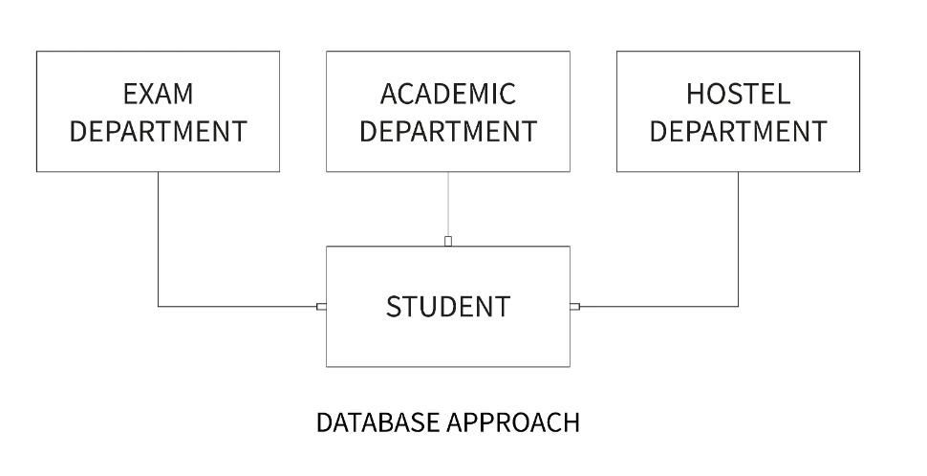
Database Approach
A database is used for storing and maintaining the data where data defined once and stored in single location, it available for multiple users or departments.

Slide 12
Characteristics of Database approach
Self-Describing Nature of a Database System

Slide 13
Characteristics of Database approach
Self-Describing Nature of a Database System
Insulation between Programs and Data, Data Abstraction and Multi-user Transaction Processing

Slide 14
Characteristics of Database approach
Self-Describing Nature of a Database System
Insulation between Programs and Data, Data Abstraction and Multi-user Transaction Processing
Support of Multiple Views of the Data

Slide 15
Characteristics of Database approach
Self-Describing Nature of a Database System
Insulation between Programs and Data, Data Abstraction and Multi-user Transaction Processing
Support of Multiple Views of the Data
Security

Slide 16
Characteristics of Database approach
Self-Describing Nature of a Database System
Insulation between Programs and Data, Data Abstraction and Multi-user Transaction Processing
Support of Multiple Views of the Data
Security
Supports Query Language to perform database operation effectively.

Slide 17

Database management system
A database management system (DBMS) is a software tool that helps organize, store and retrieve data from a database.
It involves several functions that collectively work together to ensure that the data is accurate, available and accessible.

Slide 18
DBMS Elements
Database management system consists of three main elements
A physical database that contains the data

Slide 19
DBMS Elements
Database management system consists of three main elements
A physical database that contains the data
A database engine that helps to access the data and modify its contents.

Slide 20
DBMS Elements
Database management system consists of three main elements
A physical database that contains the data
A database engine that helps to access the data and modify its contents.
A database schema which provides the logical structure of the data stored in the database.

Slide 21

Types of Database Management System
Relational database management system
Distributed database management system
Network database management system
Object-oriented database management system
Hierarchical database management system

Slide 22
Relational Database Management System (RDBMS)
A relational database management system or RDBMS is a database system that stores and fetches data in the form of tables.
How Does a Relational Database Work?
Relational Databases use tables to store data about related objects. Each column contains data attributes, whereas each row holds a record of unique data known as Key.
Relational Databases or RDBMS are managed using SQL.

Slide 23

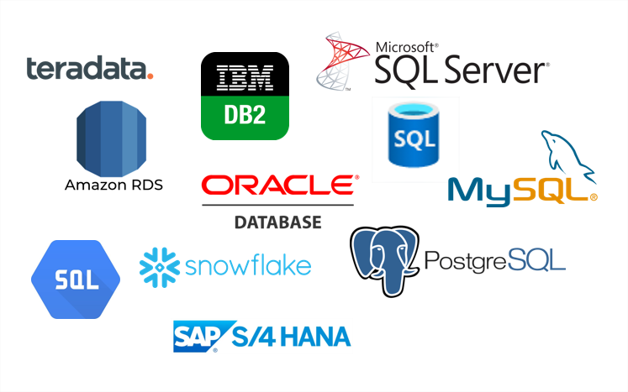
RDBMS Software
MySQL is currently the most popular database management system software used for managing the relational database.
It is open-source database software, which is supported by Oracle Company.
**Other RDBMS Software

Slide 24
In RDBMS terminologies
Columns/Fields/Attributes
EMP_ID | NAME | ADDRESS | AGE
1 | Rahul | Bengaluru | 23
2 | Suman | Kolkata | 25
3 | Raj | Delhi | 30
Records/
Tuples/
Rows

Slide 25
In RDBMS terminologies
Attribute: Attributes are properties that define the relational database. Eg: EMP_ID, NAME etc

Slide 26
In RDBMS terminologies
Attribute: Attributes are properties that define the relational database. Eg: EMP_ID, NAME etc
Relation Schema: A relational schema defines its relationship with other attributes alltogether. E.g., EMPLOYEE (EMP_ID, NAME, ADDRESS, AGE)

Slide 27
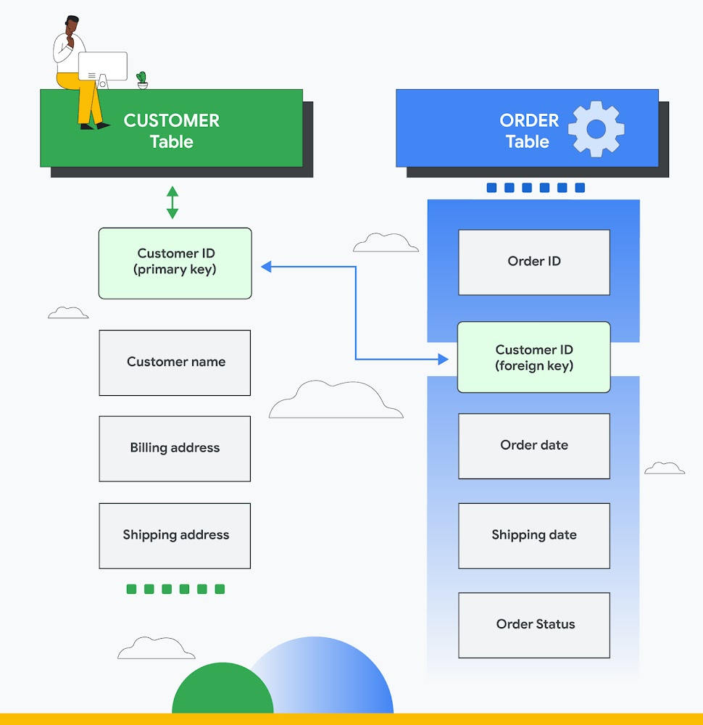

Slide 28
In RDBMS terminologies
Attribute: Attributes are properties that define the relational database. Eg: EMP_ID, NAME etc
Relation Schema: A relational schema defines its relationship with other attributes alltogether. E.g., EMPLOYEE (EMP_ID, NAME, ADDRESS, AGE)
Degree: Degree is defined by several attributes we have in a relational table. E.g., The degree of the EMPLOYEE table is 4

Slide 29
In RDBMS terminologies
Attribute: Attributes are properties that define the relational database. Eg: EMP_ID, NAME etc
Relation Schema: A relational schema defines its relationship with other attributes alltogether. E.g., EMPLOYEE (EMP_ID, NAME, ADDRESS, AGE)
Degree: Degree is defined by several attributes we have in a relational table. E.g., The degree of the EMPLOYEE table is 4
Cardinality: Cardinality is defined by the number of tuples in a relation. E.g., The cardinality of the EMPLOYEE table is 3.

Slide 30
In RDBMS terminologies
Attribute: Attributes are properties that define the relational database. Eg: EMP_ID, NAME etc
Relation Schema: A relational schema defines its relationship with other attributes alltogether. E.g., EMPLOYEE (EMP_ID, NAME, ADDRESS, AGE)
Degree: Degree is defined by several attributes we have in a relational table. E.g., The degree of the EMPLOYEE table is 4
Cardinality: Cardinality is defined by the number of tuples in a relation. E.g., The cardinality of the EMPLOYEE table is 3.
NULL Values: The values or data which are unknown are kept as NULL.

Slide 31
SQL
SQL is a standard programming language used to operate Relational Databases and carry out various operations such as inserting, manipulating, updating, and retrieving data from relational databases.
SQL is not a database system, but it is a query language.
SQL is a short-form of the structured query language, and it is pronounced as S-Q-L or sometimes as See-Quell.

Slide 32
SQL
SQL is a standard programming language used to operate Relational Databases and carry out various operations such as inserting, manipulating, updating, and retrieving data from relational databases.
SQL is not a database system, but it is a query language.
SQL is a short-form of the structured query language, and it is pronounced as S-Q-L or sometimes as See-Quell.
OR
This database language is mainly designed for maintaining the data in relational database management systems.
It is a special tool used by data professionals for handling structured data (data which is stored in the form of tables)

Slide 33
Features of SQL
RDBMS only understand SQL command and instruction to perform any kind of operation.
SQL is used to access data within the relational database.
SQL is very fast in extracting large amounts of data very efficiently.
SQL is flexible as it works with multiple database systems from Oracle, IBM, Microsoft, etc.
SQL helps you manage databases without knowing a lot of coding.

Slide 34
Some SQL Commands
The SQL commands help in creating and managing the database.
The most common SQL commands which are highly used are mentioned below:
CREATE command
UPDATE command
DELETE command
SELECT command
DROP command
INSERT command

Slide 35
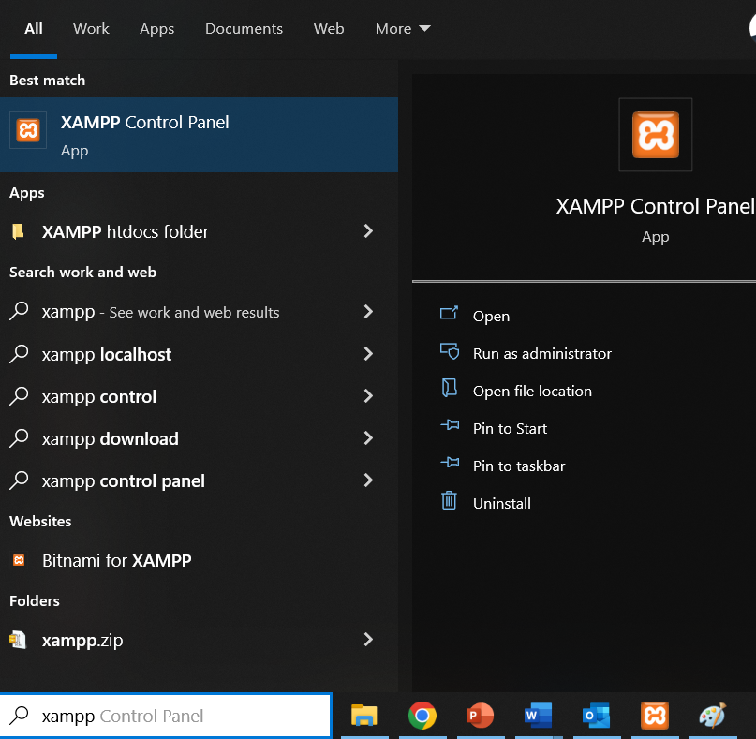
Working with MYSQL (XAMPP phpMyAdmin)
Start XAMPP application from all programs in Windows laptop

Slide 36
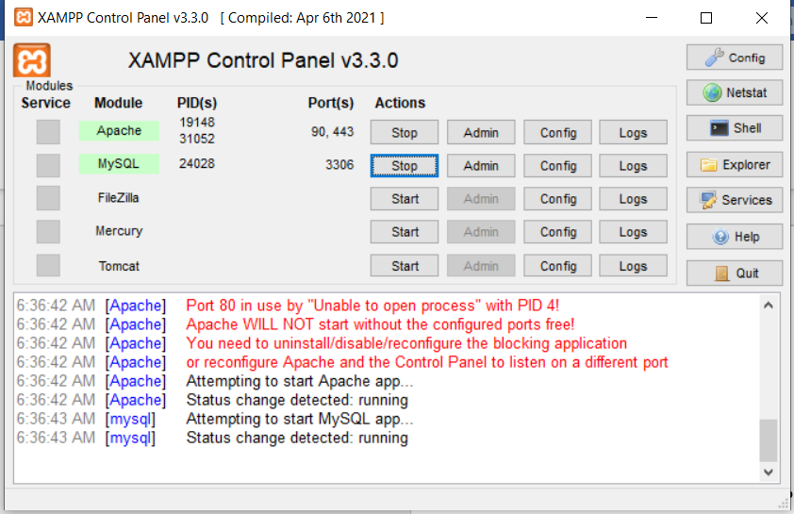
Working with MYSQL (XAMPP phpMyAdmin)
Start Apache & MySQL services on XAMPP control panel

Slide 37
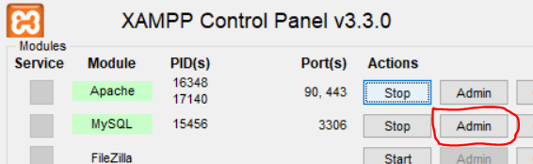
Working with MYSQL (XAMPP phpMyAdmin)
Start Apache & MySQL services on XAMPP control panel
Once both services are running click on Admin button of MySQL services. It will take you on web browser with URL like
http://localhost/phpmyadmin
http://localhost:8080/phpmyadmin
http://localhost:90/phpmyadmin

Slide 38
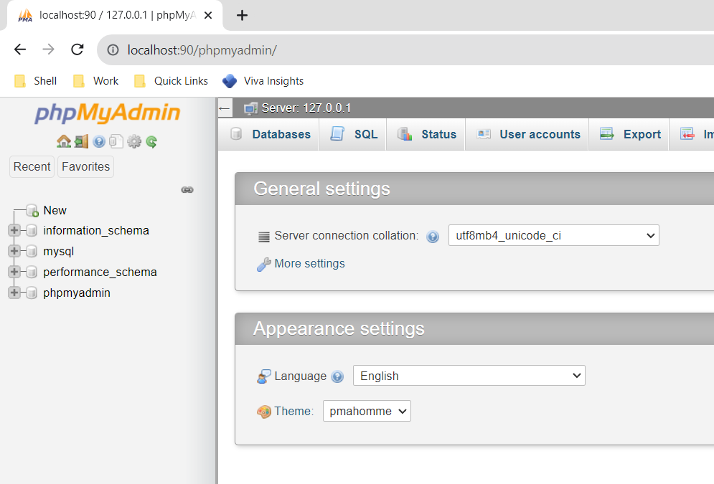
Working with MYSQL (XAMPP phpMyAdmin)
phpMyAdmin home page on web browser

Slide 39
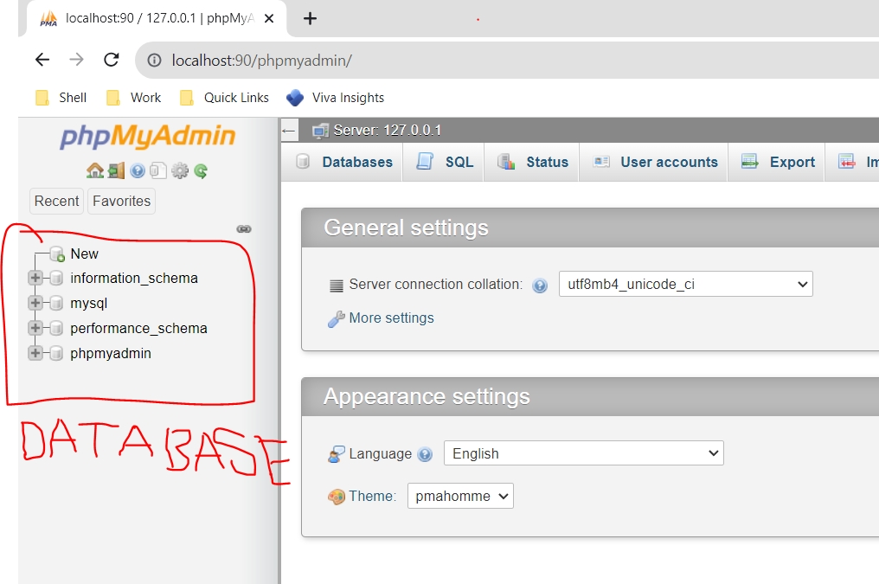
Working with MYSQL (XAMPP phpMyAdmin)
On left panel it contains all the database available on MySQL server.

Slide 40
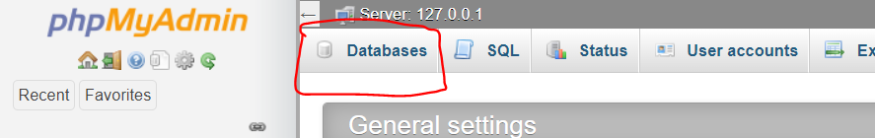
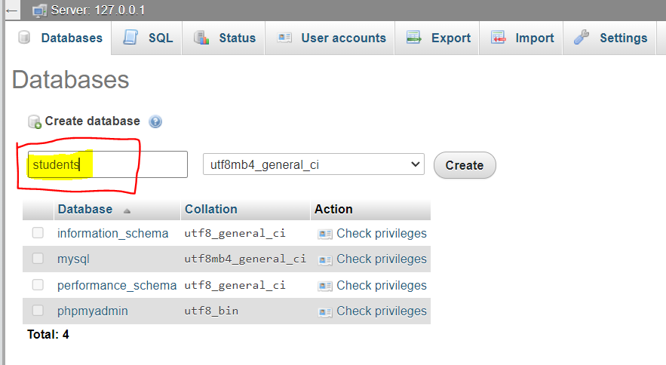
Working with MYSQL (XAMPP phpMyAdmin)
Creation of Database: Click on database on top row of phpMyAdmin
Type database name and click on Create button

Slide 41
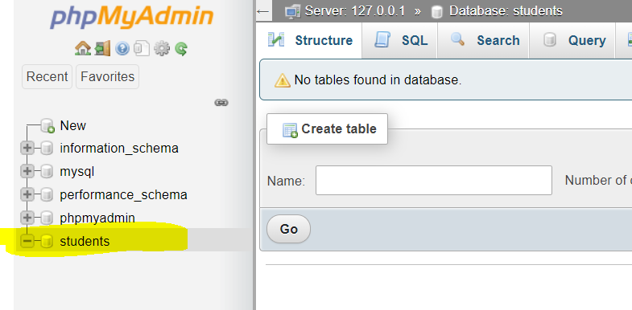
Working with MYSQL (XAMPP phpMyAdmin)
Once database created it will show in left panel windows.

Slide 42
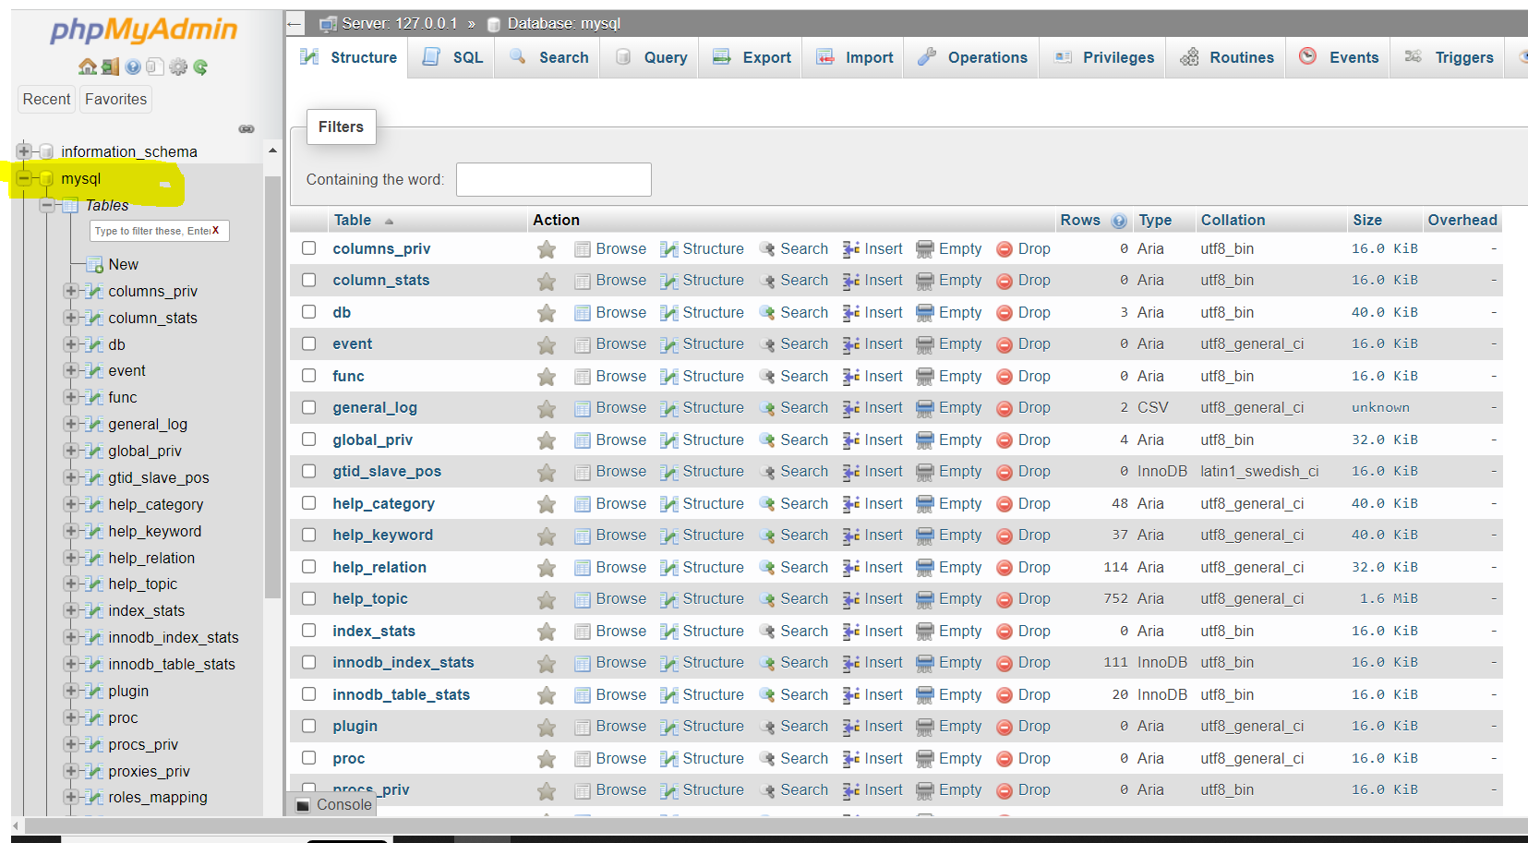
Working with MYSQL (XAMPP phpMyAdmin)
Selecting Databases
Clicking on database name it will get selected for data manipulation, and display lists of tables available in selected database.

Slide 43
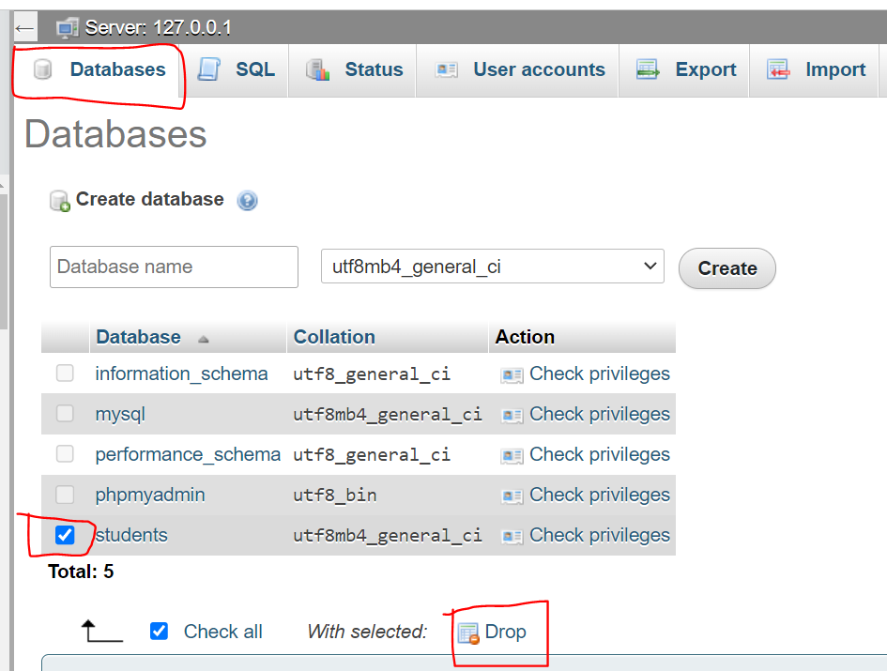
Working with MYSQL (XAMPP phpMyAdmin)
Drop Databases
Dropping database means deleting database from MySQL software.

Slide 44
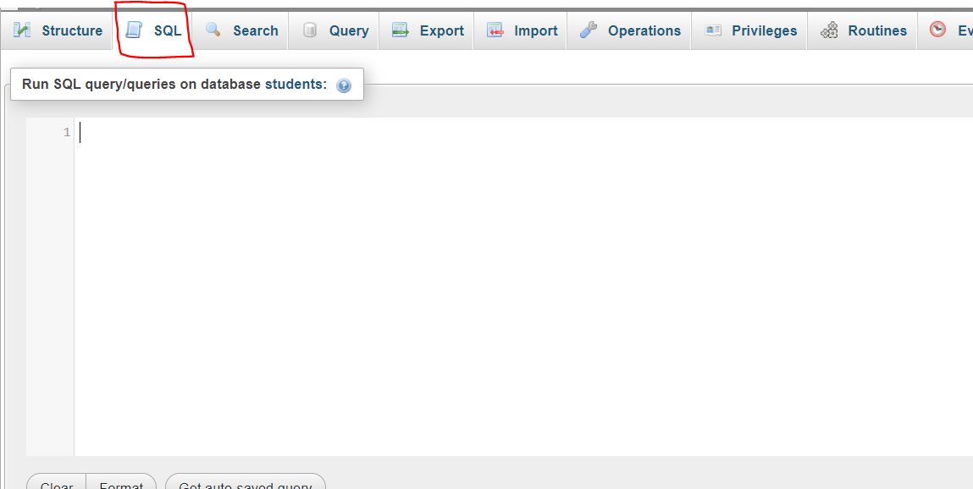
XAMPP - SQL Window
On top row of phpMyAdmin SQL button is available, click on SQL button gives SQL windows to write SQL commands / statements/ instructions.

Slide 45
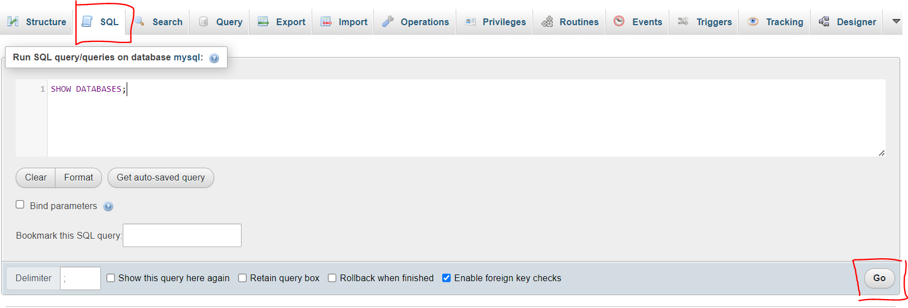
XAMPP - SQL Window
SQL Statement execution
SHOW DATABASES;

Slide 46
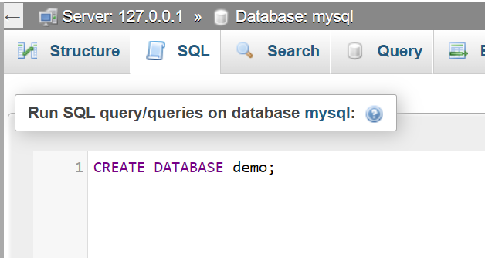
XAMPP - SQL Window
SQL Statement – Create new database “demo” using SQL command/statement in MySQL
CREATE DATABASE demo;

Slide 47
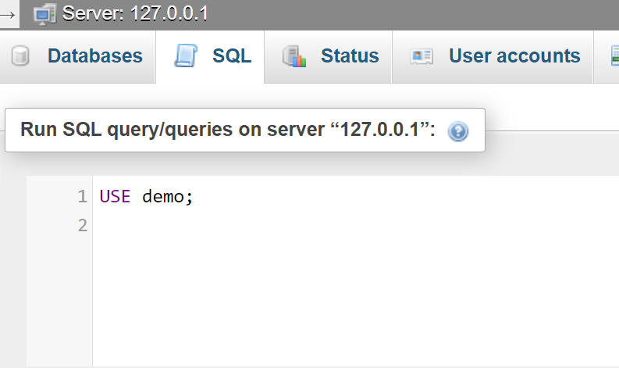
XAMPP - SQL Window
SQL Statement – Select “demo” database using SQL command/statement in MySQL
USE demo;

Slide 48
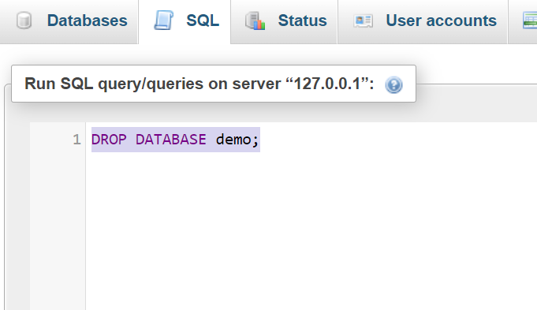
XAMPP - SQL Window
SQL Statement – Delete/Drop “demo” database using SQL command in MySQL
DROP DATABASE demo;

Slide 49
Recap
Getting familiar with XAMPP → MySQL (Start & Stop services)

Slide 50
Recap
Getting familiar with XAMPP → MySQL (Start & Stop services)
Getting familiar with phpMyAdmin(MySQL) windows.

Slide 51
Recap
Getting familiar with XAMPP → MySQL (Start & Stop services)
Getting familiar with phpMyAdmin(MySQL) windows.
Creating/Selecting/Deleting database using Navigation as well as SQL statement.

Slide 52
Exercises
Create EMPLOYEE database using SQL Statements/Command, write all the commands in a notebook and then execute in SQL windows.
LIST ALL the Database available in MySQL
CREATE EMPLOYEE statement
LIST ALL Database available in MySQL
USE EMPLOYEE statement
LIST ALL TABLE present in EMPLOYEE database

Slide 53
Exercises
Create MOVIE database using phpMyAdmin Navigation bar, create document file and copy paste the screenshot for each point.
CREATE MOVIE database
SELECT MOVIE database
Check are there any tables for MOVIE database

Slide 54
Till now…..
Database

Slide 55
Till now…..
Database
Example:
EMPLOYEE
MOVIE
demo
students

Slide 56
Till now…..
Database
What Next ?
Example:
EMPLOYEE
MOVIE
demo
students

Slide 57
What Next?
Tables
Table-1
Table-2
Table-3
Table-4
demo
Database

Slide 58
Working with Tables
Step-1 : Create EMPLOYEE database
CREATE DATABASE EMPLOYEE;
Step-2 : Select EMPLOYEE database
USE EMPLOYEE;

Slide 59
Working with Tables
Step-3 : Create employee_details table in EMPLOYEE database.
USE EMPLOYEE;
CREATE TABLE employee_details
(
ID text ,
NAME text ,
MOBILE text ,
CITY text
);

Slide 60
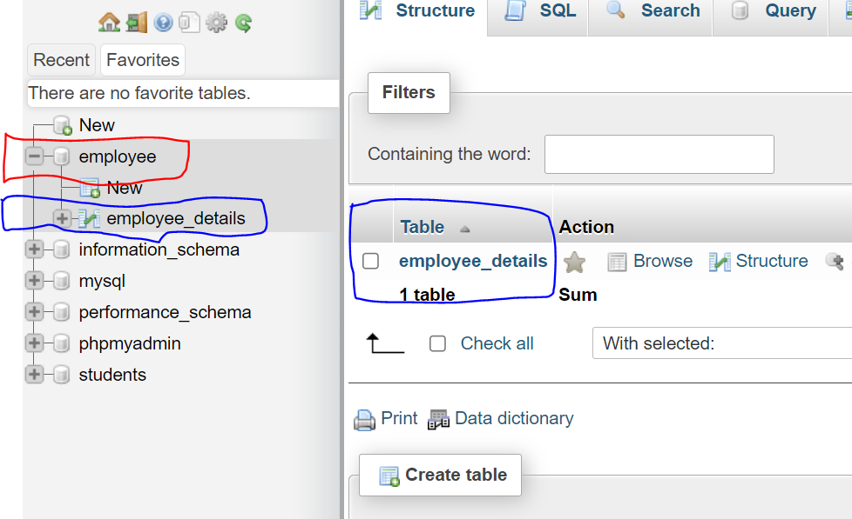
Working with Tables
Step-4 : Select EMPLOYEE database on left panel, employee_details table will be available

Slide 61
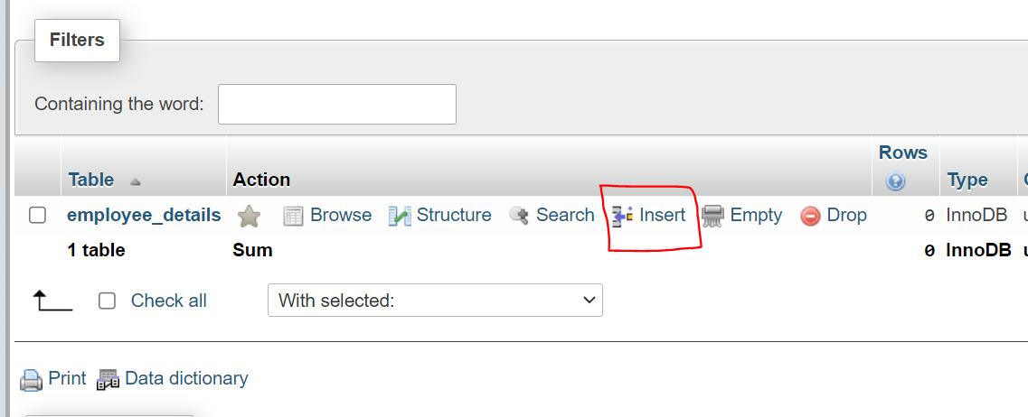
Working with Tables
Step-5 : Insert records in Table, select insert link on Table list.

Slide 62
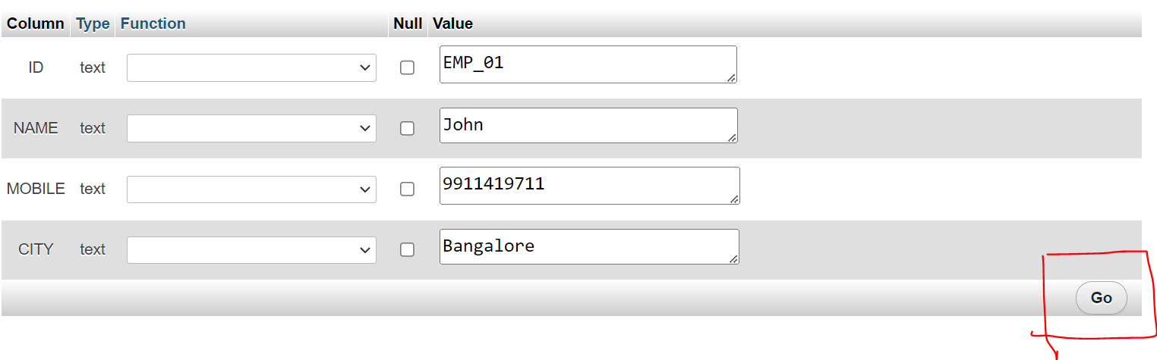
Working with Tables
Step-6: Enter the data for Table, and click on Go button to insert data into Table

Slide 63
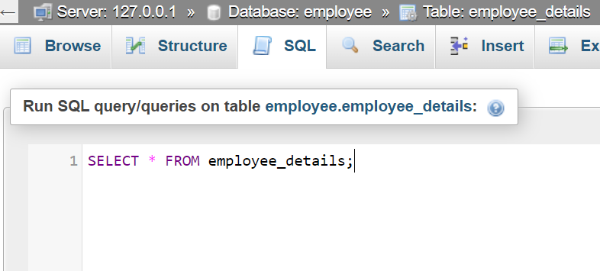
Working with Tables
Step-7:Display data from Table
SELECT * FROM employee_details;

Slide 64
Exercises
Create COLLEGE database using phpMyAdmin Navigation bar, create document file and copy paste the screenshot for each point.
CREATE COLLEGE database
CREATE student_details table in COLLEGE database
INSERT some records in student_details table
DISPLAY records from student_details table

Slide 65
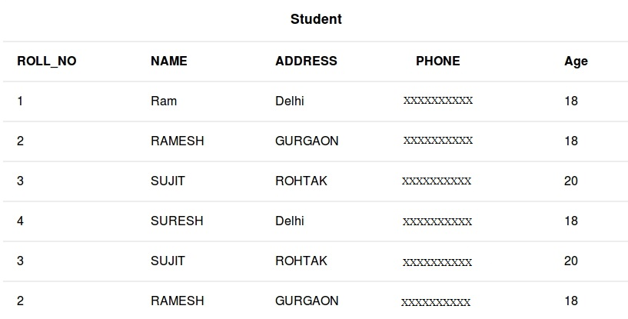
Exercises
student_details table data

