Slide 1
BIG DATA TOOLS FOR MANAGERS (N2MBA07)

Slide 2
Project analysis slide 6
Syllabus
Unit-1: Big Data, Database
Overview of Big Data
Data, Information, Database

Slide 3
Project analysis slide 6
Syllabus
Unit-1: Big Data, Database
Unit-2: SQL
Overview of Big Data
Data, Information, Database
Introduction to SQL, MySQL
Data retrieval using MySQL

Slide 4
Project analysis slide 6
Syllabus
Unit-1: Big Data, Database
Unit-2: SQL
Unit-3: R Programming
Overview of Big Data
Data, Information, Database
Introduction to SQL, MySQL
Data retrieval using MySQL
Introduction to R Language
Data Manipulation, Graph, Regression

Slide 5
Project analysis slide 6
Syllabus
Unit-1: Big Data, Database
Unit-2: SQL
Unit-3: R Programming
Overview of Big Data
Data, Information, Database
Introduction to SQL, MySQL
Data retrieval using MySQL
Introduction to R Language
Data Manipulation, Graph, Regression
Unit-4, 5: Python
Introduction to Python Programming Concept
Data Manipulation, Time Series & Text Analytics using Python

Slide 6

Examination
Internal assessment
50 Marks Question Paper
Practical Exam
Write SQL/R/Python code
1.5 hrs

Slide 7
Examination
Internal assessment
Semester end assessment
50 Marks Question Paper
Practical Exam
Write SQL/R/Python code
1.5 hrs
50 Marks MCQ Question Paper
50 questions with multiple choice option
1.5 hrs

Slide 8
Class timings
Weekly once (on Saturday)
09:00AM – 10:10AM
Theory Sessions
~3 hrs
10:10AM – 10:30AM
Break
10:30AM – 12:00PM
Practical Sessions

Slide 9
Class timings
Weekly once (on Saturday)
09:00AM – 10:10AM
Theory Sessions
~3 hrs
Theory Sessions
01:00PM – 02:10PM
10:10AM – 10:30AM
Break
Break
02:10PM – 02:30PM
10:30AM – 12:00PM
Practical Sessions
Practical Session
02:30PM – 04:00PM

Slide 10
Software Tools for BDTM
XAMPP
R
R Studio
Python
Unit 2
Unit 3
Unit 4 & 5

Slide 11
Project analysis slide 8
What is a Data ?
Data is a collection of information gathered by observations, measurements, research or analysis
It consists of facts, numbers, names, figures or even description of things.
Data can be organized in the form of free text, images, graphs, tables
Example :
City | Min. Temp. (in Degrees) | Max. Temp. (in Degrees) | Rain
Mumbai | 25 | 40 | 22%
Delhi | 32 | 45 | 16%
Bangalore | 23 | 35 | 28%
Chennai | 33 | 48 | 21

Slide 12
Project analysis slide 8
What is a Digital Data ?
Digital data is data that represents other forms of data using specific machine language systems that can be interpreted by various technologies.
The most fundamental of these systems is a binary system, which simply stores complex audio, video or text information in a series of binary characters, traditionally ones and zeros, or "on" and "off" values.

Slide 13
Project analysis slide 8
Data Sources
Internal data sources
Information that comes directly from the company’s systems and are specific to the company in question
Example:
Sales, Cash Flow, Production
Customer Relationship Management(CRM)
Enterprise Resource Planning(ERP) system
OLTP and operation data

Slide 14
Project analysis slide 8
Data Sources
Internal data sources
External data sources
Information that comes directly from the company’s systems and are specific to the company in question
Example:
Sales, Cash Flow, Production
Customer Relationship Management(CRM)
Enterprise Resource Planning(ERP) system
OLTP and operation data
Information that comes from outside of company’s or provided 3rd party vendor.
Example:
Internet, Social Media data
Government
Market Research Organization
Business Partners**

Slide 15
Project analysis slide 8
Types of Digital Data
Types of
Digital data

Slide 16
Structured data
Types of
Digital data

Slide 17
Structured data
Types of
Digital data
Semi-structured data

Slide 18
Structured data
Types of
Digital data
Unstructured data
Semi-structured data

Slide 19
Structured data
+
~20%
Types of
Digital data
Unstructured data
Semi-structured data

Slide 20
Structured data
+
~80%
~20%
Types of
Digital data
Unstructured data
Semi-structured data

Slide 21
Project analysis slide 8
Structured Data
Structured data can be defined as the data that has a defined repeating pattern.
This pattern makes it easier for any program to sort, read, and process the data.
Processing structured data is much easier and faster than processing data without any specific repeating patterns.

Slide 22
Project analysis slide 8
Structured Data
Structured data can be defined as the data that has a defined repeating pattern.
This pattern makes it easier for any program to sort, read, and process the data.
Processing structured data is much easier and faster than processing data without any specific repeating patterns.
Example:
Customer ID | Customer Name | Product ID | City | State
12345 | Smith | 214 | Mumbai | Maharashtra
23456 | John | 365 | Bangalore | Karnataka
34567 | Nick | 222 | Pune | Maharashtra
45678 | Sagar | 456 | Chennai | Tamil Nadu

Slide 23
Project analysis slide 8
Semi-Structured Data
Semi-structured data, also known as having a schema-less or self describing structure, refers to a form of structured data that contains tags or markup elements in order to separate out the elements and generate hierarchies of records and fields in the given data.

Slide 24
Project analysis slide 8
Semi-Structured Data
Semi-structured data, also known as having a schema-less or self describing structure, refers to a form of structured data that contains tags or markup elements in order to separate out the elements and generate hierarchies of records and fields in the given data.
Example:
#No | Name | Email
1 | Sam Jocabs | smj@xyz.com
2 | First Name : David Last Name : Brown | davidb@xyz.com
3 | Nick Sagar | Email-1: nick.sager@xyz.com Email-2: nicksager@gmail.com
4 | First Name : John Middle Name : P Last Name : Todd | Personal Email: johntodd@gmail.com Business Email: john@xycompany.com

Slide 25
Project analysis slide 8
Unstructured Data
Unstructured data is a set of data that might or might not have any logical or repeating patterns. About 80% of enterprise data consist of unstructured content.
What are the unstructured data ?

Slide 26
Project analysis slide 8
Unstructured Data
Unstructured data is a set of data that might or might not have any logical or repeating patterns. About 80% of enterprise data consist of unstructured content.
What are the unstructured data ?
Videos
Audio/Music
Emails
Social media
Maps

Slide 27
What if it gets combine?
Structured data
Semi-Structured data
Unstructured data

Slide 28
What if it gets combine?
Structured data
Big Data
Semi-Structured data
Unstructured data

Slide 29
What is a Big Data?
Big data refers to the datasets that are too large or complex to be manage by traditional data-processing software.
Big data is structured, unstructured and semi-structured or heterogeneous in nature. It becomes difficult for computing system to manage “Big Data” because of the extreme speed and volume at which it is generated

Slide 30
Characteristics of Big Data
Big Data
Challenge with existing system
Classified into 4Vs
Complex data ?
Is a new data challenge that requires leveraging existing system differently
Volume
Velocity
Variety
Veracity
Is usually unstructured and qualitative in nature

Slide 31






BIG DATA
Tweets
Facebook
Every second ~6000 tweets
Every minute
~5 lacs comments,
~3 lacs status update,
~1.5 lacs photos upload
UPI
Every day around
~6.5 billion transactions
E-Commerce
Every day approximate 1.6 million shipment

Slide 32
Big Data - 4Vs
According to Gartner, data is growing at the rate of 59% every year. This growth can be depicted in terms of the following four Vs.
Volume
Variety
Volume is the amount of data generated by organizations or individuals.
Variety describe the different formats for data such as images, text, video, audio, GPS.
Velocity
Velocity describes the rate at which data is generated, captured, and shared
Veracity
Veracity generally refers to the uncertainty of data. Whether the obtained data is correct or consistent.

Slide 33
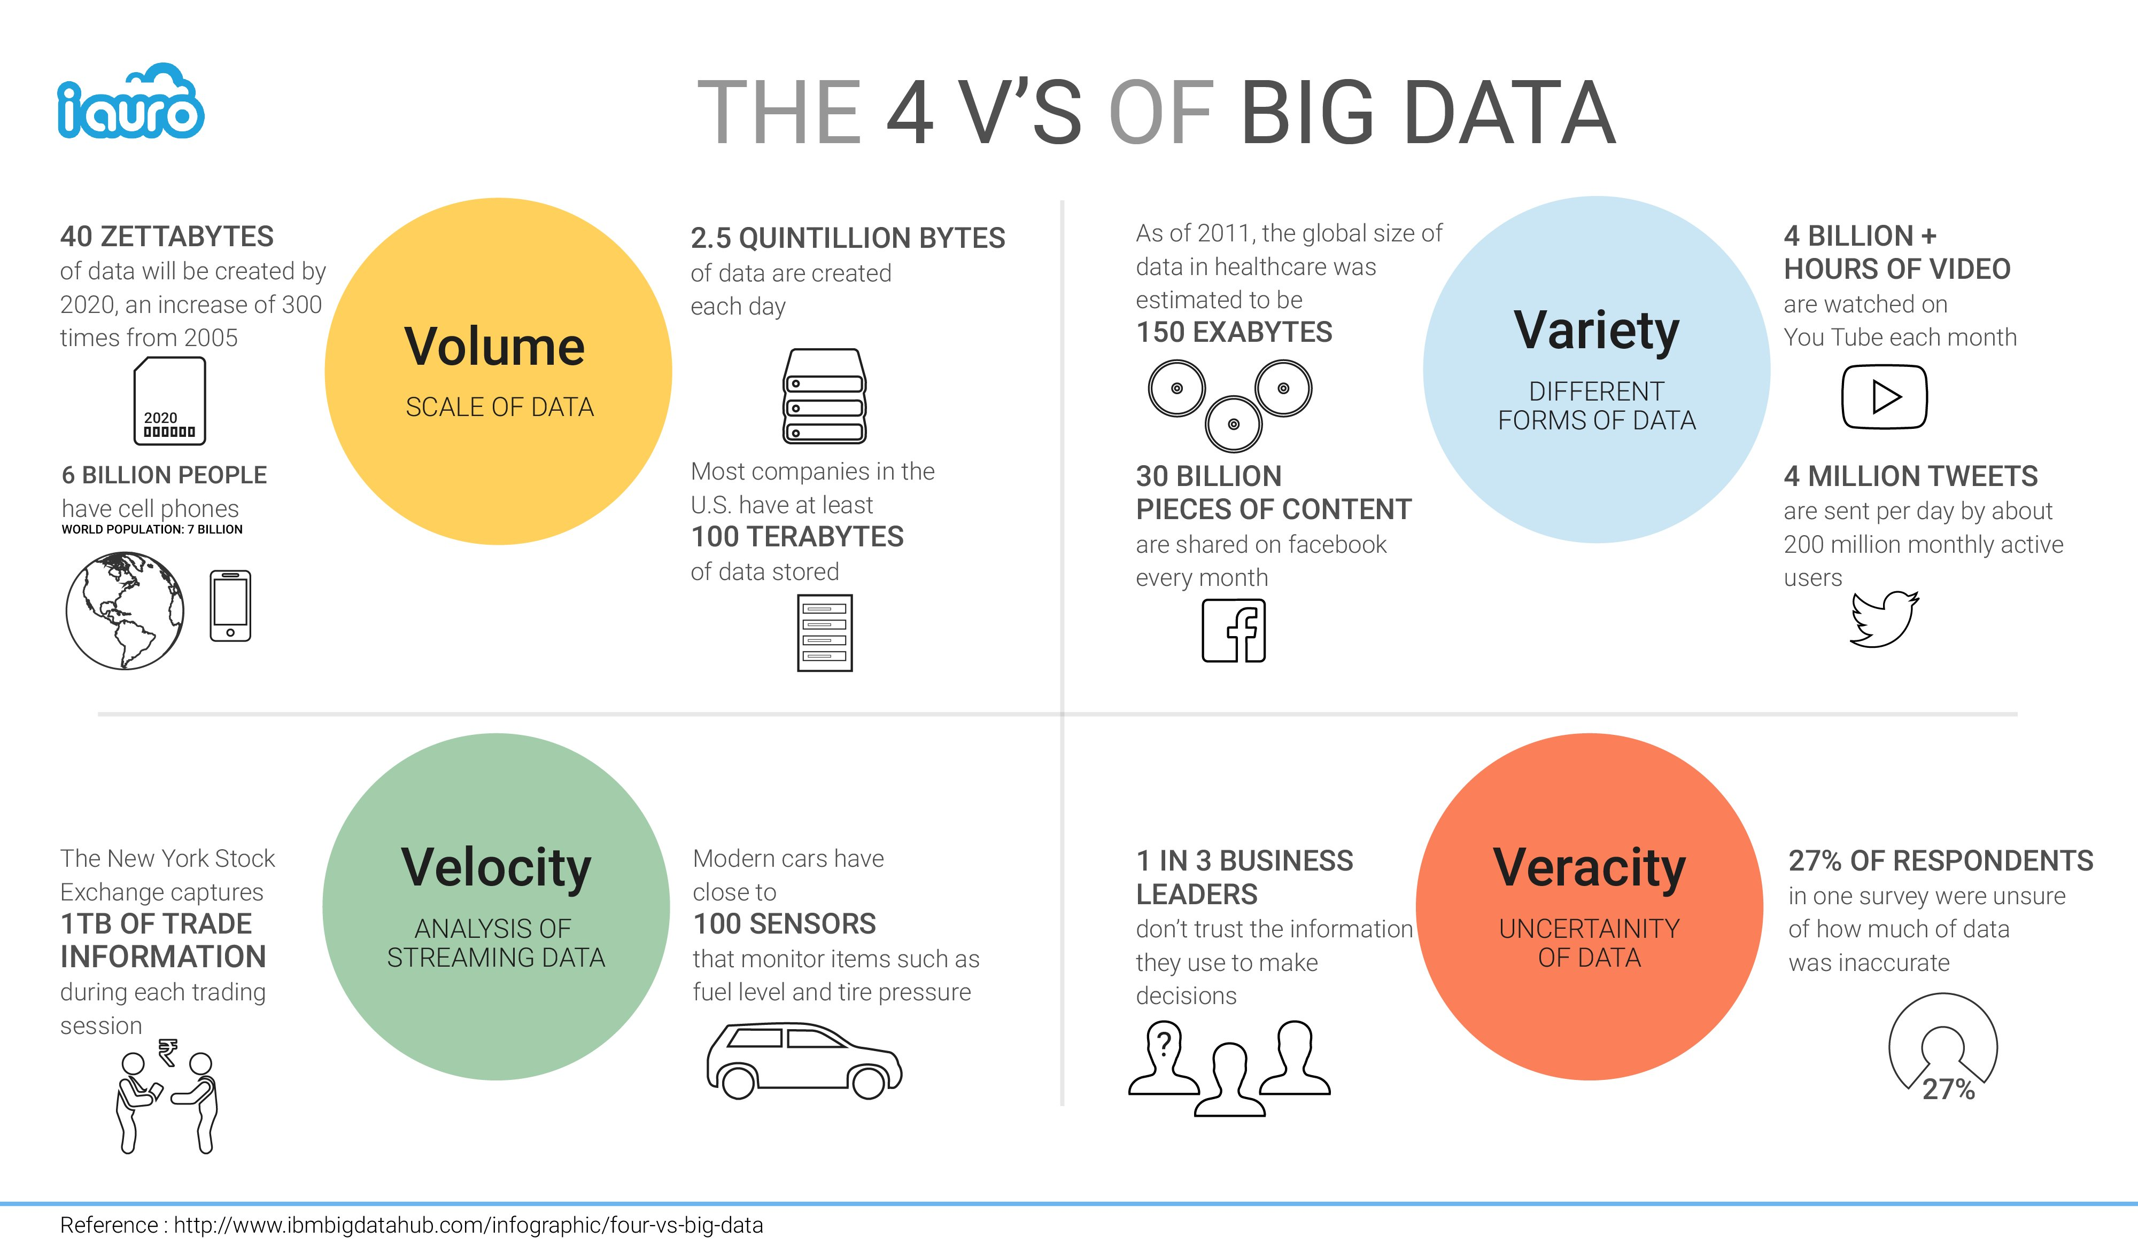

Slide 34
Future of Big Data
Most organizations today consider data and information to be their most valuable and differentiated asset. Big Data can unlock significant value by making information transparent.
Sophisticated analytics can improve decision-making, minimize risks, and unearth valuable insights that would otherwise remain hidden.
At the same time, the volume and variety of data is also increasing at the immense rate every day, so big data can be used to develop the next generation of products and services.

Slide 35
Thank You

