Slide 1
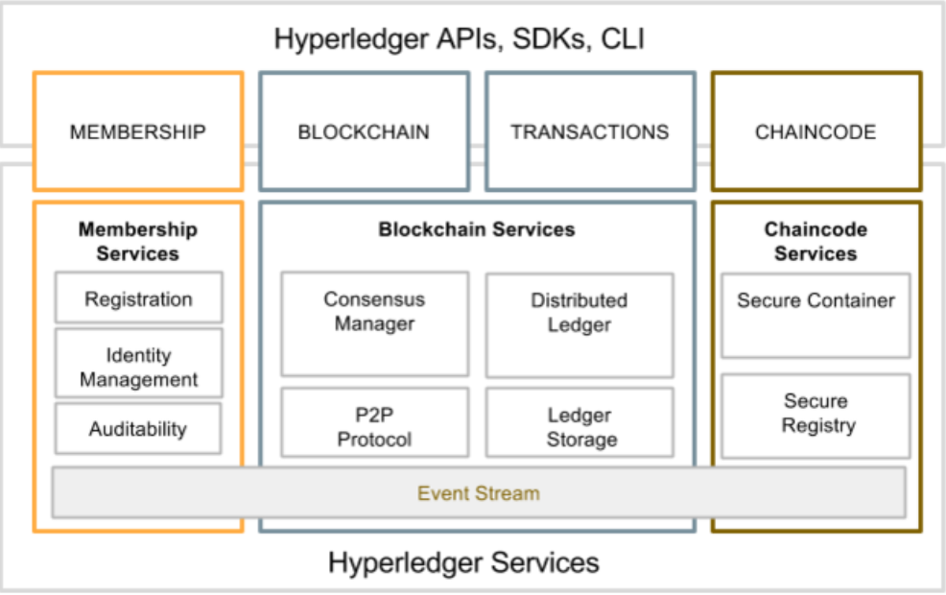
Hyperledger high level architecture

Slide 2
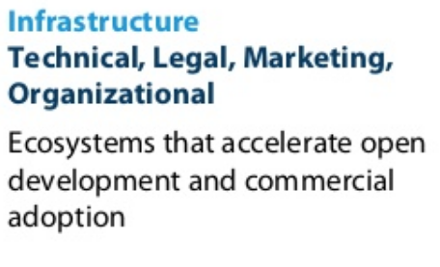


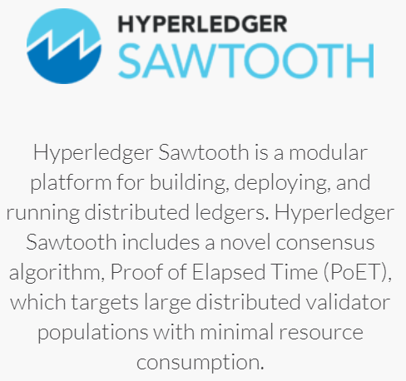
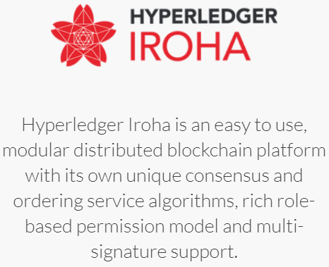
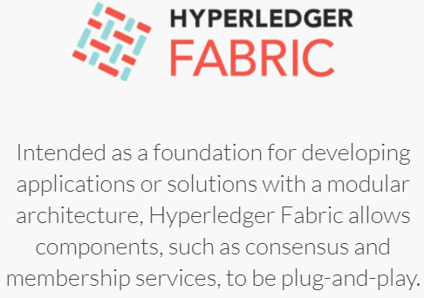

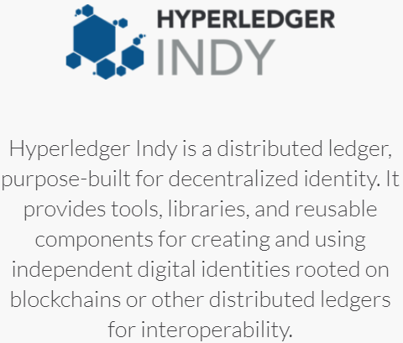
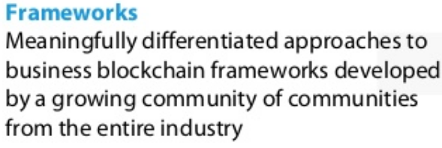

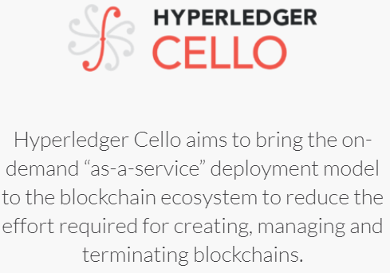
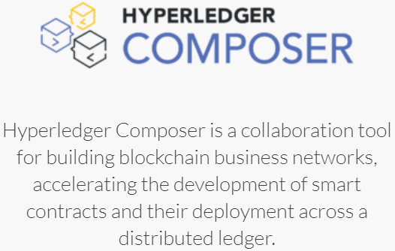
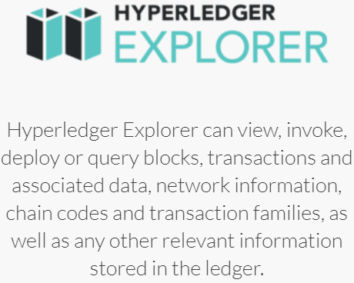
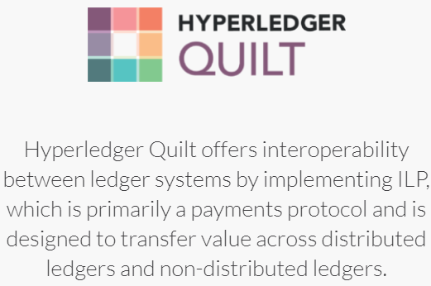
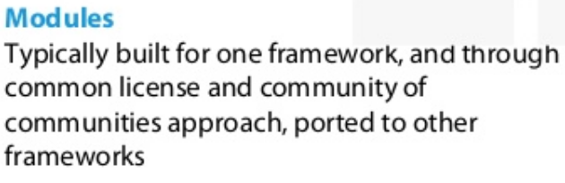
Analysis of the platforms for IHAN technology verification

Slide 3
IHAN concept in Distributed Ledger model
IHAN 1
IHAN 6
Distributed Ledger Network
IHAN 4
IHAN 2
Peer 1
Peer 2
Peer 3
Peer 4
Peer 5
…
Ordering service & Smart contracts (Chaincode)
Transaction
IHAN 3
Distributed Ledger Client
Update
Transaction
Membership service
Query
Channel 1
Channel 2
Channel N
1
2
IHAN 5
Service provider
Service provider
Distributed ledger

Slide 4
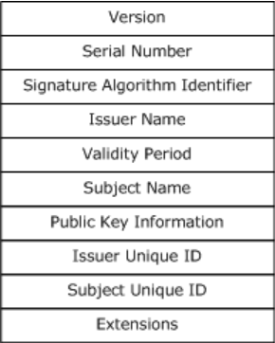
Digital identity entities
Public
Private
IHAN is a digital certificate, fully compatible with X.509 standard, containing user name, public key, issuer identity, validity information and other technical details. Compatibility with X.509 makes IHAN compatible with Hyperledger platform.
Private key used for signing data and for encryption of documents.
Ledgers are transactions chains for the different business networks.
Digital IDs Wallet is a list of service providers IDs, together with account credentials for the service.
IHAN
Private key
Ledgers
Service provider IDs Wallet
Service provider ID
Service provider ID
Account credentials for the service
Service provider ID
Account credentials for the service
Account credentials for the service

Slide 5
High level architecture of the IHAN-based service
IHAN and Business networks web service
Client application
IHAN
Generate IHAN and Keys
Secret key
Create business network
Client application
Communication over HTTP protocol
Join business network
IHAN
Get list of available networks
Secret key
Get list of own networks
Get proposals, endorse of deny
Client application
IHAN
Validate peer’s IHAN
Secret key

Slide 6
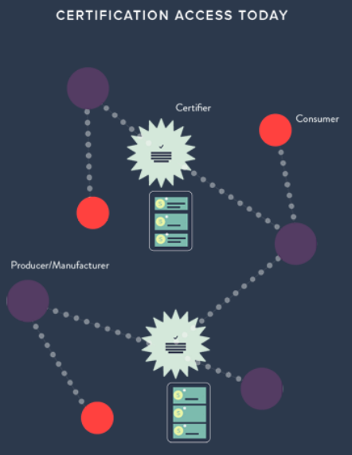
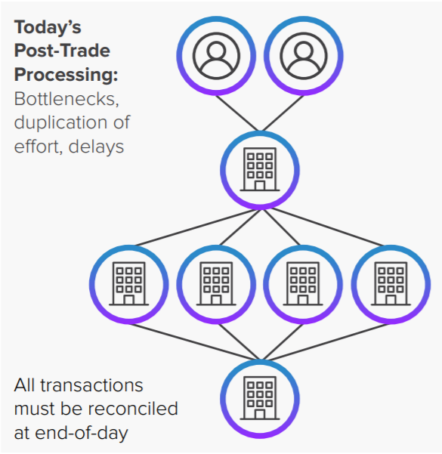
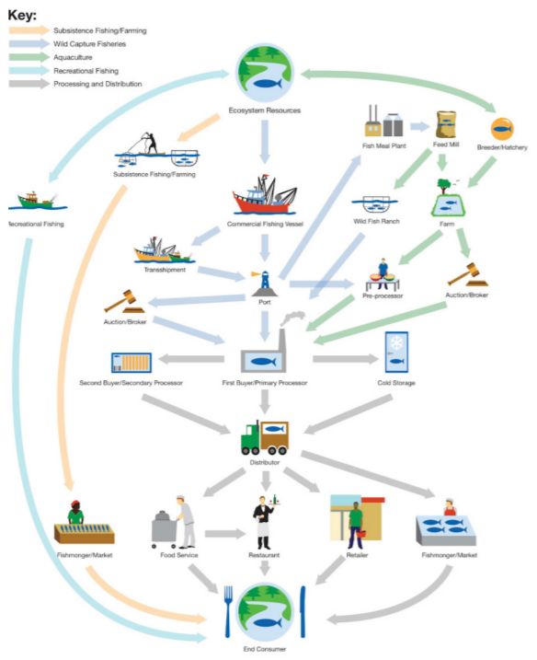
Current biz model, difficulties and bottlenecks

Slide 7
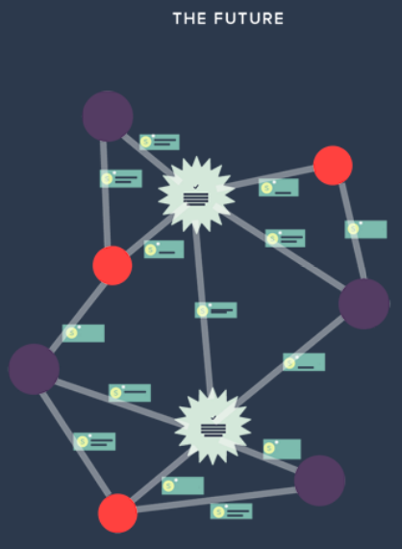
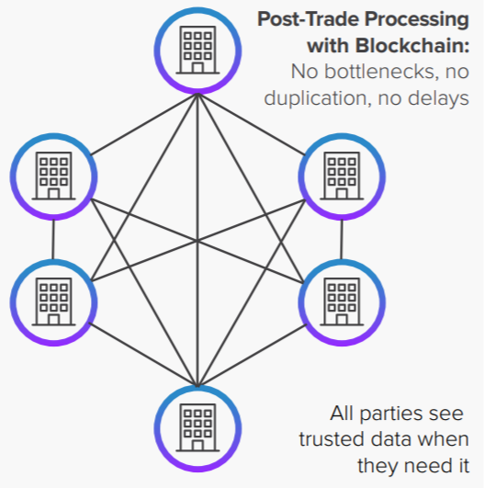
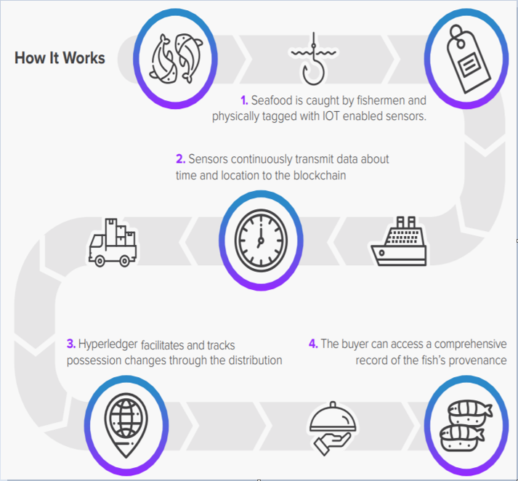
Digital identity, certification and distributed ledger impact to the biz processes and networks

Slide 8
Design of the application
Bn_client_http.py
Bn_client_http.py – client side UI application for creating, join and list business networks.
Main.py – main module, handles http requests from client.
Ledger.py – implements distributed ledger functionality.
Signature.py – implements digital signature functions.
X509 – implements x509 protocol compatibility functions.
WEB
Main.py
Ledger.py
Signature.py
X509.py

Slide 9
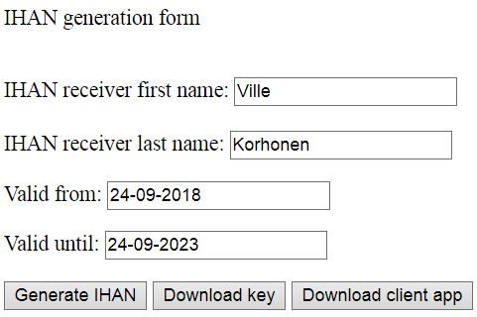
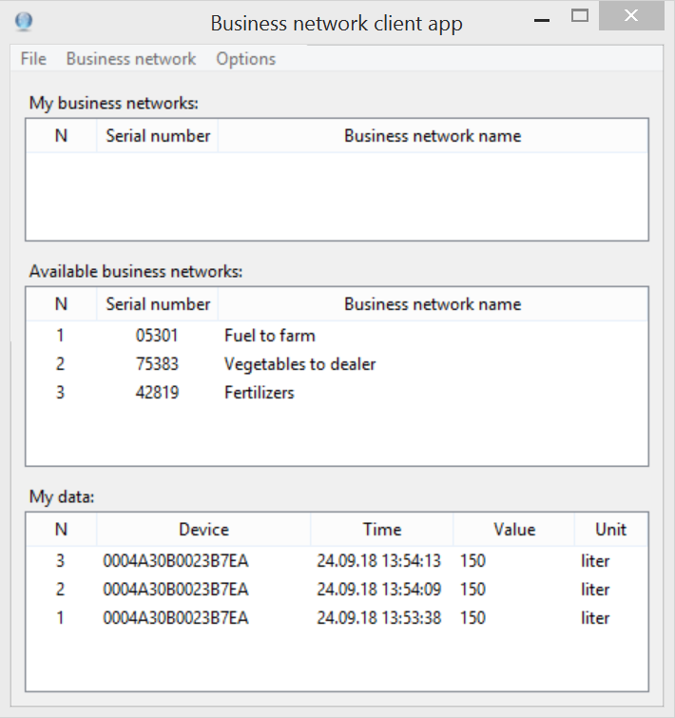
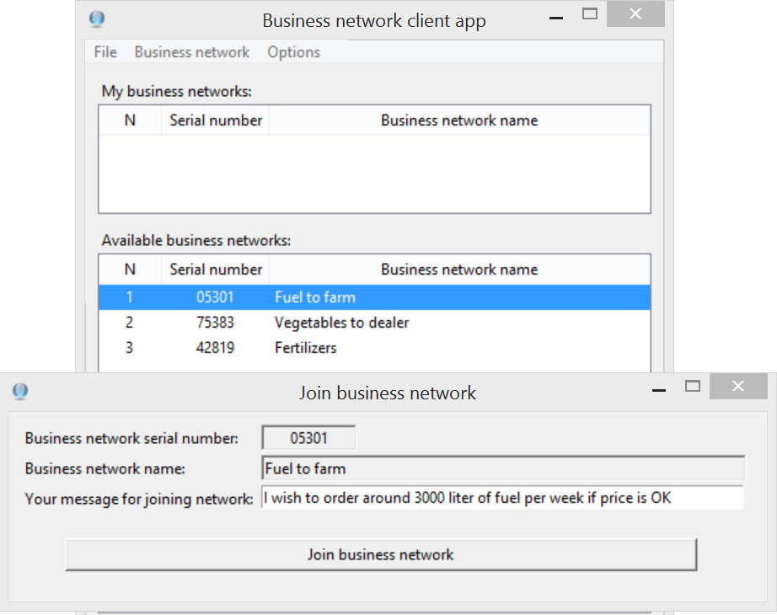
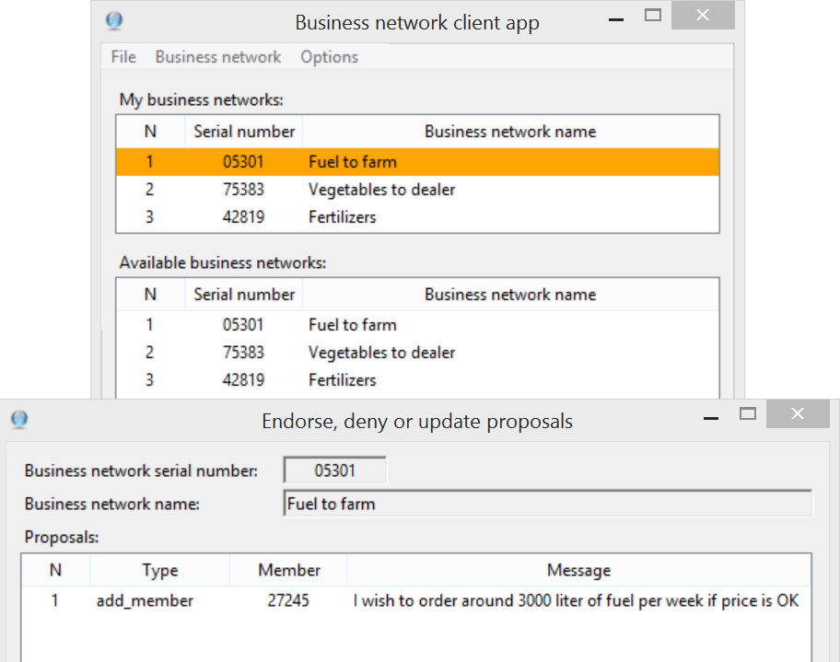
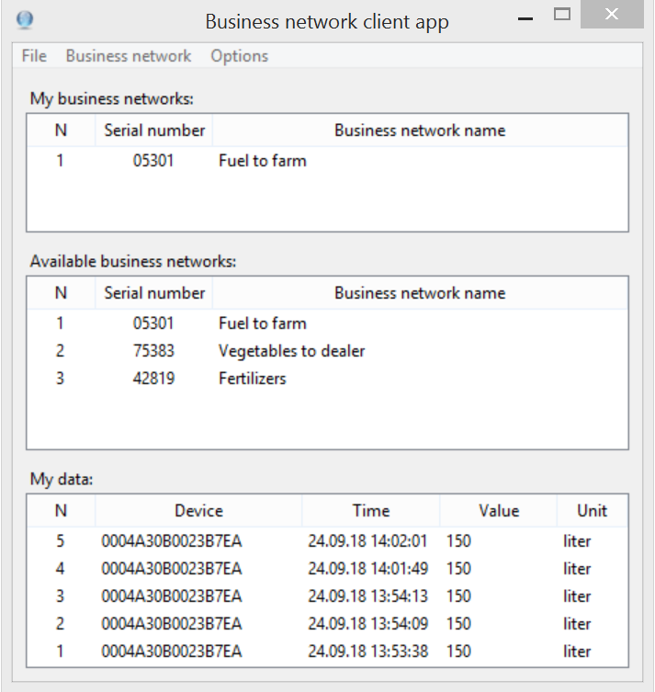
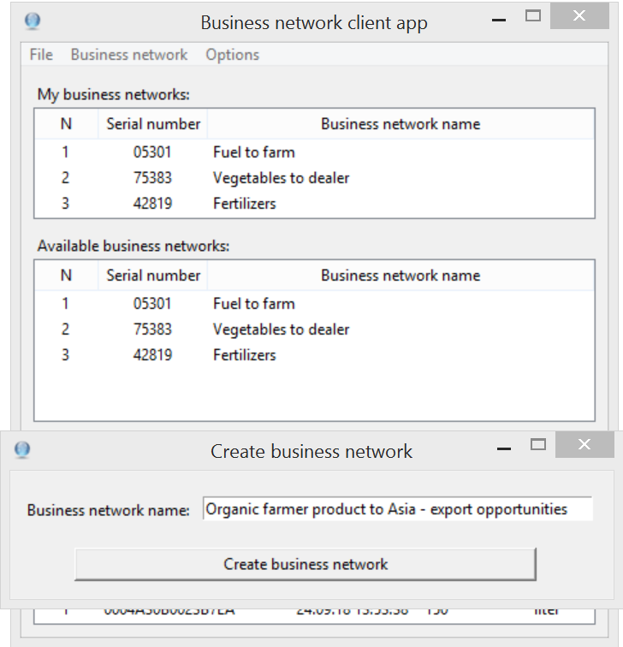
Business networks, IHAN-based POC application UI
1
2
3
4
5
6

Slide 10
Format of the data structures
Client requests:
Create business network:
{'type':'create_business_network',
'creator_cert_serial' : cert.serial_number, 'network_name': business_network_name }
Join business network:
{'type':'join_business_network_proposal', 'requestor_cert_serial' : cert.serial_number, 'bn_serial5_number': bn_join_serial5, # only 5 last digits 'bn_join_name': bn_join_name, 'join_message': bn_join_message }
Request all business networks:
{'type':'get_all_business_networks_serials_and_names', 'requestor_cert_serial' : cert.serial_number}
Request my business networks:
{'type':'get_my_business_networks_serials_and_names', 'requestor_cert_serial' : cert.serial_number }
Endorse or deny proposal:
'type':'proposal_endorsement_or_deny', 'requestor_cert_serial' : cert.serial_number, 'endorse_or_deny:': endorse_or_deny, 'bn_serial5': endorse_bn_serial5, 'bn_name': endorse_bn_name, 'endorse_type': endorse_type, 'endorse_member5': endorse_member5, 'endorse_message': endorse_message }
Server responses:
Create business network:
{'serial_number' : str(bn_serial), 'name' : bn_name, 'members' : [], 'proposals': [], 'ledger': []}
Join business network:
{'status': 'ok'}, 201
Request all business networks:
{'cert_serial': str(cert_serial), 'bns_all_serials_and_names': bns_all_serials_and_names}
Request my business networks:
{'my_bns': bns}
Endorse or deny proposal:
{'status': 'ok'}, 201

