Slide 1
Suicide Rate Analysis
Understanding successful countries the rates of suicide

Slide 2
Rules: We will group the data in decades. This give us a better understanding of the analysis we are doing. In that way we can try to understand suicide rates by generations.

Slide 3
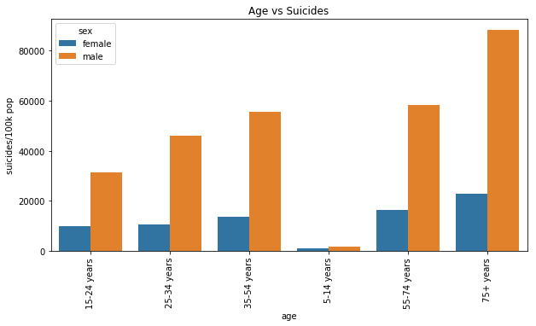
Does the age affect the rate of suicide?
As one could expect at the age of 5-12 we see by far the lowest number of suicide.

Slide 4
We saw in the previous graph that the count of men committing suicide is larger in each age group. Lets confirm that using a graph

Slide 5
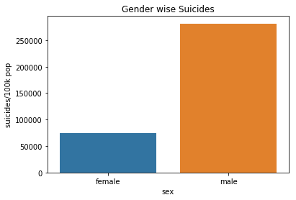
Indeed, male suicides are higher than female suicides as it can be seen in the graph below.

Slide 6
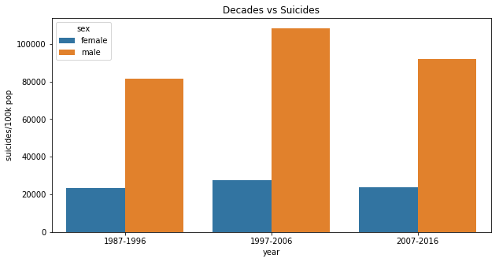
Now studying the suicides by decades we notice the following

Slide 7
In fact, "1997 - 2006" decade has seen more deaths(suicides) but overall we could say that the suicide rates are fairly stable over time as it can be interpreted by the graph below.

Slide 8
Which countries have the lowest count of suicides?
Which countries have the largest count of suicides?

Slide 9
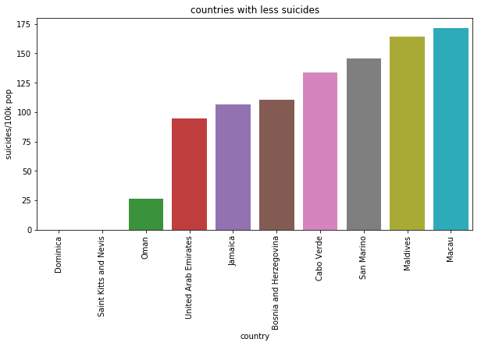
Which countries have the lowest count of suicides?

Slide 10
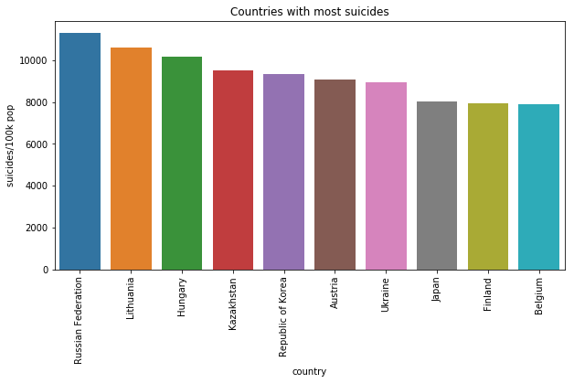
Which countries have the largest count of suicides?

Slide 11
We have to be careful about the previous two graphs since a low or large count of suicides is directly relative to the size of the country. For this reason, it is more relevant to study the increase or decrease of the rate of suicides. To have a better reference of this situation let's graph the change in the rates of suicides.

Slide 12
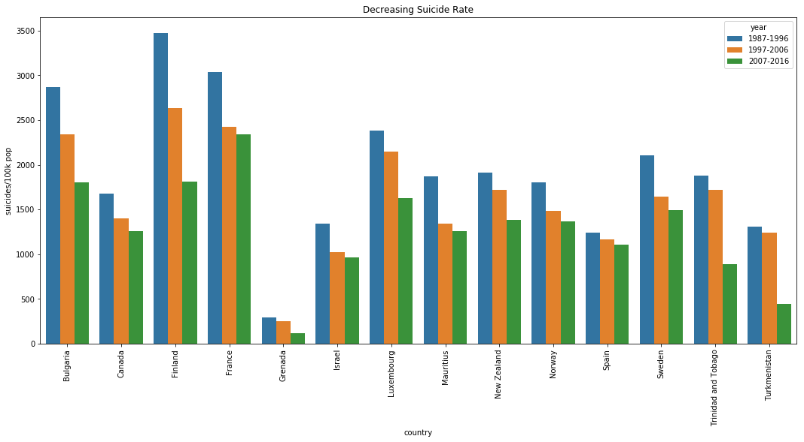
Decreasing Suicide Rate
Finland which has a greater suicide Decreasing rate.

Slide 13
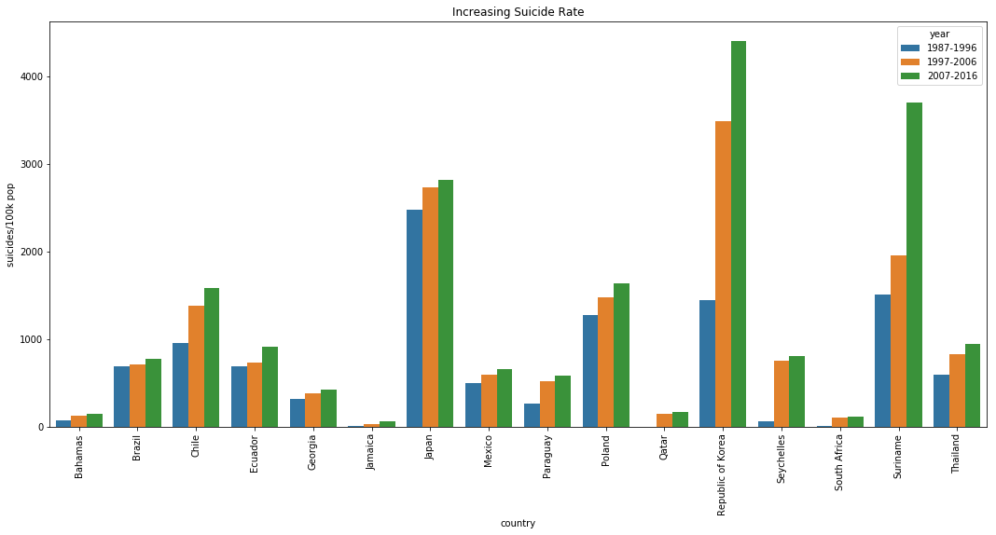
Increasing Suicide Rate
Republic of Korea and Suriname countries
have a greater suicide increasing rate.

Slide 14
We conclude that if a health department would like to make a new policy or take actions. It should try to model the policies or actions taken by Finland that successfully reduced the rates of suicide. Similarly, the health department should stay away from the policies, situation or action that resulted in increasing rates of suicide by Republic of Korea and Suriname.

