Slide 1
Manual Methadone Dispensing System
Lyani Sitti - Commodities Specialist
USAID Stawisha Pwani

Slide 2

Systems requirements
phpMyAdmin SQL Dump
version 5.2.1and above
PHP Version: 8.2.12
Windows 10 and above
RAM at least 4GM
Storage at least 512GB HDD

Slide 3
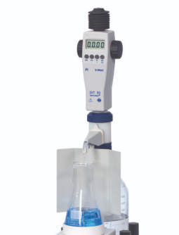


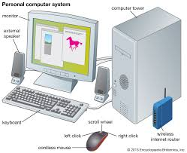
Networking requirements ….
Local Area Network – No internet required
Client Server Client
Manual Pump

Slide 4
What is New?
New User Interface
Expanded User Roles but with restricted access
All expected reports +++
Dispense only to active patients
Make online referrals
Schedule and view appointments – No dispensing without TCA date
DAR for Pharmacy, Lab, Pyscho-social, Clinician
One-time registration by HRIO
No filling of Form P5 excel sheet prior to visit

Slide 5
Folders and files
Landing page
Patient Reg
Settings
Patients
Pharmacy
Prescribing
Category
Reports
Forms
New Registration
Medical Hx
New User
UserList
Add Facility
Add County
Add pt Status
Add drug source
Password Reset
BACKUP
All
Active
LTFU
Defaulted
Transfer Out
Transfer In
Stopped
Weaned Off
Dead
DISPENSE
Stocklist
Addstock
New Drug
DrugList
Drugs Dispensed
StockSummary
SummaryReport
Prescribe
Treat Patient
New Cat
DrugList
Add NewDrug Formulation
FormP9
FormP8
FormP7
FormP6
FormP5
Drugs Dispensed
Forms for printing

Slide 6
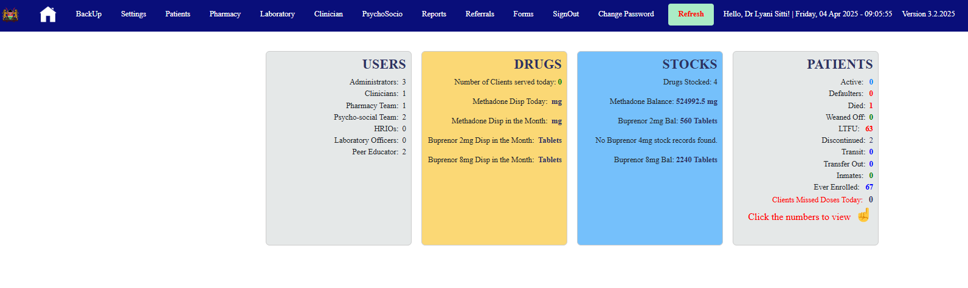

Slide 7
Proposed Names
RxFlow: Suggests a smooth, efficient, and streamlined process for prescriptions.
OpioidRx: A direct and clear name, combining "opioid" with "Rx" (the medical abbreviation for prescription).
ReliefM.A.T.: An acronym for "Medication-Assisted Treatment," a widely recognized term in the field, with "Relief" providing a positive connotation.

Slide 8
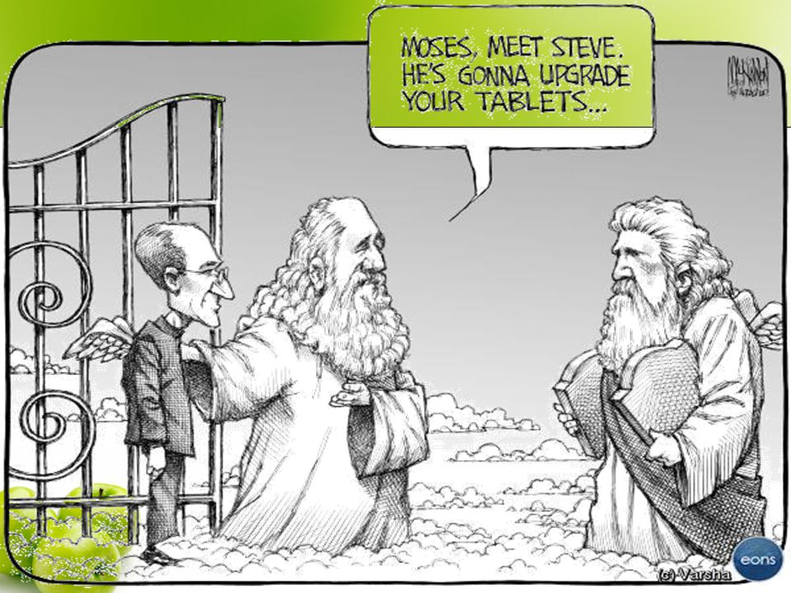
Future improvements
Link with automatic pump
Any other ????? ----
What is required
Pumps + Engineer + developers

