Slide 1
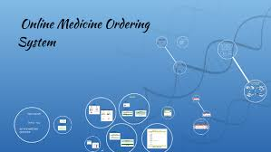
Submitted By:
Rosaline Pradhan(your regd no) xxxx xxxxx (242423432432) xxx xxxx (2201335032) xx xxx(2201335068) xxxx xxxx
Department of CSE
MITM
Bhubaneswar

Slide 2
Introduction
The Online Medicine Ordering System is a web-based application designed to simplify and modernize the process of purchasing medicines. With the rapid growth of digital technology and increasing internet penetration, online platforms have become an essential part of everyday life. The healthcare sector is also evolving to provide more accessible and convenient services, and the Online Medicine Ordering System aims to bridge the gap between customers and pharmacies through an efficient digital solution.

Slide 3
Objectives
To provide an online platform for customers to search and order medicines conveniently.
To allow users to register and maintain their personal profiles securely.
To enable customers to view medicine details such as name, price, availability, and description.
To provide a shopping cart feature for adding multiple medicines before placing an order.
To facilitate secure online payment options for completing transactions.
To allow customers to view order history and track the status of their orders.

Slide 4
Technology Used
Front End
-HTML
-CSS
-JavaScript
Business Logic(Middle Tier)
-JSP, Servlet(Java)
Back End
  MySql

Slide 5
Hardware & Software Requirements
Operating System : Windows 10 / Windows 11 / Linux.
Processor : Intel Core i3 or above
RAM : Minimum 8 GB (12 GB recommended)
Hard Disk : 500 GB or above
Database : MySQL
Server : Apache Tomcat 9.0 or above
IDE : Eclipse / NetBeans / IntelliJ IDEA / VS Code
Browser : Google Chrome / Brave

Slide 6
System Modules
Admin Module
Employee Module
Customer Module

Slide 7
Database Tables
admin, customer, employee
login
medicines
orders, orderitems,
payment,
feedback
deliverydet

Slide 8
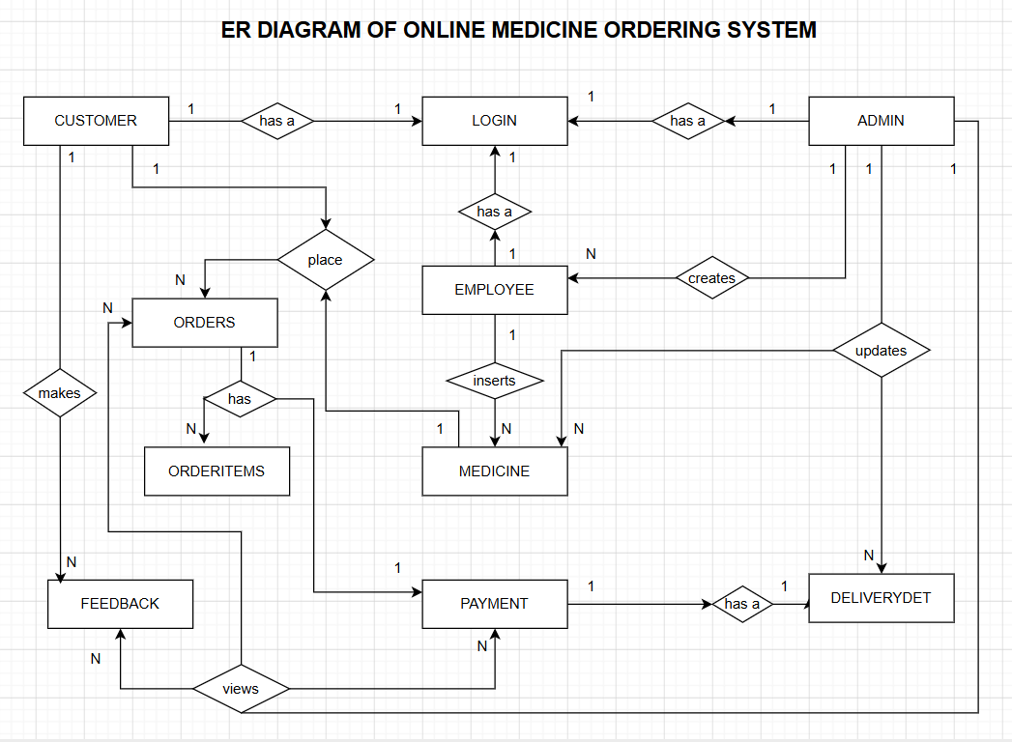

Slide 9
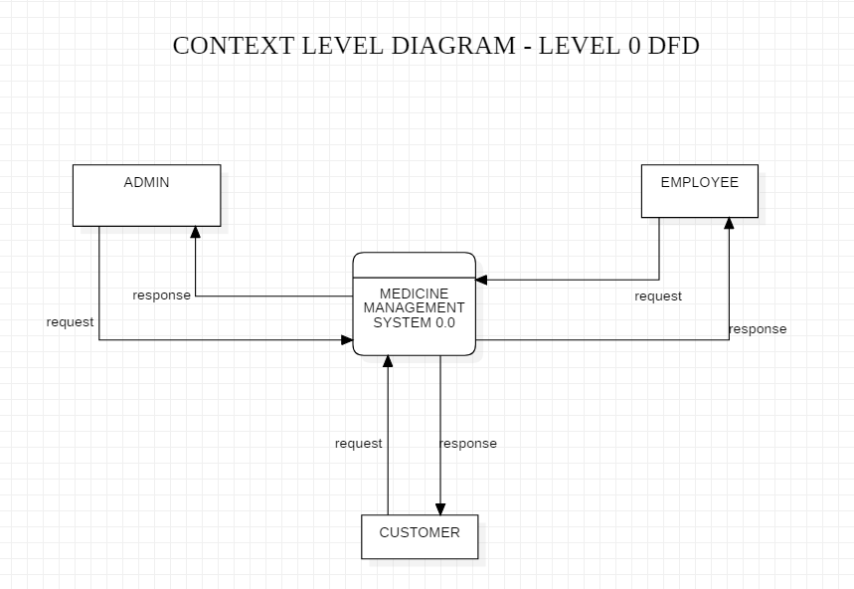

Slide 10
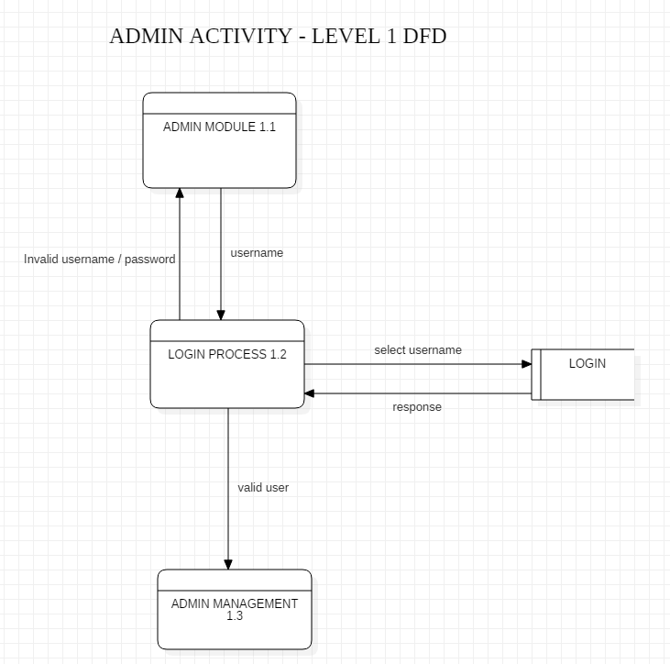

Slide 11
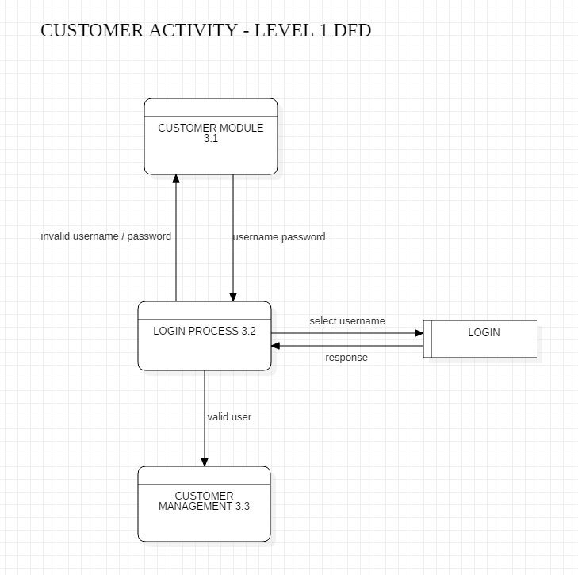

Slide 12
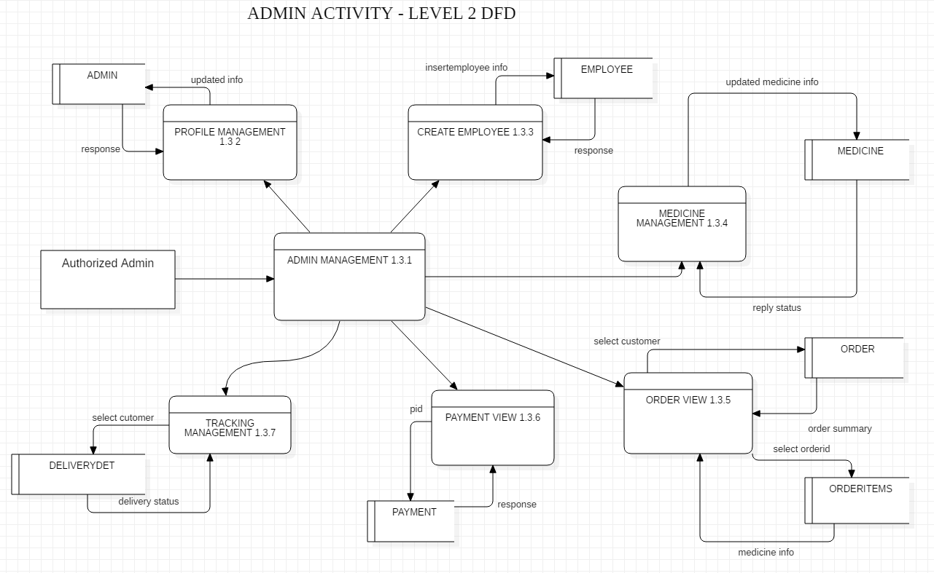

Slide 13
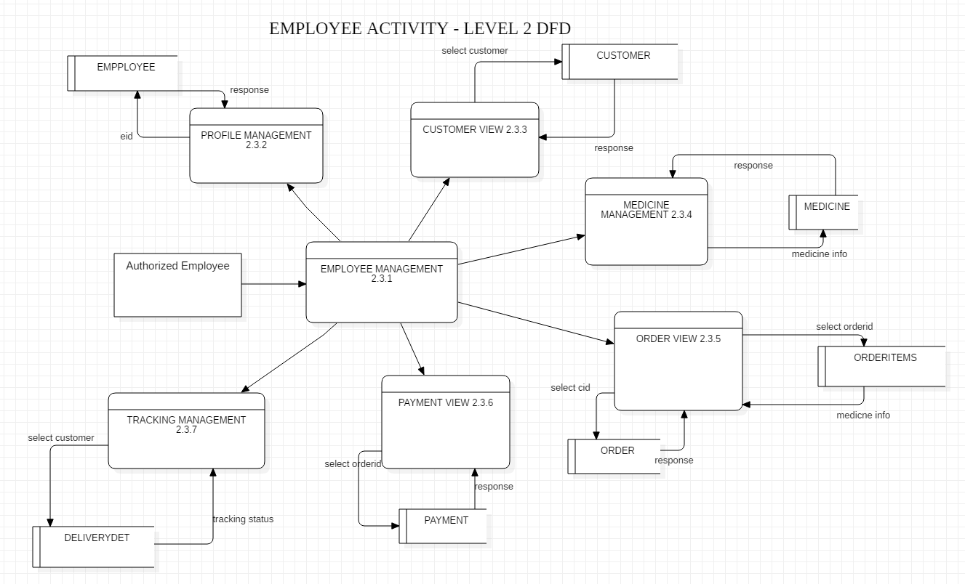

Slide 14
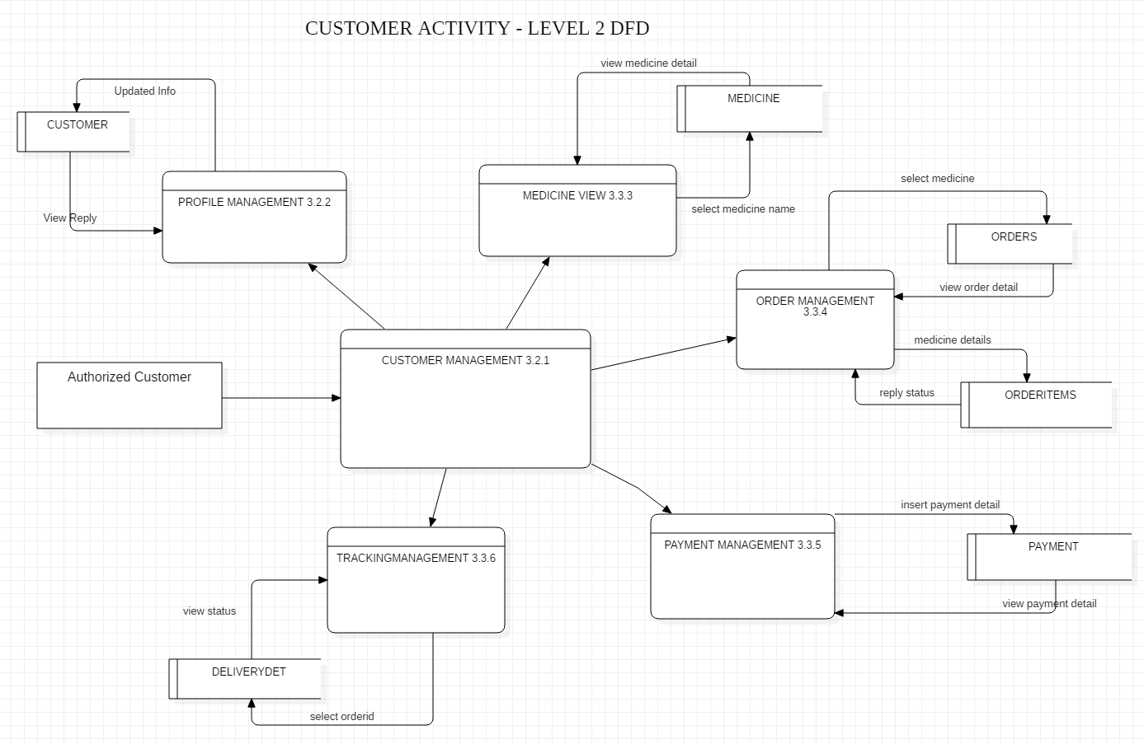

Slide 15
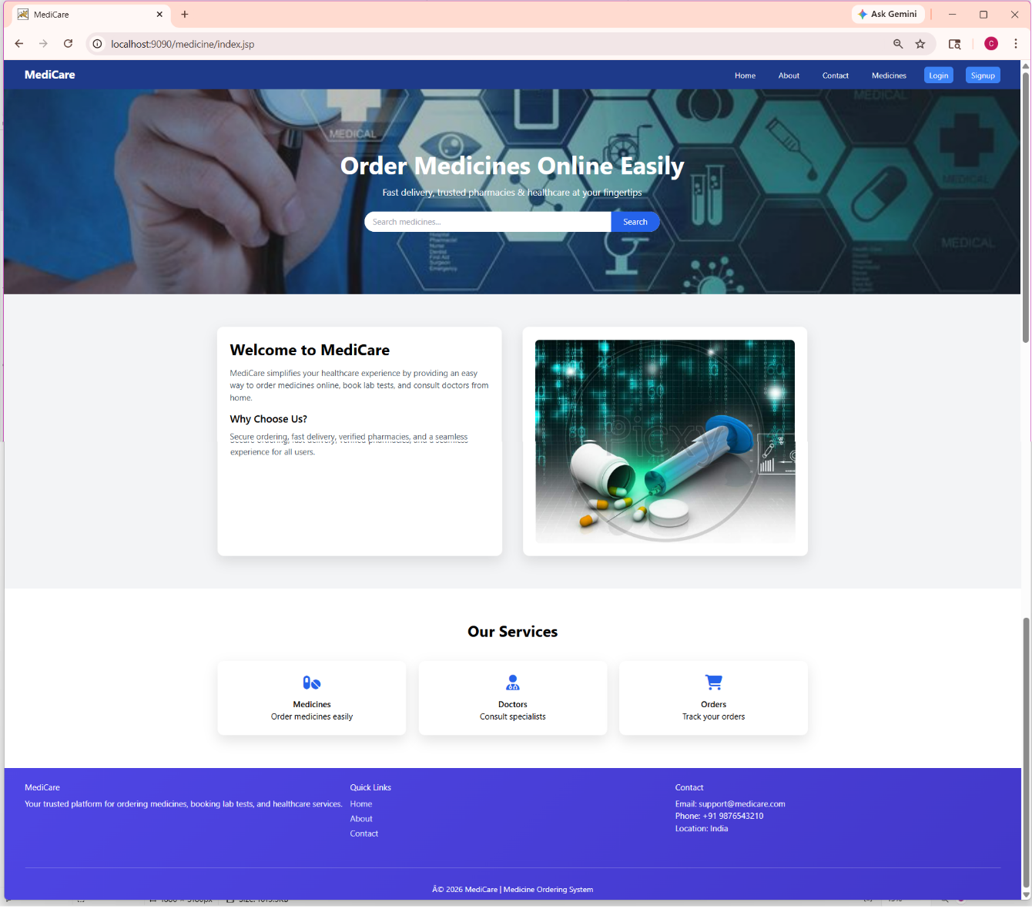
Screenshots - Home Page

Slide 16
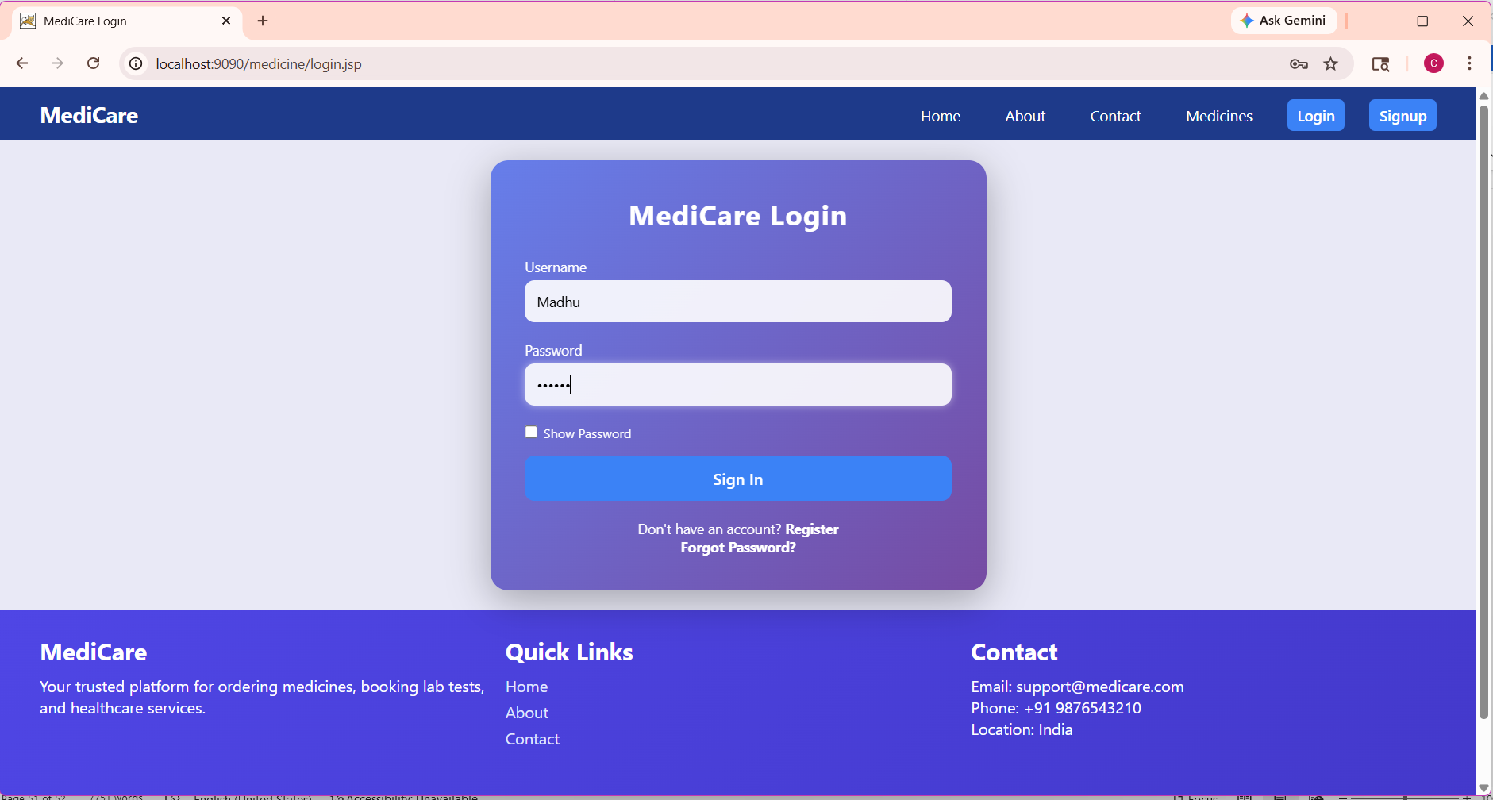
Screenshots – Login

Slide 17
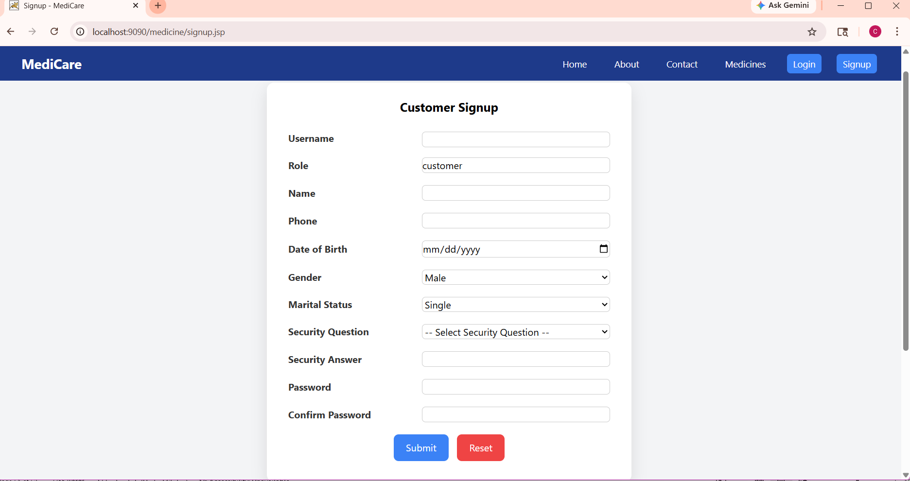
Screenshots - Registration

Slide 18
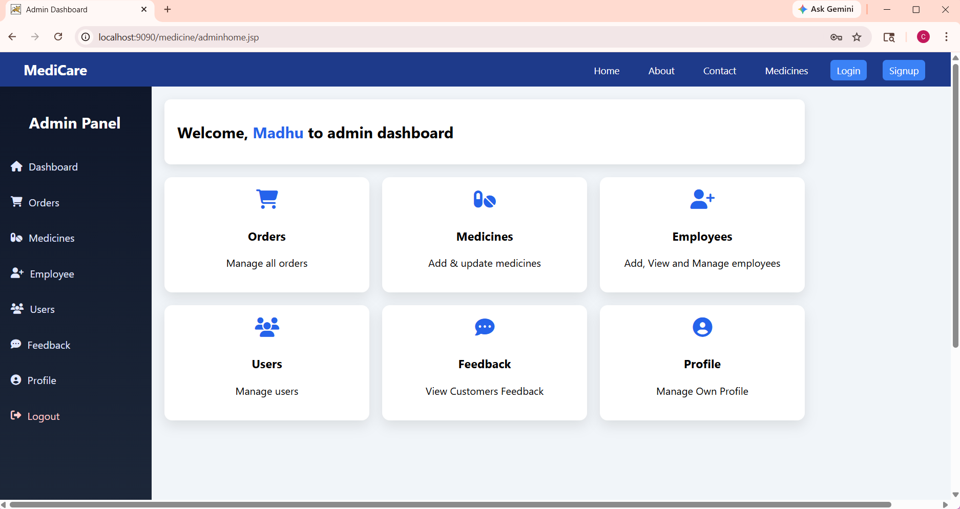
Screenshots – Admin Dashboard

Slide 19
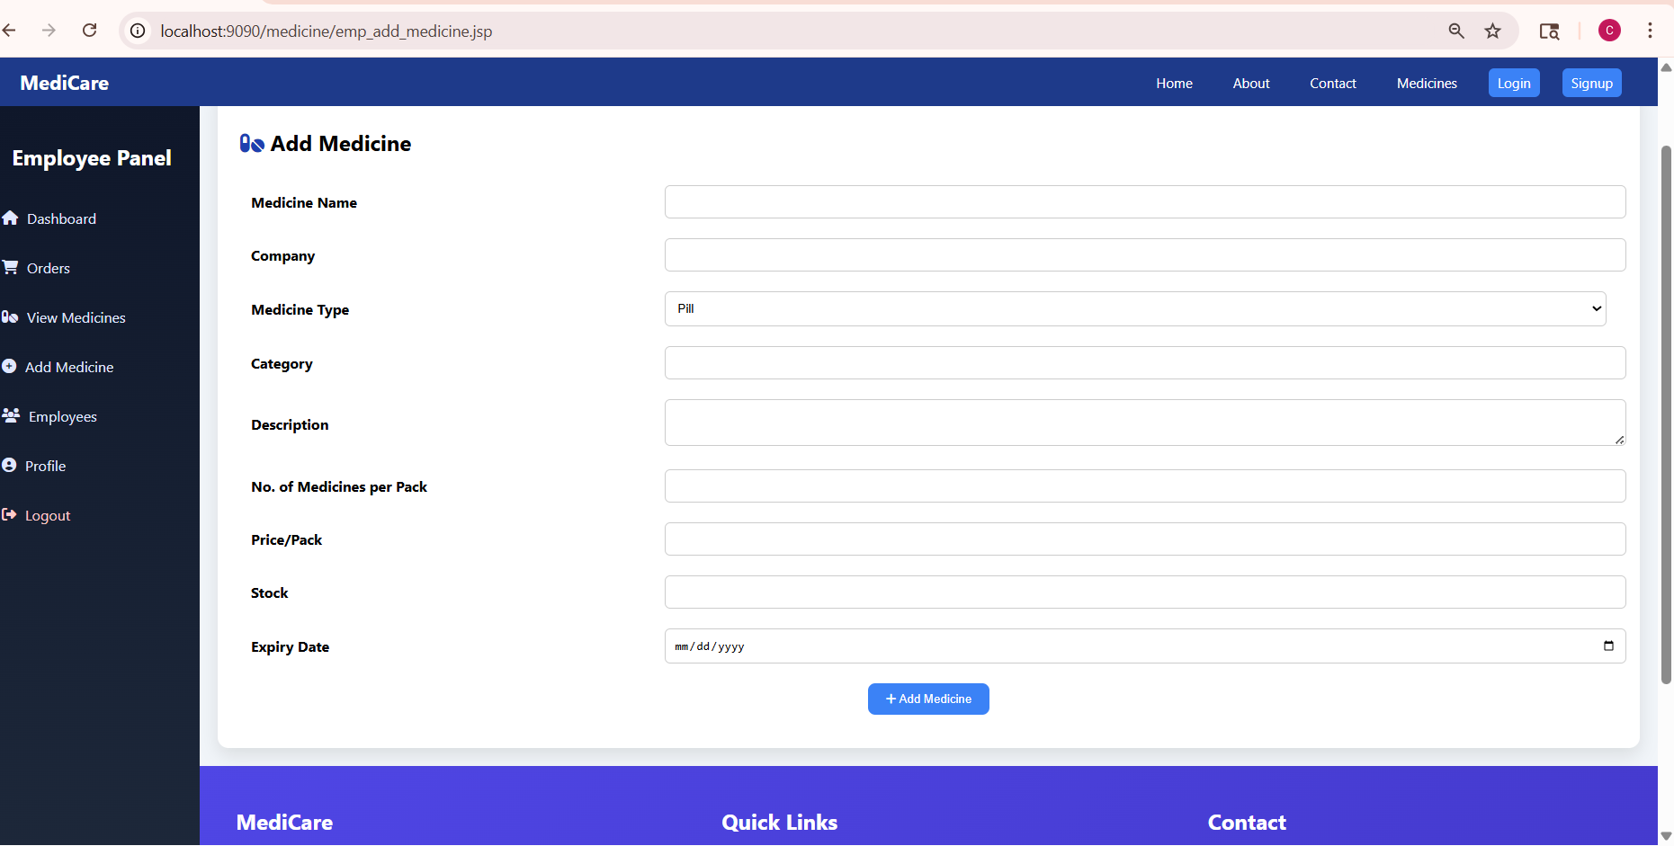
Screenshots – Employee Medicine Entry

Slide 20
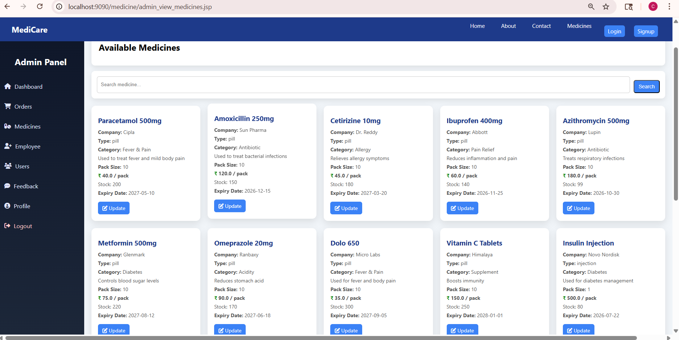
Screenshots – Admin Updates Medicine

Slide 21
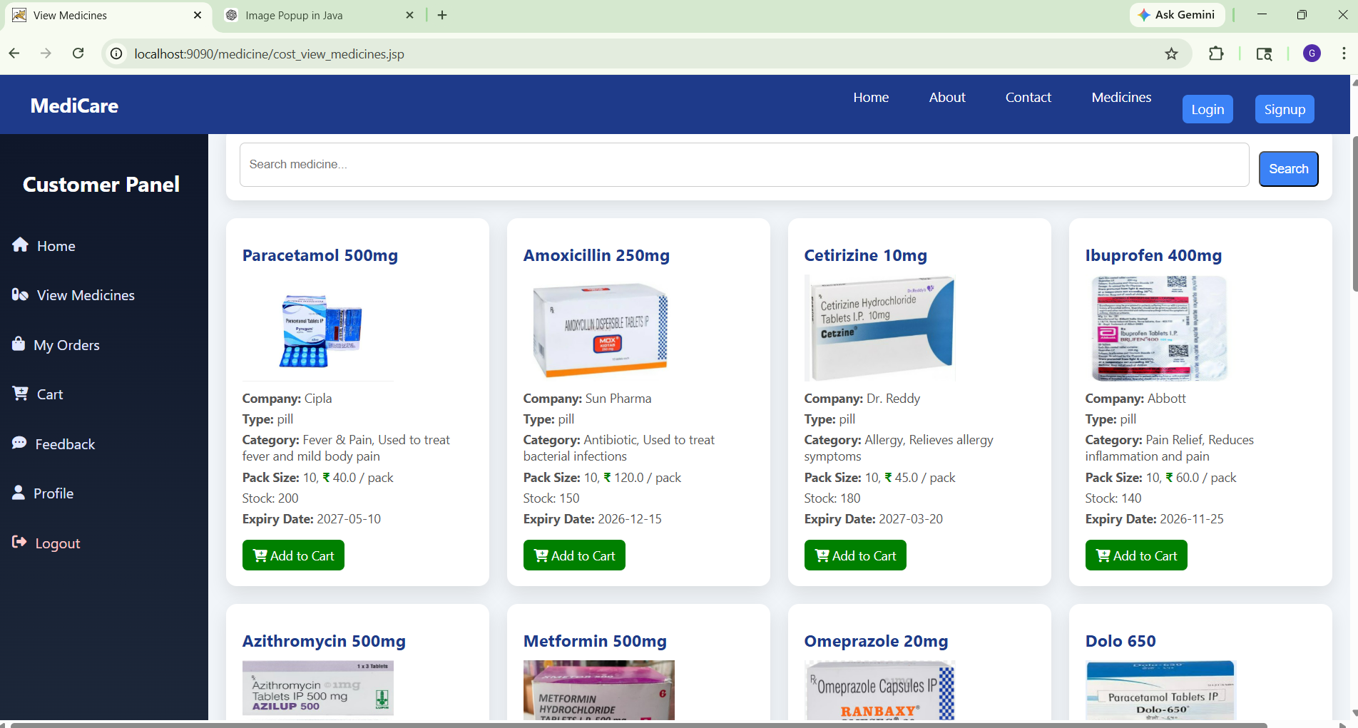
Screenshots – Customer Orders Medicine

Slide 22
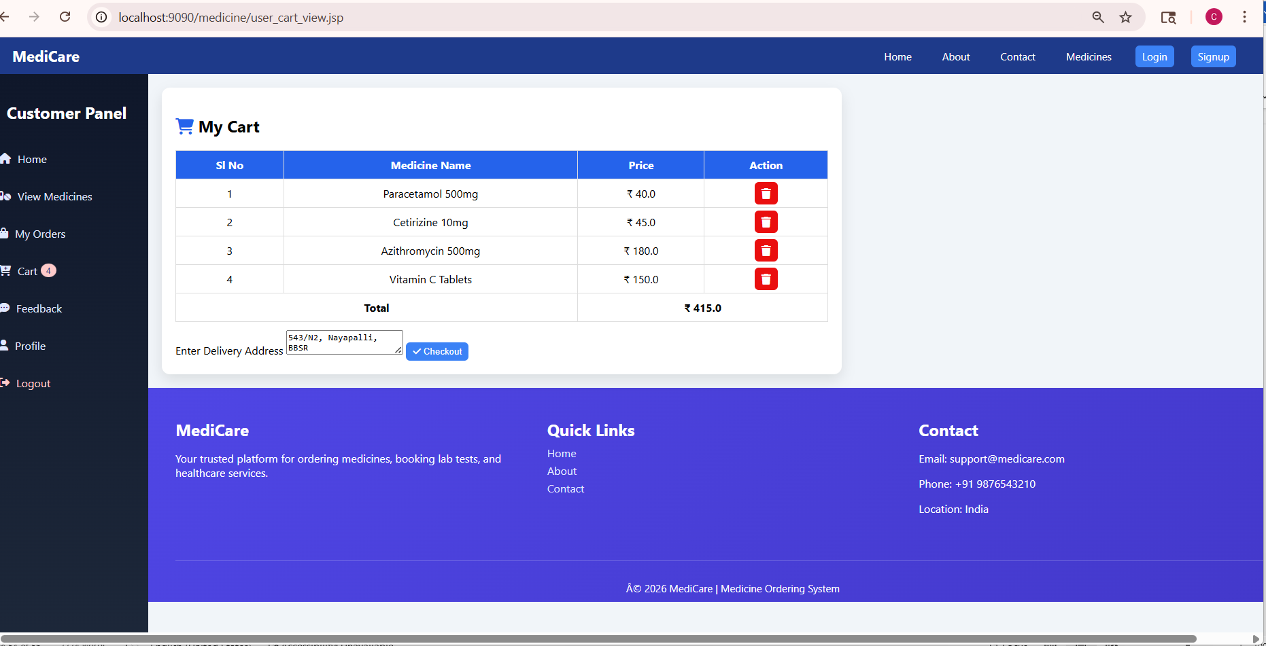
Screenshots – Customer Checking Cart

Slide 23
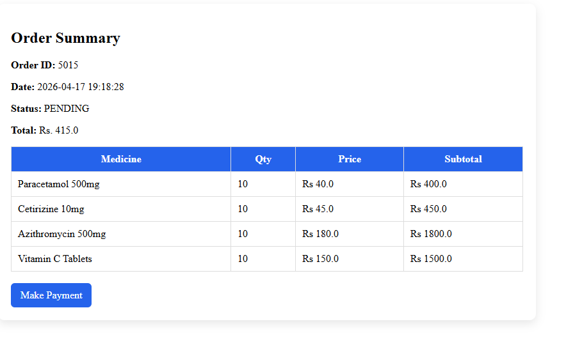
Screenshots – Customer View Item Orders

Slide 24
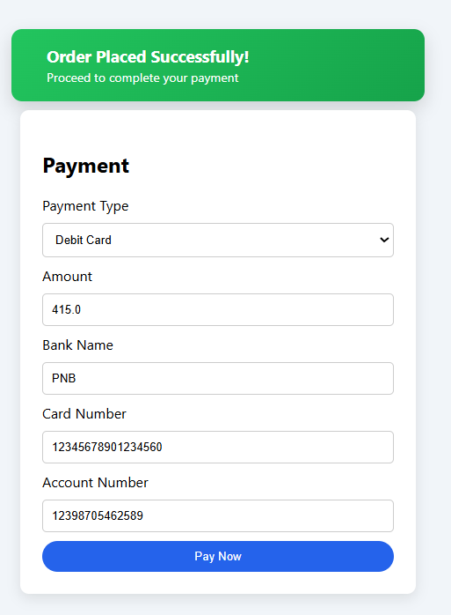
Screenshots – Customer Making Payment

Slide 25
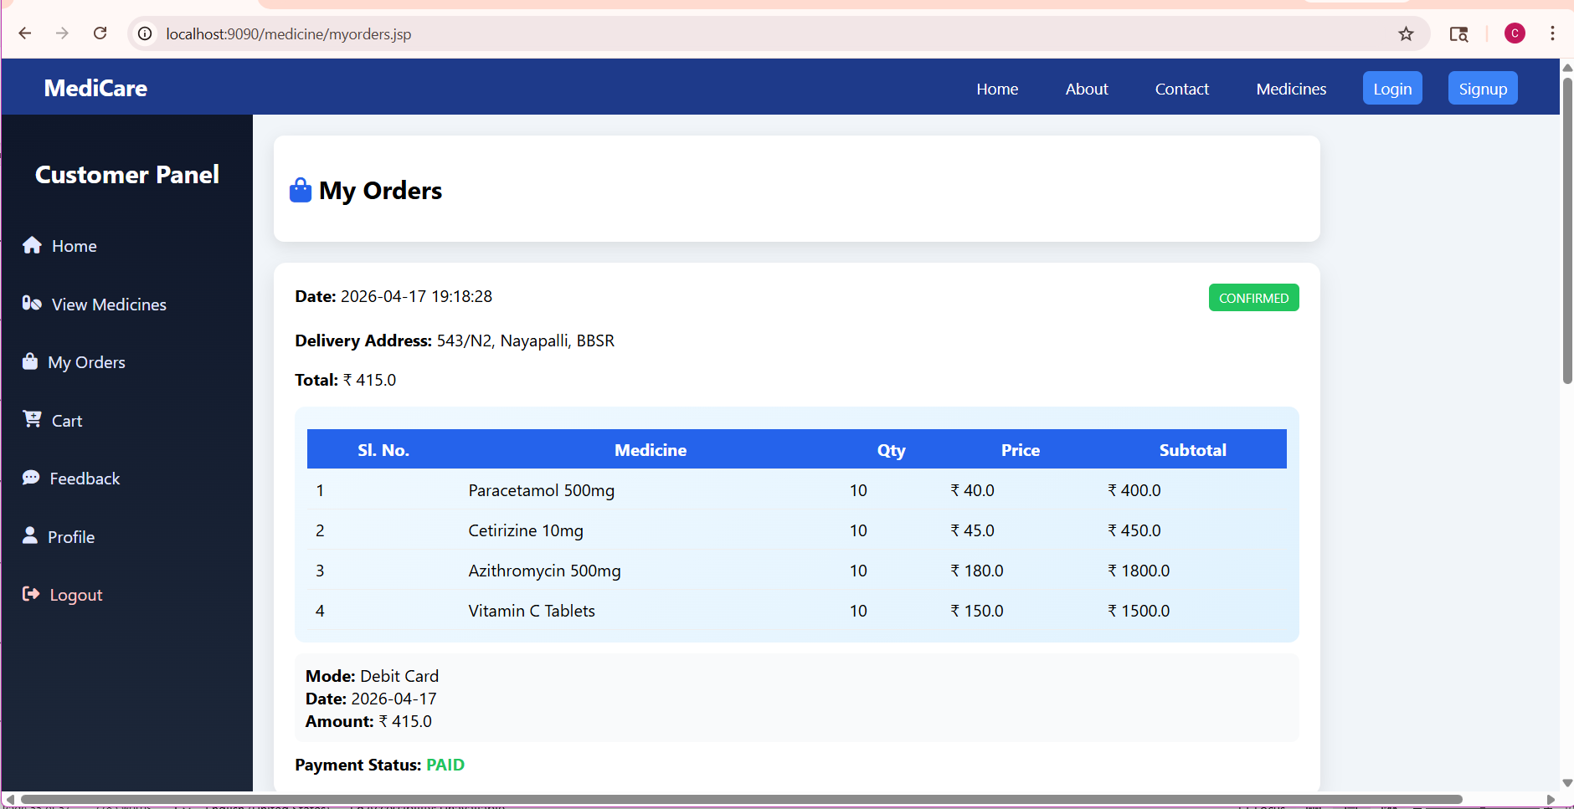
Screenshots – Customer View Purchase Receipt

Slide 26
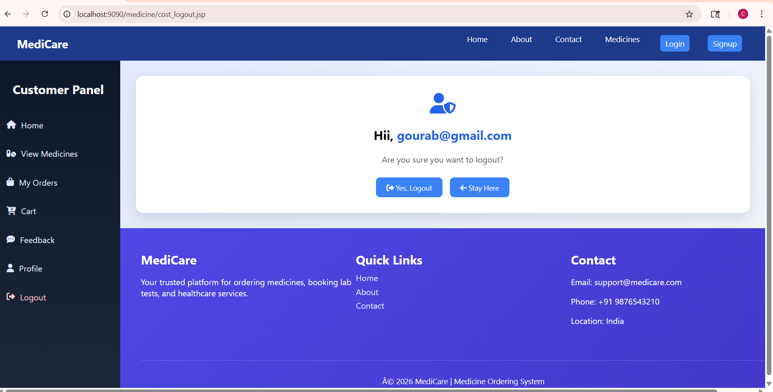
Screenshots – Sign Out Page

Slide 27
Conclusion
The Online Medicine Ordering System has been successfully designed and developed to provide an efficient and user-friendly platform for purchasing medicines online. The system simplifies the traditional method of buying medicines by allowing customers to browse available products, place orders, and make payments through an online interface. It reduces manual effort and improves the accuracy of order processing and record maintenance.

Slide 28


