Slide 1
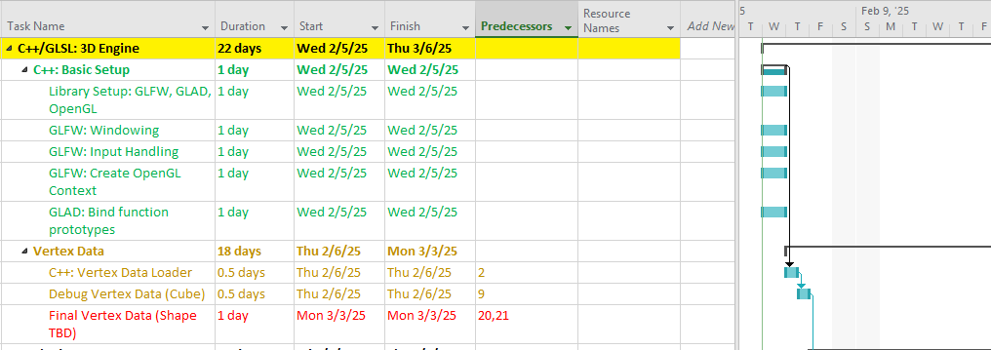
Notes
Basic setup finished ahead of schedule, offset small delay in preliminary vertex data to remain on schedule
Open source software for generating vertex data suddenly shut down – schedule may slip 1-2 weeks as replacement is sought
Expect to move on to math library next week
For Period Ending 2/9/25
Completed: Basic setup and libraries – 6hrs
In-Process: Prelim vertex data - 3hrs
At-Risk: Final vertex data

Slide 2
Format of first slide cont. as needed
Show different section of Gantt, if more than one section was worked on, or if notes require more space than usual

