Slide 1


Slide 2
Presented By
Sium Hossain
181002033
Salauddin
181002034
Sumaiya akhter
181002174
Md. Alamgir Hossen
181002049

Slide 3
Content
Introduction
Classifier we use?
Methodology
Accuracy
Manual testing

Slide 4

Introduction
Fake news is false or misleading information presented as news. It often has the aim of damaging the reputation of a person or entity, or making money through advertising revenue.So our aim is not only to detect fake news, but to also achieve the highest possible accuracy levels in the detection.

Slide 5
Classifier we use?
Logistic Regression
Logistic regression is the appropriate regression analysis to conduct when the dependent variable is binary. Like all regression analyses, the logistic regression is a predictive analysis.Logistic regression is used to describe data and to explain the relationship between one dependent binary variable and independent variable.

Slide 6

Classifier we use?
Decision Tree Classification
A decision tree is a supervised learning technique that has a pre-defined target variable and is most often used in classification problems.

Slide 7

Classifier we use?
Gradient Boosting Classifier
Gradient boosting is a type of machine learning boosting. It relies on the intuition that the best possible next model, when combined with previous models, minimizes the overall prediction error. The key idea is to set the target outcomes for this next model in order to minimize the error.

Slide 8
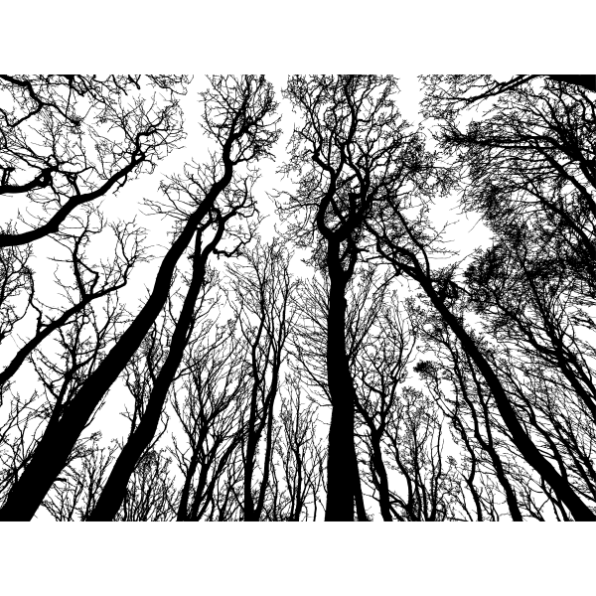
Classifier we use?
Random Forest Classifier
A random forest is a machine learning technique that's used to solve regression and classification problems. It utilizes ensemble learning, which is a technique that combines many classifiers to provide solutions to complex problems. A random forest algorithm consists of many decision trees.

Slide 9


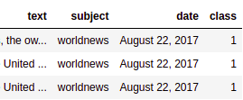
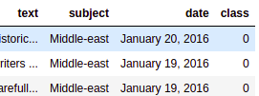
Methodology

Slide 10

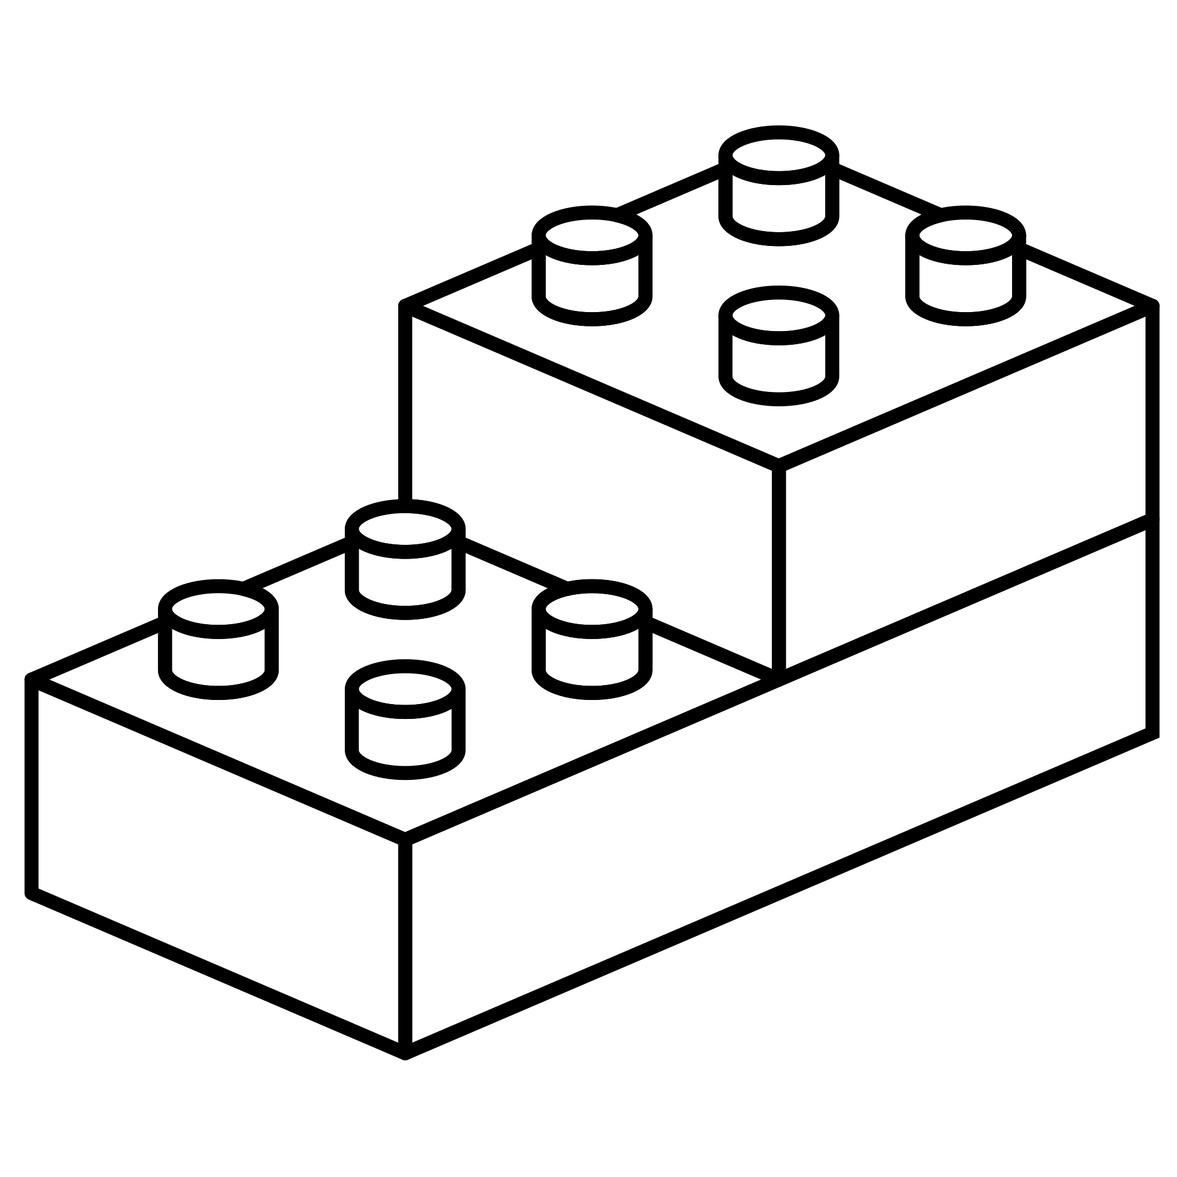


Methodology
Data Cleaning
vectorization
Tuning

Slide 11
Accuracy
97-99 %

Slide 12


Manual Testing

Slide 13
Thank You

