Slide 1
Web-Programming Project
Online English Test website
Instructor: Dr. Nguyen Duc Thai
Nguyen Ngoc Hoa
Duong Ngoc Quang Huy
Trinh Cong Vu

Slide 2
WORKLOAD
Student ID | Name | Workload
2052489 | Duong Ngoc Quang Huy | 100%
2052485 | Nguyen Ngoc Hoa | 100%
1852882 | Trinh Cong Vu | 100%

Slide 3
01
Project outcomes
02
Application Development
03
Risks and Challenges
04
Release and Maintenance

Slide 4
01
Project outcomes
x
y

Slide 5
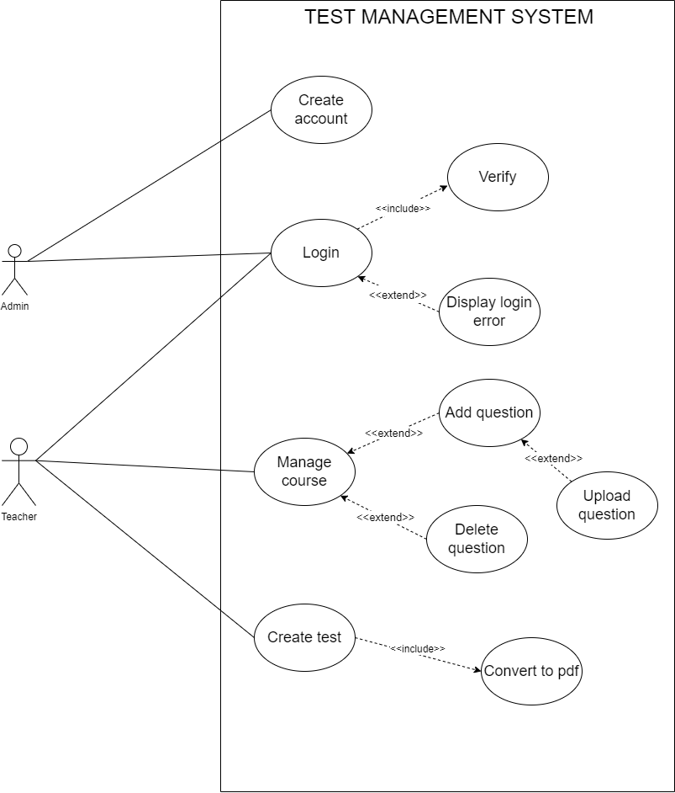
Use case diagram
4 main features:
Log in / Log out
Course managing
Create and manage question
Create test

Slide 6
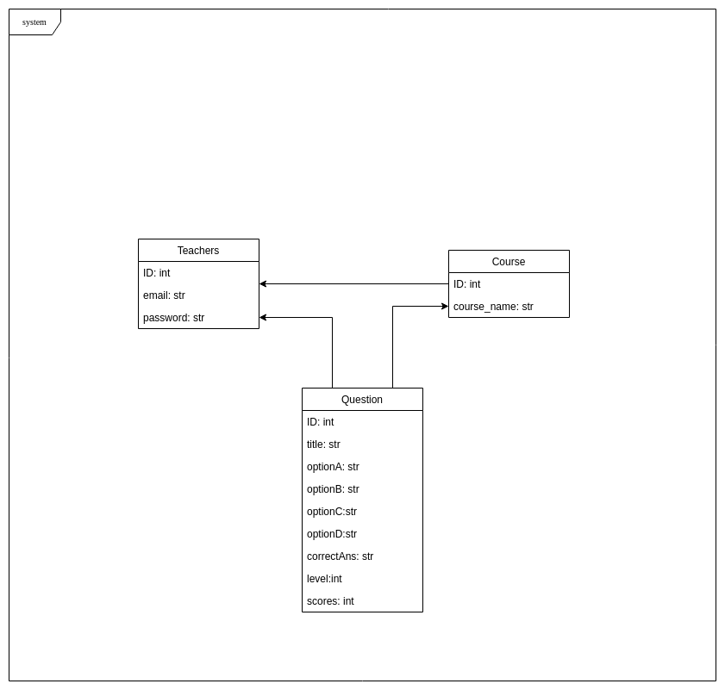
Class Diagram
The system consists of 3 models:
Teachers
Course
Question

Slide 7
02
Application Development
404 NOT FOUND

Slide 8






Implementation
Technologies

Slide 9

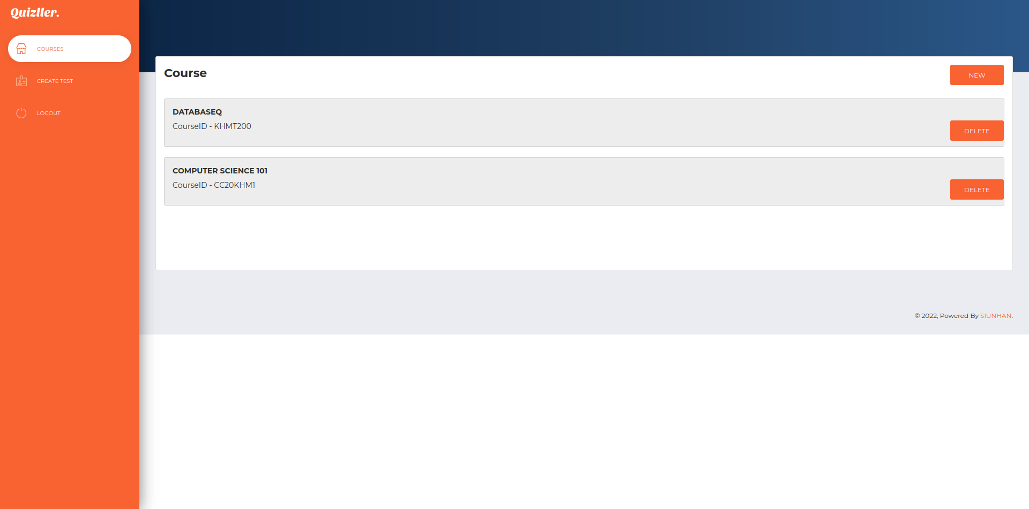
Interface design
Login Design
Dashboard design

Slide 10
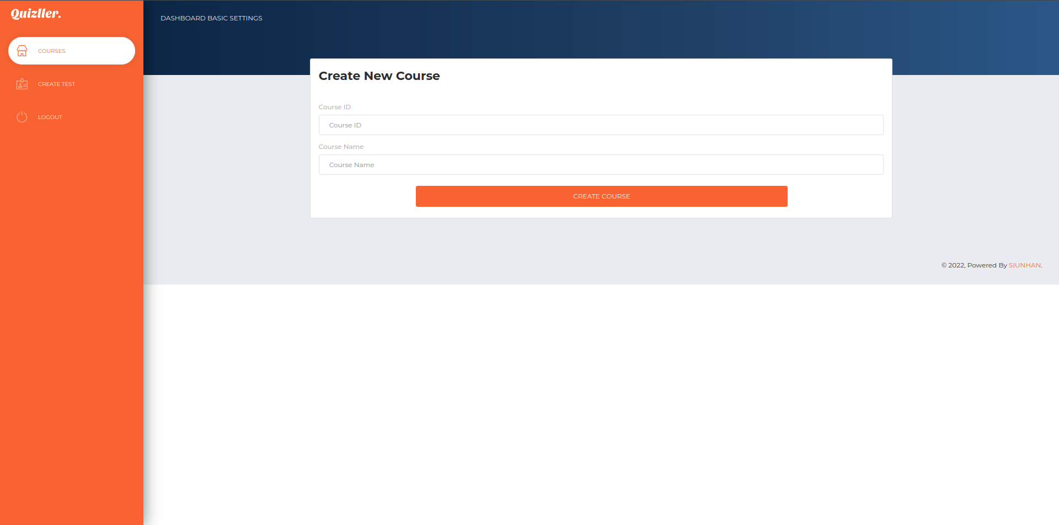
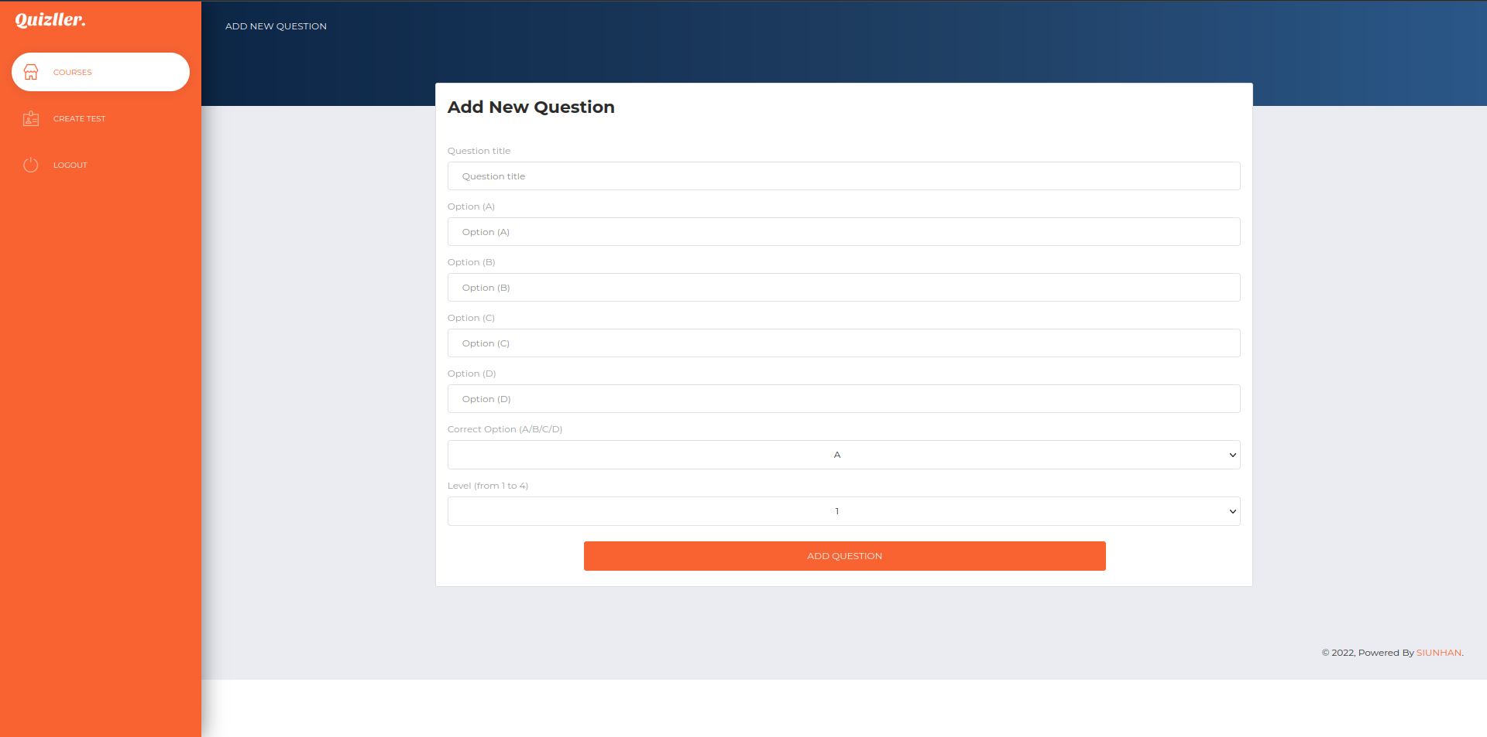
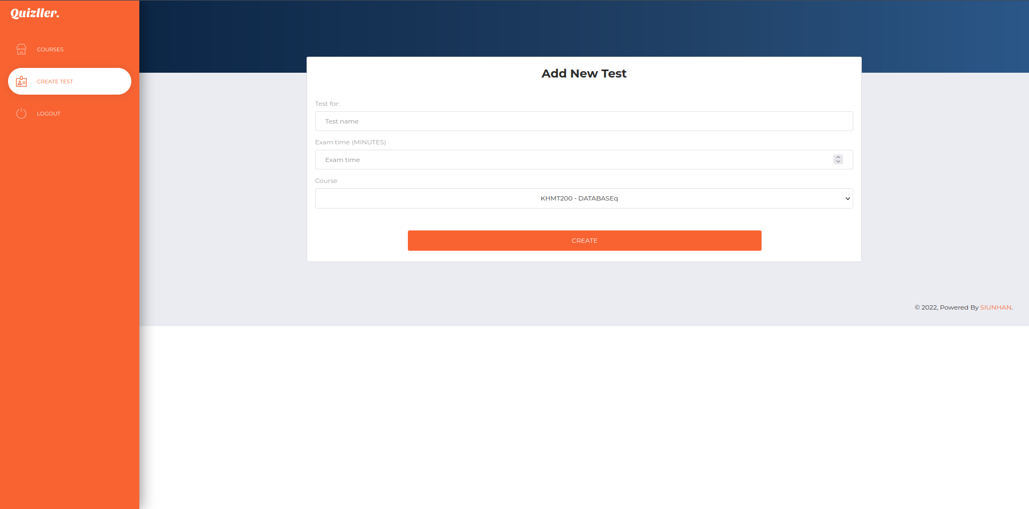
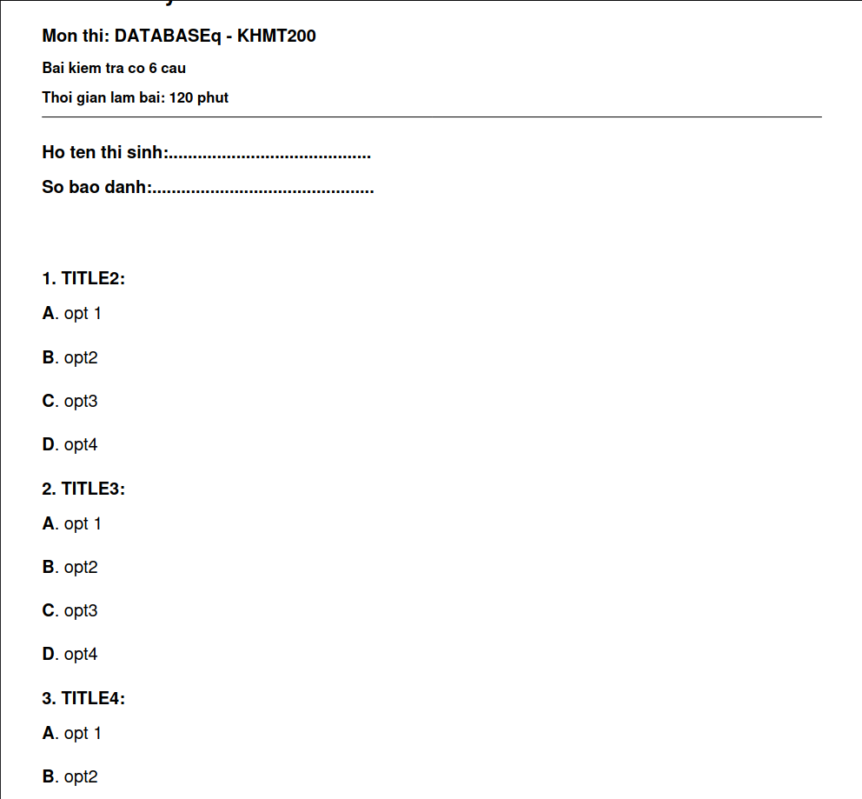
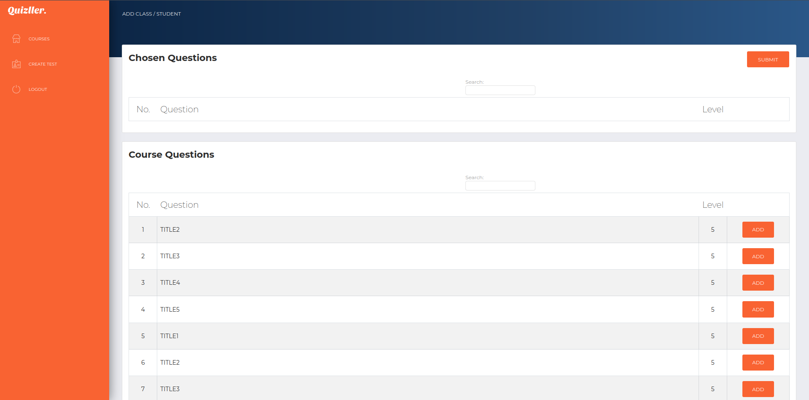
Process of creating test
Create course
Create questions
Create test
Export the test to pdf file
Add questions to the test

Slide 11
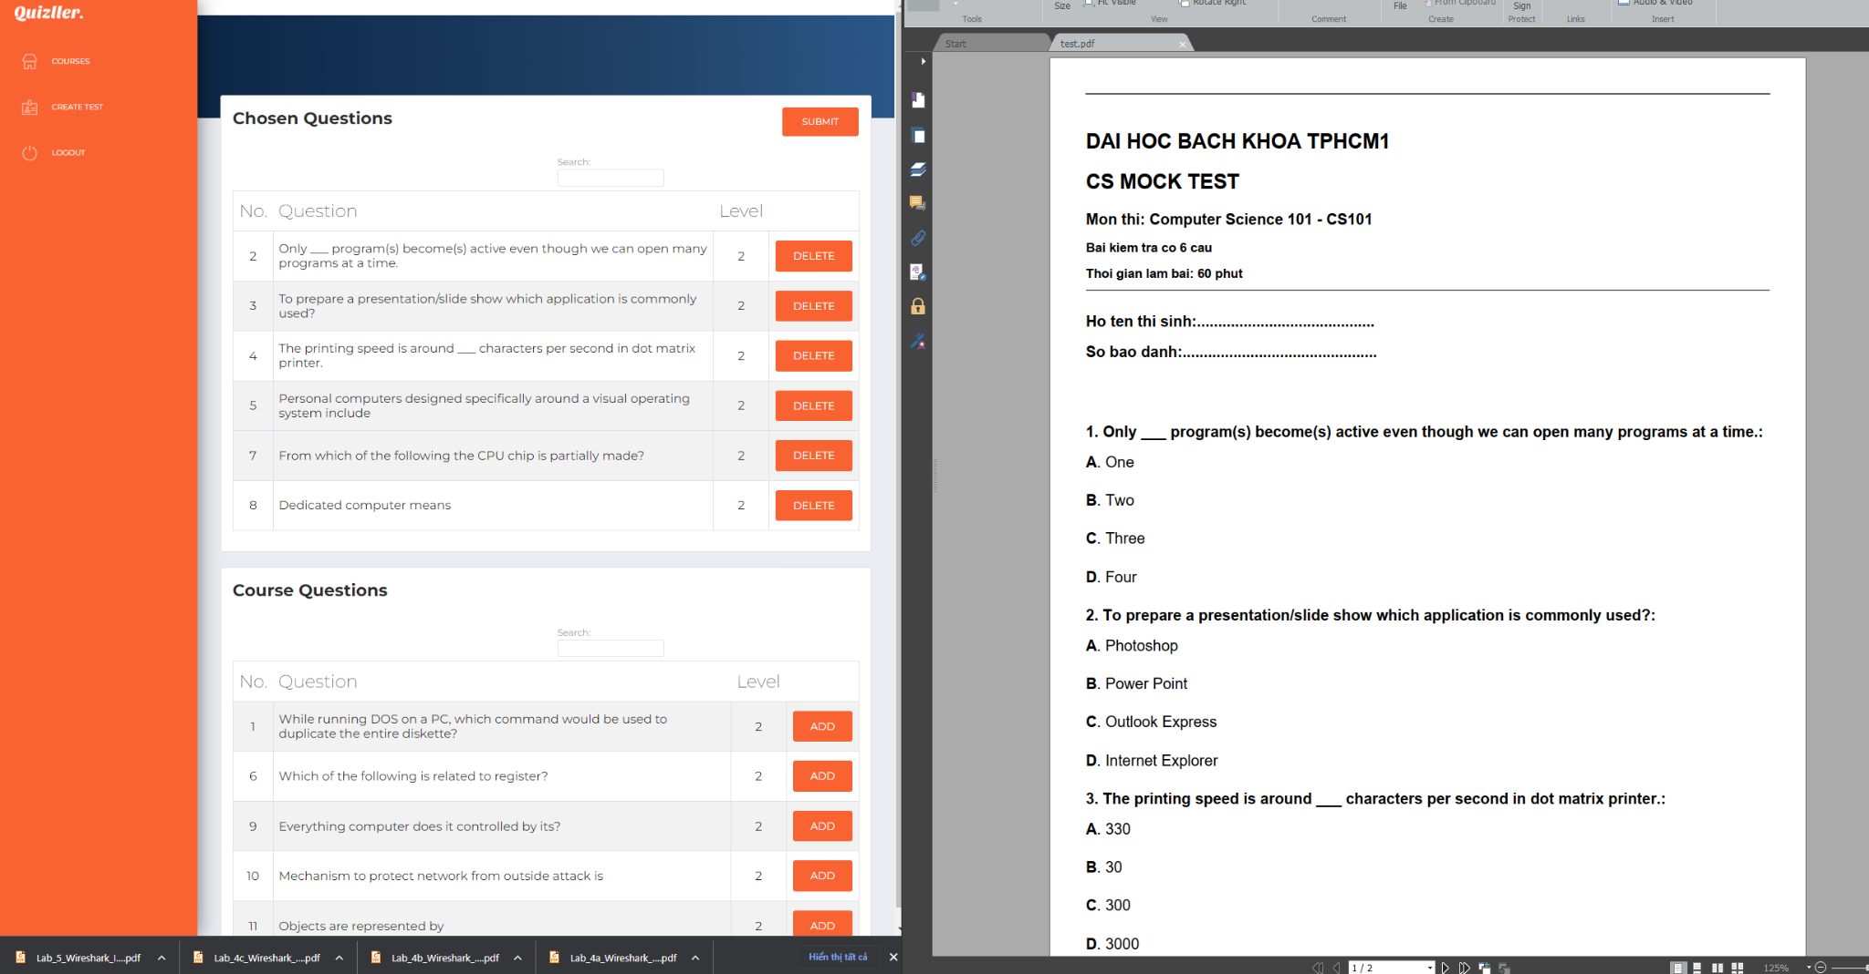
PDF result

Slide 12
03
Risks and Challenges

Slide 13
Poor planning
Poor planning for function of web
Plan better before implementation
Details
Consequence
Improvement
Time consuming

Slide 14
04
Release and Maintenance

Slide 15
Applying SEO
Title tags
Meta tags
using some Open Graph meta tags:
• og:locale - to define the language that we use for the website
• og:site_name - to define the main website’s name, in our case it is Quizller
• og:description - description of that page.
• og:type - type of that page
• og: title - the title of that page
Schema Markup

Slide 16
Thanks!

