Slide 1
A Self-Optimizing Workerpool in Go
Borrowing Concepts from Biology And Mechanical Engineering

Slide 2
Who am I?
Gophercon Speaker 2023, 2026
Casey Manus Principal Software Engineer - Bayer Crop Science
caseylmanus@gmail.com
casey.manus@bayer.com https://github.com/caseylmanus/workerpool
Notes:
Work with teams that build high throughput, low latency services, data processing pipelines and event processing

Slide 3
The Example Problem
We want to train an LLM on all data from Wikipedia Wikipedia has constrained output and rate limiting to prevent scraping We want to build a workerpool that adapts to upstream responses
Notes:
We often have to process data from event streams calling services that might support batching, might be rate limited, might be resource constrained, etc. This arbitrary example illustrates processing data from a system you don’t control, but want to ensure maximum throughput without degrading the upstream service

Slide 4
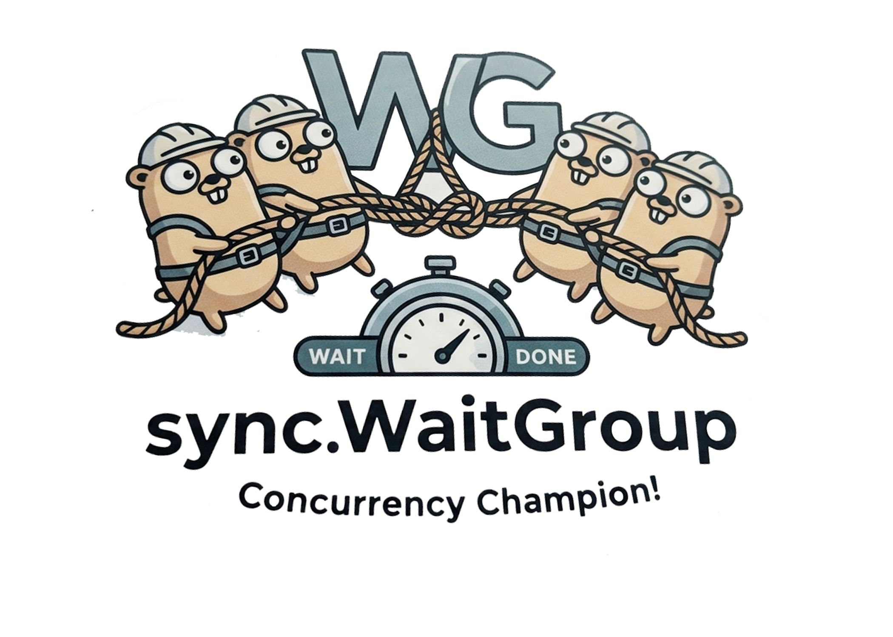
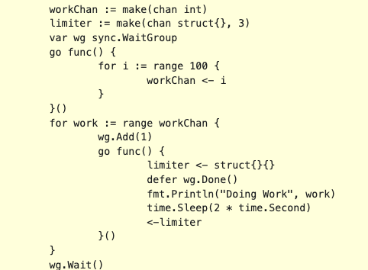
Workerpools in Go
Notes:
You’ve probably built a workerpool before using sync.Waitgroup, in this simple example we use a buffered channel to limit the number of concurrent workers

Slide 5

Errors
x/errgroup.Group
Retries
Backoff
Linear
Exponential
Jitter
Notes:
But that’s not enough, you quickly learn you have to deal with errors, so you introduce errgroup.Group instead of waitgroup…
Then you experience errors indicating that you need to retry, then you might play with different backoff strategries – linear, then exponential, the introducing jitter

Slide 6
The Problem with Static Tuning
Most concurrent architectures use hardcoded worker limits and sleep cycles.
- Fine-tuned for local machine networks.
- Fractures instantly when exposed to changing upstream rate limits.
- Leads to either over-throttling (wasting resources) or under-throttling (getting banned).
Notes:
Optimize for local, or static environments, you might make it configurable, but then you experience degrading performance, having to redeploy changes, etc.

Slide 7
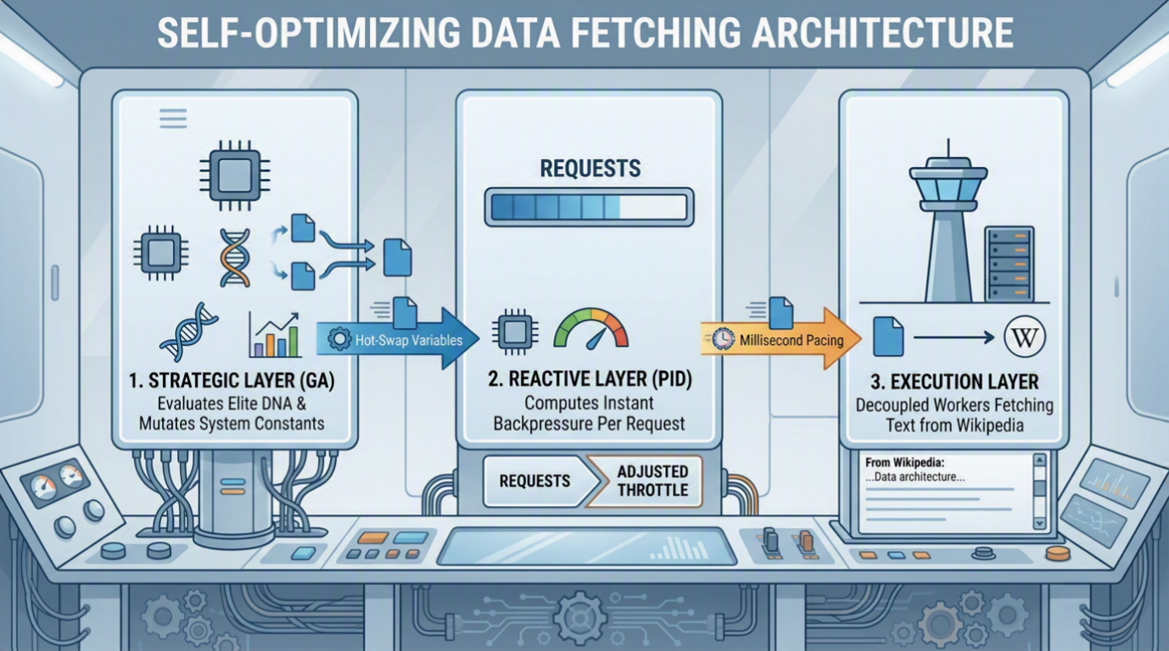
Notes:
The tiered architecture, We manage a strategic layer that uses evolutionary algorithms to find an optimal configuration
A reactive layer to make the system rapidly adapt to backpressure
And finally the actual worker (the execution layer)

Slide 8
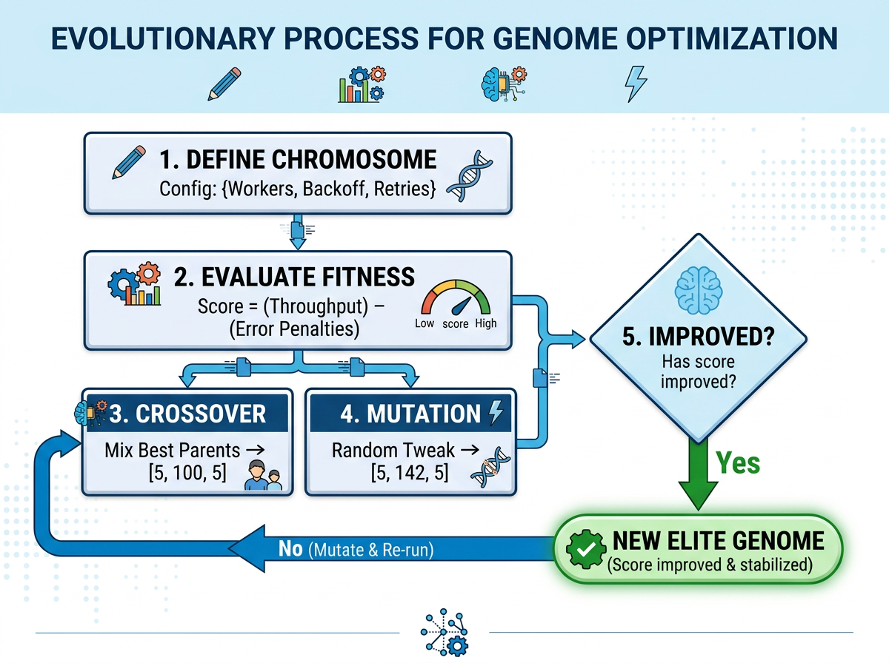
Notes:
Review GA concept Genome (Chromosome) – Evaluate fitnet, cross over ingle-Point Crossover: A single random splitting point is chosen along the chromosome. The segments to the right of this point are swapped between the two parents. [1, 2, 3]
Two-Point / Multi-Point Crossover: Two or more random splitting points are selected. The alternating segments of genetic material between these points are swapped. This reduces positional bias. [1, 2, 3, 4, 5]
Uniform Crossover: Instead of splitting the chromosome into segments, each gene (bit) is chosen independently from either parent based on a random coin flip (typically a 50/50 probability). [1, 2]

Slide 9
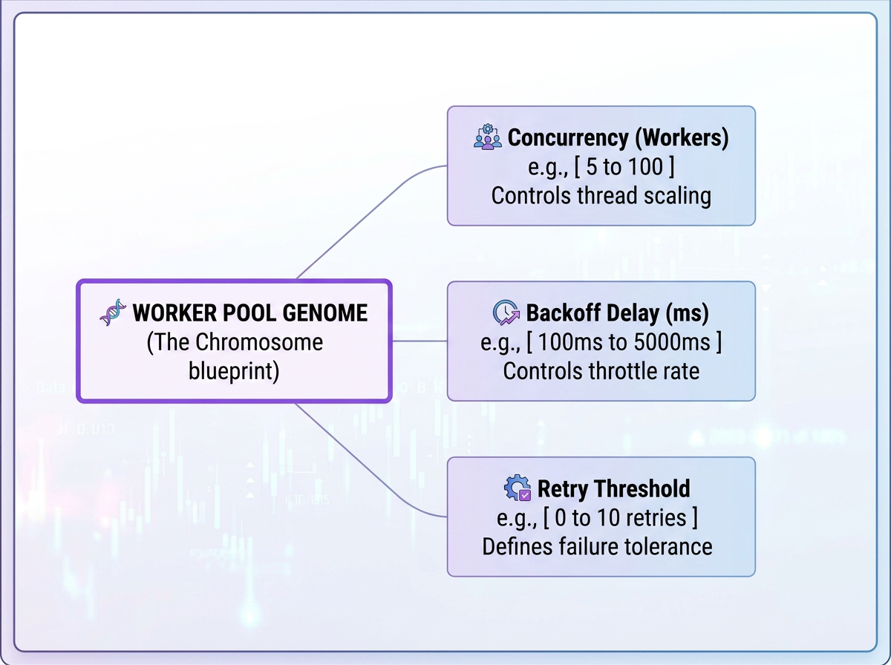

Slide 10
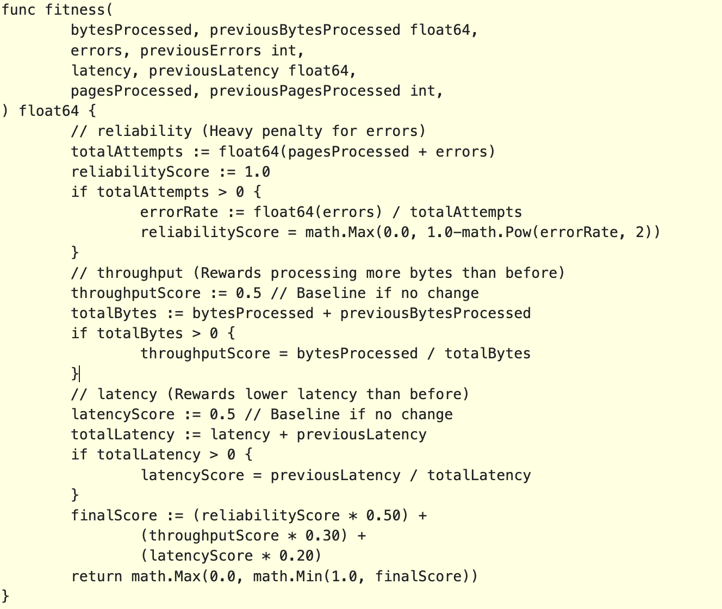
Notes:
Sample fitness function, don’t worry too much about the exact code here, we weight bytes processed, errors and latency against the previous generation,

Slide 11
Transitioning Genetic Algorithms to Real-Time Control Theory
Traditionally, fitness will increase with evolution given static environment and objective fitness functions.​
Environment Pressure and Dynamic Baselines means optimal fitness is a changing target.
Genetic Algorithms
Real-Time Control Theory
Notes:
Genetic algorithms and the fitness functions often live in determinitistic closed loops, in order to overcome this, and have it react to changing environment and delayed feedback cycles, we have to introduce a backpressure mechanism

Slide 12
Understanding PID Controllers
A PID controller is a control loop feedback mechanism that automatically corrects errors and variances in mechanical systems.
It continuously calculates an error value as the difference between a desired setpoint and a measured process variable.
Common uses include automobile cruise control, drone flight stabilization, and thermostats.

Slide 13
The Controller Applies Three Terms to Eliminate This Error
* Proportional (P): Corrects for the present error.
* Integral (I): Corrects for the accumulation of past errors.
* Derivative (D): Predicts future errors based on the current rate of change.

Slide 14
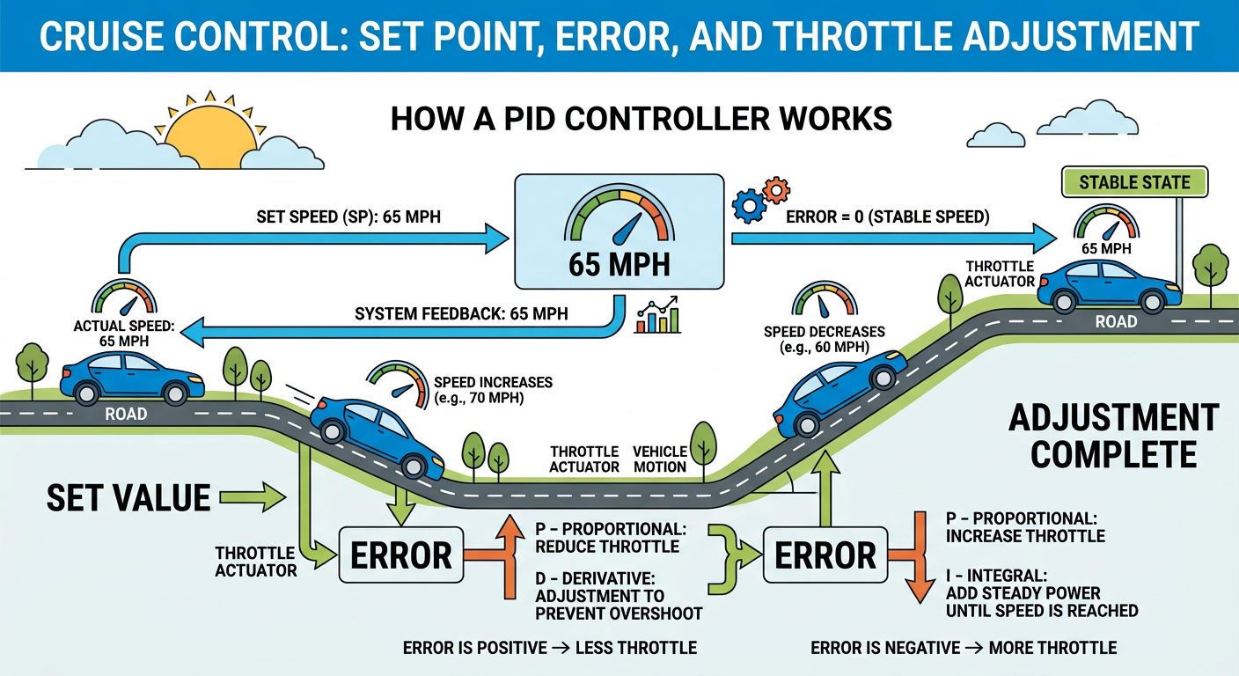

Slide 15
PID Backpressure Reflex
It samples a moving average of the crawler's HTTP Error Rate (e.g., 429 Too Many Requests).
Compares it against a strict, non-evolving target of 0% errors.
Instantly injects a dynamic sleep penalty across all workers the moment the server begins rejecting requests.
This acts as an automatic braking system, preventing the crawler from getting IP-banned or crashing the server before the next evolutionary generation.
Arrives to scale down the worker count.
Notes:
We use the PID controller loop to react immediately to error backpressure, like in our cruise control example, we have a set point of 0 errors, and our throttle is the sleep delay between work.

Slide 16
Elitist Genetic Algorithm
Every 5 seconds, the system reviews its performance via an evaluation window:
If a configuration yields exceptional throughput without triggering network failures, it is crowned the Elite Strategy.
Notes:
Talk about the cycle of the app, testing for 5 seconds to find the elite genome (highest fitness)

Slide 17
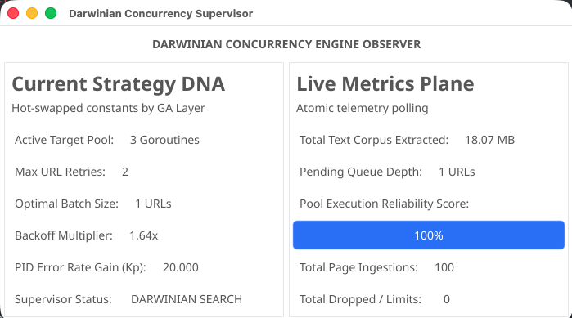
Live Demo

Slide 18
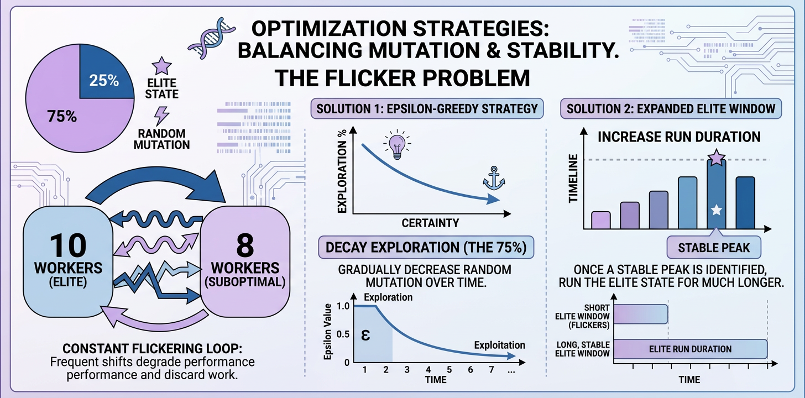
Notes:
We spend too much time “searching for the elite configuration (genome)” We reduce the exploration window over time to spend more time running the found elite configuration as we have learned it

Slide 19
Key Takeaways
Combine Mechanisms: Use deterministic controls for emergencies, but heuristic mutations for peace times. Decouple Tracking: Keep queue replenishment separate from worker routines to avoid lock contention. Isolate State: Use lockless atomic variables for your core data planes to ensure metrics collection never slows down execution.
Notes:
Possible next steps build this to work over a distributed system , possibly as a Kubernetes autoscaling operator.

