Slide 1
Spark 1.0 vs 2.0
Main programming interface of Spark was the Resilient Distributed Dataset (RDD)
After Spark 2.0, RDDs are replaced by Dataset, which is strongly-typed like an RDD, but with richer optimizations under the hood
The RDD interface is still supported
Highly recommended to switch to use Dataset, which has better performance than RDD
scala> val textFile2 = sc.textFile("README.md")
textFile2: org.apache.spark.rdd.RDD[String]
scala> val textFile = spark.read.textFile("README.md")
textFile: org.apache.spark.sql.Dataset[String] = [value: string]
RDD (Spark1.0) —> Dataframe(Spark1.3) —> Dataset(Spark1.6)

Slide 2
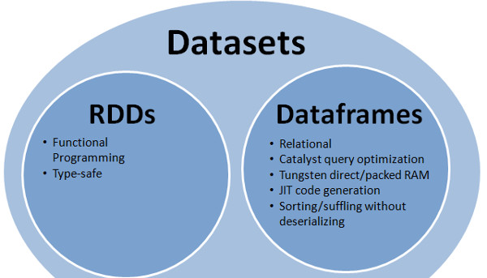
Spark RDD vs Dataframe vs Datasets
https://www.linkedin.com/pulse/apache-spark-rdd-vs-dataframe-dataset-chandan-prakash

Slide 3
Spark RDD vs Dataframe vs Datasets
Dataframe:
DataFrame is an abstraction which gives a schema view of data. Which means it gives us a view of data as columns with column name and types info, We can think data in data frame like a table in database.
Like RDD, execution in Dataframe too is lazy triggered .
offers huge performance improvement over RDDs because of 2 powerful features it has: 1. Custom Memory management (aka Project Tungsten) Data is stored in off-heap memory in binary format. This saves a lot of memory space. Also there is no Garbage Collection overhead involved. By knowing the schema of data in advance and storing efficiently in binary format, expensive java Serialization is also avoided. 2. Optimized Execution Plans (aka Catalyst Optimizer) Query plans are created for execution using Spark catalyst optimiser. After an optimised execution plan is prepared going through some steps, the final execution happens internally on RDDs only but thats completely hidden from the users.
RDD:
Its building block of spark. No matter which abstraction Dataframe or Dataset we use, internally final computation is done on RDDs.
RDD is lazily evaluated immutable parallel collection of objects exposed with lambda functions.
The best part about RDD is that it is simple. It provides familiar OOPs style APIs with compile time safety. We can load any data from a source,convert them into RDD and store in memory to compute results. RDD can be easily cached if same set of data needs to recomputed.
But the disadvantage is performance limitations. Being in-memory jvm objects, RDDs involve overhead of Garbage Collection and Java(or little better Kryo) Serialization which are expensive when data grows.
https://www.linkedin.com/pulse/apache-spark-rdd-vs-dataframe-dataset-chandan-prakash

Slide 4
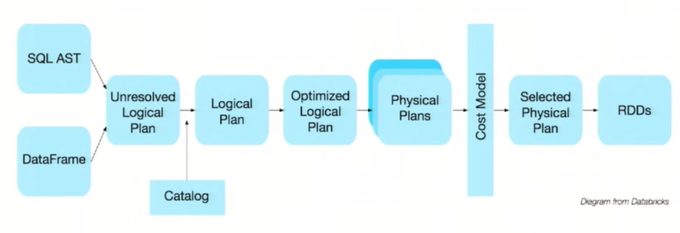
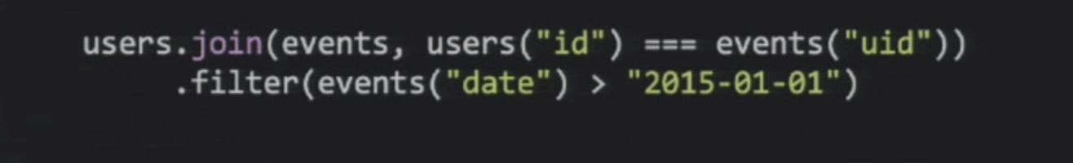
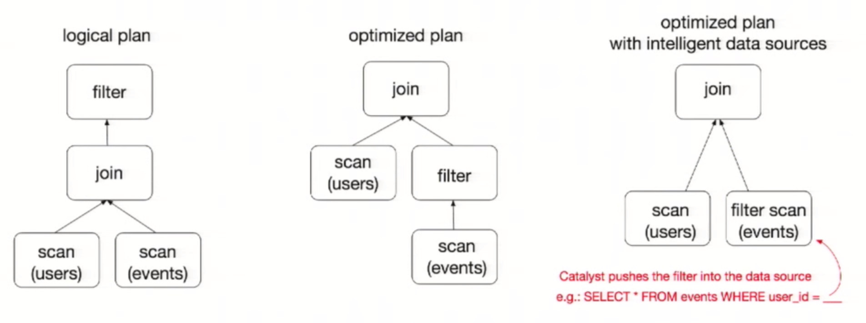
Spark RDD vs Dataframe vs Datasets
https://www.linkedin.com/pulse/apache-spark-rdd-vs-dataframe-dataset-chandan-prakash

Slide 5
Spark RDD vs Dataframe vs Datasets
Dataset:
It is an extension to Dataframe API, the latest abstraction which tries to provide best of both RDD and Dataframe.
comes with OOPs style and developer friendly compile time safety like RDD as well as performance boosting features of Dataframe : Catalyst optimiser and custom memory management.
How dataset scores over Dataframe is an additional feature it has: Encoders
Encoders act as interface between JVM objects and off-heap custom memory binary format data.
Encoders generate byte code to interact with off-heap data and provide on-demand access to individual attributes without having to de-serialize an entire object.
case class is used to define the structure of data schema in Dataset. Using case class, its very easy to work with dataset. Names of different attributes in case class is directly mapped to field names in Dataset . It gives feeling like working with RDD but actually underneath it works same as Dataframe.
Dataframe is infact treated as dataset of generic row objects.DataFrame=Dataset[Row] . So we can always convert a data frame at any point of time into a dataset by calling ‘as’ method on Dataframe. e.g. df.as[MyClass]
https://www.linkedin.com/pulse/apache-spark-rdd-vs-dataframe-dataset-chandan-prakash

Slide 6
Spark RDD vs Dataframe vs Datasets
RDD let us decide HOW we want to do where as Dataframe/Dataset lets us decide WHAT we want to do.
https://databricks.com/blog/2016/07/14/a-tale-of-three-apache-spark-apis-rdds-dataframes-and-datasets.html

Slide 7
Spark Scala vs Pyspark
scala> val textFile = spark.read.textFile("README.md")
textFile: org.apache.spark.sql.Dataset[String] = [value: string]
scala> textFile.count()
res0: Long = 126
scala> textFile.first()
res1: String = # Apache Spark
scala> textFile.filter(line => line.contains("Spark")).count()
res3: Long = 15
scala> val wordCounts = textFile.flatMap(line => line.split(" ")).groupByKey(identity).count()
wordCounts: org.apache.spark.sql.Dataset[(String, Long)] = [value: string, count(1): bigint]
scala> wordCounts.collect()
res6: Array[(String, Int)] = Array((means,1), (under,2), (this,3), (Because,1), (Python,2), (agree,1), (cluster.,1), ...)
>>> textFile = spark.read.text("README.md")
>>> textFile.count()
126
>>> textFile.first()
Row(value=u'# Apache Spark’)
>>> linesWithSpark = textFile.filter(textFile.value.contains("Spark"))
>>> textFile.filter(textFile.value.contains("Spark")).count()
15
>>> from pyspark.sql.functions import *
>>> wordCounts = textFile.select(explode(split(textFile.value, "\s+")).alias("word")).groupBy("word").count()
>>> wordCounts.collect()
[Row(word=u'online', count=1), Row(word=u'graphs', count=1), ...]

Slide 8
Spark Scala vs Pyspark
/* SimpleApp.scala */
import org.apache.spark.sql.SparkSession
object SimpleApp {
def main(args: Array[String]) {
val logFile = "YOUR_SPARK_HOME/README.md" // Should be some file on your system
val spark = SparkSession.builder.appName("Simple Application").getOrCreate()
val logData = spark.read.textFile(logFile).cache()
val numAs = logData.filter(line => line.contains("a")).count()
val numBs = logData.filter(line => line.contains("b")).count()
println(s"Lines with a: $numAs, Lines with b: $numBs")
spark.stop()
}
}
$ YOUR_SPARK_HOME/bin/spark-submit --class "SimpleApp" \
--master local[4] target/scala-2.11/simple-project_2.11-1.0.jar
...
Lines with a: 46, Lines with b: 23
"""SimpleApp.py"""
from pyspark.sql import SparkSession
logFile = "YOUR_SPARK_HOME/README.md" # Should be some file on your system
spark = SparkSession.builder.appName("SimpleApp").getOrCreate()
logData = spark.read.text(logFile).cache()
numAs = logData.filter(logData.value.contains('a')).count()
numBs = logData.filter(logData.value.contains('b')).count()
print("Lines with a: %i, lines with b: %i" % (numAs, numBs))
spark.stop()
# Use spark-submit to run your application
$ YOUR_SPARK_HOME/bin/spark-submit --master local[4] \
SimpleApp.py
...
Lines with a: 46, Lines with b: 23

