Slide 1
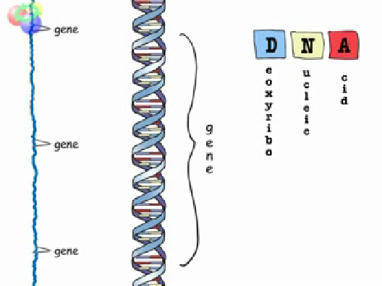
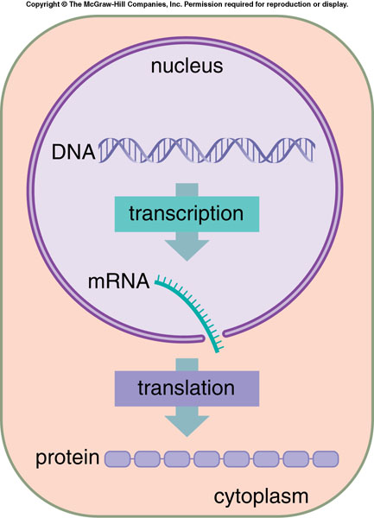
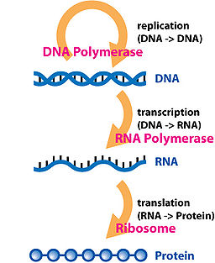
Central Dogma of Molecular Biology
What is Gene ?
What is Gene Expression ?
Eukaryotes

Slide 2
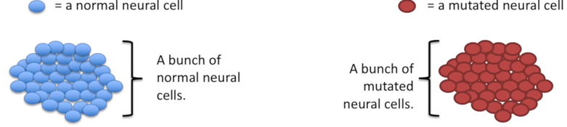
Differential Gene Expression (DGE) Analysis
The mutated cells behave differently than the normal cells.
We want to know what genetic mechanism is causing the difference.
This means we want to look at differences in gene expression

Slide 3

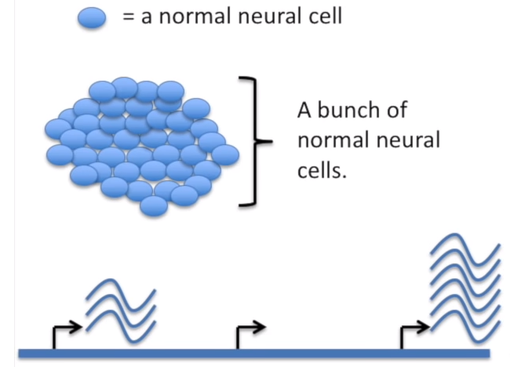
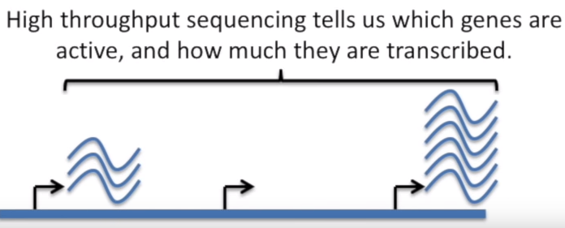
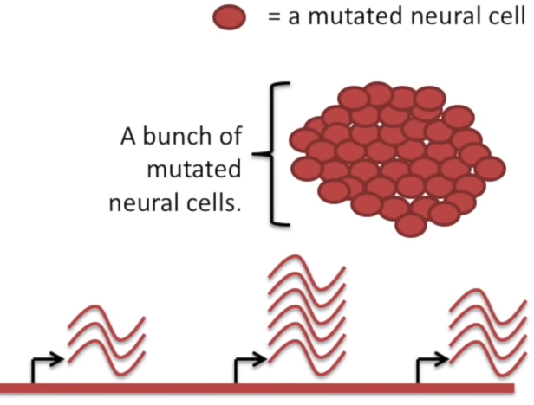
We can use RNA-Seq to measure the gene expression in normal cells. Then, use it to measure the gene expression in mutated cells.

Slide 4
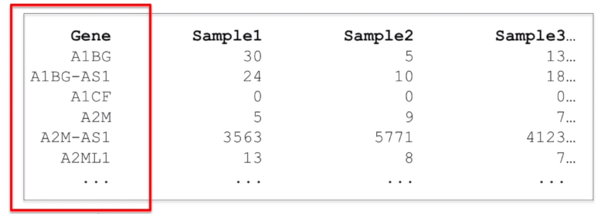
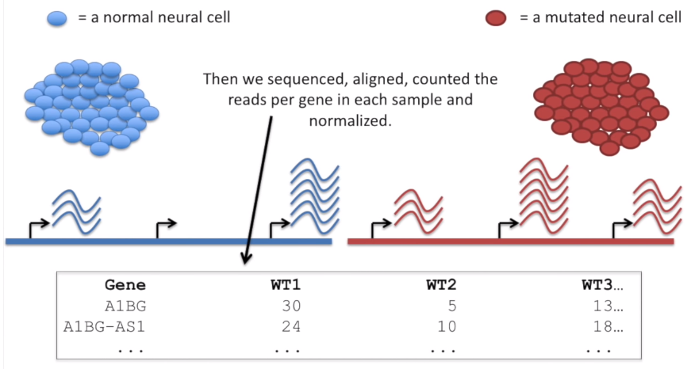
Count Reads for Genes

Slide 5
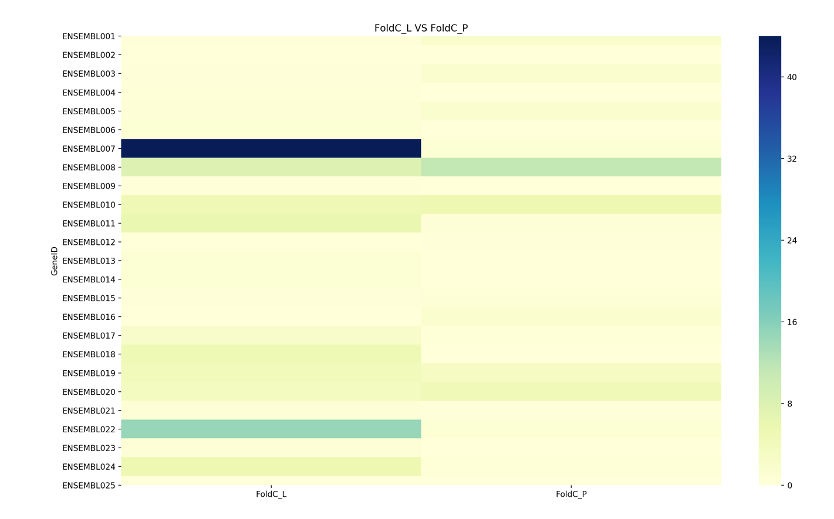
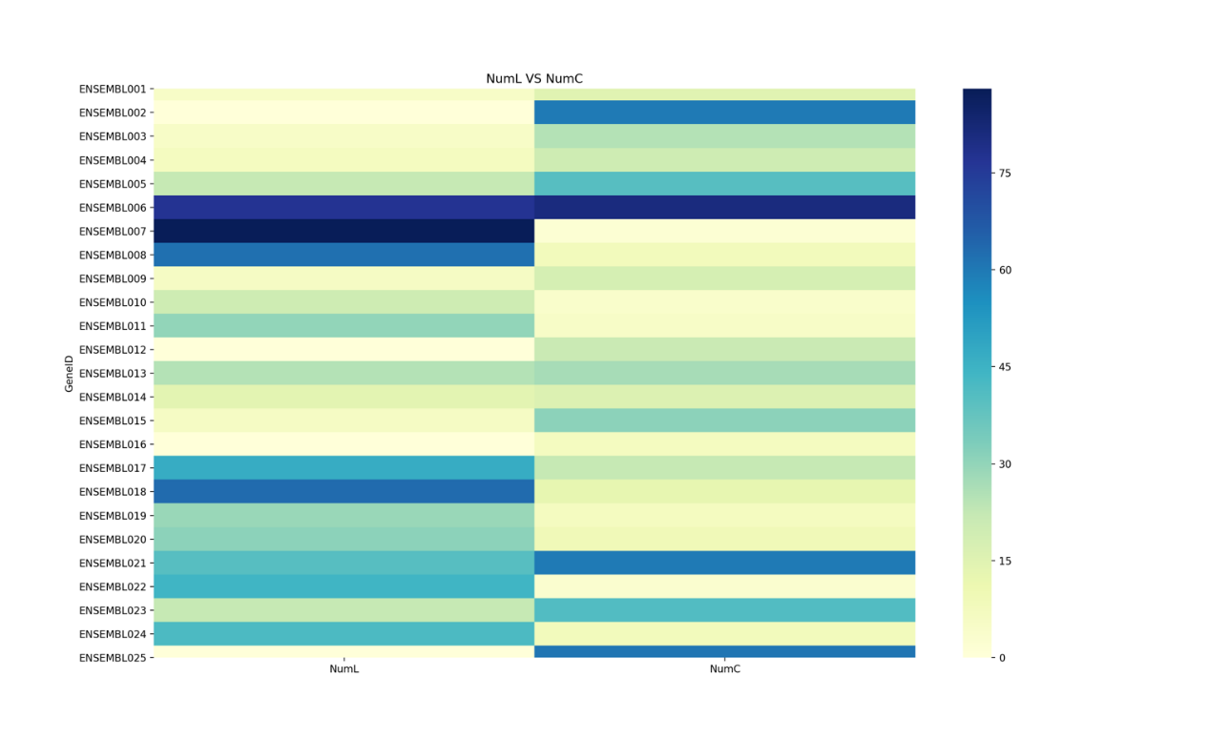
Differential Gene Expression
Suppose 2 gene expression values A,B (control-A versus treatment-B):
A=10
B=15
Fold change: is B/A => FC=1.5 or greater is up regulated , and if the values were A=15, B=10 we'll have B/A=>FC=0.667 it means all values less than 0.667 will be down regulated.
Statistical analysis of normalized count data will provide a list of genes with significant differential expression.
Down-regulated genes
Up-regulated genes
Notes:
Differential gene expression

