Slide 1

ABOUT US
TEAM ELITES
SRI KRISHNA ARTS AND SCIENCE COLLEGE COIMBATORE
Reethu. B
Siva Ranjini. C
Siva Roopini. C

Slide 2
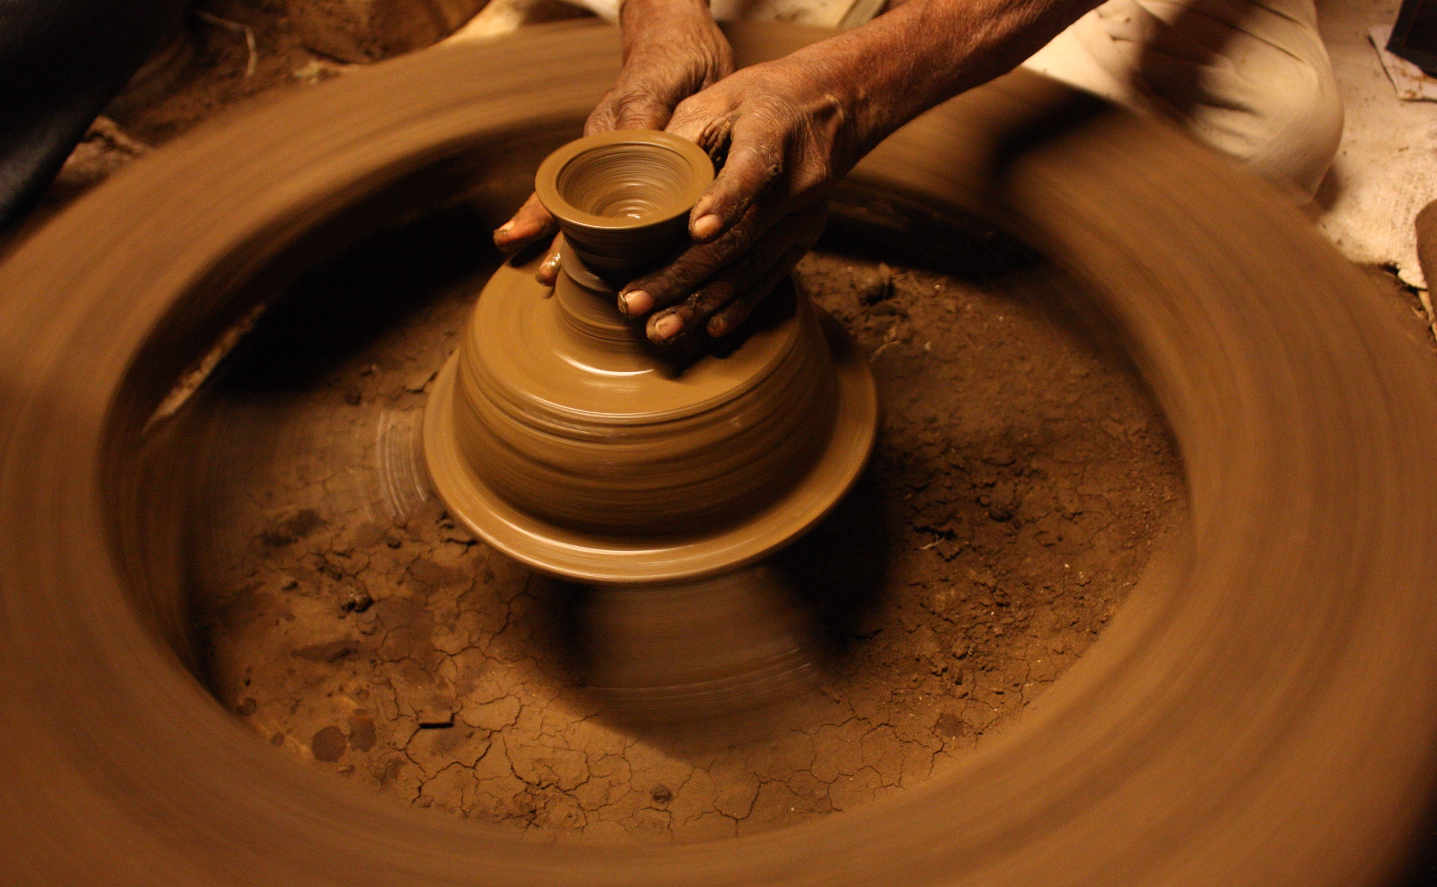
Problem Statement Title Culinary comeback: Bringing back clay pots to contemporary cook spaces.
Problem Statement Number
4

Slide 3
Developing a user-friendly and informative website dedicated to promoting the usage of clay cookware by providing comprehensive details on different types of clay pots, their benefits, usage guidelines, and recipes, accessible via scanning a QR code embedded in the cookware.
OUR APPROACH

Slide 4
The challenge lies in creating an engaging platform that educates users about the advantages of clay cookware, addresses common concerns, and inspires them to integrate these traditional vessels into their modern kitchen routines.
OUR APPROACH

Slide 5
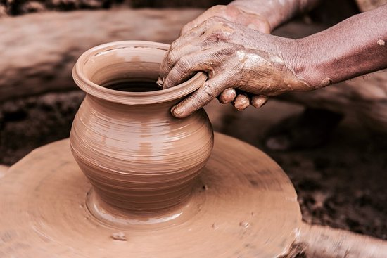

Slide 6
Educational Resource: Educate consumers about the range of possibilities available by providing comprehensive information about various types of clay pots, including their origins, materials, and production processes.
Advantages and Benefits: Stress the advantages utilizing clay cookware has for the environment and health when compared to more contemporary options, encouraging sustainability and well-being.
Usage Guidelines: Provide advice on how to use clay pots safely and effectively, along with tips on how to maintain, clean, and season them to extend their lifespan.
Recipe Repository: Assemble a menu of dishes meant to be prepared in clay pots, demonstrating the adaptability and culinary possibilities of these antique cookware pieces.
USE CASE

Slide 7
Interactive Cooking Demos: Integrate video tutorials or interactive cooking demos where users can follow along with recipes using clay cookware, enhancing the learning experience and encouraging adoption.
Personalized Recommendations: Develop algorithms to provide personalized recommendations for recipes, clay pots, and usage tips based on user preferences, dietary restrictions, and cooking habits.
Virtual Reality (VR) Experience: Create immersive VR experiences where users can explore virtual kitchens and interact with clay cookware in a simulated environment, enhancing engagement and education.
Online Marketplace: Expand the website to include an online marketplace where users can purchase clay cookware, accessories, and ingredients directly, creating a one-stop shop for all their cooking needs.
Community Challenges and Events: Organize cooking challenges, contests, and virtual events where users can showcase their culinary creations using clay cookware, fostering a sense of community and friendly competition.
Localized Content and Languages: Provide localized content and language options to cater to a global audience, ensuring accessibility and relevance for users from diverse cultural backgrounds.
_{FUTURE ENHANCEMENT}

Slide 8
HYPERTEXT MARKUP LANGUAGE
CSS
JAVA SCRIPT
QR TECHNOLOGY
LASER TECHNOLOGY
IMAGE PROCESSING
TECH STACK

Slide 9

T
A
K
O
H
N
Y
U

