Slide 1
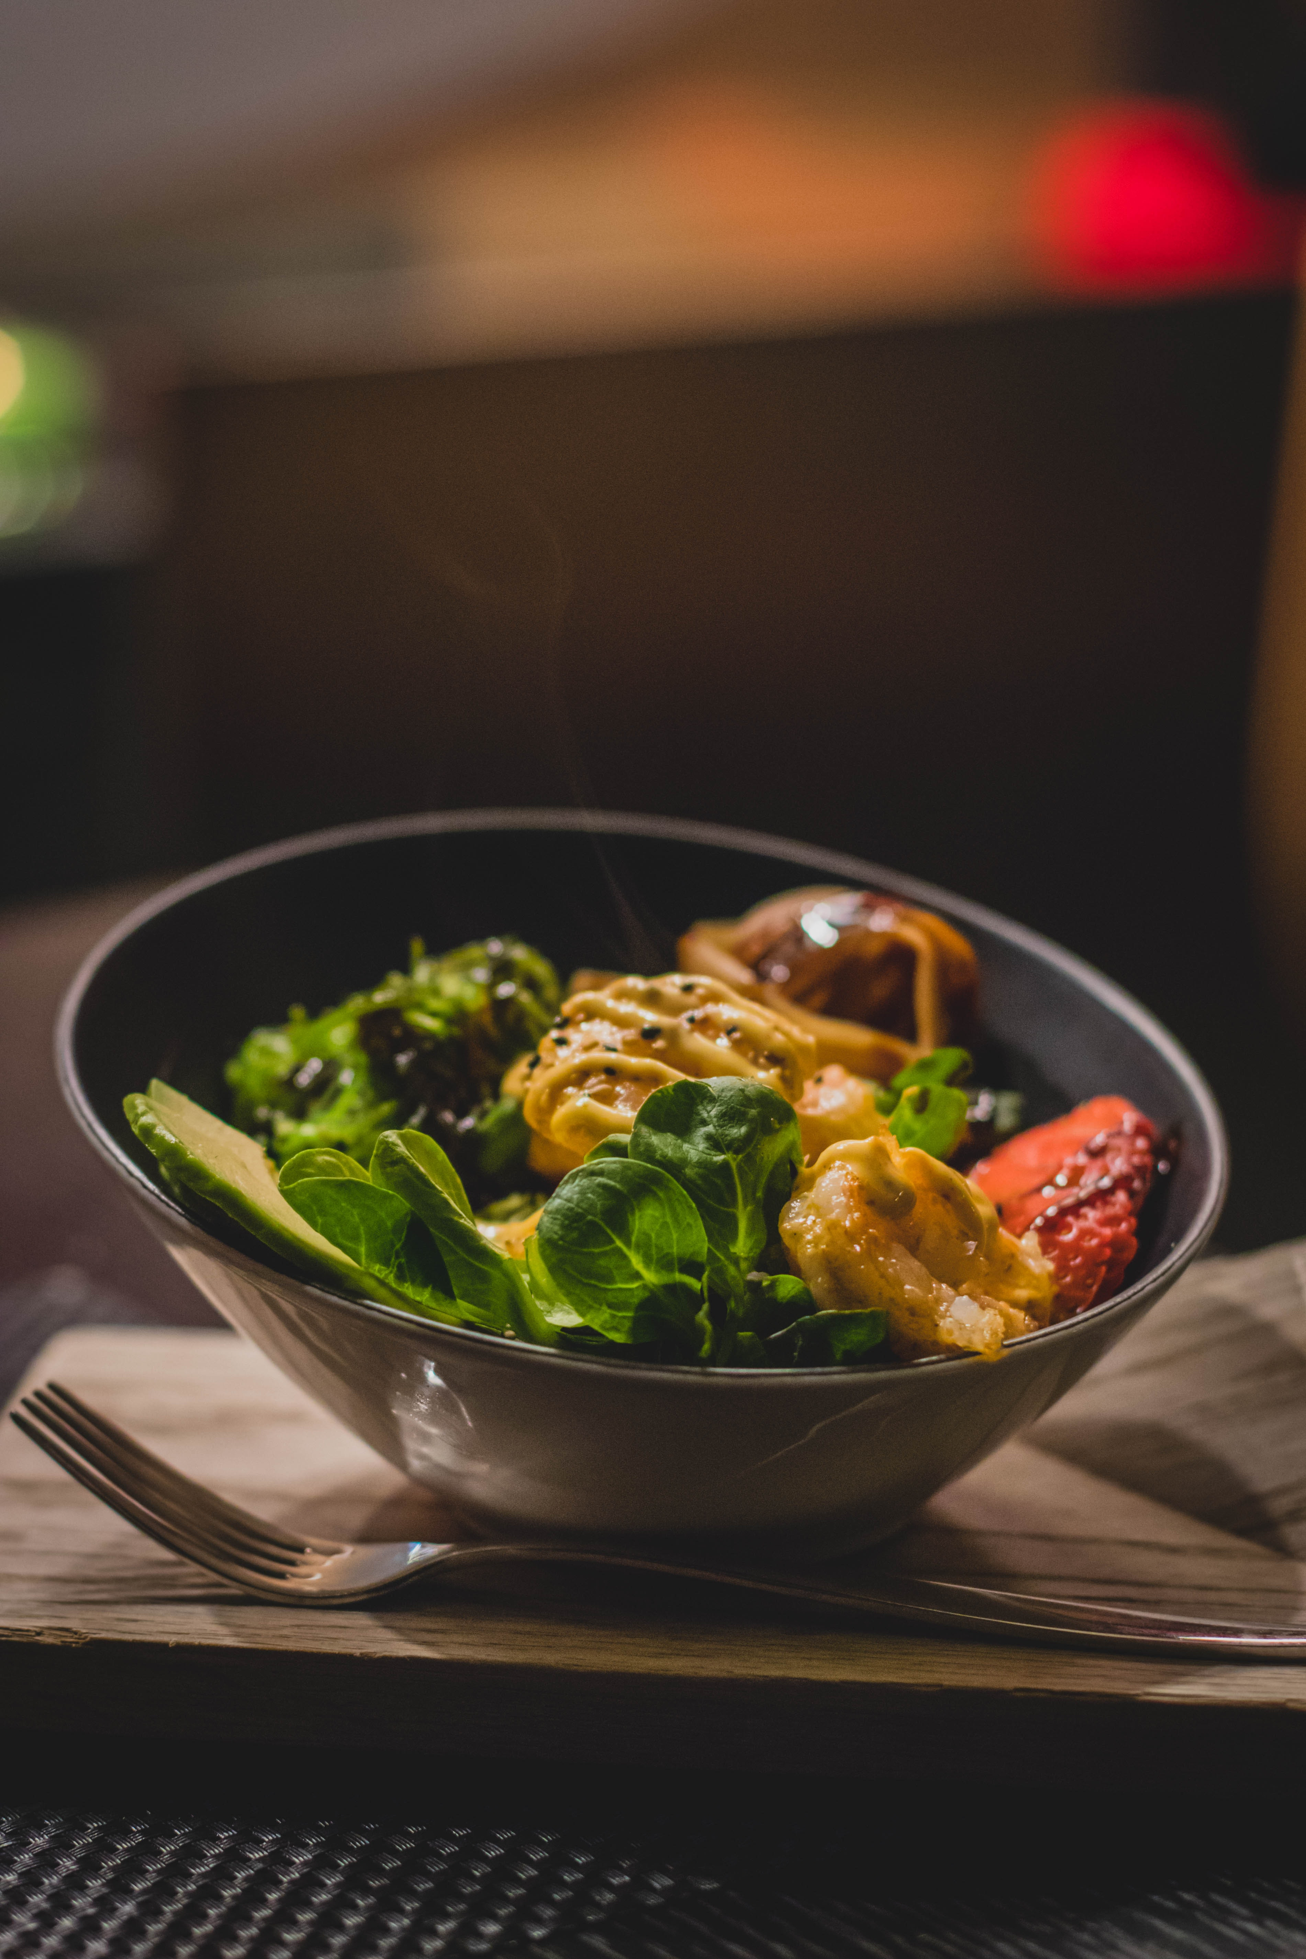
The Bowl
Team Brute-Force

Slide 2
Agenda:
Project Description
Team members & roles
Requirements
Implementation
Language
Platform
User manual
Structure of Project
Testing
Feedbacks from peer reviews
Code Inspection

Slide 3
Project Description:
The main goal of our web-application is to provide the user with an online interface for ordering food hassle-free.
In general, when we are ordering the food, both the owner and the customer might face issues like misinterpretation, delay in delivery, fatigue etc. Our web-application will overcome all these scenarios and help both the parties in delvering food in a pleasing way.
Everyone can see our website, but if a person wants to place an order, he/she need to register into our web application by filling in all the required field. If he/she is an existing user, they can directly enter the website using their credentials.

Slide 4
Our web application constis of various catogeries like food, beverages, starters etc. Where a user can order the food as per his preference.
Once the user has selected the items, he/she can preview the food they have selected, and then it direct to payment.

Slide 5
Team Members:
Siva Kumar Sri Sai Pulavarthy-admin order,admin category,admin users
Ganesh Bommisetty-admin login,signup(user),cart(user)
Akhil Kata-order details(user),user login,testing functionalities
Shasidhar Jampana-admin menu
Sandeep Gangullapattu-contact info(admin)
Satish Babu Nalajala-contact us(user)

Slide 6
Requirements(Core-Functionality)
Sign-up:
If he/she is a new user, they must sign-up into our web application.
Login:
If a user is an existing user, he/she can directly login into the website using their credentials.
Menu:
It contains all the iteams that are available on that day
Check-out:
The user will check-out after he selected the items ,he/she willing to take.
Order Details:
The user can view the orders that he/she ordered.

Slide 7

Implementation

Slide 8
Language:
Html
Css
Java-Script
Bootstrap
PHP
Platform:
Xampp

Slide 9
User Manual:
To run our website the user, need to follow these steps:
User need to install the xampp server/ mamp for windows/ Mac respectively in their system.
The user need to download the project zip file and place that file in the htdocs inside the xampp folder located in the c-drive.
Then the user need to start the Apache and the MySql servers.
The user need to open the PHP Myadmin page and he need to create a database with the name "thebowl1".
After that he need to import the Sql file into the database.
The the user need to type localhost/project_folder_name in the web browser.

Slide 10
Overall Structure of Project
Admin
user
Login
Order
Categories
Contact Info
Users
Login
Signup
Adding items toCart
Check-out
Orders
Contact-us

Slide 11
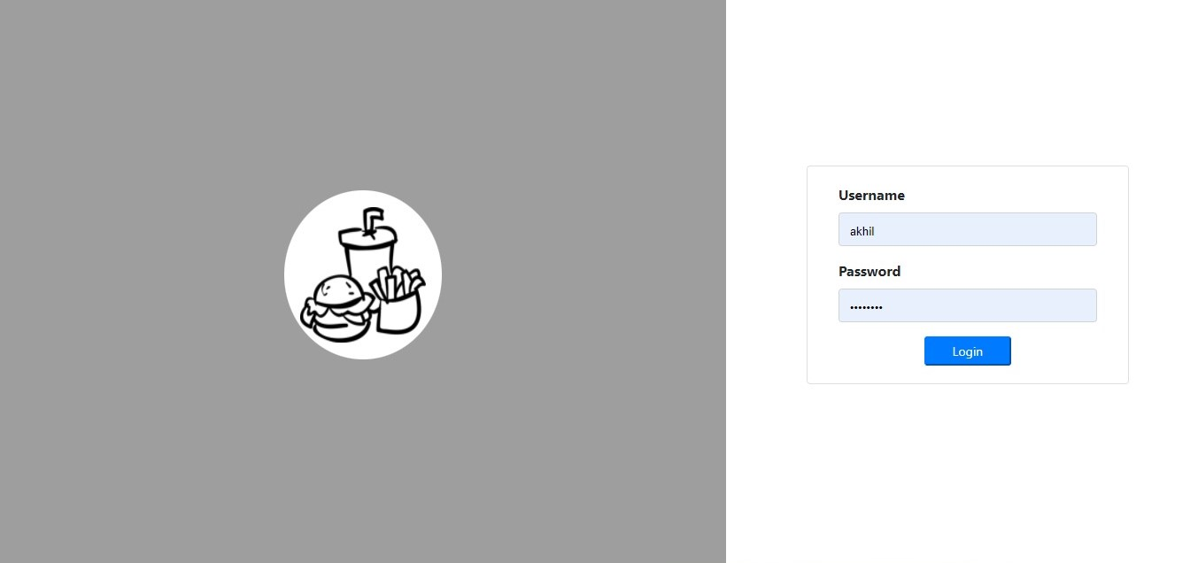
Admin Login:
This feature enable the admin to login into the website.

Slide 12
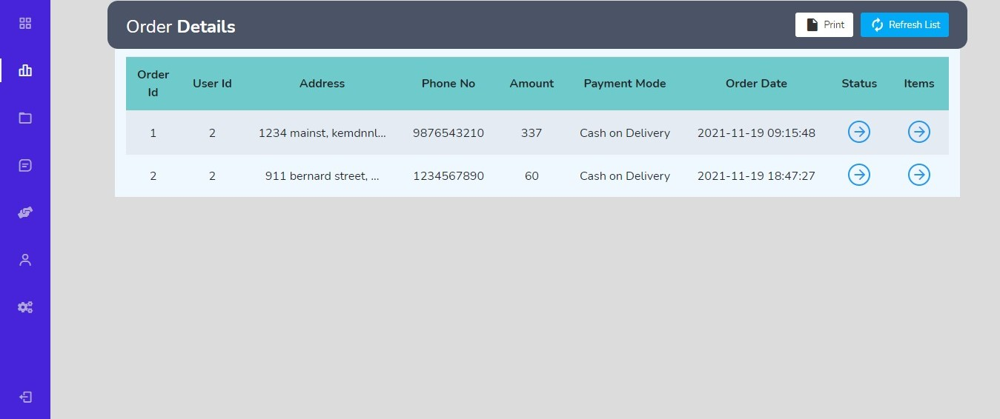
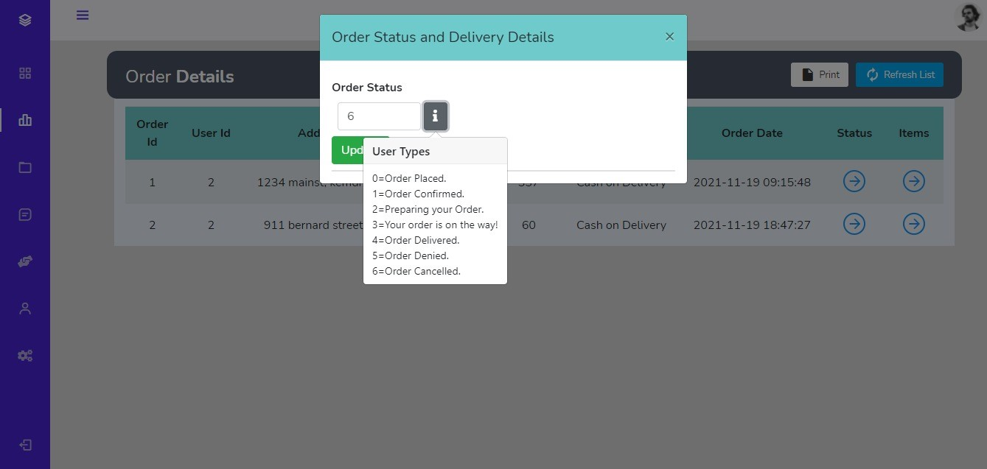
Admin Order
This feature enable the admin to view, edit and cancel the order.

Slide 13
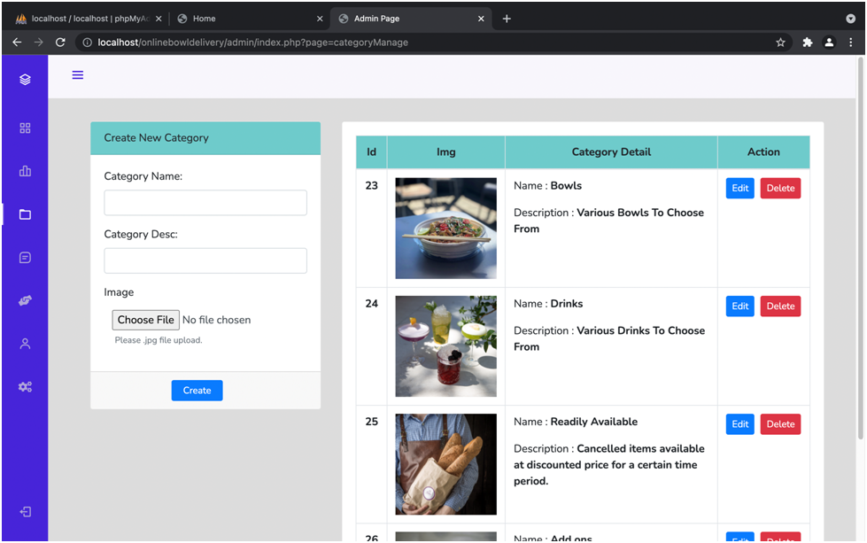
Admin Categories
This feature enable the admin to view, update and delete a category.

Slide 14
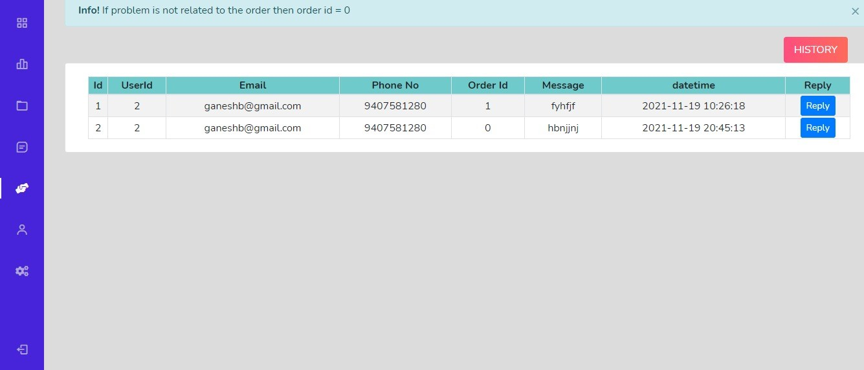
Admin Contact-info
This feature enables the admin to view the user messages and reply.

Slide 15
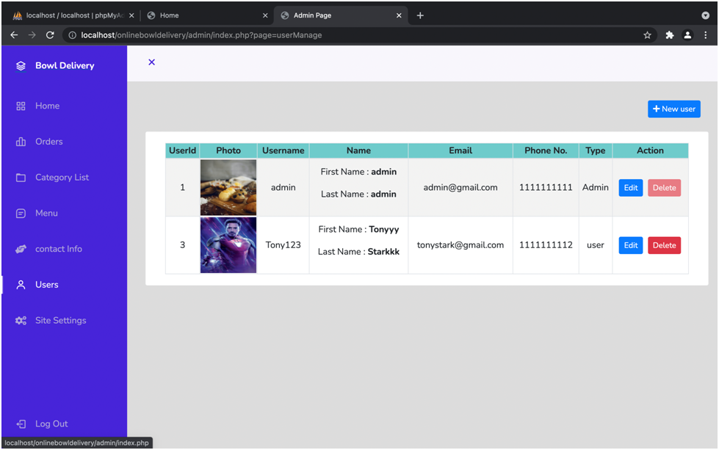
Admin Users
This feature enable the admin to view, update and delete a user.

Slide 16
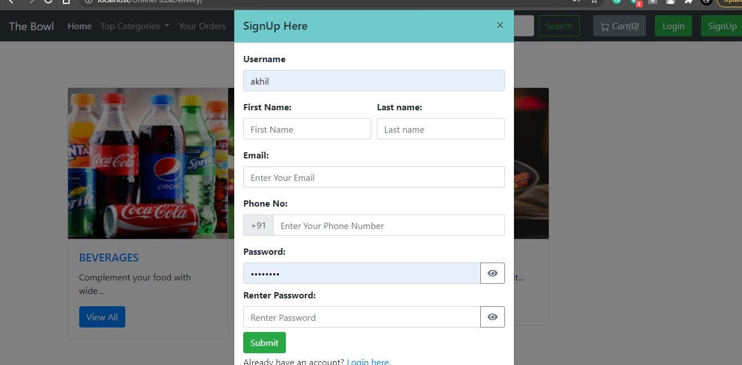
User Sign-up
If the user is a new user, he/she need to sign-up into our web application by filling the form.

Slide 17
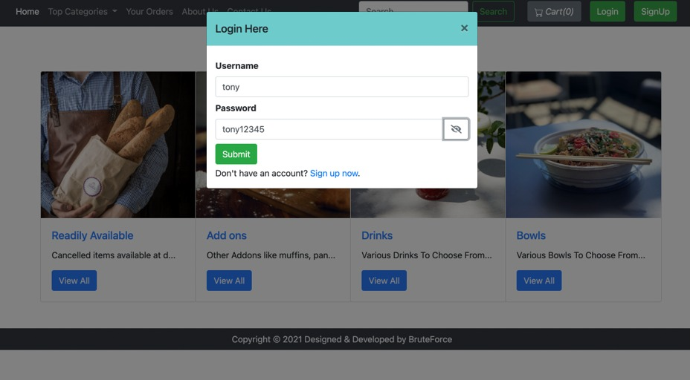
User Login
If he/she is an existing user, they can directly login with their credentials.

Slide 18
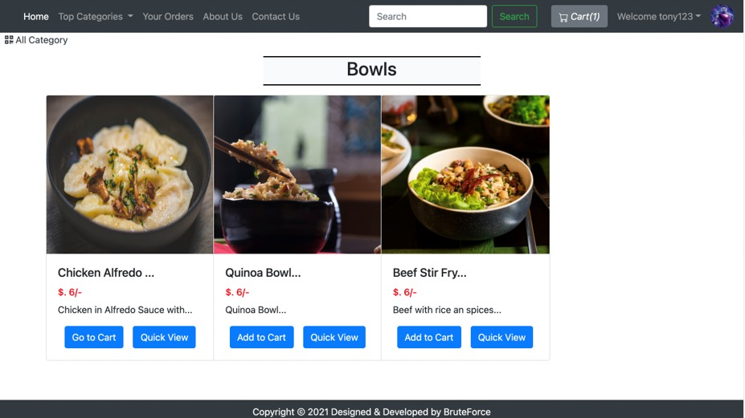
Add item
The items which the user need to order will be added into this page.

Slide 19
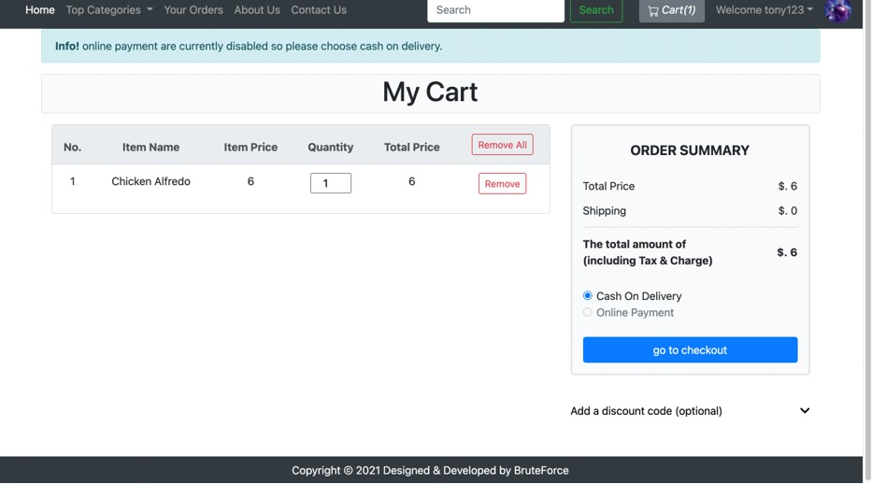
Check-out
This feature enables the users, to place the order.

Slide 20
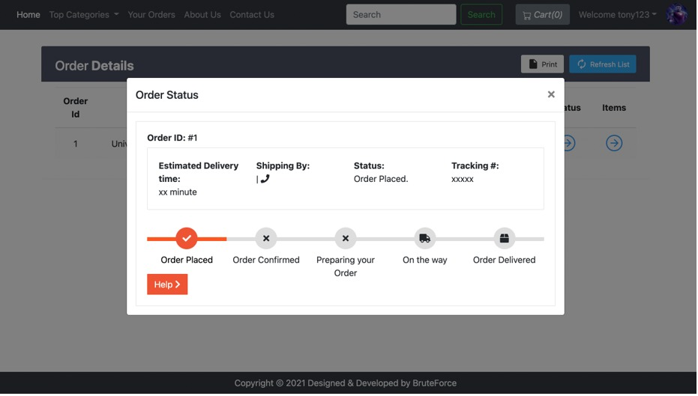
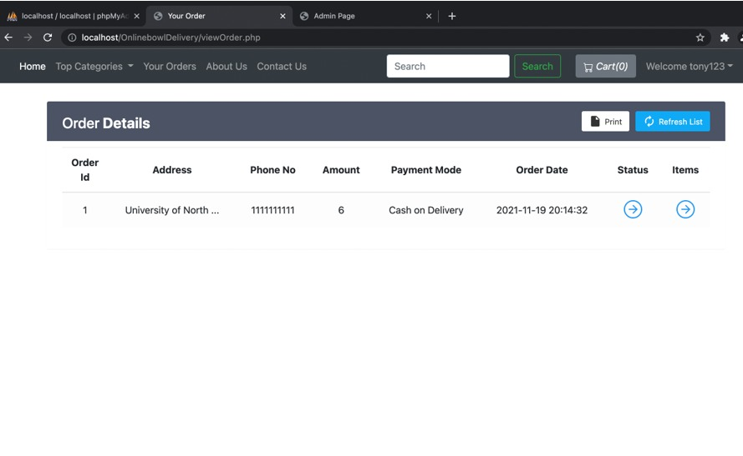
Orders
This page helps the user to view their order history.

Slide 21
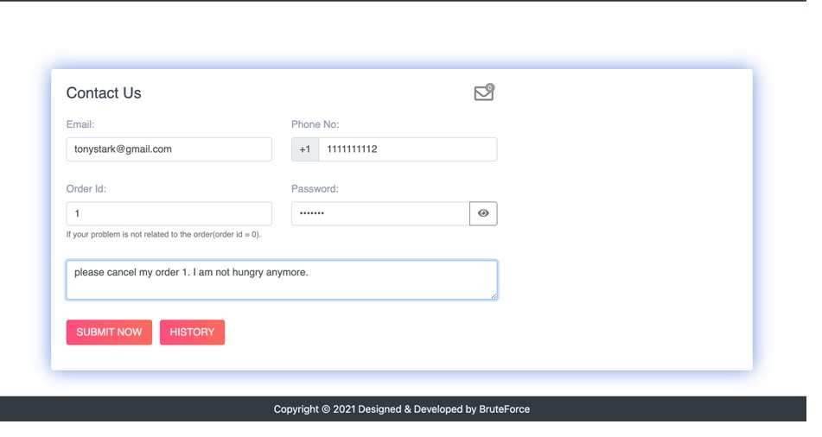
Contact-us:
This feature act as an interface between the user and the admin.

Slide 22

Testing

Slide 23
Functionality Testing:
1) Data base: all the forms and data are storing in the database or not and are we able to retrieve the information from the database or not.
2) UI: is the user interface of the user is responding or not.
3) Links: testing the reflection of the links to the other pages are working or not.
4) Forms: are all the forms in the system are working or not.

Slide 24
Unit Testing
In the system testing the whole web –application is tested in many aspects.
User login: Is user able to login to the system or not.
User signup: Is the user able to sign up to the application and are the user details are reverting to the user table in the database or not.
Adding item to the cart: Is user able to add the item to the cart.

Slide 25
Checkout: when the user able to check out from the cart page then the system asks the user to enter the details the details entered in the checkout page is the mobile number containing 10 digits or not and the entered password is matched with the user password or not.
Orders: once the user placed the order whether the user order is reflecting in the orders page of the user or not and the details of the order are storing in the database or not.
Contact us: if a user enters a message in the contact us page, then the entered password in the contact us page is matched with the user password or not and the message sent by the user is stored in the data base or not.

Slide 26
Home: Is the user able to add an item into the cart without logging in to the system or not.
Search bar: is the user able to search an item in the system using the search bar .
Categories: Is user able to view the categories page and can select the category and the food item in the category or not.
Admin Login: Is admin able to login to the system or not

Slide 27
Admin Order: Is admin able to view the orders of users and update the status of the users or not.
Admin categories: Is admin able to view the categories and delete, add and update the categories of the system.
Admin Items: Is admin able to view, delete, edit, update the items of each category type or not.
Admin Contact Info: Is admin able to view the contact us information of the user and able to send the reply for the user or not.
Admin users: Is admin able to view, edit, delete, the users of the system and the admin cannot delete the main admin of the system.

Slide 28
Testing Experience
In our testing experience in the first starting stage of development process we had some anomalies.
1. When the user is placing the order the user interface is showing as the order was placed but in the backend we are unable to retrieve the order information from the orders table we have rectified it.
2. The phone number field was also not satisfied our constraints in the previous deliverables but we have rectified it and made it work.
3. The overall testing experience was good with our project all the test cases that we expected has passed our test cases

Slide 29
Feedbacks from Peer review
We have got some suggestions from the peer review sessions the first one was implementing the orders page for the users in which the user can see his orders history as we promised to complete it, we have implemented it in the best way possible.
The second thing they have suggested us that to implement a page containing the cancelled items by the user in certain period so that people who are in a hurry can grab them with the low cost but while ongoing the implementation of this functionality it is affecting the system functionalities that has already done.

Slide 30
Limitations
The main feature that we wanted to implement a page containing the cancelled items by the user in certain period of time so that people who are in a hurry can grab them with the low cost.
But this functionality seems to be affecting the other system functionalities which may affect the system totally.

Slide 31
Thank You

