Slide 1

NLP-Driven Sentiment Analysis and Portfolio Management for Stock Price Forecasting
INNOVATION & DESIGN THINKING
PROJECT REVIEW
Under the Guidance of
Mr. Suresh Kumar
DATE: 13/05/2025
Project Members
ATMAKARU SIVA SANDEEP (221801501)
GIRIDHARAN M (221801504)
PRAVEEN B (221801503)
- AI and DS

Slide 2

Problem
Investors often struggle to quickly understand how breaking news affects their stock holdings. When market news emerges, it can be difficult to determine whether it will positively or negatively impact specific stocks in a portfolio. This project addresses this challenge by creating a system that automatically analyzes news sentiment related to stocks in real-time. The system monitors multiple news sources, determines whether the news is positive or negative for particular stocks, and shows how this might affect the overall portfolio. By providing this information quickly and clearly, investors can make more informed decisions about whether to buy, sell, or hold their positions based on how current news is likely to influence their investments.

Slide 3

Abstract
This project implements an advanced stock market sentiment analysis system that monitors real-time news to evaluate market impacts on specific securities within an investment portfolio. By aggregating and analyzing sentiment data from multiple financial news sources, the system provides investors with timely insights into how current market narratives may influence stock performance. The approach combines natural language processing techniques with financial domain knowledge to classify news sentiment across various dimensions, including relevance, source credibility, and emotional intensity. This multi-resource methodology enables the detection of sentiment shifts that often precede price movements, allowing for more informed investment decisions. The system continuously tracks portfolio holdings, providing a comprehensive view of how evolving market sentiment may impact overall portfolio performance. Preliminary results demonstrate the system's ability to identify significant sentiment-driven market events before they fully materialize in price action, potentially offering a meaningful edge in today's information-driven markets.

Slide 4

Introduction
In today's fast-moving financial markets, investors often struggle to quickly assess how breaking news affects their stock holdings. This project introduces a real-time sentiment analysis system that monitors financial news, analyzes its tone using natural language processing, and evaluates its impact on specific stocks in an investor's portfolio. By automatically identifying whether news is positive, negative, or neutral for each stock, the system helps investors make timely decisions—whether to buy, sell, or hold—based on current market sentiment. This enables more informed and strategic portfolio management in response to rapidly changing market conditions

Slide 5

Existing System
Existing systems for stock market sentiment analysis have several limitations, which this project aims to overcome. The key drawbacks include:
Manual Analysis: Investors often rely on manually reading and interpreting financial news to make investment decisions.
News Aggregator Platforms: Websites like Google News and Yahoo Finance collect financial headlines but don’t analyze sentiment.
Professional Financial Tools: Services such as Bloomberg Terminal and Reuters Eikon offer sentiment tools, mainly for institutional investors.
Social Media Monitoring: Tools like StockTwits and Reddit trackers provide crowd sentiment but lack depth and accuracy.
AI-based Sentiment Tools: Some basic sentiment analyzers use generic NLP models to classify news but are not finance-specific.

Slide 6

Limitations
Time-Consuming: Manual analysis delays decision-making in fast-moving markets.
Lack of Sentiment Analysis: Aggregators do not assess whether news is positive or negative.
High Cost: Advanced tools are expensive and not accessible to retail investors.
Low Credibility Control: Social media-based tools may rely on unverified or misleading sources.
No Portfolio Mapping: Most systems don’t show how news affects specific stocks in a user’s portfolio.
Lack of Real-Time Insights: Delayed updates reduce the effectiveness of investment decisions.

Slide 7
Proposed System
Real-Time News Analysis: Continuously monitors trusted financial news sources to detect relevant updates.
Sentiment Classification: Uses NLP to analyze and classify news as positive, negative, or neutral for specific stocks.
Portfolio Impact Mapping: Links analyzed sentiment directly to the user's portfolio to show stock-wise and overall impact.
Actionable Insights: Provides clear, real-time alerts and recommendations to help investors make informed decisions.

Slide 8
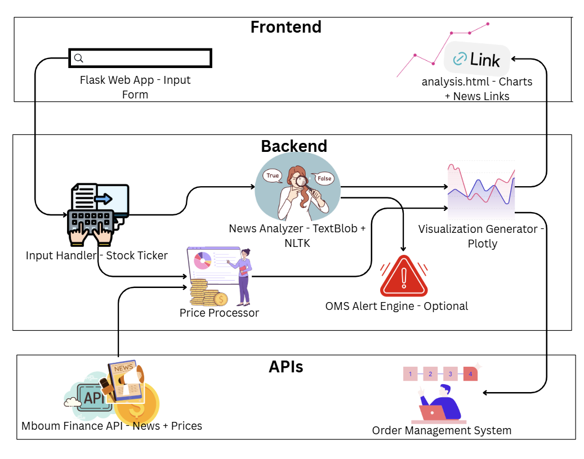
System Architecture

Slide 9
Proposed System
Real-Time News Analysis: Continuously monitors trusted financial news sources to detect relevant updates.
Sentiment Classification: Uses NLP to analyze and classify news as positive, negative, or neutral for specific stocks.
Portfolio Impact Mapping: Links analyzed sentiment directly to the user's portfolio to show stock-wise and overall impact.
Actionable Insights: Provides clear, real-time alerts and recommendations to help investors make informed decisions.

Slide 10
RESULT AND DISCUSSIONS:
The suggested system was developed as a Python-based web application using Flask and connected with the Mboum Finance API to provide real-time news and stock data. To assess its performance, the application was tested on a range of stock tickers from various industries, such as energy, finance, and technology. The main goal was to determine how well and swiftly the system could analyze and display the relationship between news sentiment and stock price changes. The findings demonstrated that the system was able to obtain current news headlines about the inputted stock and calculate sentiment ratings using TextBlob. These ratings were grouped as positive, negative, or neutral before being compared to relevant historical stock prices. The stock prices were represented as a line graph, and the sentiment distribution was represented as an interactive bar chart. Users could spot clear trends, like price rises after a group of favorable news or declines after a surge of unfavorable sentiment, thanks to these two visualizations.

Slide 11
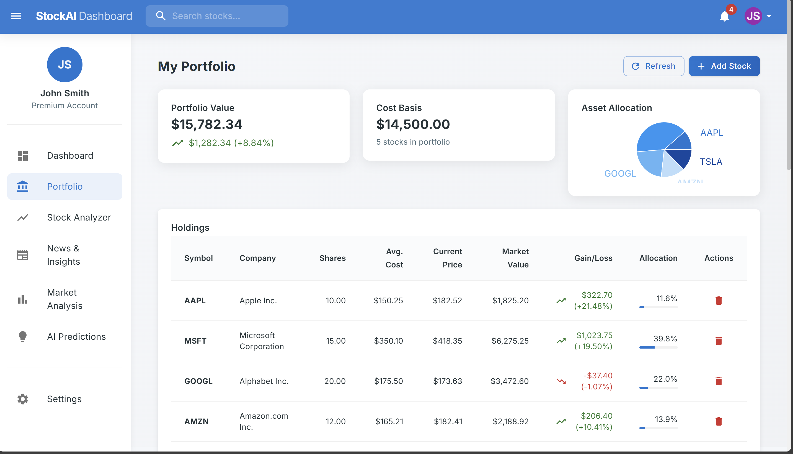
Project Output:

Slide 12
Better Decision-Making: Helps investors make informed buy/sell decisions by understanding market mood and trends.
Risk Reduction: Detects early warning signs of market downturns, allowing timely adjustments to reduce losses.
Opportunity Spotting: Identifies undervalued or trending stocks through positive sentiment before prices surge.
Real-Time Insights: Provides instant updates from news and social media, enabling quicker portfolio adjustments.
ADVANTAGES OF PROPOSED SYSTEM:

Slide 13
CONCLUSION:
In conclusion, This project's combination of Natural Language Processing (NLP) with financial data analytics has effectively shown a feasible and efficient method for improving algorithmic trading strategies via real-time sentiment analysis. The system effectively collects real-time news and historical stock data by creating a Flask-based Python web application and utilizing the Mboum Finance API. It then converts the unstructured text into measurable sentiment scores using TextBlob and NLTK. When these ratings are compared to market trends and displayed via interactive graphs, they give users a better understanding of the emotional factors influencing stock performance. The intuitive interface connects qualitative news content with quantitative financial activity, enabling analysts and traders to make rapid and well-informed decisions. Additionally, the system's extensibility toward entirely automated trading settings is underscored by the possible integration with Order Management Systems (OMS). The findings highlight that sentiment can be a key factor in predicting market direction and controlling investment risk when it is properly extracted and shown. This work provides a solid basis for future improvements, including the use of deep learning-based sentiment models, broadening data sources beyond news (such as social media), and enhancing predictive capabilities, all of which will eventually aid in creating more intelligent, responsive, and effective trading platforms.

Slide 14
1.Zhang, X., & Wang, Y. (2021). “Sentiment Analysis for Financial News Using Deep Learning,” International Journal of Computational Finance, 15(4), 212-229.
2.Li, H., et al. (2020). “Financial News and Stock Market Prediction: A Deep Learning Approach,” Journal of Financial Data Science, 7(2), 78-92.
3.Gupta, R., & Gupta, A. (2018). “Natural Language Processing for Sentiment Analysis in Financial Markets,” Journal of Artificial Intelligence in Finance, 11(5), 154-167.
4.Ranjan, A., & Jain, P. (2019). “News Sentiment and Stock Price Correlation: A Comprehensive Analysis Using Machine Learning,” International Journal of Machine Learning & Applications, 22(6), 303-317.
5.Kumar, S., & Sharma, M. (2020). “Predicting Stock Movements Based on Sentiment Analysis of News Articles,” International Journal of Data Science, 14(1), 45-58.
REFERENCES:

