Slide 1


Bank of Baroda Hackathon - 2022
Technology Partner
Your Team Name :3GuysFromEdinburgh
Bio :
Sivakumar Sankararaman : Post graduate Diploma from IIIT Bangalore having 12+ years of experience in IT and worked for clients of TCS such as Microsoft (Hyderabad & Redmond), Earthlink , Lloyds Banking Group (Chennai,Edinburgh, UK), Freelance architect / Lead in Azure , Google Cloud platform
Joseph Ajanth Rajan : 12 Years of experience in IT worked for TCS, InfoSys. Now Founder of start up
Jeevananthmam : Post graduate in Bannari Amman institute of technology, Sathyamangalam, B-Tech – Computer Science and Business System.
Date : 3/9/2022

Slide 2
Problem Statement?
Our understanding is we have to come up with a comprehensive Proof Of Concept to address below issues :
Paper cheques used to be processed manually, a process that took up to days to clear.
Large volume of cheque processing involves manual and strenuous human effort.
Requires a high human capital deployment and longer processing time.
Cheques from consumer are mostly handwritten and in multilingual and of corporates are mostly printed, This makes more complication since most of OCR can recongize only English.

Slide 3
User Segment & Pain Points
Which user /advertiser segment would be early adopter of your product & why?
Consumer & Commercial Banking segment
This solution will help Automated Cheque Processing
Consumer can scan and deposit cheque they had received from mobile app as self service
No need to walk into ATM or Branch for depositing cheque
Early detection of fraud
Loan / Insurance processing
Automated data entry of manual form for storing data securely and electronically
Process large amount of hand filled form

Slide 4
Alternatives/Competitive products
Chequereader
Amount ( bothprinted and Handwritten Both)
Date (Printed and Handwritten Both)
Account Number
MICR Code
Account Name
Backside Account Number (Payee Account Number)
Automatic UV Logo Verification (To Prevent Fraud)
Fraudone
Counterfeit Check Detection
Signature Forgery
Check Alteration

Slide 5
Azure tools or resources
Azure tools or resources to be used for Prototype are:
Category | Azure tool | Purpose
Storage | Azure Blob Storage | To store uploaded scanned image, processed of cheque
Image Processing | Azure Computer vision API (OR) Azure Form Recognizer | To parse content of image, extract text from image
Machine Learing for Fraud detection | Azure ML Studio | Build and train model for fraud detection
Datastorage | Document DB / Azure Cosmos | To store document in parsed and raw state. Reterive historical latter for machine learning

Slide 6
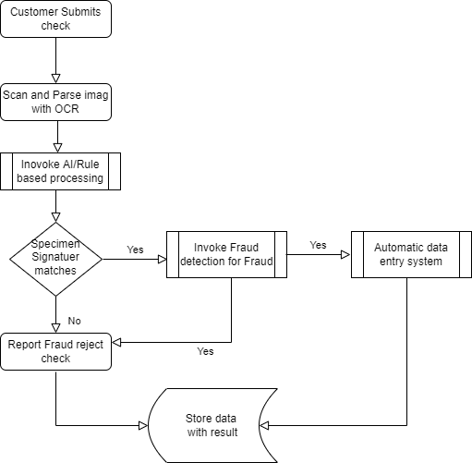
Process Flow
Process Flow diagram depicted in right side takes care of below process flow
Customer submits cheque
For offline check, scanner scans cheque and uploads check image to Azure blob
Azure function triggers once new image is uploaded to Azure Blob
Azure function calls OCR along with form recongonizer extracts signature,date, Pay or Bearer name,Account number, IFSC code,Amount
Extracted data is stored in Process folder a temporary blob folder or a storage document db
Same Azure function after getting signature compares with speciment signature of customer and gives score to verify signature
This result will be send to Fraud detection Azure function which analyse based on historic data for fraud
Fraud detection alogirthm will be both rule based such as blocked account, money laundering, hawala fraud as well as
AI based which will be bogus cheque
Once signature verification and fraud detection cheques are passed , processed data will be stored in Staging Datastore for further processing along with verification results

Slide 7
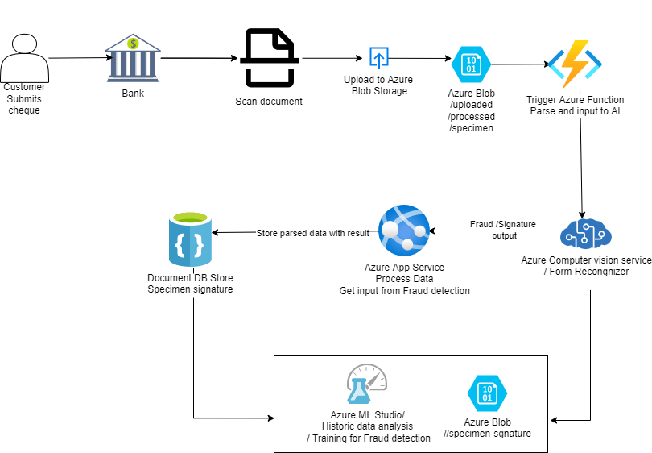
Solution and Architecture

Slide 8
Key Differentiators & Adoption Plan
Automated Cheque Processing (ACP) allows for faster cheque clearing. With ACP, deposited cheques are cleared in hours
ACP benefits consumers by:
Making funds available faster
Allowing quicker access to the digital image of their processed cheques
Detecting potential fraud sooner.
Helps reading Amount ,Date , customer Account Number, payee account number,MICR Code,
Automatic UV Logo Verification (To Prevent Fraud)
With the availability of cloud based Azure technology , AI, improved OCR processing we can leverage computer vision API and extend the same for extracting data of hand filled application in multiple languages form with Azure Form Recognizer and/or Azure computer vision servuce. This helps to provide technical solution for banking business problem. As technology enthuisaist, we three joined together to participate in this challenge to give technical working POC.

Slide 9
GitHub Repository Link & supporting diagrams, screenshots, if any
Repo Path | Notes
https://github.com/siva-tcs/TG-Auto-check | Root repo
bob_automatedcheck_3GuysFromEdinburgh.pptx | Idea submission
Process flow.png | Process Flow
Automated-Check.png | Architecture Diagram

Slide 10
Thank You
Jeevanatham M
Joseph Ajanth Rajan
Sivakumar Sankararaman

