Slide 1
IMPLEMENTATION OF A NEW SYSTEM CALL
Submitted By:
B.MAHESWARARAO-B160349CS
R.VAMSI KRISHNA-B160109CS
K.A.SIVA VARDHAN-B160333CS
P.SATYANARAYANA-B160340CS

Slide 2
INTRODUCTION
Implementing a new system call called sys_hello .
This​ ​ system​ ​ call​ ​ helps​ ​ us​ ​ to​ ​ know​ ​ the​ FILE​ NAME and​ ​PID​ of​ ​the​ ​runnable, terminated, sleeping and blocked​ processes along​ ​with​ ​their​ ​total​ ​count​ ​. Along​ with​ this​ the​ ​user​ ​also​ ​get​ ​to​ ​know​ ​the information of​ ​the​ ​high​ priority​ , static priority , and​ ​normal ​priority​ ​of​ ​the​ ​ processes​ along​ ​with their​ ​count.

Slide 3
STEPS INVOLVED
Creating a directory which contains source code.
Linking the new system call with kernel .
Modifying the file syscall_64.tbl .
Modifying the file syscalls.h .
Compiling and booting.

Slide 4
CREATING DIRECTORY
Create a new directory “hello” and open that directory.
Create a new file “hello.c” and write the source code for the system call in that.
Create a Makefile which contains:
obj -y := hello.o
It implies that our code is compiled and included in the source code.

Slide 5
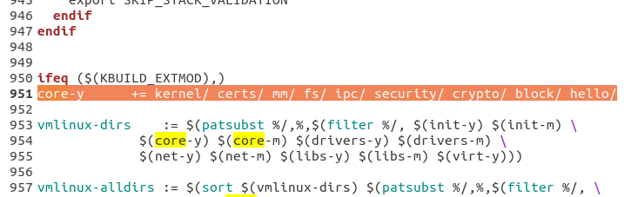
LINKING THE SYSTEM CALL TO KERNEL
Add hello directory to the Makefile .
Through this we are specifying to the compiler that the source files of system call are present in hello directory.

Slide 6
MODIFYING SYSCALL_64.TBL
It is located in /arch/x86/entry/syscalls .
You can also know it using the command:
“find –name syscall_64.tbl”
Include the new system call number and it’s entry point.

Slide 7
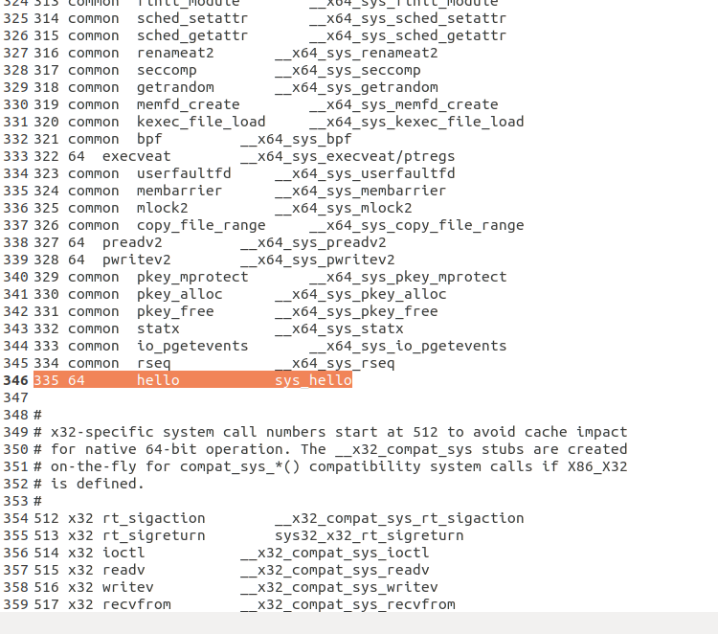

Slide 8
MODIFYING SYSCALLS.H
It is located in /include/linux .
Add the following line at the end of the file.
asmlinkage long sys_hello(void) ;

Slide 9
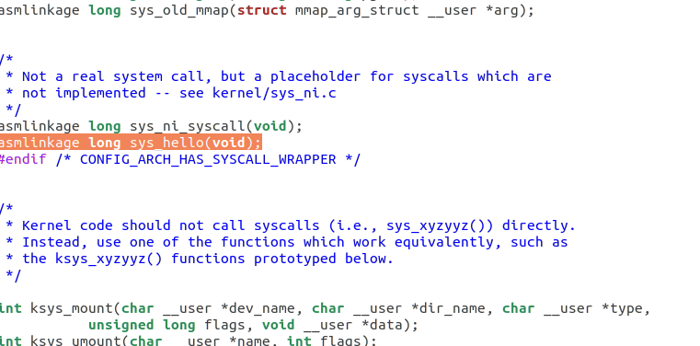

Slide 10
COMPILING AND BOOTING
To use the new system call we should recompile the kernel first.
Use the following commands for that:
sudo make –j 4
sudo make modules_install –j 4
sudo make install –j 4
sudo update-grub
Restart the system.

Slide 11
TESTING OUR NEW SYSTEM CALL
To test the new system call write a simple program “test.c” .
Compile and execute this program.
If it runs successfully, it’ll give the corresponding cause and we can use the ‘dmesg’ command to check the kernel log.

Slide 12
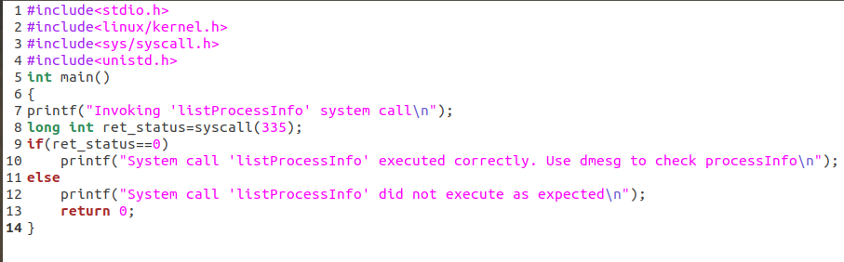

Slide 13
THANK YOU

