Slide 1
K
A DSA-POWERED KNOWLEDGE MANAGEMENT PLATFORM
with Intelligent Document Interaction
KNOPRIX · Mid-Semester Review · ~50% of final project
Advanced Data Structures & Algorithms (ADSA)
Group A12
T.V.S.S Phanindra Guptha
Athul V.R
M. Vittal
K. Nanda Kishore
cb.ai.u4aid25055
cb.ai.u4aid25005
cb.ai.u4aid25033
cb.ai.u4aid25027
Deployed live: knoprixv2midreview.netlify.app · API: knoprix-midreview-api.onrender.com
Guided by: Faculty Mentor · Dept. of AI & DS · August 2026

Slide 2
02 · CONTEXT
Motivation & Problem Statement
Why this project
Students, researchers and professionals work with vast amounts of information scattered across PDFs, presentations, documents, notes and images.
What exists today
File managers, note apps and AI chatbots each solve one slice — but none unify organisation, retrieval and recall.
• Content lives in many isolated formats
• Finding a passage later is slow & manual
• Key ideas get lost — nothing is linked
• File explorers: no content-level search
• Note apps (Obsidian/Roam): manual linking
• AI agents: black-box, opaque, heavy compute
PROBLEM STATEMENT
There is no unified, transparent DSA-based platform that organises multi-format documents, enables instant prefix autocomplete and ranked full-text retrieval, and provides LIFO recall of important passages — all explainable, self-contained, and without black-box ML or external API keys.
1

Slide 3
03 · LITERATURE SURVEY
Literature Survey (tabular)
Author(s) | Title | Year | Source | Relevance / Gap addressed
Lewis, P. et al. | Retrieval-Augmented Generation for Knowledge-Intensive NLP Tasks | 2020 | NeurIPS | Parametric + non-parametric memory; retrieval grounds answers — but relies on heavy neural retrievers (black-box)
Zobel, J. & Moffat, A. | Inverted Files for Text Search Engines | 2006 | ACM Computing Surveys | Canonical inverted-index design & compression — foundation of our full-text index
Fredkin, E. | Trie Memory | 1960 | Communications of the ACM | Origin of the trie — O(L) prefix lookup; basis of our autocomplete
Ilyas, I. F. et al. | A Survey of Top-k Query Processing Techniques in Relational Databases | 2008 | ACM Computing Surveys | Top-k with threshold/heap algorithms — motivates Min-Heap ranking (final review)
Kahn, A. B. | Topological Sorting of Large Networks | 1962 | Communications of the ACM | Graph ordering — basis of our Knowledge Graph linking (final review)
Brin, S. & Page, L. | The Anatomy of a Large-Scale Hypertextual Web Search Engine | 1998 | Computer Networks & ISDN | Web-scale retrieval architecture — context for ranked, snippet-based results
Tools studied: Obsidian (2020), Roam Research (2019), Google NotebookLM (2023) — powerful, but require manual linking or cloud AI; no transparent local DSA retrieval.
2

Slide 4
04 · NOVELTY
Research Gap & Novelty of the Work
Research gaps identified
Black-box retrieval
AI assistants fetch answers with opaque, unverifiable reasoning.
Manual knowledge linking
Note tools require users to create every connection by hand.
No content-level search
File managers index names, not the words inside documents.
External dependency
Cloud/API-based tools need keys, accounts and internet.
Novelty of KNOPRIX (mid-review build)
1
DSA-driven intelligence layer
Trie + Inverted Index + Stack replace black-box ML with transparent, explainable retrieval.
2
Visual LIFO Stack bookmarks
Reading recall mapped to push / pop / peek — an animated stack drawer with O(1) operations.
3
Ranked search with scores
Inverted Index returns results with match scores and snippets — instant, self-contained.
4
Trie autocomplete with frequency
O(L) prefix suggestions ranked by real word frequency across your documents.
5
Multi-format workspace
PDF, PPTX, DOCX, TXT/MD in isolated projects — one place to read everything.
6
Fully self-contained & secure
JWT auth, owner-scoped routes (IDOR-proof), no API keys, deployed live on Netlify + Render.
3

Slide 5
05 · OBJECTIVES
Project Objectives (mid-review scope)
1
Unified document management
Project-based workspace for PDF, PPTX, DOCX and TXT/MD — organised folders with a Tree + DFS hierarchy view.
2
Trie-based instant autocomplete
Live prefix suggestions in the navbar, ranked by word frequency across all documents (O(L) search).
3
Inverted-Index ranked full-text search
Type a phrase → scored results with snippets; click any result to jump straight into the document.
4
Stack (LIFO) bookmarking
Every highlight or page bookmark is pushed onto a visual Stack; pop() removes the most recent, peek() shows the top.
5
Secure, deployable full-stack system
JWT + bcrypt auth, rate-limited login, owner-scoped routes, SQLite persistence — deployed on Netlify + Render.
Final review extends scope: Knowledge Graph · Min-Heap top-k ranking · AI document agent · read-aloud
4

Slide 6
06 · WORKFLOW
Work-Flow Diagram
Upload documents
Parse & extract
Tokenize
Build DSA engine
PDF · PPTX · DOCX · TXT/MD
pdf / pptx / docx parser
lowercase · stopwords · split
Trie + Inverted Index
Persist to SQLite · dsa_indices (JSON)
Navbar query
Autocomplete / Search
Open document
Bookmark → Stack
word → Trie · phrase → Inverted Index
ranked results + snippets
PDF / PPTX slide viewer
push · pop · peek · O(1)
Indices rebuild automatically on upload / delete → always fresh data
Every step is pure Python + SQLite — transparent, auditable, no external AI calls
5

Slide 7
07 · IMPLEMENTATION
Implementation Details
Tech stack
DSA engine — where the code lives
FastAPI · Python 3.13
SQLite
backend/app/dsa/ — one file per data structure:
React 18 · Vite
Tailwind CSS
pdf.js · python-pptx · python-docx
JWT + bcrypt · rate limiting
File (app/dsa/) | Structure | Design | Complexity / role
trie.py | Trie | prefix tree with word frequencies | insert/search/autocomplete O(L) · top keywords
inverted_index.py | Inverted Index | word → {doc_id: count} | build O(n) · lookup O(1) · ranked scores
stack.py | Stack (LIFO) | list-backed, pure Python | push/pop/peek O(1) · powers bookmarks
Netlify + Render deploy
• Indices serialised to SQLite (dsa_indices) and rebuilt on upload/delete via services/indexer.py
• Bookmarks stored in SQLite, ordered through the Stack class (routers/bookmarks.py) — create = push, delete = pop
• Security: JWT refresh flow, bcrypt hashing, rate-limited login, owner-scoped queries (IDOR-proof — attacker gets 404, verified by 16/16 API tests)
6

Slide 8
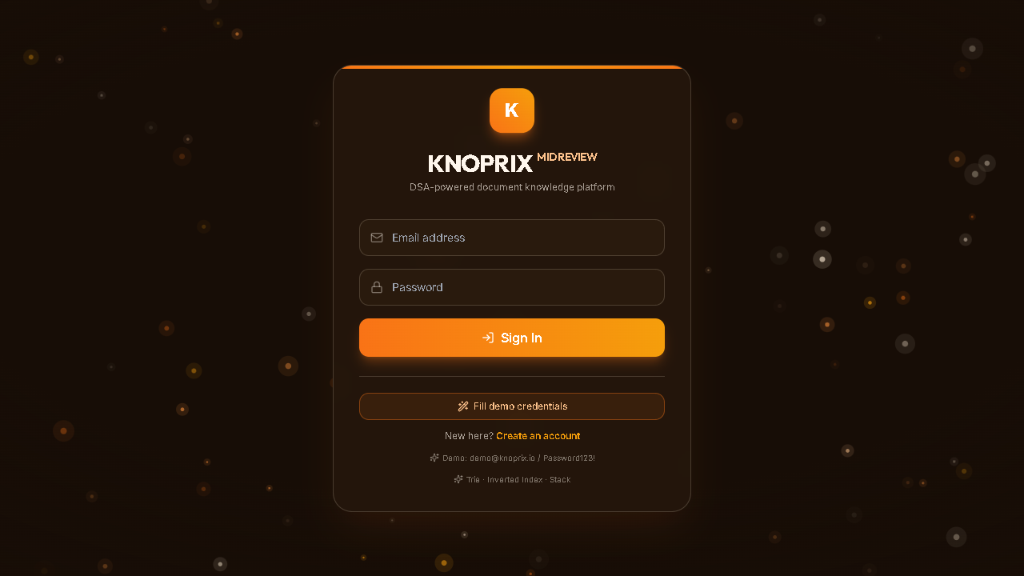
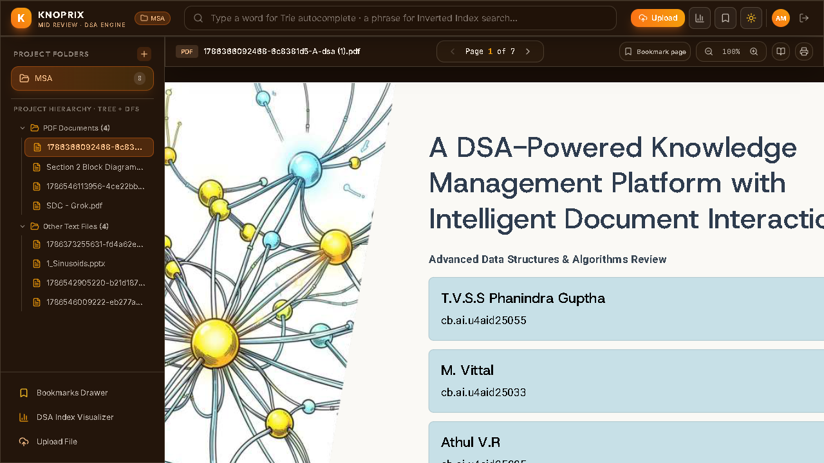
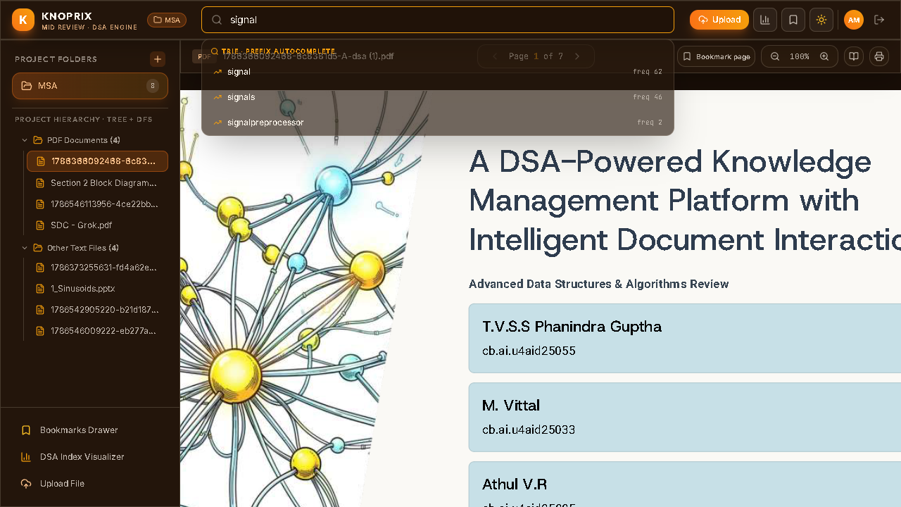
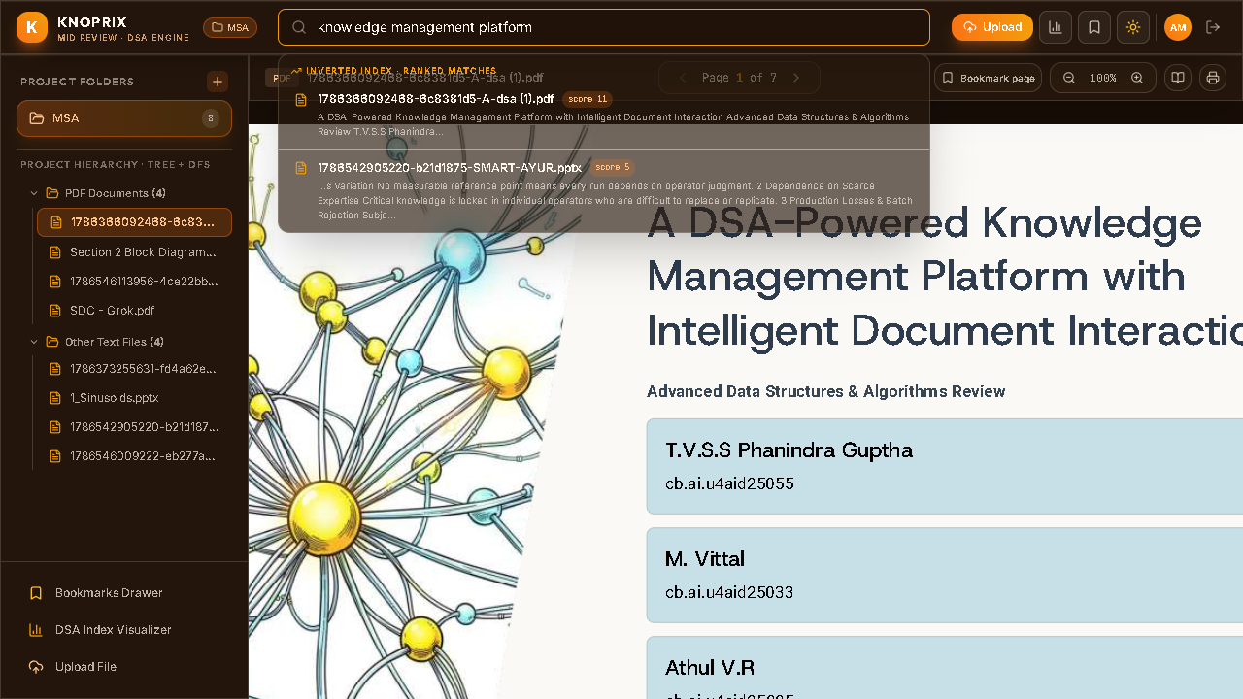
08 · OUTPUTS
Outputs — live deployed app
Login — orange Saraswati theme
Dashboard — MSA project, 8 documents
Trie autocomplete — “signal” → freq-ranked
Inverted Index — ranked results + scores
Demo account: demo@knoprix.io / Password123! · Live at knoprixv2midreview.netlify.app
7

Slide 9
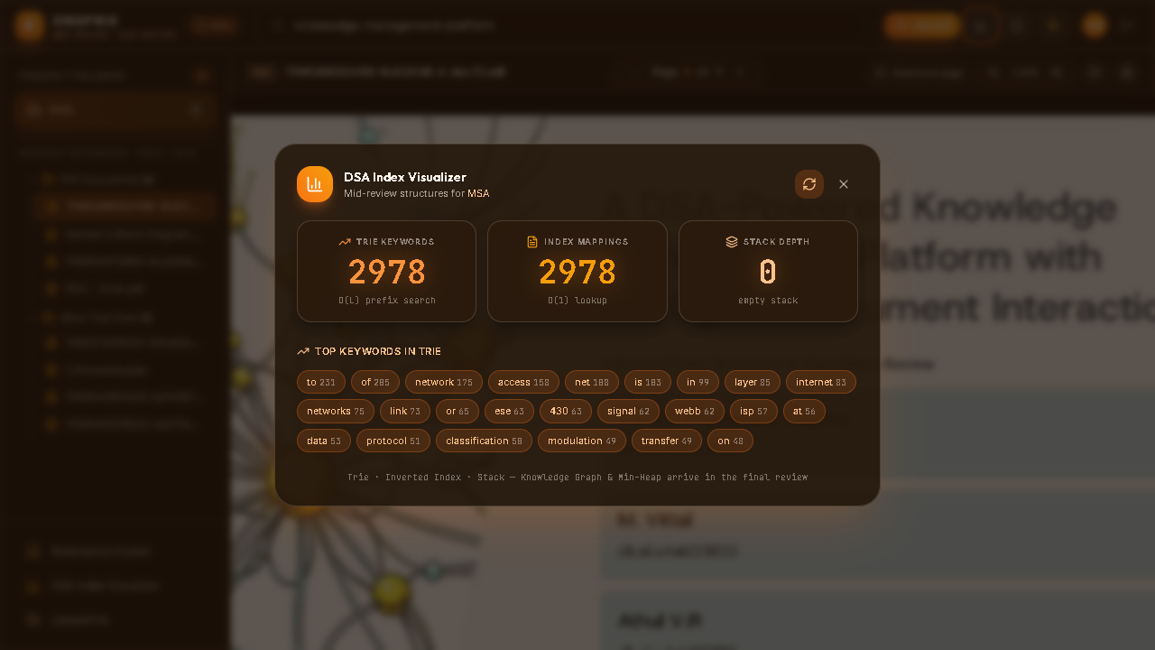
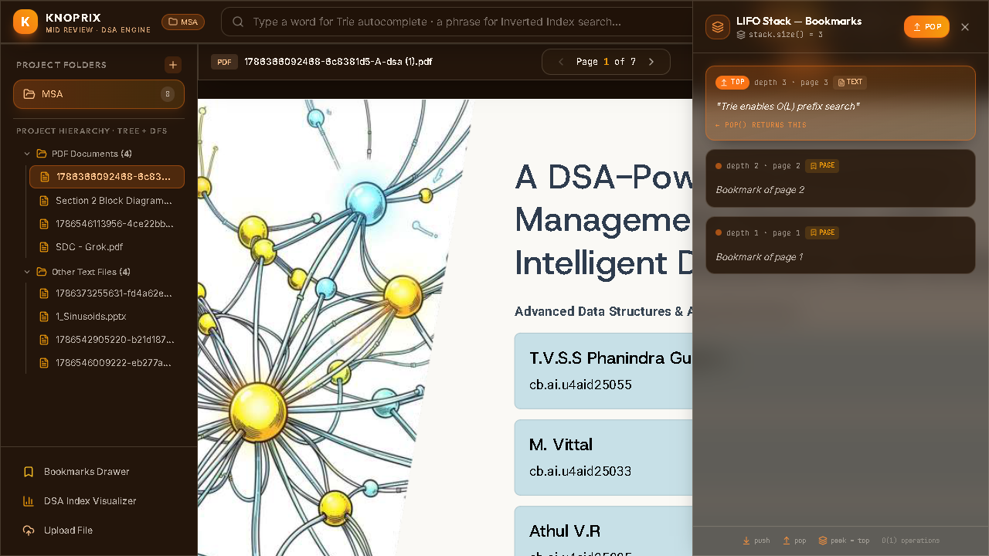
08 · OUTPUTS
Outputs — DSA visualizer & LIFO Stack
DSA Index Visualizer — Trie · Index · Stack stats
LIFO Stack drawer — 3 bookmarks, TOP highlighted
Live numbers at capture time: 2,978 Trie keywords · 2,978 index mappings · Stack depth 3 (TOP = page 3)
Rebuild one-click: re-tokenises every document and refreshes the index in place.
8

Slide 10
09 · WORK PROGRESS
Work Progress Timeline
Mid-review milestone: ~50% complete
50% DONE
✅ Completed (mid review)
⏳ Yet to do (final review)
✔ Trie autocomplete + top keywords
✔ Inverted Index ranked full-text search
◌ Knowledge Graph (auto concept linking)
✔ Stack (LIFO) bookmarks — visual drawer
✔ Auth (JWT + bcrypt), projects, uploads
◌ Min-Heap top-k passage ranking
✔ PDF / PPTX / DOCX / TXT readers
✔ Orange Saraswati theme, light/dark
◌ AI document agent (chat over files)
✔ Public deploy — Netlify + Render
✔ 16/16 API tests · frontend build clean
◌ Read-aloud (speech synthesis)
◌ Concept linking visualisation
Journey
Zeroth review Jul 2026
Mid review Aug 2026
Final review Nov 2026
Problem selection, literature, proposal
3 structures live + deployed
Knowledge Graph · Min-Heap · AI agent · read-aloud
9

Slide 11
10 · REFERENCES
References
01
Lewis, P., Perez, E., Piktus, A., et al. — “Retrieval-Augmented Generation for Knowledge-Intensive NLP Tasks.” Advances in Neural Information Processing Systems (NeurIPS), 2020.
02
Zobel, J. & Moffat, A. — “Inverted Files for Text Search Engines.” ACM Computing Surveys, 38(2), 2006.
03
Fredkin, E. — “Trie Memory.” Communications of the ACM, 3(9), 1960.
04
Ilyas, I. F., Beskales, G., Soliman, M. A. — “A Survey of Top-k Query Processing Techniques in Relational Databases.” ACM Computing Surveys, 40(4), 2008.
05
Kahn, A. B. — “Topological Sorting of Large Networks.” Communications of the ACM, 5(11), 1962.
06
Brin, S. & Page, L. — “The Anatomy of a Large-Scale Hypertextual Web Search Engine.” Computer Networks and ISDN Systems, 30(1–7), 1998.
07
Cormen, T. H., Leiserson, C. E., Rivest, R. L., Stein, C. — Introduction to Algorithms, 3rd ed., MIT Press, 2009 (Trie, heaps, hash tables).
08
Tools reviewed — Obsidian (Dynalist, 2020) · Roam Research (2019) · Google NotebookLM (2023).
10

Slide 12
Thank You
Questions & feedback are welcome
T.V.S.S Phanindra Guptha
Athul V.R
M. Vittal
K. Nanda Kishore
cb.ai.u4aid25055
cb.ai.u4aid25005
cb.ai.u4aid25033
cb.ai.u4aid25027
KNOPRIX · A DSA-Powered Knowledge Management Platform · Group A12 · ADSA

