Slide 1

Amazon Kinesis: Powering Real-Time Data Processing
This presentation will explore the power of Amazon Kinesis, a managed service that enables real-time data processing and analysis. We'll dive into its core features, why and when you'd need it, and a real-world use case to demonstrate its benefits.
Presented By SIVA R

Slide 2
What is Amazon Kinesis?
Data Streams
Real-Time Processing
Scalability and Durability
Amazon Kinesis Data Streams is a fully managed service for capturing, processing, and analyzing real-time streaming data.
It allows applications to ingest, process, and analyze streaming data as it arrives, without needing to store it first.
Kinesis Data Streams scales automatically to handle massive data volumes, ensuring high availability and durability.

Slide 3
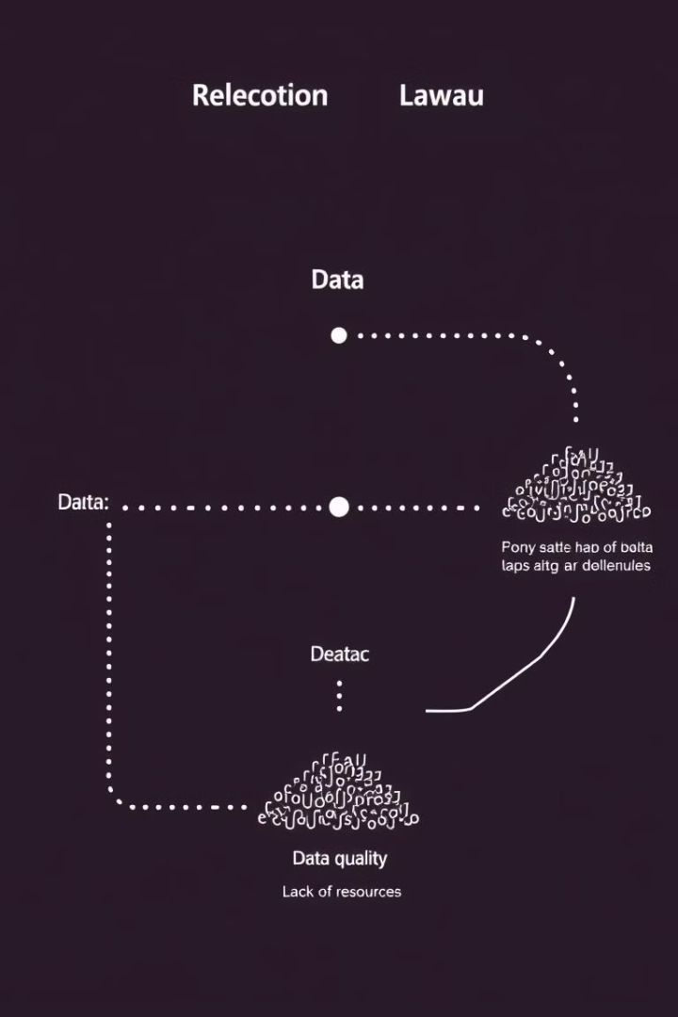
Why Do We Need Amazon Kinesis?
Real-Time Insights
Stream Processing
Gain immediate insights from data streams, enabling timely decision-making and operational efficiency.
Process data continuously, allowing for real-time analysis, filtering, and aggregation of streaming data.
Data Analytics
Power advanced analytics applications, such as fraud detection, customer behavior analysis, and real-time reporting.

Slide 4
When Should We Use Amazon Kinesis?
Real-Time Monitoring
Data Ingestion
Event Processing
Track metrics, log events, and analyze performance data in real time, enabling rapid problem identification.
Capture and ingest high-volume data streams from various sources, such as logs, sensor data, and financial transactions.
Process events from various sources, including IoT devices, web applications, and social media, for immediate insights.

Slide 5
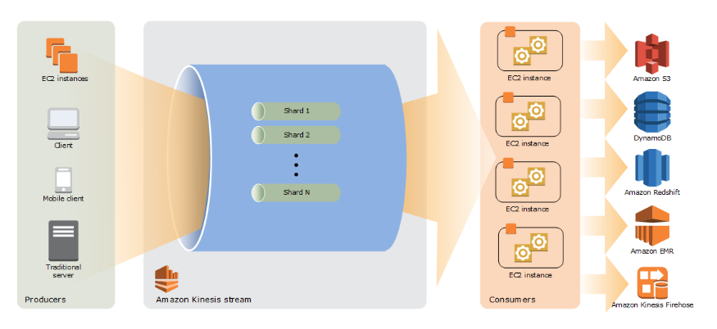
Amazon Kinesis Architecture

Slide 6
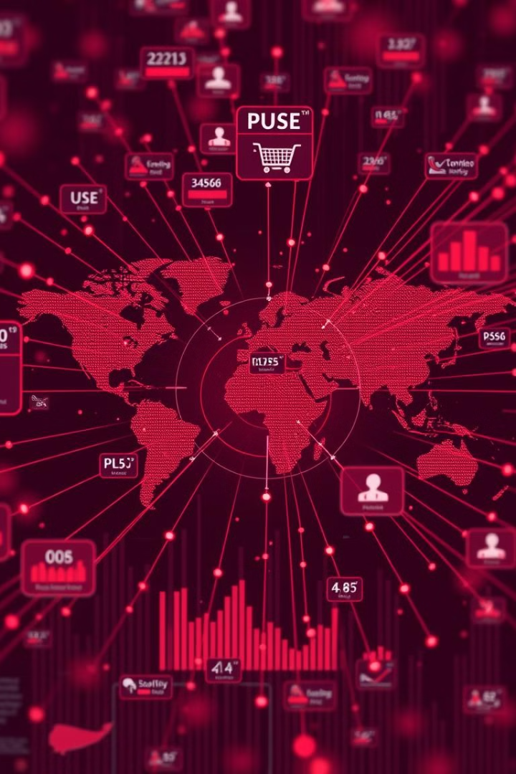



Real-World Use Case: Real-Time Fraud Detection
Transaction Monitoring
Fraud Detection
Kinesis captures real-time transaction data, including user details, purchase history, and payment information.
Machine learning models analyze transaction data to identify suspicious patterns and flag potential fraud.
Real-Time Prevention
Suspicious transactions are blocked in real time, minimizing financial losses and protecting customers.

Slide 7



Overcoming Challenges with Amazon Kinesis
Scalability
1
Kinesis scales automatically to handle peak data volumes, ensuring reliable performance.
Latency
2
Low latency processing enables near real-time analysis and quick responses to events.
Security
3
Kinesis offers robust security features, including data encryption, access controls, and auditing capabilities.

Slide 8
Integrating Kinesis with Other AWS Services
Data Storage
1
Integrate with Amazon S3 for durable and cost-effective data storage.
Data Warehousing
2
Combine with Amazon Redshift for large-scale data warehousing and analytics.
Serverless Computing
3
Utilize Amazon Lambda for event-driven serverless computations on streaming data.

Slide 9

Conclusion and Key
Takeaways
Amazon Kinesis provides a robust, scalable, and secure solution for real-time data processing. It offers a range of use cases, including real-time monitoring, event processing, and data ingestion. By integrating with other AWS services, Kinesis empowers businesses to make data-driven decisions and unlock new possibilities in real time.

