Slide 1
UNIT-I
ADITYA ENGINEERING COLLEGE(A)
OPERATING SYSTEMS
Operating Systems Overview
By
K. Saritha
Dept of Computer Science and Engineering
Aditya Engineering College(A)
Surampalem.

Slide 2
UNIT 1: Introduction
What Operating Systems Do
Operating-System Structure
Operating-System Operations
Process Management
Memory Management
Storage Management
Protection and Security
Computing Environments
Operating System Services
System Calls
Types of System Call

Slide 3
Objectives
To describe the basic organization of computer systems
To provide a grand tour of the major components of operating systems
To give an overview of the many types of computing environments
To explore several open-source operating systems

Slide 4
Operating System
An Operating System (OS) is an interface between a computer user and computer hardware.
An operating system is a software which performs all the basic tasks like file management, memory management, process management, handling input and output, and controlling peripheral devices such as disk drives and printers.
An operating system (OS) is system software that manages computer hardware, software resources, and provides common services for computer programs.
Many popular Operating systems are Windows , Linux, Mac OS by Apple etc.

Slide 5
What is an Operating System?
A program that acts as an intermediary between a user of a computer and the computer hardware
Operating system goals:
  Execute user programs and make solving user problems easier
  Make the computer system convenient to use
  Use the computer hardware in an efficient manner

Slide 6
Following are some of important functions of an operating System.
Memory Management
Processor Management
Device Management
File Management
Security
Control over system performance
Job accounting
Error detecting aids
Coordination between other software and users

Slide 7
Computer System Structure
Computer system can be divided into four components:
  Hardware – provides basic computing resources
    CPU, memory, I/O devices
  Operating system
    Controls and coordinates use of hardware among various applications and users
  Application programs – define the ways in which the system resources are used to solve the computing problems of the users
    Word processors, compilers, web browsers, database systems, video games
  Users
    People, machines, other computers

Slide 8

Four Components of a Computer System

Slide 9
What Operating Systems Do
Depends on the point of view
User view:
Users want convenience, ease of use and good performance
  Don’t care about resource utilization
But shared computer such as mainframe or minicomputer must keep all users happy
Users of dedicate systems such as workstations have dedicated resources but frequently use shared resources from servers
Some computers have little or no user interface, such as embedded computers in devices and automobiles
System view:
From computer view OS is the program most involved with the hardware.
In this point of view , the OS is viewed as a Resource allocator.
Computer resources are like CPU time, memory space, I/O devices, storage space etc.
OS acts as a manager of these resources.
In other view, OS needs to control the various I/O devices and user programs. So it is control program.

Slide 10
Operating System Definition
OS is a resource allocator
  Manages all resources
  Decides between conflicting requests for efficient and fair resource use
OS is a control program
  Controls execution of programs to prevent errors and improper use of the computer

Slide 11
Operating System Definition (Cont.)
No universally accepted definition
“Everything a vendor ships when you order an operating system” is a good approximation
  But varies wildly
“The one program running at all times on the computer” is the kernel.
Everything else is either
  a system program (ships with the operating system) , or
  an application program.

Slide 12
Computer Startup
For a computer to start running when it is powered on, it needs to have an initial program to run.
There is bootstrap program is loaded at power-up or reboot
  Typically stored in ROM or EPROM, generally known as firmware
  Initializes all aspects of system
  Loads operating system kernel and starts execution

Slide 13

Computer System Organization
Computer-system operation
  One or more CPUs, device controllers connect through common bus providing access to shared memory
  Concurrent execution of CPUs and devices competing for memory cycles

Slide 14
Computer-System Operation
A general purpose computer consists of one or more CPUs and a number of device controllers connected through a common bus that provides a shared memory.(figure shown in before slide)
I/O devices and the CPU can execute concurrently
Each device controller is in charge of a particular device type
Each device controller has a local buffer
CPU moves data from/to main memory to/from local buffers
I/O is from the device to local buffer of controller
Device controller informs CPU that it has finished its operation by causing an interrupt

Slide 15
Interrupts
In a computer , the operating system executes different processes. When the processes are executing , the operating system switches from one process to another when an interrupt occurs.
An interrupt is an event that alters the sequence in which the processor executes instructions.
The occurrence of the event is usually signaled by an interrupt, from hardware or software.
Hardware Interrupts are generated by hardware devices in form of signal to CPU by bus
Software programs give an interrupt by executing a special operation called as system call.
When an interrupt occurs, the CPU stops what is doing and immediately transfers execution to fixed location where . On completion it returns back to the previous location.

Slide 16
Common Functions of Interrupts
Interrupt transfers control to the interrupt service routine generally, through the interrupt vector, which contains the addresses of all the service routines
Interrupt architecture must save the address of the interrupted instruction
A trap or exception is a software-generated interrupt caused either by an error or a user request
An operating system is interrupt driven

Slide 17
Interrupt Handling
The operating system preserves the state of the CPU by storing registers and the program counter
Determines which type of interrupt has occurred:
  polling
  vectored interrupt system
Separate segments of code determine what action should be taken for each type of interrupt

Slide 18

Interrupt Timeline

Slide 19
I/O Structure
After I/O starts, control returns to user program only upon I/O completion
  Wait instruction idles the CPU until the next interrupt
  Wait loop (contention for memory access)
  At most one I/O request is outstanding at a time, no simultaneous I/O processing
After I/O starts, control returns to user program without waiting for I/O completion
  System call – request to the OS to allow user to wait for I/O completion
  Device-status table contains entry for each I/O device indicating its type, address, and state
  OS indexes into I/O device table to determine device status and to modify table entry to include interrupt

Slide 20
Storage Structure
Main memory – only large storage media that the CPU can access directly
  Random access
  Typically volatile
Secondary storage – extension of main memory that provides large nonvolatile storage capacity
Hard disks – rigid metal or glass platters covered with magnetic recording material
  Disk surface is logically divided into tracks, which are subdivided into sectors
  The disk controller determines the logical interaction between the device and the computer
Solid-state disks – faster than hard disks, nonvolatile
  Various technologies
  Becoming more popular

Slide 21
Storage Hierarchy
Storage systems organized in hierarchy
  Speed
  Cost
  Volatility
Caching – copying information into faster storage system; main memory can be viewed as a cache for secondary storage
Device Driver for each device controller to manage I/O
  Provides uniform interface between controller and kernel

Slide 22

Storage-Device Hierarchy

Slide 23
Caching
Important principle, performed at many levels in a computer (in hardware, operating system, software)
Information in use copied from slower to faster storage temporarily
Faster storage (cache) checked first to determine if information is there
  If it is, information used directly from the cache (fast)
  If not, data copied to cache and used there

Slide 24
Direct Memory Access Structure
Used for high-speed I/O devices able to transmit information at close to memory speeds
Device controller transfers blocks of data from buffer storage directly to main memory without CPU intervention
Only one interrupt is generated per block, rather than the one interrupt per byte

Slide 25

How a Modern Computer Works
A von Neumann architecture

Slide 26
Operating System Structure
Multiprogramming (Batch system) needed for efficiency
  Single user cannot keep CPU and I/O devices busy at all times
  Multiprogramming organizes jobs (code and data) so CPU always has one to execute
  A subset of total jobs in system is kept in memory
  One job selected and run via job scheduling
  When it has to wait (for I/O for example), OS switches to another job
Timesharing (multitasking) is logical extension in which CPU switches jobs so frequently that users can interact with each job while it is running, creating interactive computing
  Response time should be < 1 second
  Each user has at least one program executing in memory process
  If several jobs ready to run at the same time  CPU scheduling
  If processes don’t fit in memory, swapping moves them in and out to run
  Virtual memory allows execution of processes not completely in memory

Slide 27

Memory Layout for Multiprogrammed System

Slide 28
Operating-System Operations
The modern Operating systems are interrupt driven.
Interrupt driven (hardware and software)
  Hardware interrupt by one of the devices
  Software interrupt (exception or trap):
    Software error (e.g., division by zero)
    Request for operating system service
    Other process problems include infinite loop, processes modifying each other or the operating system

Slide 29
Operating-System Operations (cont.)
Dual-mode operation allows OS to protect itself and other system components
  User mode and kernel mode
  Mode bit provided by hardware
  A bit called mode bit is added to hardware to computer to indicate mode current mode:
  Kernel- mode bit is 0
  User –mode bit is 1
    Provides ability to distinguish when system is running user code or kernel code
    Some instructions designated as privileged, only executable in kernel mode
    System call changes mode to kernel, return from call resets it to user

Slide 30

Transition from User to Kernel Mode
Timer to prevent infinite loop / process hogging resources
  Timer is set to interrupt the computer after some time period
  Keep a counter that is decremented by the physical clock.
  Operating system set the counter (privileged instruction)
  When counter zero generate an interrupt
  Set up before scheduling process to regain control or terminate program that exceeds allotted time

Slide 31
Process Management
A process is a program in execution. It is a unit of work within the system. Program is a passive entity, process is an active entity.
Process needs resources to accomplish its task
  CPU, memory, I/O, files
  Initialization data
Process termination requires reclaim of any reusable resources
Single-threaded process has one program counter specifying location of next instruction to execute
  Process executes instructions sequentially, one at a time, until completion
Multi-threaded process has one program counter per thread
Typically system has many processes, some user, some operating system running concurrently on one or more CPUs

Slide 32
Process Management Activities
The operating system is responsible for the following activities in connection with process management:
Creating and deleting both user and system processes
Suspending and resuming processes
Providing mechanisms for process synchronization
Providing mechanisms for process communication
Providing mechanisms for deadlock handling

Slide 33
Memory Management
To execute a program all (or part) of the instructions must be in memory
All (or part) of the data that is needed by the program must be in memory.
Memory management determines what is in memory and when
  Optimizing CPU utilization and computer response to users
Memory management activities
  Keeping track of which parts of memory are currently being used and by whom
  Deciding which processes (or parts thereof) and data to move into and out of memory
  Allocating and deallocating memory space as needed

Slide 34
Storage Management
OS provides uniform, logical view of information storage
  Abstracts physical properties to logical storage unit - file
  Each medium is controlled by device (i.e., disk drive, tape drive)
    These devices Varying properties include access speed, capacity, data-transfer rate, access method (sequential or random)
File-System management
  Files usually organized into directories
  Access control on most systems to determine who can access what
  OS activities include
    Creating and deleting files and directories
    Supporting Primitives to manipulate files and directories
    Mapping files onto secondary storage
    Backup files onto stable (non-volatile) storage media

Slide 35
Mass-Storage Management
Usually disks used to store data that does not fit in main memory or data that must be kept for a “long” period of time
Proper management is of central importance
Entire speed of computer operation hinges on disk subsystem and its algorithms
OS activities
  Free-space management
  Storage allocation
  Disk scheduling

Slide 36
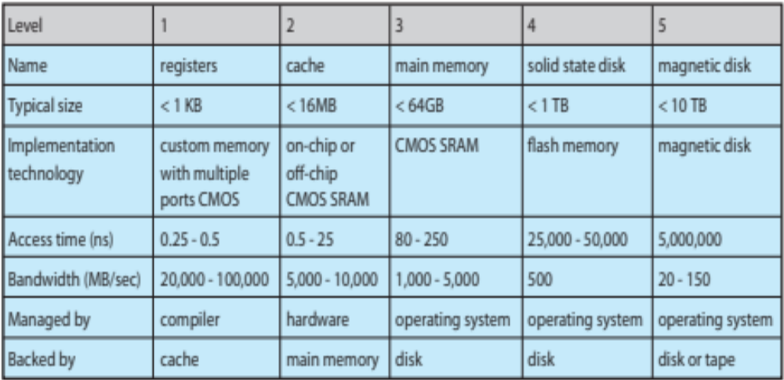
Performance of Various Levels of Storage
Movement between levels of storage hierarchy can be explicit or implicit

Slide 37

Migration of data “A” from Disk to Register
Multitasking environments must be careful to use most recent value, no matter where it is stored in the storage hierarchy
Multiprocessor environment must provide cache coherency in hardware such that all CPUs have the most recent value in their cache
Distributed environment situation even more complex
  Several copies of a datum can exist

Slide 38
Protection and Security
Protection – any mechanism for controlling access of processes or users to resources defined by the OS
Security – defense of the system against internal and external attacks
  Huge range, including denial-of-service, worms, viruses, identity theft, theft of service
Systems generally first distinguish among users, to determine who can do what
  User identities (user IDs, security IDs) include name and associated number, one per user
  User ID then associated with all files, processes of that user to determine access control
  Group identifier (group ID) allows set of users to be defined and controls managed, then also associated with each process, file
  Privilege escalation allows user to change to effective ID with more rights

Slide 39
Computing Environments
Computer Environment is a collection of Computer Devices which are used to process and exchange information to solve various types of computing problems.
It is arrangement of computer devices to a solve a problem.
Traditional Computing
Stand-alone general purpose machines
Network computers (thin clients) are like Web terminals
Mobile computers interconnect via wireless networks
Networking becoming ubiquitous – even home systems use firewalls to protect home computers from Internet attacks

Slide 40
Computing Environments - Mobile
Handheld smartphones, tablets, etc
What is the functional difference between them and a “traditional” laptop?
Extra feature – more OS features (GPS)
Allows new types of apps like augmented reality
Use IEEE 802.11 wireless, or cellular data networks for connectivity
Leaders are Apple iOS and Google Android

Slide 41
Computing Environments – Distributed
Distributed computiing
  Collection of separate, possibly heterogeneous, systems networked together
    Network is a communications path, TCP/IP most common
      Local Area Network (LAN)
      Wide Area Network (WAN)
      Metropolitan Area Network (MAN)
      Personal Area Network (PAN)
  Network Operating System provides features between systems across network
    Communication scheme allows systems to exchange messages
    Illusion of a single system

Slide 42

Computing Environments – Client-Server
Client-Server Computing.
This is a form of distributed computing.
Many computers are connected together .
  Dumb terminals supplanted by smart PCs
  Many systems now servers, responding to requests generated by clients
    1)Compute-server system provides an interface to client to request services to perform an action
    Ex: database server to read and respond to clients request.
    2)File-server system provides interface for clients to store and retrieve files
    Ex: Web server

Slide 43

General Structure of Client-Server System

Slide 44

Computing Environments - Peer-to-Peer
Another model of distributed system
P2P does not distinguish clients and servers
  Instead all nodes are considered peers
  May each act as client, server or both
  Node must join P2P network
    Registers its service with central lookup service on network, or
    Broadcast request for service and respond to requests for service via discovery protocol
  Examples include Napster and Gnutella, Voice over IP (VoIP) such as Skype

Slide 45
Web-Based Computing
Web has become ubiquitous
PCs most prevalent devices
More devices becoming networked to allow web access
New category of devices to manage web traffic among similar servers: load balancers
Use of operating systems like Windows 95, client-side, have evolved into Linux and Windows XP, which can be clients and servers

Slide 46
Open Source Operating Systems
Open source refers to the computer software or applications where the owners or copyright holders allow the users or third party to see, use and provide the right to modify the source code of the product.
An Open-source Operating System is the Operating System in which source code is visible publicly and editable. The generally known Operating Systems like Microsoft’s Windows, Apple’s iOS and Mac OS, are closed Operating system.
In Closed Operating Systems are, the source code is kept secret by the respective companies (owners) and inaccessible to third parties. By doing so, they ensure the safety and secure the Operating System and computer from any threats.
In the case of an Open Source Operating system, everyone can access and edit the source code.

Slide 47
Examples:
Linux
-Linux is the best-known and most-used open source operating system. As an operating system, Linux is software that sits underneath all of the other software on a computer, receiving requests from those programs and relaying these requests to the computer’s hardware.
Ubuntu.
Linux Lite.
Fedora.
Linux Mint.
Solus.

Slide 48
Operating System Services
One set of operating-system services provides functions that are helpful to the user:
  User interface - Almost all operating systems have a user interface (UI)
    Varies between Command-Line (CLI), Graphics User Interface (GUI), Batch
  Program execution - The system must be able to load a program into memory and to run that program, end execution, either normally or abnormally (indicating error)
  I/O operations - A running program may require I/O, which may involve a file or an I/O device
  File-system manipulation - The file system is of particular interest. Obviously, programs need to read and write files and directories, create and delete them, search them, list file Information, permission management.

Slide 49
Operating System Services
One set of operating-system services provides functions that are helpful to the user (Cont):
Communications – Processes may exchange information, on the same computer or between computers over a network
  Communications may be via shared memory or through message passing (packets of information moved by the OS)
Error detection – OS needs to be constantly aware of possible errors
    May occur in the CPU and memory hardware, in I/O devices, in user program
    For each type of error, OS should take the appropriate action to ensure correct and consistent computing
    Debugging facilities can greatly enhance the user’s and programmer’s abilities to efficiently use the system

Slide 50
Operating System Services
Another set of OS functions exists for ensuring the efficient operation of the system itself via resource sharing
  Resource allocation - When multiple users or multiple jobs running concurrently, resources must be allocated to each of them
    Many types of resources - Some (such as CPU cycles, main memory, and file storage) may have special allocation code, others (such as I/O devices) may have general request and release code
  Accounting - To keep track of which users use how much and what kinds of computer resources
  Protection and security - The owners of information stored in a multiuser or networked computer system may want to control use of that information. When separate processes are running concurrently, processes should not interfere with each other
    Protection involves ensuring that all access to system resources is controlled
    Security of the system from outsiders requires user authentication, extends to defending external I/O devices from invalid access attempts

Slide 51

A View of Operating System Services

Slide 52
User Operating System Interface - CLI
There are two fundamental types for users to interface with the operating system.
1) Command Line Interface (CLI) or command interpreter allows direct command entry-
-It allows the users to directly enter commands and perform the action by the operating system.
    Sometimes implemented in kernel, sometimes by systems program
    On systems with multiple command interpreters to choose from, these interpreters are known as – shells
    In Linux and Unix, there are several shells like Bourne shell, C shell, Korn shell etc
    Primarily fetches a command from user and executes it
      Sometimes commands built-in, sometimes just names of programs

Slide 53
User Operating System Interface - GUI
2) GUI interface:
User-friendly desktop metaphor interface
  Usually mouse, keyboard, and monitor
  Icons represent files, programs, actions, etc
  Various mouse buttons over objects in the interface cause various actions (provide information, options, execute function, open directory (known as a folder)
Many systems now include both CLI and GUI interfaces
  Microsoft Windows is GUI with CLI “command” shell
  Apple Mac OS X as “Aqua” GUI interface with UNIX kernel underneath and shells available
  Solaris is CLI with optional GUI interfaces

Slide 54
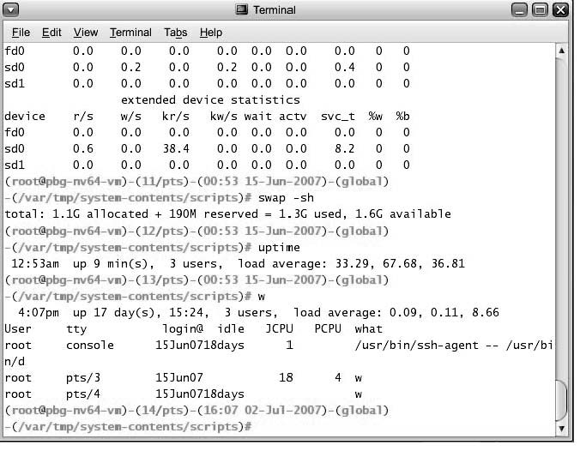
Bourne Shell Command Interpreter

Slide 55

The Mac OS X GUI

Slide 56
System Calls
System calls provide an Programming interface to the services provided by the OS.
It is a programmatic method in which a computer program requests a service from the kernel of the OS.
These calls are generally available as routines written in a high-level language (C or C++).
System call offers the services of the operating system to the user programs via API. Mostly accessed by programs via a high-level Application Program Interface (API) rather than direct system call use
Three most common APIs are Win32 API for Windows, POSIX API for POSIX-based systems (including virtually all versions of UNIX, Linux, and Mac OS X), and Java API for the Java virtual machine (JVM)

Slide 57

Example of System Calls
System call sequence to copy the contents of one file to another file

Slide 58
System Call Implementation
Typically, a number associated with each system call
  System-call interface maintains a table indexed according to these numbers
The system call interface invokes intended system call in OS kernel and returns status of the system call and any return values
The caller need know nothing about how the system call is implemented
  Just needs to obey API and understand what OS will do as a result of execution of system call.
  Most details of OS interface hidden from programmer by API
    Managed by run-time support library (set of functions built into libraries included with compiler)

Slide 59

API – System Call – OS Relationship

Slide 60

Standard C Library Example
C program invoking printf() library call, which calls write() system call

Slide 61
System Call Parameter Passing
System calls occur in different ways depending on computer in use. Often, more information is required than simply identity of desired system call
  Exact type and amount of information vary according to OS and call
Three general methods used to pass parameters to the OS
  Simplest method: to pass the parameters in registers
    In some cases, may be more parameters than registers
  In this case, Parameters stored in a block, or table, in memory, and address of block passed as a parameter in a register
    This approach taken by Linux and Solaris
  Parameters placed, or pushed, onto the stack by the program and popped off the stack by the operating system
  Block and stack methods do not limit the number or length of parameters being passed

Slide 62

Parameter Passing via Table

Slide 63
Types of System Calls
There are five types of system calls. These are as follows:
Process control
File management
Device management
Information maintenance
Communications

Slide 64

Examples of Windows and Unix System Calls

Slide 65
1) Process Control
This system calls perform the task of process creation, process termination, etc.
Functions:
End and Abort
Load and Execute
Create Process and Terminate Process
Wait and Signal Event
Allocate and free memory
2) File Management
File management system calls handle file manipulation jobs like creating a file, reading, and writing, etc.
Functions:
Create a file
Delete file
Open and close file
Read, write, and reposition
Get and set file attributes

Slide 66
3)Device Management
Device management does the job of device manipulation like reading from device buffers, writing into device buffers, etc.
Functions:
Request and release device
Logically attach/ detach devices
Get and Set device attributes
4) Information Maintenance
It handles information and its transfer between the OS and the user program.
Functions:
Get or set time and date
Get process , file and device attributes
Set process , file and device attributes
5)Communication:
These types of system calls are specially used for interprocess communications.
Functions:
Create, delete communications connections
Send, receive message
Help OS to transfer status information
Attach or detach remote devices

Slide 67

MS-DOS execution
(a) At system startup (b) running a program
MS-DOS is a single task operating system
It executes only one process at a time.

Slide 68

Running Multiple Programs

Slide 69
System Programs:
System programs provide an environment where programs can be developed and executed. In the simplest sense, system programs also provide a bridge between the user interface and system calls. In reality, they are much more complex. For example, a compiler is a complex system program.
System programs can be divided into different types. These are given as follows:
Status Information
The status information system programs provide required data on the current or past status of the system. This may include the system date, system time, available memory in system, disk space, logged in users etc.
Communications
These system programs are needed for system communications such as web browsers. Web browsers allow systems to communicate and access information from the network as required.
File Manipulation
These system programs are used to manipulate system files. This can be done using various commands like create, delete, copy, rename, print etc. These commands can create files, delete files, copy the contents of one file into another, rename files, print them etc.

Slide 70
Program Loading and Execution
The system programs that deal with program loading and execution make sure that programs can be loaded into memory and executed correctly. Loaders and Linkers are a prime example of this type of system programs.
File Modification
System programs that are used for file modification basically change the data in the file or modify it in some other way. Text editors are a big example of file modification system programs.
Application Programs
Application programs can perform a wide range of services as per the needs of the users. These include programs for database systems, word processors, plotting tools, spreadsheets, games, scientific applications etc.
Programming Language Support
These system programs provide additional support features for different programming languages. Some examples of these are compilers, debuggers etc. These compile a program and make sure it is error free respectively.

Slide 71
Operating System Structure
Operating system can be implemented with the help of various structures. The structure of the OS depends mainly on how the various common components of the operating system are interconnected and melded into the kernel. Depending on this we have following structures of the operating system:
Simple Structure
More commercial operating systems do not have well defined structure.
They are small, simple and limited systems. The interfaces and levels of functionality are not well separated. MS-DOS is an example of such operating system. In MS-DOS application programs are able to access the basic I/O routines. These types of operating system cause the entire system to crash if one of the user programs fails.
MS-DOS – written to provide the most functionality in the least space
  Not divided into modules
  Although MS-DOS has some structure, its interfaces and levels of functionality are not well separated

Slide 72

MS-DOS Layer Structure

Slide 73
UNIX structure
UNIX – limited by hardware functionality, the original UNIX operating system had limited structuring. The UNIX OS consists of two separable parts
  Systems programs
  The kernel
    Consists of everything below the system-call interface and above the physical hardware
    Provides the file system, CPU scheduling, memory management, and other operating-system functions; a large number of functions for one level

Slide 74

Traditional UNIX System Structure

Slide 75
Layered Approach
The operating system is divided into a number of layers (levels), each built on top of lower layers. The bottom layer (layer 0), is the hardware; the highest (layer N) is the user interface.
With modularity, layers are selected such that each uses functions (operations) and services of only lower-level layers
Each upper layer is built on the bottom layer
Every layer performs different functions like Hardware , Cpu scheduling, process management, memory management etc,
These layers are so designed that each layer uses the functions of the lower-level layers only. It simplifies the debugging process as if lower-level layers are debugged, and an error occurs during debugging. The error must be on that layer only as the lower-level layers have already been debugged.
Advantage is It is very easy to perform debugging and system verification.

Slide 76

Layered Operating System

Slide 77
System Boot
Booting the system is process of loading the kernel into main memory, and starting its execution.
A small program known as bootstrap program is used to load the kernel into main memory.
The initial bootstrap program is found in the BIOS read-only memory.
This program can run diagnostics, initialize all components of the system, loads and starts the Operating System loader. (Called boot strapping)
The loader program loads and starts the operating system.
When the Operating system starts, it sets up needed data structures in memory, sets several registers in the CPU, and then creates and starts the first user level program.

Slide 78
Queries?

