Slide 1
OPERATING SYSTEMS
UNIT-II
Process Management
ADITYA ENGINEERING COLLEGE (A)
By
K. Saritha
Asst.Professor
Dept of Computer Science and Engineering
Aditya Engineering College(A)
Surampalem.

Slide 2
Process Concept
Process Scheduling
Operations on Processes
Interprocess Communication

Slide 3
Objectives
To introduce the notion of a process -a program in execution, which forms the basis of all computation
To describe the various features of processes, including scheduling, creation and termination, and communication
To explore interprocess communication using shared memory and message passing

Slide 4
Process Concept
An operating system executes a variety of programs:
  Batch system – jobs
  Time-shared systems – user programs or tasks
Textbook uses the terms job and process almost interchangeably
A Process is a program in execution.
The process execution must progress in sequential fashion.
A process is unit of work in most systems.

Slide 5
Process Concept (Cont.)
Program is passive entity stored on disk such as a file containing a list of instructions stored on disk (executable file).
Process is active entity
  Program becomes process when executable file loaded into memory
Execution of program started via GUI mouse clicks, command line entry of its name, etc
One program can be several processes
  Consider multiple users executing the same program

Slide 6

Process in Memory
Multiple parts
  The program code, also called text section
  Current activity including program counter, processor registers
  Stack containing temporary data
    Function parameters, return addresses, local variables
  Data section containing global variables
  Heap containing memory dynamically allocated during run time

Slide 7
Process State
As a process executes, it changes state.
The state of a process is defined by the in part by the current activity of that process.
Each process may be in any of the following states.
  new: The process is being created
  ready: The process is waiting to be assigned to a processor
  running: Instructions are being executed
  waiting: The process is waiting for some event to occur
  terminated: The process has finished execution
It is important to realize that only one process can be running on any processor at any instant. Many processes may be ready or waiting.

Slide 8

Diagram of Process State

Slide 9

Process Control Block (PCB)
Each process is shown in OS by a Process control block(PCB). (also called task control block)
Information associated with each process
Process state – running, waiting, etc
Program counter – location of instruction to next execute
CPU registers – contents of all process-centric registers
CPU scheduling information- priorities, scheduling queue pointers
Memory-management information – memory allocated to the process
Accounting information – CPU used, clock time elapsed since start, time limits
I/O status information – I/O devices allocated to process, list of open files

Slide 10

CPU Switch From Process to Process

Slide 11
Process Scheduling
Maximize CPU use, quickly switch processes onto CPU for time sharing
Process scheduler selects among available processes for next execution on CPU
Maintains scheduling queues of processes
  Job queue – set of all processes in the system
  Ready queue – set of all processes residing in main memory, ready and waiting to execute
  Device queues – set of processes waiting for an I/O device
  Processes migrate among the various queues

Slide 12
Scheduling Queues:
All processes, upon entering into the system, are stored in the Job Queue.
Processes in the Ready state are placed in the Ready Queue.
Processes waiting for a device to become available are placed in Device Queues. There are unique device queues available for each I/O device.
A new process is initially put in the Ready queue. It waits in the ready queue until it is selected for execution(or dispatched). Once the process is assigned to the CPU and is executing, one of the following several events can occur:
The process could issue an I/O request, and then be placed in the I/O queue.
The process could create a new subprocess and wait for its termination.
The process could be removed forcibly from the CPU, as a result of an interrupt, and be put back in the ready queue.

Slide 13

Representation of Process Scheduling
Queueing diagram representation of Process Scheduling.
It represents queues, resources, flows.

Slide 14
Schedulers
The Process scheduler selects an available process (from set of several processes available ) for execution on the CPU. In Single processor system, one executes, remaining waits until processor is free.
Short-term scheduler (or CPU scheduler) – selects which process should be executed next and allocates CPU
  Sometimes the only scheduler in a system
  Short-term scheduler is invoked frequently (milliseconds) ⇒ (must be fast)
Long-term scheduler (or job scheduler) – selects which processes should be brought into the ready queue
  Long-term scheduler is invoked infrequently (seconds, minutes) ⇒ (may be slow)
  The long-term scheduler controls the degree of multiprogramming
Processes can be described as either:
  I/O-bound process – spends more time doing I/O than computations, many short CPU bursts
  CPU-bound process – spends more time doing computations; few very long CPU bursts
Long-term scheduler strives for good process mix

Slide 15

Addition of Medium Term Scheduling
Medium-term scheduler can be added if degree of multiple programming needs to decrease
  Remove process from memory, store on disk, bring back in from disk to continue execution: swapping

Slide 16
Context Switch
When CPU switches to another process, the system must save the state of the old process and load the saved state for the new process via a context switch
Context of a process represented in the PCB. It includes the values of CPU registers, process state and memory management information.
Context-switch time is overhead; the system does no useful work while switching
  The more complex the OS and the PCB ➔ the longer the context switch
Time dependent on hardware support
  Some hardware provides multiple sets of registers per CPU ➔ multiple contexts loaded at once

Slide 17
Operations on Processes
System must provide mechanisms for:
  process creation,
  process termination,
  and so on as detailed next

Slide 18
Process Creation
Parent process create children processes, which, in turn create other processes, forming a tree of processes
Generally, process identified and managed via a process identifier (pid)
Resource sharing options
  Parent and children share all resources
  Children share subset of parent’s resources
  Parent and child share no resources
Execution options
  Parent and children execute concurrently
  Parent waits until children terminate

Slide 19

A Tree of Processes in Linux

Slide 20

Process Creation (Cont.)
Address space
  Child duplicate of parent
  Child has a program loaded into it
UNIX examples
  fork() system call creates new process
  exec() system call used after a fork() to replace the process’ memory space with a new program

Slide 21

C Program Forking Separate Process

Slide 22
Process Termination
Process executes last statement and then asks the operating system to delete it using the exit() system call.
  Returns status data from child to parent (via wait())
  Process’ resources are deallocated by operating system
Parent may terminate the execution of children processes using the abort() system call. Some reasons for doing so:
  Child has exceeded allocated resources
  Task assigned to child is no longer required

Slide 23
Process Termination
Some operating systems do not allow child to exists if its parent has terminated. If a process terminates, then all its children must also be terminated.
  cascading termination. All children, grandchildren, etc. are terminated.
  The termination is initiated by the operating system.
The parent process may wait for termination of a child process by using the wait()system call. The call returns status information and the pid of the terminated process
pid = wait(&status);
If no parent waiting (did not invoke wait()) process is a zombie
If parent terminated without invoking wait , process is an orphan

Slide 24
Interprocess Communication
Processes executing concurrently in Operating system may be independent or cooperating.
Independent process are the processes which cannot affect or be affected by the execution of another process
Cooperating process are processes which can affect or be affected by other processes. Any process that shares data with other processes is a Cooperating Process.
Reasons for cooperating processes:
  Information sharing
  Computation speedup
  Modularity
  Convenience
Cooperating processes need interprocess communication (IPC) that will allow to them to exchange data and information.
There are Two models of Interprocess Communication (IPC) :
  Shared memory
  Message passing

Slide 25

Communications Models
(a) Message passing. (b) shared memory.

Slide 26

CPU Scheduling: Basic Concepts
Maximum CPU utilization obtained with multiprogramming
CPU–I/O Burst Cycle – Process execution consists of a cycle of CPU execution and I/O wait
CPU burst followed by I/O burst
CPU burst distribution is of main concern

Slide 27
CPU Scheduler
Short-term scheduler selects from among the processes in ready queue, and allocates the CPU to one of them
  Queue may be ordered in various ways
CPU scheduling decisions may take place when a process:
  Switches from running to waiting state
  Switches from running to ready state
  Switches from waiting to ready
  Terminates

Slide 28
Dispatcher
Dispatcher module gives control of the CPU to the process selected by the short-term scheduler; this function involves the following:
  switching context
  switching to user mode
  jumping to the proper location in the user program to restart that program
Dispatch latency – time it takes for the dispatcher to stop one process and start another running process

Slide 29
Scheduling Criteria
CPU utilization – keep the CPU as busy as possible
Throughput – Number of processes that complete their execution per time unit
Turnaround time – amount of time to execute a particular process
Waiting time – amount of time a process has been waiting in the ready queue
Response time – amount of time it takes from when a request was submitted until the first response is produced, not output

Slide 30
Scheduling Algorithm Optimization Criteria
Max CPU utilization
Max throughput
Min turnaround time
Min waiting time
Min response time

Slide 31
Scheduling Algorithms
Non Preemptive: Once a process is in the running state, it will continue until it terminates or blocks itself for I/O
Example: FCFS, SJF, Priority
Preemptive: Currently running process may be interrupted and moved to the ready state by OS
Example: preemptive SJF(SRTF),Preemptive Priority, Round Robin

Slide 32

First- Come First-Served (FCFS) Scheduling
Process Burst Time
P₁ 24
P₂ 3
P₃ 3
Suppose that the processes arrive in the order: P₁ , P₂ , P₃
The Gantt Chart for the schedule is:
Waiting time for P₁ = 0; P₂ = 24; P₃ = 27
Average waiting time: (0 + 24 + 27)/3 = 17
Turnaround time for P₁ = 24; P₂ = 27; P₃ = 30
Average Turnaround time: (24+27+30)/3=27

Slide 33

FCFS Scheduling (Cont.)
Suppose that the processes arrive in the order:
P₂ , P₃ , P₁
The Gantt chart for the schedule is:
Waiting time for P₁ = 6; P₂ = 0; P₃ = 3
Average waiting time: (6 + 0 + 3)/3 = 3
Turnaround time for P₁ = 30; P₂ = 3; P₃ = 6
Average turnaround time: (30 + 3 + 6)/3 = 13
Much better than previous case

Slide 34
ProcessArriva l TBurst Time
P₁ 0.0 6
P₂ 2.0 8
P₃ 4.0 7
P₄ 5.0 3

Slide 35
Shortest-Job-First (SJF) Scheduling
Associate with each process the length of its next CPU burst
  Use these lengths to schedule the process with the shortest time
SJF is optimal – gives minimum average waiting time for a given set of processes
  The difficulty is knowing the length of the next CPU request
  Could ask the user

Slide 36

Example of SJF
ProcessArriva l TBurst Time
P₁ 0.0 6
P₂ 2.0 8
P₃ 4.0 7
P₄ 5.0 3
SJF scheduling chart

Slide 37
Waiting time for P₁ = 3; P₂ = 16; P₃ = 9 ; P₄ = 0
Average waiting time: (3+16+9+0)/4 = 7
Turnaround time for P₁=9; P₂=24;
P₃ =16;P₄ =3
Average Turnaround time: (9+24+16+3)/4=13

Slide 38

Example of Shortest-remaining-time-first
Now we add the concepts of varying arrival times and preemption to the analysis
ProcessA arri Arrival TimeT Burst Time
P₁ 0 8
P₂ 1 4
P₃ 2 9
P₄ 3 5
Preemptive SJF Gantt Chart
Average waiting time = [(10-1-0)+(1-0-1)+(17-0-2)+(5-0-3)]/4 = 26/4 = 6.5 msec
Average Turnaround time=[(9+8)+(0+4)+(15+9)+(2+5)]/4=13

Slide 39
P1 6
P2 4
P3 2

Slide 40
Priority Scheduling
A priority number (integer) is associated with each process
The CPU is allocated to the process with the highest priority (smallest integer ≡ highest priority)
  Preemptive
  Non preemptive
SJF is priority scheduling where priority is the inverse of predicted next CPU burst time
Problem ≡ Starvation – low priority processes may never execute
Solution ≡ Aging – as time progresses increase the priority of the process

Slide 41

Example of Priority Scheduling
Process arriBurst TimeT Priority
P₁ 10 3
P₂ 1 1
P₃ 2 4
P₄ 1 5
P₅ 5 2
Priority scheduling Gantt Chart
Average waiting time = 8.2 msec

Slide 42
Waiting time for P₁ =6 ; P₂ = 0; P₃ = 16 ;
P₄ =18 ; P₅=1
Average waiting time: (6+0+16+18+1)/5 = 41/5
Turnaround time for P₁=16; P₂=1;P₃ =18;
P₄ =19; P₅=6
Average Turnaround time:
(16+1+18+19+6)/5=60/5

Slide 43
Round Robin (RR)
RR is similar to FCFS, but preemption is added to switch between the processes.
Each process gets a small unit of CPU time (time quantum q), usually 10-100 milliseconds. After this time has elapsed, the process is preempted and added to the end of the ready queue.
Processes are stored in FIFO queue.
If there are n processes in the ready queue and the time quantum is q, then each process gets 1/n of the CPU time in chunks of at most q time units at once.
Timer interrupts every quantum to schedule next process
Performance
  q large ⇒ FIFO
  q small ⇒ q must be large with respect to context switch, otherwise overhead is too high

Slide 44
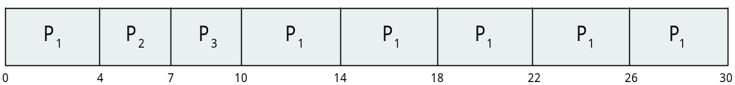
Example of RR with Time Quantum = 4
Process Burst Time
P₁ 24
P₂ 3
P₃ 3
The Gantt chart is:
Typically, higher average turnaround than SJF, but better response
q should be large compared to context switch time

Slide 45
Waiting time for P₁ = 10-4=6; P₂ = 4; P₃ = 7
Average waiting time: (6+4+7)/3 =17/3
Turnaround time for P₁=30; P₂=7; P₃ =10
Average Turnaround time: (30+7+10)/3=47/3

Slide 46
Multilevel Queue Scheduling
Created for situations where process are easily classified into different groups. Ex:
  Foreground (Interactive)
  Background (Batch)
The algorithm partitions the ready queue into several separate queues.
The process are permanently assigned to one queue, based on some property of the process such as memory size, process priority, or process type.
Each queue has its own scheduling algorithm:
  foreground – RR
  background – FCFS
Scheduling must be done between the queues:
  Fixed priority scheduling; (i.e., serve all from foreground then from background). Possibility of starvation.
  Time slice – each queue gets a certain amount of CPU time which it can schedule amongst its processes; i.e., 80% to foreground in RR
  20% to background in FCFS
In this, commonly implemented as fixed – priority preemptive scheduling.

Slide 47

Multilevel Queue Scheduling

Slide 48
Multilevel Feedback Queue
Normally, when the multilevel queue scheduling algorithm is used, processes are permanently assigned to a queue when they enter a system. If there are separate queues for foreground and background processes, processes do not move from one queue to other queue
This setup has advantage of low scheduling overhead, but it is inflexible.
Multilevel feedback queue scheduling algorithm, in contrast allows a process to move between queues.
The idea is to separate processes according to the characteristics of their CPU bursts.
If a process uses too much CPU time, it will be moved to lower priority queue.
Multilevel-feedback-queue scheduler defined by the following parameters:
  number of queues
  scheduling algorithms for each queue
  method used to determine which queue a process will enter when that process needs service

Slide 49
This scheme leaves I/O bound and interactive processes in the higher priority queues.
In addition , a process that waits too long in a low-priority queue may be moved to a high priority queue.
This form of aging prevents starvation.

Slide 50

Example of Multilevel Feedback Queue
Three queues:
  Q₀ – RR with time quantum 8 milliseconds
  Q₁ – RR time quantum 16 milliseconds
  Q₂ – FCFS
Scheduling
  A new job enters queue Q₀ which is served FCFS
    When it gains CPU, job receives 8 milliseconds
    If it does not finish in 8 milliseconds, job is moved to queue Q₁
  At Q₁ job is again served FCFS and receives 16 additional milliseconds
    If it still does not complete, it is preempted and moved to queue Q₂

Slide 51
Interprocess Communication
Processes within a system may be independent or cooperating
Independent process cannot affect or be affected by the execution of another process
Cooperating process can affect or be affected by other processes, including sharing data
Reasons for cooperating processes:
  Information sharing
  Computation speedup
  Modularity
  Convenience
Cooperating processes need interprocess communication (IPC)
Two models of IPC
  Shared memory
  Message passing

Slide 52
Communications Models
(a) Message passing. (b) shared memory.

Slide 53
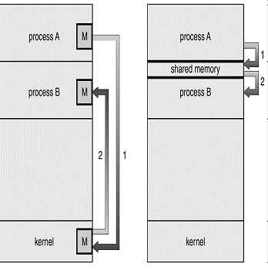

Slide 54
Interprocess Communication – Shared Memory
An area of memory shared among the processes that wish to communicate
The communication is under the control of the users processes not the operating system.
Major issues is to provide mechanism that will allow the user processes to synchronize their actions when they access shared memory.

Slide 55
Interprocess Communication – Message Passing
Mechanism for processes to communicate and to synchronize their actions
Message system – processes communicate with each other without resorting to shared variables
IPC facility provides two operations:
  send(message)
  receive(message)
The message size is either fixed or variable

Slide 56
Message Passing (Cont.)
If processes P and Q wish to communicate, they need to:
  Establish a communication link between them
  Exchange messages via send/receive
Implementation issues:
  How are links established?
  Can a link be associated with more than two processes?
  How many links can there be between every pair of communicating processes?
  What is the capacity of a link?
  Is the size of a message that the link can accommodate fixed or variable?
  Is a link unidirectional or bi-directional?

Slide 57
Direct Communication
Processes must name each other explicitly:
  send (P, message) – send a message to process P
  receive(Q, message) – receive a message from process Q
Properties of communication link
  Links are established automatically
  A link is associated with exactly one pair of communicating processes
  Between each pair there exists exactly one link
  The link may be unidirectional, but is usually bi-directional

Slide 58
Indirect Communication
Messages are directed and received from mailboxes (also referred to as ports)
  Each mailbox has a unique id
  Processes can communicate only if they share a mailbox
Properties of communication link
  Link established only if processes share a common mailbox
  A link may be associated with many processes
  Each pair of processes may share several communication links
  Link may be unidirectional or bi-directional

Slide 59
Indirect Communication
Operations
  create a new mailbox (port)
  send and receive messages through mailbox
  destroy a mailbox
Primitives are defined as:
send(A, message) – send a message to mailbox A
receive(A, message) – receive a message from mailbox A.

Slide 60
Threads
The process concept incorporates two abstractions:
  a virtual processor (an execution context)
  a resource ownership (an address space, open files etc..)
Within an address space, we can have more units of execution: threads
All the threads of a process share the same address space and the same resources

Slide 61
Threads
A thread is a basic unit of CPU utilization.
It comprises of a thread ID, a program counter, a register set, and a stack.
It shares with the other threads of same process its code section, data section and other operating system resources such as open files and signals.
If a process has multiple threads of control, it can perform more than one task at a time.

Slide 62
Process Vs Threads
Process
  all resources allocated: IPC channels, files etc..
  a virtual address space that holds the process image
Threads
  a dispatchable unit of work
  an execution state: running, ready, etc..
  an execution context: PC, SP, other registers
  a per-thread stack

Slide 63
Thread Implementation
User-level threads
  Implemented as a thread library, which contains the code for thread creation, termination, scheduling, and switching
  Kernel sees one process and it is unaware of its thread activity
  can be preemptive or not (co-routines)
Kernel-level threads
  Thread management done by the kernel

Slide 64
Threads
Overview
Multicore Programming
Multithreading Models

Slide 65
Motivation
Most modern applications are multithreaded
Threads run within application
Multiple tasks with the application can be implemented by separate threads.
For example : A Word processor may have several threads for
  Update display
  Fetch data
  Spell checking
  Answer a network request
Process creation is heavy-weight while thread creation is light-weight
Can simplify code, increase efficiency
Kernels are generally multithreaded

Slide 66
Benefits
The benefits of multithreaded programming can be divided into different types:
Responsiveness – may allow continued execution even if part of process is blocked, especially important for user interfaces.
  Example: Web browser can allow to search in one thread while an image is being loaded in another thread.
Resource Sharing – Threads share resources and memory of the process to which they belong
Economy – Creating threads is cheaper than process creation, thread switching lower overhead than context switching
Utilization of Multiprocessor architecture – benefits of multi-threading can take advantage of multiprocessor architectures

Slide 67

Single and Multithreaded Processes

Slide 68
User Threads and Kernel Threads
User threads - management done by user-level threads library
Three primary thread libraries:
  POSIX Pthreads
  Windows threads
  Java threads
Kernel threads - Supported by the Kernel
Examples – virtually all general purpose operating systems, including:
  Windows
  Solaris
  Linux
  Mac OS X

Slide 69
Multithreading Models
Many-to-One
One-to-One
Many-to-Many

Slide 70
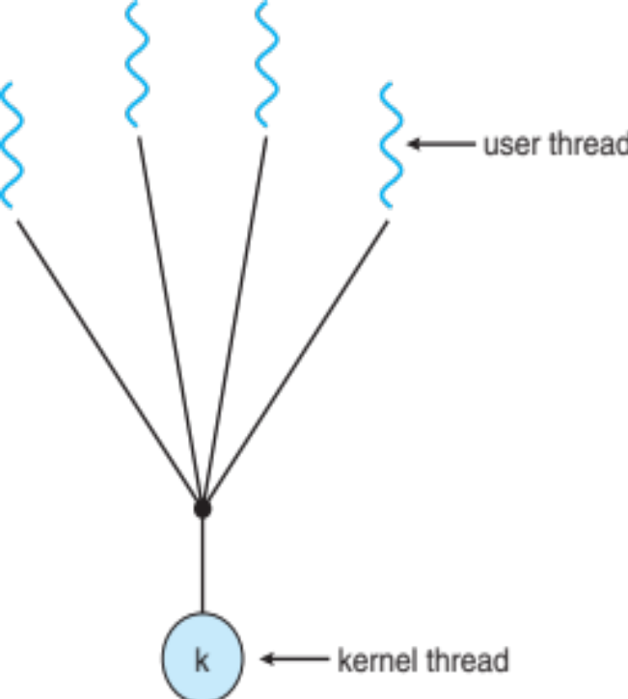
Many-to-One Model
This model maps Many user-level threads to single kernel thread.
Thread management is done by thread library.
One thread blocking causes all to block
Multiple threads may not run in parallel on system because only one may be in kernel at a time
Few systems currently use this model
Examples:
  Solaris Green Threads
  GNU Portable Threads

Slide 71
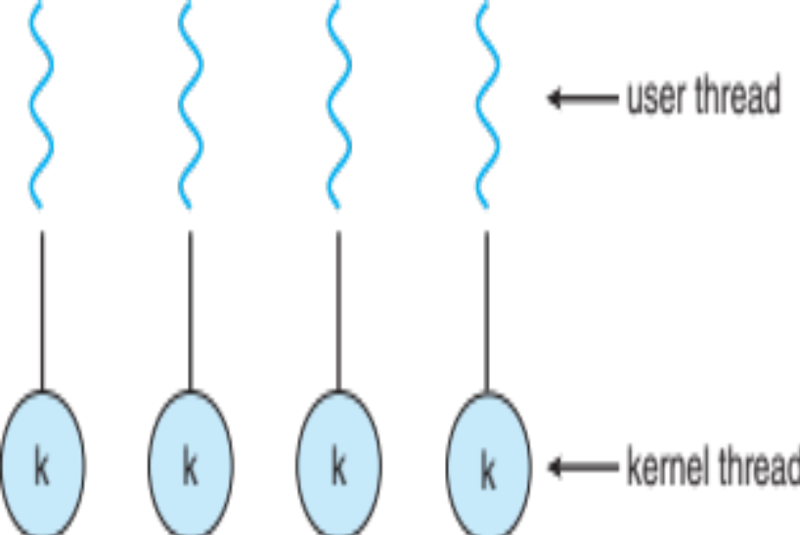
One-to-One Model
Each user-level thread maps to a kernel thread
Creating a user-level thread creates a kernel thread
More concurrency than many-to-one
Multiple threads can run in parallel on system
When one thread is blocking, it allows another thread to run.
Number of threads per process sometimes restricted due to overhead
Examples
  Windows
  Linux
  Solaris 9 and later

Slide 72
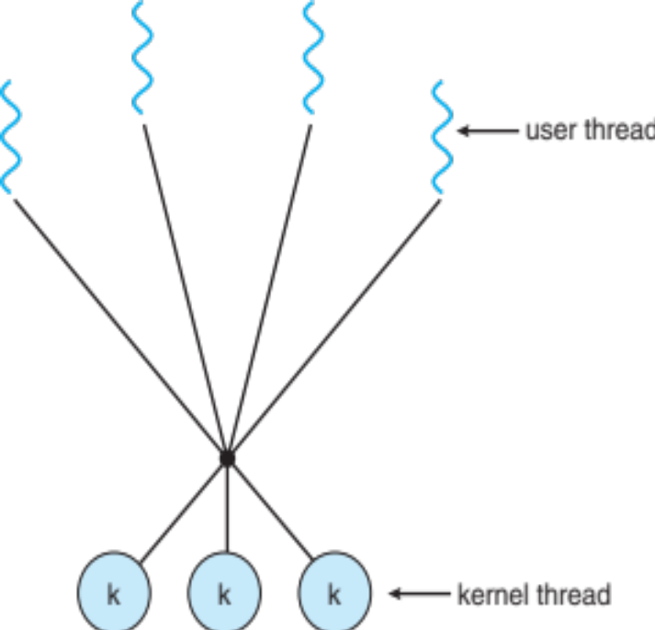
Many-to-Many Model
Allows many user level threads to be mapped to many kernel threads
Allows the operating system to create a sufficient number of kernel threads
Solaris prior to version 9
Windows with the ThreadFiber package

Slide 73

Two-level Model
Similar to M:M, except that it allows a user thread to be bound to kernel thread
Examples
  Solaris 8 and earlier

Slide 74
Thread Libraries
Thread library provides programmer with API for creating and managing threads
Two primary ways of implementing
  Library entirely in user space
  Kernel-level library supported by the OS
Three primary thread libraries:
  POSIX Pthreads
  Windows threads
  Java threads

Slide 75
Threading Issues
Semantics of fork() and exec() system calls
Thread cancellation of target thread
Signal handling
Thread pools
Thread-specific data
Scheduler activation

Slide 76
Thread Cancellation:
Terminating a thread before it has finished
Two general approaches:
Asynchronous cancellation terminates the target thread immediately
Deferred cancellation allows the target thread to periodically check if it should be cancelled.
Signal Handling
Signals are used in UNIX systems to notify a process that a particular event has occurred
A signal handler is used to process signals
1.Signal is generated by particular event
2.Signal is delivered to a process
3.Signal is handled

Slide 77
Any Queries?

