Slide 1
OPERATING SYSTEMS UNIT-III Inter Process Communication & Deadlocks
ADITYA ENGINEERING COLLEGE (A)
By
K. Saritha
Asst.Professor
Dept of Computer Science and Engineering
Aditya Engineering College(A)
Surampalem.

Slide 2
Process Synchronization
Background
The Critical-Section Problem
Peterson’s Solution
Synchronization Hardware
Mutex Locks
Semaphores
Classic Problems of Synchronization
Monitors

Slide 3
Objectives
To present the concept of process synchronization.
To introduce the critical-section problem, whose solutions can be used to ensure the consistency of shared data
To present both software and hardware solutions of the critical-section problem
To examine several classical process-synchronization problems
To explore several tools that are used to solve process synchronization problems

Slide 4
Background
Processes can execute concurrently
May be interrupted at any time, partially completing execution
Concurrent access to shared data may result in data inconsistency
Maintaining data consistency requires mechanisms to ensure the orderly execution of cooperating processes
Illustration of the problem:
Suppose that we wanted to provide a solution to the consumer-producer problem that fills all the buffers. We can do so by having an integer counter that keeps track of the number of full buffers. Initially, counter is set to 0. It is incremented by the producer after it produces a new buffer and is decremented by the consumer after it consumes a buffer.

Slide 5
Producer-Consumer Problem
Paradigm for cooperating processes, producer process produces information that is consumed by a consumer process
unbounded-buffer places no practical limit on the size of the buffer
bounded-buffer assumes that there is a fixed buffer size

Slide 6
Producer-consumer problem
In the producer-consumer problem, there is one Producer that is producing something and there is one Consumer that is consuming the products produced by the Producer. The producers and consumers share the same memory buffer that is of fixed-size.
The job of the Producer is to generate the data, put it into the buffer, and again start generating data. While the job of the Consumer is to consume the data from the buffer.
What's the problem here?
The following are the problems that might occur in the Producer-Consumer:
The producer should produce data only when the buffer is not full. If the buffer is full, then the producer shouldn't be allowed to put any data into the buffer.
The consumer should consume data only when the buffer is not empty. If the buffer is empty, then the consumer shouldn't be allowed to take any data from the buffer.
The producer and consumer should not access the buffer at the same time.

Slide 7
Producer
while (true) { /* produce an item in next produced */
while (counter == BUFFER_SIZE) ;
/* Stop- do nothing */
buffer[in] = next_produced;
in = (in + 1) % BUFFER_SIZE;
counter++;
}

Slide 8
Consumer
while (true)
{
while (counter == 0)
; /* do nothing */
next_consumed = buffer[out];
out = (out + 1) % BUFFER_SIZE;
counter--;
/* consume the item in next consumed */
}

Slide 9
Producer consumer problem
Illustration of the problem:
Suppose that we wanted to provide a solution to the consumer-producer problem that fills all the buffers. We can do so by having an integer counter that keeps track of the number of full buffers. Initially, counter is set to 0. It is incremented by the producer after it produces a new buffer and is decremented by the consumer after it consumes a buffer.

Slide 10
Race conditions
A situation where several processes access and manipulate the same data concurrently and the outcome of the execution depends on the particular order in which the access takes place, is called a Race condition.
A race condition is a situation in which two or more threads or processes are reading or writing some shared data, and the final result depends on the timing of how the threads are scheduled. Race conditions can lead to unpredictable results and subtle program bugs.

Slide 11
Race Condition
counter++ could be implemented as register1 = counter register1 = register1 + 1 counter = register1
counter-- could be implemented as register2 = counter register2 = register2 - 1 counter = register2
Consider this execution interleaving with “count = 5” initially:
S0: producer execute register1 = counter {register1 = 5} S1: producer execute register1 = register1 + 1 {register1 = 6} S2: consumer execute register2 = counter {register2 = 5} S3: consumer execute register2 = register2 – 1 {register2 = 4} S4: producer execute counter = register1 {counter = 6 } S5: consumer execute counter = register2 {counter = 4}

Slide 12
Critical Section Problem
Consider system of n processes {p₀, p₁, … p_{n-1}}
Each process has critical section segment of code
Process may be changing common variables, updating table, writing file, etc
When one process in critical section, no other should be in its critical section
That means no two processes are executing in their critical sections at the same time.
The Critical section problem is to design protocol to solve this and the processes can use to cooperate.
Each process must ask permission to enter critical section in entry section, may follow critical section with exit section, then remainder section

Slide 13
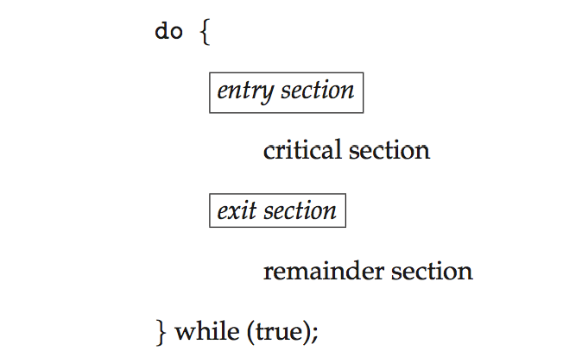
Critical Section
General structure of process P_{i}
Every process have the sections . The structure consists of four sections
Entry section
Critical section
Exit section
Remainder section
Each process must request to enter into critical section. That code is implemented in entry section.

Slide 14
Solution to Critical-Section Problem
A Solution to the Critical-section problem must satisfy the following three requirements:
1. Mutual Exclusion - If process P_{i} is executing in its critical section, then no other processes can be executing in their critical sections
2. Progress - If no process is executing in its critical section and there exist some processes that wish to enter their critical section, then the selection of the processes that will enter the critical section next cannot be postponed indefinitely
Bounded Waiting - A bound must exist on the number of times that other processes are allowed to enter their critical sections after a process has made a request to enter its critical section and before that request is granted
There is a race to execute critical sections
Assume that each process executes at a nonzero speed
No assumption concerning relative speed of the N processes

Slide 15
At any given point of time, several Kernel-mode processes may be active in the operating system.
As a result, the code implementing the operating system is subject to several race conditions.
For example: if two processes were to open files simultaneously, the separate updates could result in a race condition.
Two approaches are used to handle critical sections in OS: depending on preemptive kernel or non-preemptive kernel.
Preemptive kernel– it allows preemption of process when running in kernel mode
Non-preemptive kernel – it does not allow a process running in kernel mode to preempted. A kernel mode process runs until exits kernel mode, blocks, or voluntarily yields control of the CPU.
Essentially free of race conditions in kernel mode

Slide 16
Peterson’s Solution
Good algorithmic description of solving the problem
It requires Two processes that alternate execution between their critical section and remainder section.
Assume that the load and store machine-language instructions are atomic; that is, cannot be interrupted
The two processes share two variables:
int turn;
Boolean flag[2]
The variable turn indicates whose turn it is to enter the critical section
The flag array is used to indicate if a process is ready to enter the critical section. If flag[i] = true implies that process P_{i} is ready to enter critical section.

Slide 17
Algorithm for Process P_{i}
do {
flag[i] = true;
turn = j;
while (flag[j] && turn = = j);
critical section
flag[i] = false;
remainder section
} while (true);

Slide 18
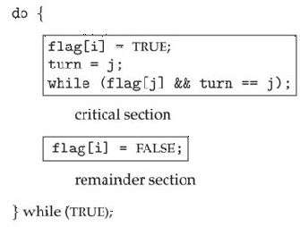

Slide 19
Peterson’s Solution (Cont.)
Provable that the three CS requirement are met:
1. Mutual exclusion is preserved
P_{i} enters CS only if:
either flag[j] = false or turn = i
2. Progress requirement is satisfied
3. Bounded-waiting requirement is met

Slide 20
Mutual Exclusion with Busy waiting
Busy waiting, also known as spinning, or busy looping is a process synchronization technique in which a process/task waits and constantly checks for a condition to be satisfied before proceeding with its execution.
In busy waiting, a process executes instructions that test for the entry condition to be true, such as the availability of a lock or resource in the computer system.
For resource availability, consider a scenario where a process needs a resource for a specific program.
However, the resource is currently in use and unavailable at the moment, therefore the process has to wait for resource availability before it can continue. This is what is known as busy waiting as illustrated below:

Slide 21
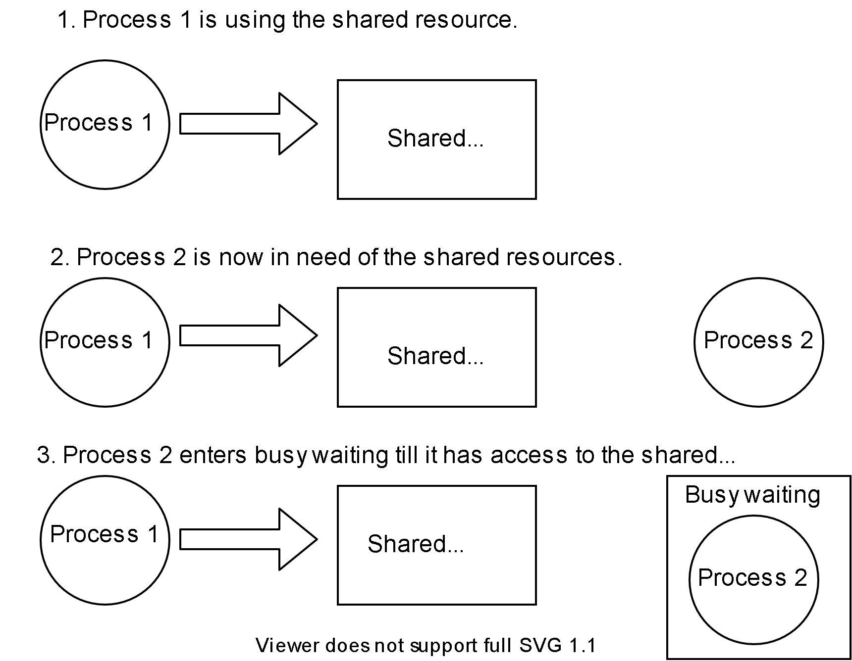

Slide 22
Sleep and Wake up:
Busy waiting can be wasteful. Processes waiting to enter their critical sections waste processor time checking to see if they can proceed.
A better solution to the mutual exclusion problem, which can be implemented with the addition of some new primitives, would be to block processes when they are denied access to their critical sections. Two primitives, Sleep and Wakeup, are often used to implement blocking in mutual exclusion.
How do Sleep and Wakeup Work?
Essentially, when a process is not permitted to access its critical section, it uses a system call known as Sleep, which causes that process to suspended.
The process will not be scheduled to run again, until another process uses the Wakeup system call. In most cases, Wakeup is called by a process when it leaves its critical section if any other processes have blocked.
The suspended process is woken by other process calling wakeup().

Slide 23
Synchronization Hardware
Many systems provide hardware support for implementing the critical section code.
All solutions below based on idea of locking
Protecting critical regions via locks
Uniprocessors – could disable interrupts
Currently running code would execute without preemption
Generally too inefficient on multiprocessor systems
Modern machines provide special atomic hardware instructions
Either test memory word and set value
Or swap contents of two memory words

Slide 24
Solution to Critical-section Problem Using Locks
do {
acquire lock
critical section
release lock
remainder section
} while (TRUE);

Slide 25
test_and_set Instruction
Definition:
boolean test_and_set (boolean *target)
{
boolean rv = *target;
*target = TRUE;
return rv:
}
Executed atomically
Returns the original value of passed parameter
Set the new value of passed parameter to “TRUE”.

Slide 26
Solution using test_and_set()
Shared Boolean variable lock, initialized to FALSE
Solution:
do { while (test_and_set(&lock))
; /* do nothing */
/* critical section */
lock = false;
/* remainder section */
} while (true);

Slide 27
compare_and_swap Instruction
Definition:
int compare _and_swap(int *value, int expected, int new_value) {
int temp = *value;
if (*value == expected)
*value = new_value;
return temp;
}
Executed atomically
Returns the original value of passed parameter “value”
Set the variable “value” the value of the passed parameter “new_value” but only if “value” ==“expected”. That is, the swap takes place only under this condition.

Slide 28
Solution using compare_and_swap
Shared integer “lock” initialized to 0;
Solution:
do { while (compare_and_swap(&lock, 0, 1) != 0)
; /* do nothing */
/* critical section */
lock = 0;
/* remainder section */
} while (true);

Slide 29
Mutex Locks
Previous solutions are complicated and generally inaccessible to application programmers
OS designers build software tools to solve critical section problem
Simplest is mutex lock
Protect a critical section by first acquire() a lock then release() the lock
Boolean variable indicating if lock is available or not
Calls to acquire() and release() must be atomic
Usually implemented via hardware atomic instructions
But this solution requires busy waiting
This lock therefore called a spinlock

Slide 30
acquire() and release()
do {
acquire lock
critical section
release lock
remainder section
} while (true);

Slide 31
Semaphore
Synchronization tool that provides more sophisticated ways (than Mutex locks) for process to synchronize their activities.
Semaphore is introduced by Dijkstra.
A Semaphore S is an integer variable that apart from initialization is accessed through two standard atomic operations
The two indivisible (atomic) operations
wait() and signal()
Originally called P() and V()
Definition of the wait() operation
wait(S)
{
while (S <= 0)
; // busy wait
S--;
}
Definition of the signal() operation
signal(S) {
S++;
}

Slide 32
Use of Semaphores
Usually two types of semaphores
Counting semaphore
Binary semaphore (also called mutex locks)
Binary semaphores can be used for:
The binary semaphore is a integer value can range only between 0 and 1
On some systems binary semaphores are called, mutex locks, as they are locks that provide mutual exclusion.
We can use binary semaphores to Critical section problems for multiple processes
Counting semaphores can be used for:
The value of counting semaphore is integer value can range over an unrestricted domain
They are used to Controlling access to multiple, but finite set of resources
Ordering the running of critical sections

Slide 33
Binary Semaphore
We can use binary semaphores to deal with critical section problem for multiple processes
The n Processes share a semaphore, mutex, initialized to 1.
Each process is organized as
do
{
wait(mutex);
// Critical section
signal(mutex);
// remainder section
}while(true);

Slide 34
Counting Semaphore
Counting semaphores can be used to control access to a given resource consisting of a finite number o£ instances.
The semaphore is initialized to the number of resources available.
Each process that wishes to use a resource performs a wait() operation on the semaphore (thereby decrementing the count).
When a process releases a resource, it performs a signal() operation (incrementing the count).
When the count for the semaphore goes to 0, all resources are being used. After that, processes that wish to use a resource will block until the count becomes greater than 0.

Slide 35
We can also use semaphores to solve various synchronization problems.
For example, consider two concurrently running processes: P1 with a statement S1 and P2 with a statement S2
Consider P₁ and P₂ that require statements S₁ to happen before S₂
Create a semaphore “synch” initialized to 0
P1:
S₁;
signal(synch);
P2:
wait(synch);
S₂;
Can implement a counting semaphore S as a binary semaphore

Slide 36
Semaphore Implementation
Must guarantee that no two processes can execute wait() and signal() on the same semaphore at the same time
The main disadvantage of the semaphore is that it requires busy waiting.
Thus, implementation becomes the critical section problem where the wait and signal code are placed in the critical section
Could now have busy waiting in critical section implementation
But implementation code is short
Little busy waiting if critical section rarely occupied
Loop continuously in the entry code
Wastes CPU cycles
This type of semaphore is also called a spin lock as the process spins while waiting for the lock
Note that applications may spend lots of time in critical sections and therefore this is not a good solution

Slide 37
Semaphore Implementation with no Busy waiting
To over come the need of busy waiting , we can modify definition of wait and signal operations.
The each semaphore there is an associated waiting queue
Each entry in a waiting queue has two data items:
value (of type integer)
pointer to next record in the list
Two operations:
block – place the process invoking the operation on the appropriate waiting queue
wakeup – remove one of processes in the waiting queue and place it in the ready queue
typedef struct{
int value;
struct process *list;
} semaphore;

Slide 38
Implementation with no Busy waiting (Cont.)
wait(semaphore *S) {
S->value--;
if (S->value < 0) { add this process to S->list;
block();
}
}
signal(semaphore *S) {
S->value++;
if (S->value <= 0) { remove a process P from S->list;
wakeup(P);
}
}
The block() operations suspends the process that invokes it,
The wakeup() operation resumes the execution of blocked process.
These two operations are provided by the operating system as basic system calls.

Slide 39
When a process executes the wait () operation and finds that the semaphore value is not positive, it must wait. However, rather than engaging in busy waiting, the process can block itself.
The block operation places a process into a waiting queue associated with the semaphore, and the state of the process is switched to the waiting state. Then control is transferred to the CPU scheduler, which selects another process to execute.
A process that is blocked, waiting on a semaphore S, should be restarted when some other process executes a signal() operation.
The process is restarted by a wakeup () operation, which changes the process from the waiting state to the ready state. The process is then placed in the ready queue.

Slide 40
Deadlock and Starvation
Deadlock –
The implementation of a semaphore with a waiting queue may result in a situation where two or more processes are waiting indefinitely for an event that can be caused by only one of the waiting processes.
Let S and Q be two semaphores initialized to 1
P₀ P₁
wait(S); wait(Q);
wait(Q); wait(S);
... ...
signal(S); signal(Q);
signal(Q); signal(S);
Suppose that Po executes wait (S) and then P1 executes wait (Q). When Po executes wait (Q), it must wait until P1 executes signal (Q). Similarly, when P1 executes wait (S), it must wait until Po executes signal(S). Since these signal() operations cannot be executed, Po and P1 are deadlocked.
We say that a set of processes is in a deadlock state when every process in the set is waiting for an event that can be caused only by another process in the set.

Slide 41
Suppose that Po executes wait (S) and then P1 executes wait (Q). When Po executes wait (Q), it must wait until P1 executes signal (Q). Similarly, when P1 executes wait (S), it must wait until Po executes signal(S). Since these signal() operations cannot be executed, Po and P1 are deadlocked.
We say that a set of processes is in a deadlock state when every process in the set is waiting for an event that can be caused only by another process in the set.
Starvation – indefinite blocking
A process may never be removed from the semaphore queue in which it is suspended
Priority Inversion – Scheduling problem when lower-priority process holds a lock needed by higher-priority process
Solved via priority-inheritance protocol
Indefinite blocking- may occur if we remove processes from the list associated with a semaphore in LIFO (last-in, first-out) order.

Slide 42
Classical Problems of Synchronization
Classical problems used to test newly-proposed synchronization schemes
Bounded-Buffer Problem
Readers and Writers Problem
Dining-Philosophers Problem

Slide 43
Bounded-Buffer Problem
n buffers, each can hold one item
Semaphore mutex initialized to the value 1
Semaphore full initialized to the value 0
Semaphore empty initialized to the value n
We assume that the pool consists of n buffers, each capable of holding one item.
The mutex semaphore provides mutual exclusion for accesses to the buffer pool and is initialized to the value 1.
The empty and full semaphores count the number of empty and full buffers.
The semaphore empty is initialized to the value n; the semaphore full is initialized to the value 0.
We can interpret this code as the producer producing full buffers for the consumer or as the consumer producing empty buffers for the producer.

Slide 44
We assume that the pool consists of n buffers, each capable of holding one item.
There are two processes running –Producer and Consumer
The producer produces the items and consumer consumes the items.
The problem arises when
The producer must not insert data when a buffer is full
The consumer should not remove data when buffer is empty.
The producer and consumer should not insert and remove data at same time.

Slide 45
Bounded Buffer Problem (Cont.)
The structure of the producer process
do {
... /* produce an item in next_produced */
...
wait(empty); //wait until empty>0 and then decrement empty
wait(mutex); //acquire lock
... /* add next_produced to the buffer */
...
signal(mutex); //release lock
signal(full); //increment full
} while (true);

Slide 46
Bounded Buffer Problem (Cont.)
The structure of the consumer process
do {
wait(full); //wait until full>0 and then decrement ‘full’
wait(mutex); //acquire lock
... /* remove an item from buffer to next_consumed */
...
signal(mutex); // release lock
signal(empty); //increment ‘empty’
... /* consume the item in next_consumed */
... } while (true);

Slide 47
Readers-Writers Problem
A data set is shared among a number of concurrent processes
Readers – only read the data set; they do not perform any updates
Writers – can both read and write
Problem – allow multiple readers to read at the same time
Only one single writer can access the shared data at the same time
Several variations of how readers and writers are considered – all involve some form of priorities
Here we use semaphore
Shared Data
Data set
Semaphore wrt initialized to 1 -common to R and W
Semaphore mutex initialized to 1 -to ensure mutual exclusion
Integer read_count initialized to 0 -when any Reader enters or exits CS

Slide 48
Readers-Writers Problem (Cont.)
The structure of a writer process
do { wait(wrt);
... /* writing is performed */
...
signal(wrt);
} while (true);

Slide 49
Readers-Writers Problem (Cont.)
The structure of a reader process
do { wait(mutex); read_count++; if (read_count == 1)
wait(wrt);
signal(mutex);
... /* reading is performed */
...
wait(mutex); read_count--; if (read_count == 0)
signal(wrt);
signal(mutex);
} while (true);

Slide 50
Reader-writer locks are most useful in the following situations:
In applications where it is easy to identify which processes only read shared data and which processes only write shared data.
In applications that have more readers than writers. This is because reader-writer locks generally require more overhead to establish than semaphores or mutual-exclusion locks. The increased concurrency of allowing multiple readers compensates for the overhead involved in setting up the reader-writer lock.

Slide 51
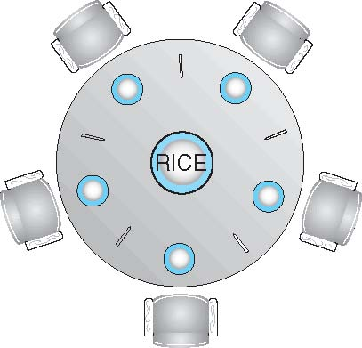
Dining-Philosophers Problem
Philosophers spend their lives alternating thinking and eating
Don’t interact with their neighbors, occasionally try to pick up 2 chopsticks (one at a time) to eat from bowl
Need both to eat, then release both when done
In the case of 5 philosophers
Shared data
Bowl of rice (data set)
Semaphore chopstick [5] initialized to 1

Slide 52
The Dining Philosopher Problem –
The Dining Philosopher Problem states that K philosophers seated around a circular table with one chopstick between each pair of philosophers.
There is one chopstick between each philosopher.
A philosopher may eat if he can pick up the two chopsticks adjacent to him.
One chopstick may be picked up by any one of its adjacent followers but not both.
The dining philosopher is a classic synchronization problem as it demonstrates a large class of concurrency control problems.
This dining philosopher problem is main example for Resource allocation.
Solution of Dining Philosophers Problem
A solution of the Dining Philosophers Problem is to use a semaphore to represent a chopstick. A chopstick can be picked up by executing a wait operation on the semaphore and released by executing a signal semaphore.
The structure of the chopstick is shown below −
semaphore chopstick [5];

Slide 53
Dining-Philosophers Problem Algorithm
The structure of Philosopher i :
do {
wait (chopstick[i] );
wait (chopstick[ (i + 1) % 5] );
// eat
signal (chopstick[i] );
signal (chopstick[ (i + 1) % 5] );
// think
} while (TRUE);

Slide 54
Dining-Philosophers Problem Algorithm (Cont.)
Semaphore provides a solution to Dining philosophers problem.
But there exist some situation which can cause deadlock.
Suppose that all five philosophers become hungry simultaneously and each grabs her left chopstick. All the elements of chopstick will now be equal to 0. When each philosopher tries to grab her right chopstick, she will be delayed forever. Several possible remedies to the deadlock problem are listed next.
Deadlock handling
Allow at most 4 philosophers to be sitting simultaneously at the table.
Allow a philosopher to pick up the forks only if both are available (picking must be done in a critical section.
Use an asymmetric solution -- an odd-numbered philosopher picks up first the left chopstick and then the right chopstick. Even-numbered philosopher picks up first the right chopstick and then the left chopstick.

Slide 55
Problems with Semaphores
Incorrect use of semaphore operations:
signal (mutex) …. wait (mutex)
Deadlock and starvation are possible.

Slide 56
Monitors
A high-level abstraction that provides a convenient and effective mechanism for process synchronization
Abstract data type, internal variables only accessible by code within the procedure
Only one process may be active within the monitor at a time
But not powerful enough to model some synchronization schemes
monitor monitor-name
{
// shared variable declarations
procedure P1 (…) { …. }
procedure Pn (…) {……}
Initialization code (…) { … }
}
}

Slide 57
A abstract data type- or ADT- encapsulates private data with public methods to operate on that data.
A monitor type is an ADT which presents a set of programmer-defined operations that are provided mutual exclusion within the monitor.
The monitor type also contains the declaration of variables whose values define the state of an instance of that type, along with the bodies of procedures or functions that operate on those variables
The representation of a monitor type cannot be used directly by the various processes.
Thus, a procedure defined within a monitor can access only those variables declared locally within the monitor and its formal parameters.
Similarly, the local variables of a monitor can be accessed by only the local procedures.

Slide 58
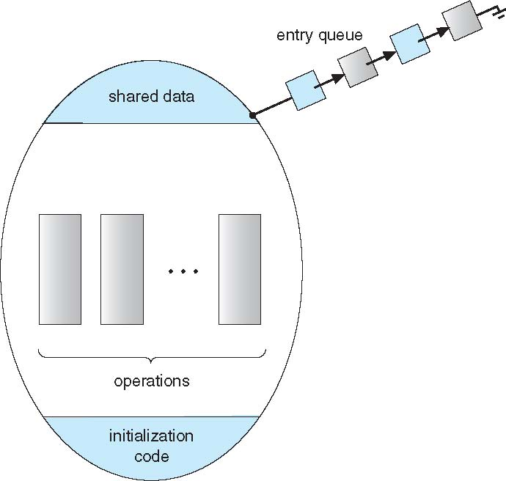
Schematic view of a Monitor

Slide 59
Condition Variables
A programmer who needs to write a synchronization scheme can define one or more variables of type condition:
condition x, y;
Two operations are allowed on a condition variable:
x.wait() – a process that invokes this operation is suspended until x.signal()
x.signal() – resumes one of processes (if any) that invoked x.wait()
If no x.wait() on the variable, then it has no effect on the variable

Slide 60
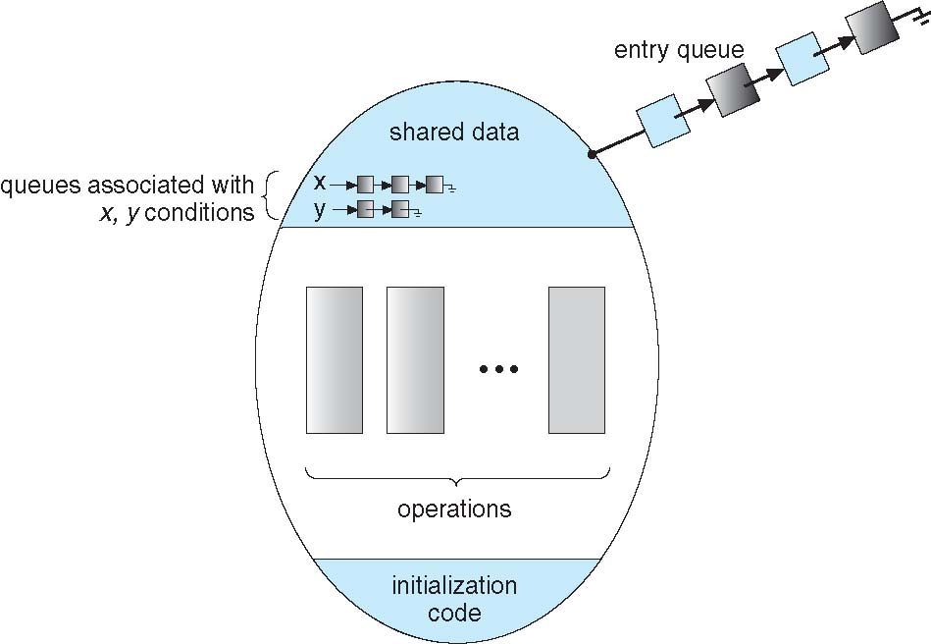
Monitor with Condition Variables

Slide 61
Condition Variables Choices
If process P invokes x.signal(), and process Q is suspended in x.wait(), what should happen next?
Both Q and P cannot execute in parallel. If Q is resumed, then P must wait
Options include
Signal and wait – P waits until Q either leaves the monitor or it waits for another condition
Signal and continue – Q waits until P either leaves the monitor or it waits for another condition
Both have pros and cons – language implementer can decide
Monitors implemented in Concurrent Pascal compromise
P executing signal immediately leaves the monitor, Q is resumed
Implemented in other languages including Mesa, C#, Java

Slide 62
Monitor Solution to Dining Philosophers
This solution imposes the restriction that a philosopher may pick up her chopsticks only if both of them are available. To code this solution, we need to distinguish among three states in which we may find a philosopher. For this purpose, we introduce the following data structure:
enum {THINKING, HUNGRY, EATING} state[5];
Philosopher i can set the variable state [i] = EATING only if her two neighbors are not eating:
(state [ (i +4) % 5] ! = EATING) and (state [ (i +1) % 5] != EATING).
We also need to declare
condition self[5];
in which philosopher i can delay herself when she is hungry but is unable to
obtain the chopsticks she needs.
Each philosopher, before starting to eat, must invoke the operation pickup(). This act may result in the suspension of the philosopher process. After the successful completion of the operation, the philosopher may eat

Slide 63
Monitor Solution to Dining Philosophers
monitor DiningPhilosophers
{
enum { THINKING, HUNGRY, EATING} state [5] ;
condition self [5];
void pickup (int i) {
state[i] = HUNGRY;
test(i);
if (state[i] != EATING) self[i].wait;
}
void putdown (int i) {
state[i] = THINKING;
// test left and right neighbors
test((i + 4) % 5);
test((i + 1) % 5);
}

Slide 64
Solution to Dining Philosophers (Cont.)
void test (int i) {
if ((state[(i + 4) % 5] != EATING) &&
(state[i] == HUNGRY) &&
(state[(i + 1) % 5] != EATING) ) {
state[i] = EATING ;
self[i].signal () ;
}
}
initialization_code() {
for (int i = 0; i < 5; i++)
state[i] = THINKING;
}
}

Slide 65
Solution to Dining Philosophers (Cont.)
Each philosopher i invokes the operations pickup() and putdown() in the following sequence:
DiningPhilosophers.pickup(i);
EAT
DiningPhilosophers.putdown(i);
No deadlock, but starvation is possible

Slide 66
Deadlocks
System Model
Deadlock Characterization
Methods for Handling Deadlocks
Deadlock Prevention
Deadlock Avoidance
Deadlock Detection
Recovery from Deadlock

Slide 67
Deadlock
In a multiprogramming environment, several processes may compete for a finite number of resources.
A process requests resources; if the resources are not available at that time, the process enters a waiting state.
Sometimes, a waiting process is never again able to change state, because the resources it has requested are held by other waiting processes. This situation is called a deadlock

Slide 68
The Deadlock Problem
■ A set of blocked processes each holding a resource and waiting to acquire a resource held by another process in the set.
■ Example
● System has 2 tape drives.
● P0 and P1 each hold one tape drive and each needs another one.
■ Example
● semaphores A and B, initialized to 1
P0 P1
wait (A); wait(B)
wait (B); wait(A)

Slide 69
Bridge Crossing Example
Traffic only in one direction
Each section of a bridge can be viewed as a resource
If a deadlock occurs, it can be resolved if one car backs up (preempt resources and rollback)
Several cars may have to be backed up if a deadlock occurs
Starvation is possible

Slide 70
System Model
A system consists of a finite number of resources to be distributed among a number of competing processes.
Resource types R₁, R₂, . . ., R_{m}
Memory space, CPU cycles, files, and I/0 devices (such as printers and DVD drives) are examples of resource types. If a system has two CPUs, then the resource type CPU has two instances. Similarly, the resource type printer may have five instances.
Each resource type R_{i} has W_{i} instances.
Each process utilizes a resource as follows:
A process must request a resource before using it and must release the resource after using it. The following sequence of operations takes place:
request
use
release

Slide 71
A process may utilize a resource in only the following sequence:
1. Request: The process requests the resource. If the request cannot be granted immediately (for example, if the resource is being used by another process), then the requesting process must wait until it can acquire the resource.
2. Use: The process can operate on the resource (for example, if the resource is a printer, the process can print on the printer).
3. Release: The process releases the resource.

Slide 72
Deadlock Characterization
In a deadlock, processes never finish executing, and system resources are tied up, preventing other jobs from starting.
Necessary conditions:
A deadlock situation can arise if the following four conditions hold simultaneously in a system:
Mutual exclusion:
At least one resource must be held in a non-sharable mode; that is, only one process at a time can use the resource. If another process requests that resource, the requesting process must be delayed until the resource has been released.
2. Hold and wait:
A process must be holding at least one resource and waiting to acquire additional resources that are currently being held by other processes.

Slide 73
3. No preemption:
Resources cannot be preempted; that is, a resource can be released only voluntarily by the process holding it, after that process has completed its task.
4. Circular wait:
A set {P₀, P₁, …, P_{n}} of waiting processes must exist such that P₀ is waiting for a resource that is held by P₁, P₁ is waiting for a resource that is held by P₂, …, P_{n–1} is waiting for a resource that is held by P_{n}, and P_{n} is waiting for a resource that is held by P₀.
We emphasize that all four conditions must hold for a deadlock to occur. The circular-wait condition implies the hold-and-wait condition, so the four conditions are not completely independent.

Slide 74
Resource-Allocation Graph
Deadlocks can be described more precisely in terms of a directed graph called a system Resource allocation graph.
This graph consists of a set of vertices V and a set of edges E. The set of vertices V is partitioned into two different types of nodes:
V is partitioned into two types:
P = {P₁, P₂, …, P_{n}}, the set consisting of all the active processes in the system
R = {R₁, R₂, …, R_{m}}, the set consisting of all resource types in the system
A directed edge from process Pi to resource type Rj is denoted by Pi-> Rj; it signifies that process Pi has requested an instance of resource type Rj and is currently waiting for that resource.
request edge – directed edge P_{i} → R_{j}
A directed edge from resource type Rj to process Pi is denoted by Rj --> Pi . It signifies that an instance of resource type Rj has been allocated to process Pi
assignment edge – directed edge R_{j} → P_{i}

Slide 75
Resource-Allocation Graph (Cont.)
Process
Resource Type with 4 instances
P_{i} requests instance of R_{j}
P_{i} is holding an instance of R_{j}
P_{i}
R_{j}
P_{i}
R_{j}

Slide 76
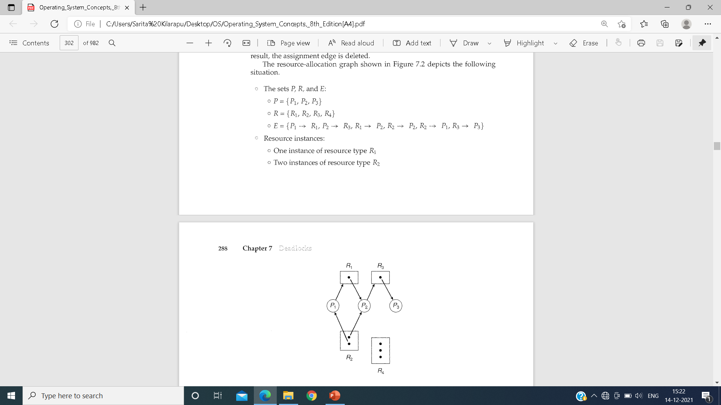
Example:

Slide 77
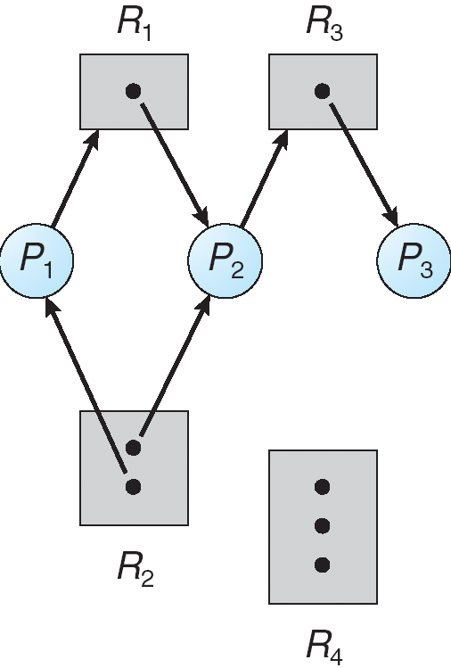
Example of a Resource Allocation Graph
Resource instances:
One instance of resource type R1
Two instances of resource type R2
One instance of resource type R3
Three instances of resource type R4

Slide 78
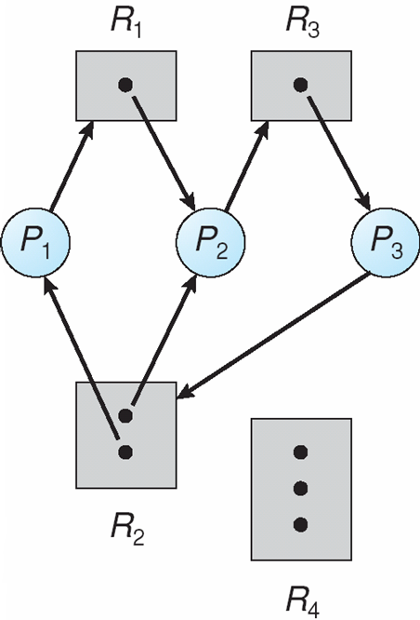
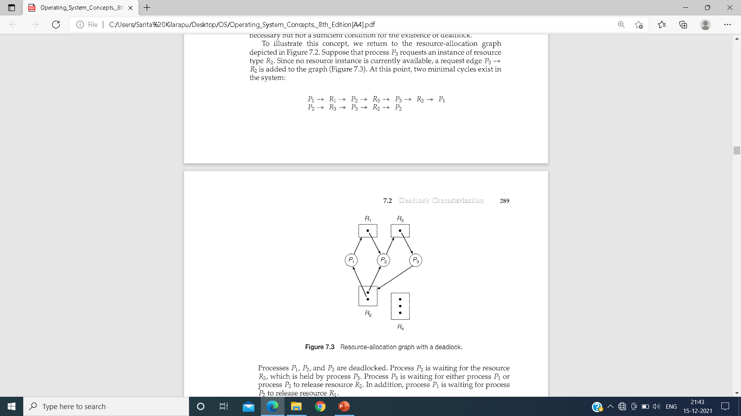
Resource Allocation Graph With A Deadlock
Suppose that process P3 requests an instance of resource type R2. Since no resource instance is currently available, a request edge P3→ R2 is added to the graph . At this point, two minimal cycles exist in the system:

Slide 79
Processes P1, P2, and P3 are deadlocked. Process P2 is waiting for the resource R3, which is held by process P3. Process P3 is waiting for either process P1 or process P2 to release resource R2.
In addition, process P1 is waiting for process P2 to release resource R1.

Slide 80
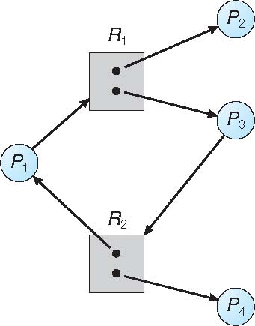
Graph With A Cycle But No Deadlock
However, there is no deadlock. Observe that process P4 may release its instance of resource type R2. That resource can then be allocated to P3, breaking the cycle.

Slide 81
Basic Facts
If graph contains no cycles ⇒ no deadlock
If graph contains a cycle ⇒
if only one instance per resource type, then deadlock
if several instances per resource type, possibility of deadlock

Slide 82
Methods for Handling Deadlocks
We can deal with the deadlock problem in one of three ways:
Ensure that the system will never enter a deadlock state:
Deadlock prevention
Deadlock avoidance
Allow the system to enter a deadlock state and then recover
Ignore the problem and pretend that deadlocks never occur in the system; used by most operating systems, including UNIX

Slide 83
Deadlock Prevention
Restrain the ways request can be made
Mutual Exclusion – not required for sharable resources (e.g., read-only files); must hold for non-sharable resources
Hold and Wait – must guarantee that whenever a process requests a resource, it does not hold any other resources
Require process to request and be allocated all its resources before it begins execution, or allow process to request resources only when the process has none allocated to it.
Low resource utilization; starvation possible

Slide 84
Deadlock Prevention (Cont.)
No Preemption –
If a process that is holding some resources requests another resource that cannot be immediately allocated to it, then all resources currently being held are released
Preempted resources are added to the list of resources for which the process is waiting
Process will be restarted only when it can regain its old resources, as well as the new ones that it is requesting
Circular Wait – impose a total ordering of all resource types, and require that each process requests resources in an increasing order of enumeration

Slide 85
Deadlock Avoidance
Requires that the system has some additional a priori information available
Simplest and most useful model requires that each process declare the maximum number of resources of each type that it may need
The deadlock-avoidance algorithm dynamically examines the resource-allocation state to ensure that there can never be a circular-wait condition
Resource-allocation state is defined by the number of available and allocated resources, and the maximum demands of the processes

Slide 86
Safe State
When a process requests an available resource, system must decide if immediate allocation leaves the system in a safe state
System is in safe state if there exists a sequence <P₁, P₂, …, P_{n}> of ALL the processes in the systems such that for each P_{i}, the resources that P_{i} can still request can be satisfied by currently available resources + resources held by all the P_{j}, with j < i
That is:
If P_{i} resource needs are not immediately available, then P_{i} can wait until all P_{j} have finished
When P_{j} is finished, P_{i} can obtain needed resources, execute, return allocated resources, and terminate
When P_{i} terminates, P_{i +1} can obtain its needed resources, and so on

Slide 87
Basic Facts
If a system is in safe state ⇒ no deadlocks
If a system is in unsafe state ⇒ possibility of deadlock
Avoidance ⇒ ensure that a system will never enter an unsafe state.

Slide 88
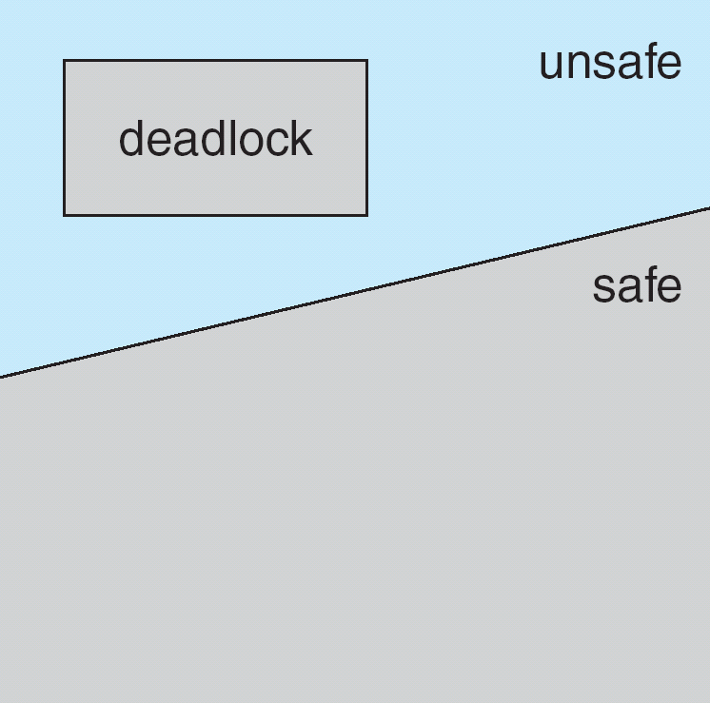
Safe, Unsafe, Deadlock State

Slide 89
Avoidance Algorithms
Single instance of a resource type
Use a Resource-allocation graph algorithm
Multiple instances of a resource type
Use the Banker’s algorithm

Slide 90
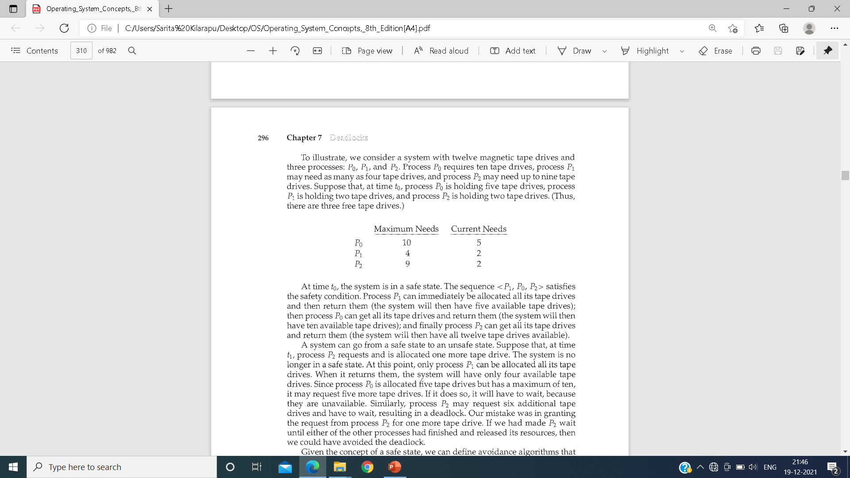

Slide 91
Resource-Allocation Graph Scheme
Claim edge P_{i} → R_{j} indicated that process P_{j} may request resource R_{j}; represented by a dashed line
Claimed edge means process may request resource in future.
Claim edge converts to request edge when a process requests a resource
Request edge converted to an assignment edge when the resource is allocated to the process
When a resource is released by a process, assignment edge reconverts to a claim edge
Resources must be claimed a priori in the system

Slide 92
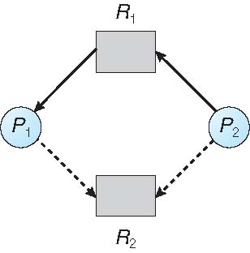
Resource-Allocation Graph

Slide 93
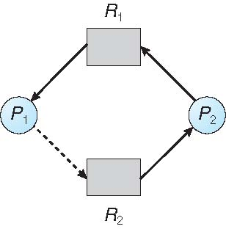
Unsafe State In Resource-Allocation Graph

Slide 94
Resource-Allocation Graph Algorithm
Suppose that process P_{i} requests a resource R_{j}
The request can be granted only if converting the request edge to an assignment edge does not result in the formation of a cycle in the resource allocation graph

Slide 95
Banker’s Algorithm
The resource-allocation-graph algorithm is not applicable to a resource allocation system with multiple instances of each resource type.
The algorithm is commonly known as the banker's algorithm. The name was chosen because the algorithm could be used in a banking system to ensure that the bank never allocated its available cash in such a way that it could no longer satisfy the needs of all its customers.
Multiple instances
Each process must a priori claim maximum use
When a process requests a resource it may have to wait
When a process gets all its resources it must return them in a finite amount of time

Slide 96
Data Structures for the Banker’s Algorithm
Let n = number of processes, and m = number of resources types.
Available:
Vector of length m. If Available[j] = k, there are k instances of resource type R_{j} available
Max:
n x m matrix. If Max[i,j] = k, then process P_{i} may request at most k instances of resource type R_{j}
Allocation:
n x m matrix. If Allocation[i,j] = k then P_{i} is currently allocated k instances of R_{j}
Need:
n x m matrix. If Need[i,j] = k, then P_{i} may need k more instances of R_{j} to complete its task
Need [i,j] = Max[i,j] – Allocation [i,j]

Slide 97
Safety Algorithm
1. Let Work and Finish be vectors of length m and n, respectively. Initialize:
Work = Available
Finish [i] = false for i = 0, 1, …, n- 1
2. Find an i such that both:
(a) Finish [i] = false
(b) Need_{i} ≤ Work
If no such i exists, go to step 4
3. Work = Work + Allocation_{i} Finish[i] = true go to step 2
4. If Finish [i] == true for all i, then the system is in a safe state

Slide 98
Resource-Request Algorithm for Process P_{i}
We describe the algorithm for determining whether requests can be safely granted
Request_{i} = request vector for process P_{i}. If Request_{i} [j] = k then process P_{i} wants k instances of resource type R_{j}
1. If Request_{i} ≤ Need_{i} go to step 2. Otherwise, raise error condition, since process has exceeded its maximum claim
2. If Request_{i} ≤ Available, go to step 3. Otherwise P_{i} must wait, since resources are not available
3. Pretend to allocate requested resources to P_{i} by modifying the state as follows:
Available = Available – Request_{i};
Allocation_{i} = Allocation_{i} + Request_{i};
Need_{i} = Need_{i} – Request_{i};
If safe ⇒ the resources are allocated to P_{i}
If unsafe ⇒ P_{i} must wait, and the old resource-allocation state is restored

Slide 99
Example of Banker’s Algorithm
5 processes P₀ through P₄;
3 resource types:
A (10 instances), B (5instances), and C (7 instances)
Snapshot at time T₀:
Allocation Max Available
A B C A B C A B C
P₀ 0 1 0 7 5 3 3 3 2
P₁ 2 0 0 3 2 2
P₂ 3 0 2 9 0 2
P₃ 2 1 1 2 2 2
P₄ 0 0 2 4 3 3

Slide 100
Example (Cont.)
The content of the matrix Need is defined to be Max – Allocation Need
A B C
P₀ 7 4 3
P₁ 1 2 2
P₂ 6 0 0
P₃ 0 1 1
P₄ 4 3 1
The system is in a safe state since the sequence < P₁, P₃, P₄, P₂, P₀> satisfies safety criteria

Slide 101
Allocation Max Available Need
A B C A B C A B C A B C
P₀ 0 1 0 7 5 3 3 3 2 7 4 3
P₁ 2 0 0 3 2 2 5 3 2 1 2 2
P₂ 3 0 2 9 0 2 7 4 3 6 0 0
P₃ 2 1 1 2 2 2 7 4 5 0 1 1
P₄ 0 0 2 4 3 3 10 4 7 4 3 1
10 5 7
The system is in a safe state since the sequence < P₁, P₃, P₄, P₂, P₀> satisfies safety criteria

Slide 102
Deadlock Detection
Allow system to enter deadlock state
Deadlock Detection algorithm
Recovery scheme

Slide 103
Single Instance of Each Resource Type
Maintain wait-for graph
Nodes are processes
P_{i} → P_{j} if P_{i} is waiting for P_{j} do release a resource that Pi needs.
Periodically invoke an algorithm that searches for a cycle in the graph. If there is a cycle, there exists a deadlock
An algorithm to detect a cycle in a graph requires an order of n² operations, where n is the number of vertices in the graph

Slide 104
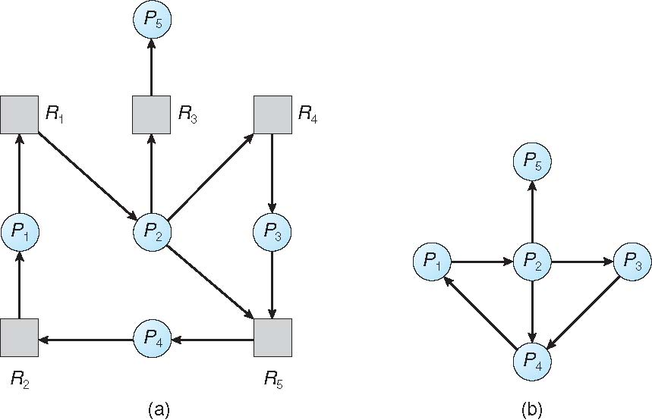
Resource-Allocation Graph and Wait-for Graph
Resource-Allocation Graph
Corresponding wait-for graph

Slide 105
Several Instances of a Resource Type
Available: A vector of length m indicates the number of available resources of each type
Allocation: An n x m matrix defines the number of resources of each type currently allocated to each process
Request: An n x m matrix indicates the current request of each process. If Request [i][j] = k, then process P_{i} is requesting k more instances of resource type R_{j}.

Slide 106
Detection Algorithm
1. Let Work and Finish be vectors of length m and n, respectively Initialize:
(a) Work = Available
For i = 1,2, …, n, if Allocation_{i} ≠ 0, then Finish[i] = false; otherwise, Finish[i] = true
2. Find an index i such that both:
(a) Finish[i] == false
Request_{i} ≤ Work
If no such i exists, go to step 4

Slide 107
Detection Algorithm (Cont.)
Work = Work + Allocation_{i} Finish[i] = true go to step 2
If Finish[i] == false, for some i, 1 ≤ i ≤ n, then the system is in deadlock state. Moreover, if Finish[i] == false, then P_{i} is deadlocked
Algorithm requires an order of O(m x n²) operations to detect whether the system is in deadlocked state

Slide 108
Example of Detection Algorithm
Five processes P₀ through P₄; three resource types A (7 instances), B (2 instances), and C (6 instances)
Snapshot at time T₀:
Allocation Request Available
A B C A B C A B C
P₀ 0 1 0 0 0 0 0 0 0
P₁ 2 0 0 2 0 2
P₂ 3 0 3 0 0 0
P₃ 2 1 1 1 0 0
P₄ 0 0 2 0 0 2
Sequence <P₀, P₂, P₃, P₁, P₄> will result in Finish[i] = true for all i

Slide 109
Allocation Request Available
A B C A B C A B C
P₀ 0 1 0 0 0 0 0 0 0
P₁ 2 0 0 2 0 2 0 1 0
P₂ 3 0 3 0 0 0 3 1 3
P₃ 2 1 1 1 0 0 5 2 4
P₄ 0 0 2 0 0 2 7 2 4
7 2 6
Safe Sequence <P₀, P₂, P₃, P₁, P₄> will result in Finish[i] = true for all i

Slide 110
Allocation Request Available
A B C A B C A B C
P₁ 1 0 2 2 2 3 4 3 3
P₂ 0 1 1 1 1 1
P₃ 1 1 0 2 2 1

Slide 111
Detection-Algorithm Usage
When, and how often, to invoke depends on:
How often a deadlock is likely to occur?
How many processes will need to be rolled back?
If deadlocks occur frequently, then the detection algorithm should be invoked frequently.
Invoking the deadlock-detection algorithm for every resource request will incur considerable overhead in computation time.
A less expensive alternative is simply to invoke the algorithm at defined intervals-for example, once per hour or whenever CPU utilization drops below 40 percent.
If detection algorithm is invoked arbitrarily, there may be many cycles in the resource graph and so we would not be able to tell which of the many deadlocked processes “caused” the deadlock.

Slide 112
Recovery from Deadlock: Process Termination
When a detection algorithm determines that a deadlock exists, several alternatives are available. One possibility is to inform the operator that a deadlock has occurred and to let the operator deal with the deadlock manually. Another possibility is to let the system recover from the deadlock automatically.
Abort all deadlocked processes
Abort one process at a time until the deadlock cycle is eliminated
In which order should we choose to abort?
What is the Priority of the process
How long process has computed, and how much longer to completion
Resources the process has used
Resources process needs to complete
How many processes will need to be terminated
Is process interactive or batch?

Slide 113
Recovery from Deadlock: Resource Preemption
1. Selecting a victim-
Which resources and which processes are to be preempted? As in process termination. As in process termination, we must determine the order of preemption to minimize cost.
2. Rollback
If we preempt a resource from a process, what should be done
with that process? Clearly, it cannot continue with its normal execution; it is missing some needed resource. We must roll back the process to some safe state and restart it from that state. 3. Starvation –
In a system where victim selection is based primarily on cost factors, it may happen that the same process is always picked as a victim. As a result, this process never completes its designated task, a starvation situation that must be dealt with in any practical system. Clearly, we must ensure that a process can be picked as a victim" only a (small) finite number of times. The most common solution is to include the number of rollbacks in the cost factor.

