Slide 1
OPERATING SYSTEMS
UNIT-V
Secondary-Storage Structure
System Protection & Security
ADITYA ENGINEERING COLLEGE (A)
By
K.Saritha
Asst.Professor
Dept of Computer Science and Engineering
Aditya Engineering College(A)
Surampalem.

Slide 2
Mass-Storage Systems
Overview of Mass Storage Structure
Disk Structure
Disk Scheduling
RAID Structure

Slide 3
Objectives
To describe the physical structure of secondary storage devices and its effects on the uses of the devices
To explain the performance characteristics of mass-storage devices
To evaluate disk scheduling algorithms

Slide 4
Storage Structure in Operating Systems
Computer Storage contains many computer components that are used to store data. It is traditionally divided into primary storage, secondary storage. Details about these storage types and devices used in them are as follows −
1. Primary Storage
Primary storage is also known as the main memory and is the memory directly accessible by the CPU. Some primary storage devices are − RAM, ROM, Cache memory.
2. Secondary Storage
Secondary or external storage is not directly accessible by the CPU. The data from secondary storage needs to be brought into the primary storage before the CPU can use it. Secondary storage contains a large amount of data permanently. The different types of secondary storage devices are − Hard disk, floppy disk, Memory cards, CDs etc.

Slide 5
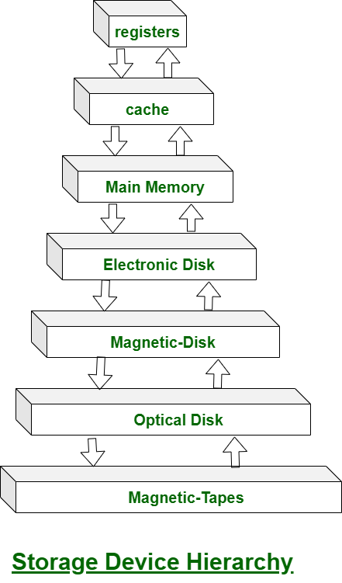

Slide 6
Secondary Storage Structure
Secondary storage devices are those devices whose memory is non volatile, the stored data will be intact even if the system is turned off. Here are a few things worth noting about secondary storage.
Secondary storage is also called auxiliary storage.
Secondary storage is less expensive when compared to primary memory like RAMs.
The speed of the secondary storage is also lesser than that of primary storage.
Hence, the data which is less frequently accessed is kept in the secondary storage.
A few examples are magnetic disks, magnetic tapes, removable thumb drives etc.

Slide 7
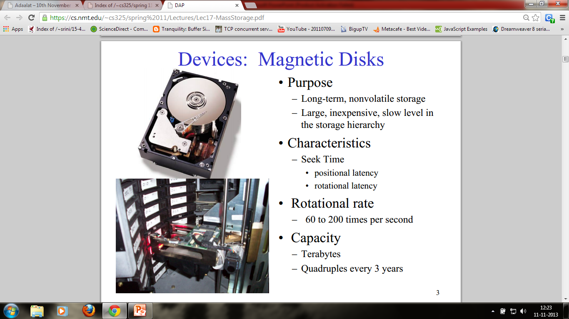


Slide 8
Overview of Magnetic Disk structure
In modern computers, most of the secondary storage is in the form of magnetic disks. Hence, knowing the structure of a magnetic disk is necessary to understand how the data in the disk is accessed by the computer.
A magnetic disk contains several platters. Each platter is divided into circular shaped tracks. The length of the tracks near the centre is less than the length of the tracks farther from the centre. Each track is further divided into sectors, as shown in the figure.
Tracks of the same distance from centre form a cylinder. A read-write head is used to read data from a sector of the magnetic disk.

Slide 9
Magnetic disks provide bulk of secondary storage of modern computers
  Drives rotate at 60 to 250 times per second
  Transfer rate: This is the rate at which data flow between drive and computer
  Positioning time (random-access time) is time to move disk arm to desired cylinder (seek time) and time for desired sector to rotate under the disk head (rotational latency)
  Head crash results from disk head making contact with the disk surface -- That’s bad
Disks can be removable
Drive attached to computer via I/O bus

Slide 10

Structure of a magnetic disk

Slide 11
The speed of the disk is measured as two parts:
  Transfer rate: This is the rate at which the data moves from disk to the computer.
  Random access time: It is the sum of the seek time and rotational latency.
Seek time is the time taken by the arm to move to the required track.
Rotational latency is defined as the time taken by the arm to reach the required sector in the track.

Slide 12
Disk Scheduling
The operating system is responsible for using hardware efficiently — for the disk drives, this means having a fast access time and disk bandwidth
Disk Scheduling: The technique that operating system uses to determine the request which is to be satisfied next is called disk scheduling.
It will try to Minimize seek time
Seek time ≈ seek distance
Seek Time is defined as the time required by the read/write head to move from one track to another.
The seek time is the time for the disk arm to move the heads to the cylinder containing the desired sector.
Disk bandwidth is the total number of bytes transferred, divided by the total time between the first request for service and the completion of the last transfer

Slide 13
Disk Scheduling (Cont.)
There are many sources of disk I/O request
  OS
  System processes
  Users processes
I/O request includes input or output mode, disk address, memory address, number of sectors to transfer
OS maintains queue of requests, per disk or device
Idle disk can immediately work on I/O request, busy disk means work must queue
  Optimization algorithms only make sense when a queue exists

Slide 14
Some important terms related to disk scheduling.
Seek Time :Seek time is the time taken in locating the disk arm to a specified track where the read/write request will be satisfied.
Rotational Latency ;It is the time taken by the desired sector to rotate itself to the position from where it can access the R/W heads.
Transfer Time :It is the time taken to transfer the data.
Disk Access Time :Disk access time is given as,
Disk Access Time = Rotational Latency + Seek Time + Transfer Time
Disk Response Time
It is the average of time spent by each request waiting for the IO operation.

Slide 15
Purpose of Disk Scheduling
The main purpose of disk scheduling algorithm is to select a disk request from the queue of IO requests and decide the schedule when this request will be processed.
Goal of Disk Scheduling Algorithm
Fairness
High throughout
Minimal traveling head time

Slide 16
Disk Scheduling Algorithms
Disk Scheduling Algorithms
The list of various disks scheduling algorithm is given below. Each algorithm is carrying some advantages and disadvantages. The limitation of each algorithm leads to the evolution of a new algorithm.
  FCFS scheduling algorithm
  SSTF (shortest seek time first) algorithm
  SCAN scheduling
  C-SCAN scheduling
  LOOK Scheduling
  C-LOOK scheduling

Slide 17
Disk Scheduling (Cont.)
Note that drive controllers have small buffers and can manage a queue of I/O requests
Several algorithms exist to schedule the servicing of disk I/O requests
We illustrate scheduling algorithms with a request queue (0-199)
98, 183, 37, 122, 14, 124, 65, 67
Head pointer 53

Slide 18

FCFS Disk Scheduling Algorithm
Simplest form of disk scheduling - first-come, first-served ( F C F S ) algorithm.
Fair, but it generally does not provide the fastest service.
In FCFS, the request which comes fist will be served first.
In FCFS, the requests are addressed in the order they arrive in the disk queue.

Slide 19
If the disk head is initially at cylinder 53, it will first move from 53 to 98, then to 183, 37, 122, 14, 124, 65, and finally to 67, for a total head movement of 640 cylinders.
The wild swing from 122 to 14 and then back to 124 illustrates the problem with this schedule.
If the requests for cylinders 37 and 14 could be serviced together, before or after the requests for 122 and 124, the total head movement could be decreased substantially, and performance could be thereby improved.
Advantages:
Every request gets a fair chance
No indefinite postponement
Disadvantages:
Does not try to optimize seek time
May not provide the best possible service

Slide 20
SSTF Scheduling
Shortest Seek Time First selects the request with the minimum seek time from the current head position
SSTF scheduling is a form of SJF scheduling; may cause starvation of some requests
In SSTF (Shortest Seek Time First), requests having shortest seek time are executed first. So, the seek time of every request is calculated in advance in the queue and then they are scheduled according to their calculated seek time. As a result, the request near the disk arm will get executed first. SSTF is certainly an improvement over FCFS as it decreases the average response time and increases the throughput of system. Let us understand this with the help of an example.

Slide 21

Example for SSTF

Slide 22
Example: Consider the above request queue, the closest request to the initial head position(53) is at cylinder 65.
Once we are at cylinder 65, the next closest request is at cylinder 67. From there, the request at cylinder 37 is closer than the one at 98, so 37 is served next. In this way nearest request are served. Continuing, it services the request at cylinder 14, then 98, 122, 124, and finally 183. This scheduling method results in a total head movement of only 236 cylinders—little more than one-third of the distance needed for FCFS scheduling of this request queue.
Advantages:
Average Response Time decreases
Throughput increases
Disadvantages:
Overhead to calculate seek time in advance
Can cause Starvation for a request if it has higher seek time as compared to incoming requests
High variance of response time as SSTF favours only some requests.

Slide 23
SCAN Scheduling Algorithm
In this, The disk arm starts at one end of the disk, and moves toward the other end, servicing requests until it gets to the other end of the disk. After reaching the other end of disk, it reverses its direction and again services the request arriving in its path
The head continuously scans back and forth across the disk.
SCAN algorithm Sometimes called the elevator algorithm
As a result, the requests at the midrange are serviced more and those arriving behind the disk arm will have to wait.

Slide 24

SCAN Scheduling Algorithm: Example
Assuming that the disk arm is moving toward 0 and that the initial head position is again 53, the head will next service 37 and then 14. After reaching end, it reverses direction and services all requests in that path.

Slide 25
SCAN algorithm
Advantages:
High throughput
Low variance of response time
Average response time
Disadvantages:
Long waiting time for requests for locations just visited by disk arm

Slide 26
C-SCAN Scheduling Algorithm
Circular S C A N ( C - S C AN ) scheduling is a variant of SCAN designed to provide a more uniform wait time than SCAN
In this algorithm, the head moves from one end of the disk to the other, servicing requests as it goes
  When it reaches the other end, however, it immediately returns to the beginning of the disk, without servicing any requests on the return trip
The C - S C A N scheduling algorithm essentially, treats the cylinders as a circular list that wraps around from the last cylinder to the first one
Advantages:
Provides more uniform wait time compared to SCAN

Slide 27

C-SCAN (Cont.)
Example:

Slide 28
C-LOOK Scheduling Algorithm
Both SCAN and C-SCAN move the disk arm across the full width of the disk(to the end of disks). In practice, neither algorithm is often implemented this way.
LOOK a version of SCAN, C-LOOK a version of C-SCAN
In these algorithms, the arm only goes as far as the last request in each direction, then it reverses direction immediately, without first going all the way to the end of the disk
Thus it prevents the extra delay which occurred due to unnecessary traversal to the end of the disk.

Slide 29

C-LOOK (Cont.)

Slide 30
Selecting a Disk-Scheduling Algorithm
With any scheduling algorithm, performance depends heavily on the number and types of requests.
Requests for disk service can be greatly influenced by the file-allocation method. A program reading a contiguously allocated file will generate several requests that are close together on the disk, resulting in limited head movement. A linked or indexed file, in contrast, may include blocks that are widely scattered on the disk, resulting in greater head movement.
SSTF is common and has a natural appeal
SCAN and C-SCAN perform better for systems that place a heavy load on the disk
  Less starvation
The disk-scheduling algorithm should be written as a separate module of the operating system, allowing it to be replaced with a different algorithm if necessary
Either SSTF or LOOK is a reasonable choice for the default algorithm

Slide 31
RAID Structure
RAID, or “Redundant Arrays of Independent Disks” is a technique which makes use of a combination of multiple disks instead of using a single disk for increased performance, data redundancy or both. The term was coined by David Patterson, Garth A. Gibson, and Randy Katz at the University of California, Berkeley in 1987.
Why data redundancy?
Data redundancy, although taking up extra space, adds to disk reliability. This means, in case of disk failure, if the same data is also backed up onto another disk, we can retrieve the data and go on with the operation. On the other hand, if the data is spread across just multiple disks without the RAID technique, the loss of a single disk can affect the entire data.
How RAID Works
RAID works by placing data on multiple disks and allowing input/output operations to overlap in a balanced way, improving performance. Because various disks increase the mean time between failures (MTBF), storing data redundantly also increases fault tolerance.

Slide 32
RAID LEVELS
RAID arrays appear to the operating system as a single logical drive. RAID employs the techniques of disk mirroring or disk striping.
Disk Mirroring will copy identical data onto more than one drive.
Disk Striping partitions help spread data over multiple disk drives. Each drive's storage space is divided into units ranging from 512 bytes up to several megabytes. The stripes of all the disks are interleaved and addressed in order.
Disk mirroring and disk striping can also be combined in a RAID array.

Slide 33
RAID (Cont.)
Disk striping uses a group of disks as one storage unit
RAID is arranged into six different levels
RAID schemes improve performance and improve the reliability of the storage system by storing redundant data
  Mirroring or shadowing (RAID 1) keeps duplicate of each disk
  Striped mirrors (RAID 1+0) or mirrored stripes (RAID 0+1) provides high performance and high reliability
  Block interleaved parity (RAID 4, 5, 6) uses much less redundancy
RAID within a storage array can still fail if the array fails, so automatic replication of the data between arrays is common
Frequently, a small number of hot-spare disks are left unallocated, automatically replacing a failed disk and having data rebuilt onto them

Slide 34
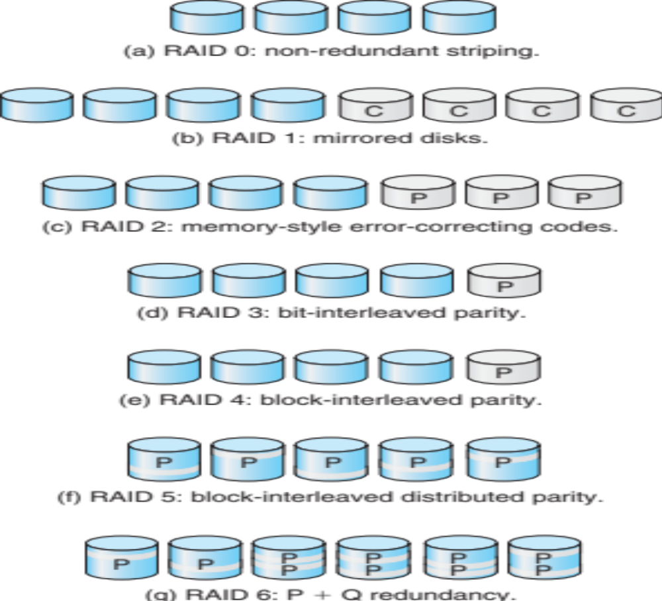
RAID Levels

Slide 35

RAID (0 + 1) and (1 + 0)

Slide 36
RAID Level 0: Non redundant:
Data striping is used in level 0 for increase performance but no redundant information is maintained. Striping is done at block level but without any redundancy. Writing performance is best in this level because due to absence of redundant information there is no need to update redundant information.
RAID Level 1: Mirrored
In this level same data is copied on two different disks. This type of redundancy is called as mirroring. It is the most expensive system. Because two copies of same data are available in two different disks, it allows parallel read
RAID Level 1+0:
Striping and Mirroring
This level is combination of level 0 and level 1, sometimes called as level 10.
RAID Level 0+ 1:
Mirroring and Striping
RAID 0+1 is similar to RAID 1+0, except the data organization method is slightly different. Rather than creating a mirror and then striping the mirror, RAID 0+1 creates a stripe set and then mirrors the stripe set.
RAID Level 2: Error correcting codes.
This level uses bit-level data stripping in place of block level. It is used with drives with no built in error detection technique. Error-correcting schemes (ECC) store two or more extra bits and it is used for reconstruction of the data if a single bit is damaged.

Slide 37
Level 3: Bit-Interleaved parity
In this level a single parity bit is used for error correction as well as for detection. Systems have disk controller that detects which disk has failed. Check disks does not contains the information about failed disks. RAID level 3 has a single check disk with parity bit.
Level 4: Block-Interleaved parity:
RAID level 4 is similar as RAID level 3 but it has Block-Interleaved parity instead of bit parity. You can access the data independently so read performance is high.
Level 5: Block-Interleaved distributed parity
RAID level 5 distributes the parity block and data on all disks. For each block, one of the disks stores the parity and the others store data. RAID level 5 gives best performance for large read and write.
Level 6: P+Q Redundancy
What happen if more than one disk fails at a time? This level stores extra redundant information to save the data against multiple disk failures. It does not use parity but uses reed-solomon codes for data recovery.

Slide 38
Drawbacks of RAID
Nested RAID levels are more expensive to implement than traditional RAID levels because they require many disks.
The cost per gigabyte of storage devices is higher for nested RAID because many of the drives are used for redundancy.
Some RAID levels, such as RAID 1 and 5, can only sustain a single drive failure.
RAID arrays are in a vulnerable state until a failed drive is replaced and the new disk is populated with data.
When RAID was implemented, it takes a lot longer to rebuild failed drives because drives have much greater capacity..

Slide 39
Protection
Goals of Protection
Principles of Protection
Domain of Protection
Access Matrix
Implementation of Access Matrix
Access Control
Revocation of Access Rights

Slide 40
Objectives
Discuss the goals and principles of protection in a modern computer system
Explain how protection domains combined with an access matrix are used to specify the resources a process may access
Examine capability and language-based protection systems

Slide 41
Protection
A mechanism that controls the access of programs, processes, or users to the resources defined by a computer system is referred to as protection. You may utilize protection as a tool for multi-programming operating systems, allowing multiple users to safely share a common logical namespace, including a directory or files.
It needs the protection of computer resources like the software, memory, processor, etc. Users should take protective measures as a helper to multiprogramming OS so that multiple users may safely use a common logical namespace like a directory or data. Protection may be achieved by maintaining confidentiality, honesty and availability in the OS. It is critical to secure the device from unauthorized access, viruses, worms, and other malware.

Slide 42
Need of Protection in Operating System
Various needs of protection in the operating system are as follows:
To prevent the access of unauthorized users and
  There may be security risks like unauthorized reading, writing, modification, or preventing the system from working effectively for authorized users.
It helps to ensure data security, process security, and program security against unauthorized user access or program access.
It is important to ensure no access rights' breaches, no viruses, no unauthorized access to the existing data.
Its purpose is to ensure that only the systems' policies access programs, resources, and data.

Slide 43
Goals of Protection
Operating system consists of a collection of objects, hardware or software. Each object has a unique name and can be accessed through a well-defined set of operations.
Protection problem - ensure that each object is accessed correctly and only by those processes that are allowed to do so.
The policies define how processes access the computer system's resources, such as the CPU, memory, software, and even the operating system. It is the responsibility of both the operating system designer and the app programmer. Although, these policies are modified at any time.
Protection is a technique for protecting data and processes from harmful or intentional infiltration. It contains protection policies either established by itself, set by management or imposed individually by programmers to ensure that their programs are protected to the greatest extent possible.
It also provides a multiprogramming OS with the security that its users expect when sharing common space such as files or directories.

Slide 44
Principles of Protection
Guiding principle – principle of least privilege
  It dictates that programs, users, and even systems should be given just enough privileges to perform their tasks
  An operating system following the principle of least privilege implements its features, programs, system calls, and data structures so that failure or compromise of a component does the minimum damage and allows the minimum damage to be done.

Slide 45
Domain of Protection
To facilitate the protection, a process operates within a protection domain, which specifies the resources that the process may access.
A protection domain specifies the resources that a process may access.
Each domain defines a set of objects and the types of operations that may be invoked on each object. The ability to execute an operation on an object is an access right.
A domain is a collection of access rights, each of which is an ordered pair <object-name, rights-set>.
For example, if domain D has the access right <file F, {read, write}>, then a process executing in domain D can both read and write file F; it cannot, however, perform any other operation on that object.

Slide 46
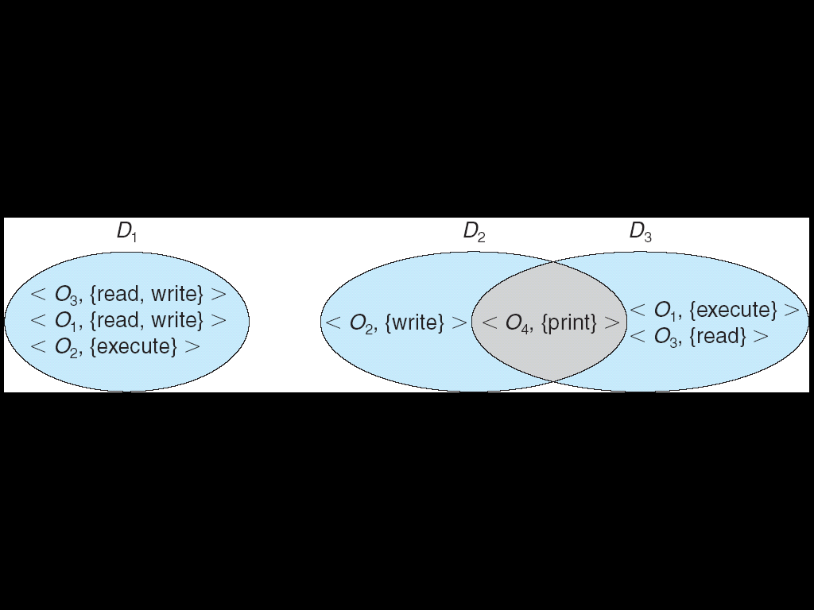
Domain Structure
Access-right = <object-name, rights-set>
where rights-set is a subset of all valid operations that can be performed on the object.
Domain = set of access-rights
Example: Figure shows- System with three protection domains
In this example: we have three domains: D1, D2, and D3 . The access right < 0₄, {print}> is shared by D2 and D3, implying that a process executing in either of these two domains can print object 0₄. Note that a process must be executing in domain D1 to read and write object 0₁, while only processes in domain D3 may execute object 0₁.

Slide 47
Association between Process and Domain
When processes have the necessary access rights, they can switch from one domain to another. It could be of two types, as shown below.
1. Fixed or Static
In a fixed association, all access rights could be given to processes at the start. However, the results in a large number of access rights for domain switching. As a result, a technique of changing the domain's contents is found dynamically.
2. Changing or dynamic
In dynamic association ,a process can switch dynamically, creating a new domain in the process, if need be.

Slide 48
Domain Implementation (UNIX)
System consists of 2 domains:
  User
  Supervisor
UNIX
  Domain = user-id
  Domain switch accomplished via file system.
    Each file has associated with it a domain bit (setuid bit).
    When file is executed and setuid = on, then user-id is set to owner of the file being executed. When execution completes user-id is reset.

Slide 49
Access Matrix
Access Matrix is a security model of protection state in computer system. It is represented as a matrix. Access matrix is used to define the rights of each process executing in the domain with respect to each object.
The rows of matrix represent domains and columns represent objects. Each cell of matrix represents set of access rights which are given to the processes of domain means each entry(i, j) defines the set of operations that a process executing in domain Di can invoke on object Oj.

Slide 50
Access Matrix
View protection as a matrix (access matrix)
Rows represent domains
Columns represent objects
Access(i, j) is the set of operations that a process executing in Domain_{i} can invoke on Object_{j}

Slide 51
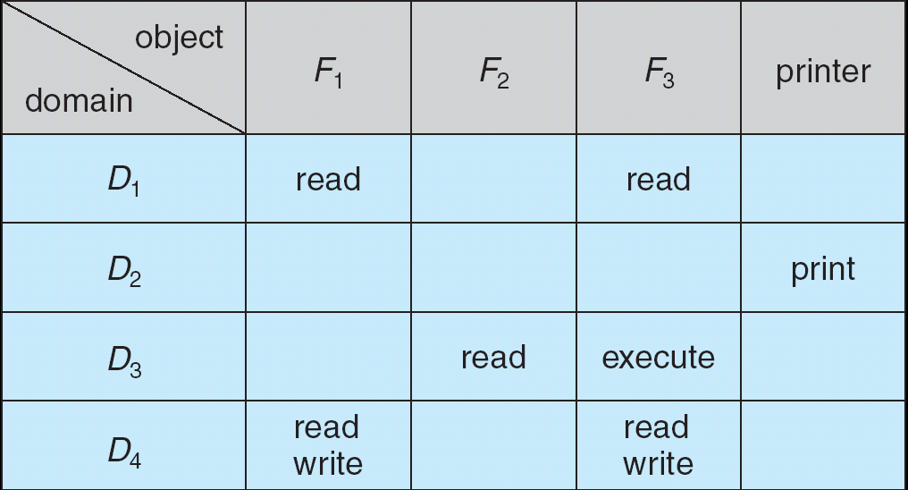
Access Matrix
According to the above matrix: there are four domains and four objects- three files(F1, F2, F3) and one printer. A process executing in D1 can read files F1 and F3. A process executing in domain D4 has same rights as D1 but it can also write on files. Printer can be accessed by only one process executing in domain D2. The mechanism of access matrix consists of many policies and semantic properties. Specifically, We must ensure that a process executing in domain Di can access only those objects that are specified in row i.

Slide 52
Use of Access Matrix
If a process in Domain D_{i} tries to do “op” on object O_{j}, then “op” must be in the access matrix.
Can be expanded to dynamic protection.
  Operations to add, delete access rights.
  Special access rights:
    owner of O_{i}
    copy op from O_{i} to O_{j}
    control – D_{i} can modify D_{j} access rights
    transfer – switch from domain D_{i} to D_{j}

Slide 53
Use of Access Matrix (Cont.)
Access matrix design separates mechanism from policy.
  Mechanism
    Operating system provides access-matrix + rules.
    If ensures that the matrix is only manipulated by authorized agents and that rules are strictly enforced.
  Policy
    User dictates policy.
    Who can access what object and in what mode.

Slide 54
Implementation of Access Matrix
Each column = Access-control list for one object
Defines who can perform what operation.
Domain 1 = Read, Write
Domain 2 = Read
Domain 3 = Read

Each Row = Capability List (like a key)
Fore each domain, what operations allowed on what objects.
      Object 1 – Read
      Object 4 – Read, Write, Execute
      Object 5 – Read, Write, Delete, Copy

Slide 55
Switching between Domains.
Processes should be able to switch from one domain to another. Switching from domain D_{i} to domain D_{j} is allowed if and only if the access right switch E access(i,j). Thus, in Figure, a process executing in domain D2 can switch to domain D3 or to domain D4 . A process in domain D4 can switch to D1, and one in domain D1 can switch to D2-
When we switch a process from one domain to another, we execute a switch operation on an object(the domain). We can control domain switching by including domains among the objects of the access matrix. Processes should be able to switch from one domain (Di) to another domain (Dj) if and only is a switch right is given to access(i, j).

Slide 56
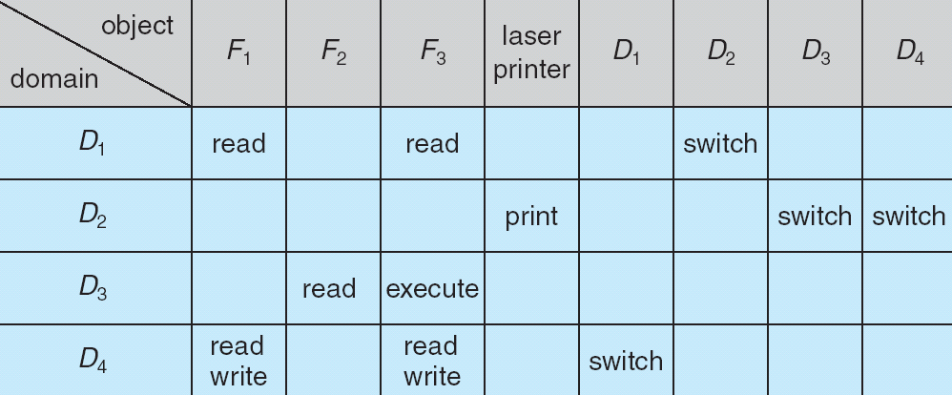
Access Matrix of Figure A With Domains as Objects
According to the matrix: A process executing in domain D2 can switch to domain D3 and D4. A process executing in domain D4 can switch to domain D1 and process executing in domain D1 can switch to domain D2.

Slide 57
Access control:
Access control for an operating system determines how the operating system implements accesses to system resources by satisfying the security objectives of integrity, availability, and secrecy. Such a mechanism authorizes subjects (e.g., processes and users) to perform certain operations (e.g., read, write) on objects and resources of the OS (e.g., files, sockets).
Operating system is the main software between the users and the computing system resources that manage tasks and programs. Resources may include files, sockets, CPU, memory, disks, timers, network, etc. System administrators, developers, regular users, guests, and even hackers could be the users of the computing system. Information security is an important issue for an operating system

Slide 58
Access Control
Protection can be applied to non-file resources
Solaris 10 provides role-based access control to implement least privilege
  Privilege is right to execute system call or use an option within a system call
  Can be assigned to processes
  Users assigned roles granting access to privileges and programs

Slide 59
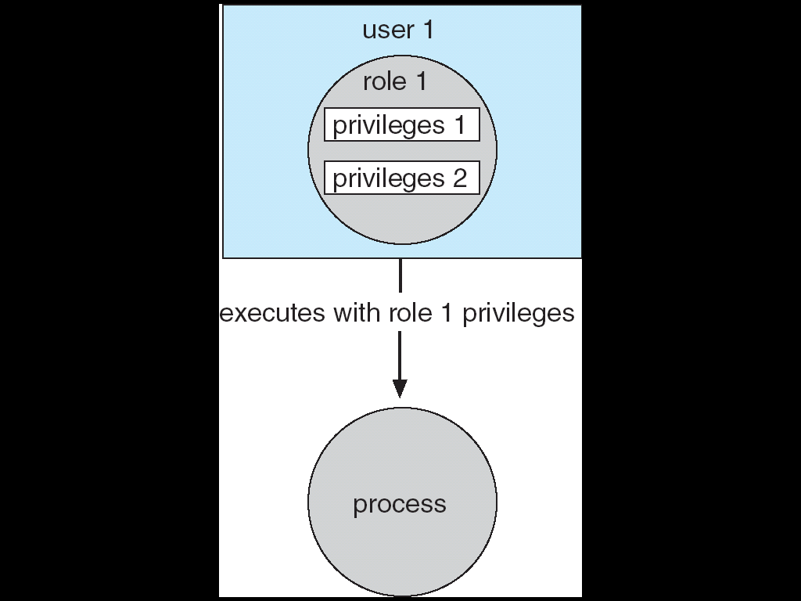
Role-based Access Control in Solaris 10

Slide 60
Revocation of Access Rights
In a dynamic protection system, we may sometimes need to revoke access rights to objects shared by different users.
Since the capabilities are distributed throughout the system, we must find them before we can revoke them.
Access List – Delete access rights from access list.
  Simple
  Immediate
Capability List – Scheme required to locate capability in the system before capability can be revoked.
  Reacquisition
  Back-pointers
  Indirection
  Keys

Slide 61
Schemes that implement revocation for capabilities include the following:
Reacquisition : Periodically, all capabilities are deleted from each domain. If a process wants to use a capability, it may find that that capability has been deleted. The process may then try to reacquire the capability. If access has been revoked, the process will not be able to Reacquire the capability.
Back-pointers: A list of pointers is maintained with each object, pointing to all capabilities associated with that object. When revocation is required, we can follow these pointers, changing the capabilities as necessary.
Indirection: The capabilities point indirectly to the objects. Each capability points to a unique entry in a global table, which in turn points to the object. We implement revocation by searching the global table for the desired entry and deleting it. Then, when an access is attempted, the capability is found to point to an illegal table entry.
  Access rights can be revoked by changing or invalidating the table entry, which may affect multiple processes, which must then re-acquire access rights to continue.

Slide 62
Keys:- A key is a unique bit pattern that can be associated with a capability. This key is defined when the capability is created, and it can be neither modified nor inspected by the process owning the capability. A master key is associated with each object; it can be defined or replaced with the set-key operation.
  When a capability is created, the current value of the master key is associated with the capability. When the capability is exercised, its key is compared with the master key. If the keys match, the operation is allowed to continue; otherwise, an exception condition is raised.
  In key-based schemes, the operations of defining keys, inserting them into lists, and deleting them from lists should not be available to all users.

Slide 63
Security
The Security Problem
Program Threats
System and Network Threats

Slide 64
Operating System Security
The process of ensuring OS availability, confidentiality, integrity is known as operating system security. OS security refers to the processes or measures taken to protect the operating system from dangers, including viruses, worms, malware, and remote hacker intrusions.
Operating system security comprises all preventive-control procedures that protect any system assets that could be stolen, modified, or deleted if OS security is breached.
Security refers to providing safety for computer system resources like software, CPU, memory, disks, etc. It can protect against all threats, including viruses and unauthorized access. It can be enforced by assuring the operating system's integrity, confidentiality, and availability. If an illegal user runs a computer application, the computer or data stored may be seriously damaged.

Slide 65
The Security Problem
Security must consider external environment of the system, and protect the system resources
Intruders (crackers) attempt to breach security
Threat is potential security violation
Attack is attempt to breach security
Attack can be accidental or malicious
Easier to protect against accidental than malicious misuse

Slide 66
System security may be threatened through two violations, and these are as follows:
1. Threat
A program that has the potential to harm the system seriously.
2. Attack
A breach of security that allows unauthorized access to a resource.

Slide 67
Security Violations
Categories
  Breach of confidentiality
    -It involves the unauthorized reading of data.
  Breach of integrity
    -This violation has unauthorized data modification.
  Breach of availability
    -It involves the unauthorized destruction of data.
  Theft of service-
    -It involves the unauthorized use of resources.
  Denial of service
    -It includes preventing legitimate use of the system. Some attacks may be accidental.
Methods
  Masquerading (breach authentication)
  Replay attack
    Message modification
  Man-in-the-middle attack
  Session hijacking

Slide 68
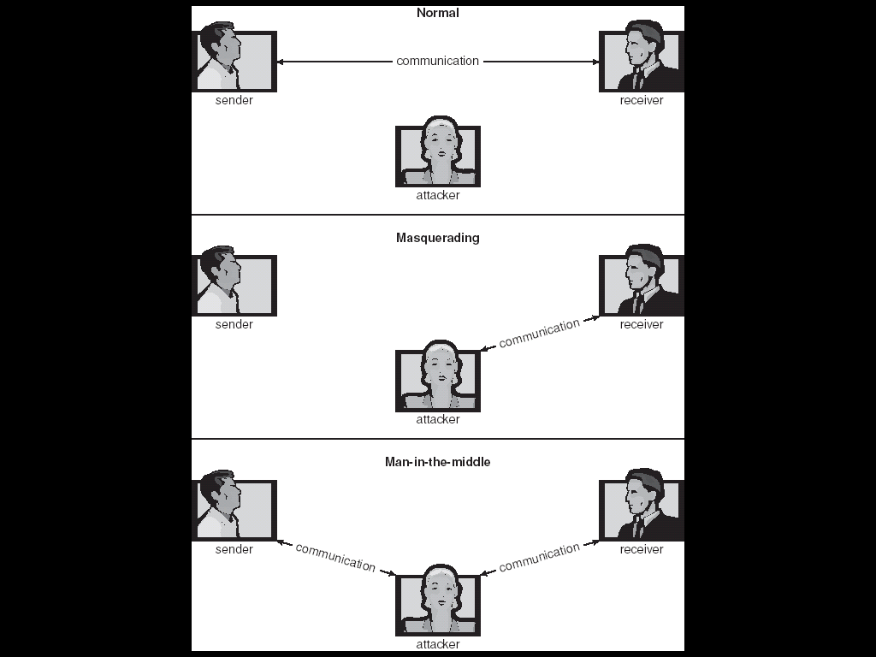
Standard Security Attacks

Slide 69
The goal of Security System
There are several goals of system security. Some of them are as follows:
1. Integrity
Unauthorized users must not be allowed to access the system's objects, and users with insufficient rights should not modify the system's critical files and resources.
2. Secrecy
The system's objects must only be available to a small number of authorized users. The system files should not be accessible to everyone.
3. Availability
All system resources must be accessible to all authorized users, i.e., no single user/process should be able to consume all system resources. If such a situation arises, service denial may occur. In this case, malware may restrict system resources and preventing legitimate processes from accessing them.

Slide 70
Security Measure Levels
Security must occur at four levels to be effective:
  Physical
  Human
    Avoid social engineering, phishing, dumpster diving
  Operating System
  Network
Security is as week as the weakest chain

Slide 71
Program Threats
The operating system's processes and kernel carry out the specified task as directed. Program Threats occur when a user program causes these processes to do malicious operations. The common example of a program threat is that when a program is installed on a computer, it could store and transfer user credentials to a hacker. There are various program threats. Some of them are as follows:
Trojan Horse
  This is a Code segment that misuses its environment
  This type of application captures user login credentials. It stores them to transfer them to a malicious user who can then log in to the computer and access system resources.
  Exploits mechanisms for allowing programs written by users to be executed by other users.
  Spyware, pop-up browser windows, covert channels
Trap Door
  A trap door is when a program that is supposed to work as expected has a security weakness in its code that allows it to do illegal actions without the user's knowledge.
  It is a Specific user identifier or password that circumvents normal security procedures
  It could be included in a compiler

Slide 72
Logic Bomb
  A logic bomb is a situation in which software only misbehaves when particular criteria are met; otherwise, it functions normally.
  It is a Program that initiates a security incident under certain circumstances
Stack and Buffer Overflow
  Exploits a bug in a program (overflow either the stack or memory buffers)
  The stack- or buffer-overflow attack is the most common way for an attacker outside the system, on a network or dial-up connection, to gain unauthorized access to the target system. An authorized user of the system may also use this exploit for privilege escalation.

Slide 73
C Program with Buffer-overflow Condition
#include <stdio.h>
#define BUFFER SIZE 256
int main(int argc, char *argv[])
{
char buffer[BUFFER SIZE];
if (argc < 2)
return -1;
else {
strcpy(buffer,argv[1]);
return 0;
}
}

Slide 74
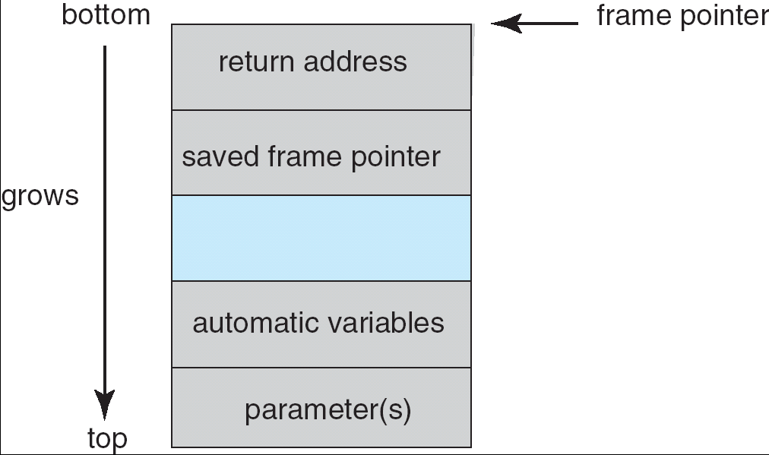
Layout of Typical Stack Frame

Slide 75
Program Threats (Cont.)
Viruses
  Another form of program threat is a virus.
  A virus is a fragment of code embedded in a legitimate program.
  Viruses are self-replicating and are designed to "infect" other programs. They can wreak havoc in a system by modifying or destroying files and causing system crashes and program malfunctions.
  Viruses are very specific to CPU architectures, operating systems, and applications.
  Viruses are a particular problem for users of PCs. UNIX and other multiuser operating systems generally are not susceptible to viruses because the executable programs are protected from writing by the operating system.
  Viruses are usually borne via e-mail, with spam the most common vector. They can also spread when users download viral programs Internet file-sharing services or exchange infected disks.
  Usually borne via email or as a macro

Slide 76
How do viruses work?
Once a virus reaches a target machine, a program known as a virus dropper inserts the virus into the system.
The virus dropper is usually a Trojan horse, executed for other reasons but installing the virus as its core activity. Once installed, the virus may do any one of a number of things. There are literally thousands of viruses, but they fall into several main categories. Note that many viruses belong to more than one category.

Slide 77
Program Threats (Cont.)
Virus dropper inserts virus onto the system
Many categories of viruses, literally many thousands of viruses
  File
  Boot
  Macro
  Source code
  Polymorphic
  Encrypted
  Stealth
  Tunneling
  Multipartite
  Armored

Slide 78
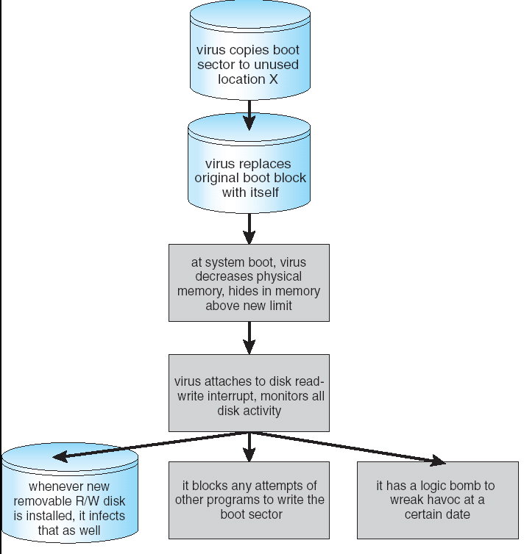
A Boot-sector Computer Virus

Slide 79
System and Network Threats
System threats are described as the misuse of system services and network connections to cause user problems. These threats may be used to trigger the program threats over an entire network, known as program attacks. System threats make an environment in which OS resources and user files may be misused. There are various system threats. Some of them are as follows:
1. Worm
The worm is a process that can choke a system's performance by exhausting all system resources. A Worm process makes several clones, each consuming system resources and preventing all other processes from getting essential resources. Worm processes can even bring a network to a halt.
Internet worm
  Exploited UNIX networking features (remote access) and bugs in finger and sendmail programs
  Grappling hook program uploaded main worm program

Slide 80
System and Network Threats
2. Port scanning
  It is a method by which the cracker determines the system's vulnerabilities for an attack. It is a fully automated process that includes connecting to a specific port via TCP/IP. To protect the attacker's identity, port scanning attacks are launched through Zombie Systems, which previously independent systems now serve their owners while being utilized for such terrible purposes.
  It is an Automated attempt to connect to a range of ports on one or a range of IP addresses
3. Denial of Service
  Denial of service attacks usually prevents users from legitimately using the system. For example, if a denial-of-service attack is executed against the browser's content settings, a user may be unable to access the internet.
  Overload the targeted computer preventing it from doing any useful work
  Distributed denial-of-service (DDOS) come from multiple sites at once

Slide 81
Some of types of attacks are:
1.Malicious threat: Malicious threat include Computer viruses, Trojan, worm and spyware.
2.DOS attack: A Denial-of-Service (DOS) attack is an attack intended to close down a machine or network, making it unavailable to its intended users.
3.Phishing: Phishing is the process to gain sensitive information like usernames, passwords and credit card information, frequently for malicious reasons, by taking on .the appearance of a dependable element

Slide 82
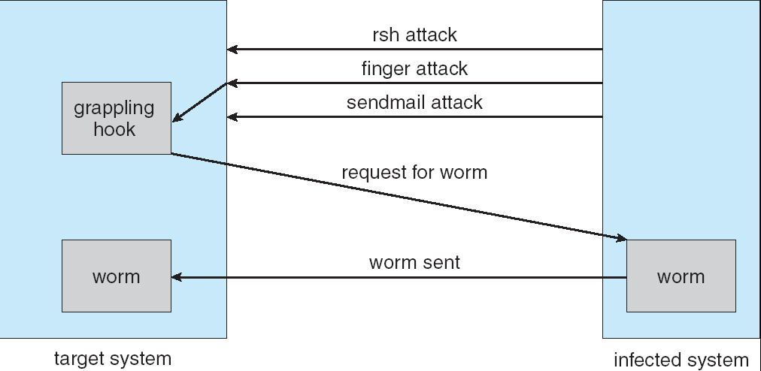
The Morris Internet Worm

Slide 83
Cryptography as a Security Tool
Broadest security tool available
  Source and destination of messages cannot be trusted without cryptography
  Means to constrain potential senders (sources) and / or receivers (destinations) of messages
Based on secrets (keys)

Slide 84
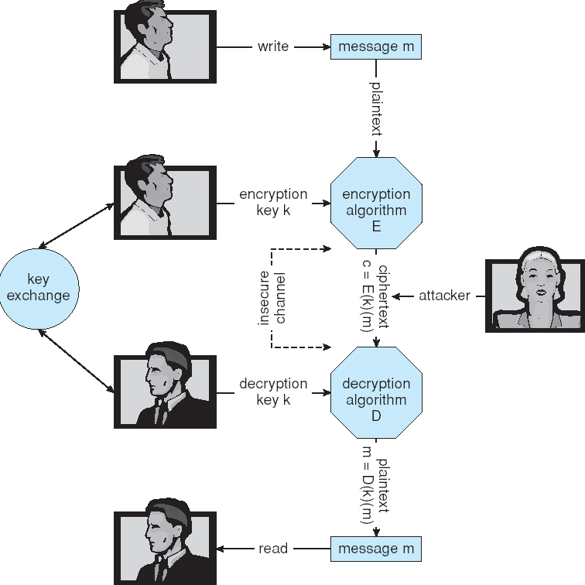
Secure Communication over Insecure Medium

