Slide 1
UNIT-4

Slide 2
Unsupervised Learning
Unsupervised learning is the training of a machine using information that is neither classified nor labeled and allowing the algorithm to act on that information without guidance. Here the task of the machine is to group unsorted information according to similarities, patterns, and differences without any prior training of data.
Unlike supervised learning, no teacher is provided that means no training will be given to the machine. Therefore the machine is restricted to find the hidden structure in unlabeled data by itself. For instance, suppose it is given an image having both dogs and cats which it has never seen.
Thus the machine has no idea about the features of dogs and cats so we can’t categorize it as ‘dogs and cats ‘. But it can categorize them according to their similarities, patterns, and differences, i.e., we can easily categorize the above picture into two parts. The first may contain all pics having dogs in them and the second part may contain all pics having cats in them. Here you didn’t learn anything before, which means no training data or examples.
It allows the model to work on its own to discover patterns and information that was previously undetected. It mainly deals with unlabelled data.

Slide 3
Unsupervised learning is classified into two categories of algorithms:
1.clustering
2.association

Slide 4
Clustering
Clustering or cluster analysis is a machine learning technique, which groups the unlabelled dataset. It can be defined as "A way of grouping the data points into different clusters, consisting of similar data points. The objects with the possible similarities remain in a group that has less or no similarities with another group."
It does it by finding some similar patterns in the unlabelled dataset such as shape, size, color, behavior, etc., and divides them as per the presence and absence of those similar patterns.
It is an unsupervised learning method, hence no supervision is provided to the algorithm, and it deals with the unlabeled dataset.
After applying this clustering technique, each cluster or group is provided with a cluster-ID. ML system can use this id to simplify the processing of large and complex datasets.

Slide 5
K-Means
K-Means Clustering is an Unsupervised Learning algorithm, which groups the unlabeled dataset into different clusters. Here K defines the number of pre-defined clusters that need to be created in the process, as if K=2, there will be two clusters, and for K=3, there will be three clusters, and so on.
It is an iterative algorithm that divides the unlabeled dataset into k different clusters in such a way that each dataset belongs only one group that has similar properties.
It allows us to cluster the data into different groups and a convenient way to discover the categories of groups in the unlabeled dataset on its own without the need for any training.
It is a centroid-based algorithm, where each cluster is associated with a centroid. The main aim of this algorithm is to minimize the sum of distances between the data point and their corresponding clusters.
The algorithm takes the unlabeled dataset as input, divides the dataset into k-number of clusters, and repeats the process until it does not find the best clusters. The value of k should be predetermined in this algorithm.

Slide 6
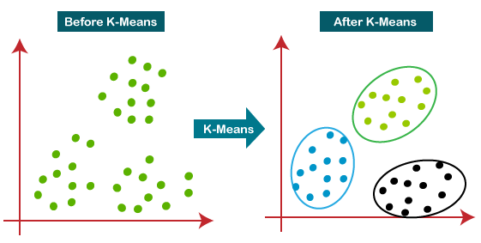

Slide 7
How does the K-Means Algorithm Work?
The working of the K-Means algorithm is explained in the below steps:
Step-1: Select the number K to decide the number of clusters.
Step-2: Select random K points or centroids. (It can be other from the input dataset).
Step-3: Assign each data point to their closest centroid, which will form the predefined K clusters.
Step-4: Calculate the variance and place a new centroid of each cluster.
Step-5: Repeat the third steps, which means reassign each datapoint to the new closest centroid of each cluster.
Step-6: If any reassignment occurs, then go to step-4 else go to FINISH.
Step-7: The model is ready.

Slide 8
Image Segmentation By Clustering
Image Segmentation: In computer vision, image segmentation is the process of partitioning an image into multiple segments. The goal of segmenting an image is to change the representation of an image into something that is more meaningful and easier to analyze. It is usually used for locating objects and creating boundaries.
It is not a great idea to process an entire image because many parts in an image may not contain any useful information. Therefore, by segmenting the image, we can make use of only the important segments for processing.
An image is basically a set of given pixels. In image segmentation, pixels which have similar attributes are grouped together. Image segmentation creates a pixel-wise mask for objects in an image which gives us a more comprehensive and granular understanding of the object.

Slide 9
Image Segmentation By Clustering
Uses:
Used in self-driving cars. Autonomous driving is not possible without object detection which involves segmentation.
Used in the healthcare industry. Helpful in segmenting cancer cells and tumours using which their severity can be gauged.
There are many more uses of image segmentation.
In this article, we will perform segmentation on an image of the monarch butterfly using a clustering method called K Means Clustering.

Slide 10
Stages of Data preprocessing for K-means Clustering
1. Data Cleaning
Removing duplicates
Removing irrelevant observations and errors
Removing unnecessary columns
Handling inconsistent data
Handling outliers and noise
2. Handling missing data
3. Data Integration
4. Data Transformation
Feature Construction
Handling skewness
Data Scaling
5. Data Reduction
Removing dependent (highly correlated) variables
Feature selection
PCA

Slide 11
Using Clustering for Semi-Supervised Learning.
Semi-supervised clustering is a method that partitions unlabeled data by creating the use of domain knowledge. It is generally expressed as pair wise constraints between instances or just as an additional set of labeled instances.
The quality of unsupervised clustering can be essentially improved using some weak structure of supervision, for instance, in the form of pair wise constraints (i.e., pairs of objects labeled as belonging to similar or different clusters). Such a clustering procedure that depends on user feedback or guidance constraints is known as semi supervised clustering.

Slide 12
Using Clustering for Semi-Supervised Learning.
Constraint-based semi-supervised clustering − It can be used based on user-provided labels or constraints to support the algorithm toward a more appropriate data partitioning. This contains modifying the objective function depending on constraints or initializing and constraining the clustering process depending on the labeled objects.
Distance-based semi-supervised clustering − It can be used to employ an adaptive distance measure that is trained to satisfy the labels or constraints in the supervised data. Multiple adaptive distance measures have been utilized, including string-edit distance trained using Expectation-Maximization (EM), and Euclidean distance changed by the shortest distance algorithm.

Slide 13
DBSCAN Clustering
Clusters are dense regions in the data space, separated by regions of the lower density of points. The DBSCAN algorithm is based on this intuitive notion of “clusters” and “noise”. The key idea is that for each point of a cluster, the neighborhood of a given radius has to contain at least a minimum number of points.

Slide 14
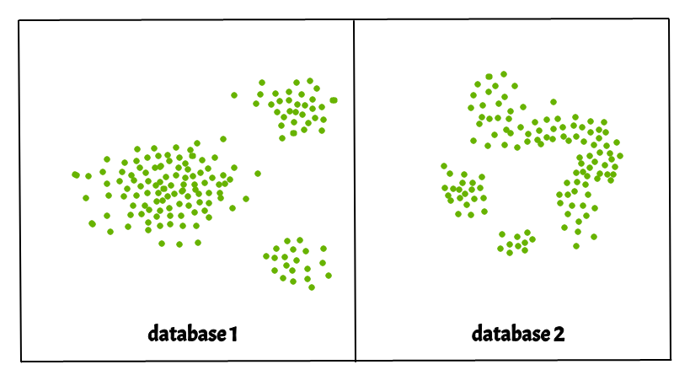
DBSCAN Clustering

Slide 15
Gaussian Mixture
The Gaussian Mixture object implements the expectation-maximization (EM) algorithm for fitting mixture-of-Gaussian models. It can also draw confidence ellipsoids for multivariate models, and compute the Bayesian Information Criterion to assess the number of clusters in the data. A Gaussian Mixture
The GaussianMixture comes with different options to constrain the covariance of the difference classes estimated: spherical, diagonal, tied or full covariance.

Slide 16
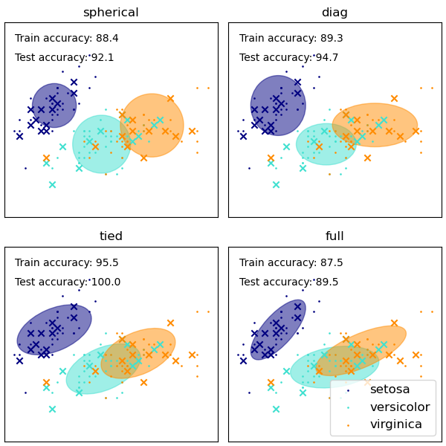

Slide 17
Dimensionality reduction
Dimensionality reduction technique can be defined as, "It is a way of converting the higher dimensions dataset into lesser dimensions dataset ensuring that it provides similar information." These techniques are widely used in machine learning for obtaining a better fit predictive model while solving the classification and regression problems.

Slide 18
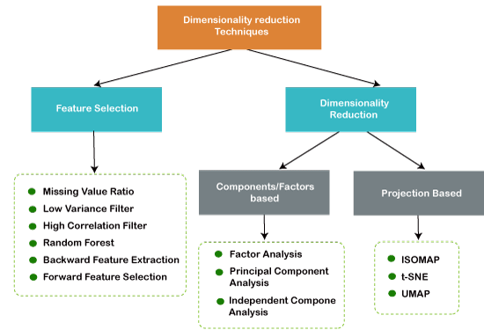

Slide 19
Curse of Dimensionality
Curse of Dimensionality refers to a set of problems that arise when working with high-dimensional data. The dimension of a dataset corresponds to the number of attributes/features that exist in a dataset. A dataset with a large number of attributes, generally of the order of a hundred or more, is referred to as high dimensional data. Some of the difficulties that come with high dimensional data manifest during analyzing or visualizing the data to identify patterns, and some manifest while training machine learning models. The difficulties related to training machine learning models due to high dimensional data is referred to as ‘Curse of Dimensionality’. The popular aspects of the curse of dimensionality; ‘data sparsity’ and ‘distance concentration’ are discussed in the following sections.

Slide 20
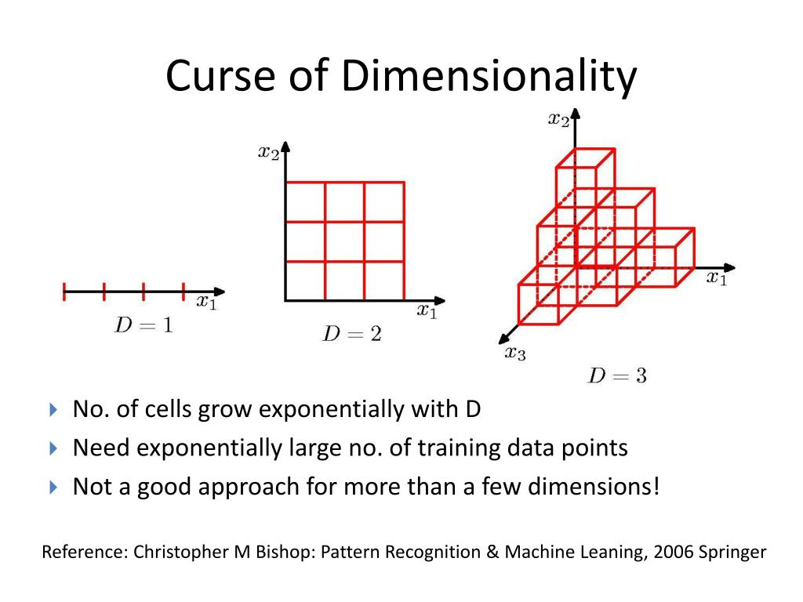

Slide 21
Main Approaches for Dimensionality Reduction
1. Principal Component Analysis (PCA)
2. Non-negative matrix factorization (NMF)
3. Linear discriminant analysis (LDA)
4. Generalized discriminant analysis (GDA)
5. Missing Values Ratio
6. Low Variance Filter
7. High Correlation Filter
8. Backward Feature Elimination
9. Forward Feature Construction
10. Random Forests

Slide 22
Principal Component Analysis
The Principal Component Analysis is a popular unsupervised learning technique for reducing the dimensionality of data. It increases interpretability yet, at the same time, it minimizes information loss. It helps to find the most significant features in a dataset and makes the data easy for plotting in 2D and 3D. PCA helps in finding a sequence of linear combinations of variables.

Slide 23
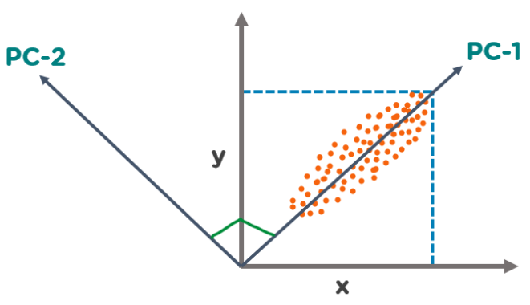
Principal Component Analysis

Slide 24
What is Scikit-Learn (Sklearn)
Scikit-learn (Sklearn) is the most useful and robust library for machine learning in Python. It provides a selection of efficient tools for machine learning and statistical modeling including classification, regression, clustering and dimensionality reduction via a consistence interface in Python. This library, which is largely written in Python, is built upon NumPy, SciPy and Matplotlib.

Slide 25
kernel PCA
PCA is a linear method. That is it can only be applied to datasets which are linearly separable. It does an excellent job for datasets, which are linearly separable. But, if we use it to non-linear datasets, we might get a result which may not be the optimal dimensionality reduction. Kernel PCA uses a kernel function to project dataset into a higher dimensional feature space, where it is linearly separable. It is similar to the idea of Support Vector Machines. There are various kernel methods like linear, polynomial, and gaussian.
In the kernel space the two classes are linearly separable. Kernel PCA uses a kernel function to project the dataset into a higher-dimensional space, where it is linearly separable. Finally, we applied the kernel PCA to a non-linear dataset using scikit-learn.
Kernel Principal Component Analysis (PCA) is a technique for dimensionality reduction in machine learning that uses the concept of kernel functions to transform the data into a high-dimensional feature space. In traditional PCA, the data is transformed into a lower-dimensional space by finding the principal components of the covariance matrix of the data. In kernel PCA, the data is transformed into a high-dimensional feature space using a non-linear mapping function, called a kernel function, and then the principal components are found in this high-dimensional space.

Slide 26
kernel PCA
Advantages of Kernel PCA:
Non-linearity: Kernel PCA can capture non-linear patterns in the data that are not possible with traditional linear PCA.
Robustness: Kernel PCA can be more robust to outliers and noise in the data, as it considers the global structure of the data, rather than just local distances between data points.
Versatility: Different types of kernel functions can be used in kernel PCA to suit different types of data and different objectives.
Disadvantages of Kernel PCA:
Complexity: Kernel PCA can be computationally expensive, especially for large datasets, as it requires the calculation of eigenvectors and eigenvalues.
Model selection: Choosing the right kernel function and the right number of components can be challenging and may require expert knowledge or trial and error.

