Slide 1

Microservices
Siva Sankar Alamalakala

Slide 2

.NET Microservices
What are “Microservices”
Small (2 pizza team, 2 week to build)
Responsible for doing 1 thing well
Organizationally aligned
From part of the (distributed) whole
Self-contained / Autonomous
Flight Catalog
(.NET)
Booking
(Ruby on Rails)
Check In
(Node)
Instance 1
Instance 1
Instance 1
SQL Server
SQL Server
SQL Server
Team: Avengers Country: USA
Team: Shield
Country: Scotland
Team: Thor Country: India

Slide 3
Services & Ingredients
The “Platform” Services
Function as an “Asset Register”
Track all the platforms/ systems in the company
Build by the infrastructure team
Used By
Infrastructure Team
Technical Support Team
Engineering
Accounting
Procurement
VS Code
.NET 5
Docker Desktop
Ann account on Docker Hub
Insomnia or Postman
In this step-by-step tutorial I take you through an introduction on building microservices using .NET. As the name suggests we build everything completely from start to finish –with the full scope of the course outlined in the time-stamp section below. However, at a high-level we’ll cover:
Building two .NET Microservices using the REST API pattern
Working with dedicated persistence layers for both services
Deploying our services to Kubernetes cluster
Employing the API Gateway pattern to route to our services
Building Synchronous messaging between services (HTTP & gRPC)
Building Asynchronous messaging between services using an Event Bus (RabbitMQ)
The “Commands” Services
Function as a repository of common line augments for given platforms
Aid in the automation of support processes
Built by the Technical Support Team
Used By
Technical Support Team
Infrastructure Team
Engineering

Slide 4
Solution Architecture
Platform Service
SQL Server
XYZ Service
SQL Server
REST API
Http
Grpc
Pub.
Sub.
Pub.
API Gateway
RabbitMQ Message Bus
Grpc
Sub.
Pub.
Command Service
In Mem
ABC Service
SQL Server
REST API

Slide 5
Platform Service Architecture
HTTP Request
Gprc
(Synchronous - in)
HTTP Client
(Synchronous - out)
HTTP Response
HTTP Request
Controller
(Synchronous - in)
Msg. Publisher
(Asynchronous - out)
HTTP Response
Publish to
Message Bus
Models
Repository
Models
DB Context
SQL Server

Slide 6
Command Service Architecture
HTTP Request
Controller
(Synchronous - in)
HTTP Response
Grpc Client
(Synchronous - out)
Msg. Subscriber
(Asynchronous - in)
Received from
Message Bus
Models
Repository
Models
DB Context
SQL Server

Slide 7
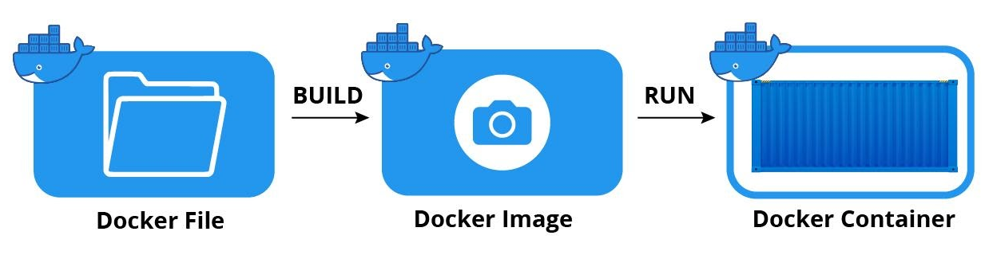
Docker
App1
App2
App1
App2
App1
App2
OS
OS
Hypervisor
Docker
Operating System
Operating System
Operating System
Physical Machine
Virtual Machine
(OS Virtualization)
Container (Docker)
(OS Virtualization)

Slide 8
Kubernetes
Cluster
Node
Node Port
POD
POD
POD
Platform Service Container
Platform SQL Server
Container
RabbitMQ Container
3xxx
80
80
666
1433
5672
15672
POD
80
666
1433
5672
15672
Cluster IP
Cluster IP
Cluster IP
Ingress Nginx
Container
POD
Ingress Nginx Load Balancer
Command
Service Container
80
80
Persistent Volume Claim
80
80
Cluster IP
Kubernetes (Docker Desktop)
Container Runtime (Docker)
Operating System (Windows 10 with WSL2)
Hardware (PC)

Slide 9
Messaging
Synchronous Messaging
Request/ Response cycle
Requester will "wait" for response
Externally facing services usually synchronous (e.g., http requests)
Services usually need to "know" about each other
Using 2 forms
Http
Grpc
Asynchronous Messaging
No Request/ Response Cycle
Requester does not wait
Event model, e.g., publish – subscribe
Typically used between services
Event bus is often used (will using RabbitMQ)
Services don't need to know about each other, just the bus
What if we mark http actions as Async?
From a messaging perspective this method is still synchronous
The client still must wait for a response
Async (the C# language) means that the action will not wait for a long running operation
It will hand back it's thread to the thread pool, where it can be reused
When the operation finishes it will re-acquire a thread and complete, (and respond back to the requestor)
So Async is about thread exhaustion – the requestor still has to wait (the call is synchronous)

Slide 10
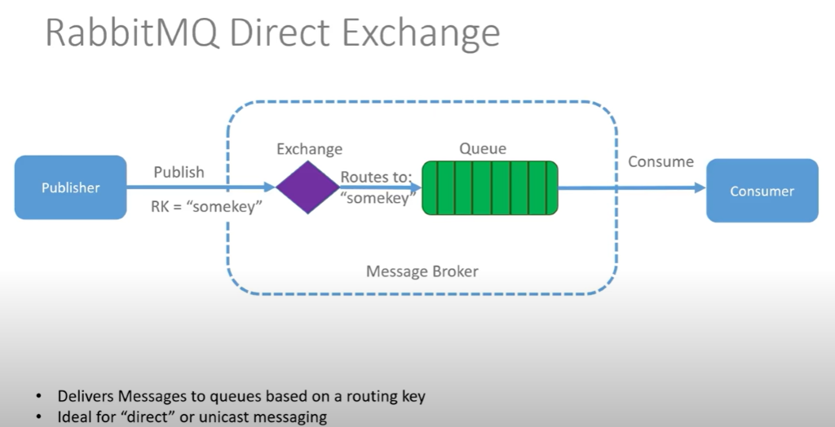
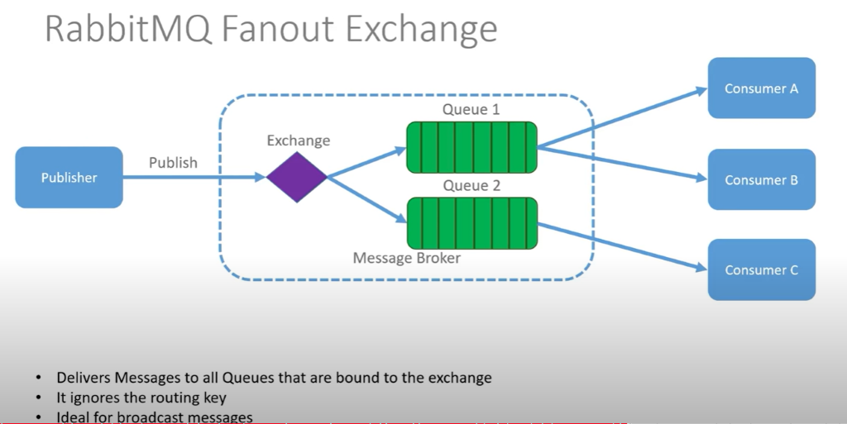
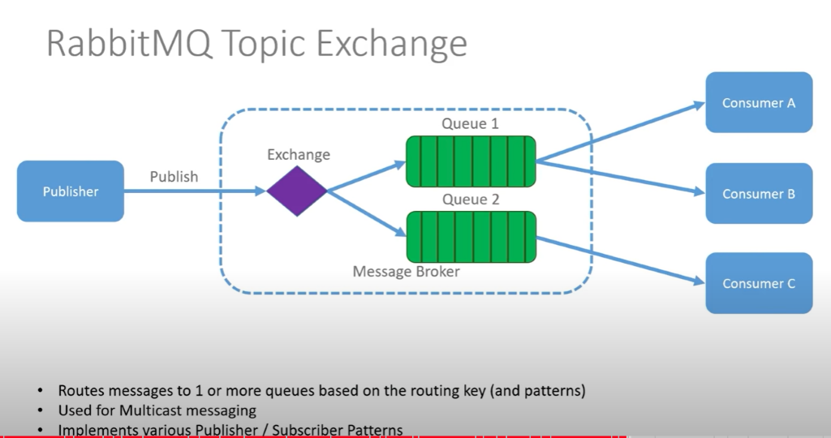
RabbitMQ
What is RabbitMQ?
A message Broker – it accepts and forwards messages
Messages are sent by Producers (or publishers)
Messages are received by Consumers (or Subscribers)
Messages are stored on Queues (essentially a message buffer)
Exchanges can be used to add "routing" functionality
Uses Advanced Message Queuing Protocol (AMOP) & others
It supports 4 types of Exchanges
Direct Exchange
Fanout Exchange
Topic Exchange
Header Exchange

Slide 11
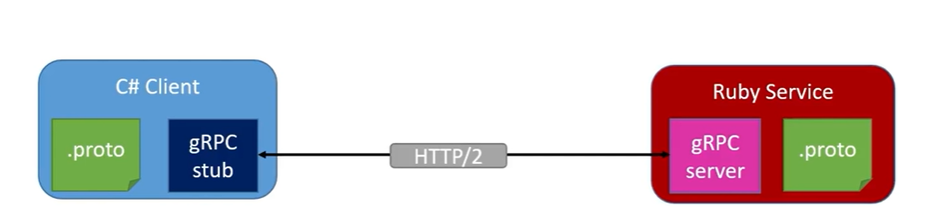
gRPC
What is it, and why should we use it?
"Google" Remote Procedure Call
Use Http/2 protocol to transport binary messages (inc. TLS)
Focused on high performance
Relies on "Protocol Buffers" (aka Protobuf) to defined the contract between end points
Multi-language support (C# client can call a Ruby service)
Frequently used as a method of service-to-service communication

