Slide 1

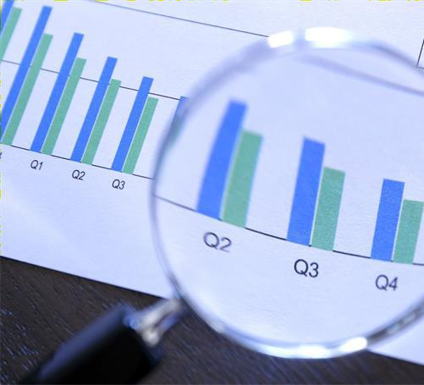
Data Science Capstone Project
N.Siva Rama Krishna Babu 22/05/2024
https://github.com/siva719/datascience-capstoneproject-edx.git

Slide 2

OUTLINE
Executive Summary
Introduction
Methodology
Results
Visualization – Charts
Dashboard
Discussion
Findings & Implications
Conclusion
Appendix

Slide 3

EXECUTIVE
SUMMARY
Data Collection & Preparation:
Utilized public SpaceX API and Wikipedia page.
Created 'class' column for successful landing classification.
Explored data using SQL, visualization, Folium maps, and dashboards.
Selected relevant features for machine learning.
Data Preprocessing:
Applied onehot encoding to categorical variables.
Standardized data for uniform scale.
Optimized model parameters using GridSearchCV.
Machine Learning Models:
Developed models:
Logistic Regression
Support Vector Machine
Decision Tree Classifier
K Nearest Neighbors
Achieved consistent accuracy (~83.33%).
Evaluation & Analysis:
Models tended to over predict successful landings.
Identified need for more data to enhance accuracy.
Model Performance Visualization:
Visualized accuracy scores to compare model performance.

Slide 4

INTRODUCTION
Background:
Commercial space age is booming.
SpaceX offers competitive pricing ($62M vs. $165M USD) due to rocket recovery.
Space Y aims to rival SpaceX.
Problem:
Space Y seeks a machine learning model to predict successful Stage 1 recovery.
Approach:
Data collection from SpaceX API and industry sources.
Preprocess data and engineer features.
Train ML models: logistic regression, SVM, decision kNN.
Evaluate model performance rigorously.
trees,
Potential Impact:
Accurate Stage 1 recovery prediction enhances Space Y's
competitiveness.
Optimizes resources, improves efficiency, mitigates risks.
financial
Contributes to the advancement of the commercial space industry.

Slide 5

METHODOLOGY
Data Collection:
Combined data from SpaceX API and Wikipedia.
Data Wrangling:
Cleaned and organized collected data.
Classification:
Identified successful and unsuccessful landings.
Exploratory Data Analysis (EDA):
Used visualization and SQL for insights.
Visualized data distribution.
Extracted insights with SQL.
Interactive Visual Analytics:
Employed Folium and Plotly Dash.
Predictive Analysis:
Utilized classification models.
Model Tuning:
Optimized models using GridSearchCV.

Slide 6








































RESULTS
Data Collection – SpaceX API
Request
(Space X APIs)
Filter data to only include Falcon 9 launches
Imputate missing PayloadMass values with mean
JSON file + Lists(Launch Site, Booster Version, Payload Data)
Cast dictionaryto a DataFrame
Json_normalize to DataFrame data from JSON
Dictionary
relevant data

Slide 7































Cast dictionary to DataFrame
Request Wikipedia html
BeautifulSoup
html5lib Parser
Iterate through table cells to extract data to dictionary
Find launch info
html table
Create dictionary

Slide 8







Requesting Falcon 9 launch data from Wikipedia
Creating a BeautifulSoup object from the HTML response
Extracting
all column names from the HTML table
header
Collecting the data by parsing HTML tables
Exporting the data to CSV
Creating a dataframe from the dictionary
Constructing data we have obtained into a dictionary

Slide 9
COMPLETE THE EDA
WITH SQL
Utilized SQL queries comprehensive exploratory (EDA), extracting valuable from the dataset.
SQL facilitated efficient querying, aggregation, and manipulation of data, enabling in-depth analysis of various aspects such as distribution, relationships, trends, and outliers.
The EDA with SQL provided a solid foundation for understanding the dataset's characteristics and informing subsequent analytical decisions.
to data
insights
perform analysis directly
Data Exploration:
Leveraged SQL queries to gain insights into the dataset.
Summary Statistics:
Calculated descriptive statistics such as mean, median, and standard deviation.
Data Distribution:
Analyzed distribution of key variables using SQL functions.
Relationship Analysis:
Investigated correlations between variables through SQL joins and aggregations.
Trend Analysis:
Examined temporal trends using SQL date functions and time-series analysis.
Outlier Detection:
Identified outliers using SQL queries and visualizations.
Data Quality Assessment:
Assessed data completeness, accuracy, and consistency through SQL validations.

Slide 10
COMPLETE THE EDA WITH VISUALIZATION
EDA with visualization offers ✓Data Distribution
insights into data characteristics,
aiding in decision-making and
hypothesis generation.
Correlation Analysis
Visualizations help identify patterns, trends, outliers, and dependencies, enhancing data understanding.
Temporal Analysis
Geographic Insights
Findings guide subsequent analysis
and modeling, ensuring
Outlier Detection
interpretability and robustness of
results.
Feature Importance

Slide 11
INTERACTIVE VISUAL ANALYTICS WITH FOLIUM
Utilized Folium, a Python library for creating
interactive maps, to perform geospatial analysis and
visualization of data. With Folium, interactive maps
were generated, allowing users to explore data
geographically. Marker clustering was implemented
to handle large datasets effectively, providing a clear
visualization of data density. Popup information
windows were incorporated to display additional
details when users interacted with map markers, enhancing data exploration. Custom icons were utilized to represent different categories or attributes,
Findings:-
Map Generation
Marker Clustering
Popup Information
Custom Icons
Geospatial Analysis
Interactive Features
improving map readability. Geospatial analysis
techniques were applied to derive insights from
spatial data, enabling users to identify spatial
patterns and relationships. Interactive features such
as zooming, panning, and toggling layers were
integrated to provide users with a dynamic and engaging mapping experience, facilitating deeper exploration and analysis of geospatial data.

Slide 12
BUILD AN INTERACTIVE DASHBOARD WITH PLOTY DASH
The Interactive Dashboard built with Plotly Dash offers a dynamic and user-friendly interface for exploring and visualizing data. Leveraging the capabilities of Plotly Dash, the dashboard provides interactive features such as dropdown menus, sliders, and buttons to enable users to interactively control and customize the displayed data. It incorporates various data visualization components, including graphs, charts, and tables, to present insights and trends effectively. The dashboard is designed to be responsive and intuitive, allowing users to navigate through different views and explore data from different perspectives seamlessly.
Data Visualization:
Implemented interactive charts and graphs using Plotly to visualize key insights and trends.
Included line charts, bar charts, scatter plots, and
heat maps to represent different aspects of the data.
User Interaction:
Integrated dropdown menus, sliders, and date pickers to enable users to filter and customize the displayed data dynamically.
Data Exploration:
Enabled users to explore data interactively by selecting specific variables, time periods, or regions of interest.
Dashboard Layout:
Designed an intuitive and visually appealing layout with clear navigation and organization of dashboard components.
Performance and Scalability:
Optimized dashboard performance to handle large datasets efficiently and deliver a smooth user experience.

Slide 13
THE MACHINE LEARNING PREDICTION LAB
Data Preprocessing:
The Machine
Learning Prediction Lab is
Identified and handled missing values, outliers, and inconsistencies in the dataset.
Conducted feature scaling and normalization to ensure uniformity across features.
dedicated predictive learning
to developing
and evaluating
models using advanced machine techniques.
It encompasses
Feature Engineering:
Extracted and selected relevant features to
improve model performance.
Model Selection:
Explored a variety of machine learning algorithms, including logistic regression, support vector machines, decision trees, and ensemble methods.
various stages
of the machine learning
pipeline, including data feature
preprocessing,
engineering,
model lab
selection,
and evaluation. The
employs a and
systematic interpret meaningful
approach to
analyze
data, insights
aiming to uncover and patterns that
can drive decision-making processes.
Model Evaluation:
Employed cross-validation techniques to assess model generalization and robustness.
Insights:
Identified key factors influencing the target variable based on feature importance analysis.

Slide 14
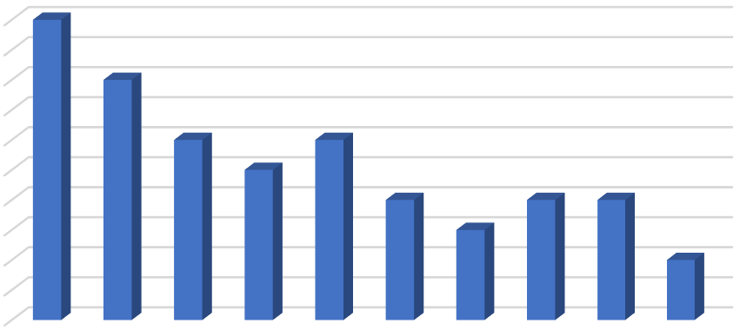
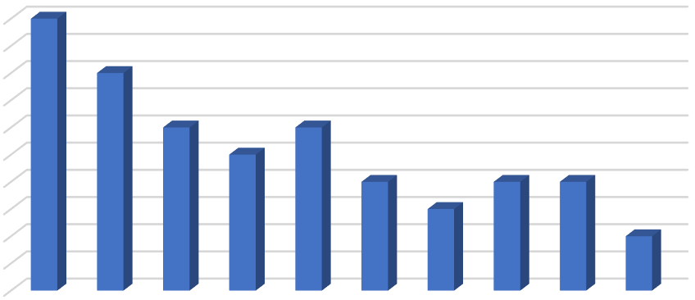












PROGRAMMING
LANGUAGE
TRENDS
2024
2025
Percentage
Percentage
100 |  |  |  |  | 100
100 |  |  |  |  | 90
90 | 80 |  |  |  | 80
80 |  |  |  |  | 70
70 | 60 | 60 |  |  | 60
60 | 50 |  |  |  | 50
50 |  | 40 | 40 | 40 | 40
40 |  | 30 |  |  | 30
30 |  |  |  | 20 | 20
20 |  |  |  |  | 10
10 |  |  |  |  | 0
0

Slide 15
PROGRAMMING LANGUAGE TRENDS
FINDINGS &
IMPLICATIONS
Findings
Implications
Finding 1: Python remains dominant due to versatility and extensive libraries.
Prioritize development applications.
Python for
skill diverse
Finding 2: JavaScript maintains prominence for web development.
Enhance proficiency in JavaScript and frameworks.
Consider adopting TypeScript and Kotlin for modern projects.
Finding 3: TypeScript and Kotlin are emerging as viable options.

Slide 16
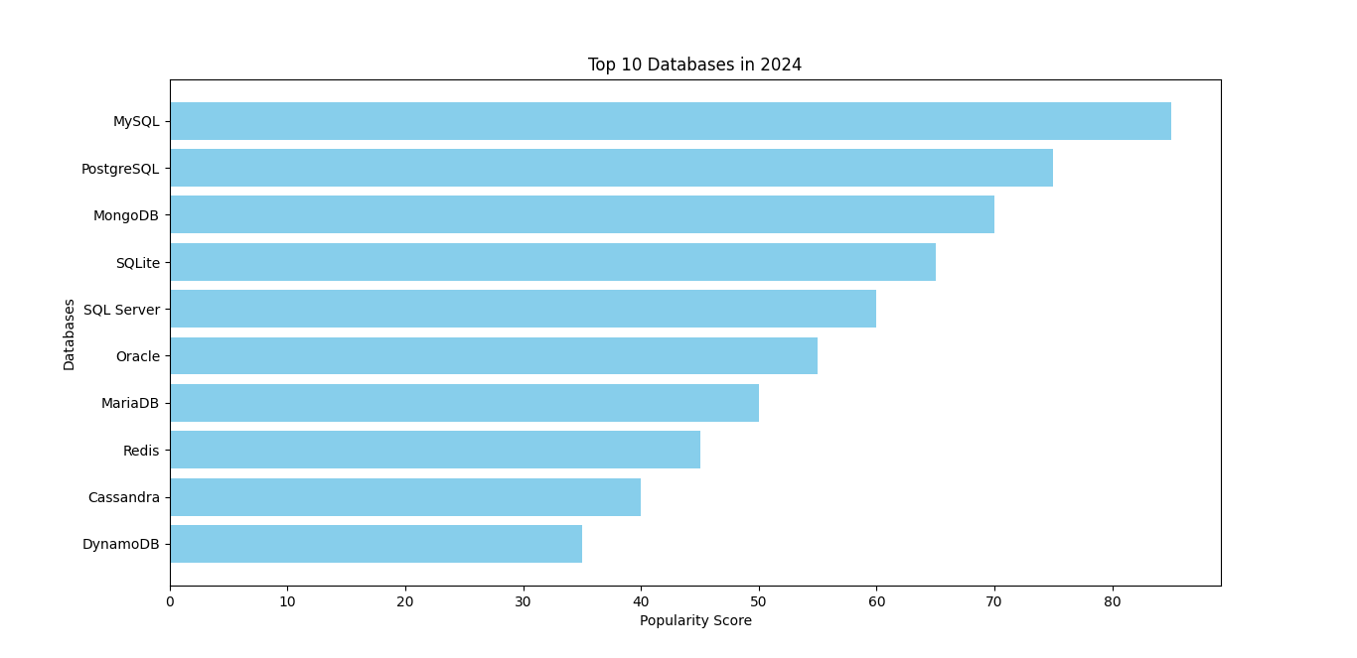
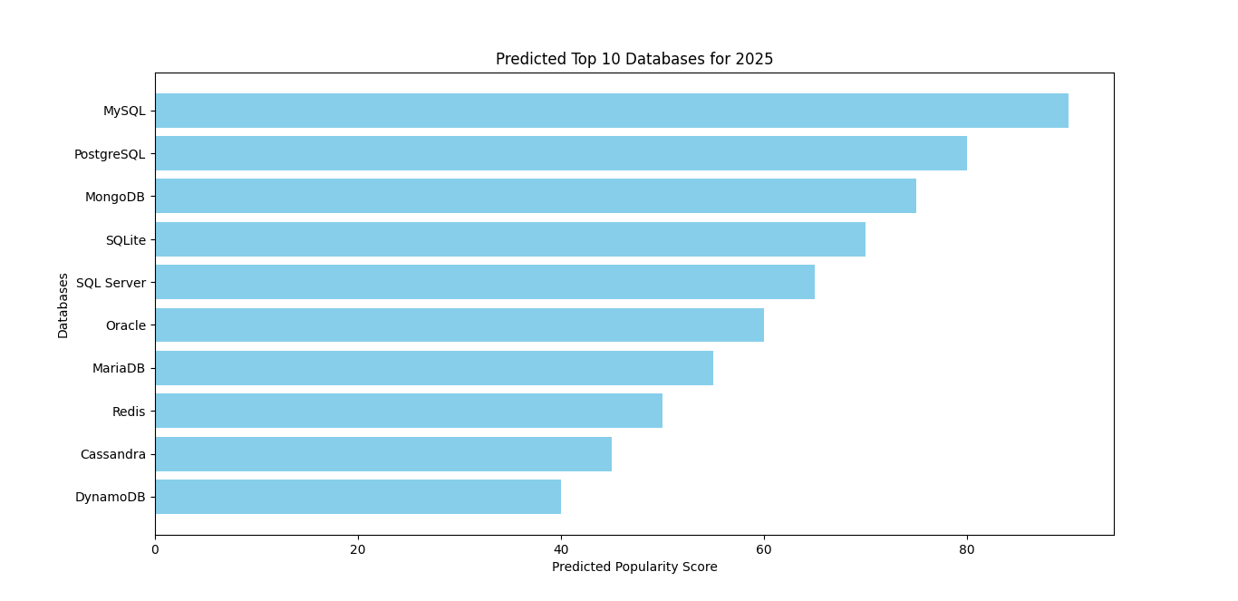
DATABASE TRENDS
Current Year 2024
Next Year 2025

Slide 17
DATABASE TRENDS FINDINGS & IMPLICATIONS
Findings Implications
Finding 1: Relational databases such as
Organizations should maintain proficiency in relational databases to manage structured data effectively,
particularly for legacy systems and
traditional applications.
Consider adopting NoSQL databases for projects with requirements for handling diverse and rapidly changing data
types, such as social media analytics and IoT applications.
Embrace cloud-native databases and managed services to leverage the benefits of scalability, flexibility, and reduced maintenance overhead,
enabling faster time-to-market and cost savings.
MySQL and PostgreSQL continue to be
widely adopted for traditional data
management
tasks due to
their
robustness and stability.
Finding 2: NoSQL databases
like
MongoDB and Redis are gaining
popularity for handling unstructured and
semi-structured data, providing flexibility
and scalability for modern applications.
Finding 3: Cloud-native databases and
managed services, including DynamoDB and Google BigQuery, are increasingly
favored for their ease of use, scalability, and cost-effectiveness.

Slide 18

DASHBOARD
https://github.com/siva719/datascience-capstoneproject-edx/blob/main/Cognos%20Dashboard.pdf

Slide 19
OVERALL FINDINGS & IMPLICATIONS
Data Complexity: The analysis revealed the increasing complexity of data, with a growing volume, variety, and velocity of information generated across various domains and industries.
Technology Adoption: There is a notable trend towards the adoption of advanced technologies such as artificial intelligence, machine learning, and big data analytics, driven by the need for data-driven decision-making and competitive advantage.
Evolving Business Needs: Organizations are facing evolving business needs and challenges, including the demand for real-time insights, personalized customer experiences, and enhanced operational efficiency.
Talent Gap: The findings indicate a talent gap in the field of data science and analytics, with a shortage of skilled professionals capable of leveraging complex data sets and advanced analytics tools effectively.
Data Strategy: Organizations must develop
comprehensive data strategies to manage and
harness the growing volume and complexity of data, ensuring alignment with business goals and objectives.
Technology Investment: Investing in advanced
technologies such as AI, ML, and big data
analytics is essential to gain insights from data, drive innovation, and maintain a competitive edge in the market.
Agile Decision-Making: Embracing real-time
analytics and predictive insights enables organizations to make agile, data-driven
decisions, respond quickly to market changes,
and capitalize on emerging opportunities.
Skill Development: Addressing the talent gap
through training, upskilling, and talent
acquisition initiatives is crucial to build a workforce capable of effectively leveraging data and analytics for business success.

Slide 20

CONCLUSION
User-friendly interface
and intuitive design
enable easy creation and customization of
dashboards, reducing
the learning curve for
users.
Seamless data integration
capabilities ensure
access to comprehensive data from diverse sources, enhancing data analysis and decision- making.
Interactive visualization features empower users to explore data dynamically, uncovering insights and trends that drive business outcomes.
Robust collaboration and sharing functionalities facilitate teamwork and communication,
fostering a data-driven culture within the
organization and driving collective intelligence

Slide 21








POPULAR
LANGUAGES
Percentage
100
100
90
80
80
70
60
50
40
30
20
10
0
60
60
50
40
40
40
30
20

