Slide 1
Introduction to Digital Signal Processing
Sivakumar Balasubramanian
Dept. of Bioengineering
Christian Medical College Vellore

Slide 2
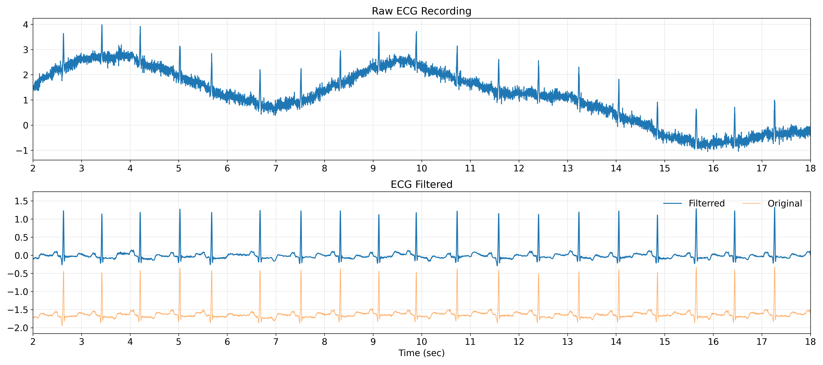
What is this course about?

Slide 3
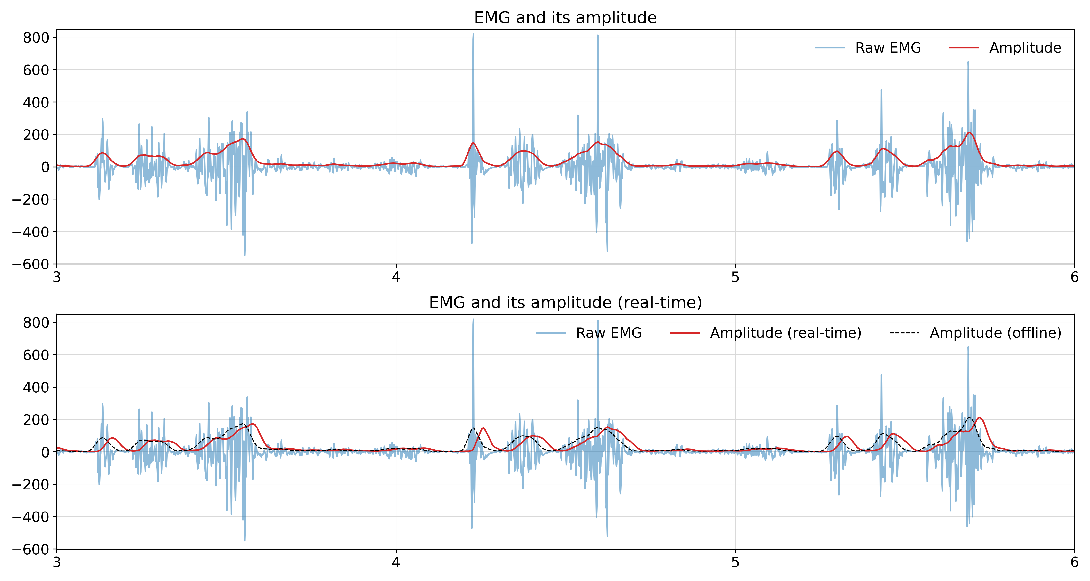
What is this course about?

Slide 4
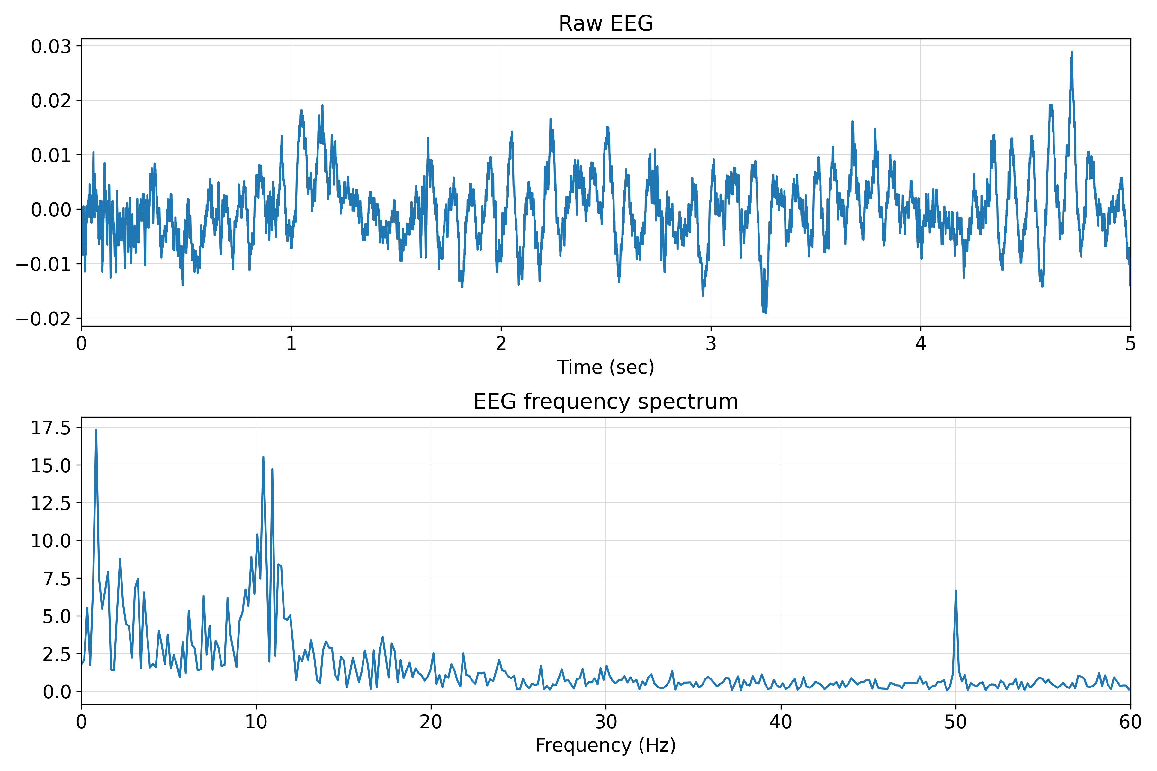
What is this course about?

Slide 5
Specific topics covered
Mathematical preliminaries
Python programming
What are signals?
Sampling theorem
What are systems?
Linear time-invariant systems
Convolution
Fourier representation of signals
Z-transform
Discrete Fourier Transform
Frequency selective filters
Introduction to spectral analysis
Short-time Fourier transform
Introduction to Wavelet transform*

Slide 6
Assignments, Quizzes, and Exams
One assignment per week, due on Monday the following week.
One quiz per week.
Midterm on the 2nd week of October
Final on the third week of December

