Slide 1
Introduction to Digital Signal Processing
Sivakumar Balasubramanian
Dept. of Bioengineering
Christian Medical College Vellore

Slide 2
Introduction to Python Programming
Computers follow instructions.
A program is simply a set of instruction that a computer executes.
Instructions take the form of binary codes (machine code) that a microprocessor hardware is designed to "understand" and execute.
Programming languages allow us to write instructions for a computer to execute.

Slide 3
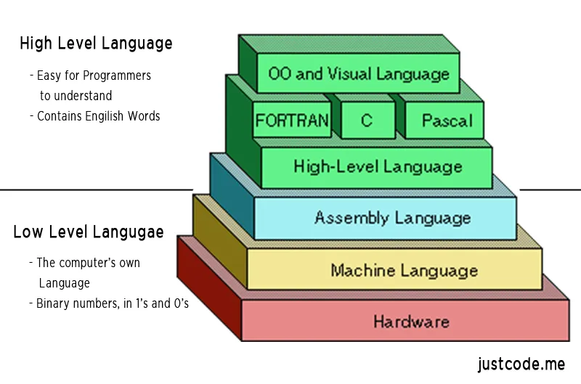
Low-level vs. High-level programming languages
Low-level languages allow us to write efficient programs but are tedious and time consuming.
High-level languages are more human friendly and make it easier to develop complex software.
Source: https://i2.wp.com/justcode.me/wp-content/uploads/2017/06/Low-Level-and-High-Level-Language.png?fit=800%2C529&ssl=1

Slide 4
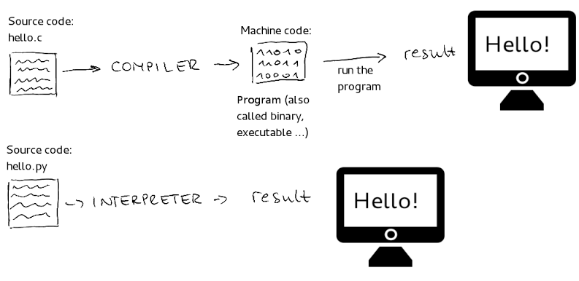
Compiled vs. Interpreted languages
Compiled language
Interpreted language
Source: https://encrypted-tbn0.gstatic.com/images?q=tbn%3AANd9GcQUbS3z-_l-coi1oPrDmfzr1rApltmtaHwdKECcfEfWLDNHlzIk

Slide 5
Python
A high-level, interpreted, general-purpose programming language.
One of the most popular languages for scientific computing.
Why Python?
Open source and free.
Actively developed.
Strong community worldwide
Huge set of libraries for various applications

Slide 6
Python
Most programs are for processing some form of data.
Programing languages consists of set of basic building blocks for representing and processing/transforming data.
To learn a programing language, one needs to be aware of these building blocks, and how to put them together meaningfully.

